Slide 1

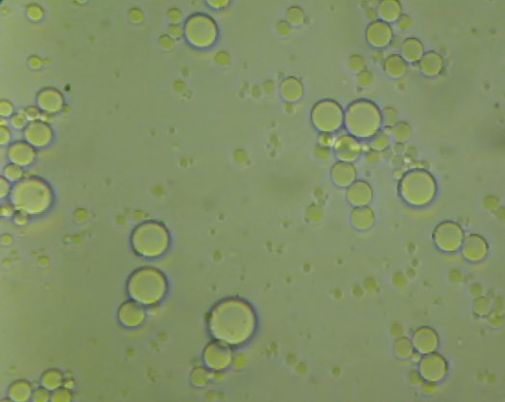
Submitted by:
Alaa Kaabneh .
Amani Abd_Allah.
Aysha Hilo.
Olfat Khatatbeh.
An-Najah National University
Chemical Engineering Department
Preparation of biodegradable polycaprolactone microcapsules by membrane emulsification
Supervisor:
Dr. Hassan Sawalha

Slide 2
contents
Objectives
Introduction
Materials
Methods
Results
Discussion
Conclusion

Slide 3
Objective
The objective of the current study is to prepare biodegradable polycaprolactone microcapsules using premix membrane emulsification.

Slide 4
Introduction
Biodegradable microcapsules
It is a small sphere with a uniform wall made of biodegradable polymer around it .
This sphere may contain a liquid droplet or gas bubble (hollow microcapsule) .
Polymer shell
drug
(1 – 5) µm

Slide 5

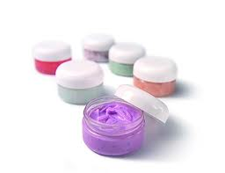

Applications of microcapsules:
Cosmetics
Medicine
Food

Slide 6

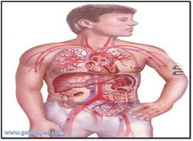
In biomedical field, biodegradable microcapsules have been used to encapsulate drugs for controlled and sustained release.
Oral drug
targeting drug delivery

Slide 7
Poly caprolactone microcapsules:
Polymer phases:
poly caprolactone.
Dichloromethane(solvent).
Decane(poor solvent).
non solvent phase:
water
Sodium dodecyl sulfate (SDS)

Slide 8

Polycaprolactone is one of the widely used biodegradable polymers due to its good drug
permeability and bio- compatibility.
Why polycaprolactone ?

Slide 9
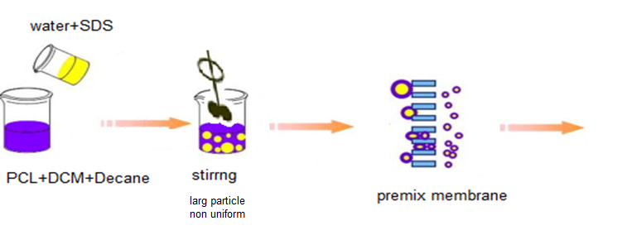
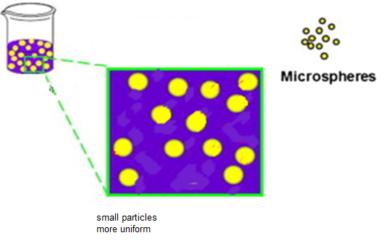
Preparation of polymer microcapsules:

Slide 10
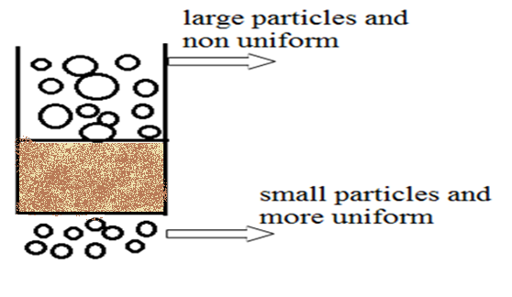
Why premix membrane emulsification?
small size have larger circulation time.
uniform size have uniform doses .
uniform size have better biocompatibility.

Slide 11
Materials
Poly (caprolactone)
Dichloromethane
Decane (as poor solvent)
Sodium dodecyl sulfate (SDS) (as surfactant)

Slide 12
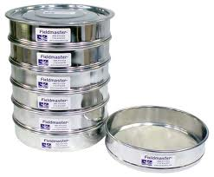
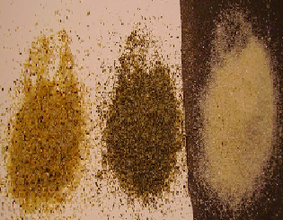

Methods:
Screening of sand beads
At the first the sand was washing with water and then separated by using standard sieves into three different sizes .
600µm
300µm
150µm

Slide 13
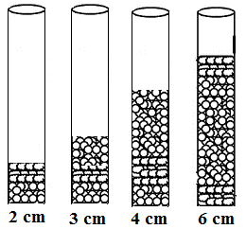
Membrane – sand beads bed system
First the membrane consist of a bed of beads of the same size but at different heights.

Slide 14

Three different sand sizes of the beads were used to make a bed of 4 cm total height.
1.3 cm(150µm)
1.3 cm(600µm)
1.3 cm(300µm)
1.3 cm(300µm)
Mixture of three size
1.3 cm(600µm)
1.3 cm(150µm)
Gradual decreasing
Gradual increasing
Mix

Slide 15
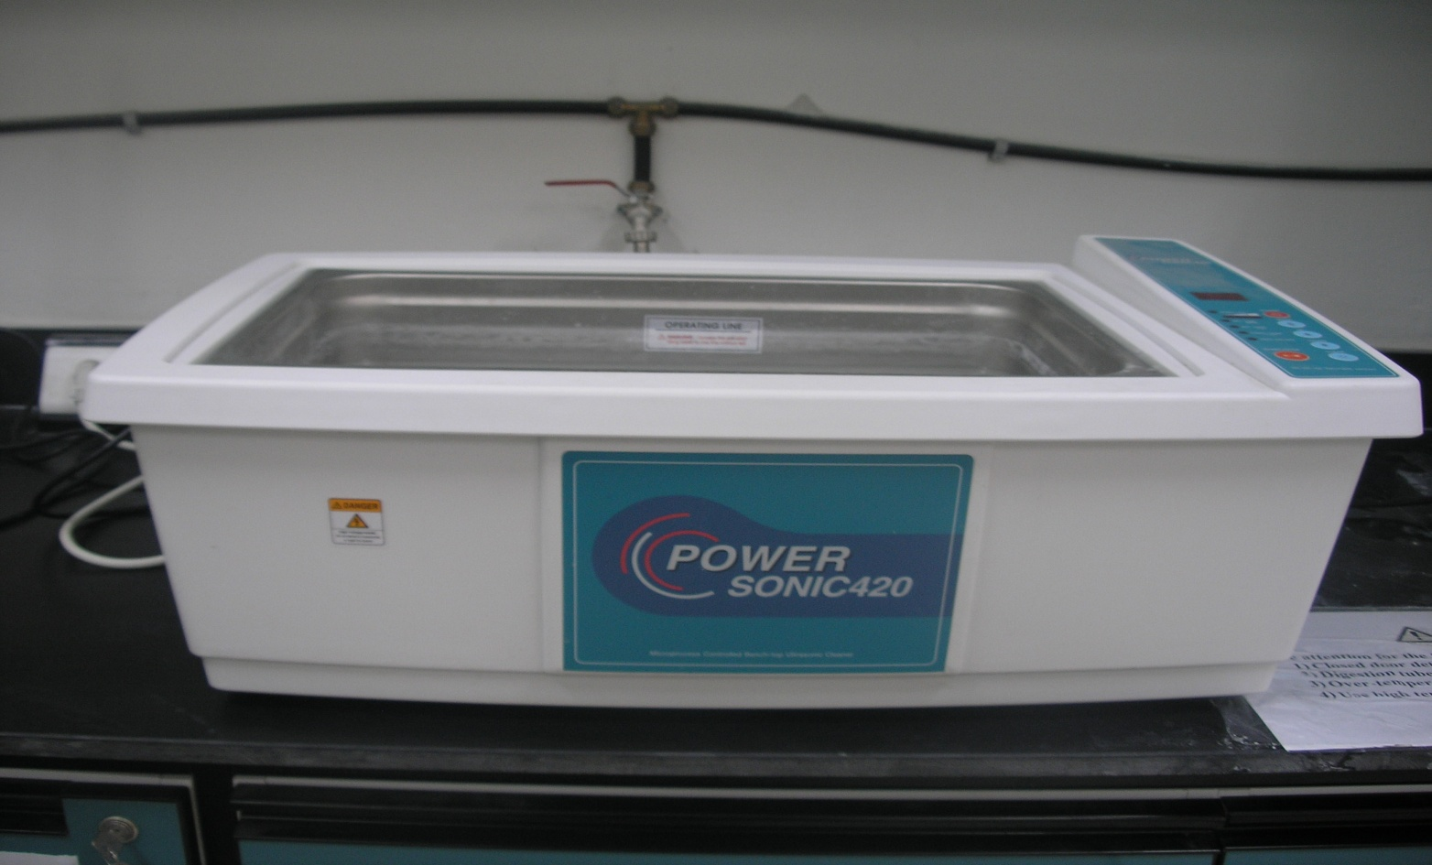
Shaking by using power sonic:
To compact the sand beads layer and make the size of pores more uniform, the bed was sonicated using ultra sound device .

Slide 16
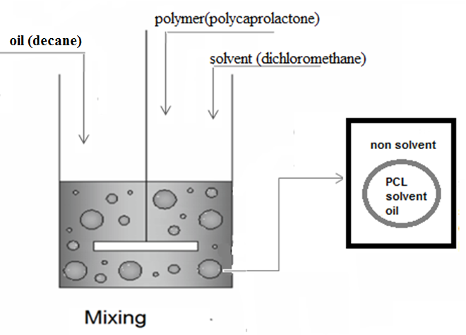
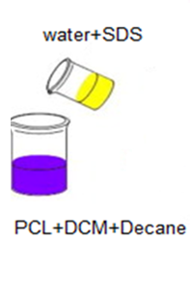
Premix solution:

Slide 17
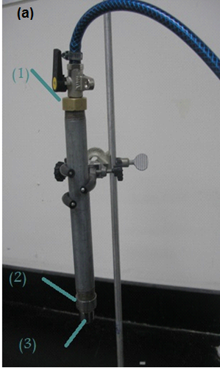
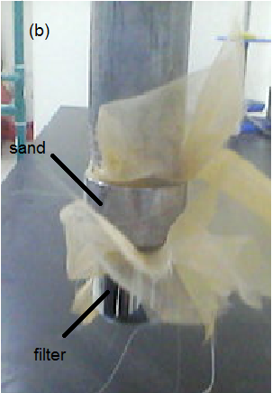
Reducing particles size using membrane:
metallic membrane module

Slide 18
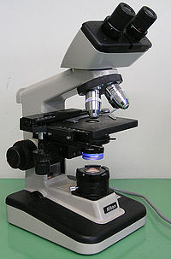
Average size measurements:
A photograph pictures from microscope of the microcapsules was taken as a sample to make our calculations on it, where each picture was nearly contains 50-100 micro capsules and the average size was found .

Slide 19
Results:
Effect of premix emulsification.
Effect of the height of the sand bed.
Effect of the size of sand beads.
Effect sand beads arrangement.

Slide 20
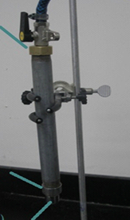

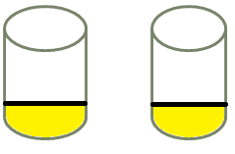
Effect of premix emulsification
Premix emulsion
before
after

Slide 21
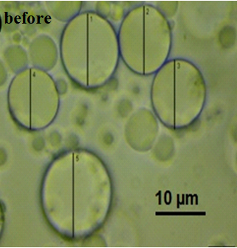
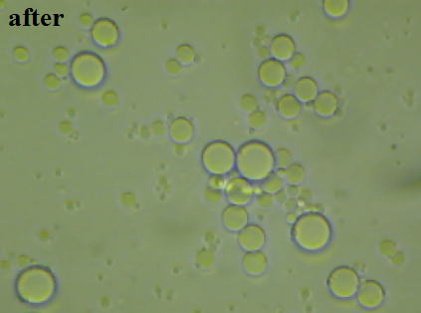
Microscopic photographs of PCL microcapsules before and after passing through membrane.

Slide 22
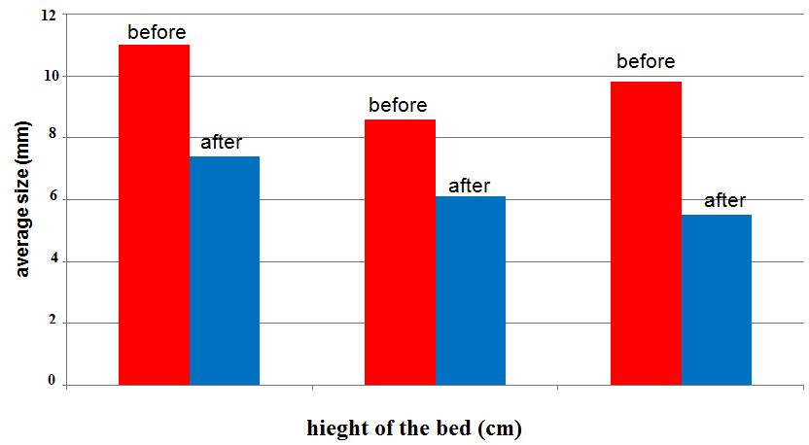
The average size of microcapsules before and after passing through the membrane.

Slide 23
1- The size of the microcapsules decreases after passing the emulsion thorough the membrane from 9.8µm to 5.5µm .
2- The microcapsules are more uniform after being passed through the membrane.

Slide 24
Effect of the height of the sand bed:

Slide 25
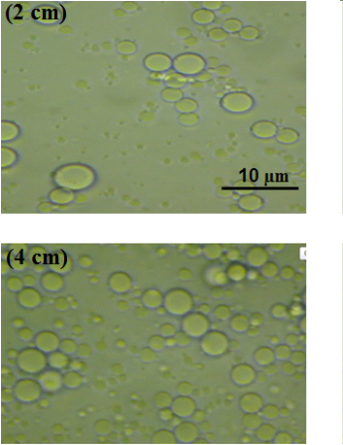
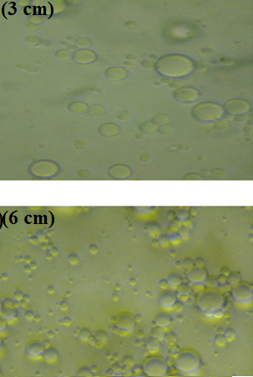
Microscopic photographs of PCL microcapsules prepared using a bed of sand beads 150µm .

Slide 26
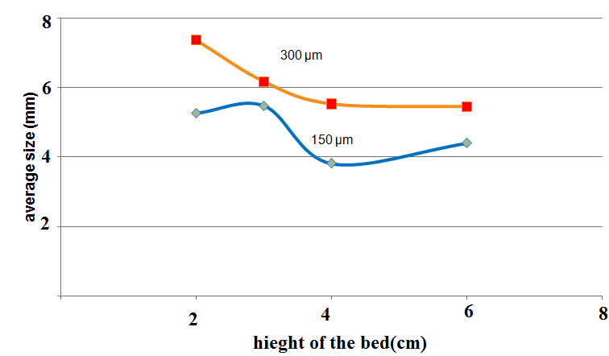
It was found that increasing the height of the bed decreases the average size of the particles.
The relationship between the average size and height of the bed for size 150 and 300µm.

Slide 27
The average particle size of the microcapsules was decreasing with increasing the bed height (i.e.: for 150 µm at 2 cm ,6cm the average size reduce respectively from˜ 5 µm to˜ 4 µm ) .
This is may be attributed to fact that the length of the pores within the bed increases with increasing the bed height.

Slide 28
Effect of the size of sand beads:
.
3 cm
4 cm
The relationship between the average size and sand size for 150 and 300µm.

Slide 29
The average size of microcapsules was increased as the
size of sand particles increased (i.e.: the average size reduce from ˜ 7µm at 300µm to˜ 5 µm at 150µm) .
This may be explained as the size of the sand bead decreases the porosity of the bed is expected to decrease .

Slide 30
Effect of sand beads arrangement:
1.3 cm(150µm)
1.3 cm(600µm)
1.3 cm(300µm)
1.3 cm(300µm)
Mixture of three size
1.3 cm(600µm)
1.3 cm(150µm)
Gradual decreasing
Gradual increasing
Mix

Slide 31
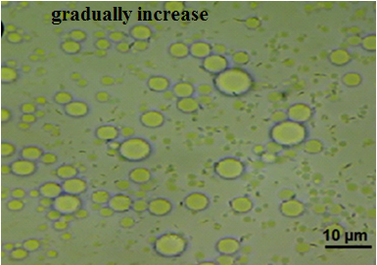
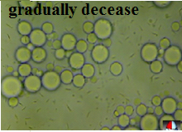
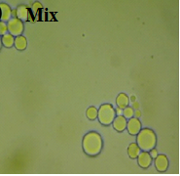

Slide 32
8
Average size resulted when three sizes of sand used in the bed
0

Slide 33
The results showed that:
The gradual increasing of the sand bed sizes from the bottom to the top renders the smallest average size of the particles (~ 3.5 µm) .
Followed by the random beads mixture (~5.5 µm) .
And then the gradual decrease of the sand bed sizes from the bottom to the top (~7.3 ).

Slide 34
CONCLUSION
The passage of the emulsion through the membrane reduces the size of the microcapsules and makes them more uniform.

Slide 35
decreasing the size of the sand particles or increasing the bed height decreases the size of the microcapsules .
The configuration of the sand beads within the bed highly affected the average size of the microcapsules.

Slide 36
The average size of the PCL microcapsules could be optimized through the controlling the size of the sand beads, the bed height and the configuration of the sand beads within the bed.

Slide 37
Thanks for your attention

Slide 38
1-The passage of the emulsion through the membrane reduces the size of the microcapsules and makes them more uniform.
3-decreasing the size of the sand particles or increasing the bed height decreases the size of the microcapsules .
Take home massage
2-The configuration of the sand beads within the bed highly affected the average size of the microcapsules.
4-The average size of the PCL microcapsules could be optimized through the controlling the size of the sand beads, the bed height and the configuration of the sand beads within the bed.

