Slide 1
A Project on buck-boost converters prepared by: mohammad slameh supervisor:
Prof.Dr. Marwan Mahmoud

Slide 2
Contents:
Introduction
Elements and devices I used .
Buck converter .
Result of Buck converter.
Boost converter .
Result of Boost converter .
Existing problem .
Conclusion.

Slide 3
Introduction:
The main objective .
Why we prefer converters ?
Where we use Dc-Dc converters ?

Slide 4
Elements and devices I used :
Elements
Transistor
(MOSFET)
Inductor
Capacitor
Load
Diode

Slide 5
DEVICES
FUNCTION GENERATOR
MULTIMETER
OSCILLOSCOPE
POWER SUPPLY

Slide 6
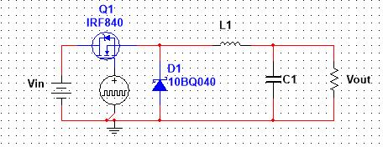
BUCK CONVERTER:
Vin = 12v.
Vout=6v.
Duty cycle=50%.
Frequency =50KH.
Voltage ripple = 0.025 x Vin = 30%.
Current ripple = 10% (typically).
Inductor : by using this equation L = (Vs-V0)*D/Δif
L= 0.6 mH .(I used 1 mH ).
CAPACITOR: by using this equation C = T * Δi/8Δv
C= (0.83*10^-6 )F (I used 3.3*10^-6 F).
R LOAD = 3 K ohm .

Slide 7
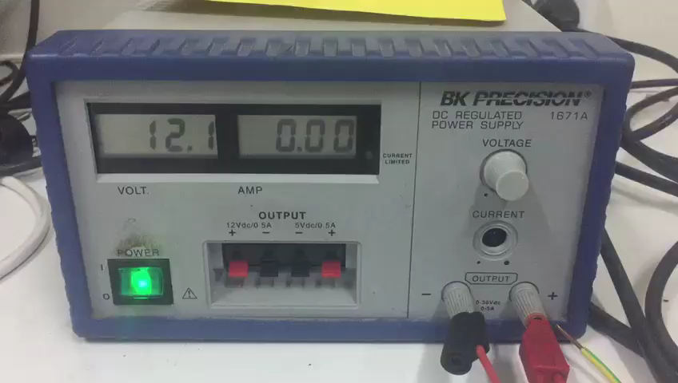

Slide 8
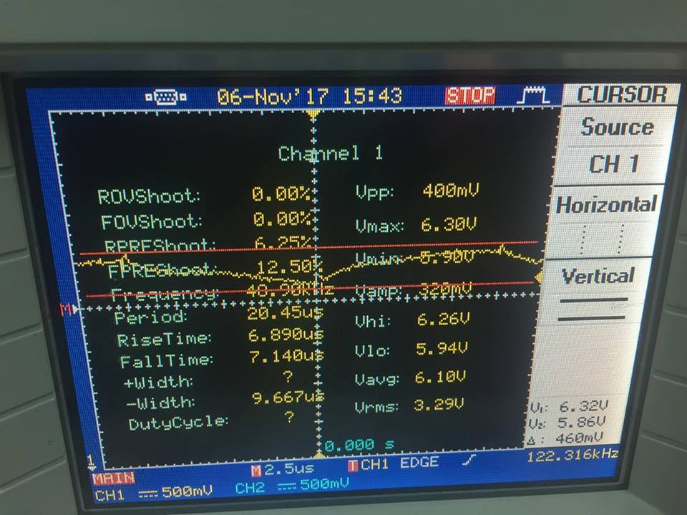
RESULT OF BUCK CONVERTER:
Vout= 5.95 v .
Voltage ripple = 32%.(difference between Vhi and Vlow).
Efficiency=68% .

Slide 9
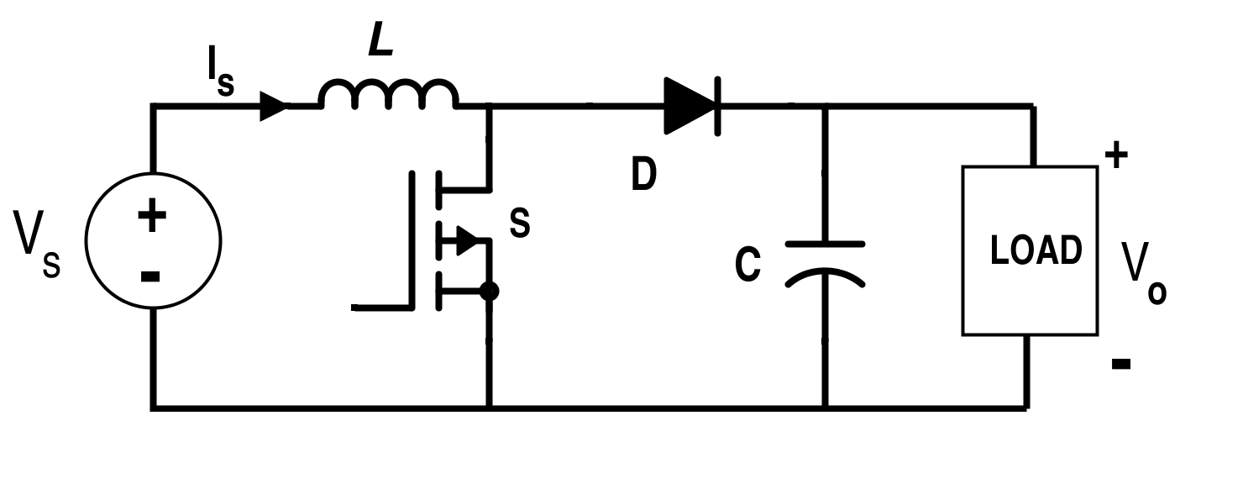
BOOST CONVERTER :
Vin = 6v.
Vout=12v.
Duty cycle=50%.
Frequency =50KH.
Voltage ripple = 0.025 x Vin = 15%.
Current ripple = 10% (typically).
Inductor : by using this equation L = (Vs-V0)*D/Δif
L= 0.6 mH .(I used 2 mH ).
CAPACITOR: by using this equation C = T * Δi/8Δv
C= (0.83*10^-6 )F (I used 3.3*10^-6 F).
R LOAD = 3 K ohm .

Slide 10
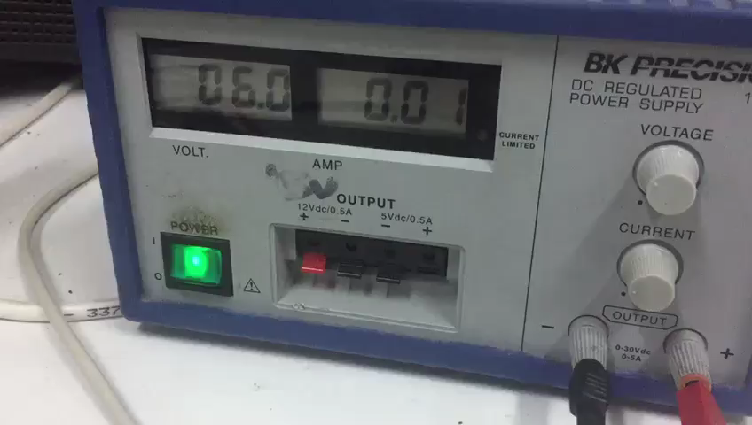

Slide 11
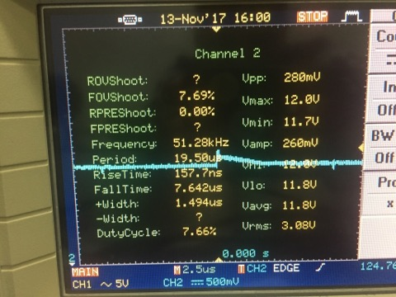
RESULT OF BOOST CONVERTER:
Vout = 11,7v.
Voltage ripple = 20%.
Efficiency= 79% .

Slide 12
EXISTING PROBLEM:
Sensitivity of elements .
Cant find exact value of elements .
See the output current curve .
Working alone ^_^ .

Slide 13


Slide 14


