Slide 1
Graduation Project Report 2
Design of Water Tank
prepared by:
1- Ahmad Sameh Sous.
2- A’hed Mohammad Qtaishat.
3- Anas Hamadnah.
4- Nazeh Naser Najim.
. Under supervision of : Dr. Mohmmad Ghazal

Slide 2
Contents of this project report:
This report contains six chapters:
Introduction.
Literature Review.
Site Description.
Load Analysis.
Design of water tank.
Conclusion.

Slide 3
General information about this project:
This project is the design of two water tanks, one of which is cylindrical and the other is cuboid.
We designed these two tanks in the northern mountain of Nablus.
And since the necessary soil tests were conducted so that we can design a water tank within the correct engineering specifications.

Slide 4
General information about this project:
Water tank are as any structures that should have foundation.
Moreover, the foundation of water tanks should be studied carefully,
any problems in the foundation, such as, settlement, differential
settlement, failure …

Slide 5
Introduction:
What is a water tank:
A water tank is a container for storing water.
*Classification of tanks:
Tanks are classified into the following main types:
1-According to use..
2-According to the shapes of the tanks…
3-According to the type of stored materials…
*Tanks can be classified according to the position of the tank in relation to the Ground:
-Placed on the floor.
-Rectangular ground or semi-ground tank.
-A ground or semi-ground circular tank

Slide 6
Literature Review
History:
Throughout history, wood, ceramic and stone tanks have been used as water tanks.
These tanks were all naturally occurring and some man made and a few of these tanks are still in service.
The Indus Valley Civilization (3000–1500 BC) made use of granaries and water tanks.
Medieval castles needed water tanks for the defenders to withstand a siege.
A wooden water tank found at the Ano Nuevo State Reserve (California) was restored to functionality after being found completely overgrown. It had been built in 1884.

Slide 7
The following table , types water tank based on their location and shapes:

Slide 8
Site Description
This report presents the outcome of the site investigations carried
out for the proposed construction site of the Water Tank at the
northern mountain in the city of Nablus.

Slide 9
Location Description:
The project objective is Distributing water from the water line coming from the water tank on Asira Street to the village Aladdin area and An-Najah National University Hospital area with appropriate pressure.
The proposed construction site of the Water Tank is located at at the northern mountain in the city of Nablus) In the lands of Asira Alshamalia), parcel No.14 and segment No.29 .
The site is located at highest level in the mountain approximately (714m EMSL).

Slide 10
The purpose of this site investigation:
Investigation of the underground conditions at a site is prerequisite to the economical design of the substructure elements. It is also necessary to obtain sufficient information for feasibility and economic studies for any project.
In general, the purpose of this investigation on the site was to provide several important points, including:
1- to determine the type of foundation.
2- to allow the geotechnical consultant.
3- to make settlement predictions.
4- solution of excavation problems can be made.

Slide 11
BEARING CAPACITY ANALYSIS
The bearing capacity was calculated using the shear test parameters of cohesion and angle of internal friction and the soil density of the specimens extracted from the boreholes.
The bearing capacity was computed by a special computer program using the general bearing capacity theory method.
The bearing capacity in this project 250 KPa (2.5 Kg/cm2), Based on this value we designed the water tank.

Slide 12
SELECTION OF FOUNDATION TYPE:
According to the nature and characteristics of the materials encountered in the drilled boreholes as described, and the bearing capacity analysis above, we recommend considering matt foundation.

Slide 13
Design of water tank:
Reinforced soil is a building material composed of soil that has been strengthened by tensile elements such as metallic strips, geo textiles, or geo grids. Reinforced soil or mechanically stabilized soil.
Types of foundation: The choice of the type of rules depends on the following points:
Soil bearing strength below bases.
Load the column.
the water table.
Digging depth for bases in adjacent buildings.
We used Matt foundation and we noticed the foundation pressures are to be spread over large area.

Slide 14
In this project, we designed two types of water tanks:
1-)Cylindrical water tank.
Height=10m.
Thickness for slab and wall=500mm.
Diameter=24m.
Total area = 471.3 m^2.

Slide 15
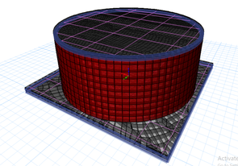
Cylindrical water tank Design:

Slide 16
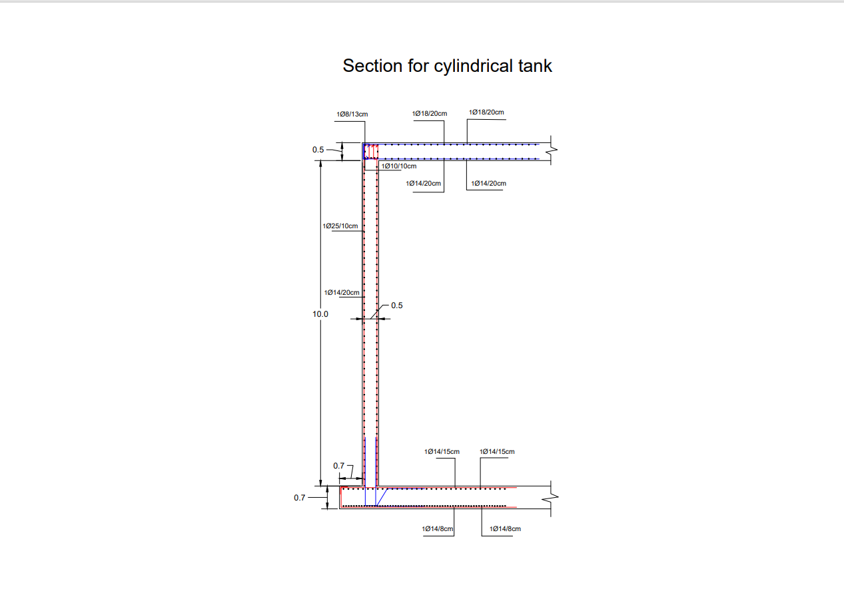
Cylindrical water tank Design:

Slide 17
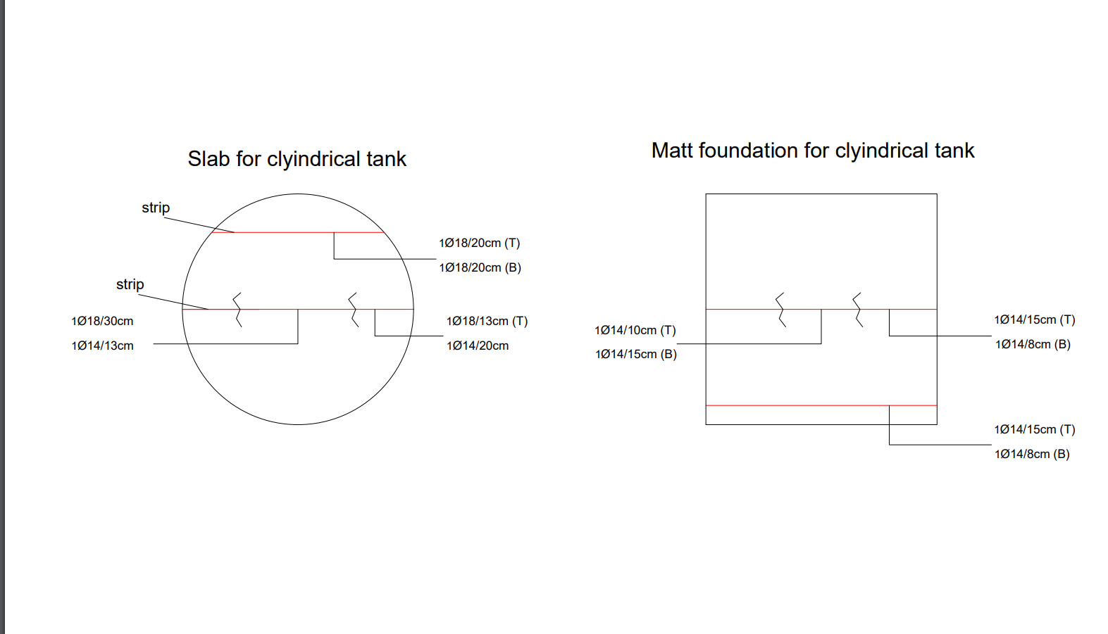
Cylindrical water tank Design:

Slide 18
2-)Cubic water tank Design:
Length of the side=24m.
Thickness slab =550mm.
Height = 10 m.
Thickness wall =500mm.
Total area = 576m^2.

Slide 19
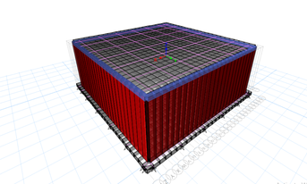
Cubic water tank Design:

Slide 20
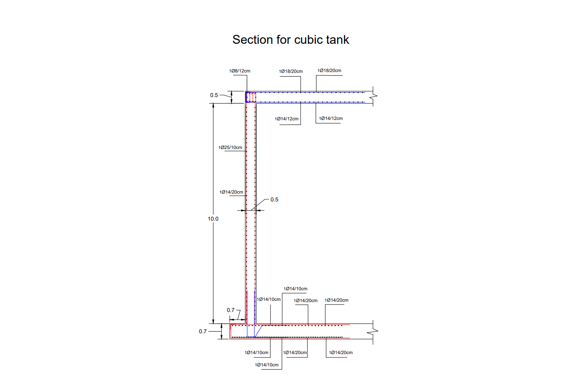
Cubic water tank Design

Slide 21
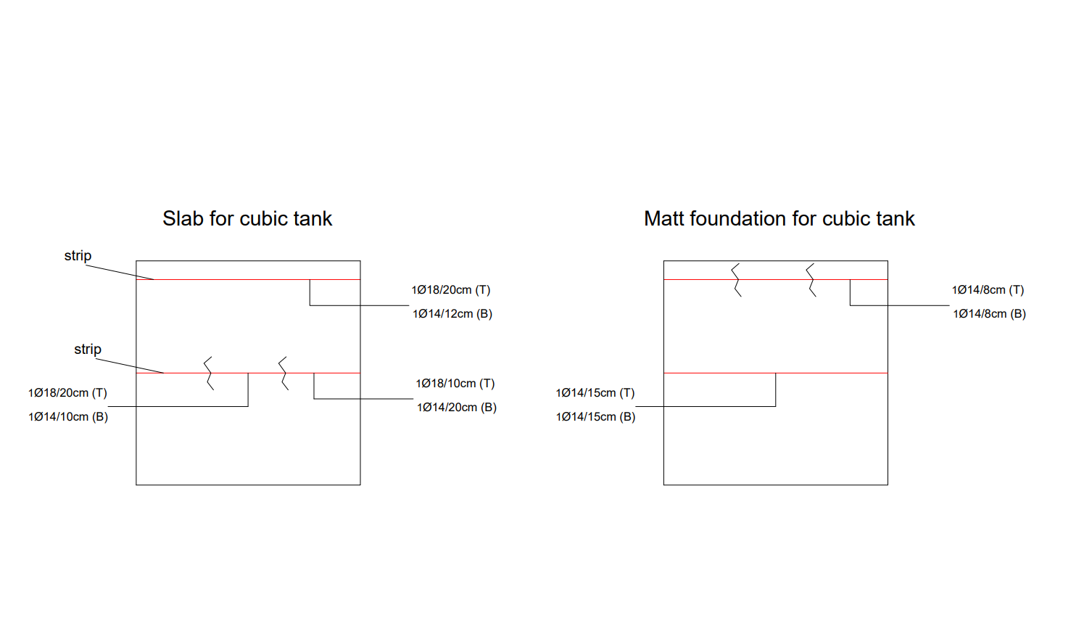
Cubic water tank Design:

Slide 22
Load Analysis
Reinforced concrete is widely used for water-retaining structures of all kinds, such
as treatment tanks, water-towers and reservoirs. By the expression water (or
liquid) structures, it is meant structures that retain water or contain liquid.

Slide 23
Concrete requirements:
Aggregates.
Suitable granular composition.
Water-cement ratio.
Cement content.
Mixing.
Compaction.

Slide 24
Types of loads:
There are two types of loads, which are:
1-)Horizontal loads:
We neglect the wind (because they have small effect in these cases). For elevated tanks, we consider 5% of gravity to be the horizontal demand for earthquake design.
2-) Vertical loads.

Slide 25
Conclusion
The following is from the experimental work mentioned in this thesis. General assumptions concerning the application of the more system to the more technique It is possible to draw designs for raft foundations.
With great gain, the technique can be used to pick the most Economic design when alternative designs for rafts are considered. The fringes provide an indication of the distribution of stress in the raft slab. In order to pick the template that results in the most uniform distribution.

