Slide 1
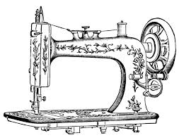
Implementation of LEAN MANUFCTURING At Al- Aqqad Garment Company
Prepared By : Ghassan Sleem , Lamia Fahed , Mutaz Abu Eisheh , Razan Atout

Slide 2
Outline :
About The Company
Problem Statement
Objectives
Literature Review
Methodology
Results
Discussion and Conclusion
Recommendations

Slide 3


About The Company :
Aqqad Company For Trouser Producing
Located In Palestine Nablus
Started In 1975
120 Workers
Golden Age
(1985 – 1999 )

Slide 4
Problem Statement:
Problem statement
WIP
Over motion
Demand
Layout and product flow
Lean Waste
Waiting time

Slide 5

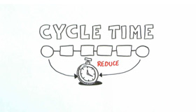

Objectives :
Min WIP
Reduce Cycle Time
Meet The Customer Demand

Slide 6

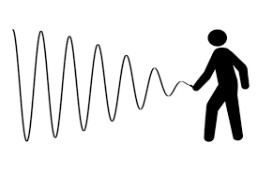

Objectives :
Find better layout
Reduce Cost
Find solution to fluctuating demand

Slide 7

Literature Review :
LEAN MANUFACTURING
It was introduced in the Toyota Production System in the 1970s
It based on improvement of continuous flow manufacturing, customer-driven production, flexibility, waste elimination, zero defects, visual management, safe and orderly working environment, and customer-perceived quality
TOYOTA PRODUCTION SYSYTEM
is a philosophy of operations management
I t is based on three basic ideas:
1. Integration and optimization of the entire manufacturing process
2. Kaizen (continuous improvement)
3. Understand and respond to customer needs

Slide 8

Literature Review :
Value Stream Mapping
The main purpose of this tool is to reduce time between placement of order by customer and the time of delivery of the product
Lead time, according to the VSM theory, is determined by the sum of processing time with the sum of the times that intermediate stocks are standing still in the production line.
Line Balancing
The study of line balancing ensure that this method is effective tool to improve the throughput of assembly line while reducing non-value-added activities, cycle time ,
The procedure contain many steps includes calculation of cycle time of process, identifying the non –value added activities, calculating total work load on station and distribution of work load in order to improve the efficiency of line and increase overall productivity.

Slide 9

Literature Review :
Cellular Layout
A cell is a combination of people, equipment and workstations organized in the order of process to flow, to manufacture all or part of a production unit
There are lots of benefits of cellular manufacturing :
1.Reduced work in process inventory
2. Reduced direct labor cost
3. Reduces throughput time and increases velocity for customer orders
Forecasting
A suitable forecasting system should also deal with the specificities of the demand: fashion trends, seasonality, influence of many exogenous factors, etc

Slide 10
Methodology :
Factory visit
Process Flow chart
Processes Timing
Layout and Flow between Machines
Value Stream Mapping for the existing situation
Lead Time for the existing situation calculations
Existing Production system Performance Metrics
Forecasting Model Building
Variation in Capacity for each process
Line balancing
New layout
Value Stream Mapping After line Balancing
Proposed Production system Performance Metrics
Next year schedule

Slide 11
Results
Existing Production System
Sewing
Washing
Ironing
Packaging
Cutting

Slide 12
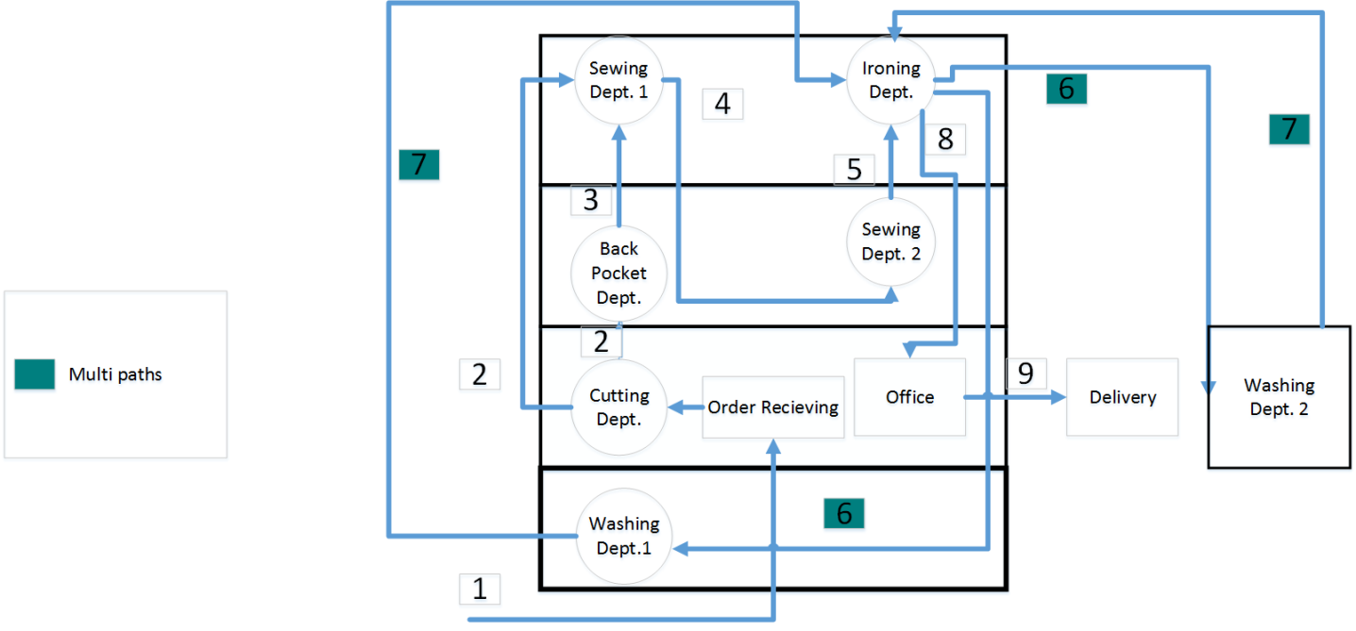
Results
Existing Flow Pattern

Slide 13
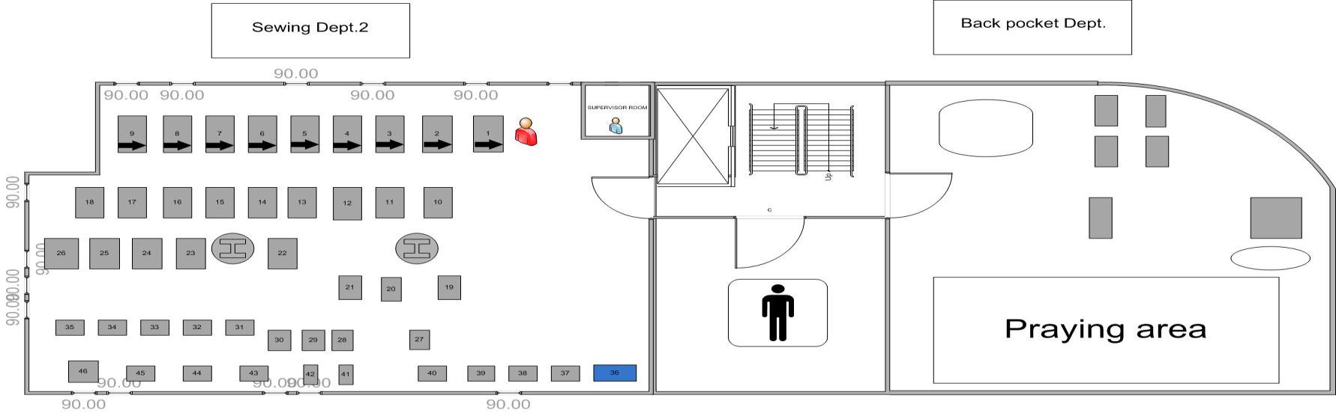
Results
Production Department Layout
layout of the 2nd floor

Slide 14
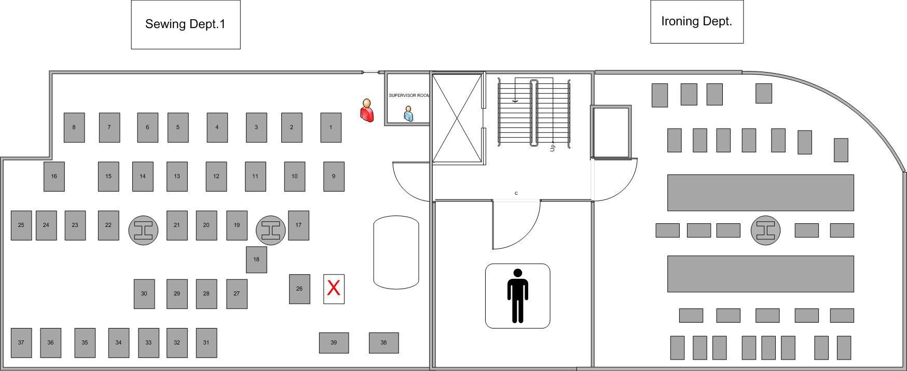
Results
Production Department Layout
layout of the 3rd floor

Slide 15
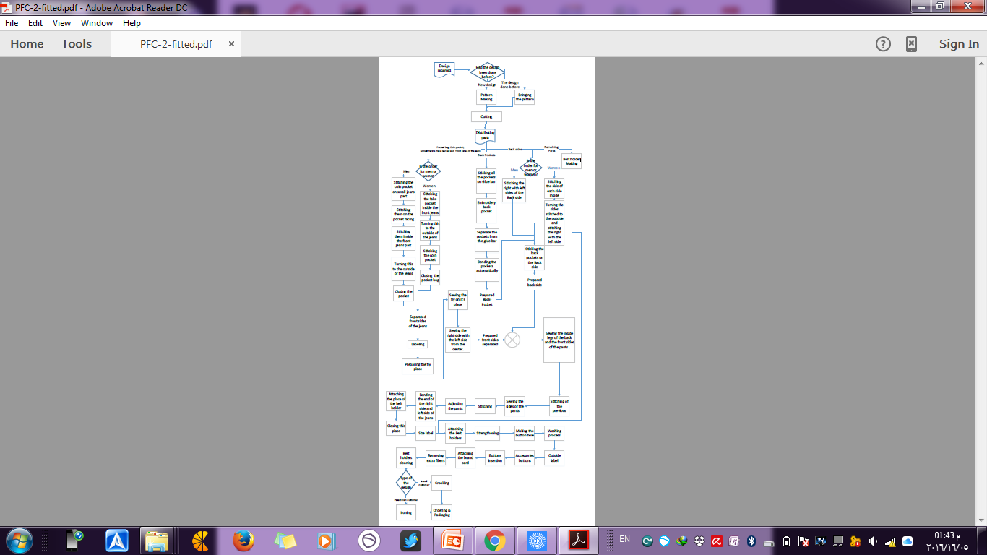
Results
Process
Flow Chart

Slide 16
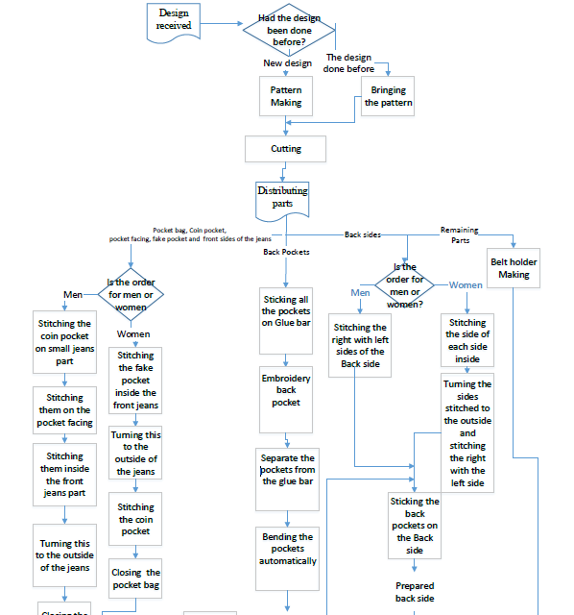

Slide 17
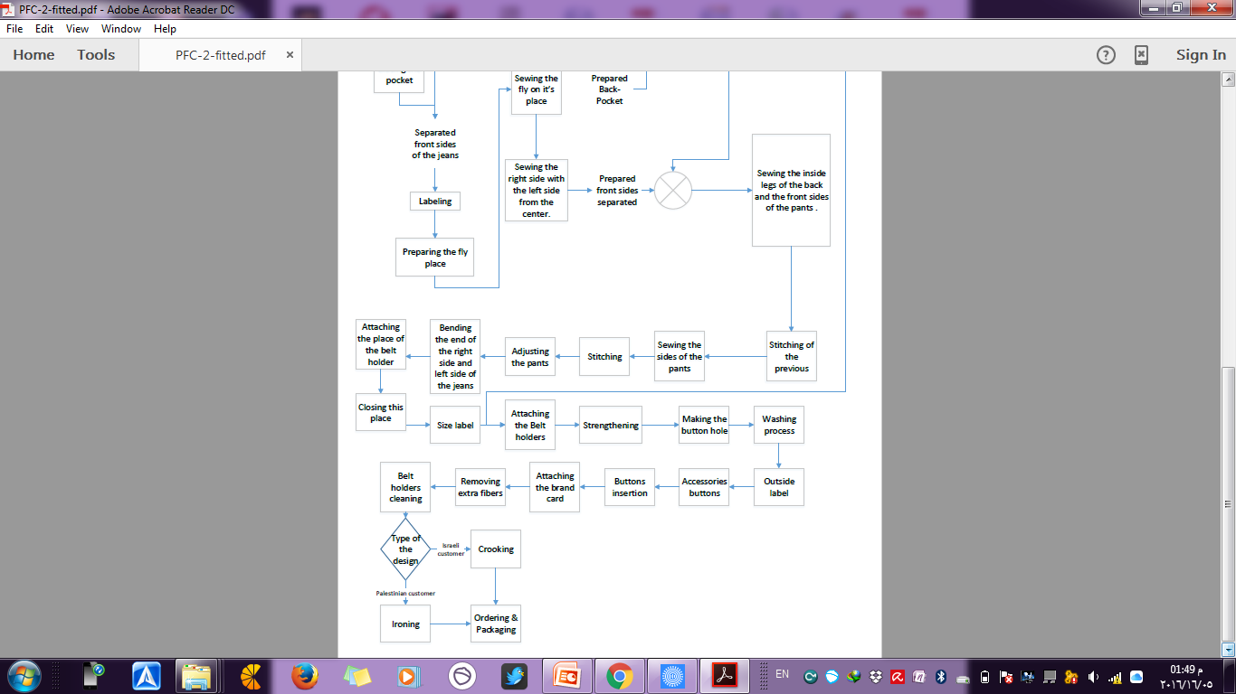

Slide 18
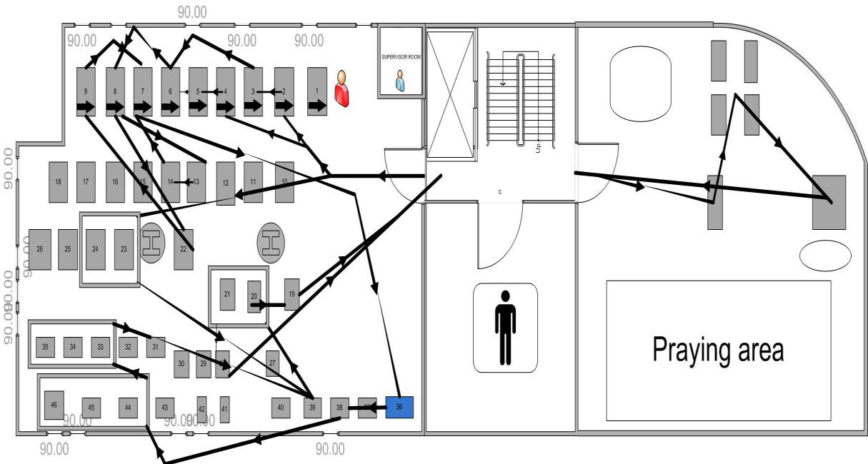
Results
flow between machines in second floor

Slide 19
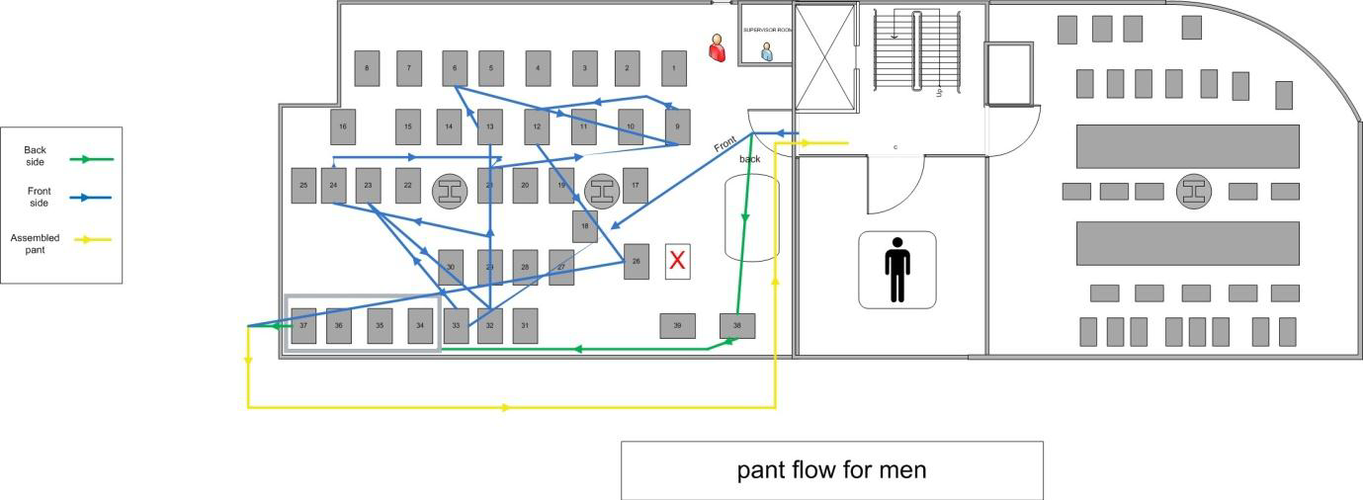
Results
flow between stations in the third floor for men pants

Slide 20
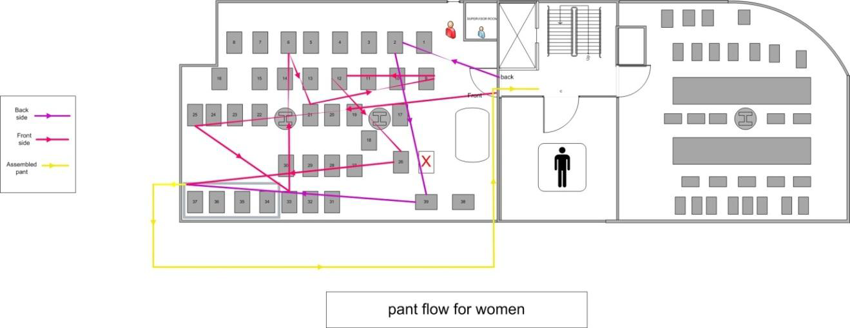
Results
flow between stations in the third floor for woman pants

Slide 21
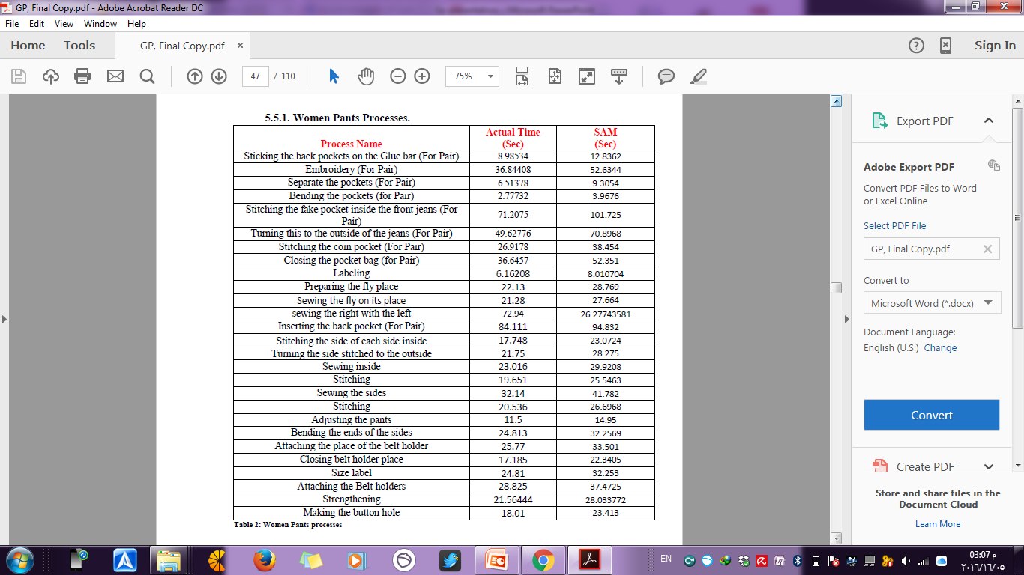
Results
Processes Timing
Women Pants Processes
∑S.A.M = 15.4 minute
to produce one classic women trouser
∑S.A.M = 14.6 minute
to produce one classic men trouser

Slide 22
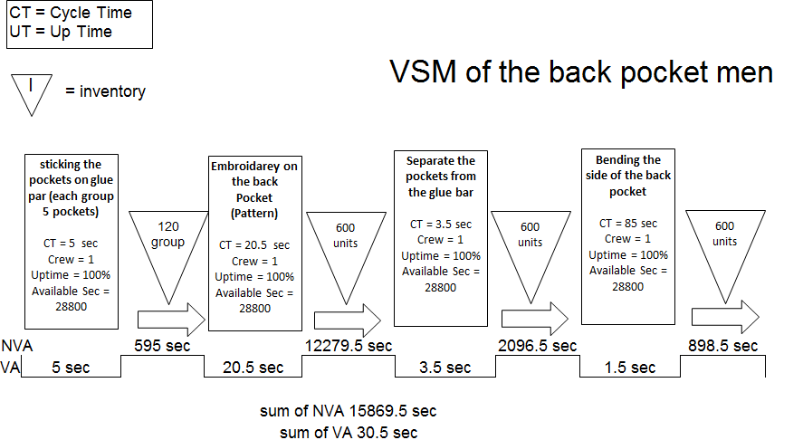
Results
Value Stream Mapping for Existing Production System

Slide 23
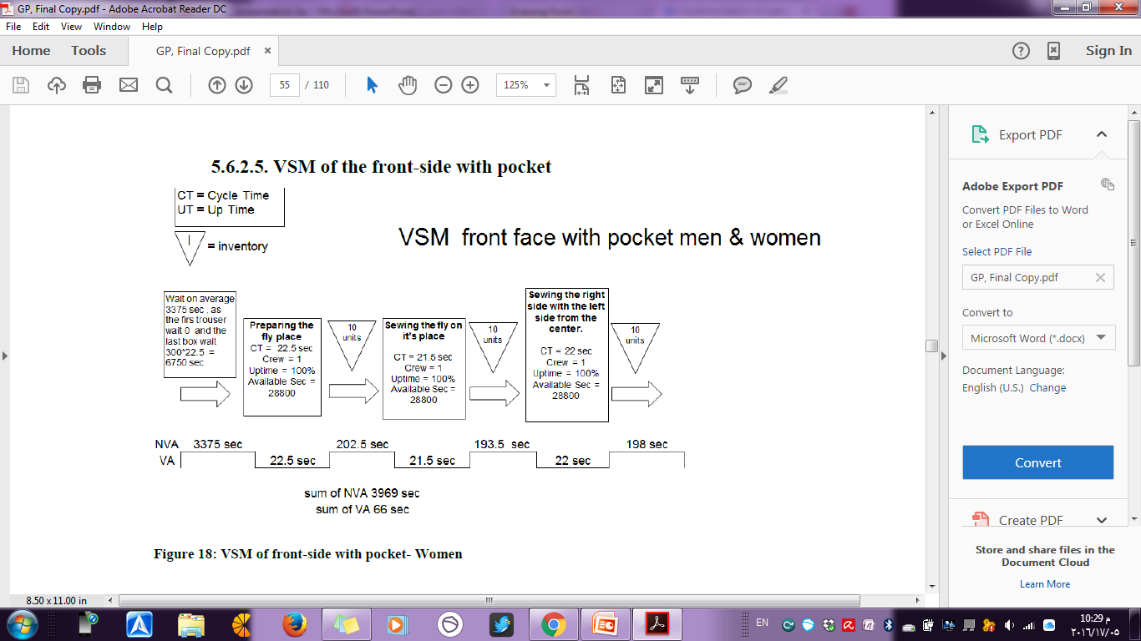
Results
Value Stream Mapping for Existing Production System

Slide 24
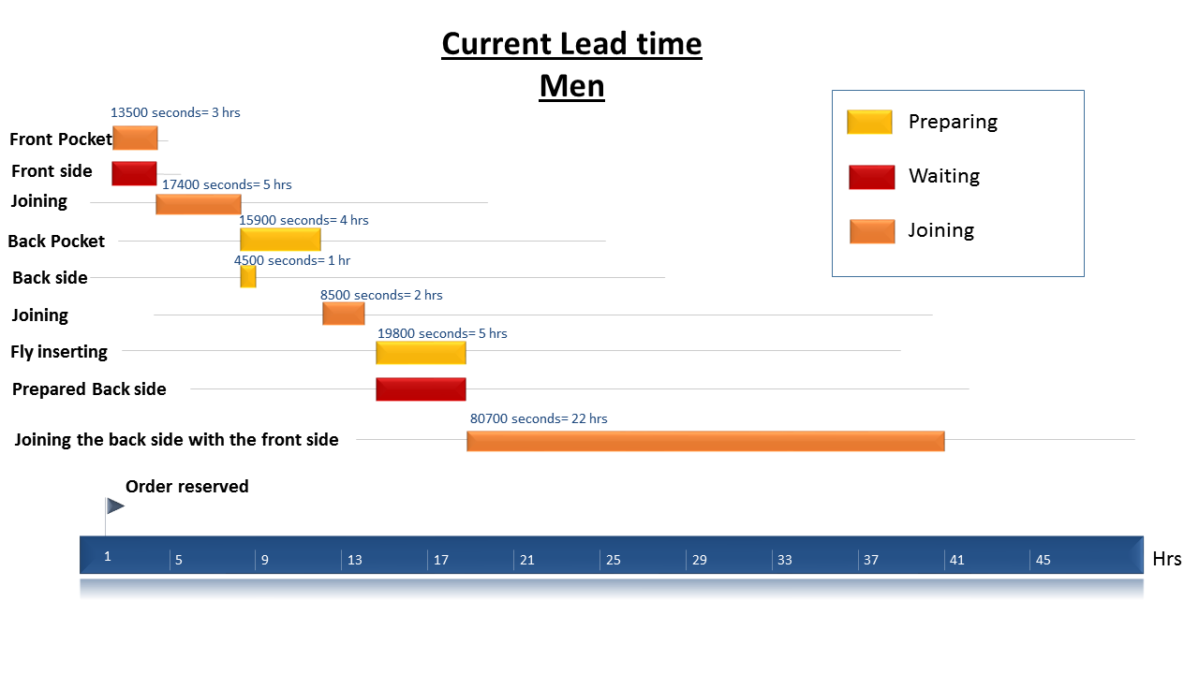
Results
Existing Lead Time for men order
throughput time = lead time = 41 hour for 300 classic pants

Slide 25
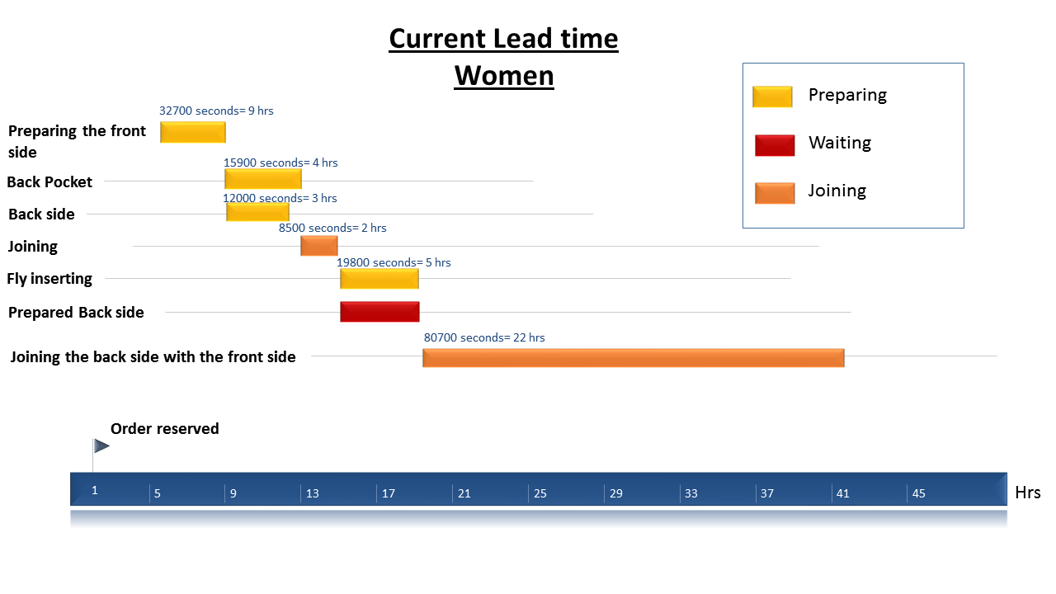
Results
Existing Lead Time for women order
throughput time = lead time = 42 hrs hour for 300 classic pants

Slide 26

Results
Existing Production system Performance Metrics
Lead time = 42 hour for women
∑S.A.M for women = 15.4 min
∑S.A.M for women = 15.4 min
Process velocity for women =
(42 hour * 60 min/hour ) / 15.4 min
=163.6
Process velocity for men = 168.5
Theoretical productivity
= 35700 /15 min per pant on avg =2380
85 * 7 hour * 60 min = total available time
Lead time = 41 hour for men
∑S.A.M for men = 14.6 min
Efficiency = 1500/ 2380 =60%
Max productivity from production manager

Slide 27
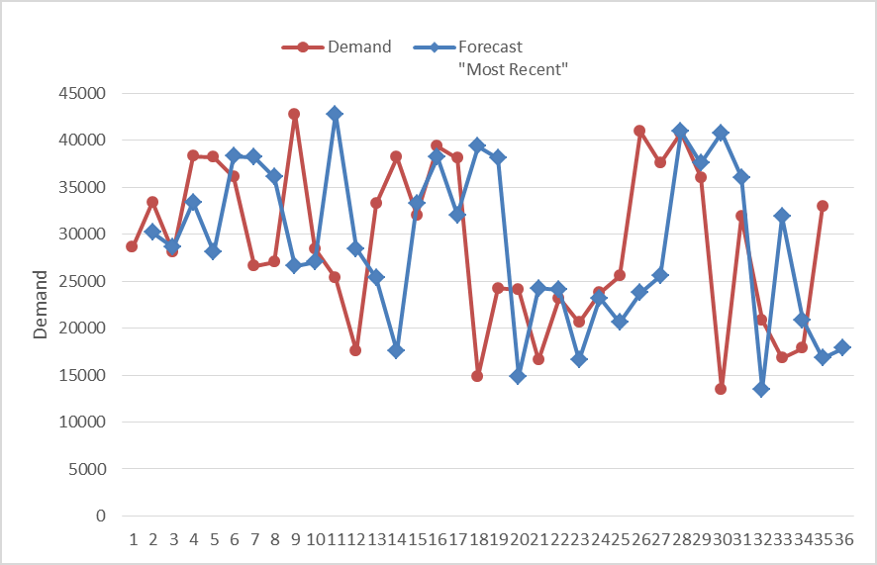
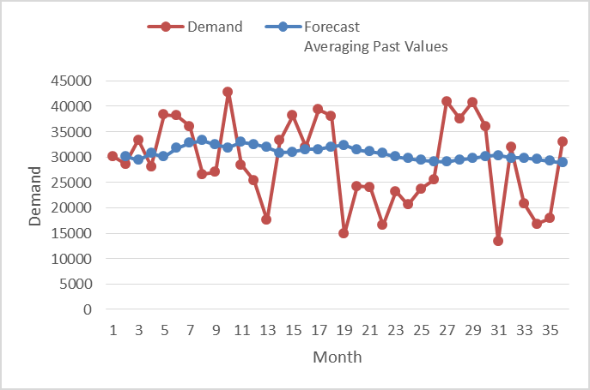
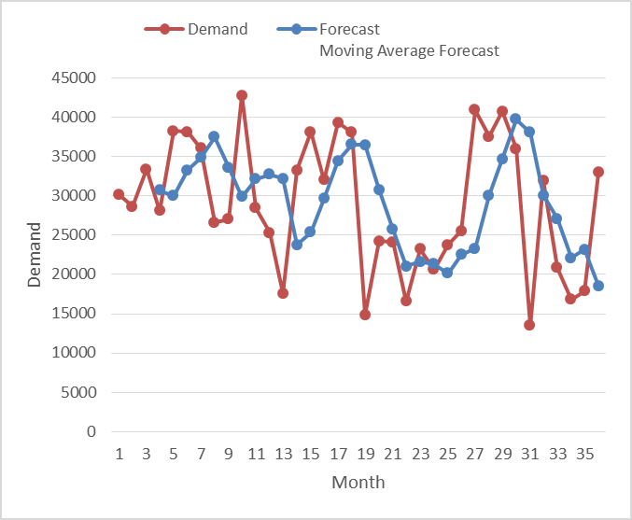
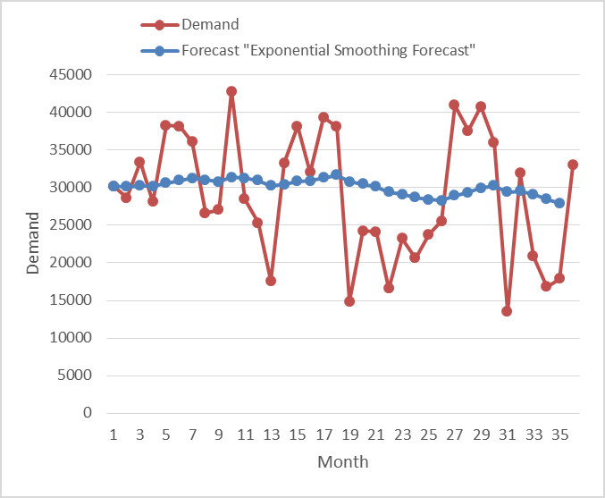
Results
Forecasting

Slide 28
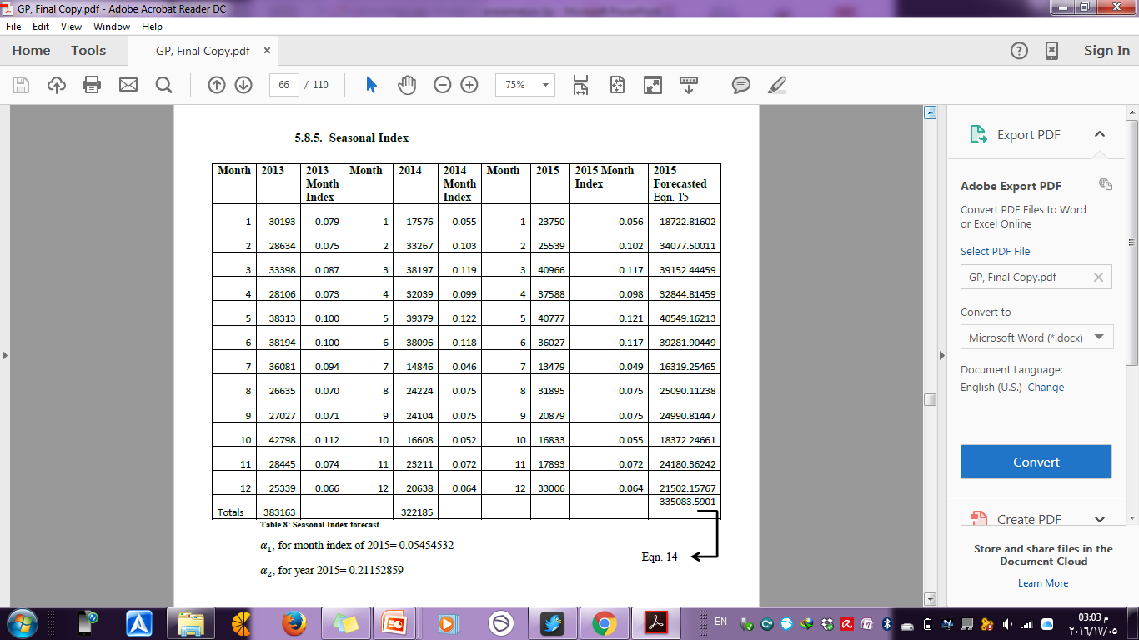
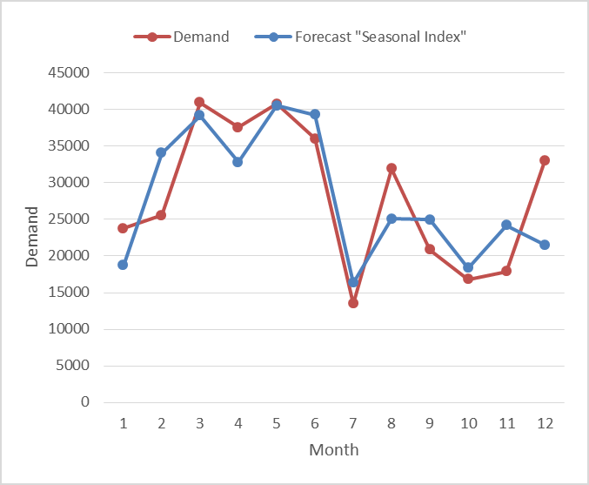
Results
Forecasting

Slide 29
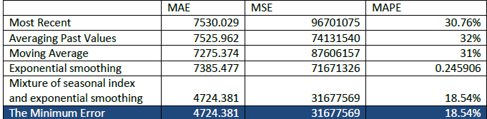
Results
Forecasting
Choosing the minimum error between the five methods

Slide 30
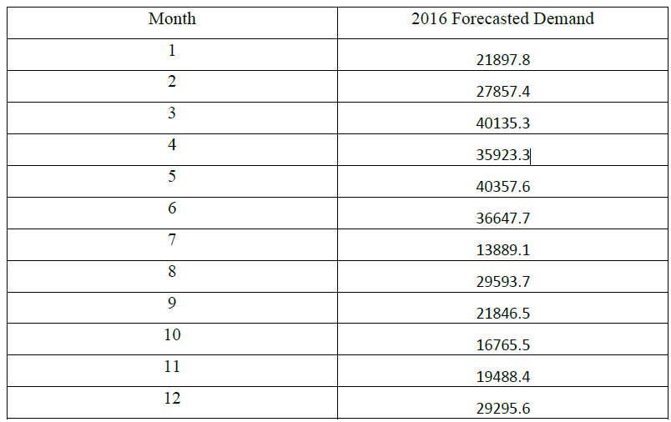
Results
Forecasting :
2016 Forecasted Demand using the mixture of seasonal index and exponential smoothing method:

Slide 31
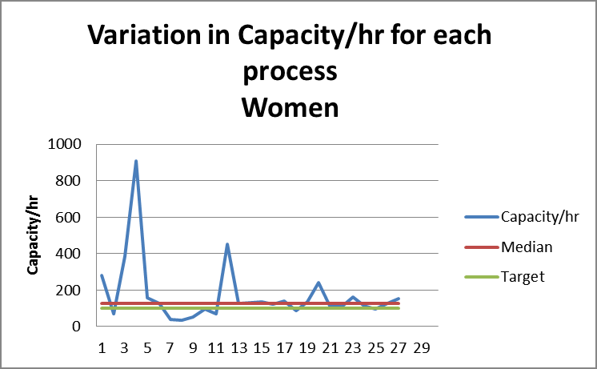
Results
Production Capacity Variation

Slide 32
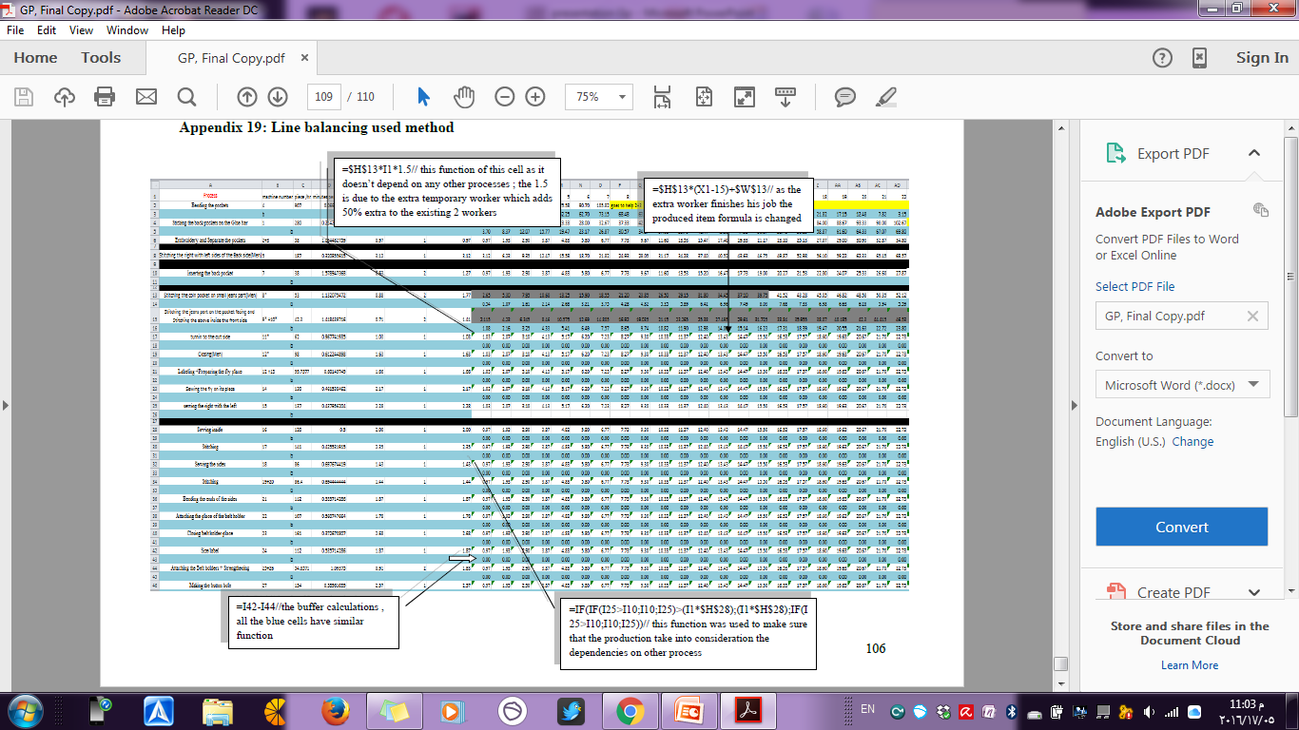
Lead time = 42 hour for women
Results
Line Balancing

Slide 33
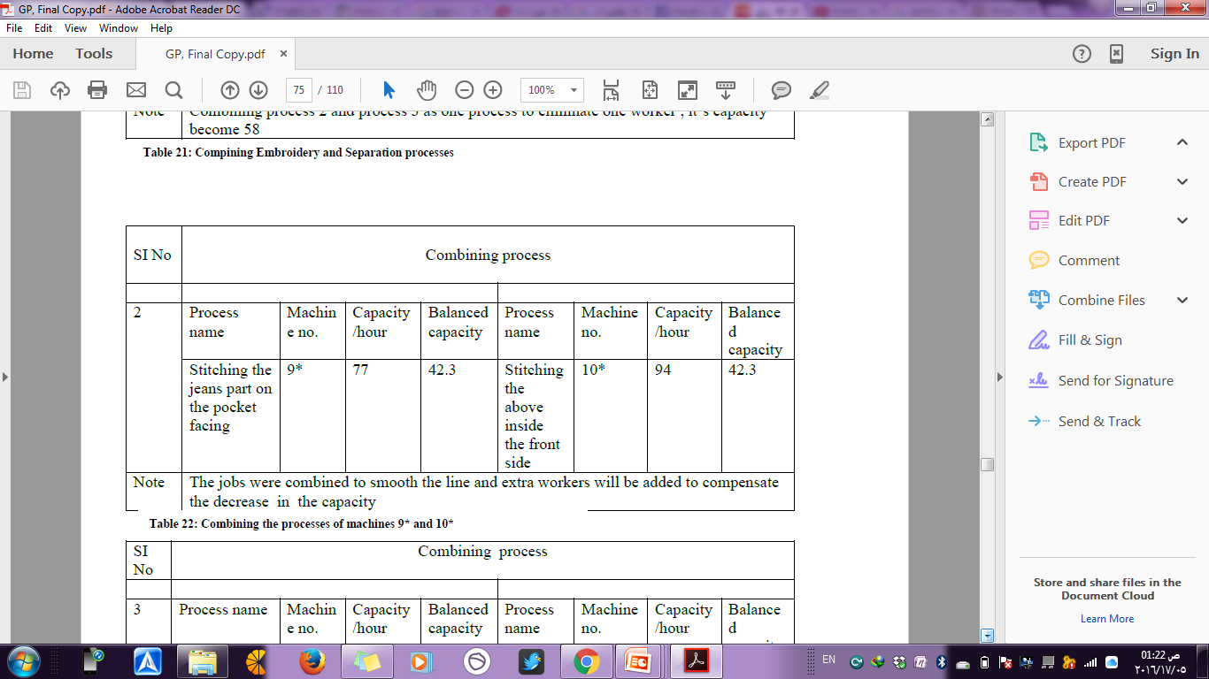
Results
Line Balancing

Slide 34
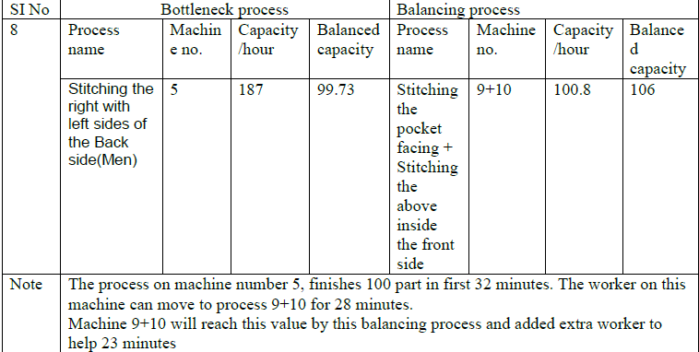
Results
Line Balancing

Slide 35
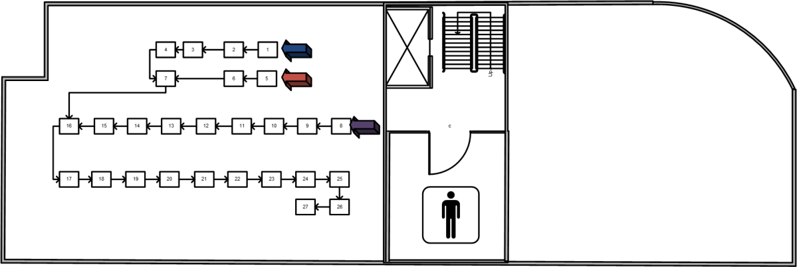
Results
First improvement on layout

Slide 36
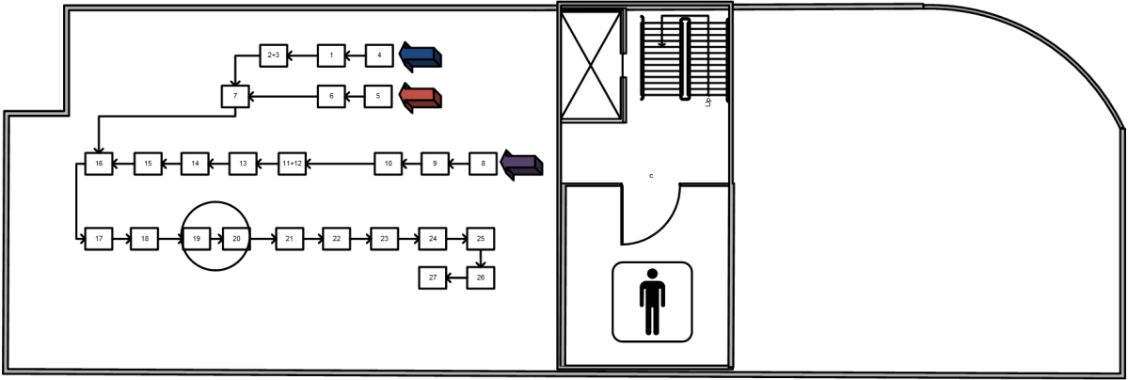
Results
Second improvement on layout

Slide 37
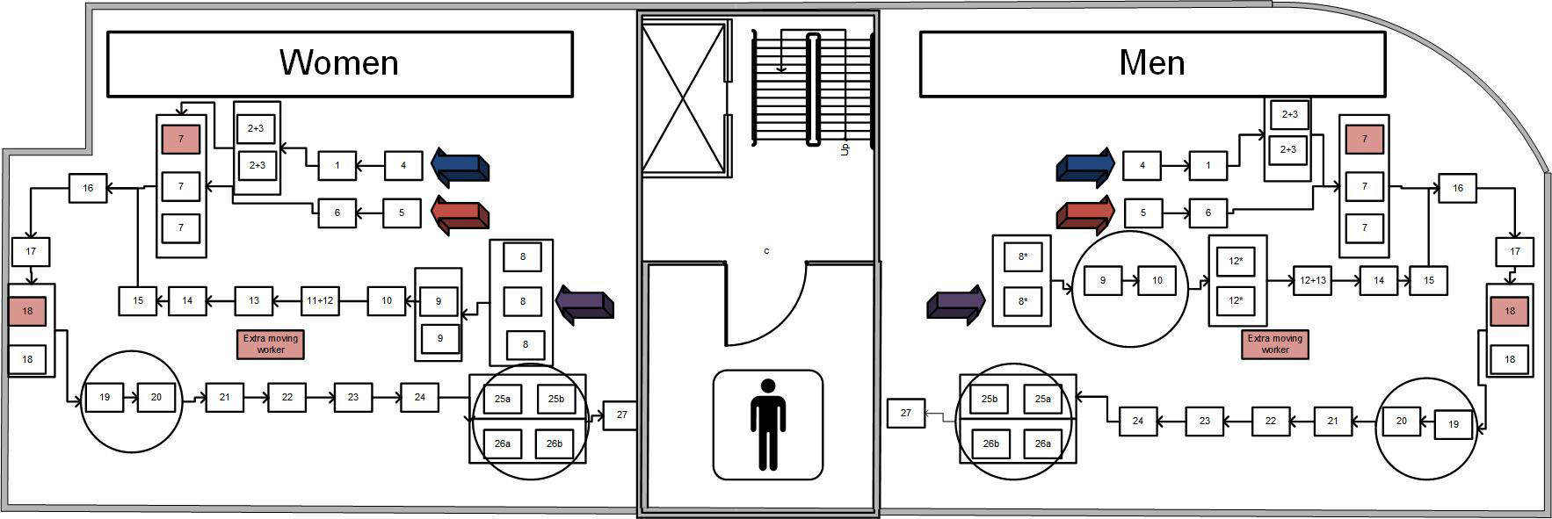
Results
the area minimized from 1017 m2 to 678 m2

Slide 38
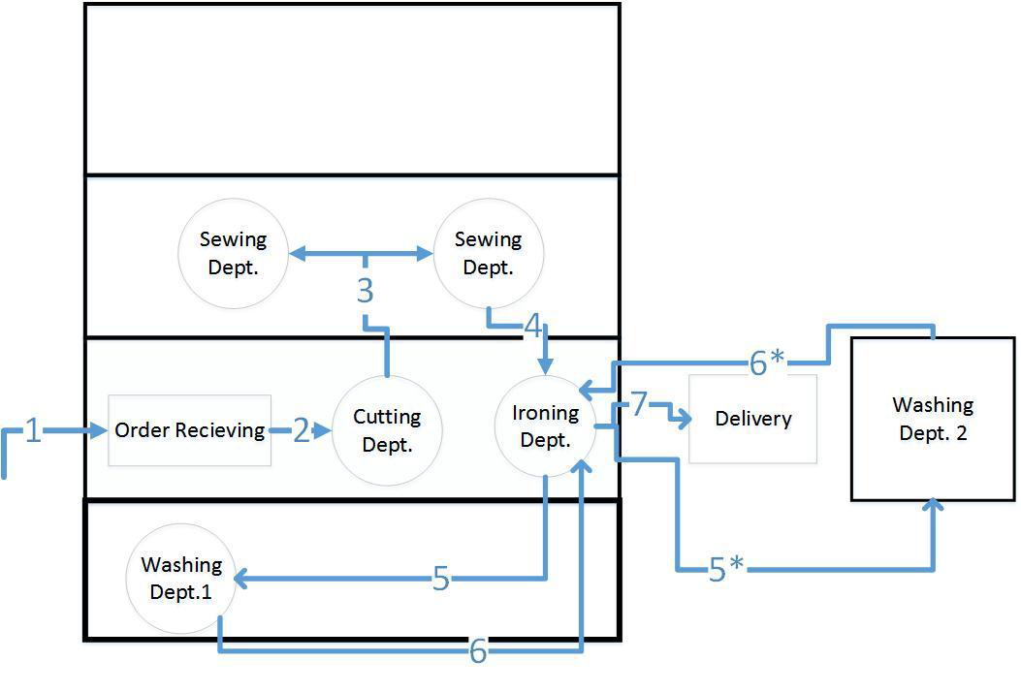
Results
Flow Pattern after line balancing

Slide 39
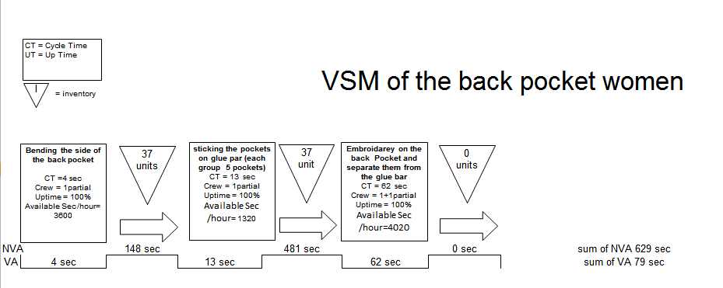
Results
VSM of preparing back pocket (women)- after line balancing
  for both women and men, the time in production (sewing) department is three hours

Slide 40

Results
Proposed Production system Performance Metrics
Lead time = 1 hour
Process velocity for women =
(1 hour * 60 min/hour ) / 15.4 min
=3.89
∑S.A.M for women = 15.4 min
Process velocity for men = 4.1
Theoretical productivity for women
= 1740 /15.4 min per pant on avg =113 pants/hour
Total available time =29 *1 hour *60 min
Theoretical productivity for men = 115 pants / hour
Efficiency for women = 100/113 =88.5%
29 worker for women
28 worker for men
∑S.A.M for men = 14.6 min
Target value per hour
Efficiency for men =87%

Slide 41


Results
First scenario
Next year Schedule
Second Scenario
1 cell full time
1 cell part time
Two cells full time

Slide 42
Results
Number of cell = Demand / one cell production
For Month January = 1 . 2
For Example
Indication for number of full cells
Indication for over time or extra working days

Slide 43
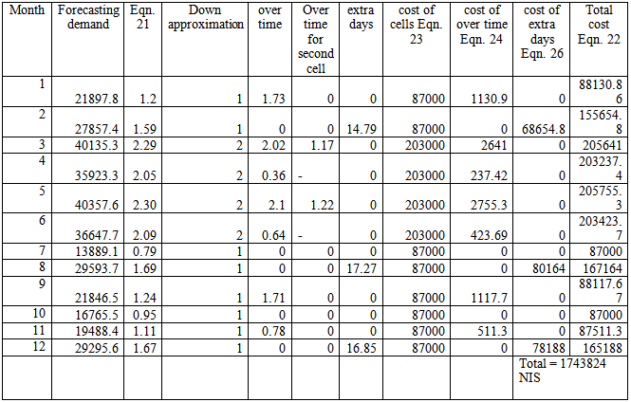
Results
For First scenario : will save 1,061,176 NIS yearly

Slide 44
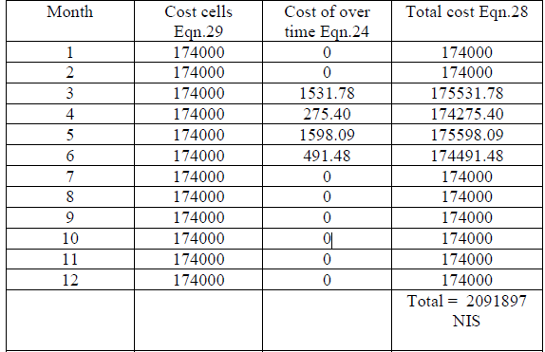
Results
For Second Scenario : will save 713,103 NIS yearly

Slide 45
Discussion and Conclusion
Production System followed and WIP
Maximum 2 order will be in process
the order will follow specific path
15-20 order
No specific sequence of process

Slide 46
Discussion and Conclusion
Number Of Process
27 for men classic jeans
27 for women classic jeans
22 For men classic jeans
23 for women classic jeans

Slide 47

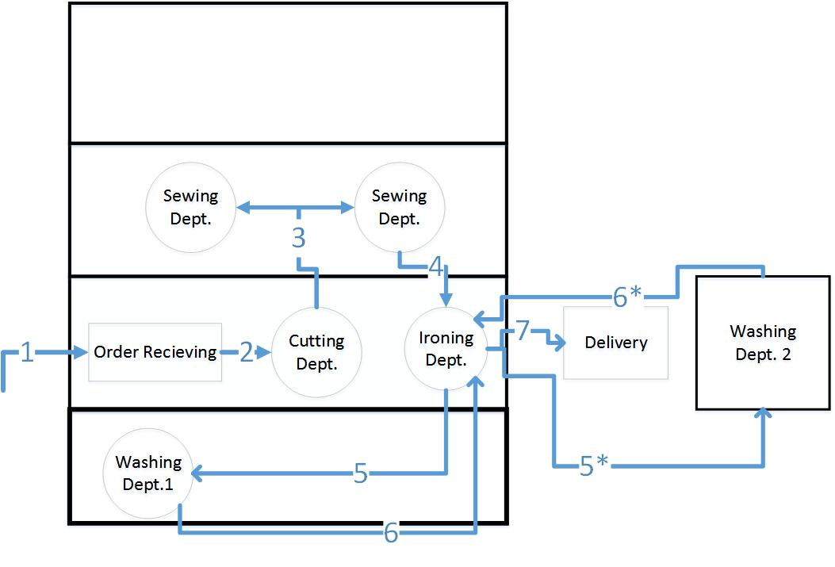
Discussion and Conclusion
Layout and flow pattern

Slide 48
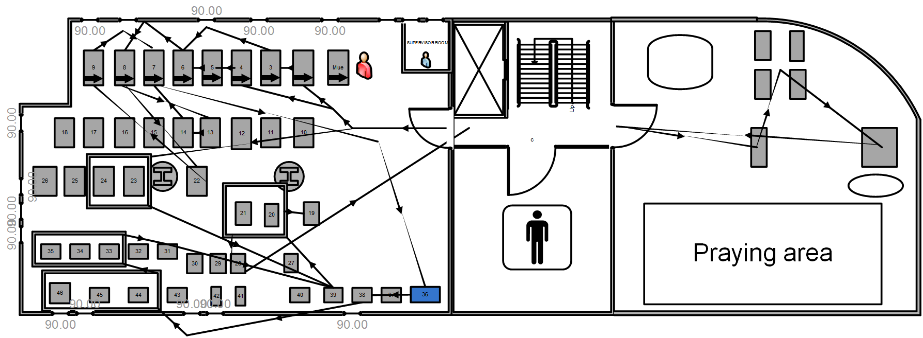
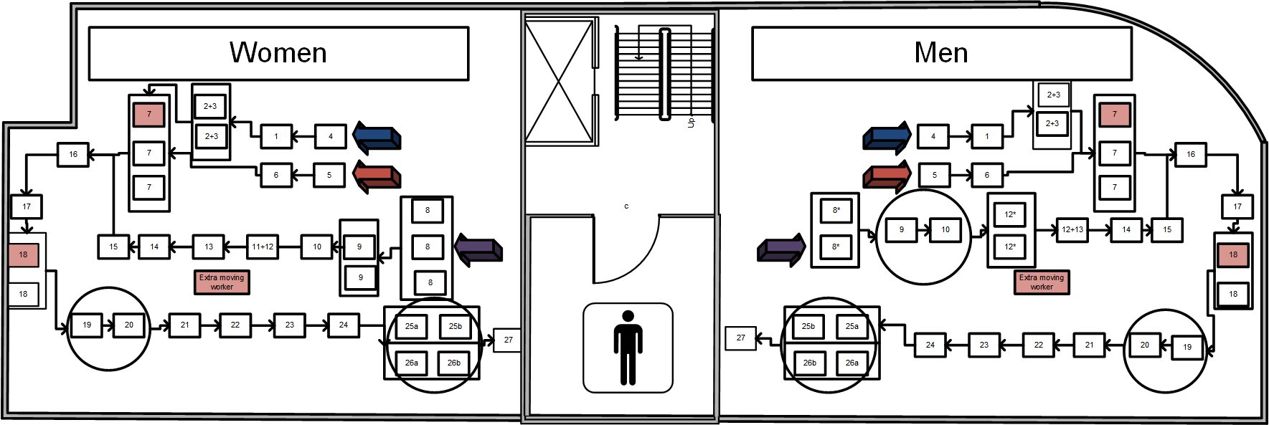
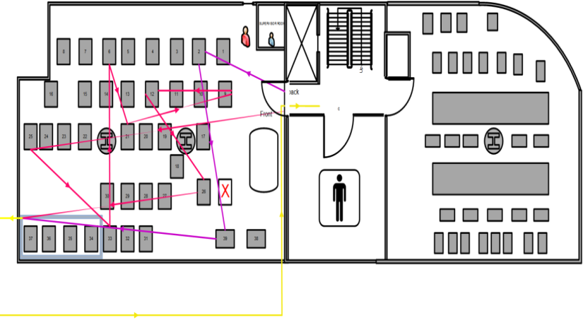
Discussion and Conclusion
Flow between machine
Used area = 1017 m2
After Reduction = 678 m2

Slide 49
Discussion and Conclusion
Number Of Workers and qualifications of worker
Before
19 Beginners
28 moderate
38 Expert
After
58 workers
OR
29 worker + contractors
All must be expert workers
85 worker

Slide 50
Discussion and Conclusion
Process velocity and production system Efficiency
Before
Process velocity men =168.5
After
Process velocity men =4.1
Production system efficiency=63%
Process velocity women =3.89
Production system efficiency men cell =87%
Production system efficiency women cell =88.5%
Process velocity women =163.6

Slide 51
Discussion and Conclusion
Time spent in sewing department
300 men pants took 41 hours
300 women pants took 42 hours
300 of either men or women will take 3 hours
before
After

Slide 52

Discussion and Conclusion
Labor cost
1,743,824 NIS first scenario
2,091,897 NIS second scenario
2,805,000 NIS

Slide 53

Discussion and Conclusion
Forecasting and scheduling of production
Forecasting model with relatively low error and good accuracy will help to plan and schedule the production and yearly leaves and holidays of workers
No forecasting model
or technique existed , the work was planned judgmentally

Slide 54
Recommendations
Documentation with description and graphs should be provided for each process
More expert workers should be hired at the first implementation as they have much higher productivity and they are able to produce huge amounts of jeans with non-classic designs
The forecasting model should be used and updated monthly to get more accuracy in it, and the results of the forecasting model should be used in capacity planning and in the hiring and firing of the temporary workers.
The proposed production system should be implemented as it would save huge in the labor costs and reduce lead, WIP and non-value added activities .
The sewing department should be moved to the first floor as this would minimize the total distance and usage of elevator, also the other improvements in the layout should be implemented as it would make the layout rating of the factory better.
New machines with high technology should be bought because it was noticed that all the factory machines were at least 20 years old, and for sure the new machines are saving more energy and are faster

Slide 55
Recommendations
5s’s and other lean concepts should be spread in the company as a culture of the work place and should be seeded inside the workers themselves as the can always help in improving the company
A new business model should start to be adopted gradually, as the business followed business model is depending totally on pull demand
New markets should be studied as possible markets , like Jordan and the Gulf countries
New products should be added to the factory’s basket of products; shirts , blouses, coats and other garment products should be added gradually to the production as the variety can assure higher sales and higher customer loyalty

Slide 56
Thank you ☺

