Slide 1
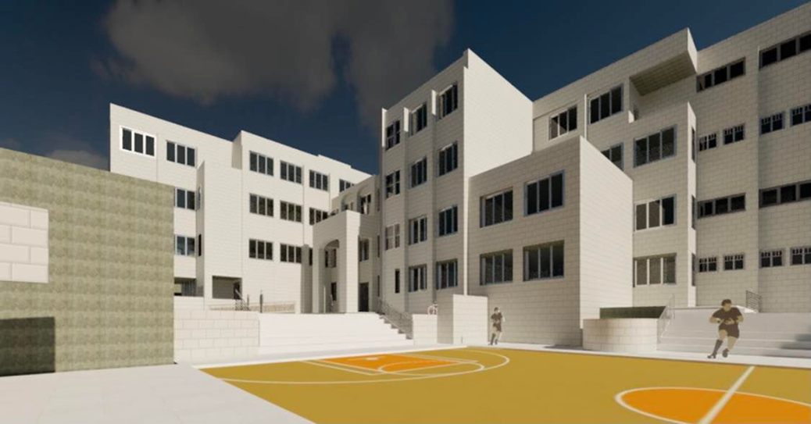

Graduation Project report-II-
"Qabatia Basic Girls School“
Prepared by:
Sara Hamdan
Yousef Maree
Khalid Attili
Supervisor: Dr. Mutasim Baba
May 2022

Slide 2
-1-
Chapter One
Introduction

Slide 3

Introduction
Qabatiya is a Palestinian village, located in Jenin city, about 10 km to the southwest, between longitudes 35.22, latitude 31.78, and at an altitude of 256 m above sea level.
The number of students at Qabatiya Elementary School for Girls is 450 students.
The number of classrooms in the school is 18 classrooms. It is equipped with laboratories and necessary facilities.

Slide 4
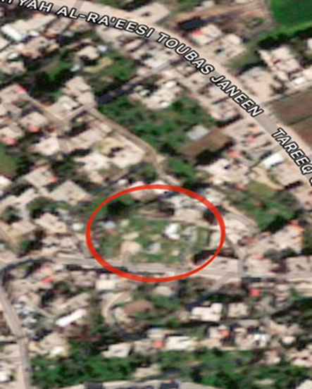
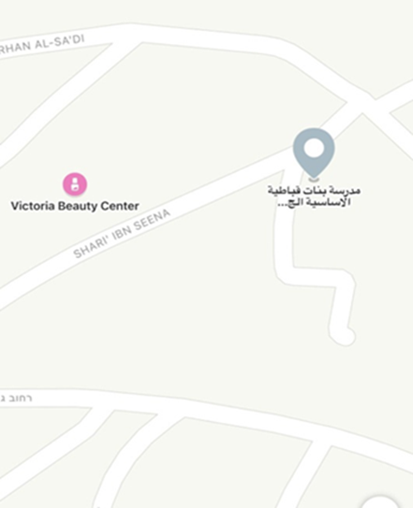
Location

Slide 5
-2-
Chapter two
Architectural Aspects

Slide 6
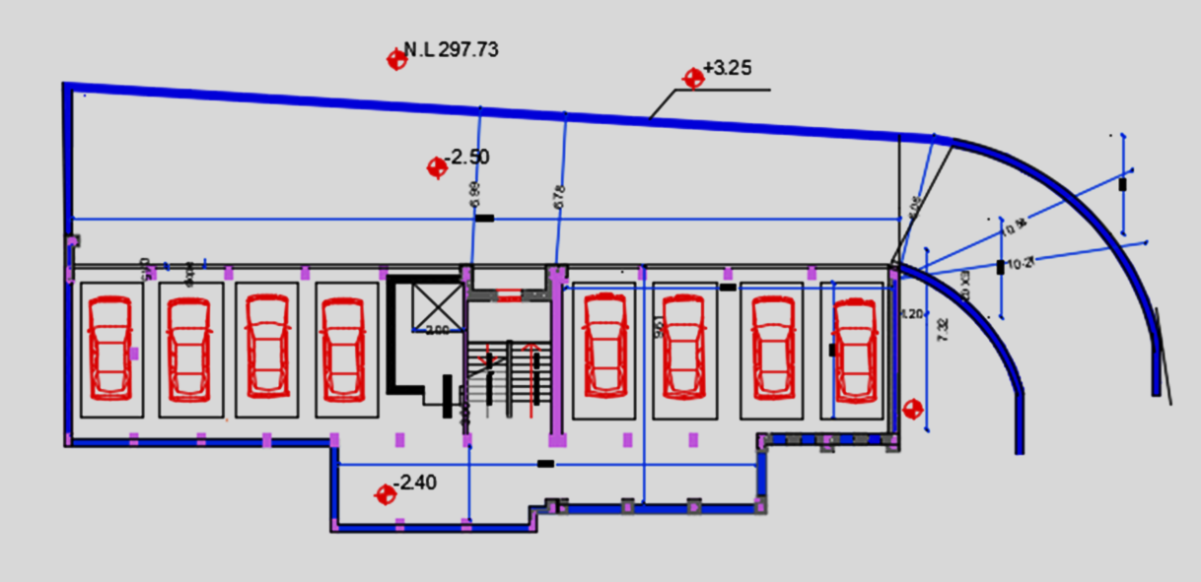
Architectural modification
a garage has been added in the basement

Slide 7
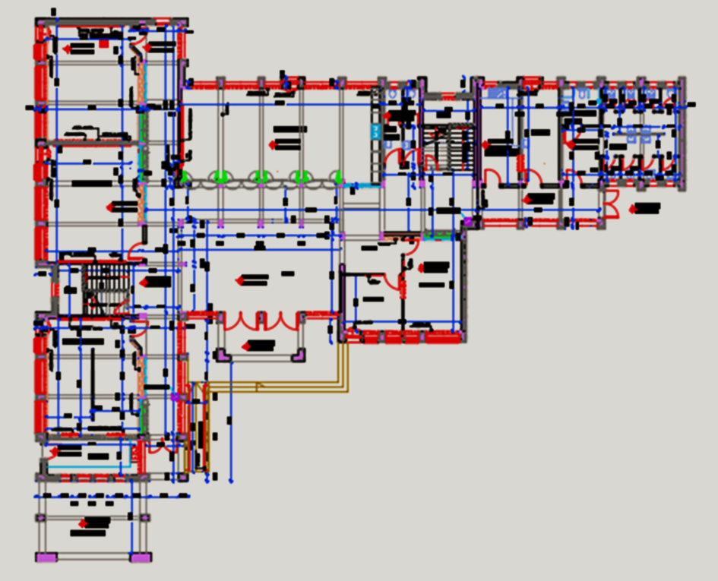
Ground floor before modification

Slide 8
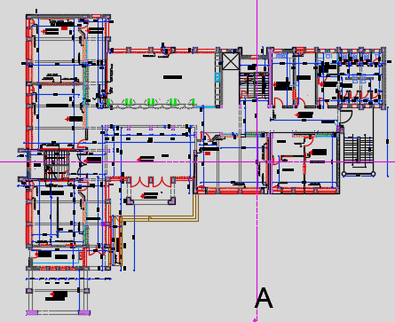
Ground floor after modification

Slide 9
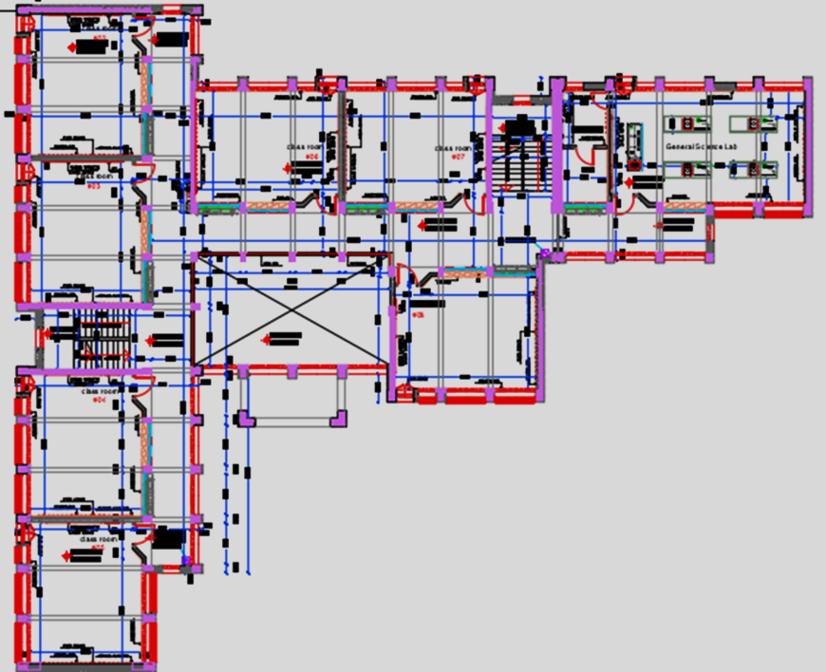
First floor before modification

Slide 10
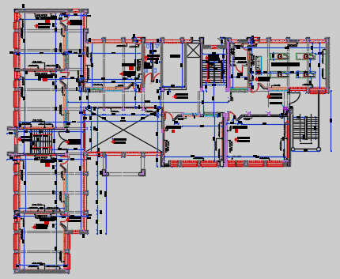
First floor after modification

Slide 11
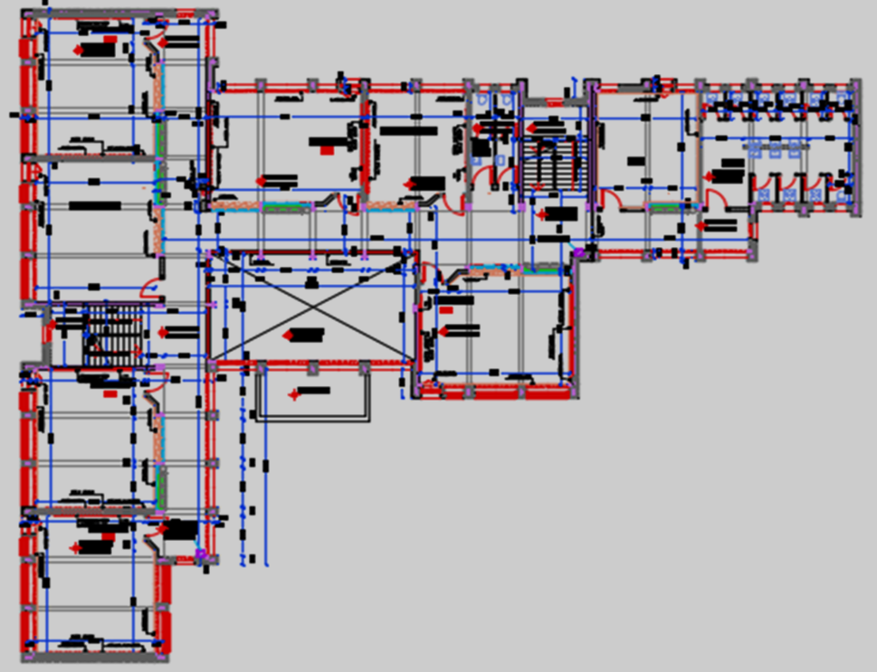
Second floor before modification

Slide 12
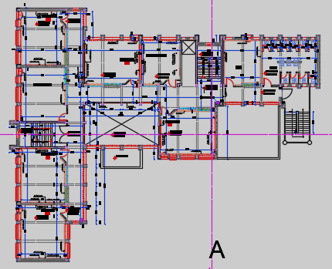
Second floor after modification

Slide 13
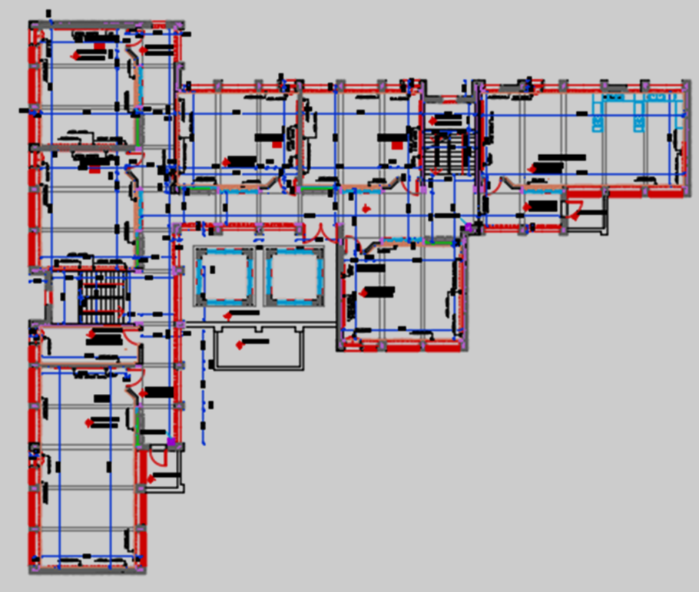
Third floor before modification

Slide 14
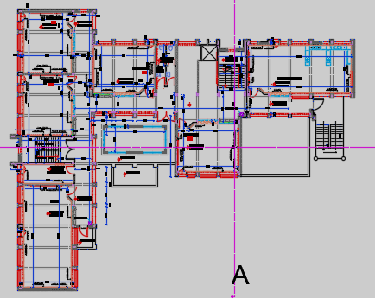
Third floor after modification

Slide 15
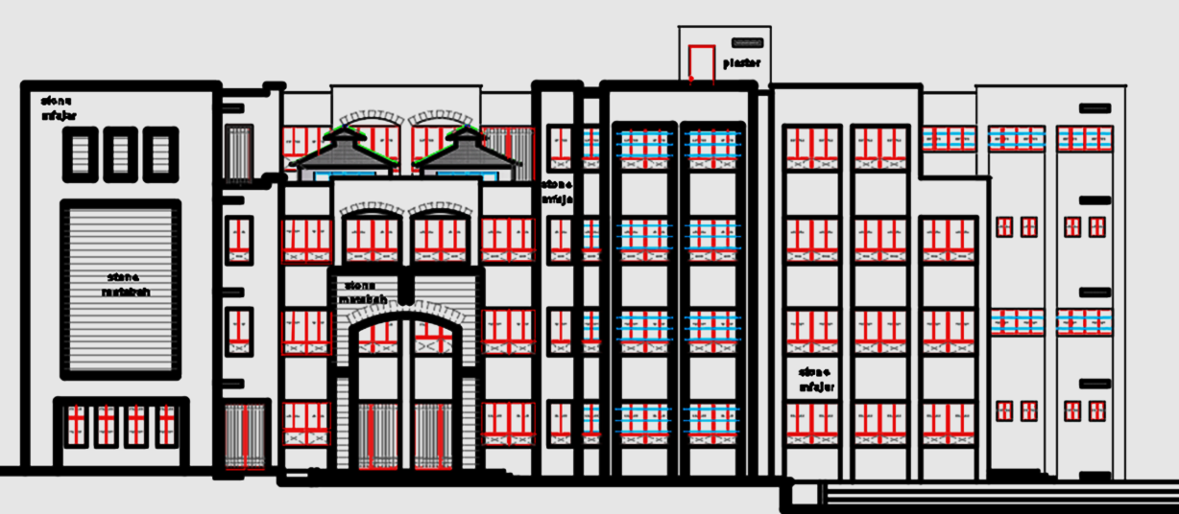
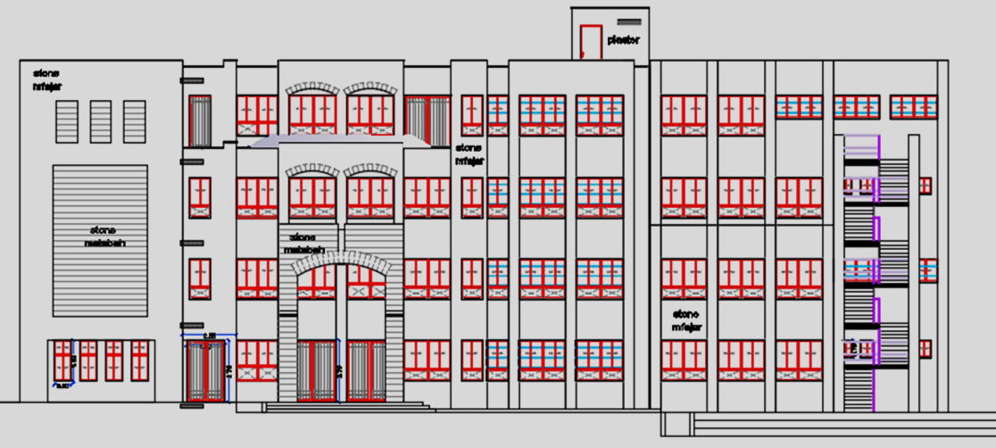
South elevation

Slide 16
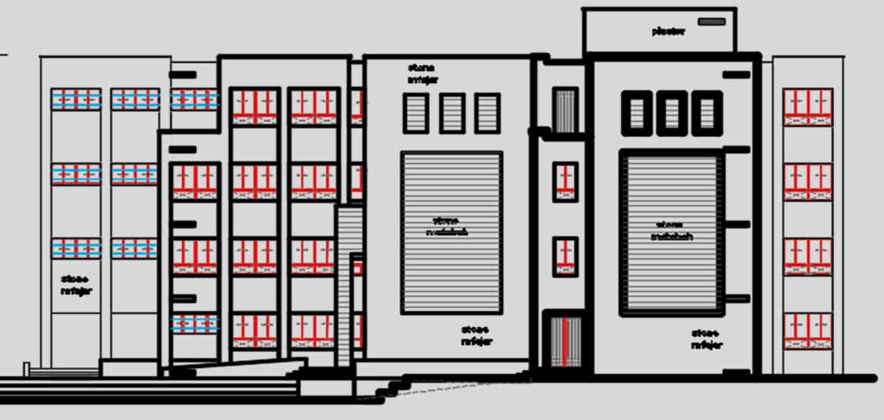
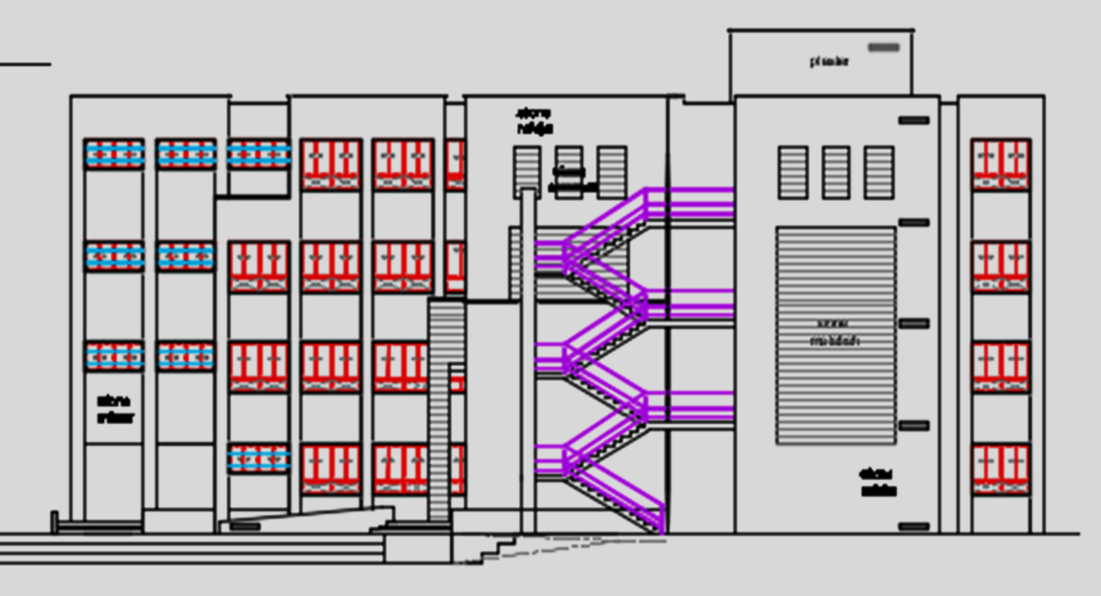
East elevation

Slide 17
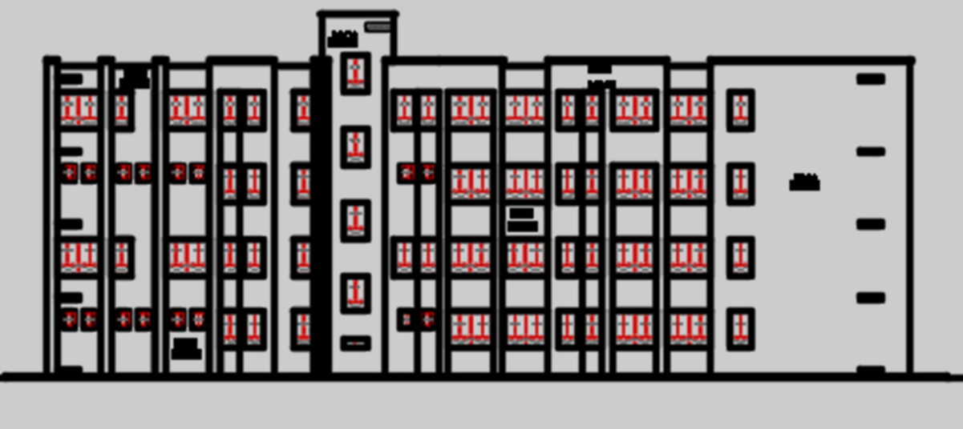
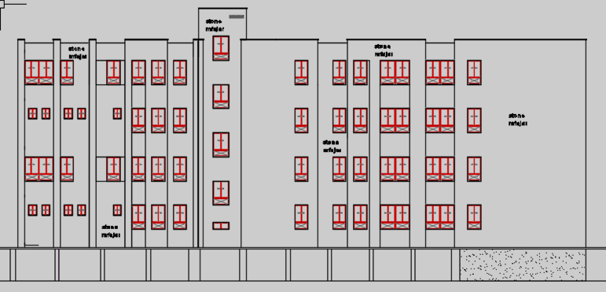
North elevation

Slide 18
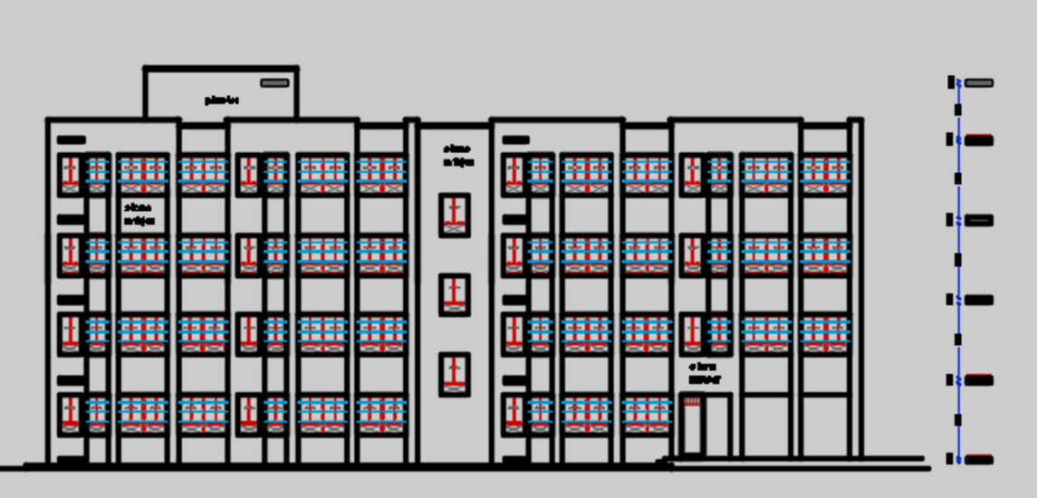
West elevation

Slide 19
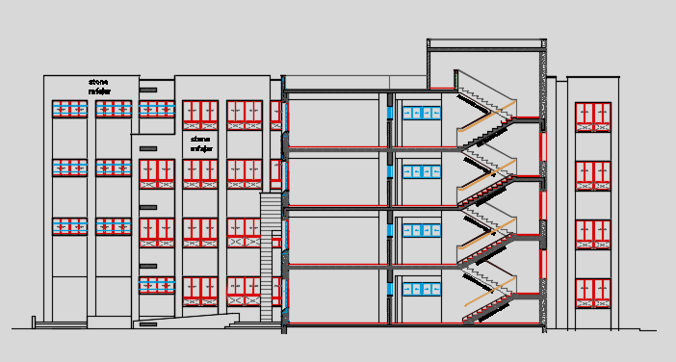
Section A-A

Slide 20
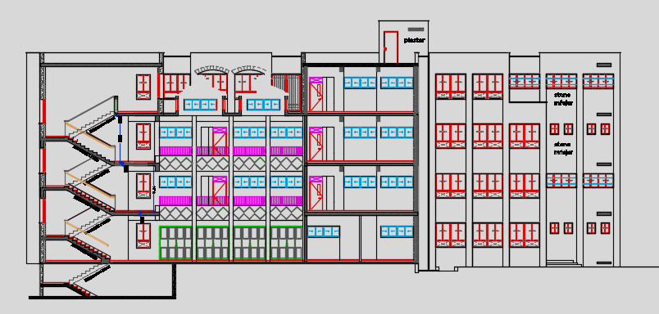
Section B-B

Slide 21
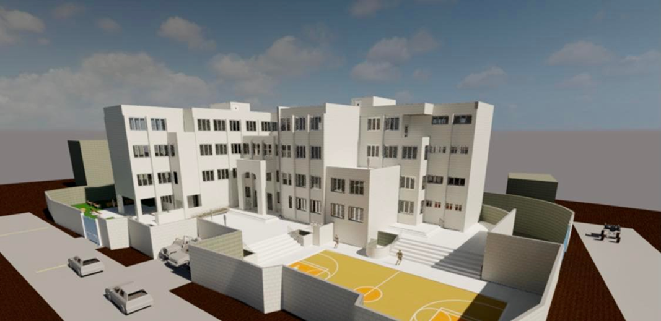
3D picture for the school

Slide 22
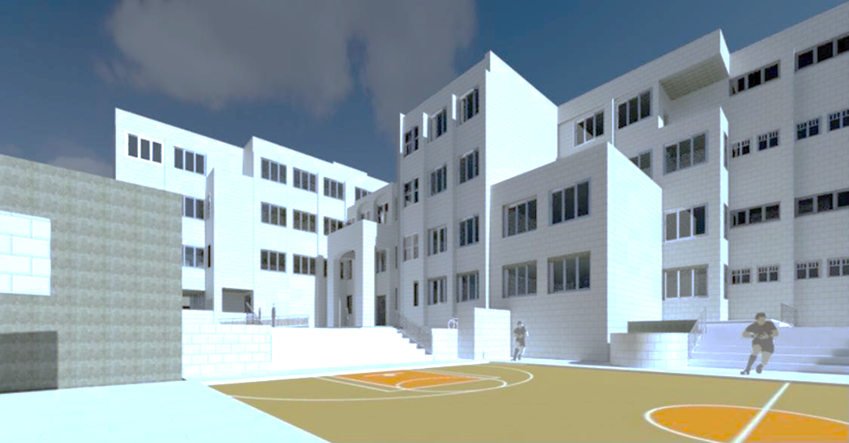
-3-
Chapter three
Environmental Aspects

Slide 23
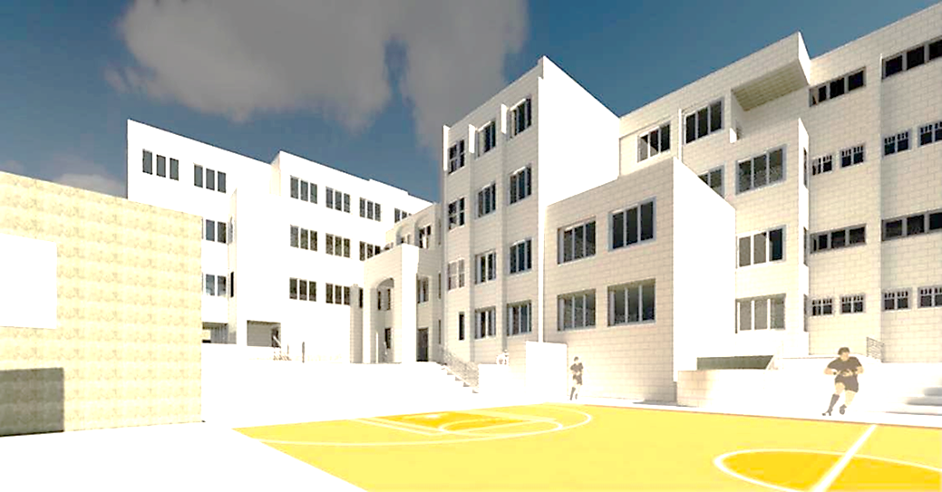
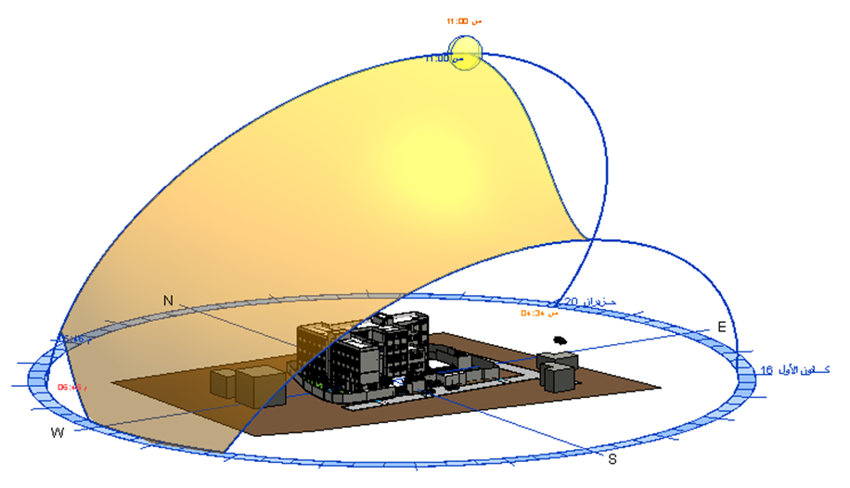
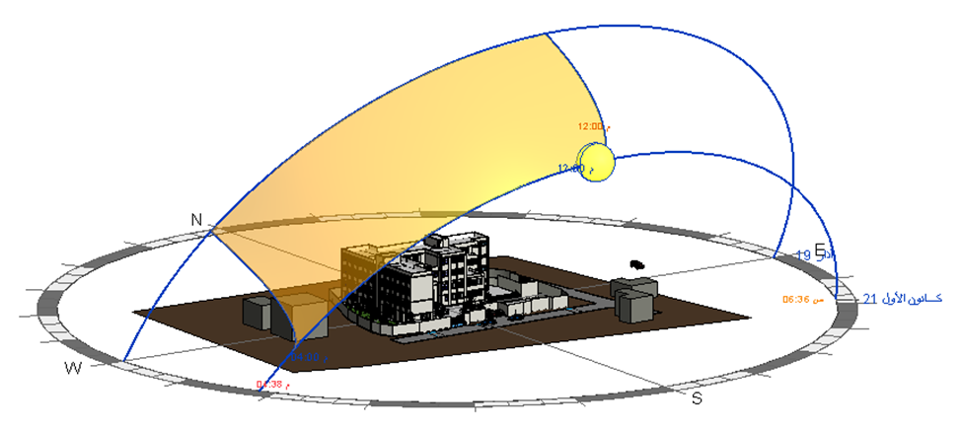
Sun bath
Sun bath in summer
Sun bath in winter

Slide 24
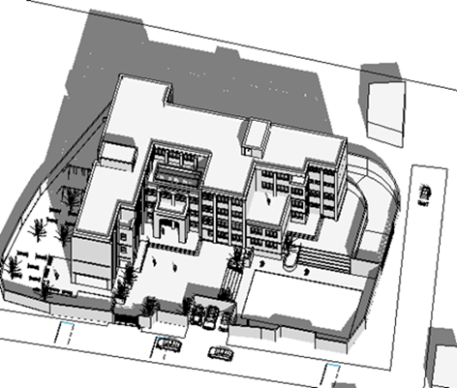
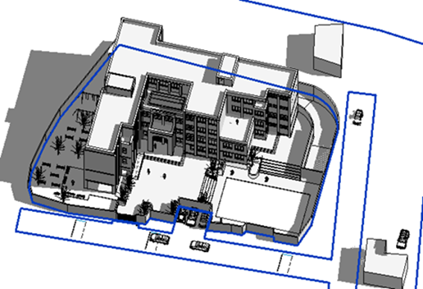
Shadowing
Shadow in winter
Shadow in summer

Slide 25
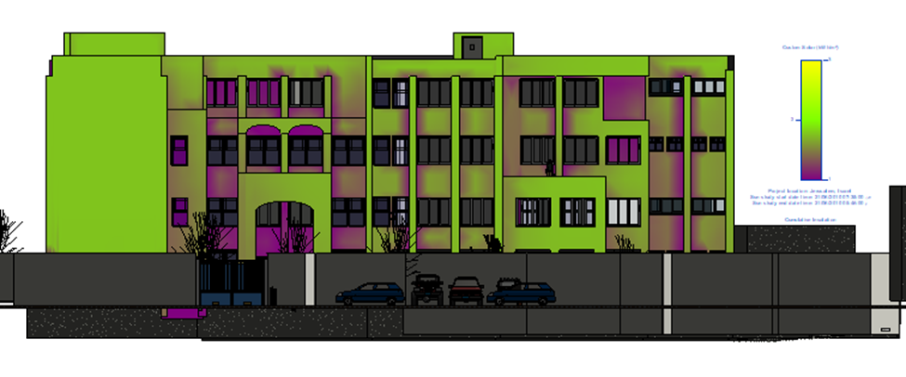
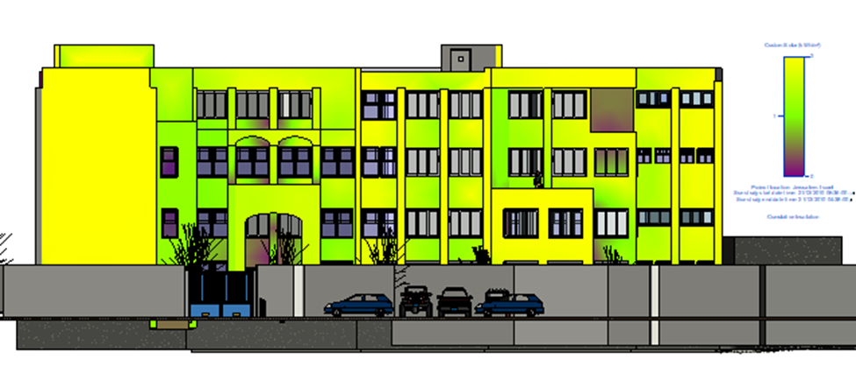
solar simulation
In summer
South elevation
In winter

Slide 26
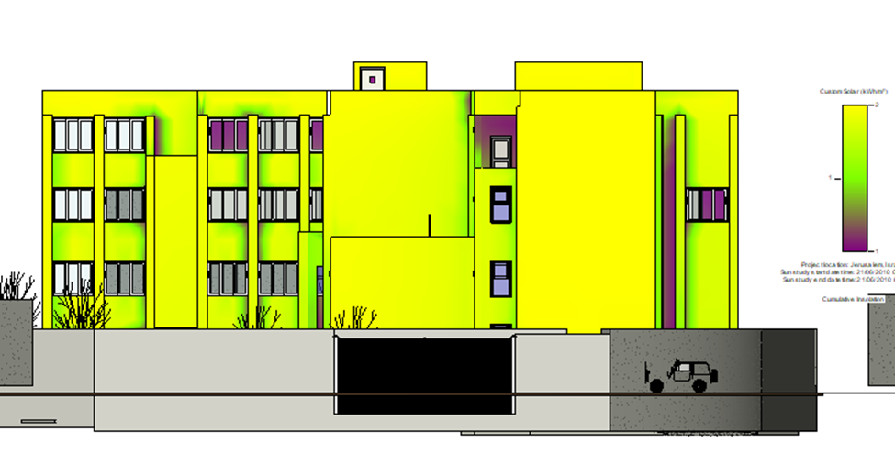
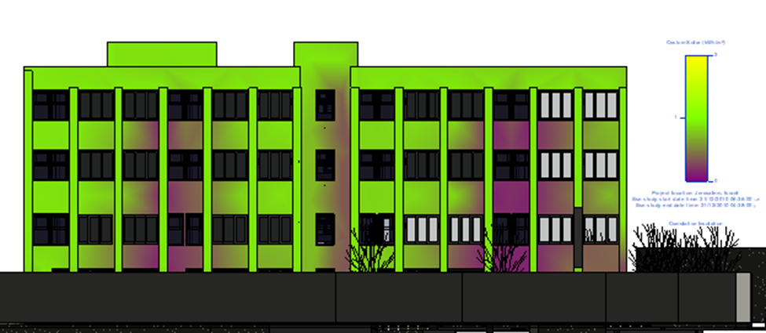
In summer
West elevation
In winter

Slide 27
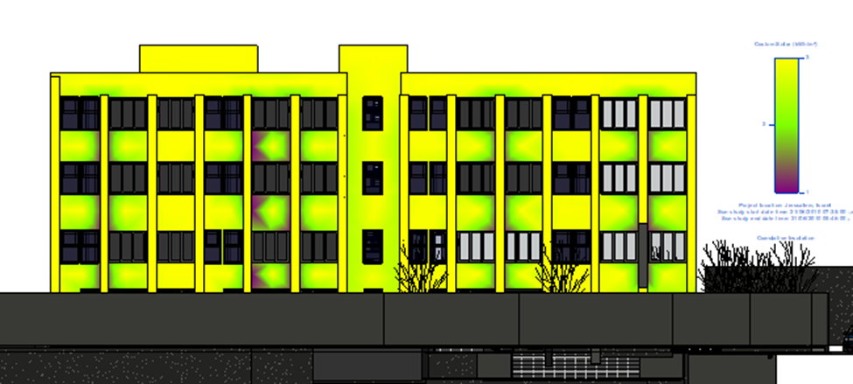
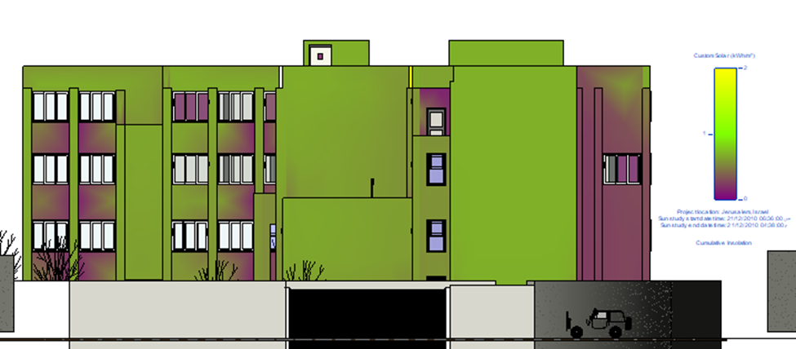
In summer
east elevation
In winter

Slide 28
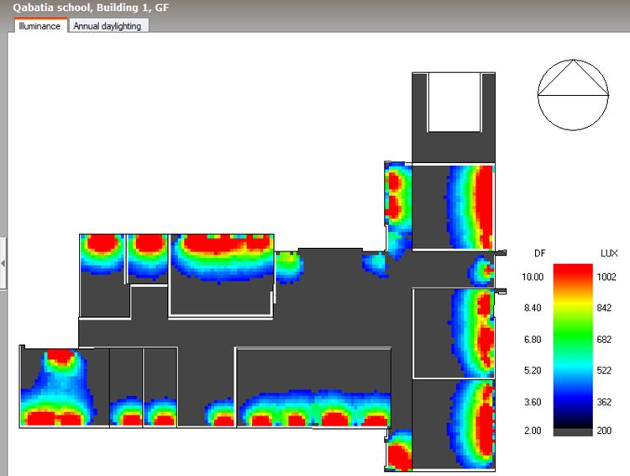
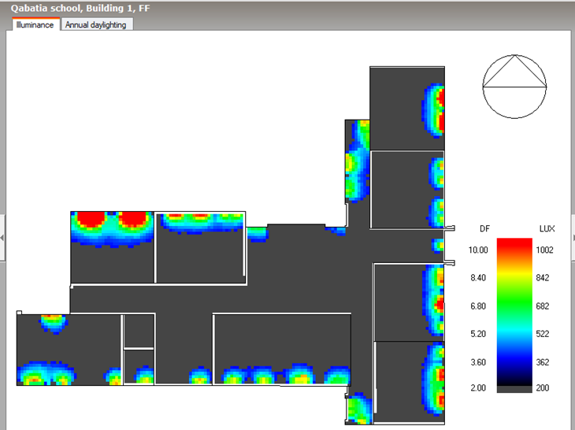
DF
DF in GF
DF in FF

Slide 29
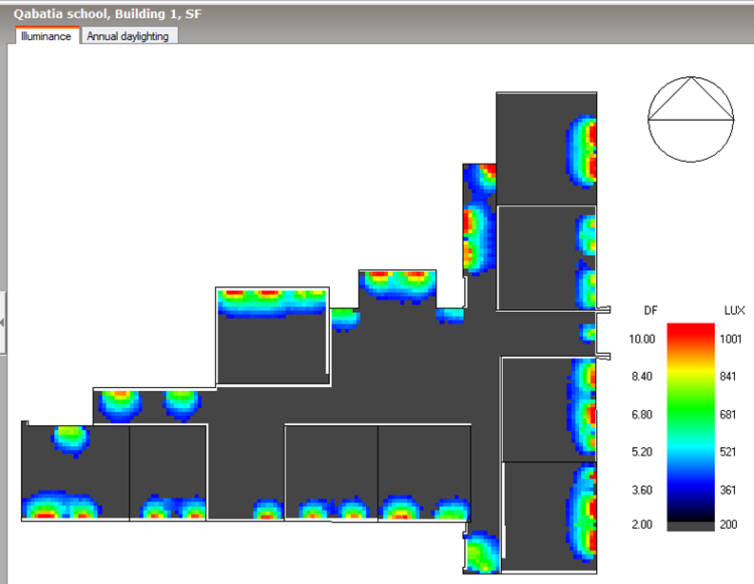
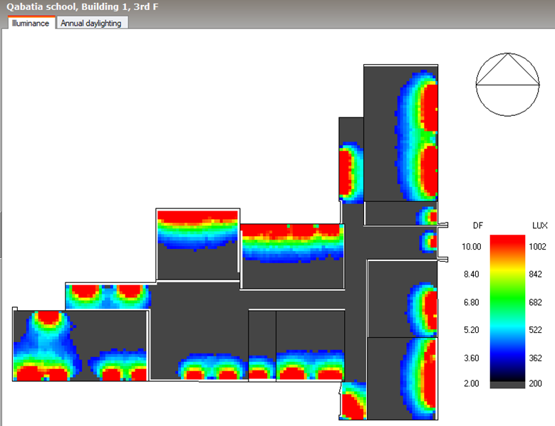
DF in SF
DF in TF

Slide 30
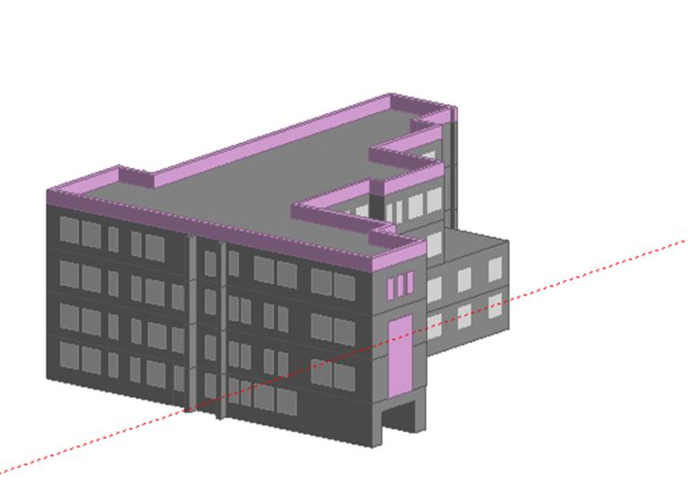
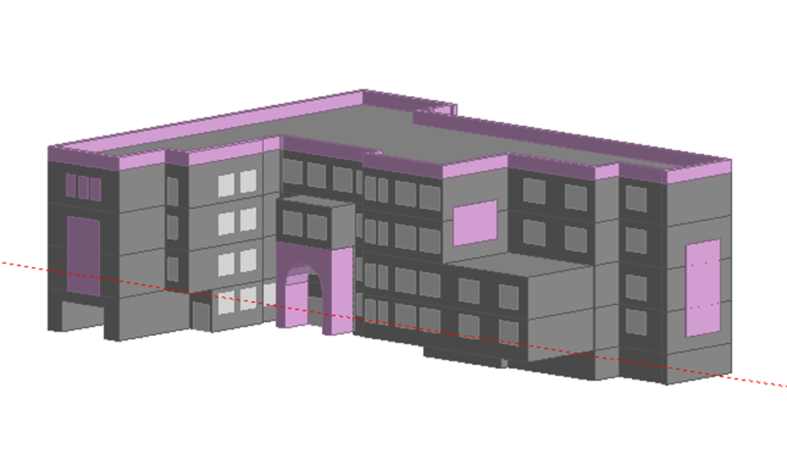
heating and cooling load
As shown below from design builder the heating and cooling load:
Heating load=88.65 KW
Cooling load:=135.36 KW
Design builder figures

Slide 31
-4-
Chapter four
Structural Aspects

Slide 32
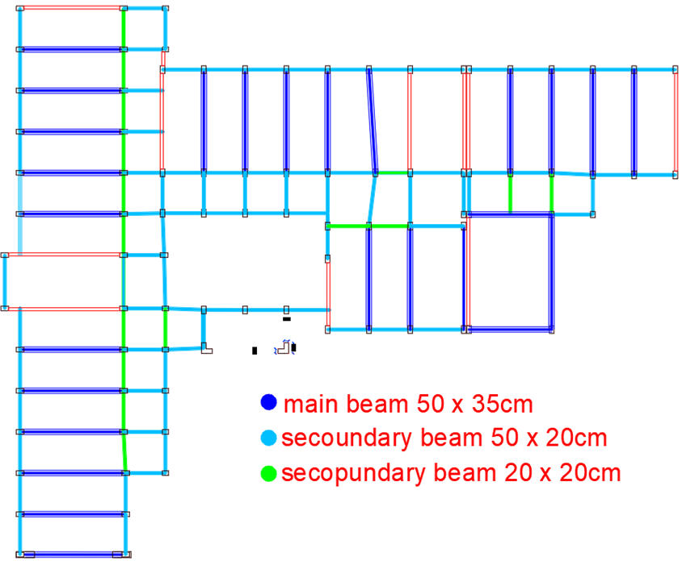
40cm

Slide 33
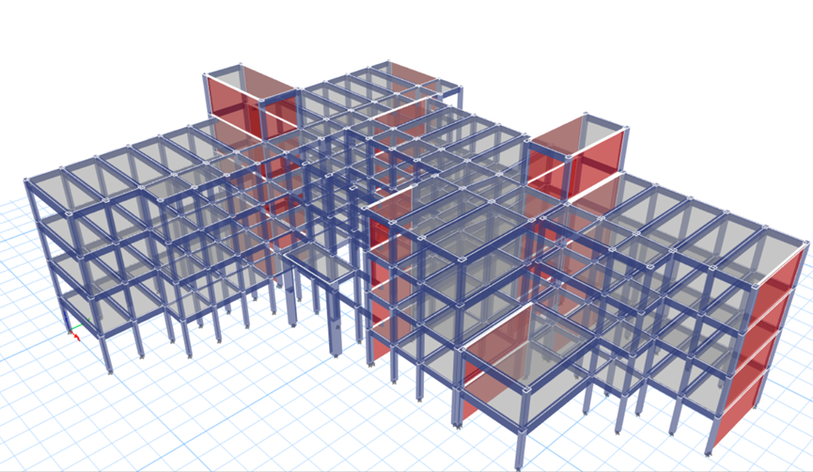
Figure 4.4 3D model

Slide 34
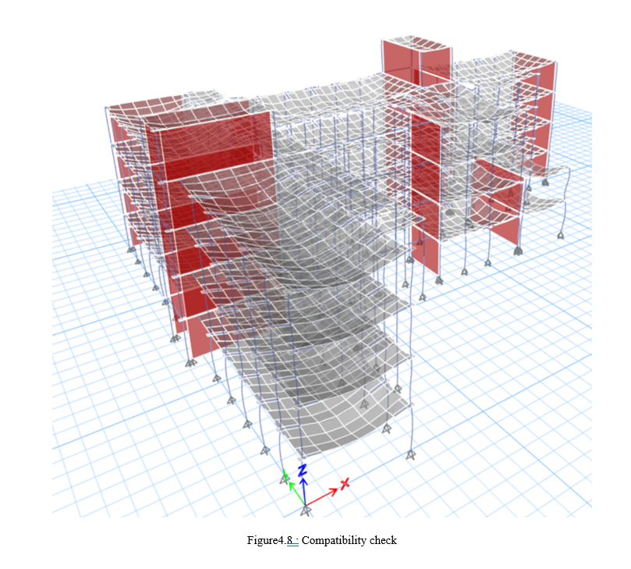

Slide 35
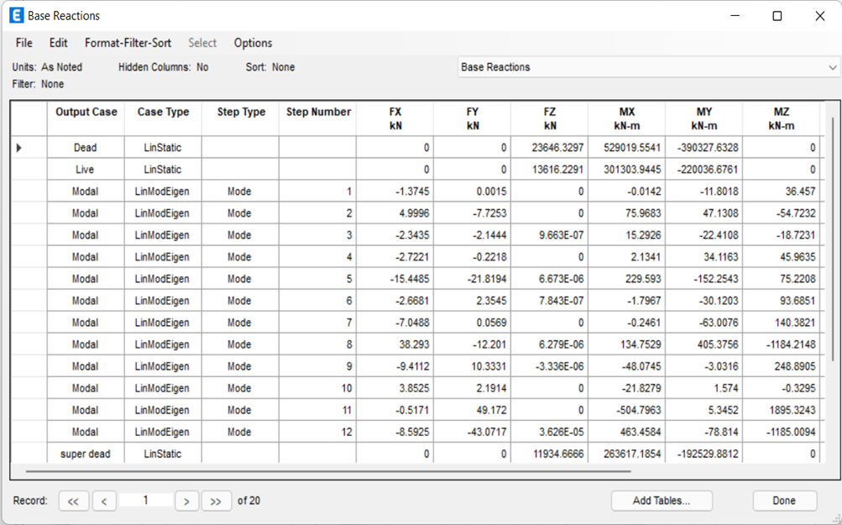
Equilibrium check
Weight of building =-23473.9 kn = total dead load
Super dead= area x 4.5 =12014.55
Live dead= area x 5 =13349.5

Slide 36
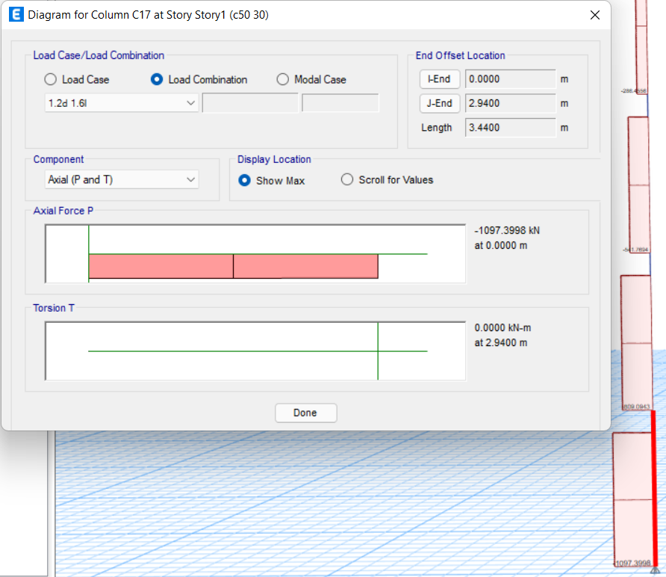
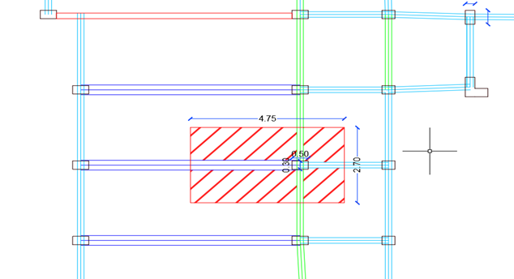
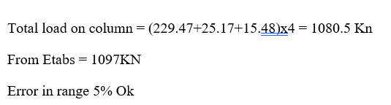
Figure4.11 : Axial load on internal column
figure 4.10: tributary area in internal column]

Slide 37
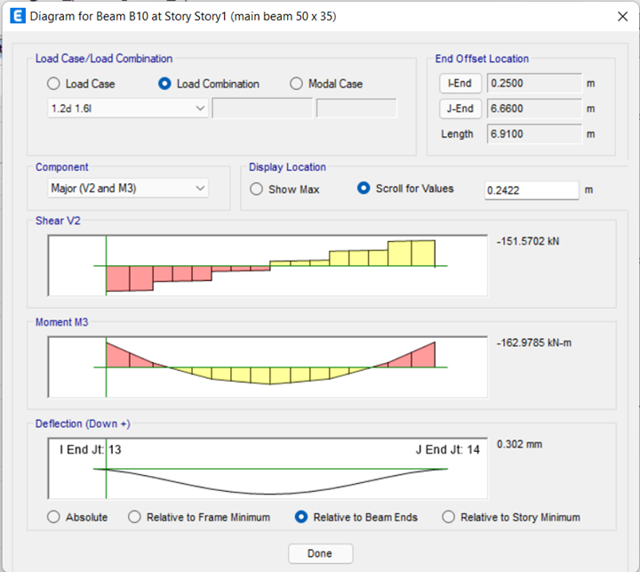
Moment Right side = 161.24kn.m
moment in left side = 162.97kn.m
moment at meddle of beam = 109.5kn.m
Mu ETABS = (162.97+161.24)/2+109.5 = 271.6 KN.m
Error in range 5% OK
Manual moment = WL2/8
52.7*6.422/8 = 271.513Kn.m

Slide 38
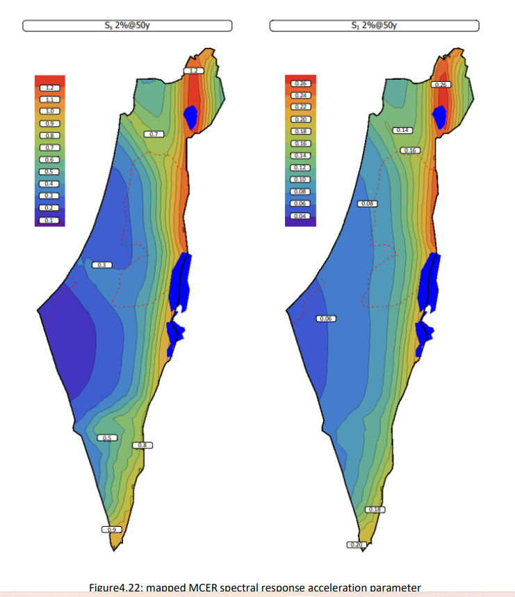

Ss = 0.65 S1 = 0.14

Slide 39
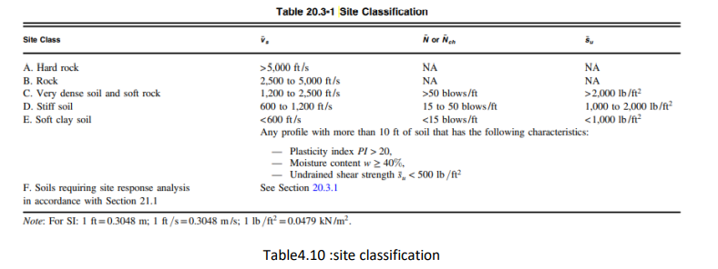


Fa= 0.9 Fv= 0.8 .

Slide 40




Slide 41

1- equivalent static analysis
2- response spectrum analysis

Slide 42


Equivalent static
V = CsW

Slide 43




Slide 44


Slide 45




Slide 46





Slide 47




v

Slide 49



Slide 50



Slide 51




Slide 52








Slide 53




Slide 54





Beam dimensions = 40cm width , 50cm depth , d= 45cm , , Fy=420

Slide 55





Slide 56






Slide 57



Slide 58




Slide 59







Slide 60




Slide 61





Slide 62


Slide 63



Slide 65



Slide 66


Wall footing

Slide 67


Slide 68



Slide 69





Slide 70


Slide 71


Slide 72


Slide 73
-5-
Chapter five
Mechanical and Electrical aspects

Slide 74


HVAC design
As shown below from design builder the heating and cooling load:
•Heating load=88.65 KW
•Cooling load:=135.36 KW
Some standard from design builder:
•Tin (winter)=22c
•Tin (summer)=25c
•relative humidity=30%-70%
•Outdoor unit model name :
( AM260KXVGGH/ET).
•Type :( DVM S).
Outdoor unit

Slide 75


Indoor unit:
Cassatt unit
Properties:
Indoor unit model name (AC140RN4DKG/EU)
Air flow rate = 0.1m³/s
Indoor unit

Slide 76

Distribution for indoor unit
Ground floor

Slide 77

First floor

Slide 78

Second floor

Slide 79

Third floor

Slide 81


Water supply design :
Design pipes size:
Design vertical pipes :

Slide 82


Design Horizontal pipes:

Slide 83


Design branch pipes:

Slide 84

Pipes size for all floors:

Slide 85

Water supply for G.F

Slide 86

Water supply for 1st F

Slide 87

Water supply for 2nd F

Slide 88

Water supply for 3rd F

Slide 89
Drainage system:
Sample of calculation :
• Max number of dfu for 2 inch =21 dfu with slope 2%.
• Max number of dfu for 4 inch =180 dfu with slope 1%.

Slide 90

The following figure shows the distribution of all points and then gives each pipe its diameter according to dfu for each unite :

Slide 91

Drainage for garage

Slide 92

Drainage for G.F

Slide 93

Firefighting system
number of Sprinklers used

Slide 94

G.F Sprinklers distribution , Fire exit & Extinguishers distribution

Slide 95

1st F Sprinklers distribution , Fire exit & Extinguishers distribution

Slide 96

2nd F Sprinklers distribution , Fire exit & Extinguishers distribution

Slide 97

3rd F Sprinklers distribution , Fire exit & Extinguishers distribution

Slide 98


Detector distribution
Gf Detector distribution
fire symbol

Slide 99

1st f Detector distribution

Slide 100

2nd f Detector distribution

Slide 101

3rd f Detector distribution

Slide 102

Electrical design
Power design
Electrical symbols used

Slide 103


Main Distribution board

Slide 104





Slide 106



Artificial lighting design
type luminaire

Slide 107


show the distribution for luminaire in braking
distribution for luminaire in ground floor

Slide 108


show the distribution for luminaire in 1st floor
show the distribution for luminaire in 2nd floor

Slide 109

show the distribution for luminaire in 3rd floor

Slide 110

ELECTRICAL DESIGN :
Power of light of barking floor
show the power from lighting for the ground floor

Slide 111


power from lighting for the 1st floor
power from lighting for the 2nd floor

Slide 112

power from lighting for the 3rd floor

Slide 113




The acoustical design:
by Using the ecotect program, we obtained the results of the RT60 for the classroom and corridors

Slide 114


By using EASE
Total SPL for class room
ALC for class room

Slide 115

By using EASE
STI for class room

Slide 116


speaker selenium
Sound preshure level in speaker

Slide 117


Treatment by using insull
STC external wall
STC internal wall

Slide 118


stc for glass
STC in slab

Slide 119
-6-
Chapter six
Quantity surveying & Cost Estimate

Slide 120
Project total cost =5300000 nis
project area = 3261.5 sm
project unit cost =1625 nis/sm
structural work unit cost = 905.15 nis/sm
Finishing unit cost = 418.81 nis/sm
electrical work unit cost =11 nis/sm
mechanical work unit cost =58.64 nis/sm

