Slide 1

water Desalination system using solar energy
AN-NAJAH NATIONAL UNIVERSITY
FACULTY OF ENGINEERING
DEPARTMENT OF MECHANICAL ENGINEERING
Mohammed Safi Mohannad Sameer
Mahmoud Hanish Mahmoud Saqqa

Slide 2

Water desalination definition
Desalination is the process that used to clear and separate dissolved salts, dirt and any impurities from ground water and seawater or any type of raw water to provide fresh and clean drinking water

Slide 3
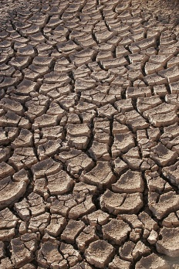
Why this project ?
the world has water crises
the needed for fresh water increasing every day worldwide

Slide 4

Solar radiation
In Palestine the average of solar radiation reach to 3400 hour/year
Annual Average Of Solar Radiation Reach To 5.4 Kwh/M2 – Day (19.44MJ) On Horizontal Surface, Which Classified As A High Rate

Slide 5
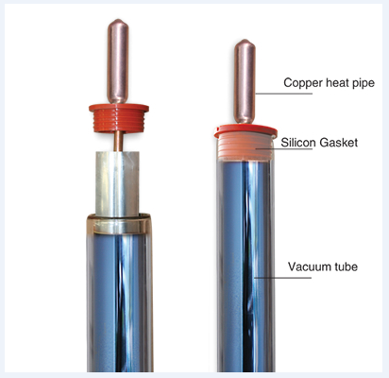
project headlines
The project is depend on solar energy technology which is Evacuated tubes
the system used this technology to rise The temperature of water to high Temperature

Slide 6
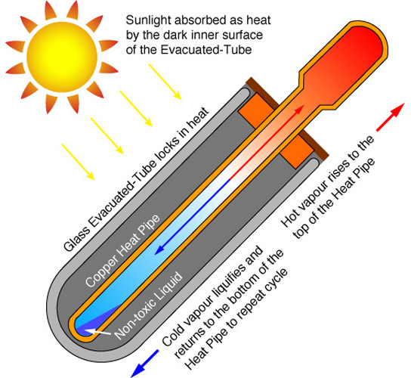
Evacuated tube

Slide 7
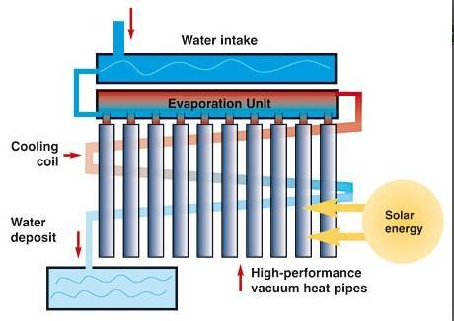
Project main Concept

Slide 8
System THERMAL ANALYSIS

Slide 9

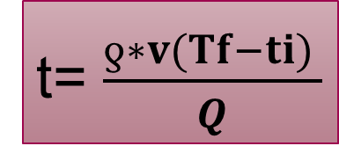
thermal analyses
the heat delivered from the evacuated tube:
the amount of energy which is absorbed by water
To calculate the time that needed to heat the water to specific temperature by the equation

Slide 10
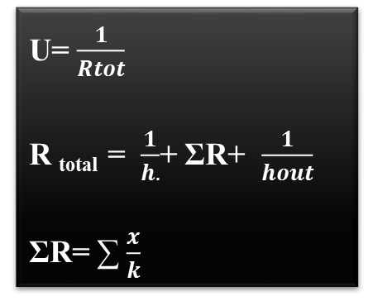
Qlosses is the energy dissipated (lost) from the wall of the tank
Qlosses theoretically:
Q_{losses}= Q_{delivered} - Q
Q_{losses} =UA (Ti -To)
The overall heat transfer coefficient is given by

Slide 11
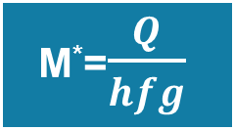

The amount of vapor produced( M*)
The efficiency for the system

Slide 12
System design

Slide 13
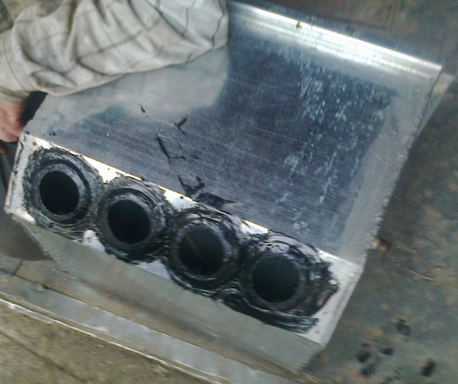
*System design *
Metal tank

Slide 14
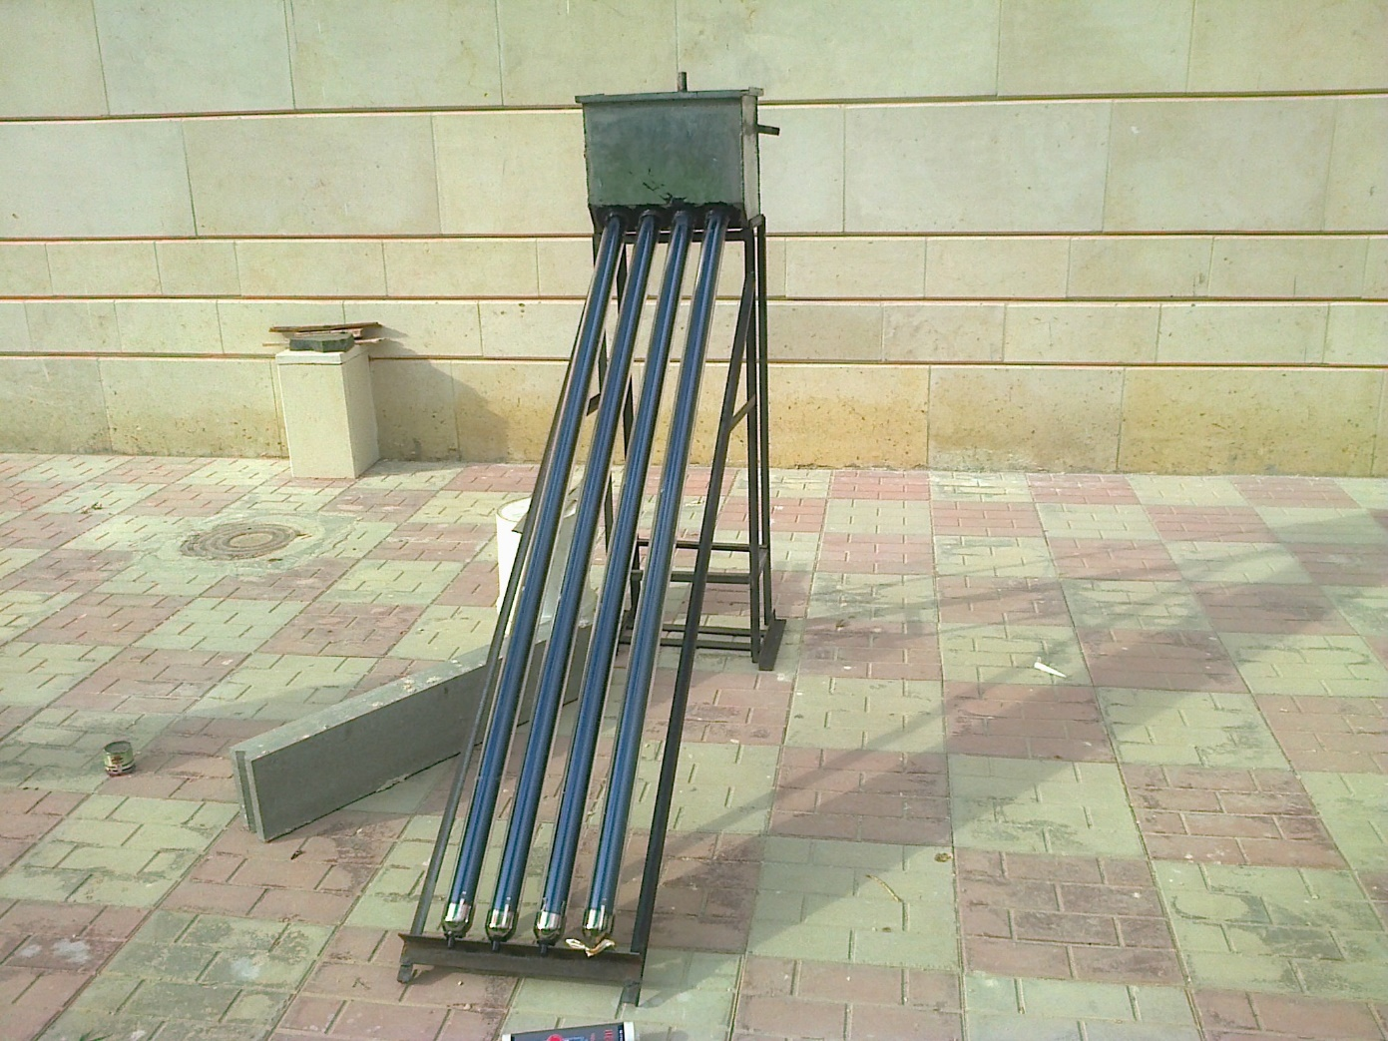

Slide 15
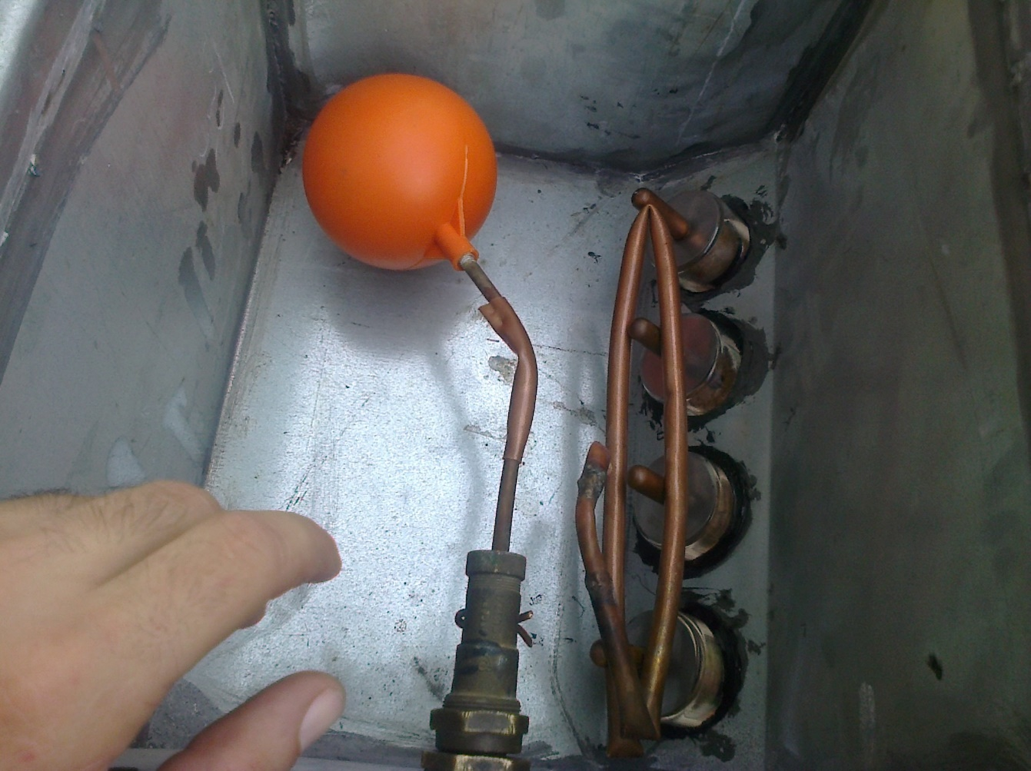

Slide 16
Experimentally result
The amount of water is fixed inside the tank ,and the initial temperature of the water was measured
During the days hours the level of the water inside the tank and the temperature of the water were measured each time

Slide 17
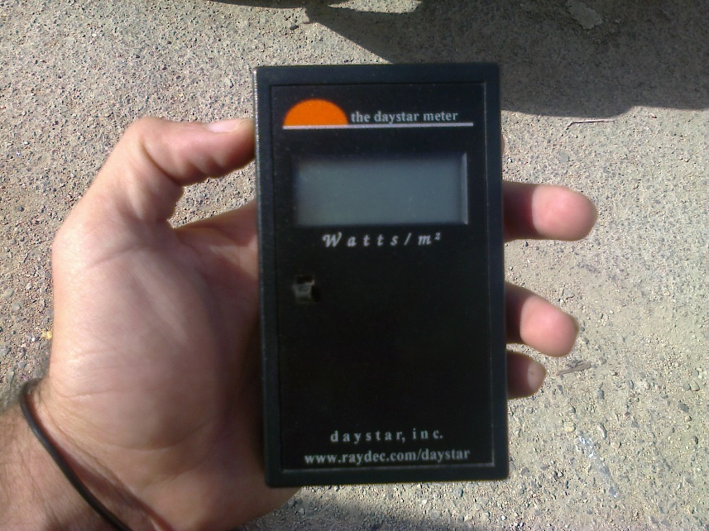
Also the solar radiation(I) was measured by using solar daystar meter
(device is used to measure the solar radiation )

Slide 18
Experimentally result
1-Experimentally result without using isolation
2-Experimentally result by using isolation for the tank

Slide 19
First day result
time(17/10/2013) | mass flow rate(l)
8.15 | 17
11.1 | 16.4
12.35 | 16.1
14.22 | 15.3
15.15 | 15.1
Total desalinate water | total =1.9 litter

Slide 20


second day result
time(31/10/2013) | mass flow rate(l) | solar radiation (w/m2) | water temp(c0) | power produced by evacuated tube (KJ) | power absorbed by water | Efficiency | Qlosses
8.53 | 11.6 | 682 | 21 | - | - | - | -
10.53 | 11.5 | 950 | 37 | 1368 | 576.84 | 42.16667 | 791.16
12.05 | 11.1 | 846 | 51 | 925.8624 | 649.572 | 70.15859 | 276.2904
12.55 | 10.8 | 690 | 55 | 248.4 | 180.576 | 72.69565 | 67.824
Total desalinate water = 0.9 litter |  | avarge= 661.5 |  |  |  | Avg=61.67364 | 0

Slide 22
third day result
time(2/11/2013) | mass flow rate(l) | solar radiation (w/m2) | water temp(c0) | power produced by evacuated tube (KJ) | power absorbed by water | efficiency | Qlosses
8.55 | 13 | 853 | 25 | - | - | - | -
10.05 | 12.8 | 893 | 34.5 | 964.44 | 508.288 | 52.70292 | 456.152
11.09 | 12.6 | 904 | 41 | 676.9152 | 342.342 | 50.57384 | 334.5732
12.04 | 12.2 | 930 | 51 | 636.12 | 509.96 | 80.16726 | 126.16
12.4 | 12 | 941 | 59 | 530.85 | 401.28 | 75.59198 | 129.57
13.3 | 11.8 | 870 | 63 | 563.76 | 197.296 | 34.99645 | 366.464
14.1 | 11.6 | 815 | 64 | 469.44 | 222.4 | 47.3756 | 247.04
15.5 | 11.4 | 640 | 56 | 645.12 | 381.216 | 59.09226 | 263.904
Total desalinate water 1.6 L |  | avarge= 855.75 | ∆T=41 |  | average | 57.21433

Slide 24
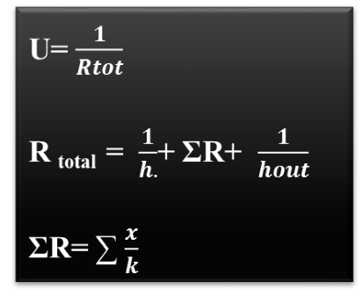
Result check
With free convection (h for water =100, h for air =25-40
Q_{losses} =UA (Ti -To)
U= 57.4, and tank area=.85 m
And k=1000 for the tank

Slide 25
Qlosses (theoretically)
Qlosses (theoretically)
Qlosses(experimentally)
-
791.16 | 780.64
276.29 | 260.49
67.824 | 54.67
Qlosses(experimentally)
-
456.152 | 463.505
334.573 | 317.135
126.16 | 140.45
129.57 | 110.98
366.464 | 345.98
247.04 | 230.48
263.904 | 250.89

Slide 26
FACT ABOUT THE EXPEREMENTAL RESULT
from the experimental result the system efficiency is reached 59.5%
the maximum rate for the amount of desalinate water 1.9 L
the minimum rate for the amount of desalinate water 0.9 L
the average reached temperature = 60C
there is high losses in the energy from the tank to atmosphere because of lack of insulation

Slide 27
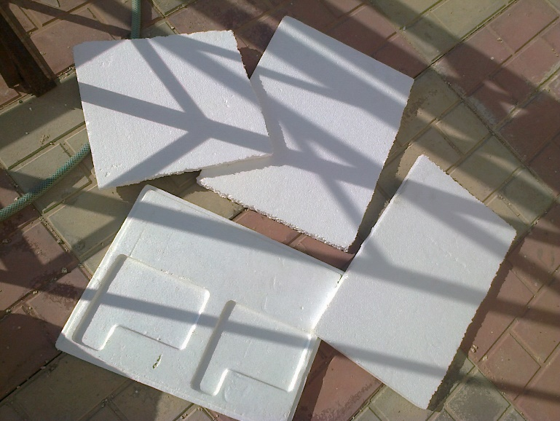
Experimentally result by using isolation for the tank

Slide 28
First day result after insulate the system
time(17/11/2013) | mass flow rate(l) | solar radiation (w/m2) | water temp(c0) | power produced by evacuated tube (KJ) | power absorbed by water | efficiency | Qlosses
9.1 | 13 | 900 | 26 | - | 0 | 0 | 0
11.3 | 12.75 | 1150 | 49 | 1821.6 | 1225.785 | 67.29167 | 595.815
12.35 | 12.55 | 1000 | 59 | 756 | 524.59 | 69.39021 | 231.41
13.1 | 12.2 | 1150 | 66 | 621 | 450 | 72.46377 | 171
14.3 | 11.9 | 1200 | 67 | 1036.8 | 760 | 73.30247 | 276.8
 | Total desalinate water =1.1 l |  |  |  |  | AVG 70.61203 | 0

Slide 30
Second day result after insulate the system
time(19/11/2013) | mass flow rate(l) | solar radiation (w/m2) | water temp(c0) | power produced by evacuated tube (KJ) | power absorbed by water | efficiency | Qlosses
8.3 | 14 | 1000 | 29 | - | 0 | 0 | 0
9.35 | 13.8 | 1150 | 42 | 869.4 | 749.892 | 86.25397 | 119.508
10.5 | 13.6 | 1200 | 50.5 | 993.6 | 483.208 | 65.63205 | 510.392
12.15 | 13.1 | 1147 | 61 | 1362.64 | 574.959 | 59.55478 | 787.677
13.3 | 12.75 | 680 | 63 | 563.04 | 500 | 65.45897 | 63.04
14.2 | 12.5 | 400 | 60.5 | 259.2 | 130.625 | 56.39545 | 128.575
14.45 | 12.1 | 1000 | 59.4 | 180 | 55.6358 | 57.6674 | 124.3642
 | Total desalinate water= 1.9l |  |  |  |  | Avgas 65.32 | 0

Slide 32
Result check
With free convection (h for water =100, h for air =25-40
Q_{losses} =UA (Ti -To)
U= 11.55, and tank area=.85 m
And k=1000 for the tank and for polystyrene=1.3

Slide 33
Qlosses (theoretically)
Qlosses
0 | 0
119.51 | 121.55
510.39 | 490.65
787.68 | 777.59
63.04 | 18.7
128.58 | 99.45
124.36 | 110.25
Qlosses (theoretically)
Qlosses
0 | 0
595.8 | 585.99
231.4 | 214
171 | 161.68
276.8 | 280.54

Slide 34
fact about the experimental result after insolation
after the insolation the efficiency increased to 67%
the average reached temperature = 69 C
losses in the energy from the tank to atmosphere decrease in a good range because of the isolation material

Slide 35
Thermo resistive temperature sensor

Slide 36
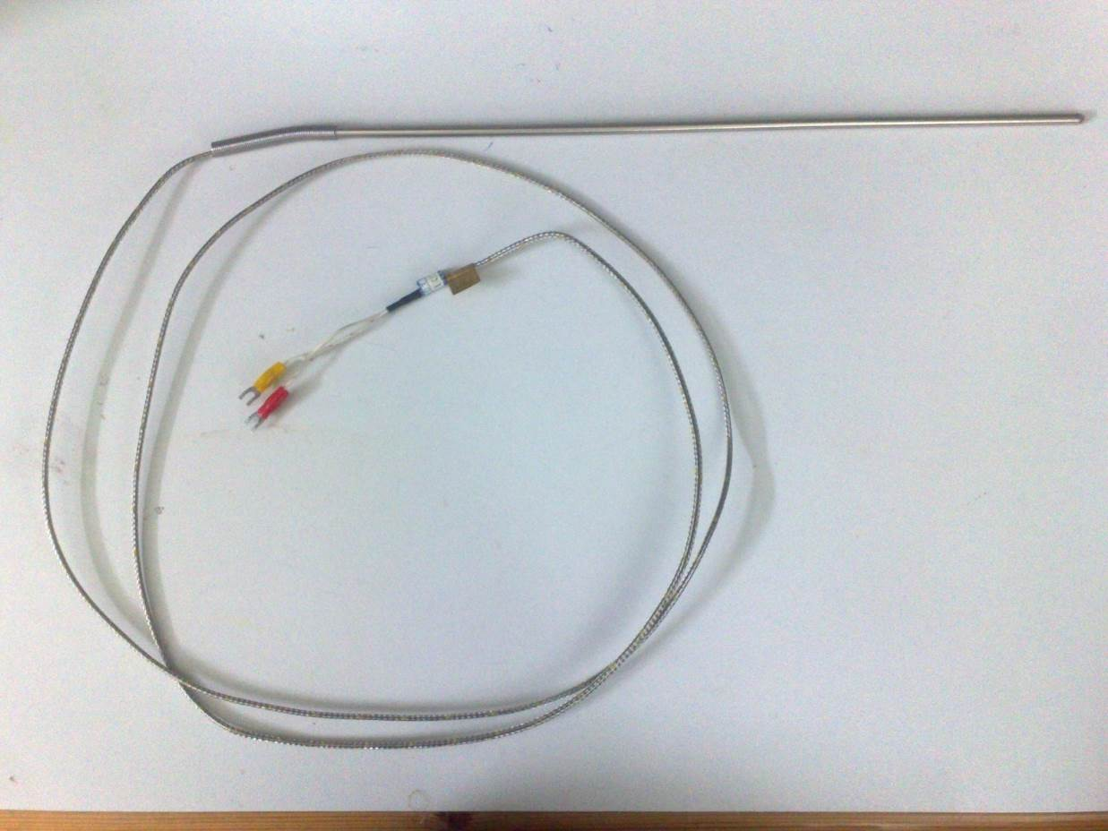
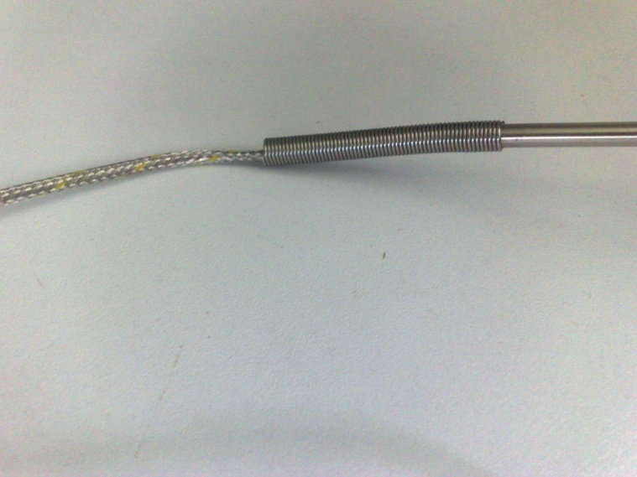
resistive temperature Detector(RTD)
Notes:
Here is the sensor that used in our project as you see it couldn’t affected by the fluid so he is suitable to measure water temperature

Slide 37
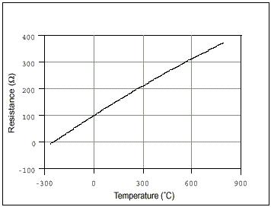
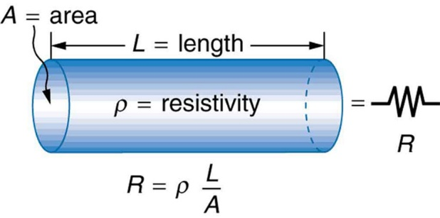
Temperature Vs. Resistance
Temperature affect resistivity, and resistivity affect resistance:
Notes:
Temperature affect resistivity, The resistance is proportion to the resistivity with positive relationship ,so when the temperature increase the resistance increase also

Slide 38
There is no data sheet !!
Here a calibration was done
Notes:
There is no data sheet !! So we had gone to the control lab for chemical

Slide 39
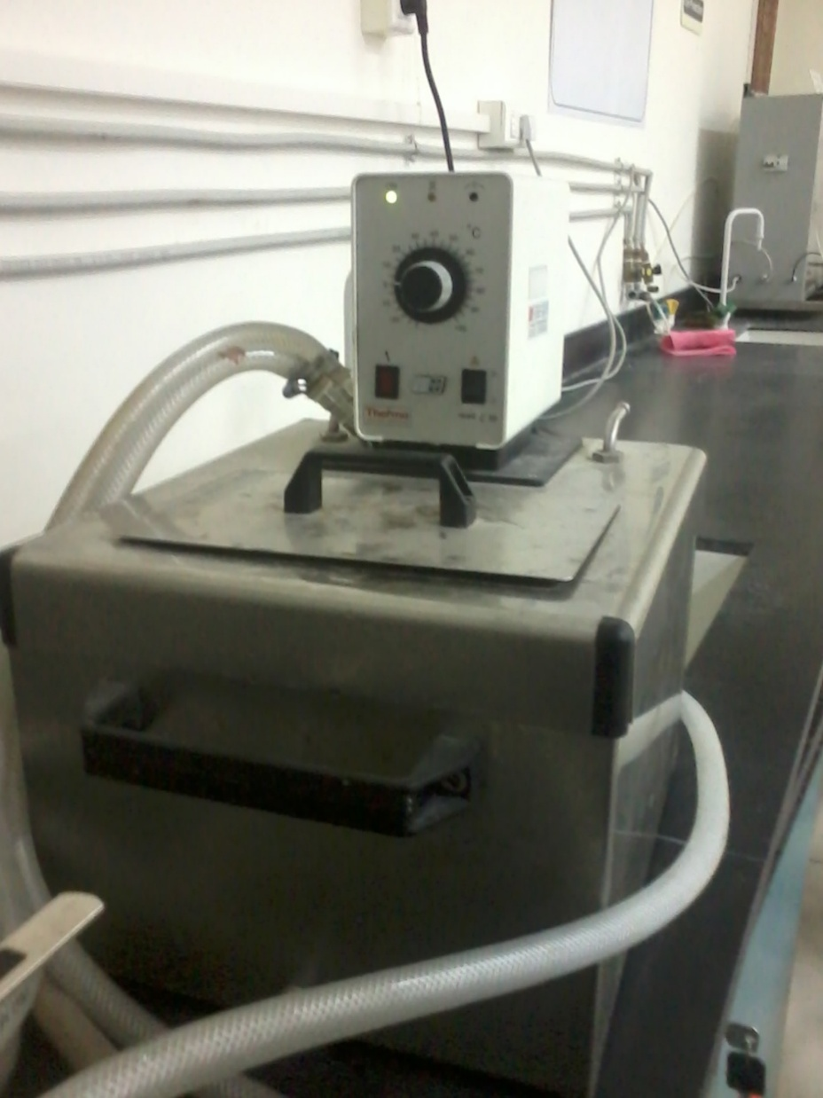
Notes:
The device used to perform the calibration< from this knob we can adjust the temperature

Slide 40
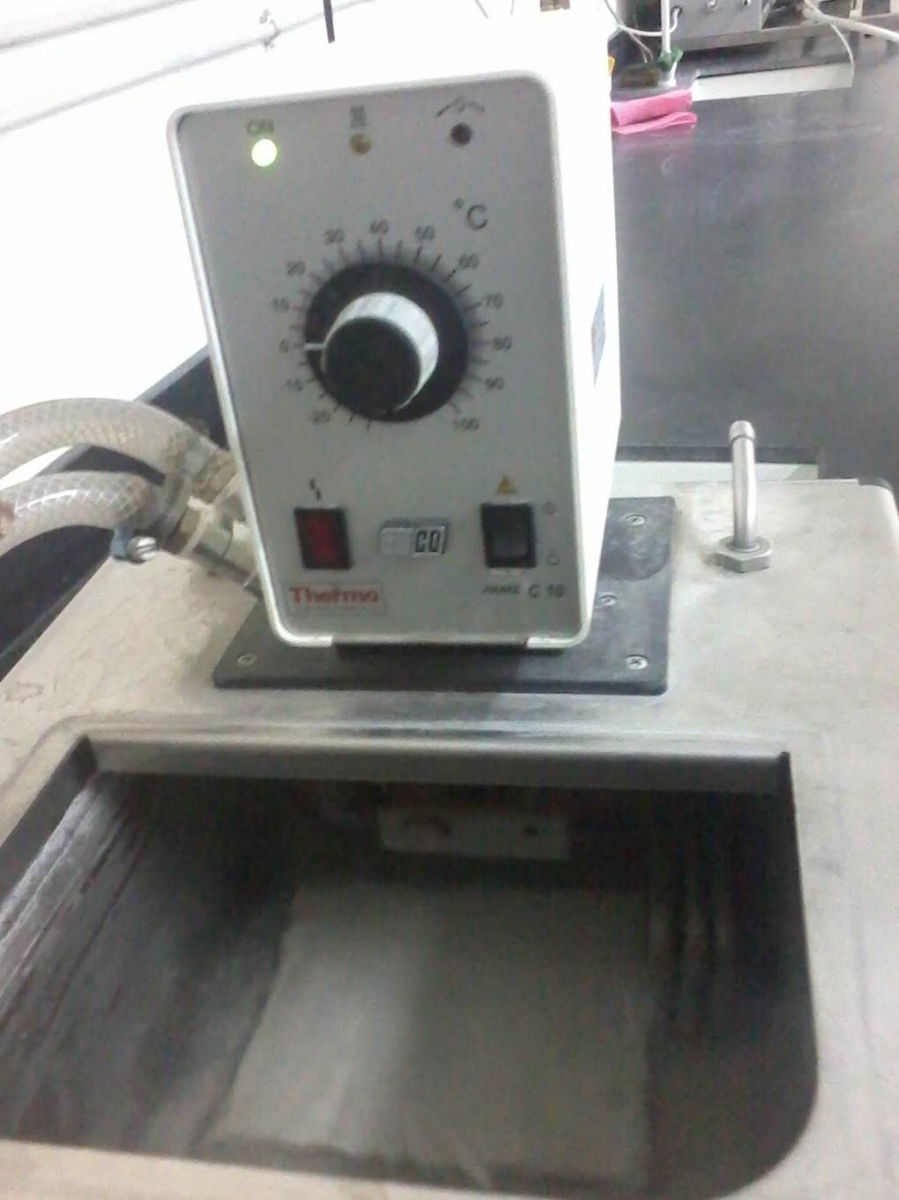
Notes:
Boil used to put the sensor in it >>>>>>

Slide 41
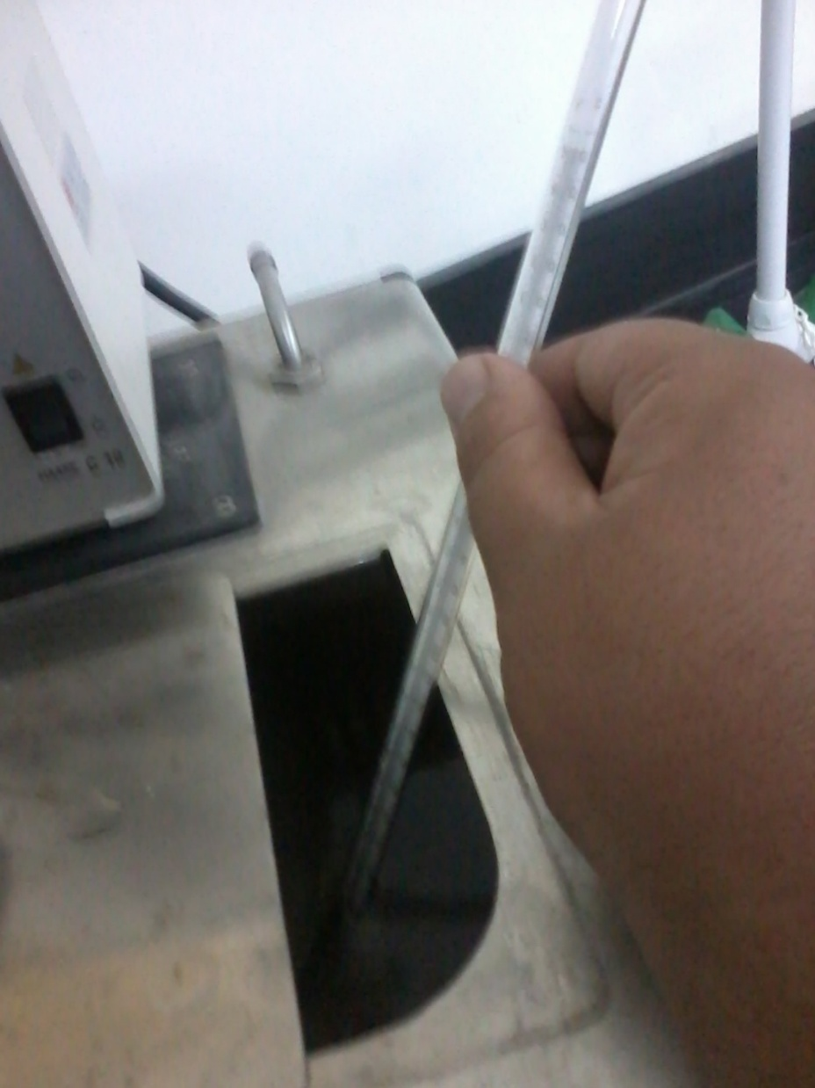
Notes:
The mercury thermometer to make sure that the needed temperature was reached

Slide 42
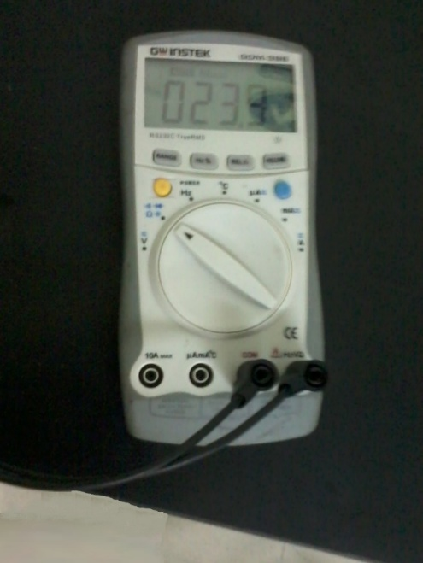
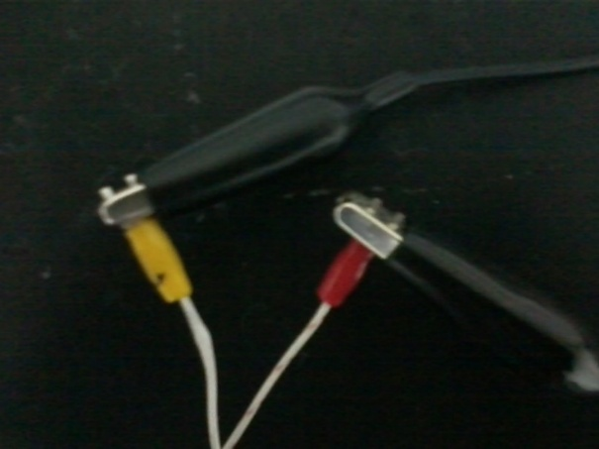
Notes:
The multimeter was connected with sensor sides

Slide 43
T[ºC] | 0 | 5 | 10 | 15 | 20 | 25 | 30 | 35 | 40 | 45 | 50
R[KΩ] | #### | #### | #### | #### | 4 | 5.7 | 6.85 | 8.3 | 8.4 | 10.05 | 11.4
T[ºC] | 55 | 60 | 65 | 70 | 75 | 80 | 85 | 90 | 95 | 97 | ####
R[KΩ] | 12.8 | 14.1 | 15.7 | 17 | 18.4 | 20 | 21.1 | 22.8 | 23.9 | 24.6 | ####
T[ºC] | 0 | 5 | 10 | 15 | 20 | 25 | 30 | 35 | 40 | 45 | 50
R[KΩ] | 0.1 | 0.15 | 0.17 | 1.54 | 2.9 | 4.27 | 5.64 | 7 | 8.37 | 9.4 | 11.2
T[ºC] | 55 | 60 | 65 | 70 | 75 | 80 | 85 | 90 | 95 | 100 | ####
R[KΩ] | 12.5 | 13.8 | 15.3 | 16.7 | 18.1 | 19.4 | 20.7 | 22 | 23.3 | 24.6 | ####

Slide 45
The average was taken:
Notes:
The average was taken(blue line) ,moreover the linear line(orange one) that we want to reach it by deflection bridge was drawn also.

Slide 46
The nonlinearity errors as function with the input (T)

Slide 47
Needing component to define the output:
Using
supply voltage 9 volt
Electrical circuit(deflection bridge)
Microcontroller PIC C
Screen
Notes:
Of course a regulator will be used to have 5 volt supply to the microcontroller
To minimize the nonlinearity and for the starting point
To amplify and interface with the screen

Slide 48
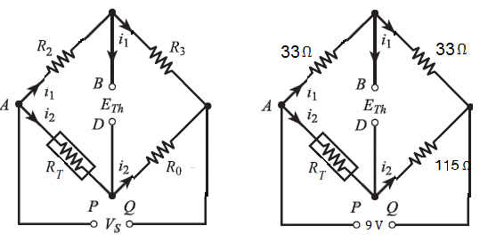
Deflection bridge:
It consists of four resistance
Notes:
Main task for each one
Ro: Set the output voltage of the bridge E_{Th} = 0 for T = 0 ºC
R3 & R2 :Minimize linearity
The fourth one is the sensor(variable resistance depending on temperature)

Slide 49
Results after connecting the Deflection Bridge
T[ºC] | 0 | 5 | 10 | 15 | 20 | 25 | 30 | 35 | 40 | 45 | 50
E_{Th}[volt] | 0 | 0 | 0.01 | 0.11 | 0.21 | 0.31 | 0.4 | 0.5 | 0.59 | 0.66 | 0.77
T[ºC] | 55 | 60 | 65 | 70 | 75 | 80 | 85 | 90 | 95 | 100 | ####
E_{Th}[volt] | 0.85 | 0.93 | 1 | 1.1 | 1.2 | 1.3 | 1.34 | 1.4 | 1.48 | 1.55 | ####

Slide 50
Design of amplifier:
T actual
T measured
99.6
100
E th
1.5
0
0.775
0
50
0
49.79
Notes:
The purpose of the amplifier is to convert the output voltage potential (Eth )of the deflection bridge(Eth is proportional to the true value of the input temperature) to temperature (measured value) in order when reading the output of the amplifier by a digital indicator (voltmeter),the value of measured temperature appears on the screen of the voltmeter indicates the measured temperature (C), rather than voltage proportional to temperature.

Slide 51
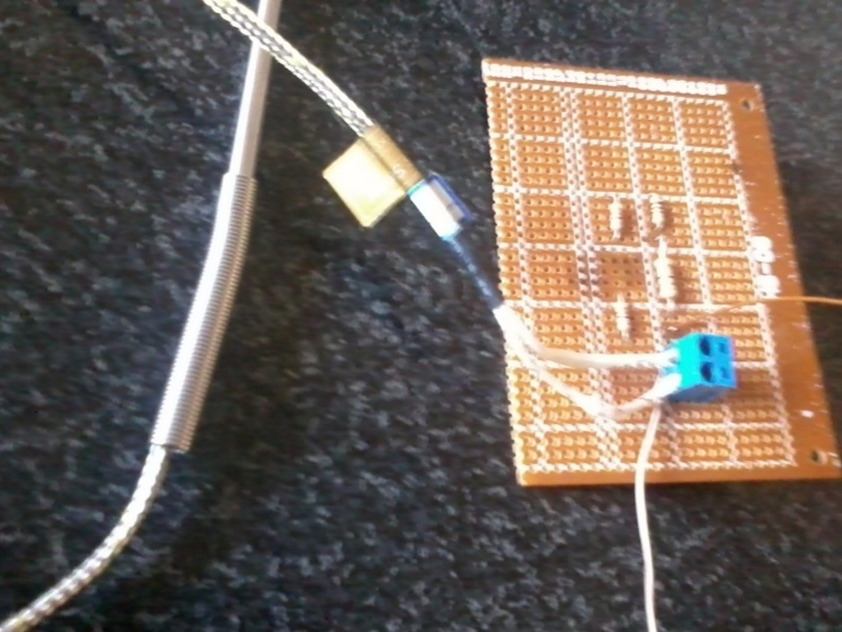
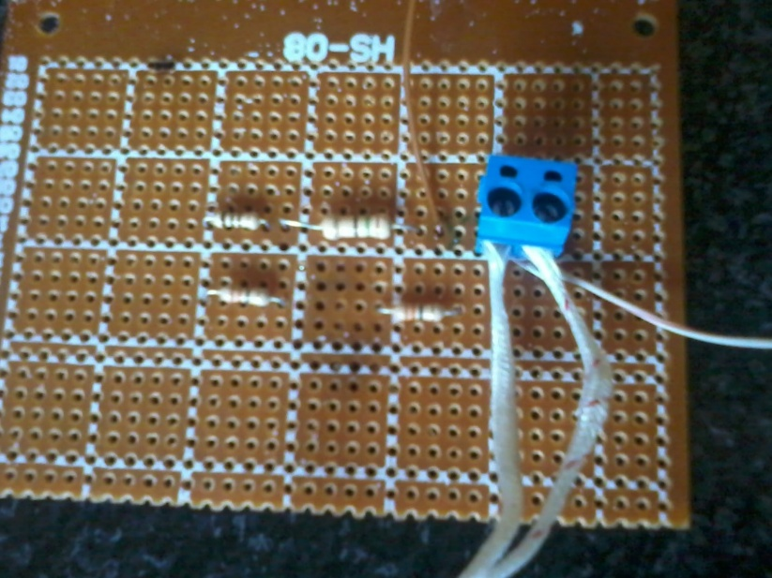
Deflection bridge

Slide 52
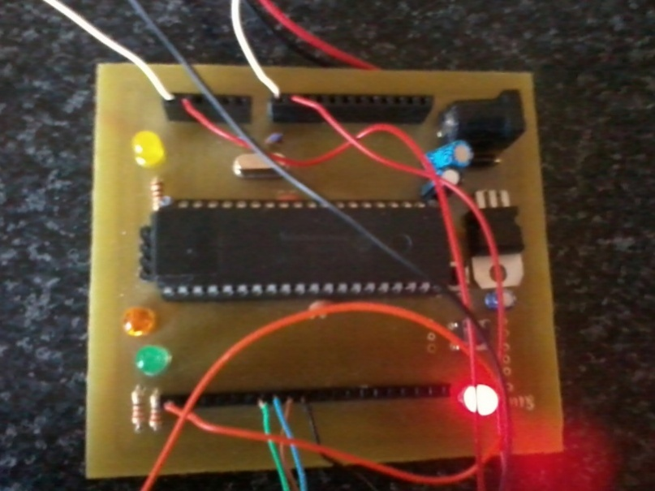
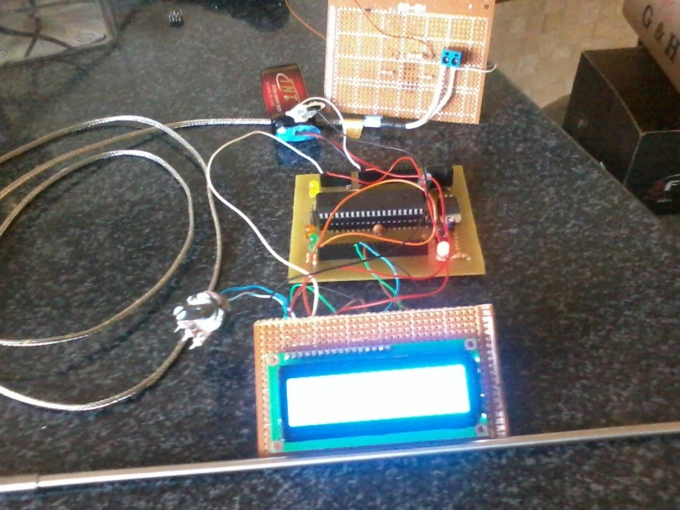
Pic c with screen

Slide 53
COST ANALYSIS

Slide 54

Cost analysis
Every device or new system must be useful for the society which is provided in.
it cost must suitable for almost for every one and it life must be long enough

Slide 55
Cost analysis
In our case the system is solar desalination system work only on the solar radiation, with low initial cost and very cheap maintenance cost and long life for the system

Slide 56
Social Back Ground
Here in Palestine the amount of fresh water is decrease every day
in Gaza the ground water are mixed with salt water from the sea
in al-agooar (Jericho region) a lot of ground water is polluted
and the price of fresh there water is very high

Slide 57
Social Back Ground
In Palestine the average of the Palestinian family equal to 5.8 person.
Each person need from 2-3 litter of fresh water every day
And in some part in the Palestinian territory complete family cant used more the 10 fresh water every day.
So system like our system can be used to provide fresh water in high average in the lost possible cost, and it can be used not only in Palestine but all over the world.

Slide 58
Cost Analysis for the System
For each month the total family in the Palestinian territory needed to 540 litter from fresh water (6480 litter /year)
If the system built for commercially used the construction cost will be very cheap
To build complete unit can produce very large amount of water the number of the evacuated tube must be increase and the size of the also in addition to it shape.

Slide 59
Commercial desalination unit
The unit will use 10 evacuated tube
The size of the main tank is equal to 100 litter
Electronic measurement system will used to control the level inside the tank and to measure the temperature of the water

Slide 60
Commercial unit output
By taking system efficiency equal 67% with 10 evacuated tubes
by taking the average temperature for heated water equal 69 C
By taking the average of solar radiation for each month We can predict the system output in the next table

Slide 61
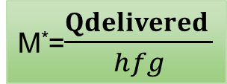
Commercial unit out put
Month | I(W/m² ⁾ | RADIATION TIME] | (Q FROM EV PER MONTH)*67% | M*/MONTH | the number of families that have the use the unit
1 | 106.79 | 8 | 4182.751 | 1771.976581 | 3.937725736
2 | 132.25 | 8 | 5179.968 | 2194.436772 | 4.87652616
3 | 176.07 | 8 | 6896.31 | 2921.546181 | 6.492324846
4 | 253.7 | 9 | 11179.04 | 4735.876636 | 10.5241703
5 | 255.9 | 10 | 12528.86 | 5307.716162 | 11.7949248
6 | 288.13 | 11 | 15517.53 | 6573.83151 | 14.60851447
7 | 276.6 | 11 | 14896.57 | 6310.768735 | 14.02393052
8 | 256.02 | 11 | 13788.21 | 5841.225639 | 12.98050142
9 | 217.49 | 11 | 11713.14 | 4962.144224 | 11.02698716
10 | 153.46 | 10 | 7513.402 | 3182.970388 | 7.073267528
11 | 91.78 | 9 | 4044.194 | 1713.278509 | 3.807285575
12 | 67.7 | 8 | 2651.674 | 1123.35251 | 2.496338911
 |  |  |  | Total=46639.12 l | Average=8.63
Where equal 2360.5 hfg _{at=60c} equal 2360.5

Slide 62
Commercial unit out put

Slide 63
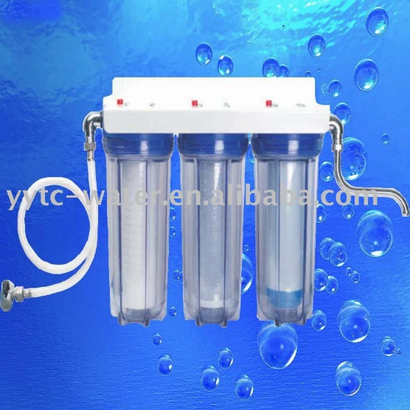
System cost
The desalination unit can last more than 10 years by making good maintained every year and by cleaning the pipes and the tank from sediment weekly
You must noticed that the water which is produced from the unit is pure water(no mineral in it) so these mineral must added to the water after the viper condensed by a simple filter

Slide 64
System cost
item | cost price
10 evacuated tubes | 40$
the system tank with the base of the system | 60$
total measurements system(level and thermocouple sensor and micro controller | 50$
Multi-stage home filtering units | 120$
pipe and tank to store raw water desalinated water and | 25$
maintenance cost per year | 150$
total cost | 445$

Slide 65
Thanks for yours attention
Any question?

