Slide 1
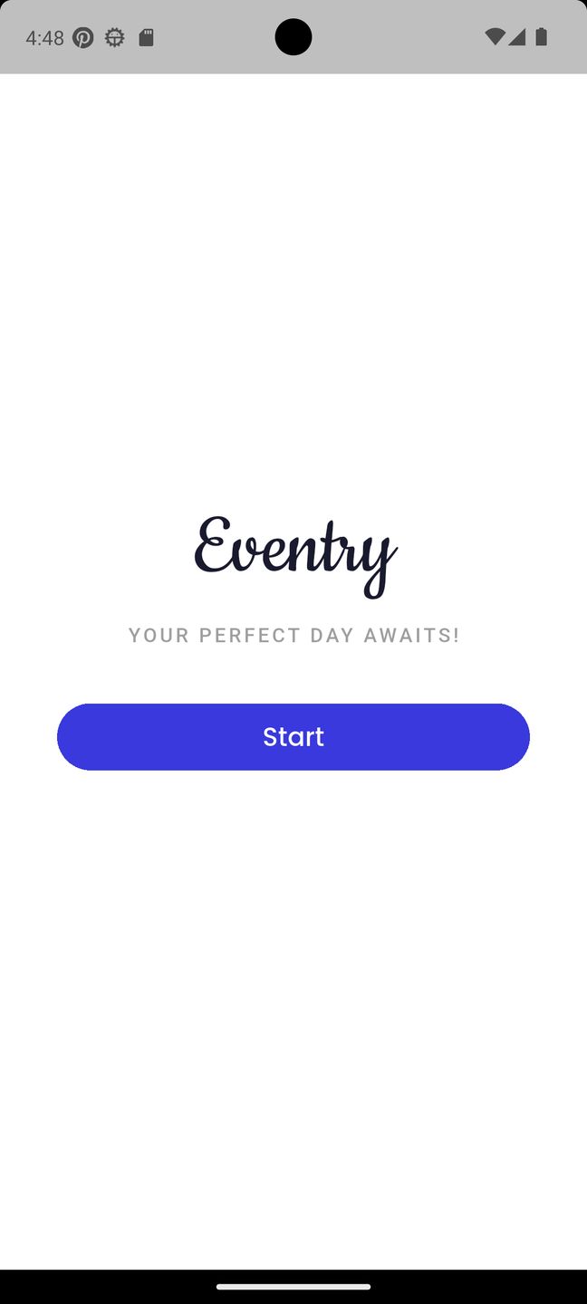

Home
About Us
Service
Contact
By Tamara Abu Aisheh & AbdAlhameed Haj Hamad
SUPERVISOR: ENG. KHALED DAWOUD

Slide 2

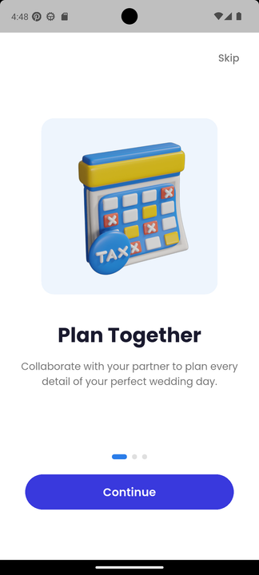
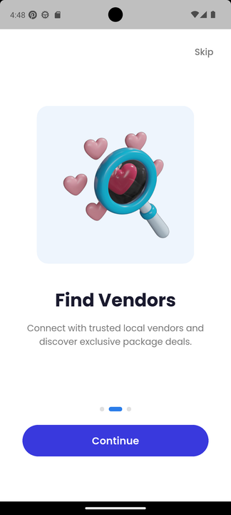
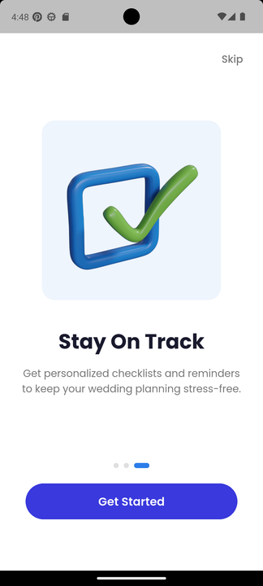
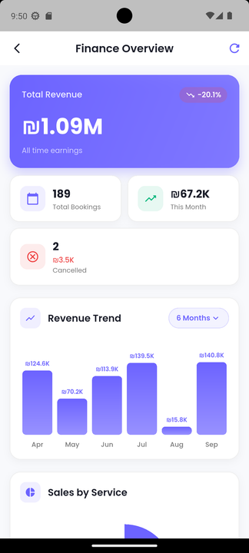
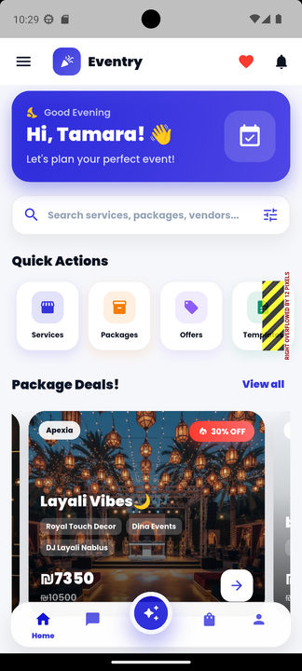
Content:
Introduction
Objectives
Tools used
Features
Future work

Slide 3
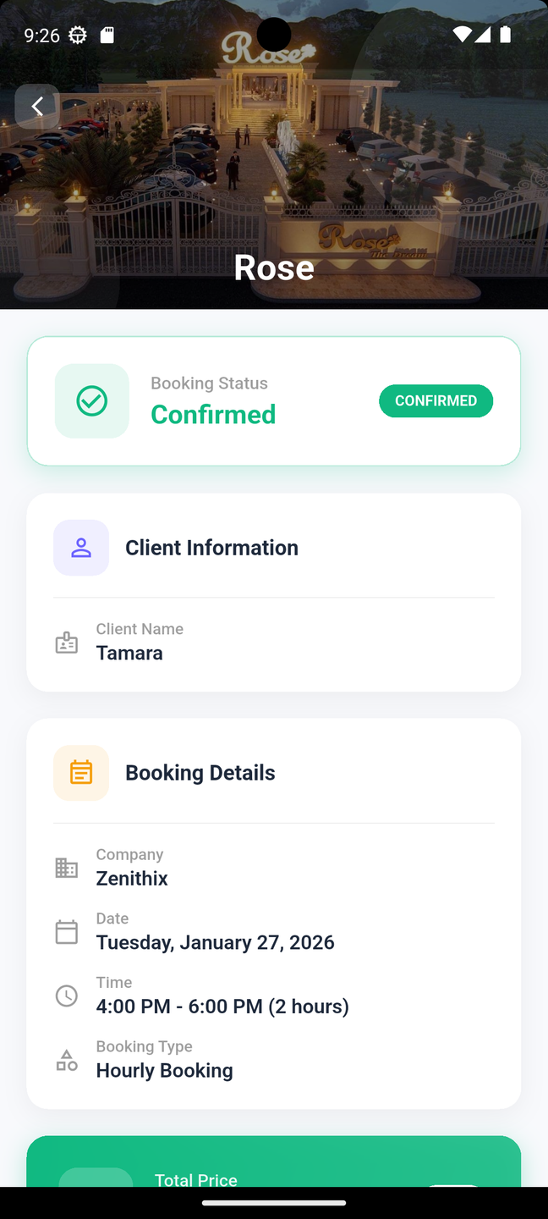
Why Eventry?
We connect customers who are planning events with trusted service providers in one unified platform

Slide 4
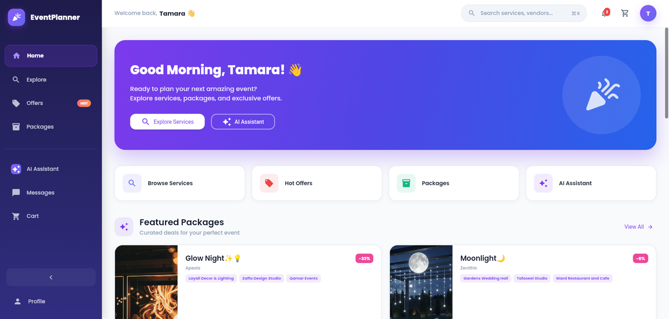
Introduction
Eventry is a Mobile and web platform with 2 dedicated portals:
Customer Portal for browsing services, filtering by budget and location, chatting with providers, and completing secure bookings
Provider Portal for managing profiles, services, bookings, and customer communication in an organized and efficient way

Slide 5
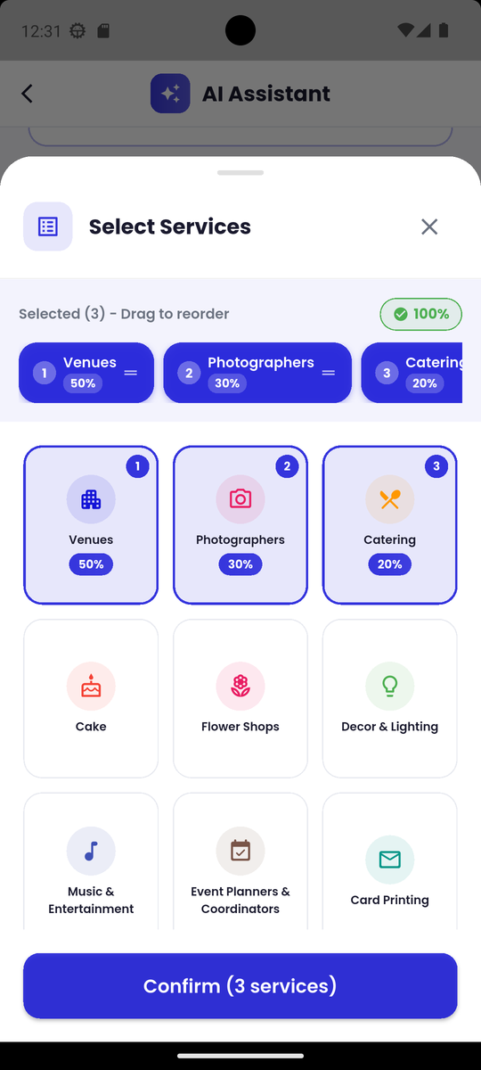
Key Features
1
3
Provider Verification & Security
AI Assistant
Verified providers ensure higher trust and platform security
Smart recommendations based on budget, location, and event needs
2
4
Packages & Catering Management
Payments & Chat System
Secure online payments and direct customer–provider communication
Ready-made or custom packages with clear pricing

Slide 6






Tools

Slide 7
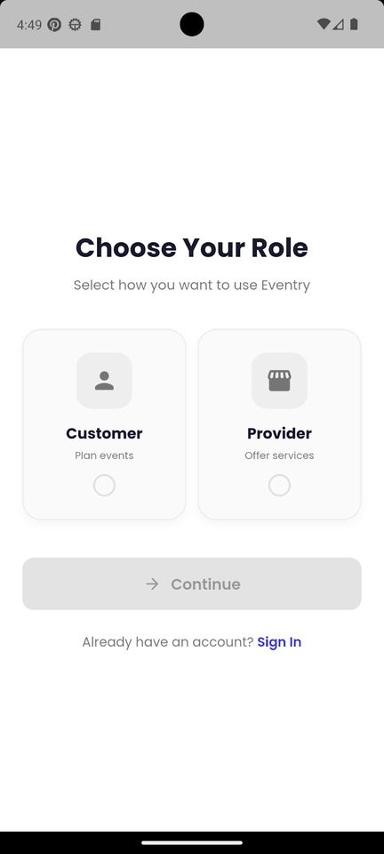
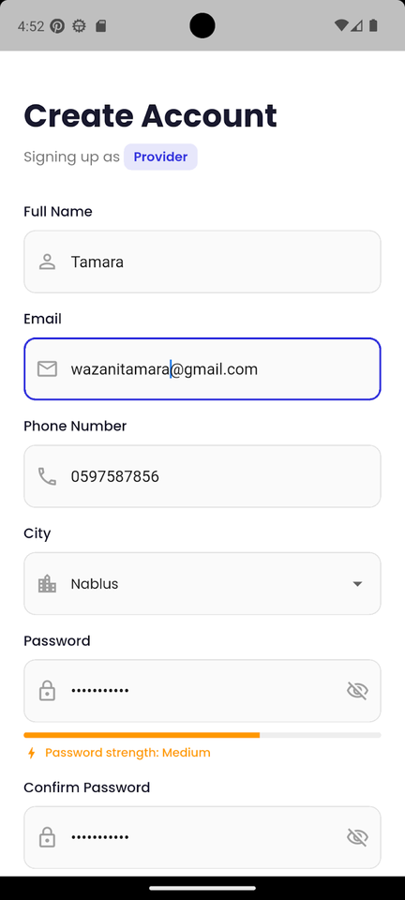
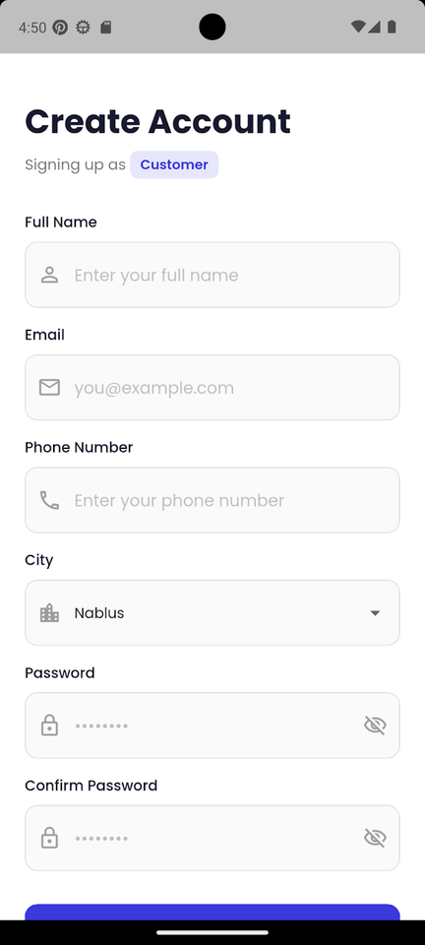
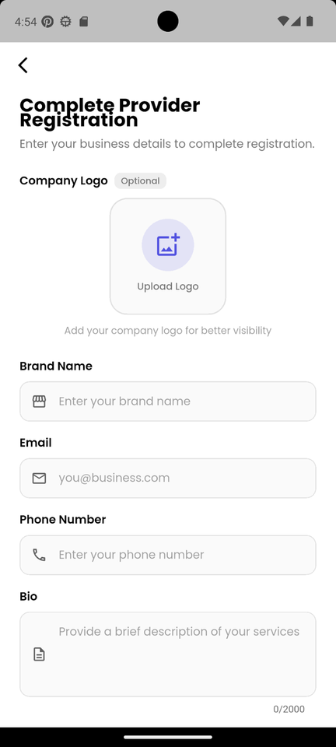
Sign-Up

Slide 8

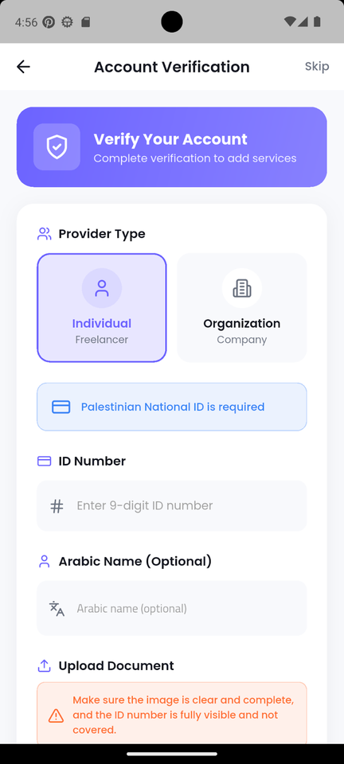
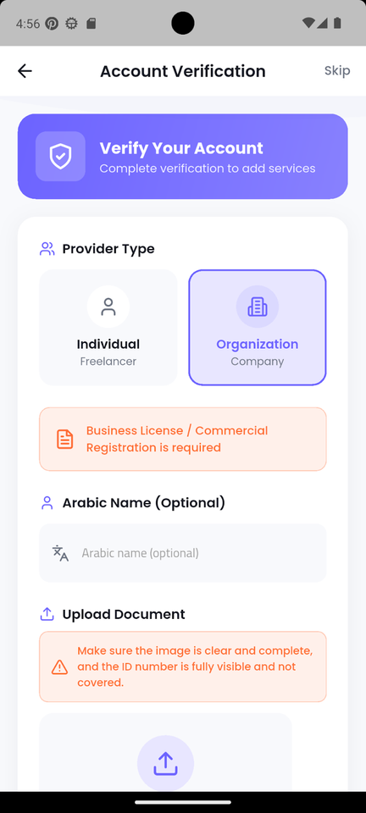

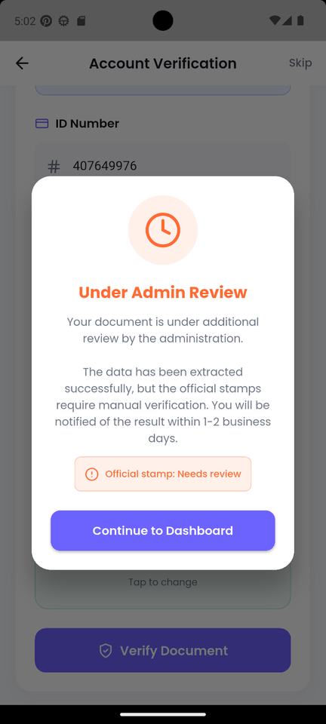


Account
Verification

Slide 9

Account
Verification

Slide 10
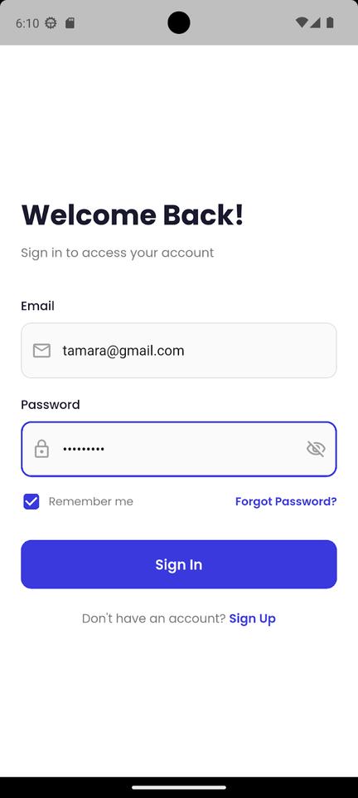
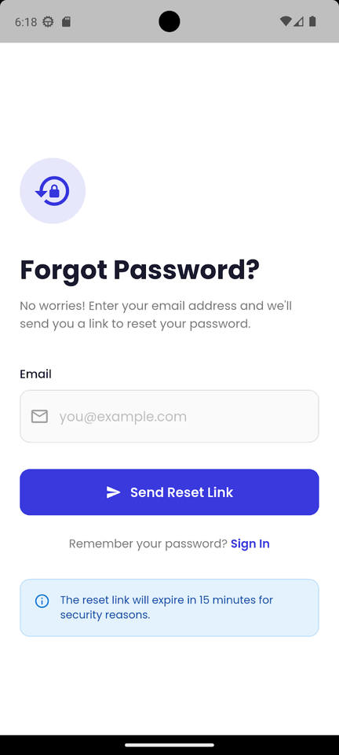
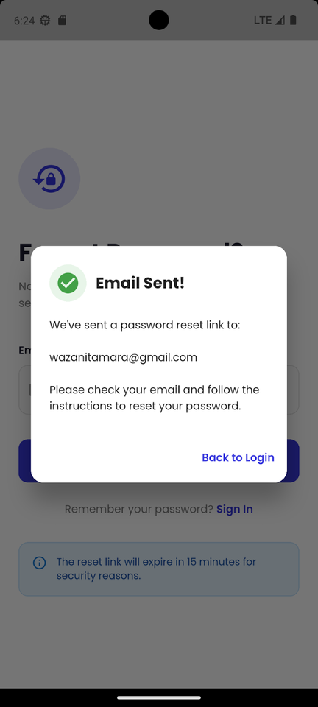
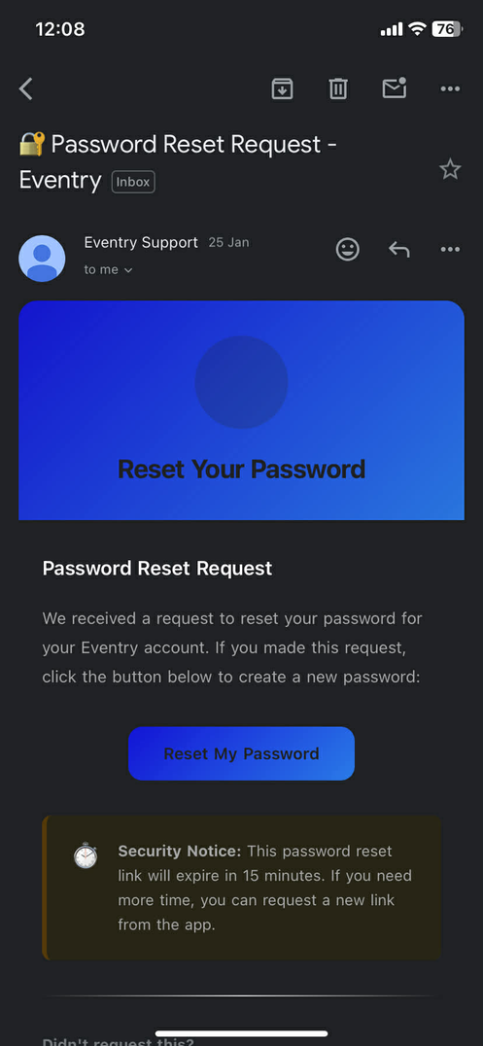
Login & Forget Password

Slide 11
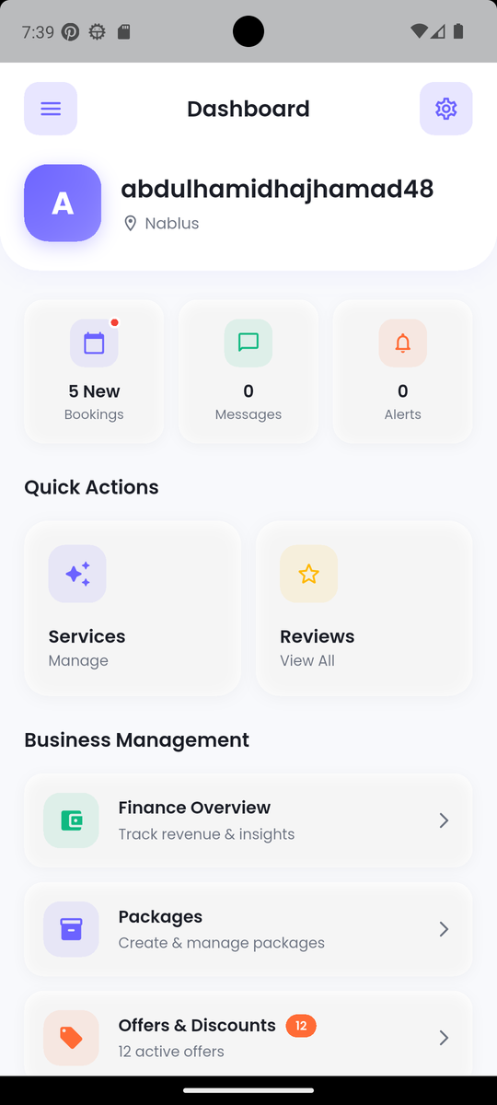
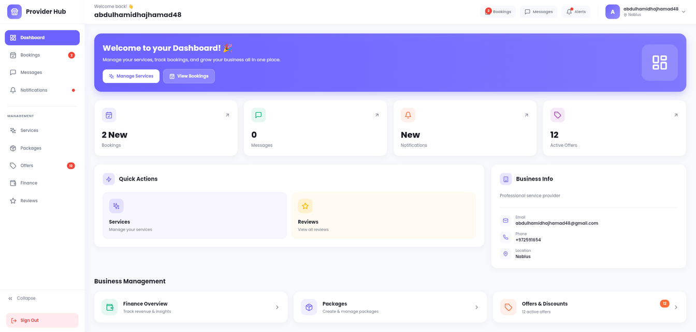
Provider Portal
Dashboard

Slide 12
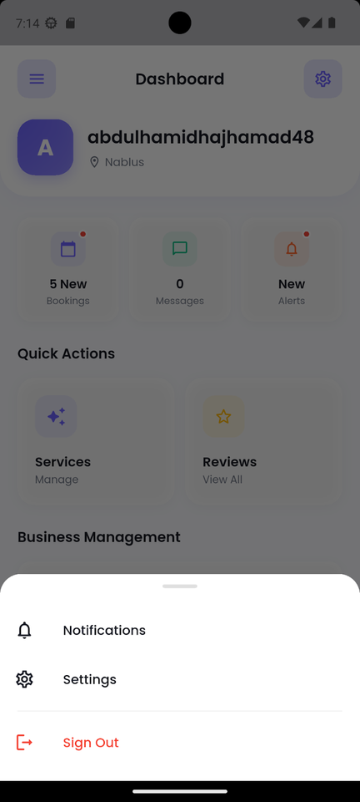
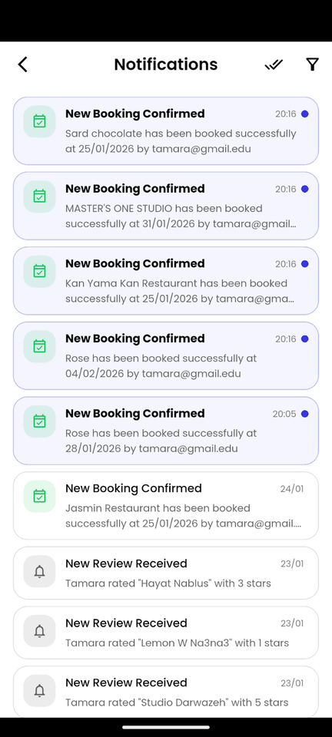
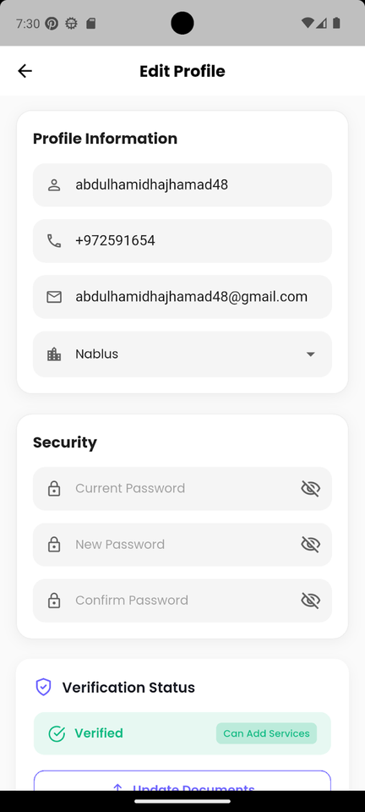
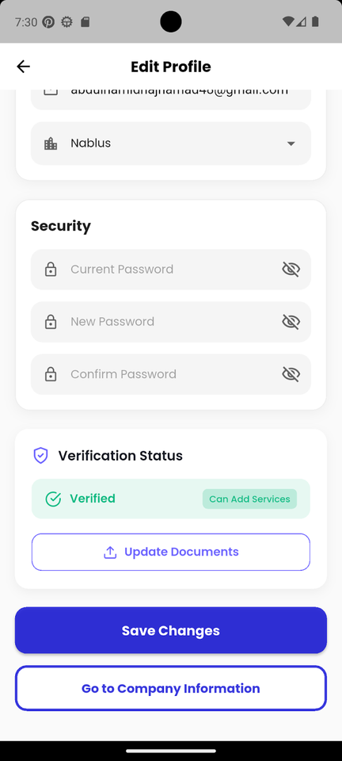
Provider Portal

Slide 13
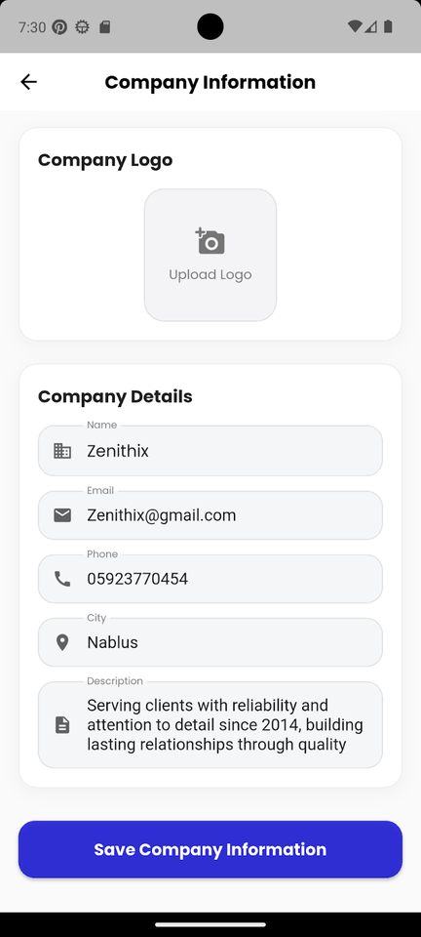
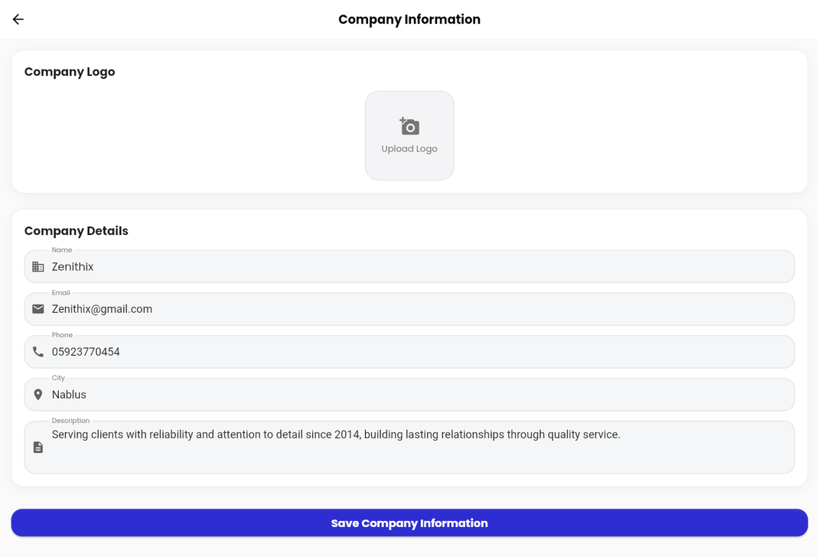
Company Information

Slide 14
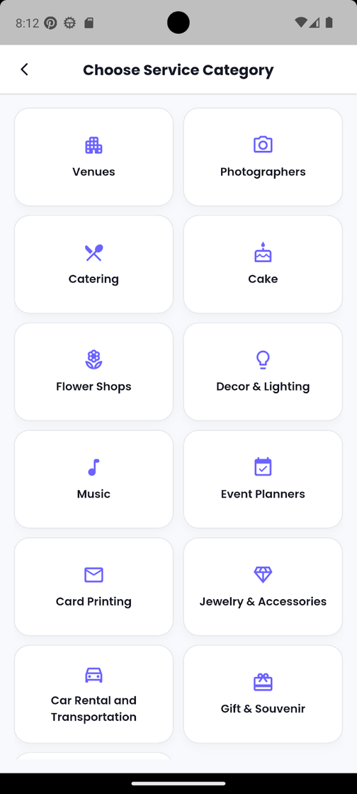
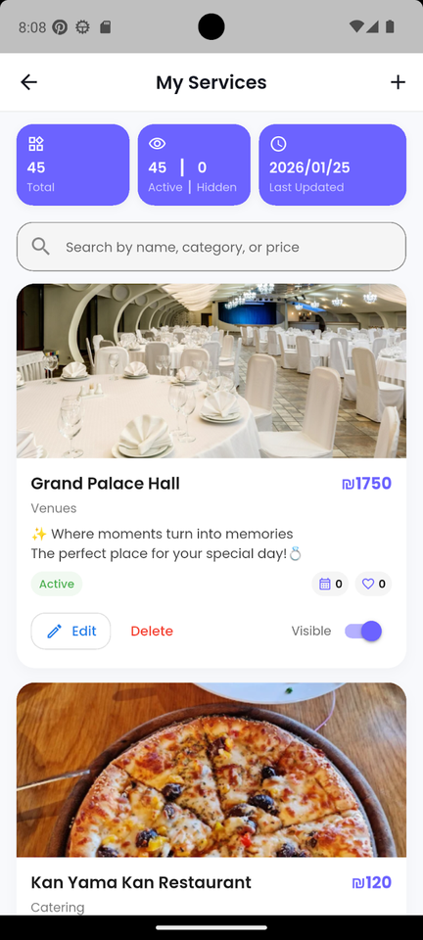
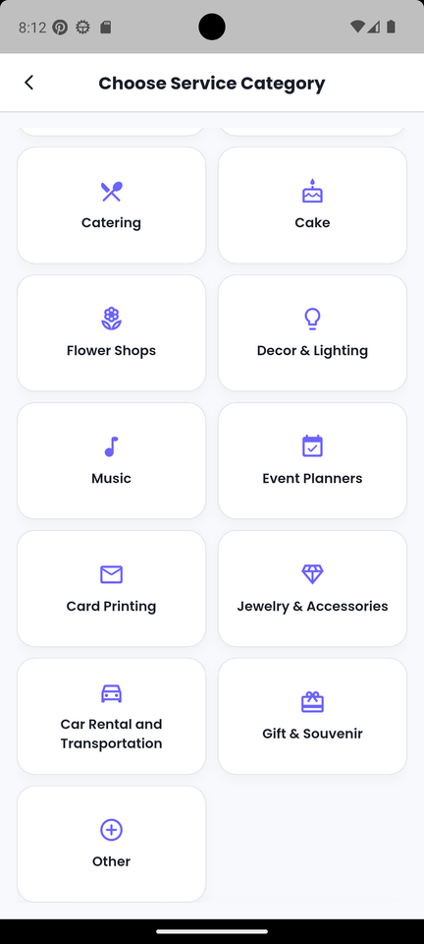
Service Categories & Management

Slide 15
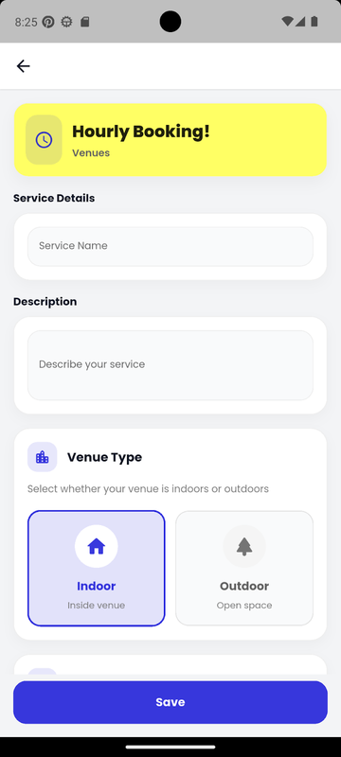
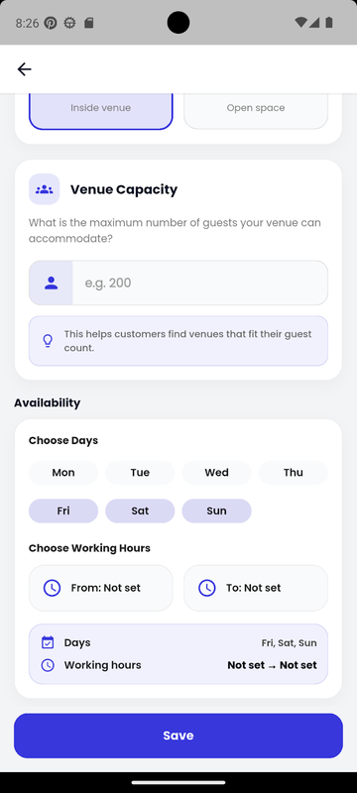
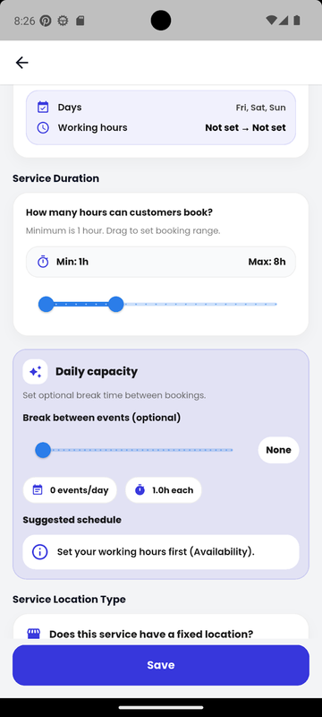
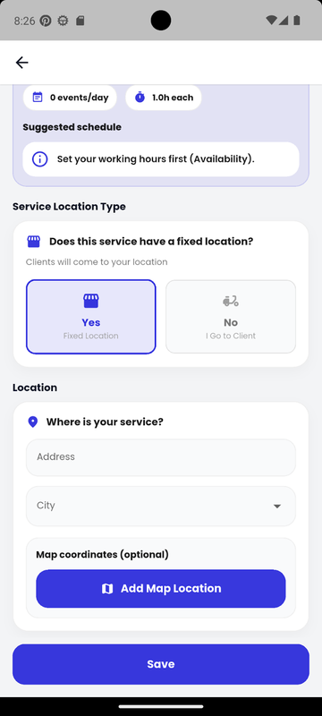
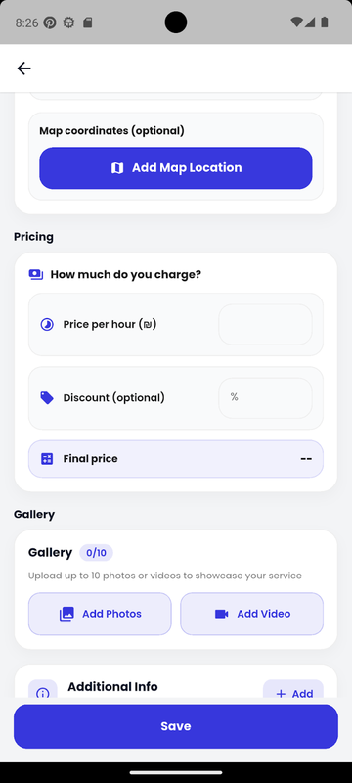
Booking Types
Hourly Booking

Slide 16
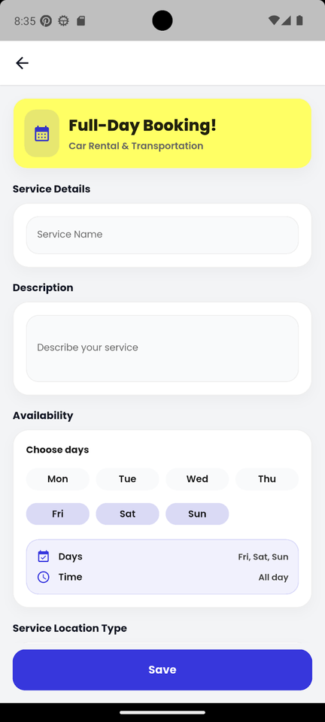
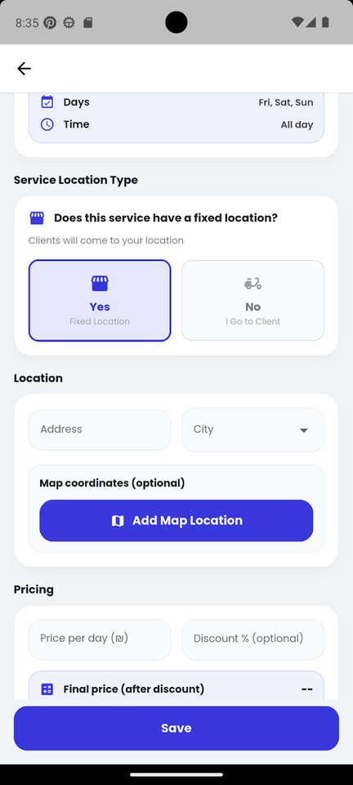
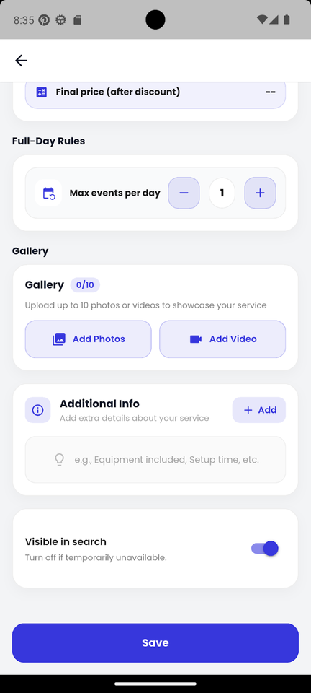
Booking Types
Full-Day Booking

Slide 17
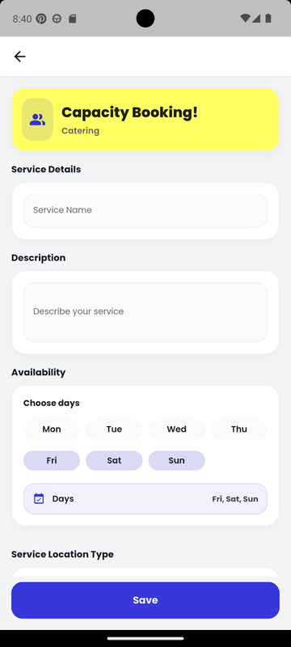
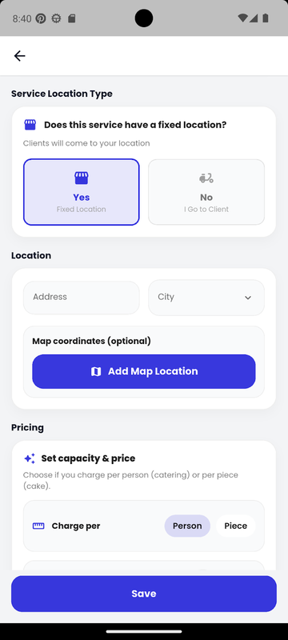
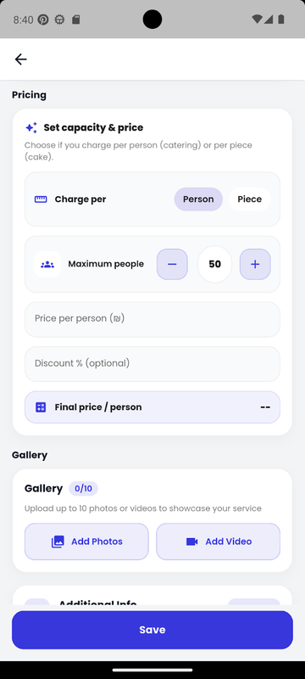
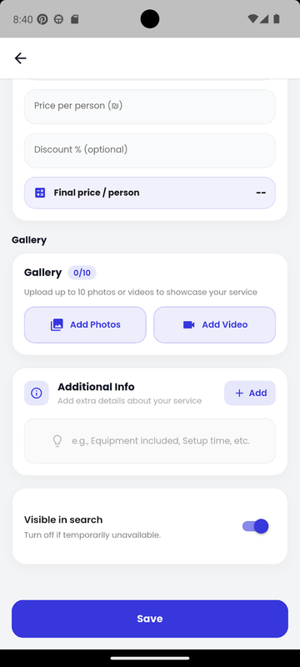
Booking Types
Capacity Booking

Slide 18
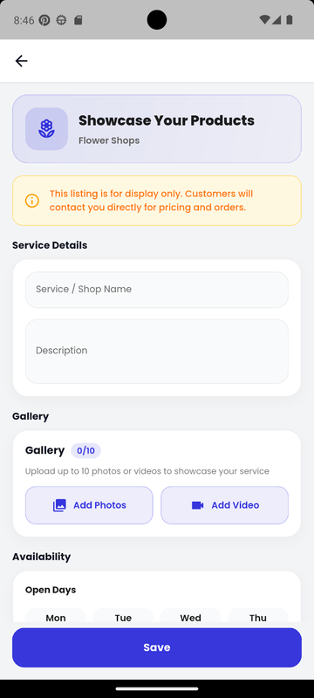
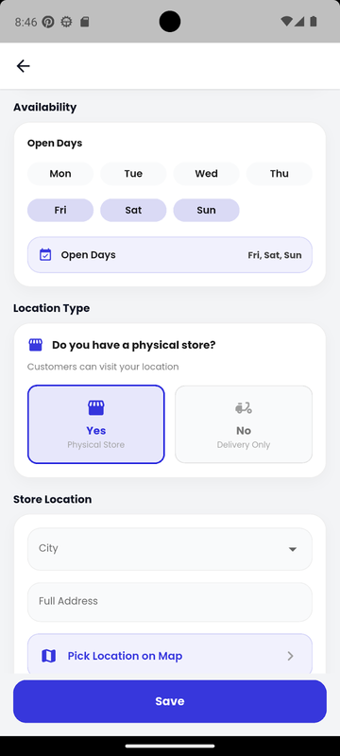
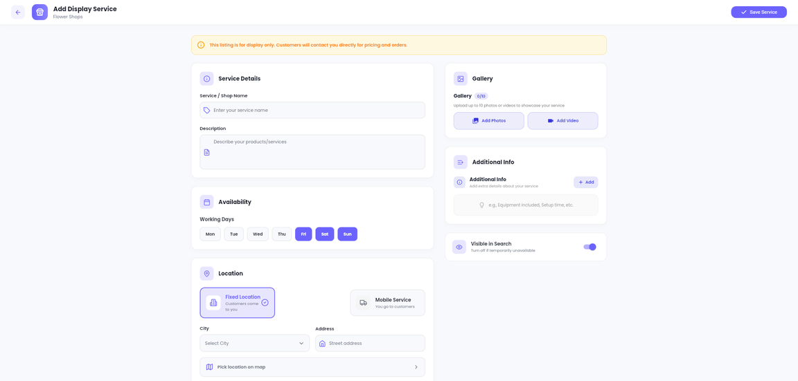
Booking Types
Showcase Your Products

Slide 19
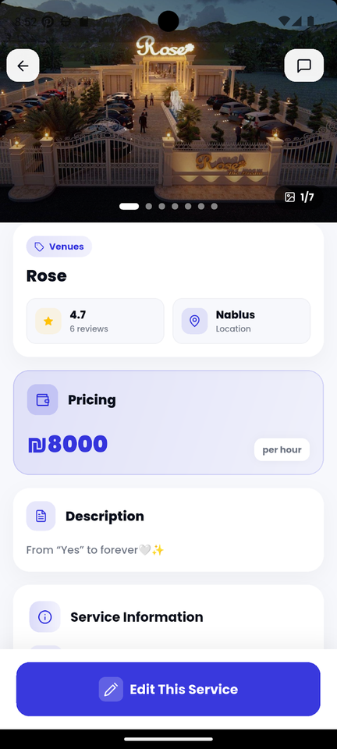
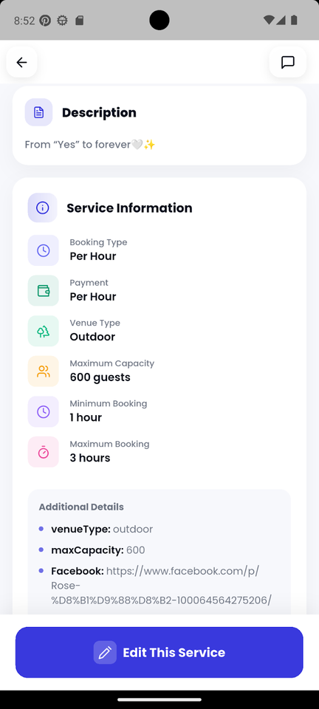
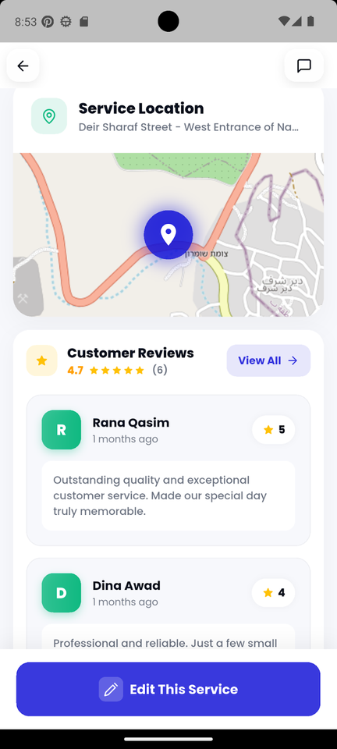
Service Details

Slide 20
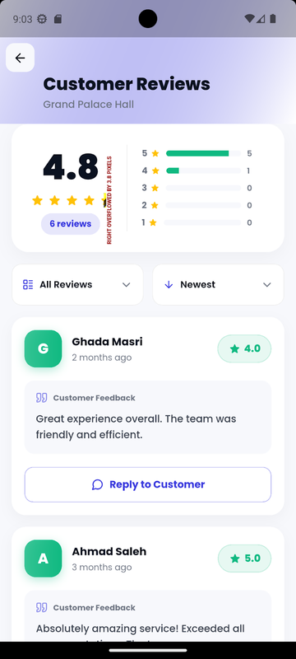



Customer Reviews & Direct Replies

Slide 21



Edit & Delete Service

Slide 22




Reviews Hub

Slide 23



Provider Bookings
Confirmed

Slide 24


Provider Bookings
Completed

Slide 25



Provider Bookings
Cancelled

Slide 26



Messages & Chat Management

Slide 27



Messages & Chat Management

Slide 28




Finance Overview

Slide 29



Packages

Slide 30



Add a Package

Slide 31





Offers & Discounts

Slide 32



Customer Portal
Dashboard

Slide 33



Services &
Advanced Filtering

Slide 34




Service Details
Overview

Slide 35



Packages

Slide 36



Packages

Slide 37




Offers

Slide 38






Add to Cart

Slide 39





Payment

Slide 40



Invitation Templates

Slide 41



Favorites &
Notifications

Slide 42


AI Assistant

Slide 43




Single Service AI

Slide 44




Single Service AI

Slide 45



Full Package AI

Slide 46



Full Package AI

Slide 47




Customer Portal
Chat & Messages

Slide 48



Customer Profile & Account Management

Slide 49




Settings &
Change Password

Slide 50



Admin Portal
Dashboard

Slide 51


Admin Portal
Verification

Slide 52

Admin Portal
Verification

Slide 53


Admin Portal
Financial Growth

Slide 54


Admin Portal
Manage Users

Slide 55


Admin Portal
Manage Providers

Slide 56


Admin Portal
Reviews

Slide 57


Admin Portal
Reply to Review

Slide 58



Admin Portal
Messages

Slide 59


Admin Portal
Notifications

Slide 60


Admin Portal
Service Sales

Slide 61


Admin Portal
Package Sales

Slide 62
Home
About Us
Service
Contact
Constraints
Service Booking Classification
Availability Consistency
Services are divided into different booking types, each with its own rules and pricing to ensure correct reservations
Availability and payments are synchronized in real time to avoid conflicts or errors

Slide 63
Home
About Us
Service
Contact
FUTURE
Advanced AI Recommendations
WORK
Improve the AI assistant to provide more personalized suggestions based on user behavior and past bookings
Government Verification APIs
Integrate official government APIs to verify provider identities and ensure that registered providers are trustworthy
Advanced OCR Technologies
Replace the current OCR with more accurate solutions like Google Vision API to enhance identity verification

Slide 64
Home
About Us
Service
Contact
Conclusion
An all-in-one platform that connects customers with event service providers in one place

Slide 65


Home
About Us
Service
Contact
Scan & Go!
Website
Mobile App

