Slide 1

بسم الله الرحمن الرحيم
An-Najah National University
Faculty of Engineering
Civil Engineering Department

Slide 2
Asera Al-Shamaliyeh Stadium
Supervisor:
Dr. Riyad Awwad.
Prepared by:
Abdulsabour Alhassan
Haitham Abu Sa’adeh
Iyad Barham

Slide 3
Presentation Outline:
Introduction
Project description
Methodology
Tools
Design codes
Structural parts
References

Slide 4
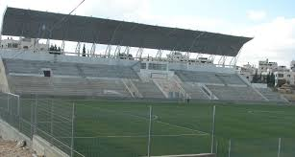
Introduction:
AL-Ram stadium (AL-Shaheed Faisal Al-Hussieny)

Slide 5
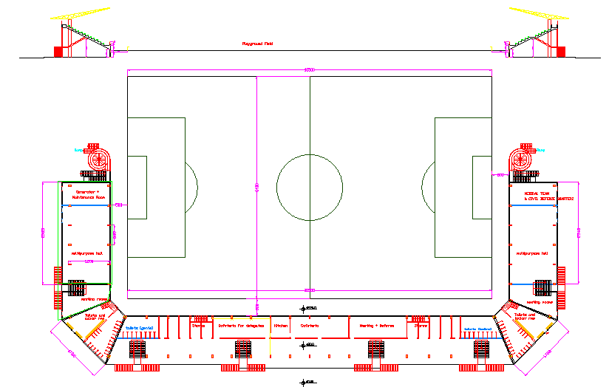
Project description:

Slide 6

Project description:
design the football stadium structurally.
As requested by Asera Al-shamaliya municipality

Slide 7
Methodology:
1
Plans
2
Design material
3
Structural Systems
4
5
6
Loads computations
Preliminary design
SAP2000 models
7
Check results

Slide 8

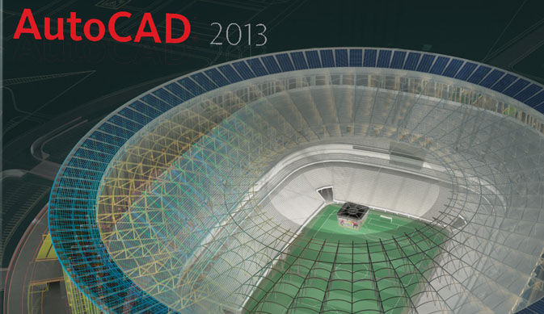


Tools:
Design Codes:

Slide 9
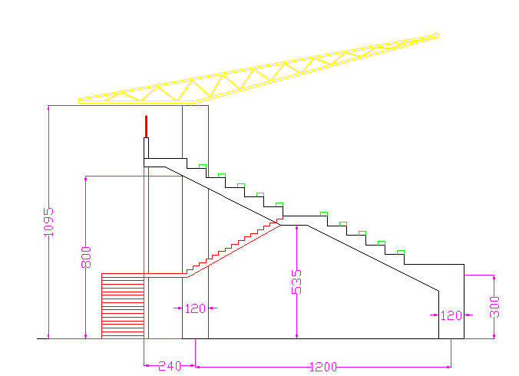
Structural parts:
Coverage
Amphitheaters

Slide 10
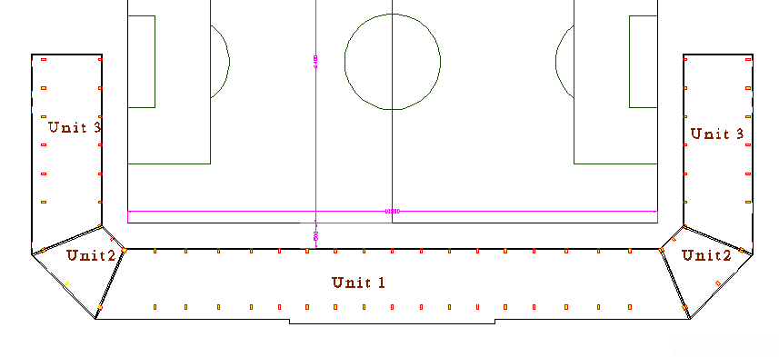
Cont..
Structure units:

Slide 11
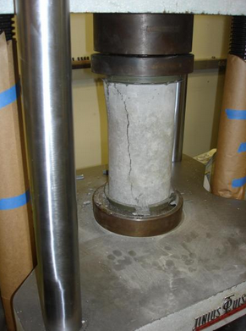
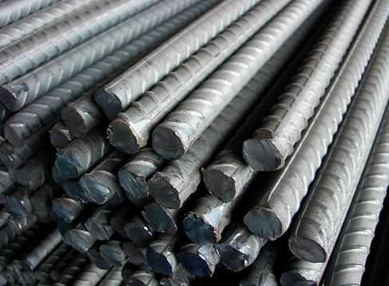
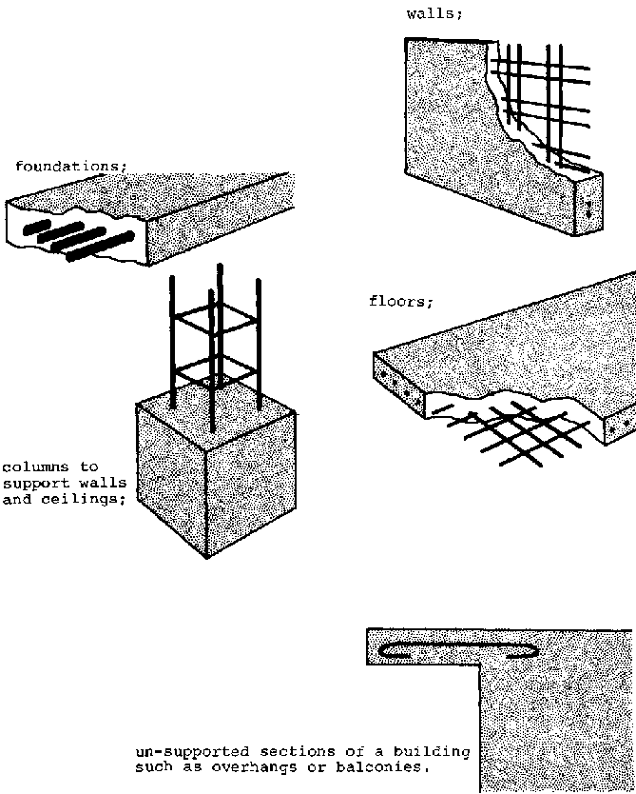
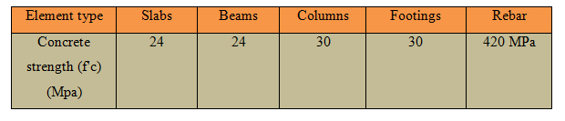
Design materials:
Amphitheaters

Slide 12
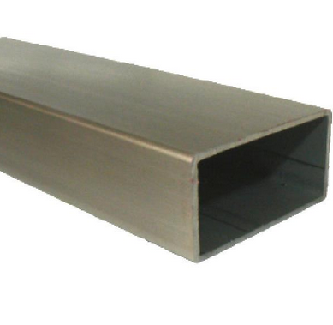
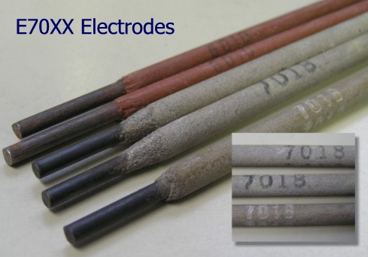
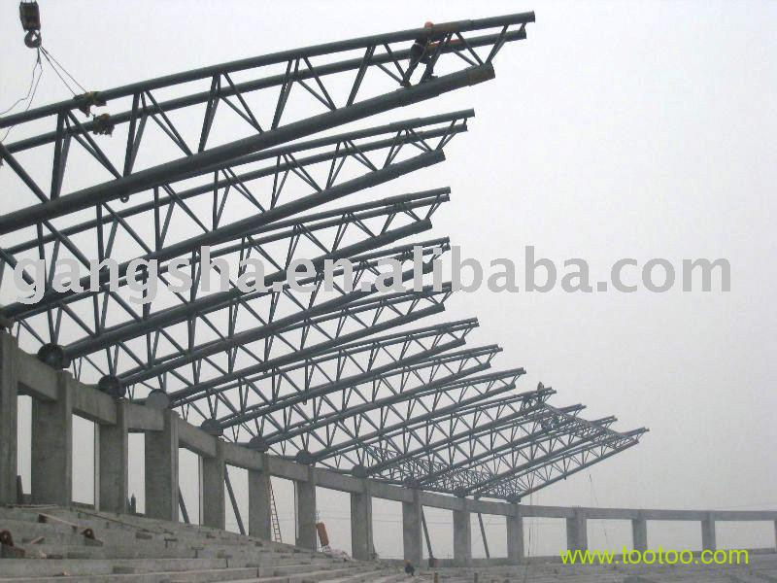
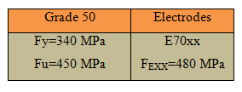

Design materials:
Steel Structures:

Slide 13
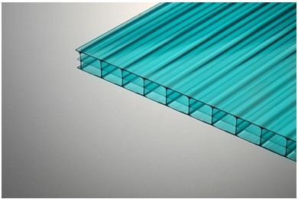
Coverage material:
Polycarbonate sheets

Slide 14
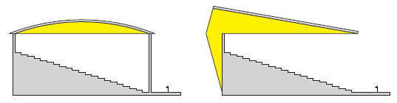
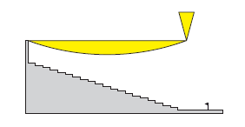
Cont..
Covering system:
Alternatives:
Curved truss
Simply supported truss
Cantilever truss systems
With cables system

Slide 15
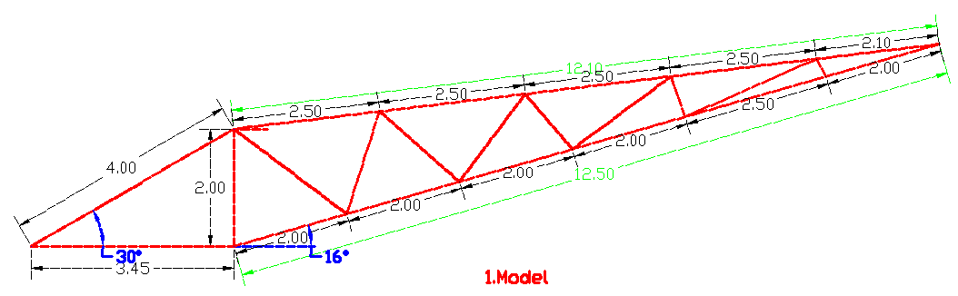
Cont..
Cantilever truss systems with cables

Slide 16
Cont..
Loads Computations
Steel structure
Load Type | Value of load(KN/m2)
Live load | 1.25
Wind load (Suction) | 0.47
Other loads(Dead) | Computed by SAP2000
Concrete structure
Load Type | Value of load(KN/m2)
Live load | 3
Other loads(Dead) | Computed by SAP2000

Slide 17
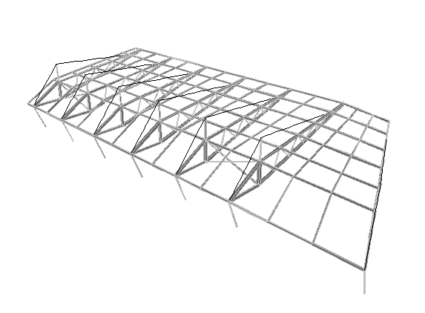
Cont..
Truss distributions (unit 1)

Slide 18
Cont..
Equilibrium Check
For Live and Wind loads
Load | Percent of error (%)
Live load | 0.23
wind load | 0.42
Load distribution Check
Load | Percent of error (%)
Live load | 4.85

Slide 19
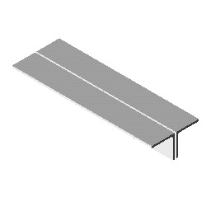
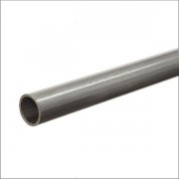
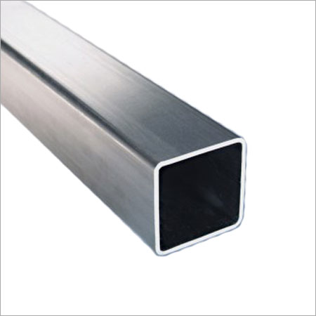
Cont..
Selected Section:
Selected section | Shape | Weight (KN)
Double angle |  | 713.24
Hollow circular section |  | 430.54
Hollow tube section |  | 430.85
hollow tube section for Purlins in all cases

Slide 20
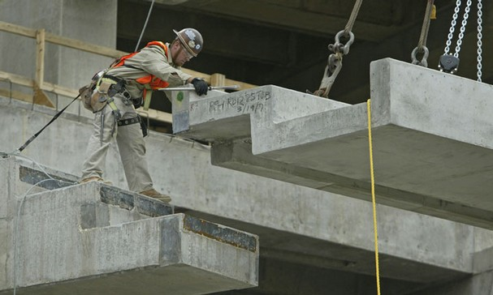
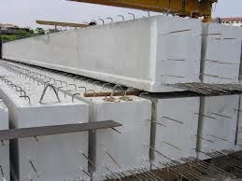
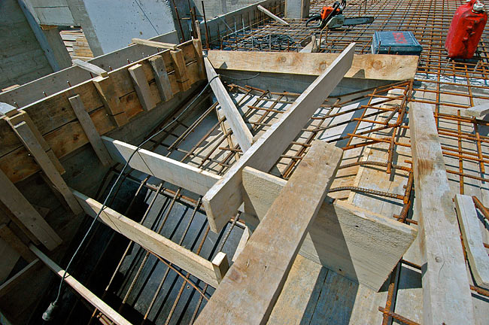
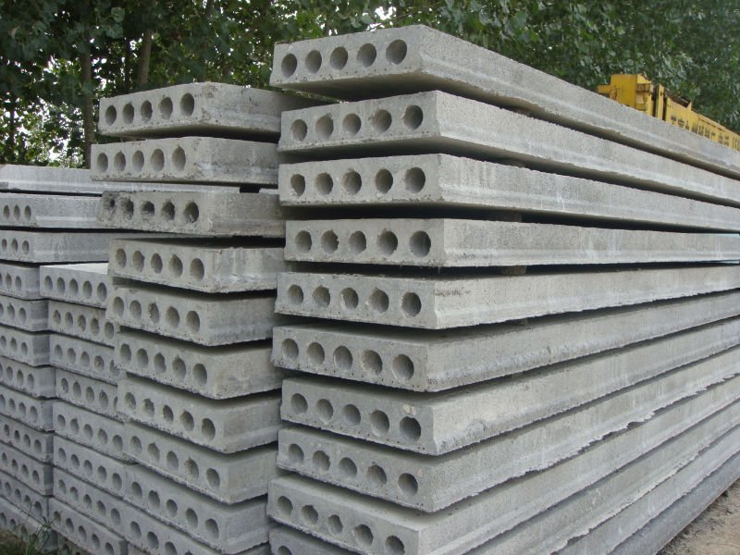
Concrete structure:
Alternatives:

Slide 21
Compatibility Check ( Block 1 )

Slide 22
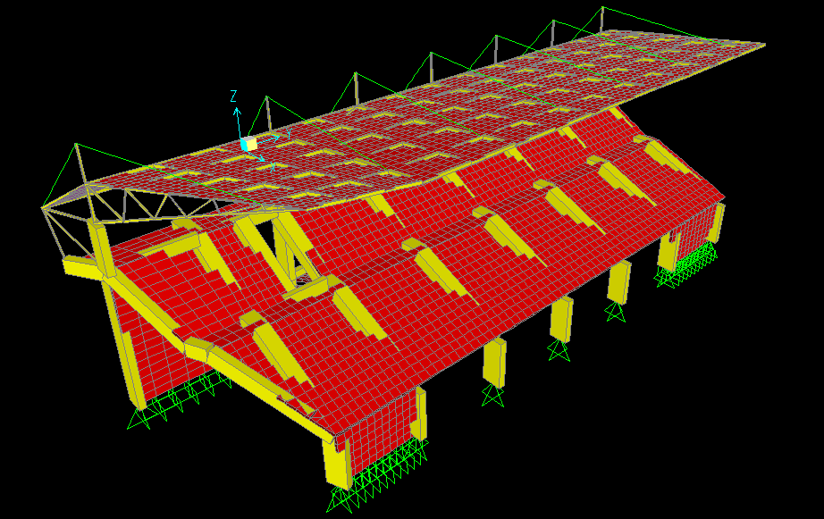
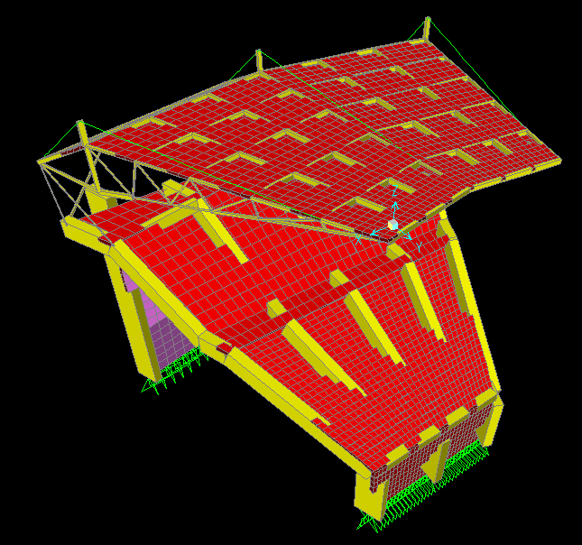
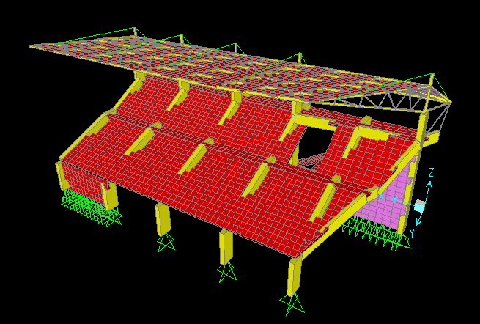
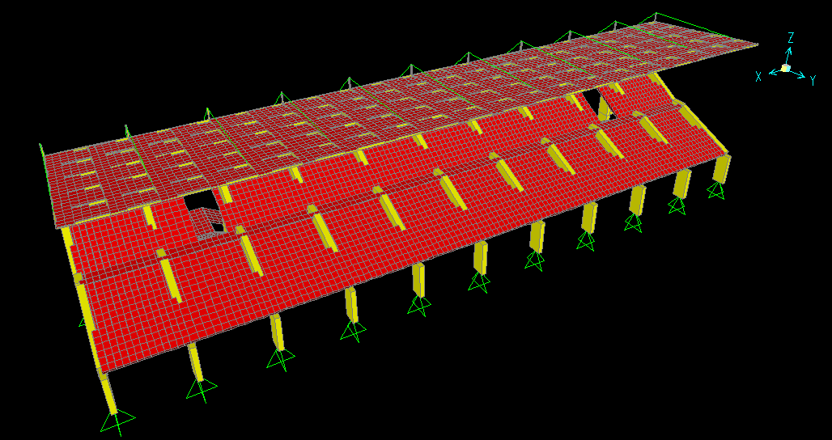
Ready SAP2000 models:
Unit one
Unit two
Unit three A ( 3 )
Unit three B ( 4 )

Slide 23
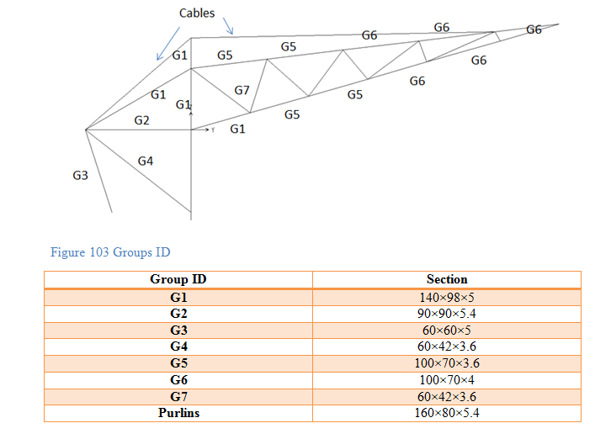
Steel results:

Slide 24
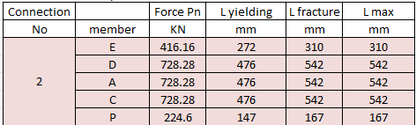
Connections
Thickness of gusset plate = 5 mm
Ag=thickness × Length of plate’s side
Based on yielding=Pu/(0.9×Fy)
Based on Fracture=Pu/(0.6×Fu)
Weld length = Pn/(0.707×a×0.6×F_{EXX})

Slide 25
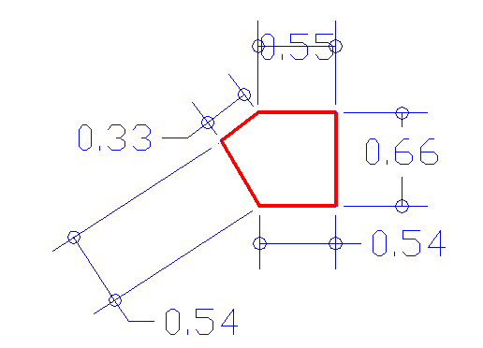
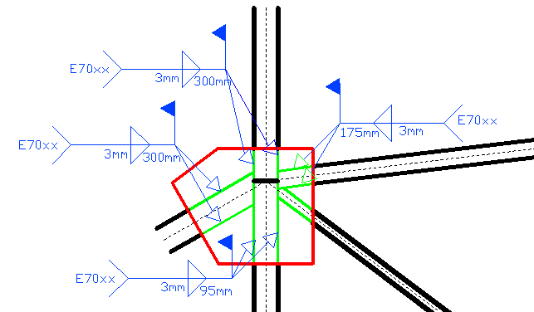
Connection no. two

Slide 26
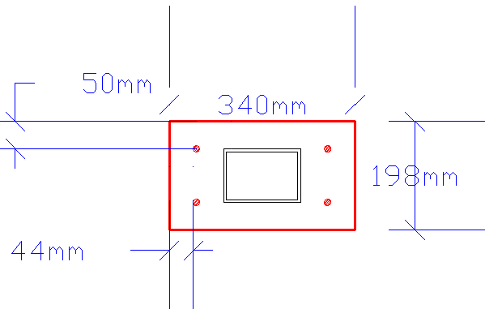
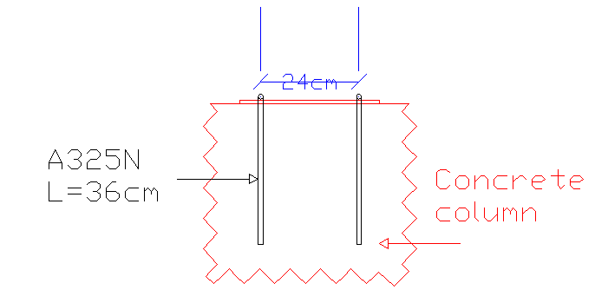
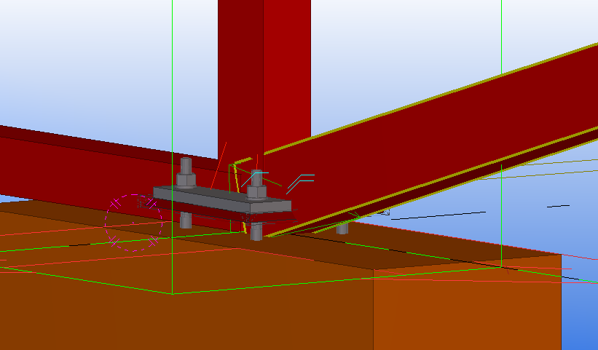
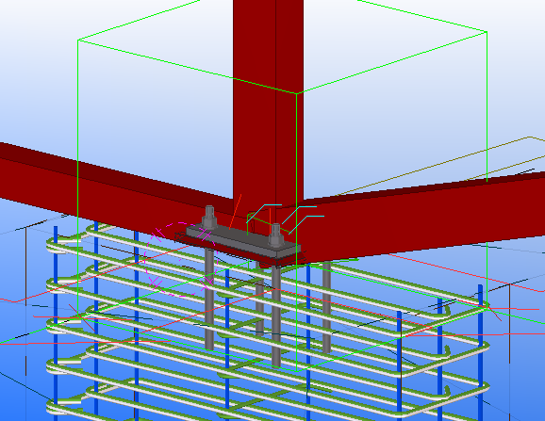
Base plate and bolts distribution:
d bolts = 12 mm

Slide 27
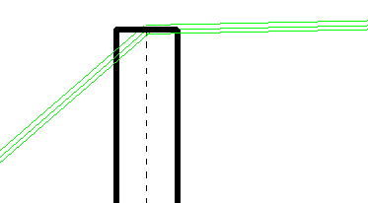
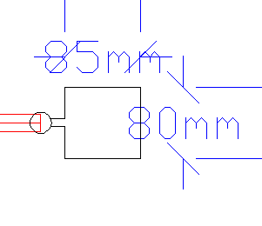
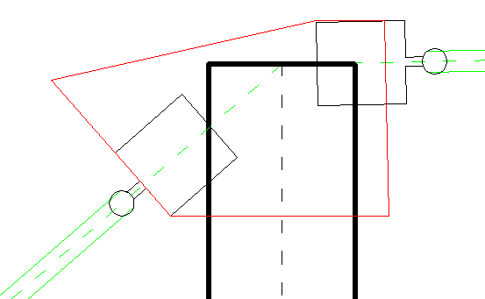
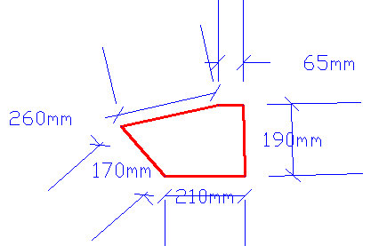
Connection no. fourteen

Slide 28
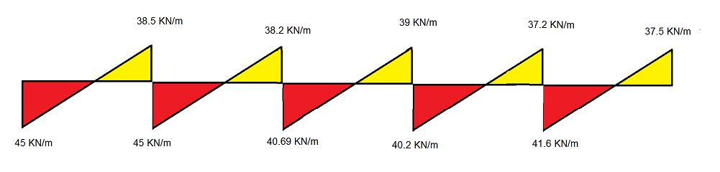
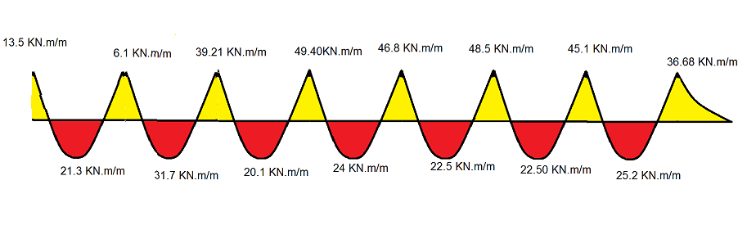
Concrete Structures Results:
Slab:
Block one “ spans 5.35m”
S.F.D.
B.M.D.

Slide 29
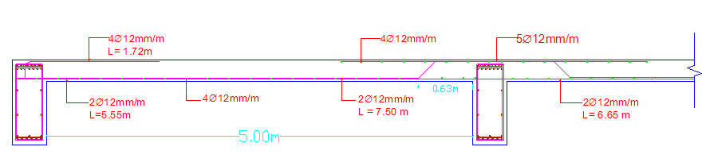
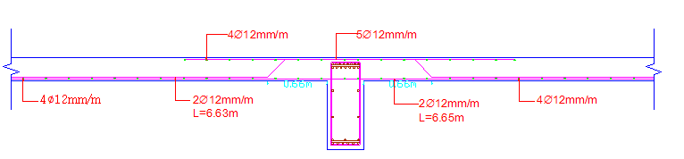
Slab detailing:

Slide 30
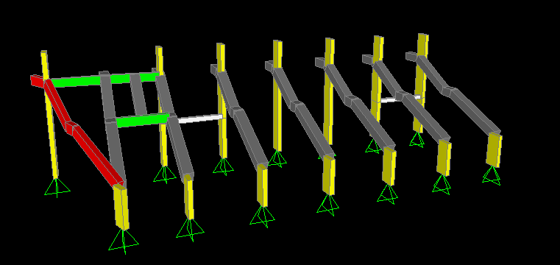
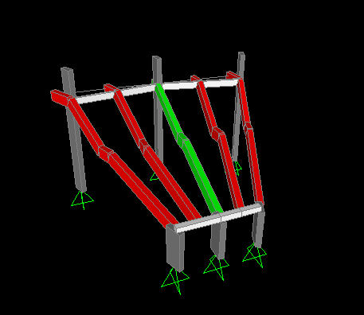
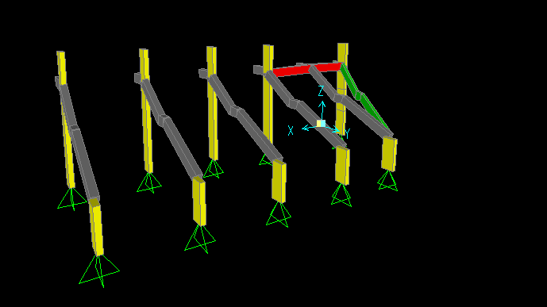
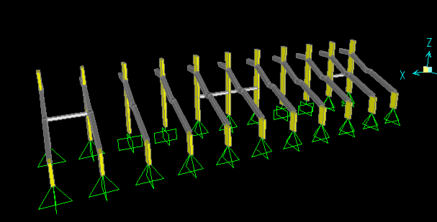
Concrete Structures:
Beams:
Unit one
Unit two
Unit three
Unit four

Slide 31
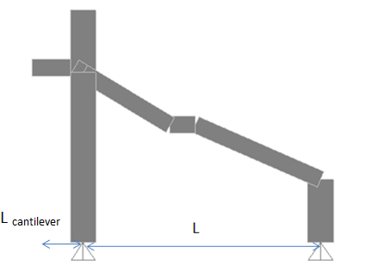
Concrete Structures:
Beams:
Beam | L | h min | Lcant | h min | h used | b
1 | 11.2 m | 605 mm | 2.2 m | 275 mm | 800 mm | 400 mm
2 | 12.17m | 657 mm | 2.2 m | 275 mm | 1000 mm | 400 mm

Slide 32


Concrete Structures:
Beams:
B.M.D. beam 2
S.F.D. beam 2

Slide 33

Concrete Structures:
Beams:
Arrows indicate :two layers been used.

Slide 34

Concrete Structures:
Beams:

Slide 35


Concrete Structures:
Beams:
Av/s(Total)=1.087 mm²/mm, stirrups diameter 10mm, with two legs, the spacing equals= 144 mm, used 140 mm=14cm.

Slide 36



Concrete Structures:
Columns:
Ψ = $\frac{{∑(\frac{EI}{L})}_{c}}{{∑(\frac{EI}{L})}_{B}}$
Q (stability index) = $\frac{\sum{Pu×∆}}{Vus×Lc}$
= 31.75 <34

Slide 37



Concrete Structures:
Columns:

Slide 38

Concrete Structures:
Footings:
Q allowable soil = 300 KN/m²
= 3 Kg/cm²

Slide 39



Concrete Structures:
Footings:

Slide 40


Concrete Structures:
Footings: F4

Slide 41


Concrete Structures:
Stairs:

Slide 42



References:

Slide 43

Thank you ..
Questions

Slide 44



Cont..
Concrete structure:
Unite 1
Unite 2
Unite 3

Slide 45


Slide 46



Slide 47


Slide 48


Slide 49


Slide 50



Slide 51


