Slide 1


An-Najah National University
Management system for Sard Chocolate Company
A management system for Sard Chocolate, covering factory operations, manufacturing, manage stock, sales, employees and trader interactions.
Supervisor: Dr. Kamal Irshaid

Slide 2

Introduction
A comprehensive management system for Sard Chocolate Company designed to improve efficiency and productivity by optimizing and integrating inventory, sales, and distribution processes. The system facilitates seamless coordination between departments and enhances the organization of daily operations

Slide 3
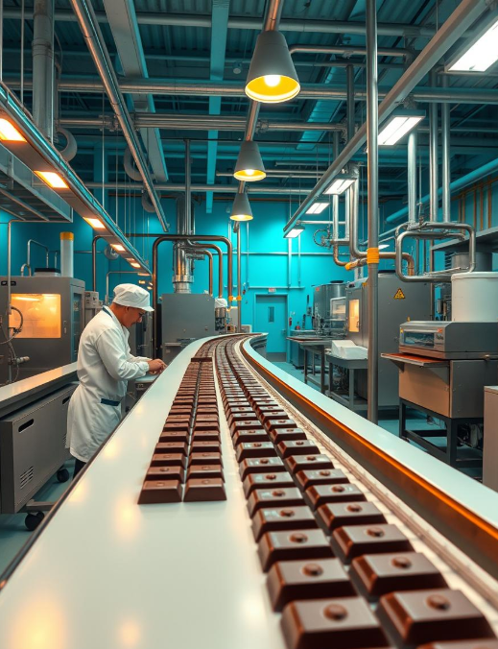
Challenges in the old system
  Inventory Management
  Challenge: Difficulty in tracking quantities and recurring errors using paper records or Excel sheets.
  Solution: Automate inventory updates with alerts for low stock or expired products.
  Exhibition Sales
  Challenge: Delays in generating invoices and manually recording sales.
  Solution: Quickly generate electronic invoices and provide reports on monthly performance and top-selling products.
  Factory and Exhibition Integration
  Challenge: Difficulty in linking manufacturing with exhibition orders and production delays.
  Solution: Synchronize orders with production and set a schedule based on demand.

Slide 4
Challenges in the old system
  Employee and Leave Management
  Challenge: Errors in leave calculations and difficulty managing documents.
  Solution: Automate leave calculations and allow document submissions through a dedicated interface.
  Performance Reports and Decision-Making
  Challenge: Lack of accurate reports for informed decision-making.
  Solution: Provide periodic statistical reports showcasing financial and operational performance to facilitate decision-making.
  Customer Experience
  Challenge: Delays in fulfilling orders and difficulty in tracking them.
  Solution: Offer an interface for customers to track their orders directly and improve response times.

Slide 5





System Objectives
Improve inventory management
Integrate factory operations with store sales
01
02
Simplify employee leave management
Enhance customer experience and order management
Create a system for easy generation and review of invoices
03
04
05

Slide 6





Programming Languages Used in System Development

Slide 7



System Workflow

Slide 8
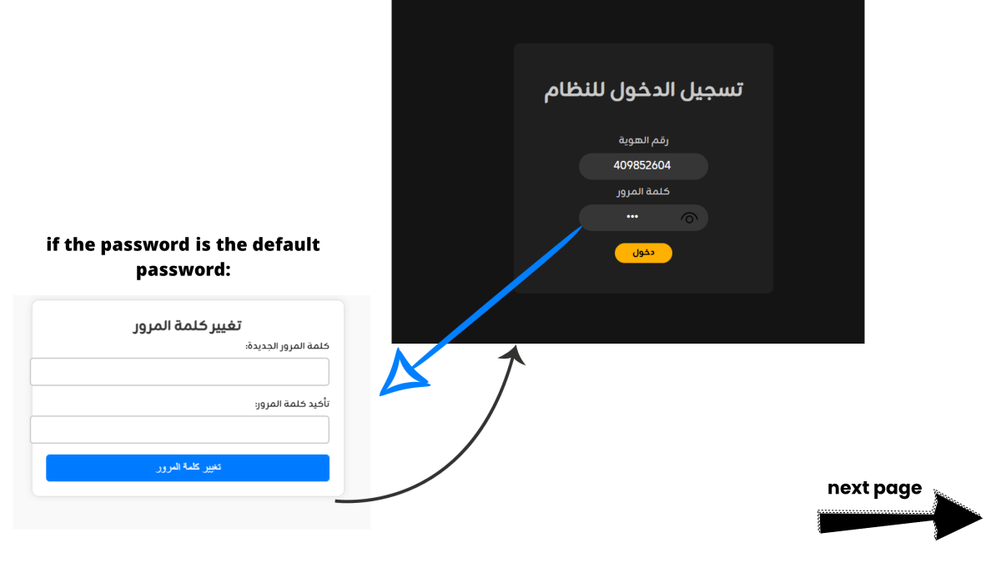

Slide 9
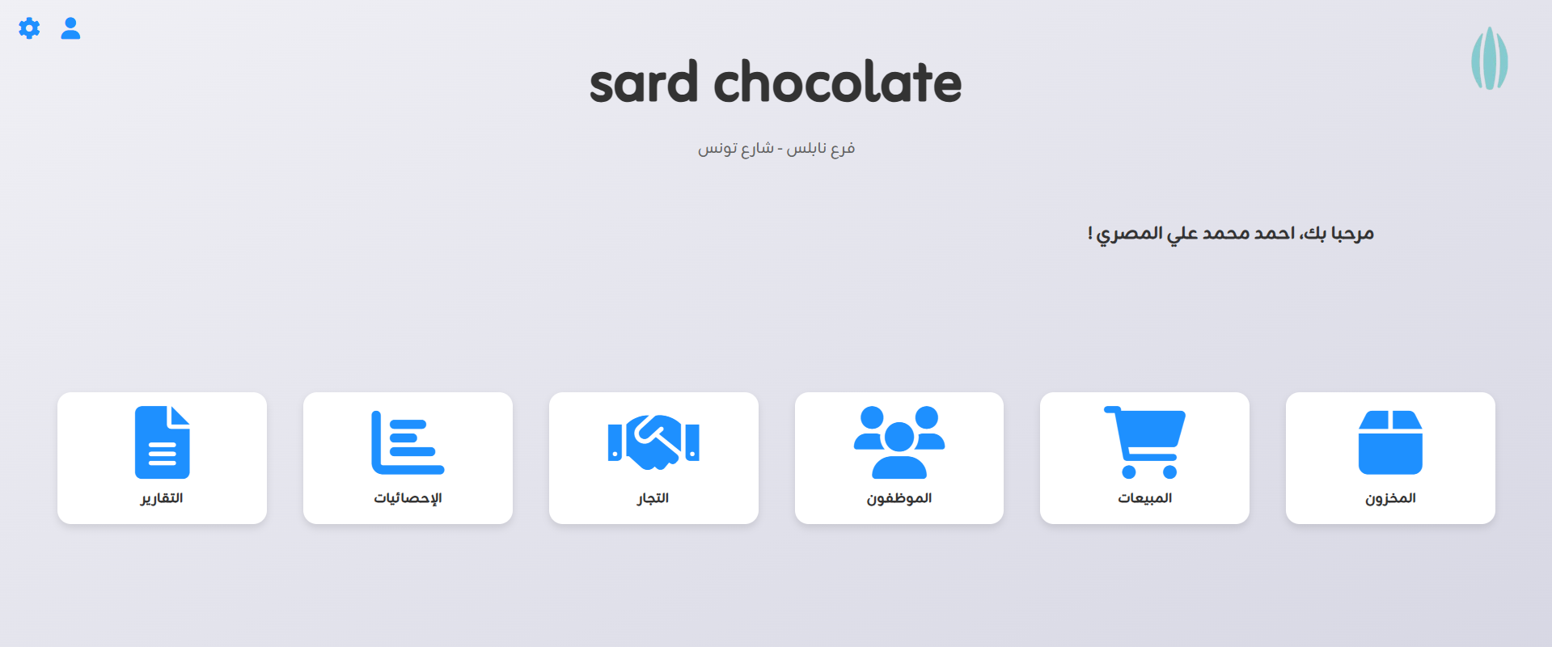
Exhibition Director

Slide 10
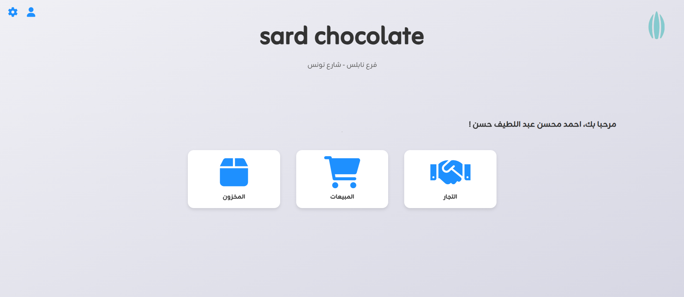
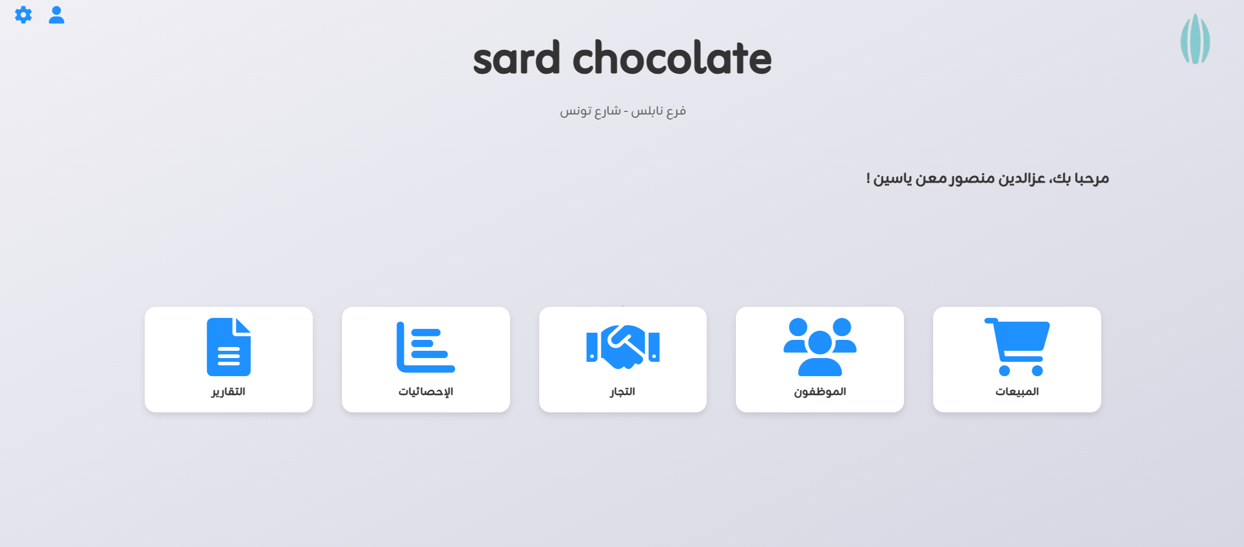
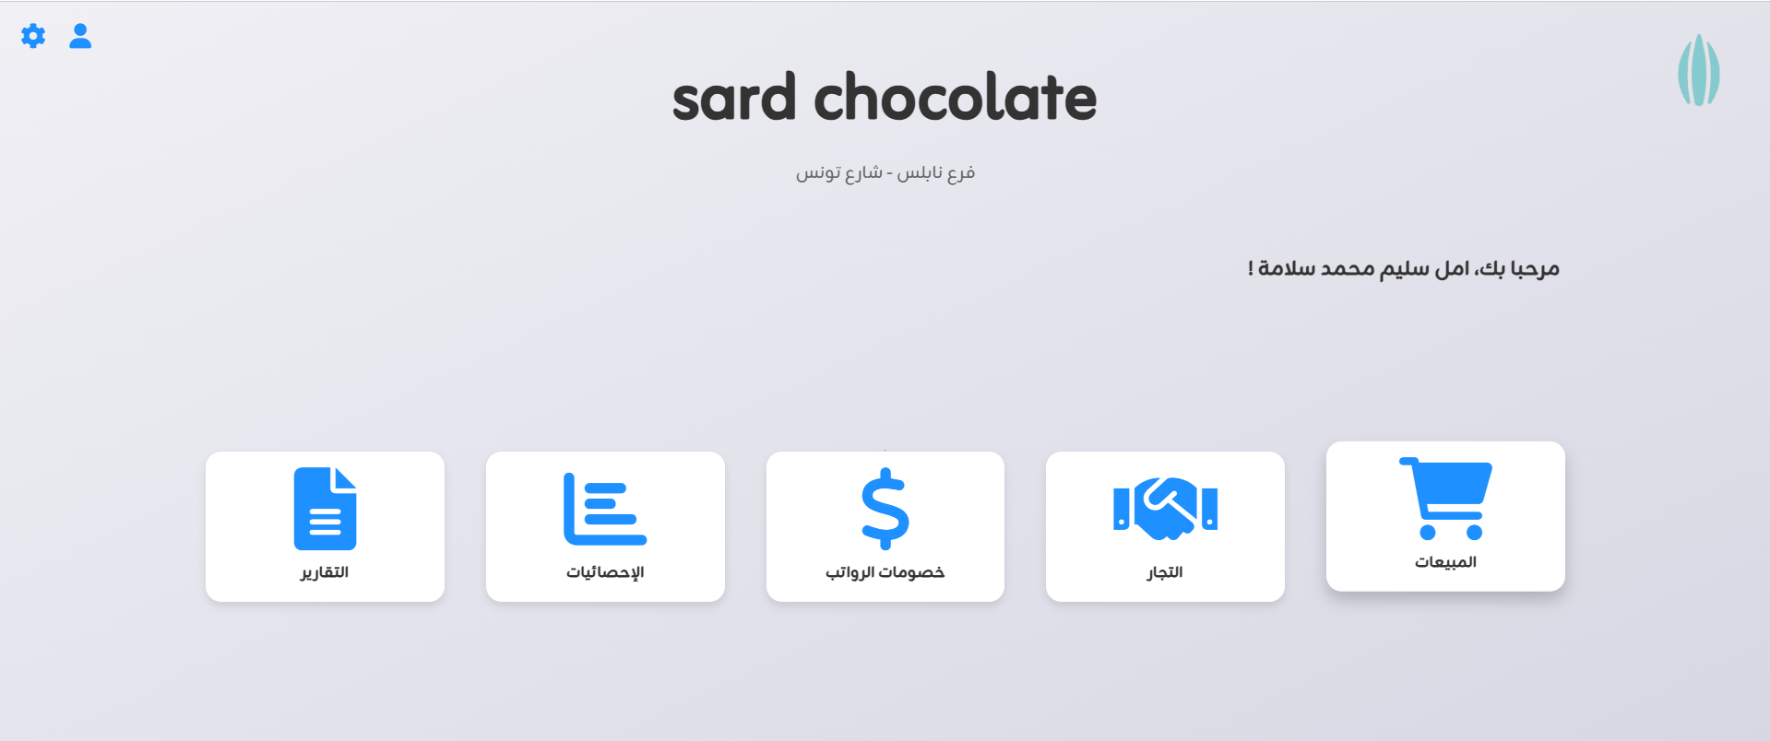
Sales staff
Financial Manager
Accountant

Slide 11
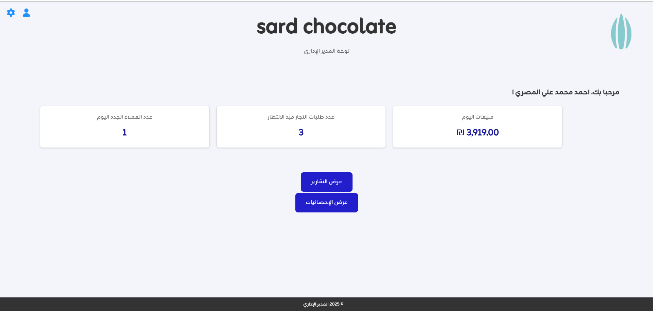
Administrative Manager

Slide 12
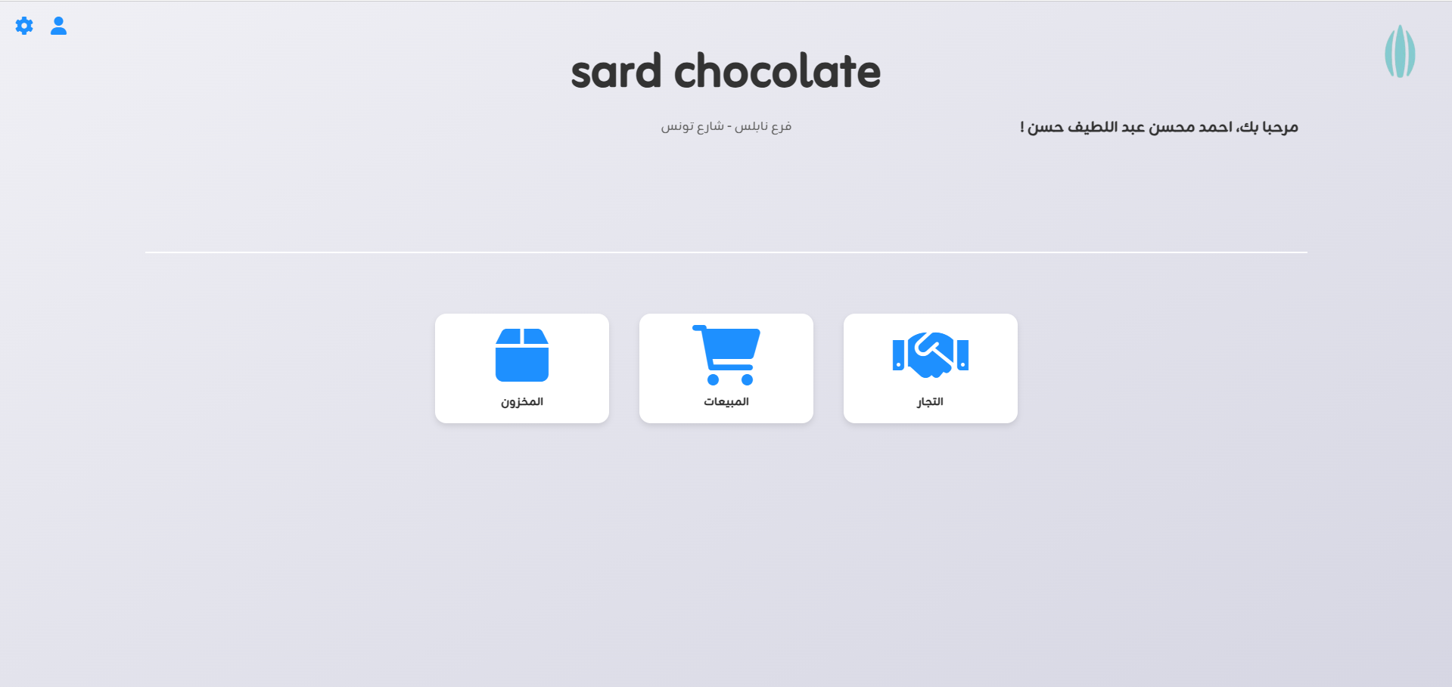

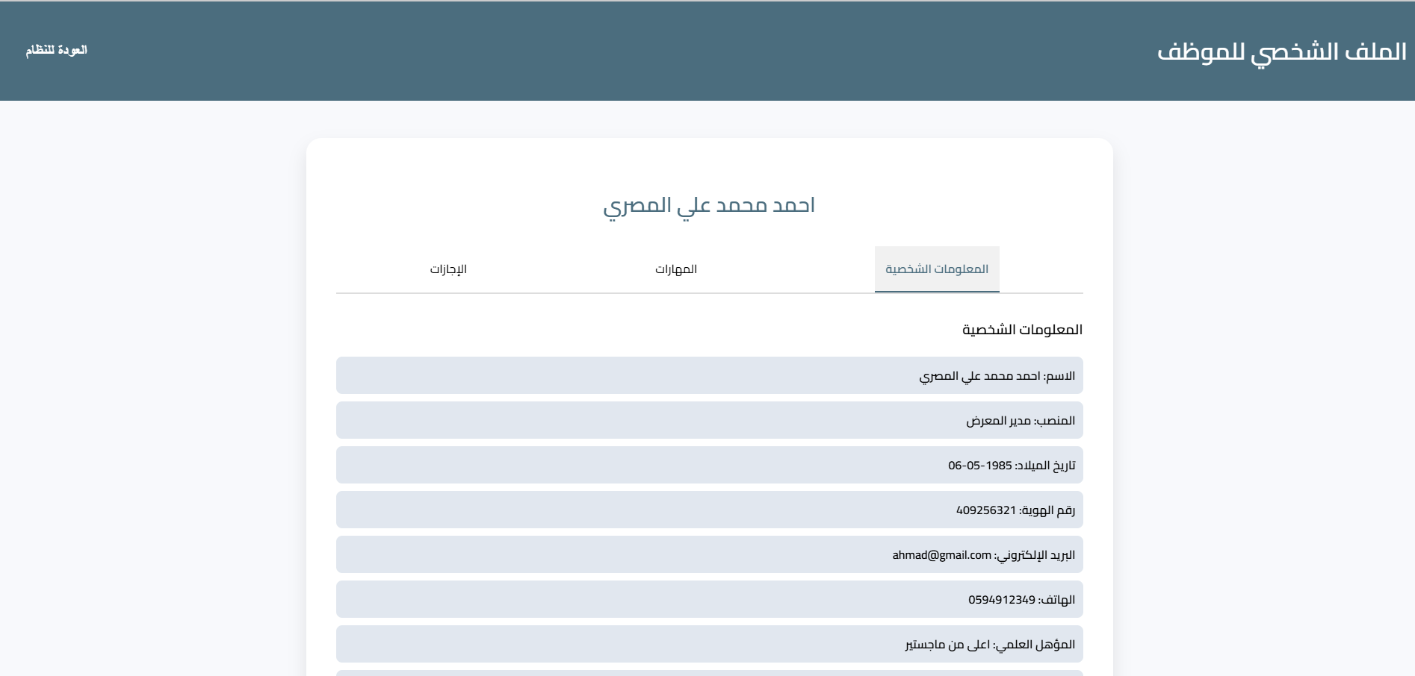


Slide 13
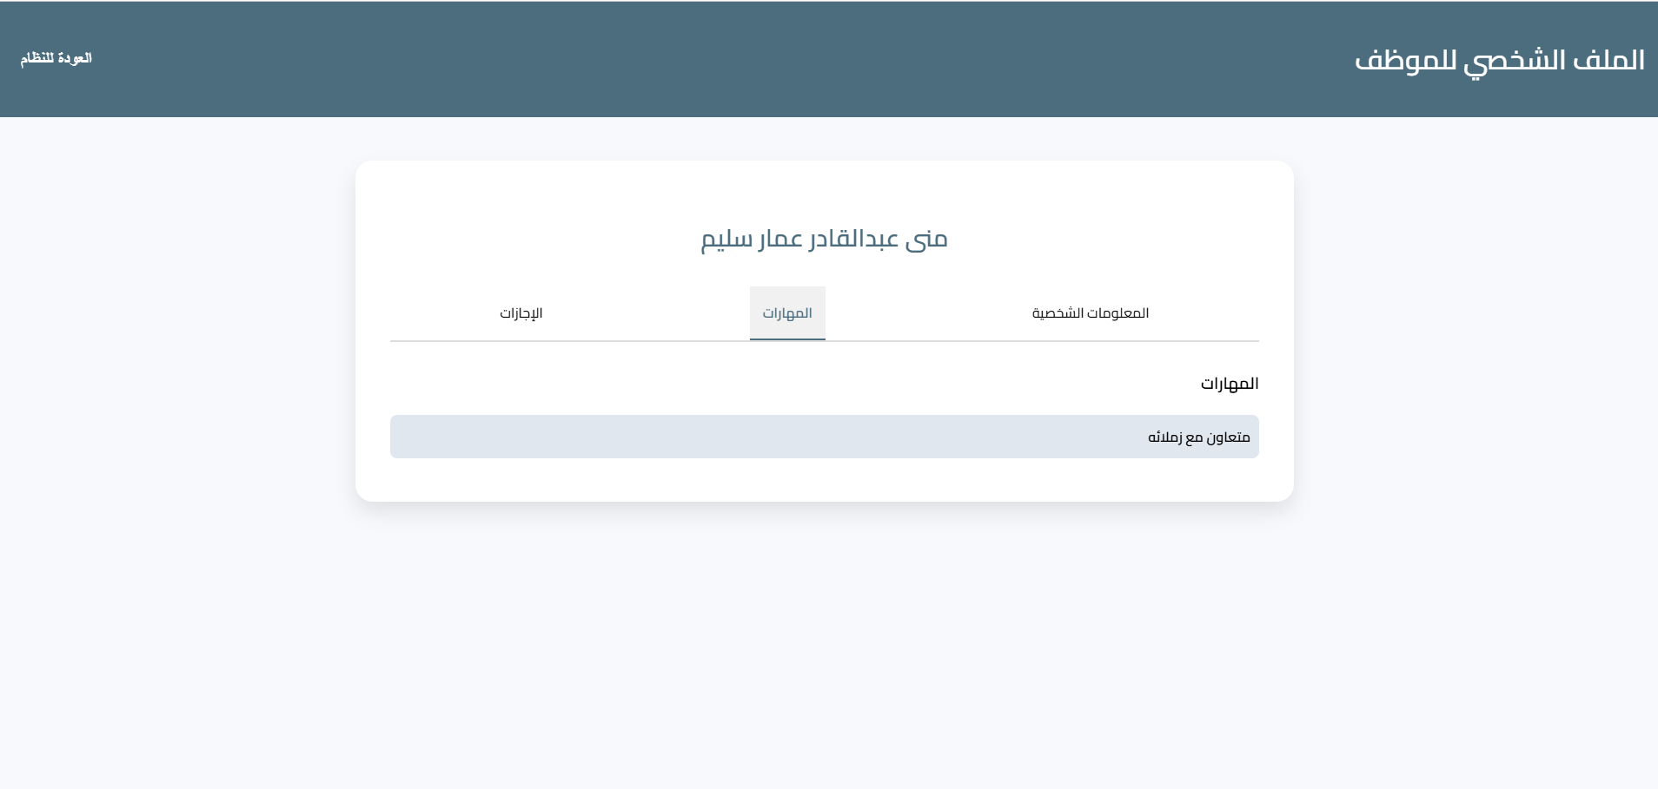

Slide 14
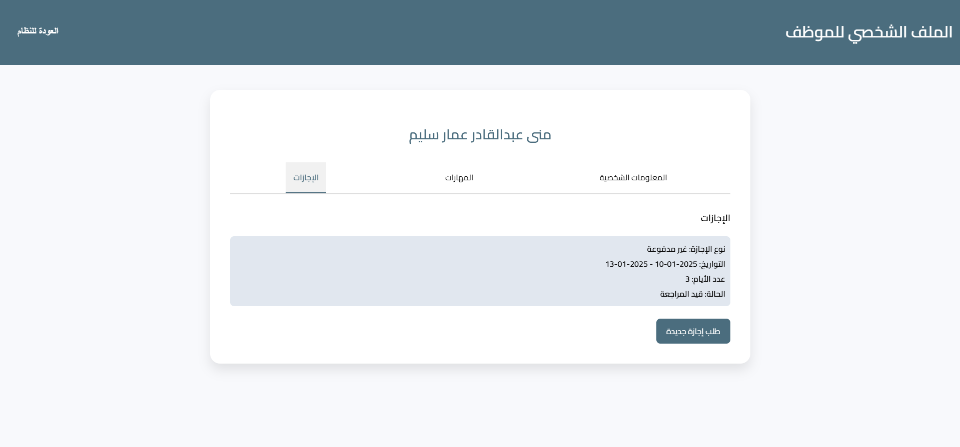

Slide 15
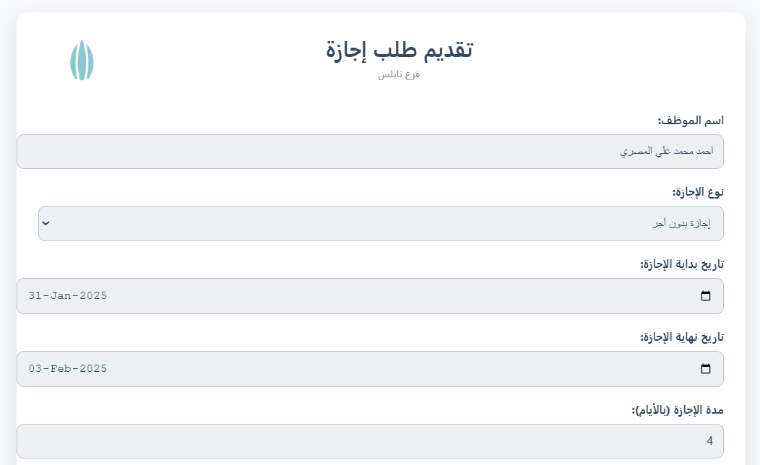
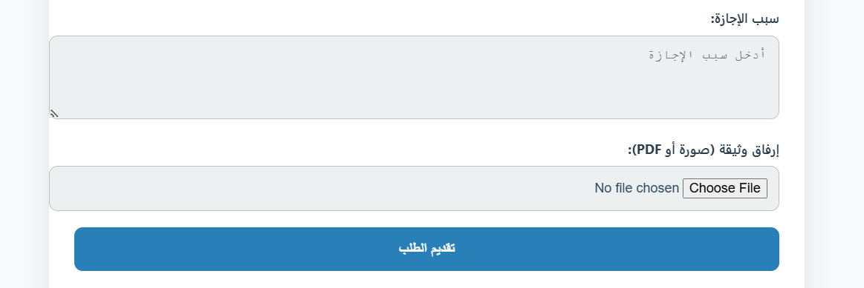

Slide 16
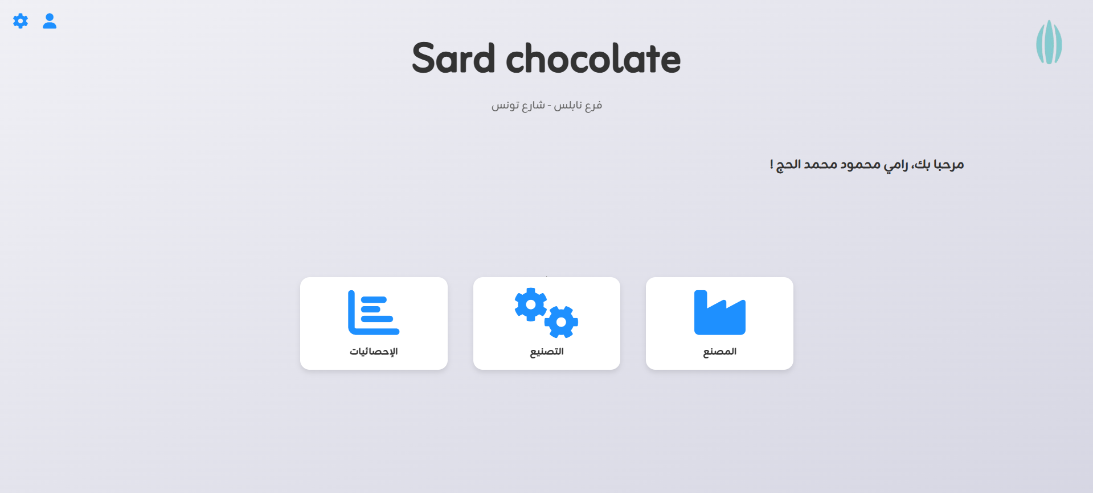
Manufacturing staff

Slide 17
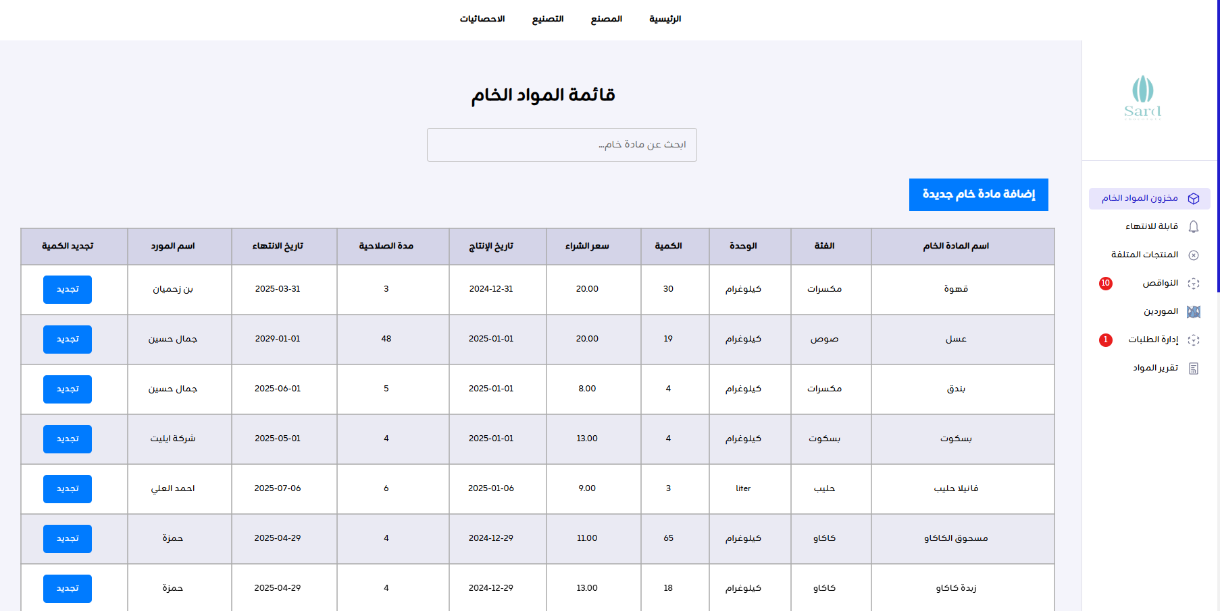

Slide 18
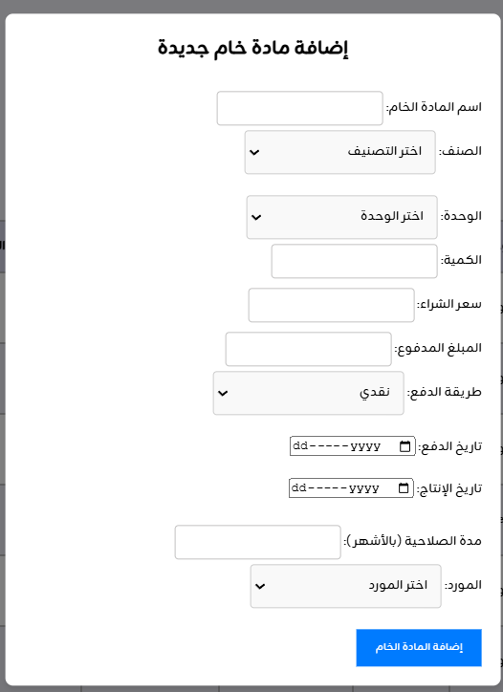
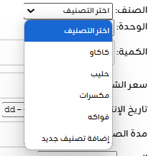
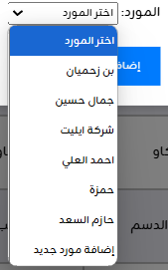

Slide 19
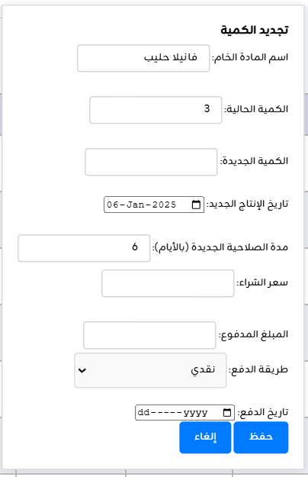
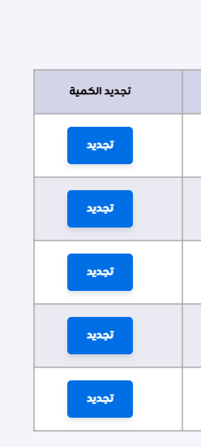

Slide 20
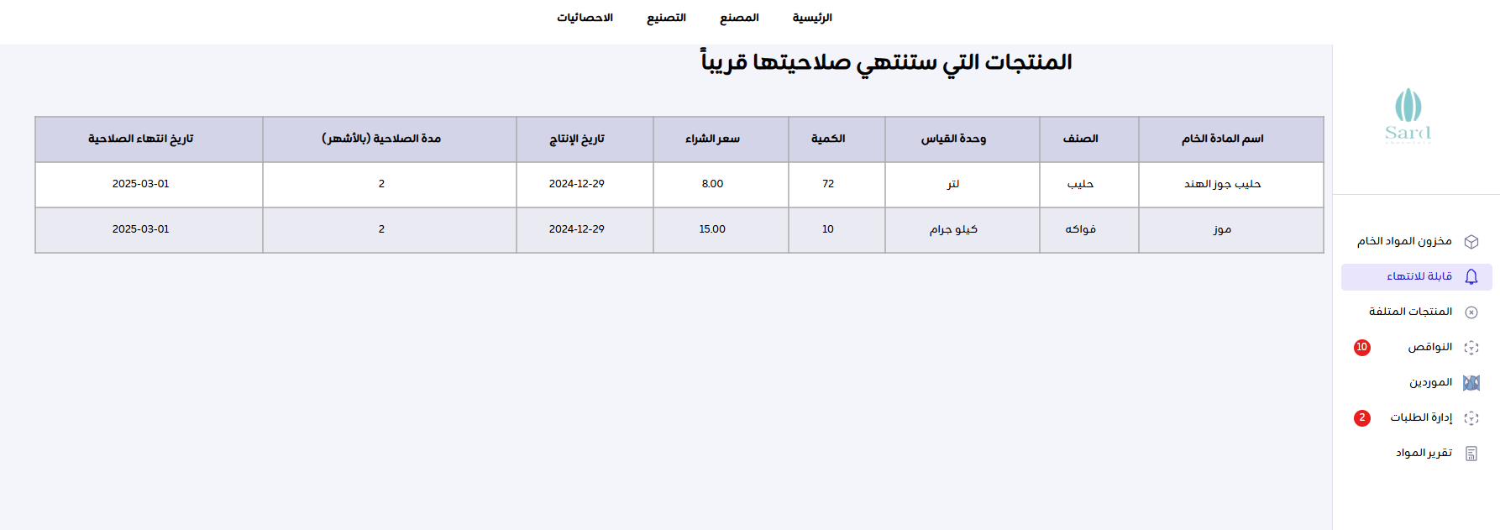

Slide 21
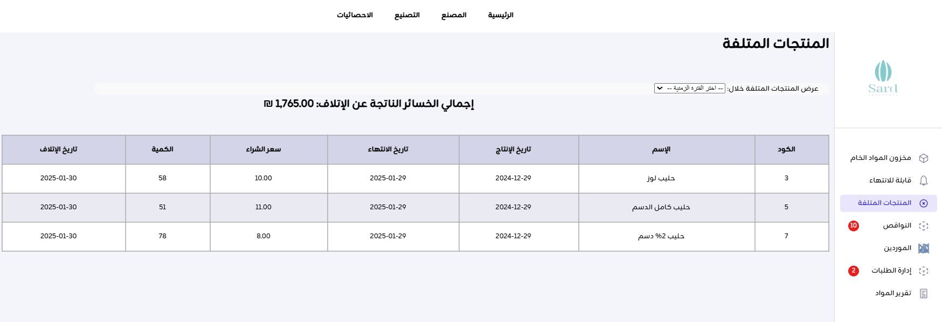

Slide 22
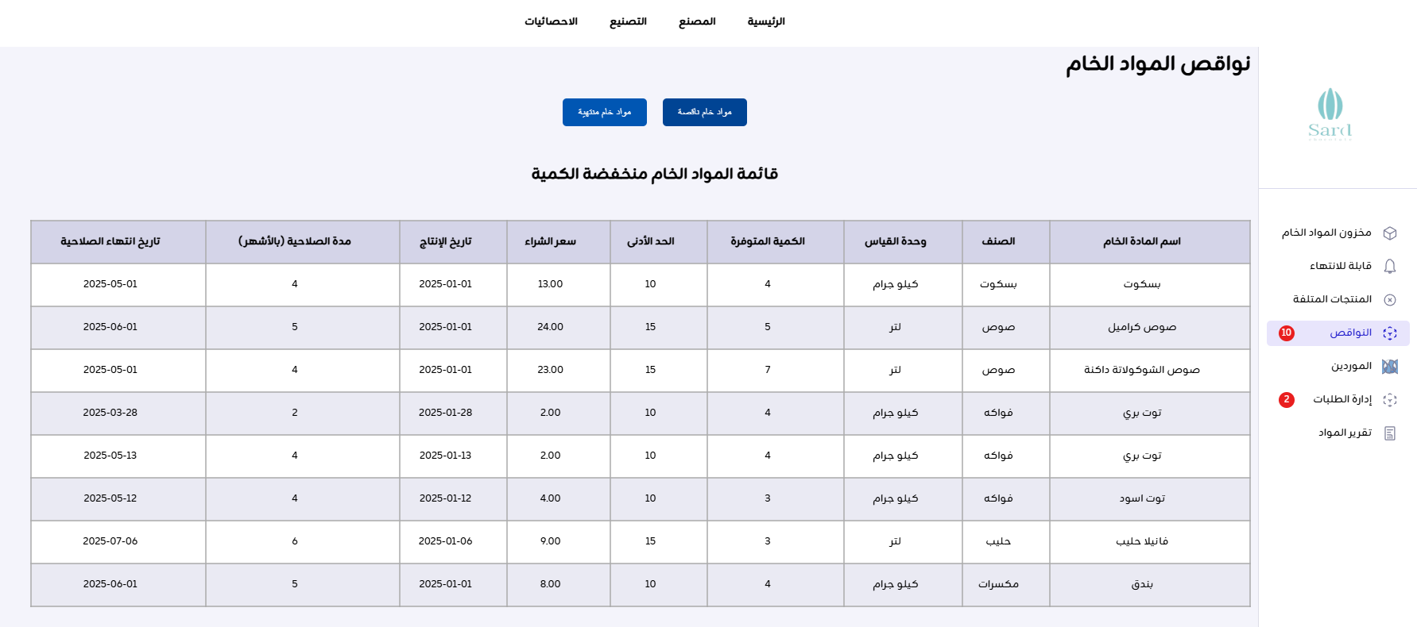
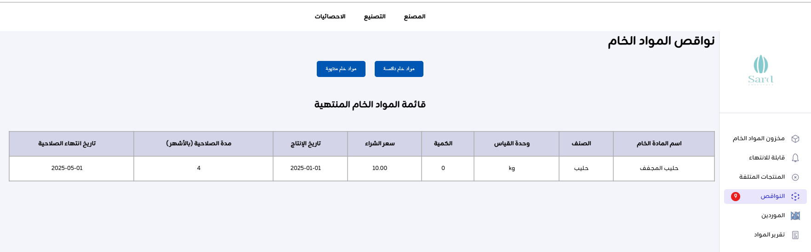

Slide 23
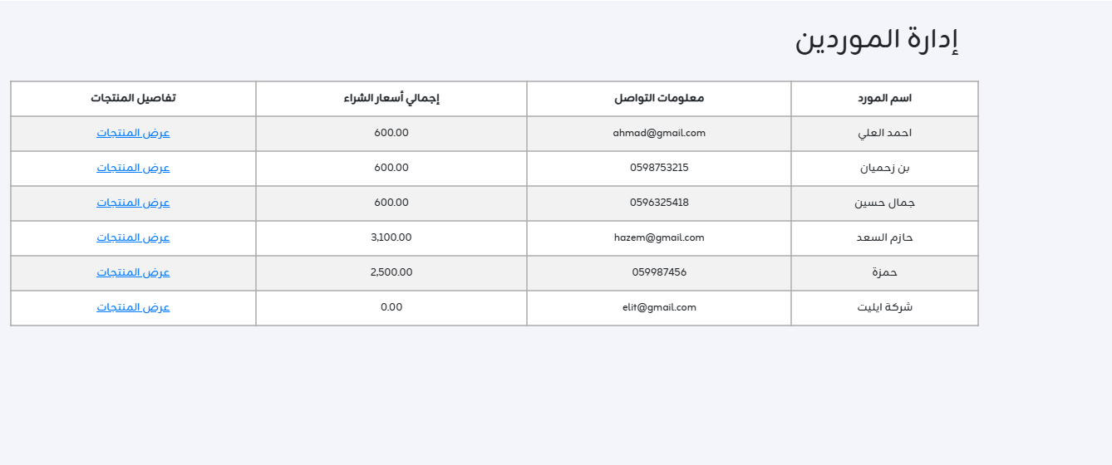
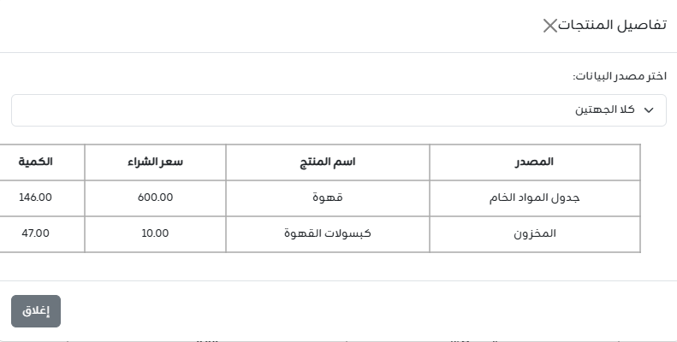
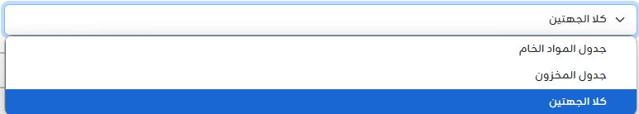

Slide 24
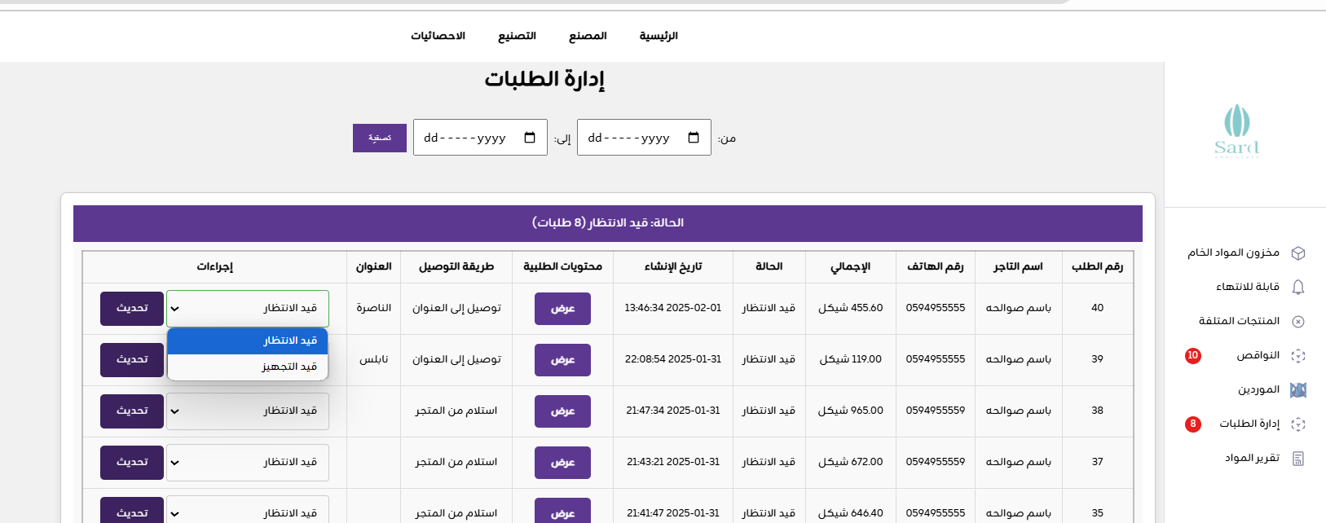
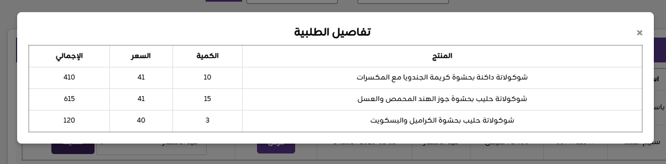

Slide 25
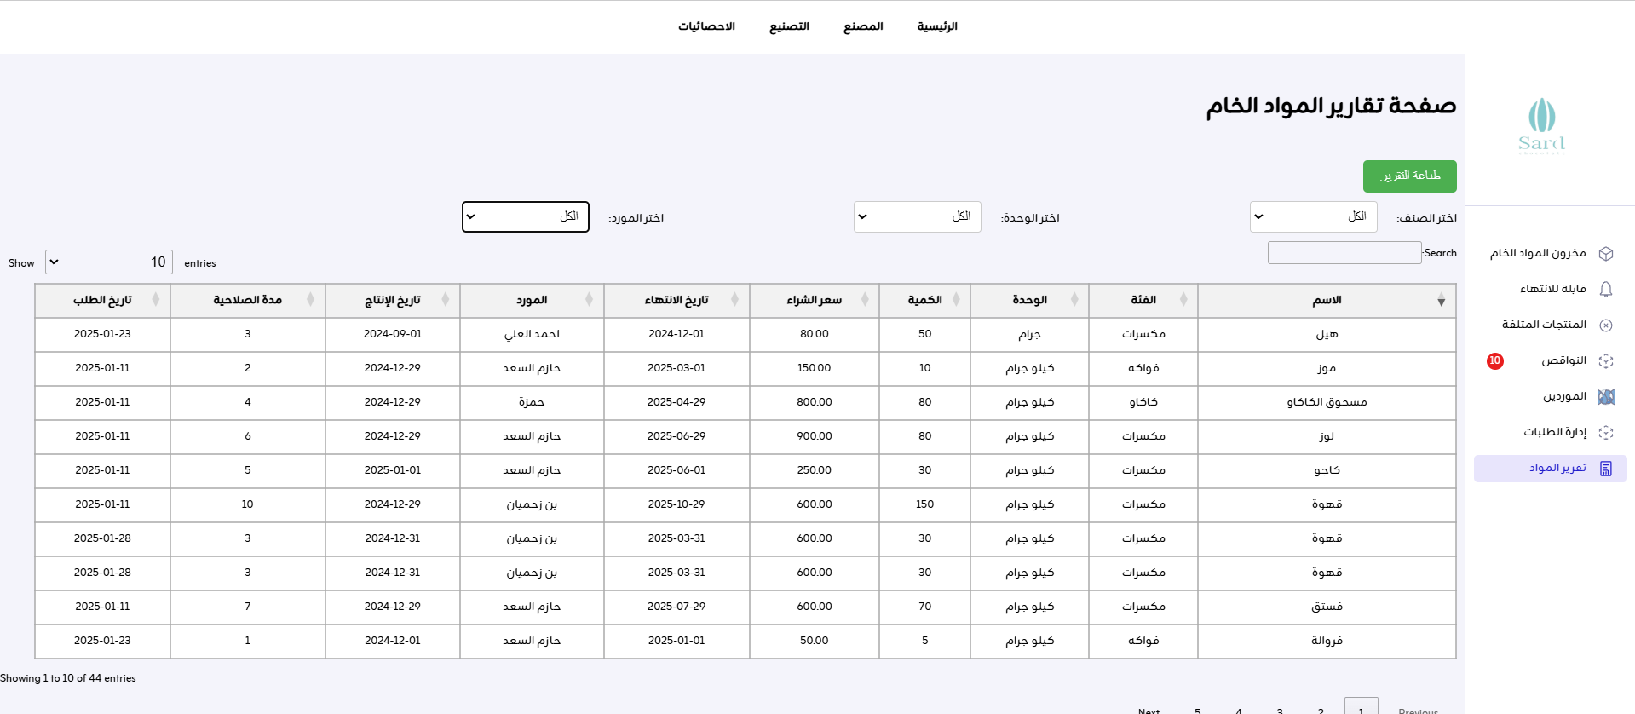

Slide 26
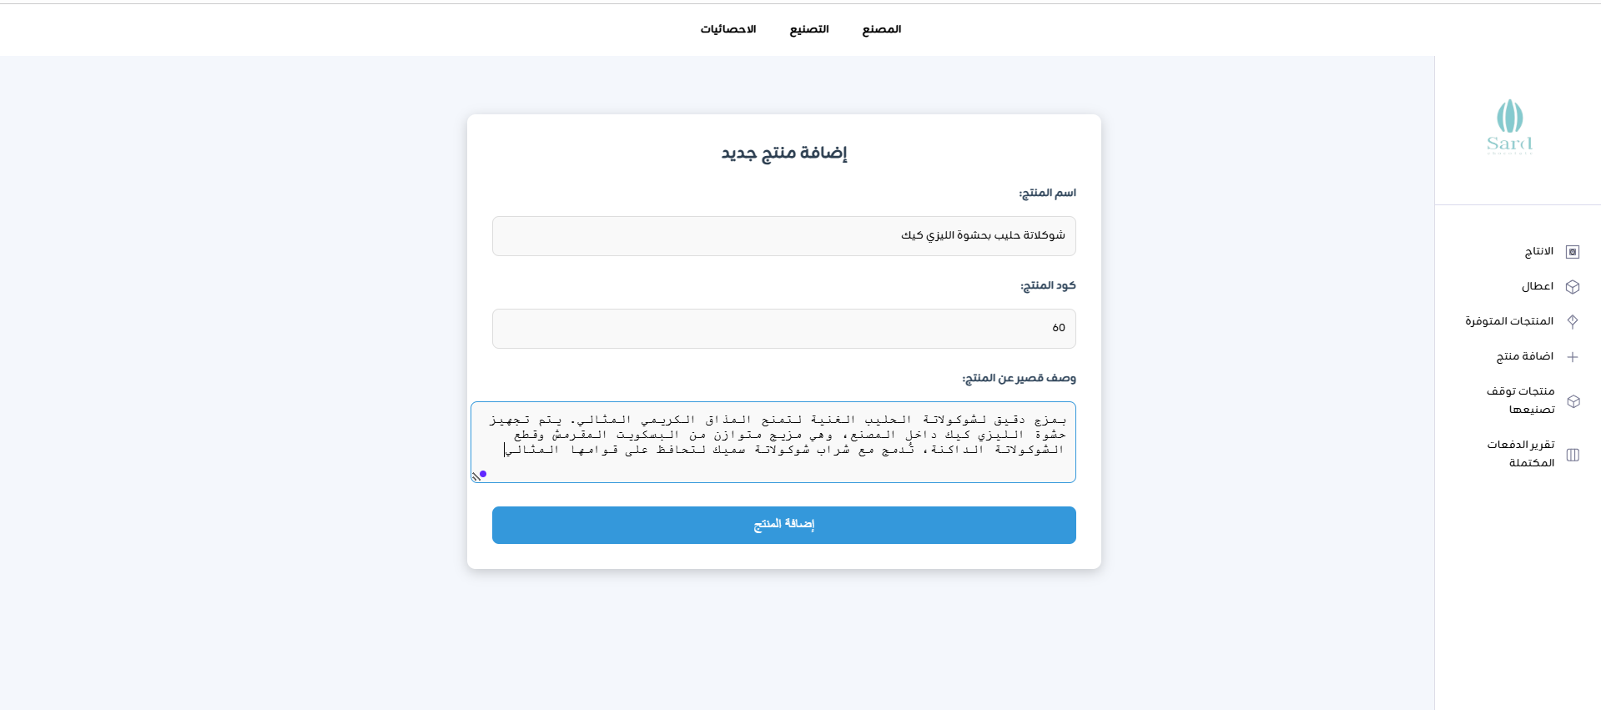
Add a new product to be manufactured

Slide 27
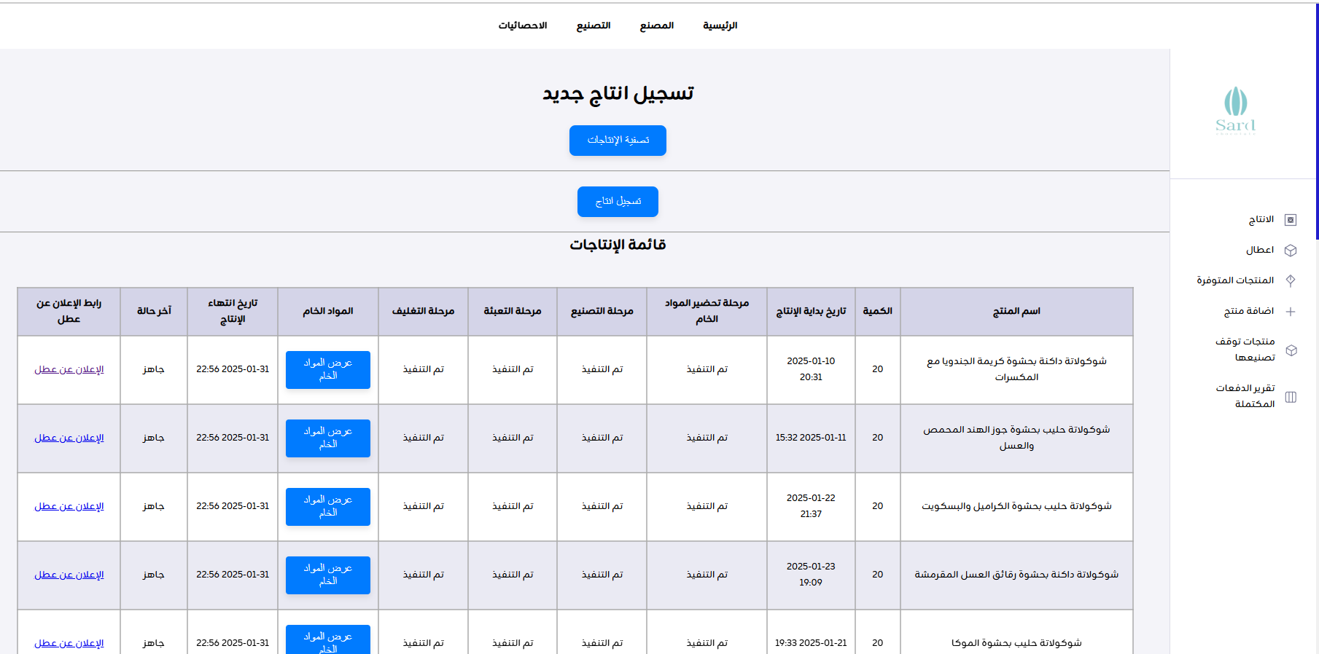

Slide 28
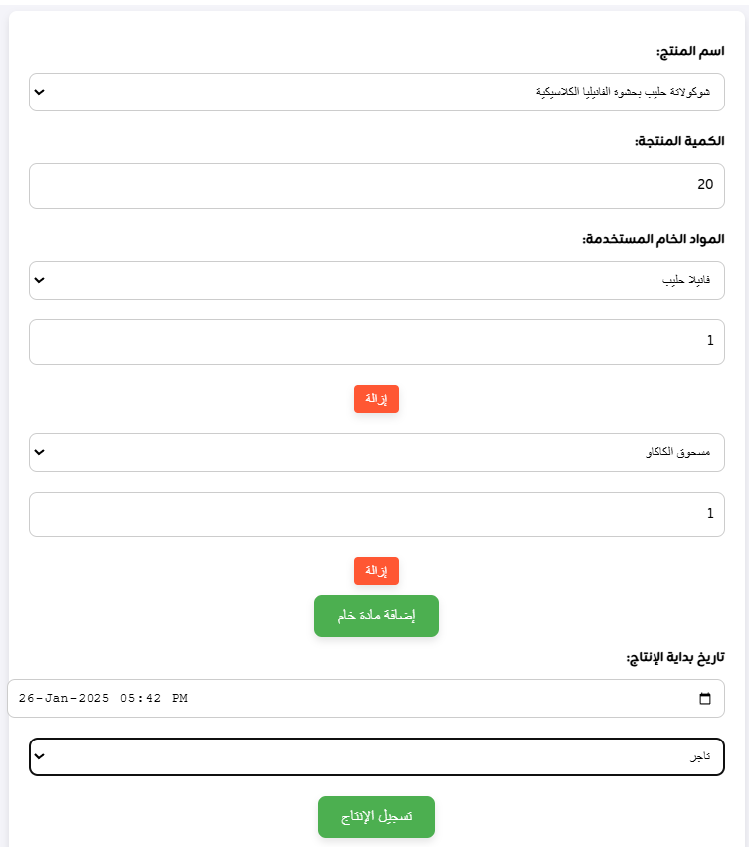

Slide 29

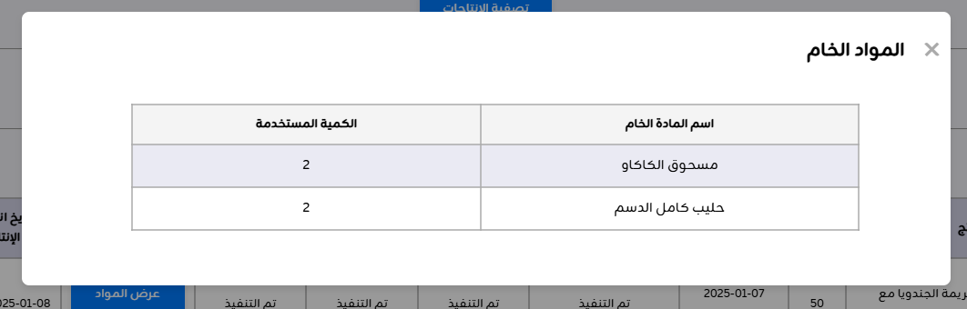

Slide 30
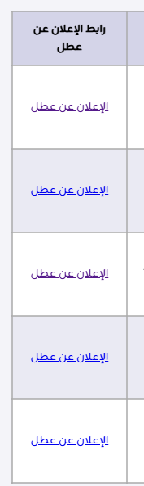
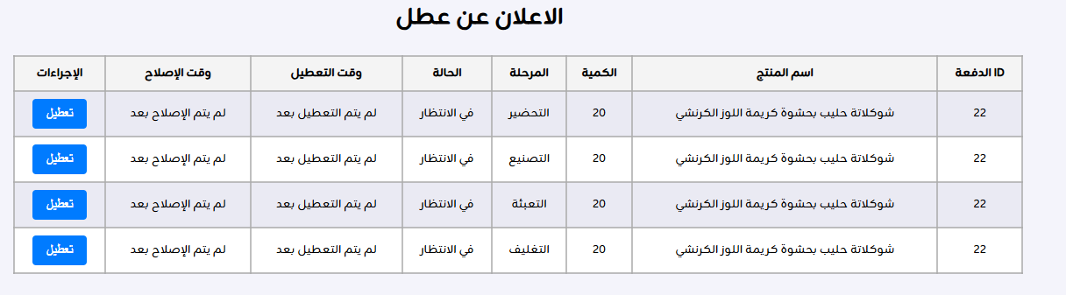
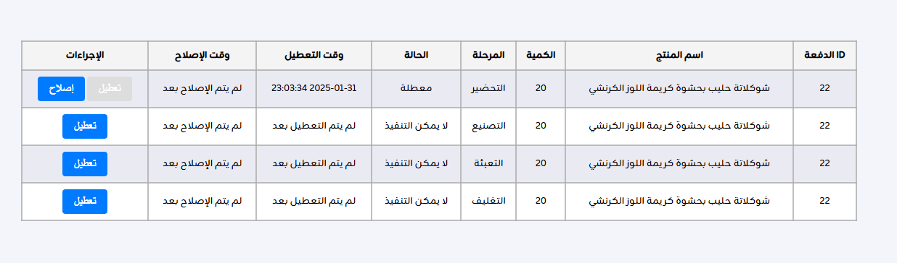

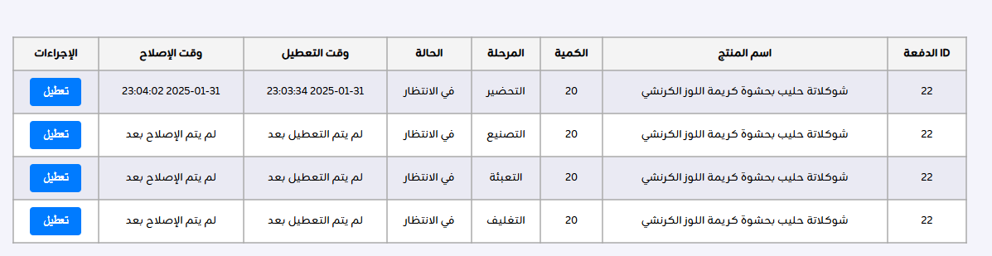

Slide 31
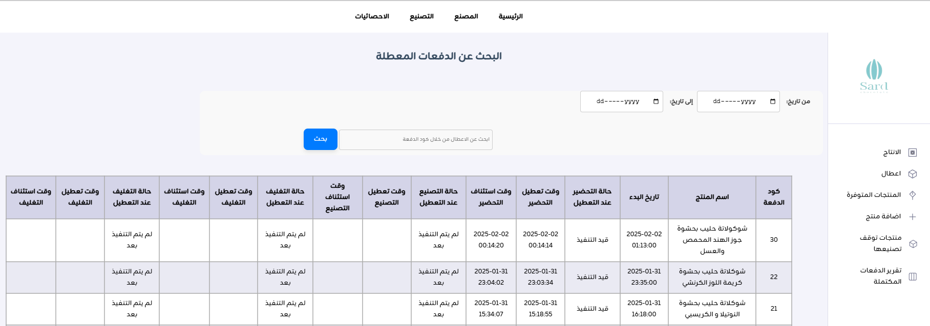

Slide 32
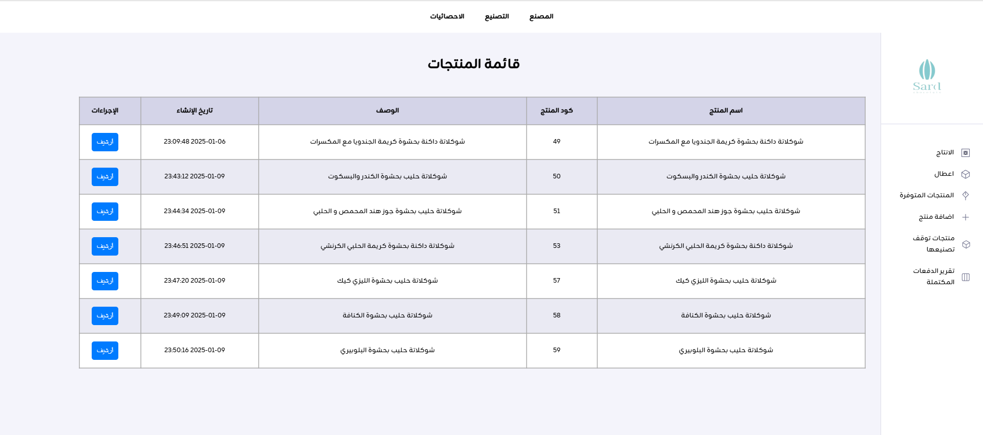

Slide 33
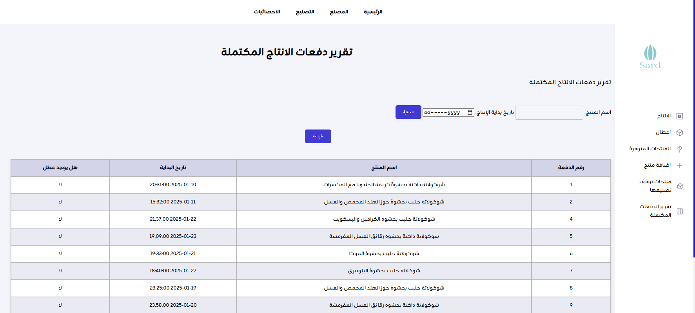

Slide 34
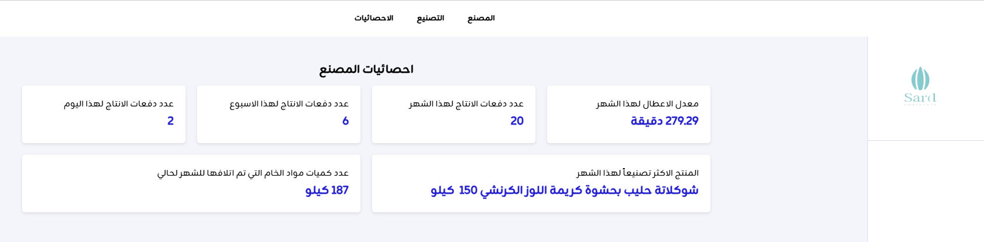


Slide 35
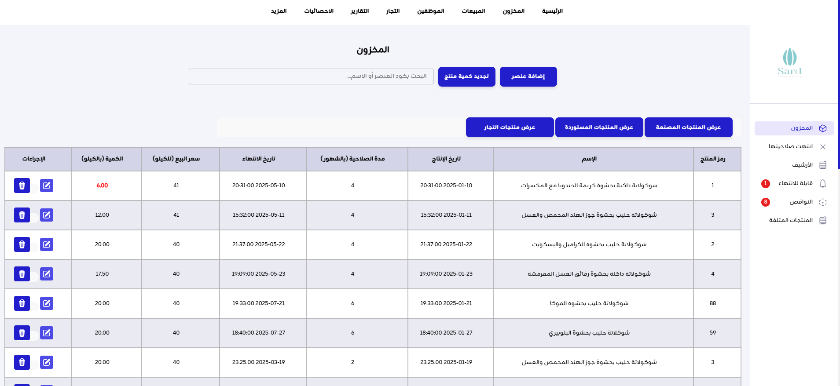

Slide 36
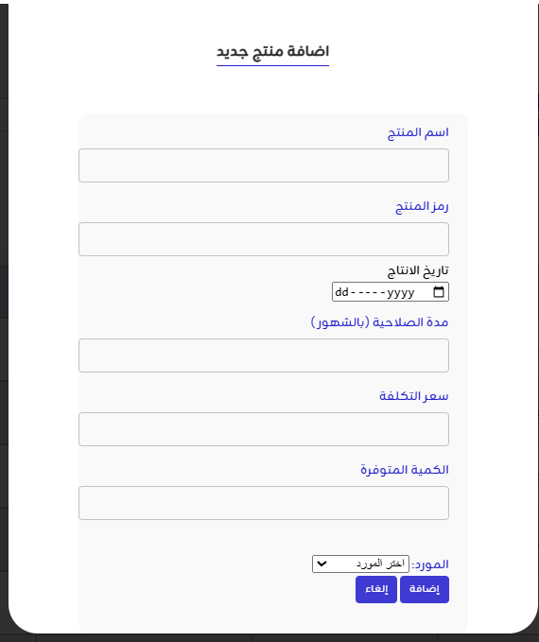
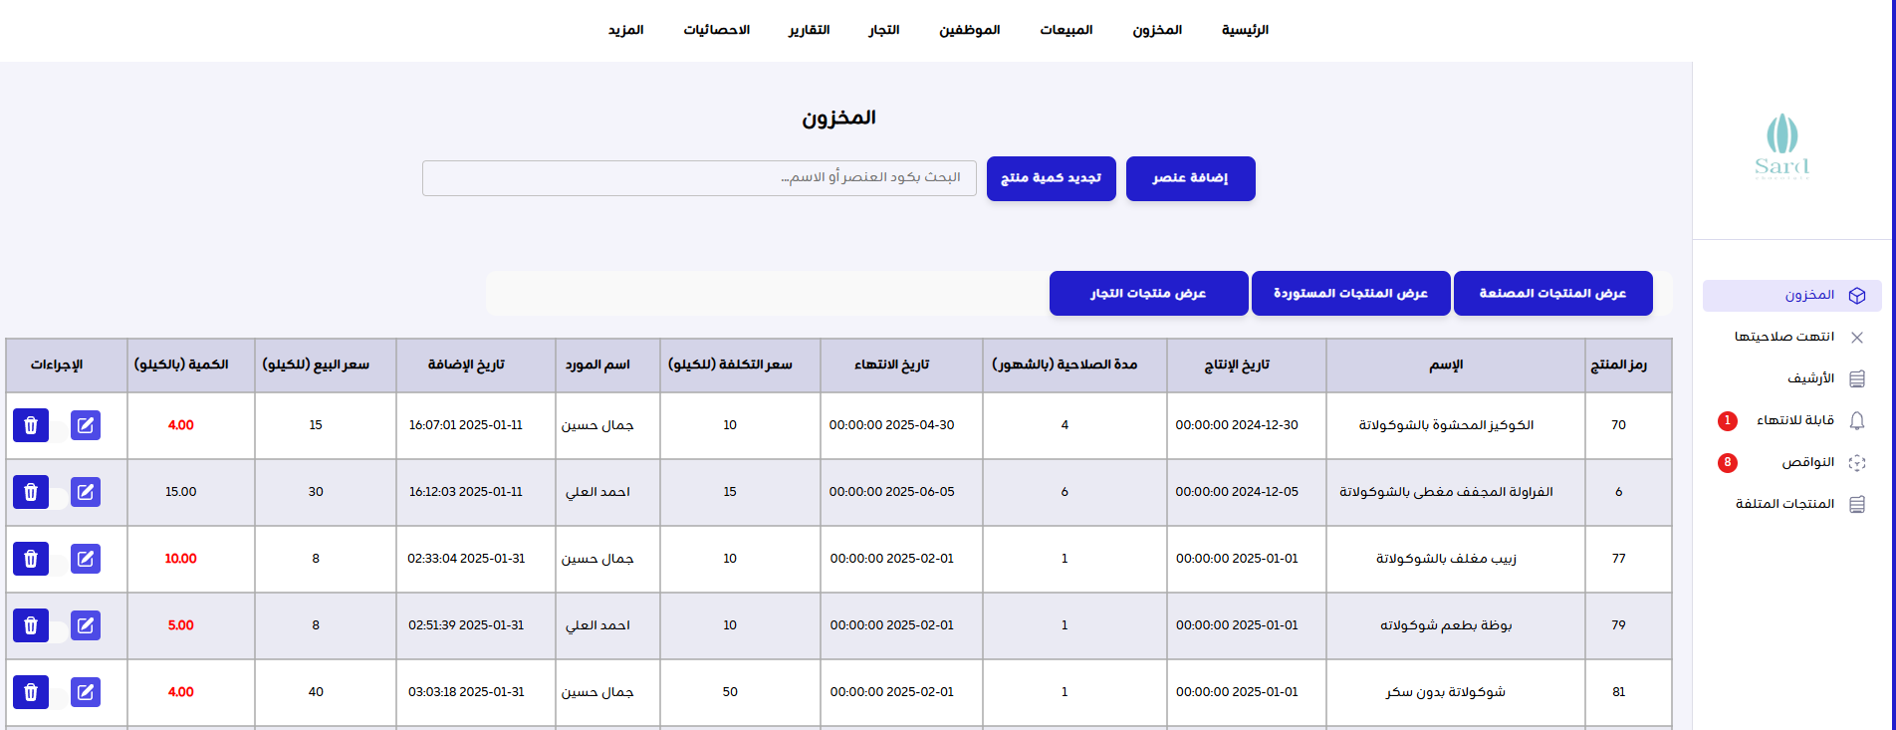


Slide 37
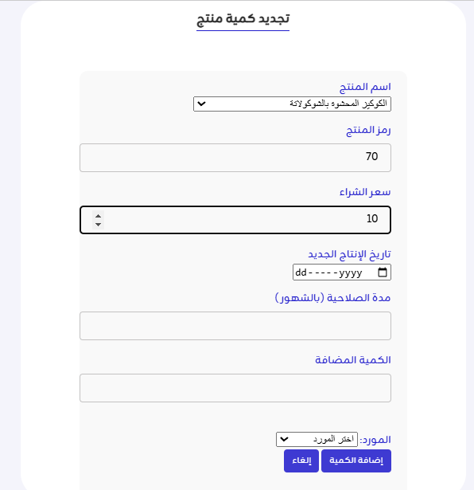
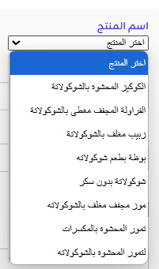
Information is added automatically when selecting the product

Slide 38
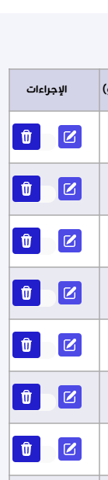
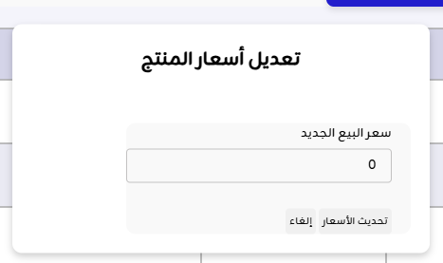
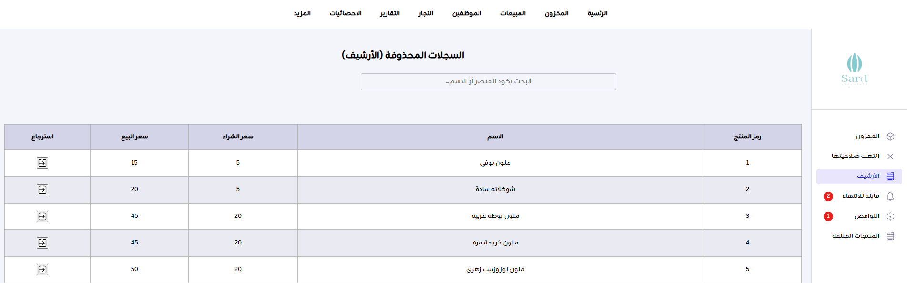

Slide 39


Slide 40


Slide 41


Slide 42



Slide 43



Slide 44


Slide 45



Slide 46


Slide 47


Slide 48



Slide 49



Slide 50


Slide 51


Slide 52


Delivery fees are added automatically depending on the area

Slide 53

After confirming the order

Slide 54




Slide 55



On the customer side

Slide 56




Slide 57


Slide 58


Slide 59


Slide 60



Slide 61


Slide 62



Slide 63




Slide 64


Slide 65



Slide 66


Slide 67


Slide 68


Slide 69


Slide 70


Slide 71


Slide 72


Slide 73



Slide 74


Slide 75


Slide 76


Slide 77



Slide 78


Future Outlook
  Installing Sensors for Automatic Fault Detection
  Developing a Website to Enhance Customer Experience in Ordering
  Upgrading the Employee Management System and Integrating the Fingerprint System

Slide 79



Our Team
Nouralhuda Sawalha
Samya Abu Hanish
Batool sholi

Slide 80

THANK YOU FOR LISTENING. I’M OPEN TO ANY QUESTIONS OR FEEDBACK YOU MIGHT HAVE

