Slide 1
An-Najah National University
Faculty of Engineering & Information Technology
Computer Engineering Department
Kid Secure
A mobile application for parents
to monitor their children
Mahmoud Basha & Tariq Sabri

Slide 2
Outline
1- Introduction
2-Problem
3-Solution
4-Technologies
5-Final Outcome
6- Future work

Slide 3
Introduction
What is Kid secure?
Parental app for monitoring the children mobile and location.
How it works?

Slide 4
Problem Statement
Smartphones:
Why its a problem?
Our kids safety :
We all want our children safe.

Slide 5
Solution
Building a software to monitor and keep tracks with childrens

Slide 6
Technologies
We used in our application a lot of technologies :
Front end: Flutter
Back end:
1- Firebase
2- Node Js
3- MongoDB
4- Railway app

Slide 7
Flutter
1- Cross-Platform Performance
2- Native Performance
3- Intuitive Widgets

Slide 8
Firebase
1- Fast & Safe Hosting
2- Firebase Cloud Messaging for Cross-Platform
3- Cloud Firestore

Slide 9
Node JS
1- Better efficiency and overall developer productivity.
2- Code sharing and reuse.
3- Speed and performance.
4- A huge numbers of free tools

Slide 10
MongoDB
1- Full cloud-based data platform.
2- Flexible document schemas.
3- Widely supported and code native.
4- Free Cloud database.
5- Full documentation

Slide 11
Railway.app
What its Railway.app?
1-Hosting service.
2- For any language.
3- Online server.

Slide 12
Final outcome
1- Help parents to monitor their children remotely.
2- Save time for parents to know what are children doing.
3- Increase the children outcomes.
4- Increase the comfort for parents.

Slide 13
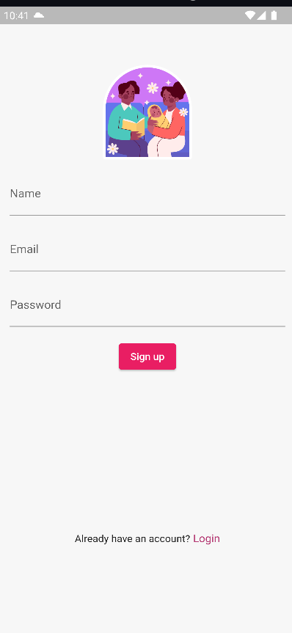
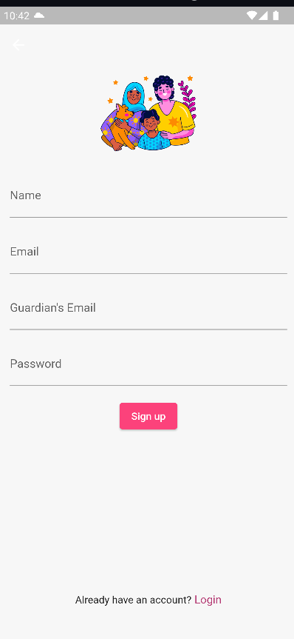
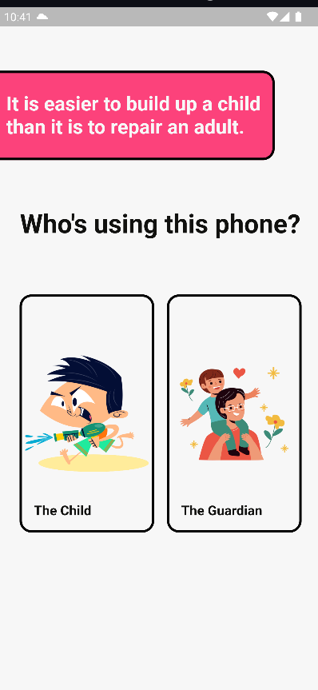
UI Discussion

Slide 14
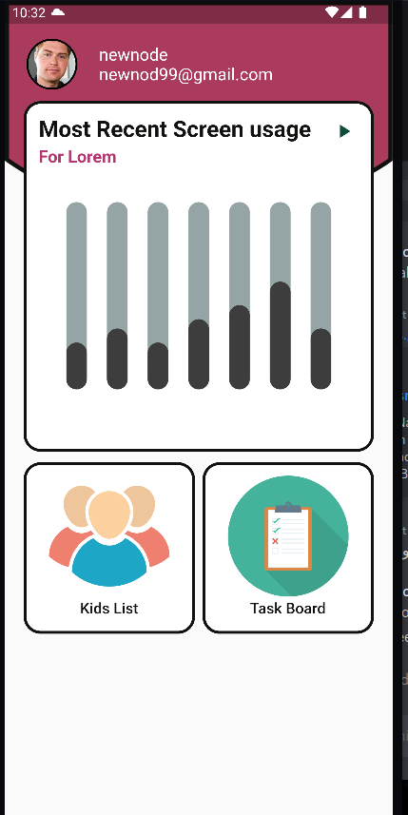
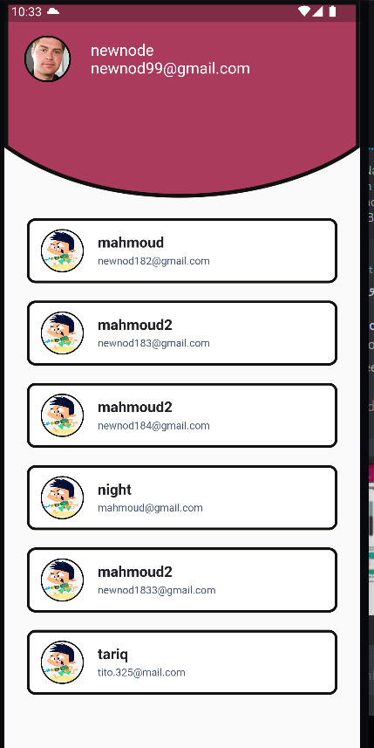
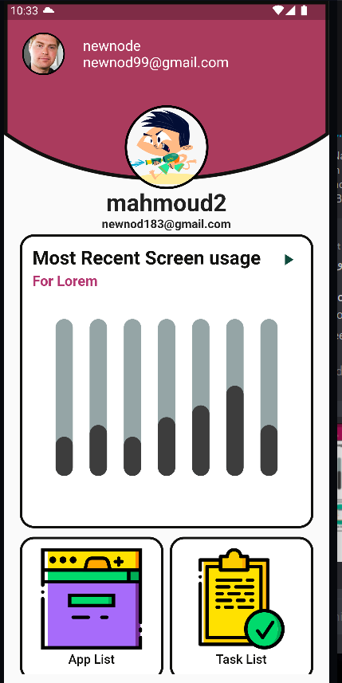
UI Discussion

Slide 15
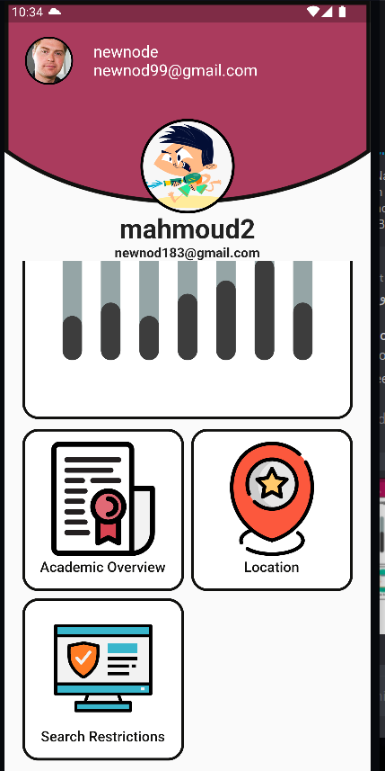
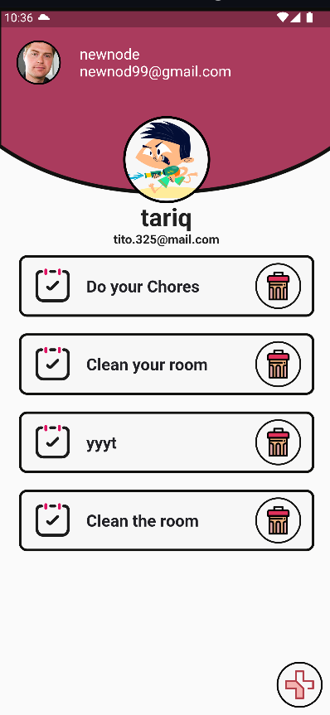
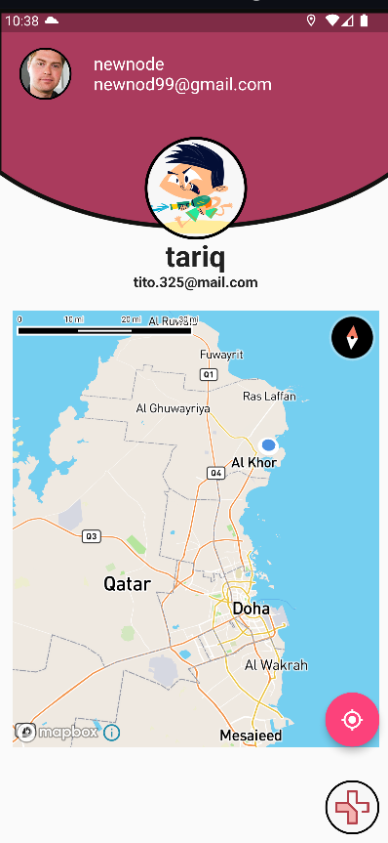
UI Discussion

Slide 16
Future work
1- Remotely control device,lock and data wipe.
2- Remotely track calls and Massages for children device.

Slide 17
THANK
YOU!

