Slide 1

Graduation Project Structural Analysis And Design of Darwich Building
An-Najah National
University
Prepared By:
Amer Abufares
Khaled Sleem
Maher Taha
Supervised By:
Dr. Wael AbuAsab
2015
Engineering College
Civil Engineering
Department

Slide 2
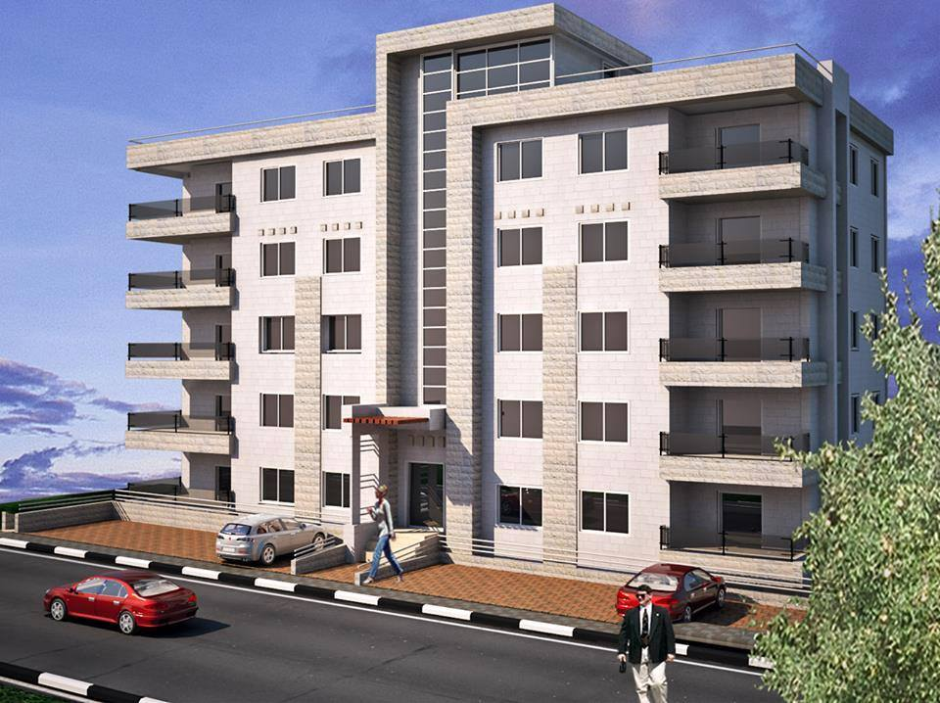
Project Definition This project will introduce the structural analysis and design of the multi-storey building of “Darwich” Which is located in Nablus.

Slide 3
Project Description
This building consists of 7 stories with about 300 square meter for each floor.
Each floor has a height of approximately 3m.
From a structural point of view the structural elements, footings, columns, beams and slabs will be designed by hand and then by using SAP2000.

Slide 4
Codes & Standards
The structure is designed using practice codes and specifications that control the design process and variables.
The following codes and standards are used in this study:
ACI 318-10: American concrete institute provisions for reinforced concrete structure design.
UBC-97: code which is used here for seismic load parameters determination.
ASCE 7-10: For minimum design loads for building

Slide 5
Loads
Live and superimposed dead load as follow:
Live load was considered to be 2 KN/m2
Superimposed dead load 4KN/m2.

Slide 6
Materials
B300 Concrete (f’c=24MPa, E=2.33x10⁷ KN/m²).
Unit weight of reinforced concrete = 25 KN/m²
Steel Grade 60 ( Fy= 420 MPa , E= 200GPa)
Soil Bearing Capacity = 300 KN/m²

Slide 7
The Structural System
This system is a combination of moment resisting frames supported by shear walls.
As the building has relatively short spans the slab system was chosen as one way ribbed slabs with hidden beams.

Slide 8
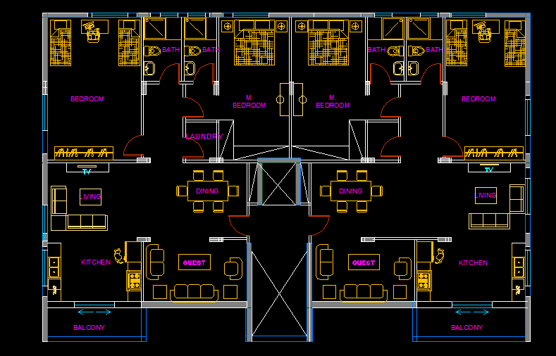
Plan

Slide 9
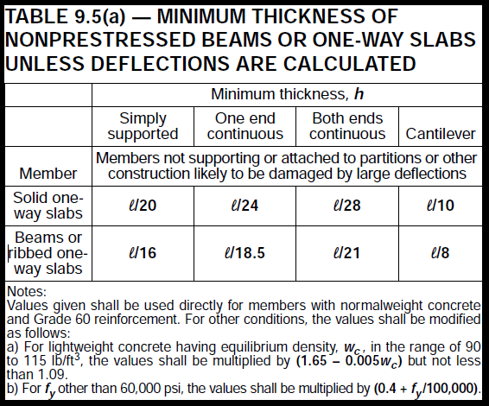
Preliminary Design “Dimensions”
Slabs & beams

Slide 10
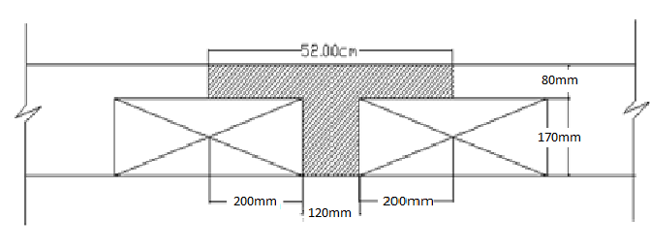
Slab
Thickness of slab is ( 250mm) according to deflection requirements shown in the table attached previously.
The longest span in the slab is ( 3.55m ) length .
The minimum thickness is ( =0.192 m) , take slab thickness = 250mm

Slide 11
Beams
Beam ID | Width (mm) | Depth (mm)
B1 | 700 | 250
B2 | 600 | 250
B3 | 800 | 250
B4 | 600 | 250
B5 | 500 | 250
Drop Beam | 300 | 500
Beam Dimensions

Slide 12
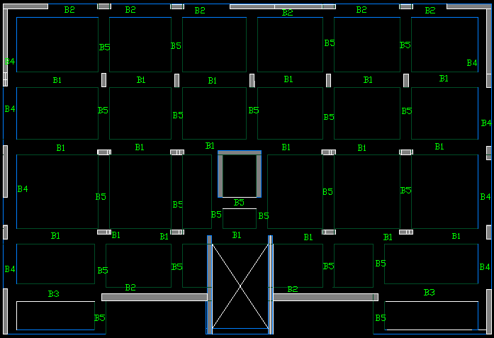
Beams Distribution

Slide 13
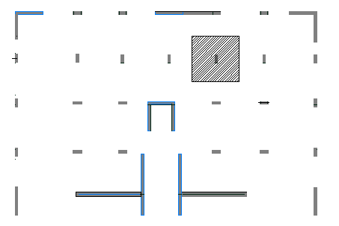
Columns
Take this Column as example

Slide 14
ØP_{n} = Øλ (0.85 fc` (A_{g}-A_{s}) +f_{y}A_{s})
Pu From Dead & live = (1.2D + 1.6L) * #of stories
ØP_{n} must be greater than Pu
According to these information we found the dimensions of two columns we used in the building

Slide 15
Columns dimensions
Column | Dimension | Steel ratio | Area of steel As | Bars | Lo mm | Ls mm | Ties
C1 | 30 * 80 | 1 % | 2400mm² | 12Ø16 | 500 | 800 | 2Ø10 / 10cm
C2 | 30 * 50 | 1 % | 1540mm² | 10Ø14 | 500 | 800 | 1Ø10 / 10cm

Slide 16
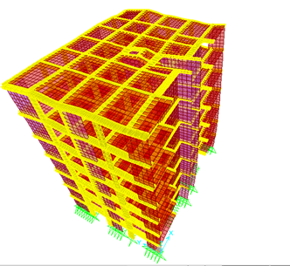
3-D Model

Slide 17
Equilibrium check
Manual calculation Live load= 290 *2 * 7 = 3990 KN
Sap value From sap = 3987.83 KN
Error = = 0.05 %
Since error < 5% …. It’s Ok

Slide 18
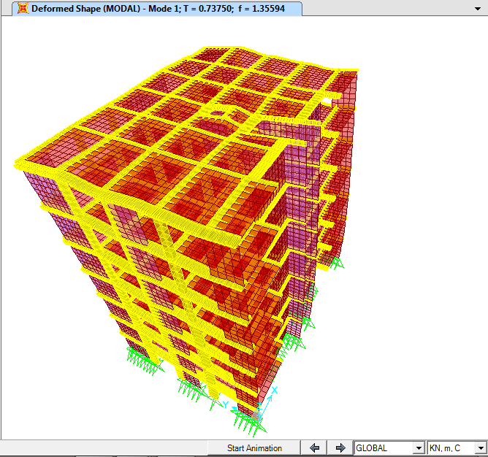
Compatibility Check

Slide 19
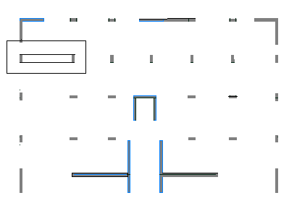
Stress-strain check
Selected Beam to be checked

Slide 20
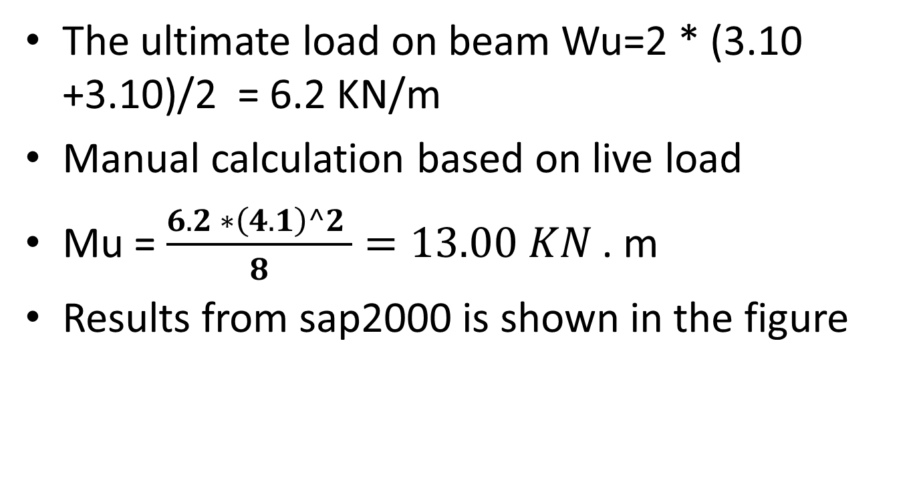
Stress-strain check
The ultimate load on beam Wu=2 * (3.10 +3.10)/2 = 6.2 KN/m
Manual calculation based on live load
Mu = $\frac{6.2 ∗\left(4.1\right)^2 }{8}=13.00 KN$ . m
Results from sap2000 is shown in the figure

Slide 21
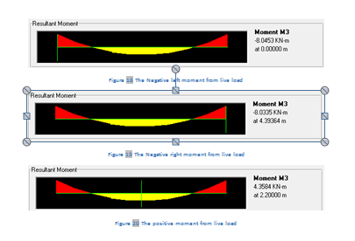
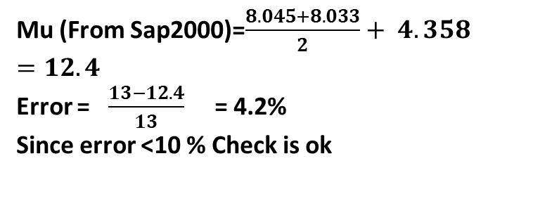
Stress-strain check
Mu (From Sap2000)=$\frac{8.045+8.033}{2}+ 4.358=12.4$
Error = $\frac{13−12.4}{13}$ = 4.2%
Since error <10 % Check is ok

Slide 22
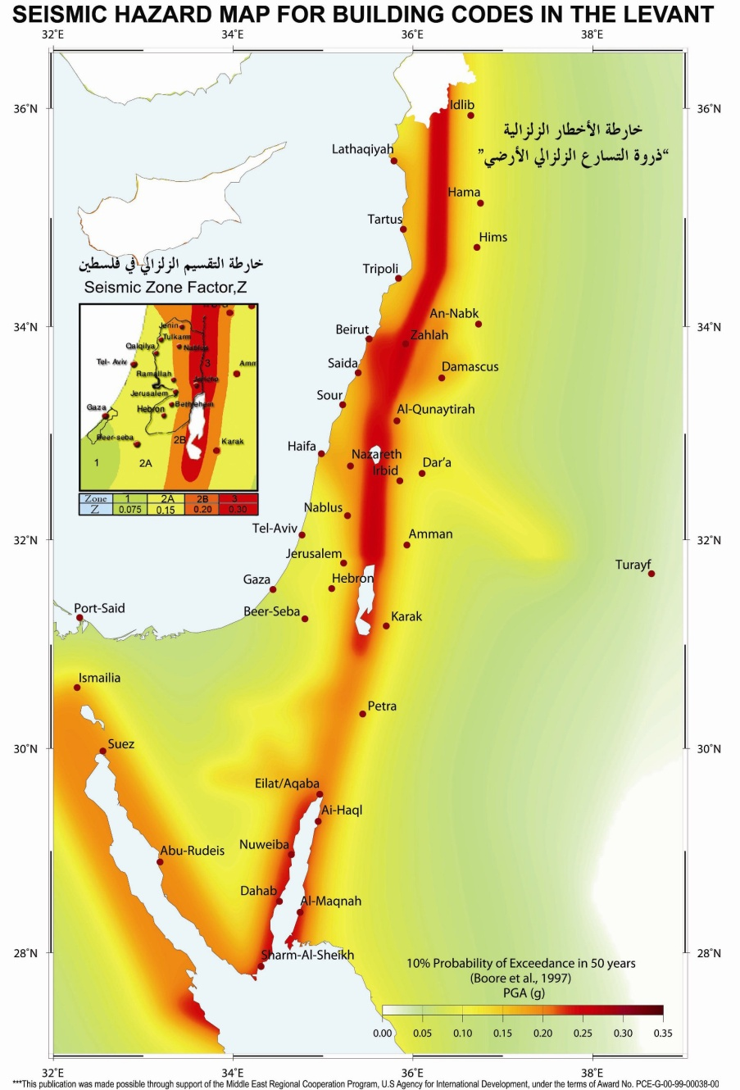
Seismic Design
Zone factor, Z = 0.2
Seismic Coefficient C_{a} = 0.24
Seismic Coefficient C_{v} = 0.32
Since, B.C = 300 KN/M2 The Soil Profile Coefficient is S_{c}
Importance factor = I = 1.00
g = 9.81 m/sec²
Over strength factor, R = 6.5

Slide 23
Periodic check
The natural period is the time required to complete one whole cycle during dynamic loading.
The following equation is used to check T:
T= Ct (hn)3/4 , Ct : a constant = 0.0731
The structure has a period T =0.73750 seconds as shown

Slide 24
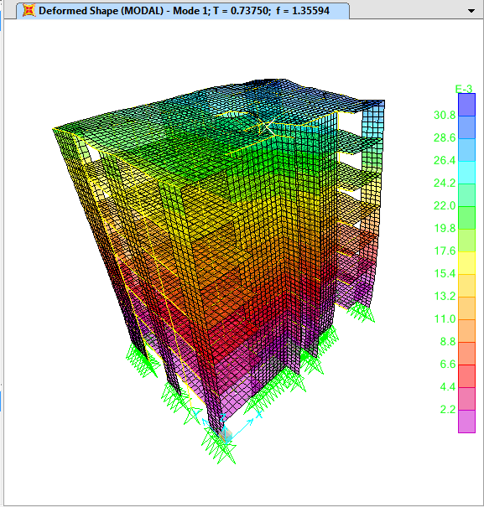
Periodic check
% Error = ((T_{model} – T_{Hand})/T_{model}) * 100% = ((0.73750 – 0.71710)/0.73750) * 100% = 2.77% Which is ok

Slide 25
Footing Design
Area of building = 300 m²
Area of footings (total area ) = Total loads and weights / soil bearing capacity
= 54398KN/ 300KN = 181.3 m2
181.3 > 150
use Mat foundation

Slide 26
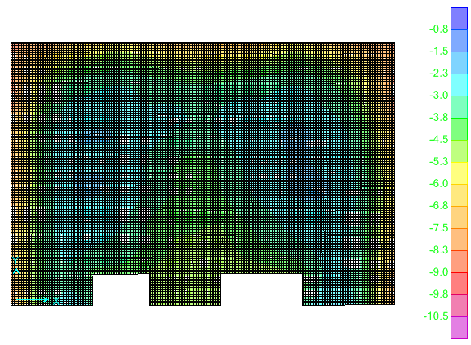
Compatibility & Deformation checks:

Slide 27
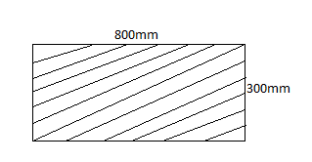
Shear check
For column 30*80
Ps largest =1185 KN
Assume h=700 mm
D=600 mm
ØVc = p x b_{o} x d
ØVc = 0.003 x 2200 x 600 / 1000 = 2376 KN
Vu = 1185 KN < ØVc ..........So punching shear is OK
Take 7Ø 16 top and bottom steel in both direction = 1400mm² Also we can add 7Ø 25 under columns to make the structure more safe

Slide 28
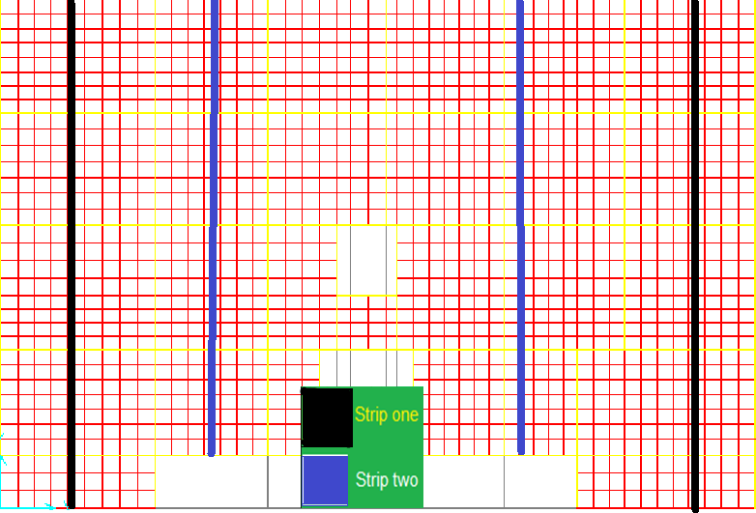
Slab Design

Slide 29
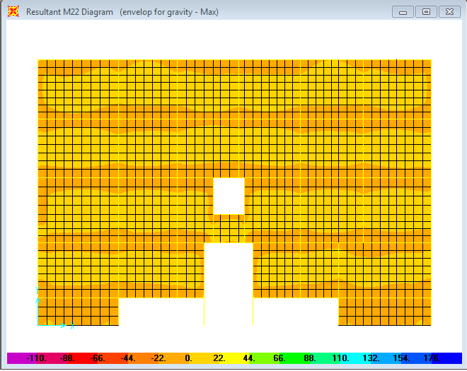
Slab Design
Bending moment for slab

Slide 30
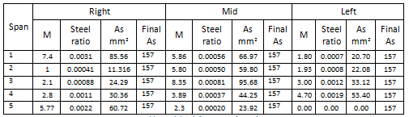
Slab Design
Strip one reinforcement
Use 2Ø10 for top and bottom steel
That was determined after calculations using the moment values

Slide 31
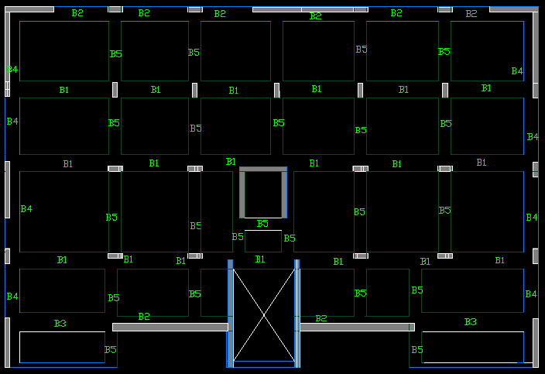
Beam Design

Slide 32
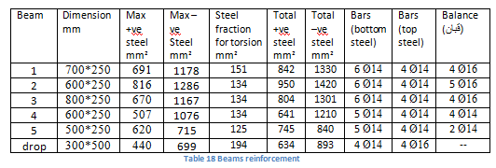
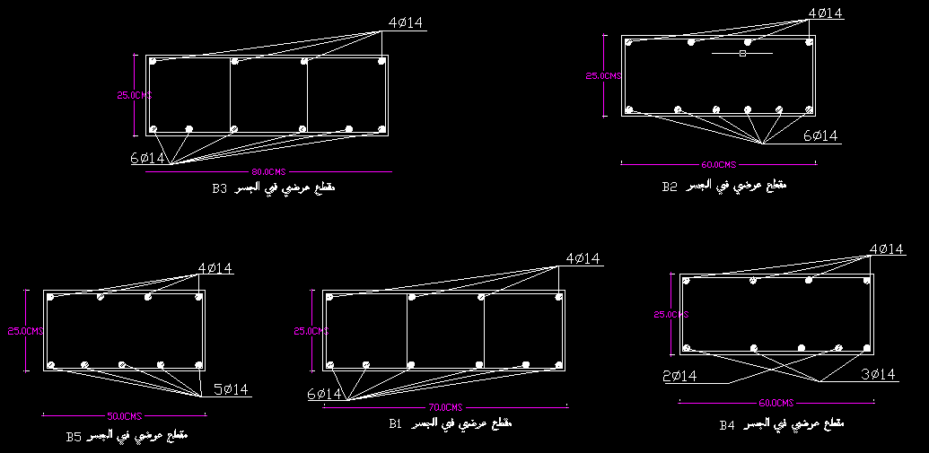
Beam Design

Slide 33
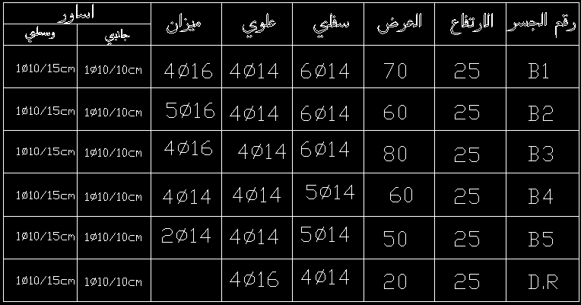
Beam Design

Slide 34
Column Design
The dimensions of column are : 30 cm × 80 cm p_{sap} = 1% (we use this value for economic considerations). As= p×Ag = 0.01 × (300 × 800) = 2400 mm² S_{max} = 150 mm S_{min} = 50 mm use 12Ø16 .

Slide 35
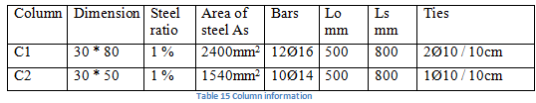
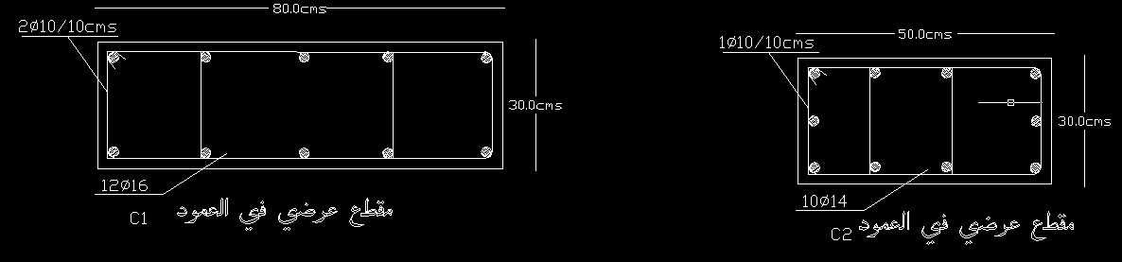
Column Design

Slide 36
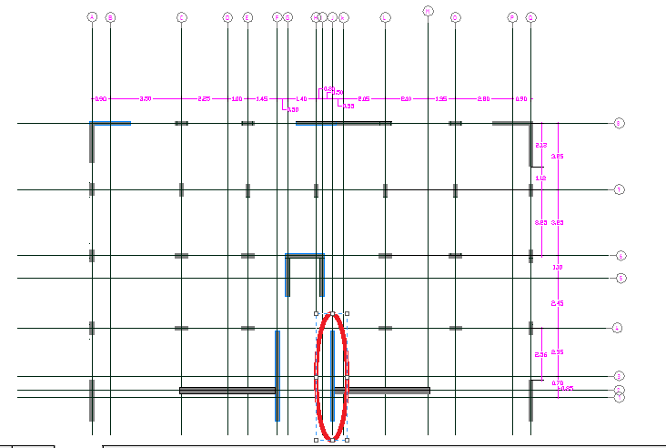
Shear Wall Design
A shear wall is a wall that is designed to resist shear, the lateral force that causes the bulk of damage in earthquakes.

Slide 37
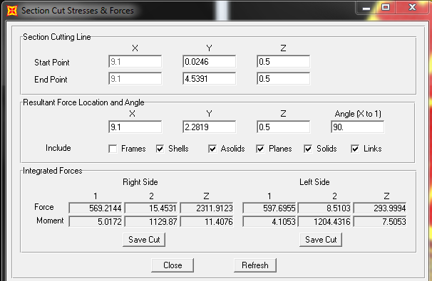
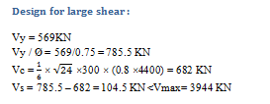
Shear Wall Design
Vx = 15.4531 Vy = 569.2 KN . Axial = 2311 KN Mx = 1129.87 KN.m My = 5 KN.m
Asmin = 0.0025×4400 × 300 = 3300 mm2 Asmin/2 = 1650 mm2 → 17Ø12 on each side S = = = 176 mm → use s = 200 mm use 2 Ø 12 /200 mm → for horizontal steel on both sides

Slide 38
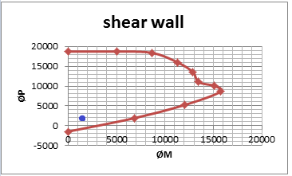
Shear Wall Design
Small Moment = 60 mm2
Total area of steel needed for moment and axial load : Astotal = 60 + 1687.5 = 1710 mm2 then use 18Ø12 → for vertical steel on each side
use 1Ø12/ 200 mm

Slide 39
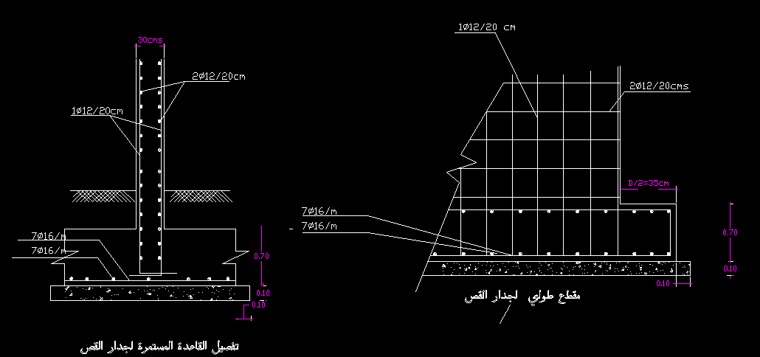
Shear Wall Design

Slide 40
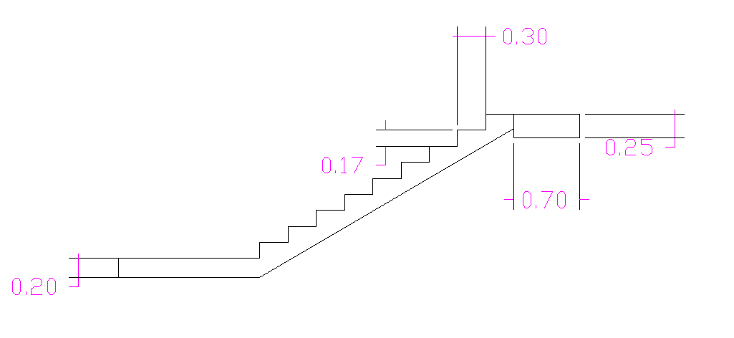
Stairs Dimensions
Stair dimensions :
Going = 30 cm
Riser = 17 cm
Floor height = 3m
No. of goings = 8
No. of risers = 9

Slide 41
Stair Design
As stair should be a safe escape root for the residents in the buildings , a slight increase in the loads will be used. This is a residential building with 2 KN/m², therefore 5 KN/m²will be used on stairs .
Thickness = L/20 = 290/20 = 14.5 cm → use 20 cm
As = p*b*d= 0.000747*1000*170 =127 mm2/m < Asmin
Take 4 φ12

Slide 42
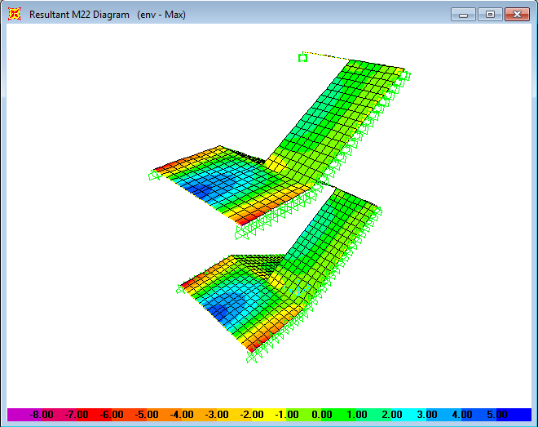
Bending Moment

Slide 43
THANK YOU

