Slide 1
Objectives
1 – introduction
2 – mechanical design
3 – pneumatic circuit
4 – control circuit
5 – conclusion

Slide 2
Introduction
Automation is the use of control systems and information technologies to reduce the need for human work in the production of goods and services

Slide 3
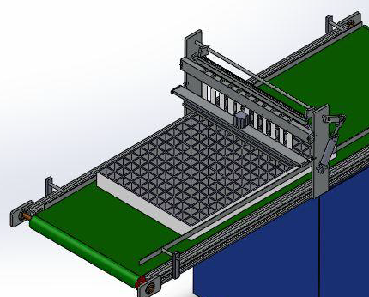

Comparison
Traditional seeding
Automation seeding

Slide 4
Advantages
Automation brings comfort to our life
increase productivity
fulfill the lack of man power
low cost
high efficiency and reduce the time to plant a large amount of seeds

Slide 5
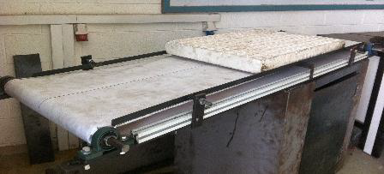
Mechanical design explanation of the parts of machine
conveyor belt
Bed
Pulley
Motor
Bearing
Shaft

Slide 6
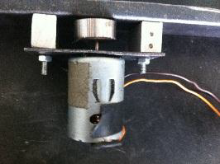
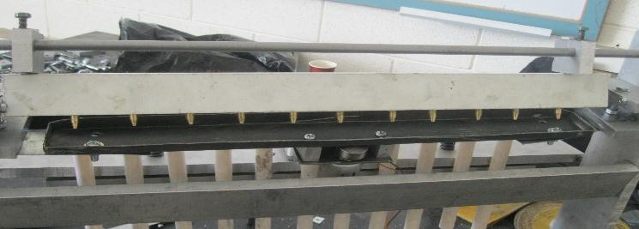
Electrical Vibrator motor
Seeding plate
Electrical Vibrator motor

Slide 7
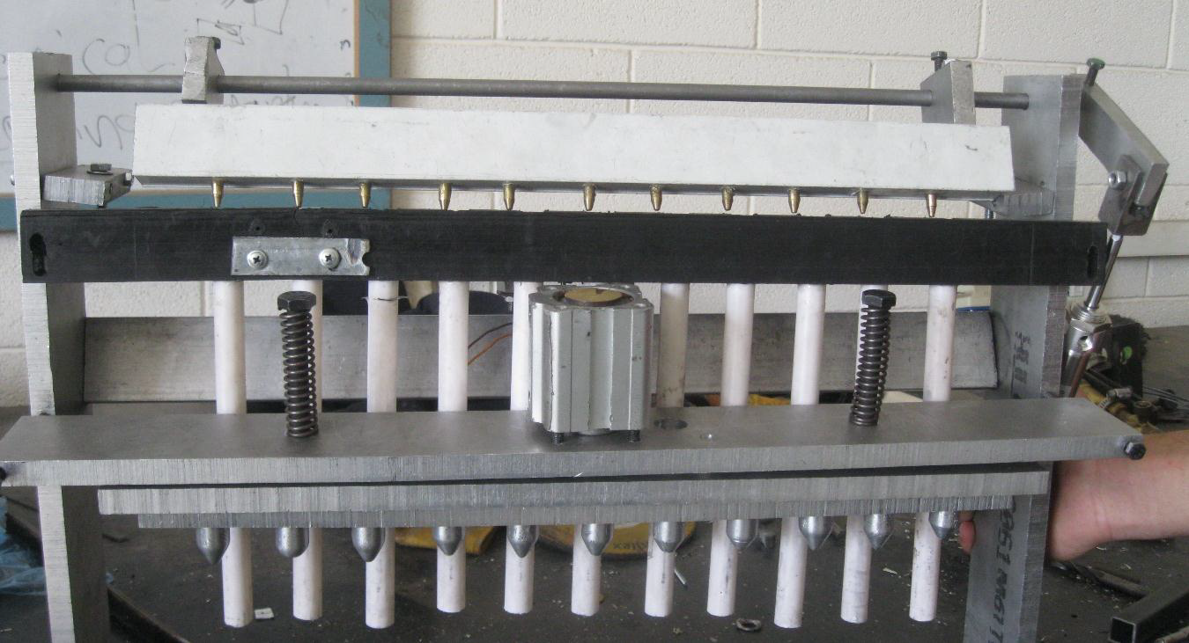
vacuum bar and the bar that punches soil
vacuum bar
bar that punches soil

Slide 8
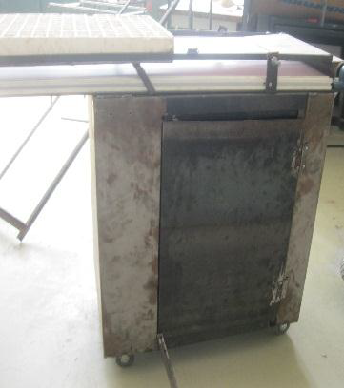
The trolley
It’s placed under the conveyor belt. We will put the components of the pneumatic circuit

Slide 9
PENUMATIC SYSTEM
Pneumatic system use pressurized gases to transmit and control power. pneumatic system typically use air as the fluid medium because air is
a safe
low-cost
and readily available fluid.

Slide 10
advantages
easy to implement
low cost
easy to interface with electronics and mechanical structure

Slide 11
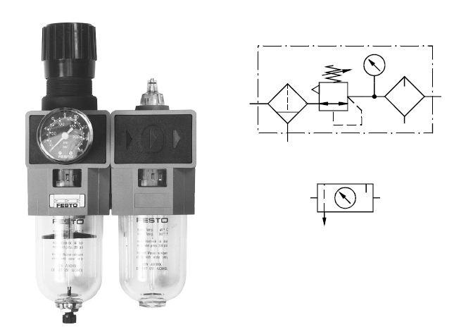
Component
Compressor
Fluid Conditioner

Slide 12
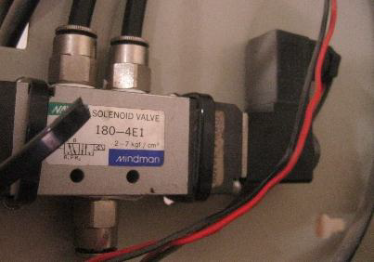
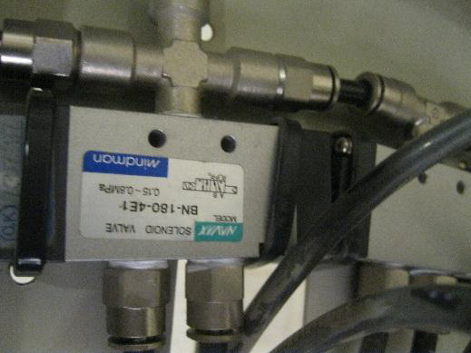
Air Control Valve.
3/2-Way NC - El. Cont. with Spring Return
5/2-Way NC

Slide 13
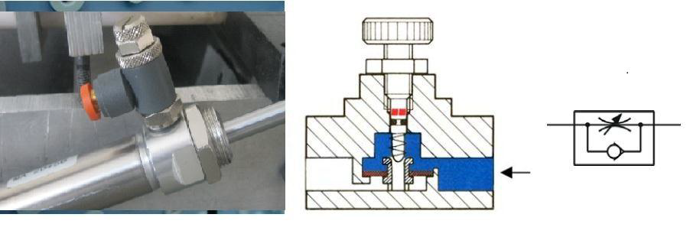
Flow control valve
The flow control valve restricts or throttles the air in a particular direction to reduce the flow rate of the air and hence control the signal flow

Slide 14
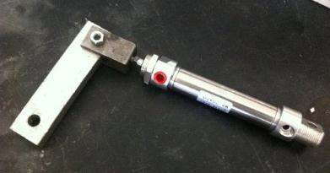
Pneumatic Actuator
Double acting cylinder

Slide 15
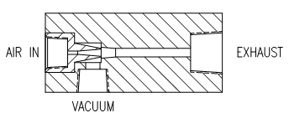
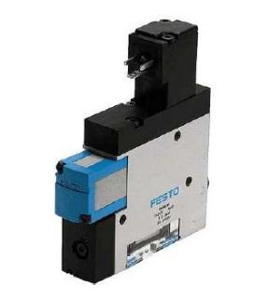
Vacuum generator
How is vacuum produced
Compressed air is allowed to flow through a nozzle which causes a venture action

Slide 16
CONTROL
Microcontroller is a small computer on a single integrated circuit containing
CPU
memory
timers
serial and parallel ports
and input output peripherals

Slide 17
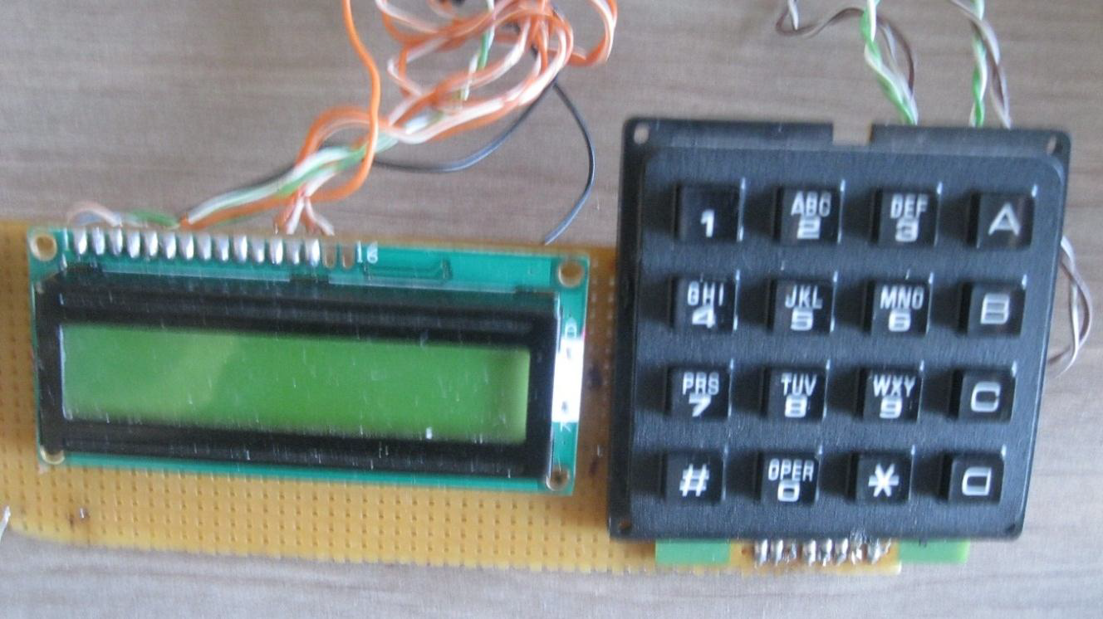
Keypad & LCD

Slide 18
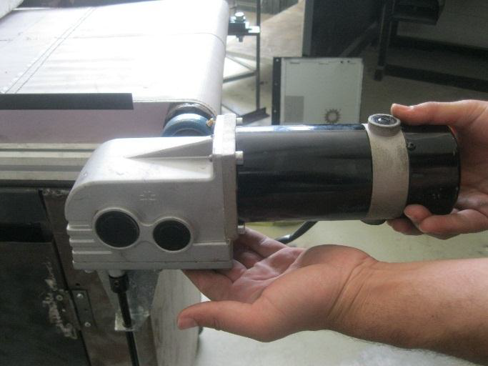
Direct current (DC) motor
Industrial applications use dc motors because the speed-torque relationship can be varied to almost any useful form

Slide 19
Why DC MOTORS IS USED
DC motors is that their torque-speed characteristic is very good
they are relatively cheap
small size
Simple compared with another motors

Slide 20
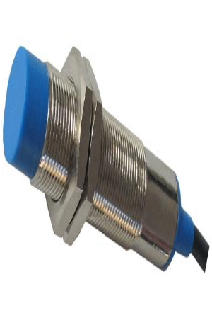
Sensors
Inductive proximity sensor

Slide 21
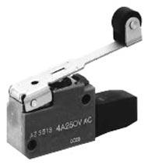
Micro switch
A micro switch is an electrical switch which can be operated using a very small force and also possibly using a small movement.

Slide 22
Conclusion

