Slide 1


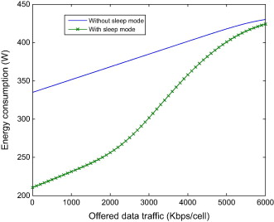
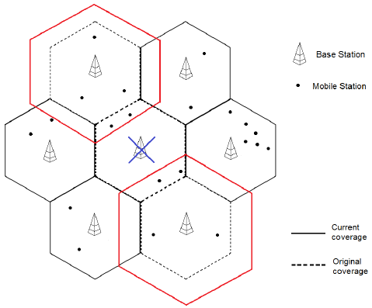
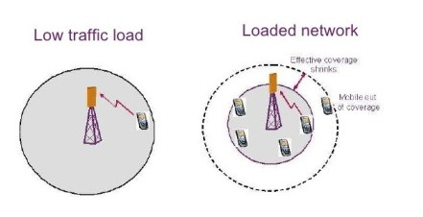
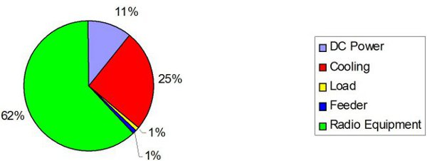
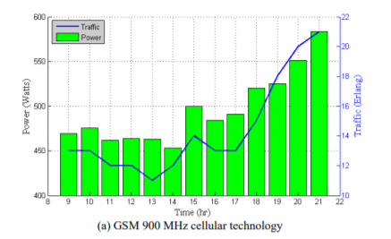
.
Cellular Load Balance Analysis
Jinan hamdieh, Mahar khalili and Ward jaber
Electrical and telecommunication Engineering department
Problem Statement
Methodology
General Power Saving Actions
High daily OPEX , High CO2 emissions , high interference..
.
Frequency Domain Actions: they are done during low traffic time, they represents carriers switching off, and the respective power amplifiers.
Spatial Domain Actions: they implement the cell sleep mode during low traffic time
Time Domain Actions: they switch off power amplifiers during free-traffic time slots
.
objective
Energy consumption reduction to reduce daily OPEX and save money, with no effect on the QoS, Which results in what is called “Green cellular networks”, and less interference..
Abstract
This project will solve the problem of high cost in daily operations by using the BTS power saving in 2G and trying to use the same idea in 3G by combining the cell breathing with the sleep mode technique.
.
Cell Breathing
The concept of cell breathing describes the variation of cell’s coverage borders based on the traffic load, we can benefit from the mentioned phenomenon by combining it with the sleep mode technique in order to obtain the efficient network power consumption to save the money and reduce the cost
Conclusion
Implementing this project leads to a reduction in the power consumption. As a result, reducing the OPEX as well as reducing the interference, and that yields to an efficient network without affecting the QoS..
Introduction
In the last decade, the number of subscribers increased widely, as a result the total power consumption increased as well, which in turn led to a continuous increase in CO2 emissions, and in order to get over this problem, many algorithms have been established, we are interested in two of them, which are the BTS power saving and time slot power saving in terms of GSM, Cell breathing combined with a technique which is called the sleep mode in terms of 3G.
.
BTS Power Saving:
During periods of low network traffic, this feature effectively puts transceivers that are not being used in standby mode
this innovation can save between 5 and 20 percent of the energy per BTS when a base station is in use, while still providing the same services and quality to end users.
Future work
For the next step, practical measurements will be taken with more details, methods and equations will be understood, simulation will be made .
Acknowledgements
The success and final outcome of this project required a lot of guidance and assistance from many people and I am extremely privileged to have got this all along the completion of my project. All that I have done is only due to such supervision and assistance and I would not forget to thank them
We can benefit from the mentioned phenomenon by combining it with the sleep mode technique in order to obtain an efficient network power consumption as well as keeping the QoS not effected, to obtain the efficient network power consumption which yield to save money and reducing the cost which is our objective of our study

