Slide 1
Autocraft
Omar & Motasem
Tool For Constructing 3D CAD From 2D Projections

Slide 2
Walkthrough (13 Slides)
Orthogonal Projection
Reconstruction Problem
Autocraft (Big Picture)
Stages
Autocraft (Main Algorithm)
Autocraft (Tracing Example)
Sample Output
What’s next?
Minecraft Game
Malmo plugin
Autocraft Current Limitations and Challenges
Autocraft Futuristic Vision and Anticipations

Slide 3
Orthogonal Projection
Describing the model using 2D projections
Front, Side and Top views/projections
Used by engineers
An edge is shared by multiple projections; the main idea of our algorithm stands on that!
Rules exist for projection process
Engineers currently must imagine the 3D CAD for simulation
Omar

Slide 4
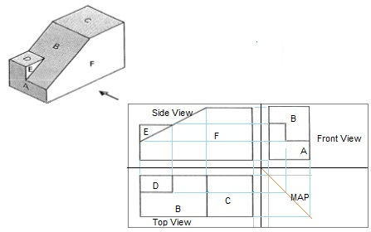
Orthogonal Projection (Example)
Omar

Slide 5
Reconstruction Problem
Converting from 2D projections to 3D CAD
Existed for the past four decades
Many publications published on this topic
Finding an automated way to ease the imaging the 3D model for engineers
When you convert from 2D to 3D you’ll always miss information due to the third axis
Omar

Slide 6
Autocraft (Big Picture)
Final Goal: A robot that constructs 3D models, given only the three 2D-projections
As a First Step: Simulate this robot in Minecraft game (our graduation project)
Invented an algorithm for solving the reconstruction problem in efficient way
Final output of the algorithm are the instructions to build
This algorithm is a product of previously failing algorithms; the first was depending on points only, the next one was depending on points and helper views, until this came up.
The current one depends on corners + edges + main view + helper view
Omar

Slide 7
Autocraft (Big Picture)
Helper View: The view that shares an edge with the current one
To keep the consistency of drawing; we trace only the edges that are shared by a helper
Choosing the helper depends on the type of the current view and the direction of the traced edge
Mapping shall be done in order to keep the consistency of tracing
Omar

Slide 8
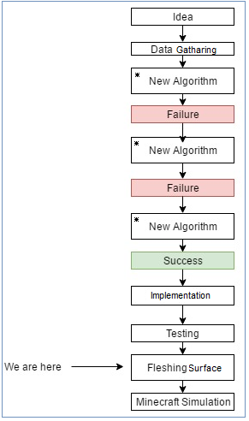
Stages
Omar

Slide 9
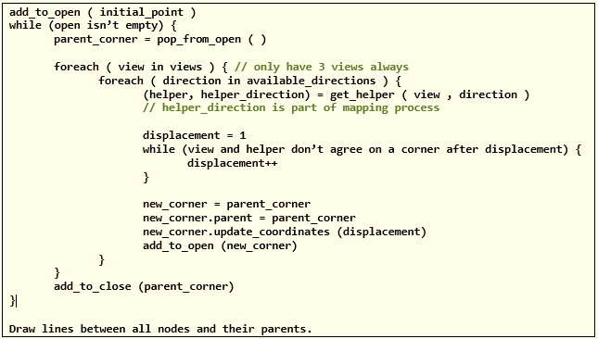
Autocraft (Main Algorithm)
Motasem

Slide 10
Autocraft (Tracing Example)
Motasem

Slide 11
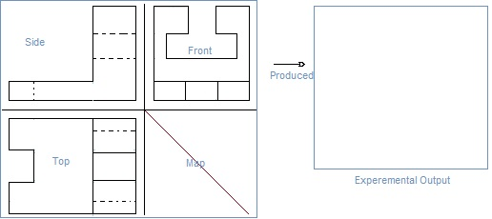
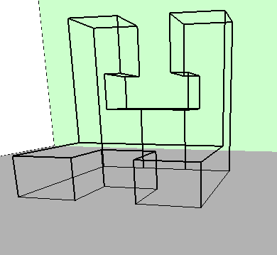
Sample Output
Motasem

Slide 12
What’s Next?
Fleshing the surface
Building the model on Minecraft
Omar

Slide 13
Minecraft & Malmo Plugin
Minecraft: A game that allows gamers to build their own buildings
Malmo: An open source plugin by Microsoft, used to control Minecraft character
Using python scripting language
Has basic movement, building and jumping commands
Omar

Slide 14
Autocraft Current Limitations and Challenges
There’re some special cases in which the tool looses its track
Inclined and curved edges aren’t yet implemented
User must give the tool its starting point for each separate walkthrough
Motasem

Slide 15
Autocraft Futuristic Vision and Anticipations
This tool opens the doors for many applications
Getting the robots into building work
Simulation of 3D CADs
Minecraft automated construction plugin (Commercial)
Motasem

Slide 16
Any Questions?
We really appreciate all suggestions

Slide 17
Motasem Aghbar & Omar Natour
Thank You!

