Slide 1

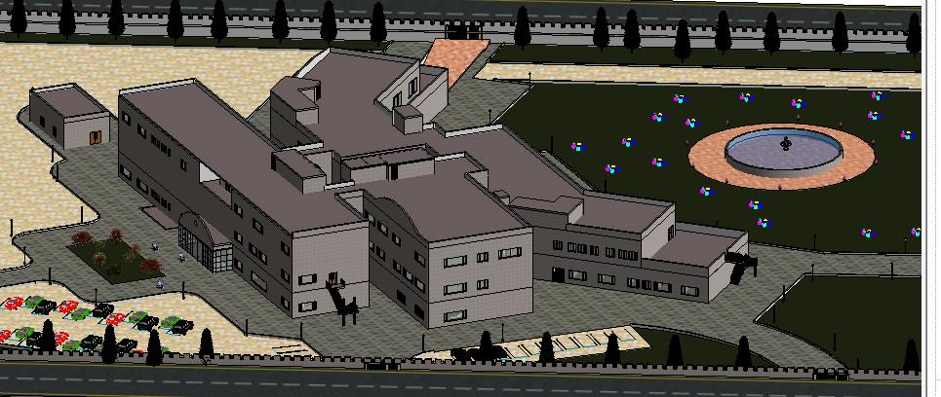
An-Najah National University
Building Engineering Department
Graduation Project 2:
Design Orthopedic Specialist Hospital
Prepared By: Mohannad Iyad Al-Shak’a. Supervisor: Dr. Mutasim Baba.
Yasmine Fareed Sarah.
Mais Nabeel Abu-Alhasan.
May, 2015

Slide 2
Outline:
Introduction To project
Architectural Design
Structural Design
Environmental Design
Mechanical Design
Fire system Design
Electrical Design
Cost estimation

Slide 3
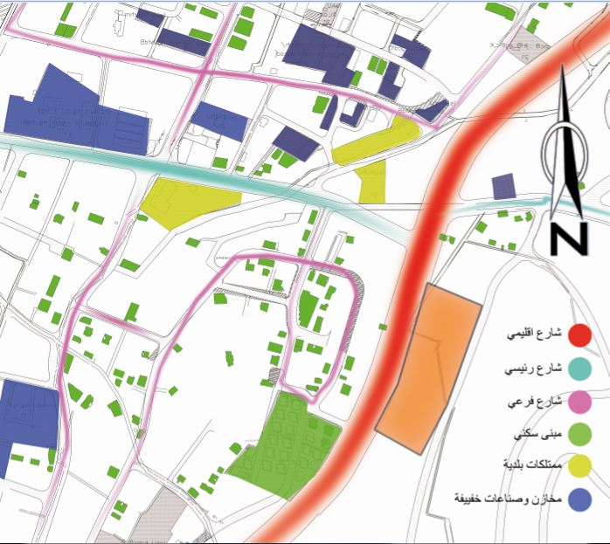
Since there is no orthopedic specialist hospital in North-West Bank, it has been assigned to serve the northern regions and parts of the southern regions.
Introduction to project:

Slide 4
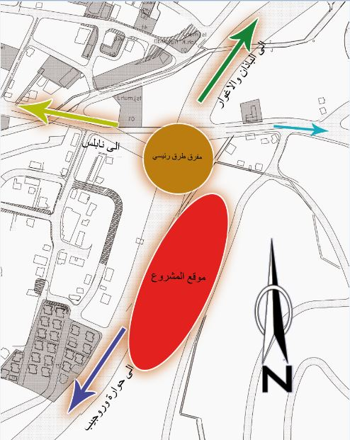

Slide 5
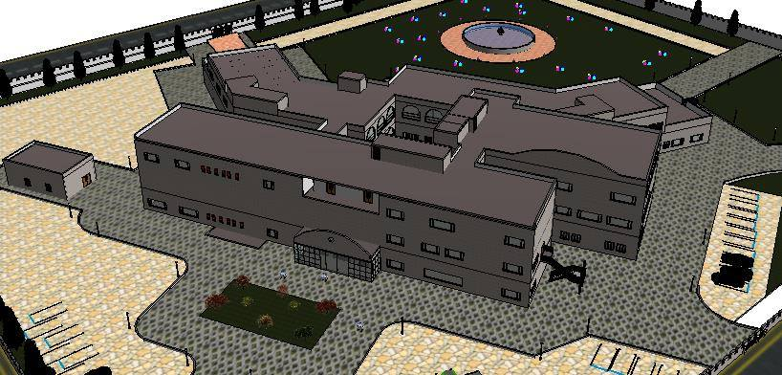
Architectural design:-

Slide 6
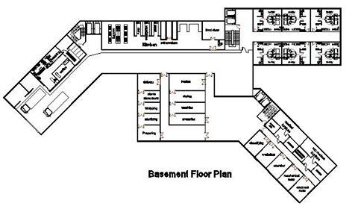
Architectural design:-
Original Design

Slide 7
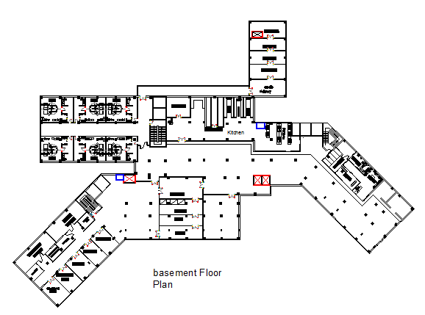
Architectural design:-
New Design

Slide 8
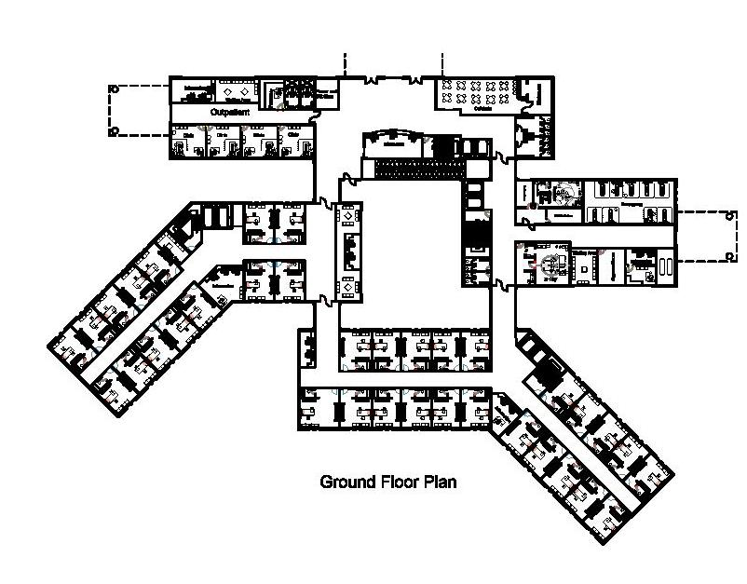
Architectural design:-
Original Design

Slide 9
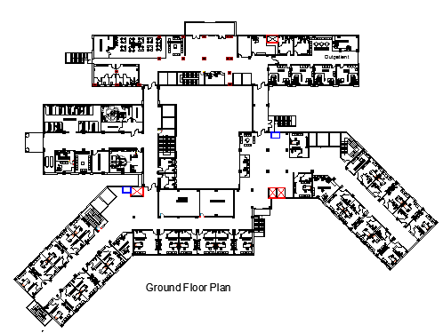
Architectural design:-
New Design

Slide 10
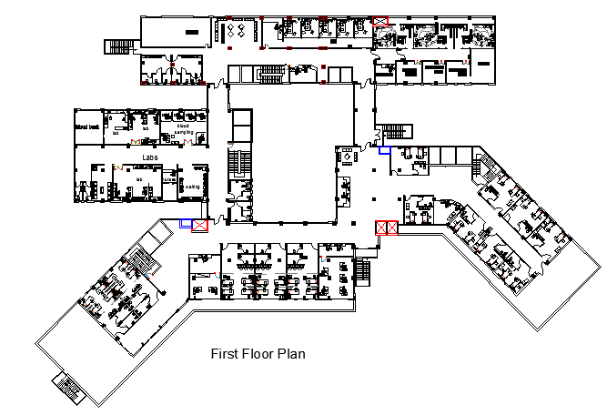
Architectural design:-
New Design

Slide 11
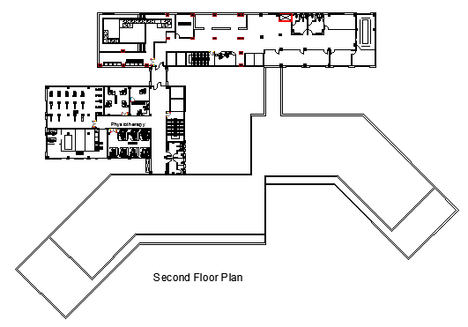
Architectural design:-

Slide 12
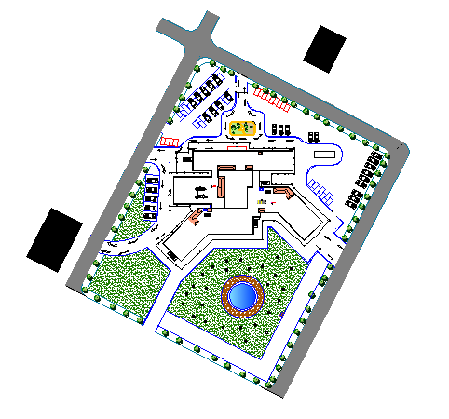
Site plan:

Slide 13
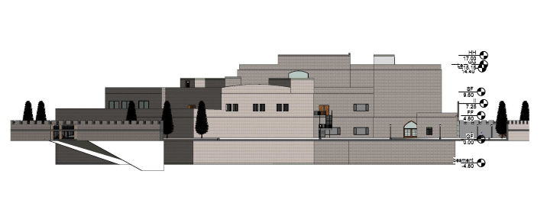
ELEVATIONS :-
East elevation

Slide 14
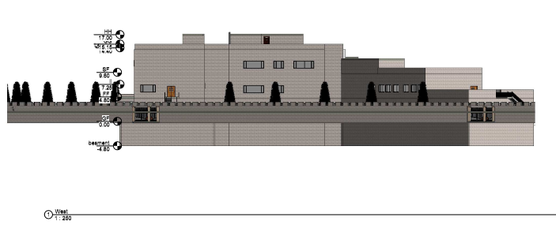
ELEVATIONS :-
West elevation

Slide 15
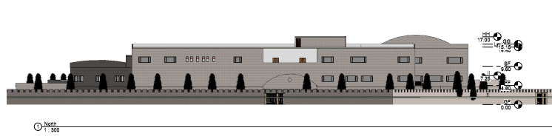
ELEVATIONS :-
North elevation

Slide 16
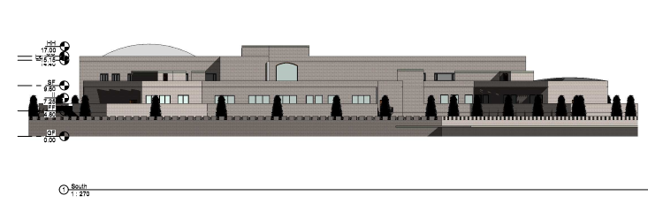
ELEVATIONS :-
South elevation

Slide 17
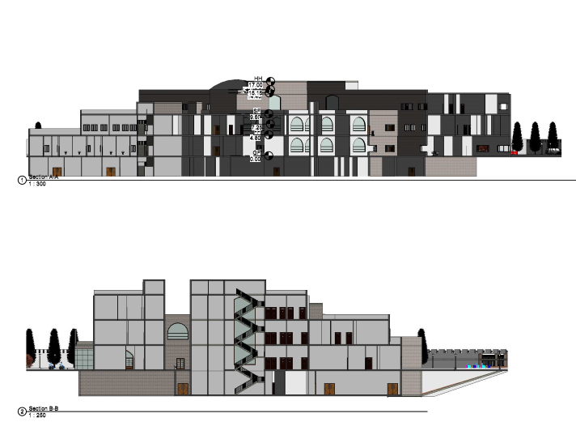
The Sections :-
Section A-A

Slide 18
The Sections :-
Section B-B

Slide 19
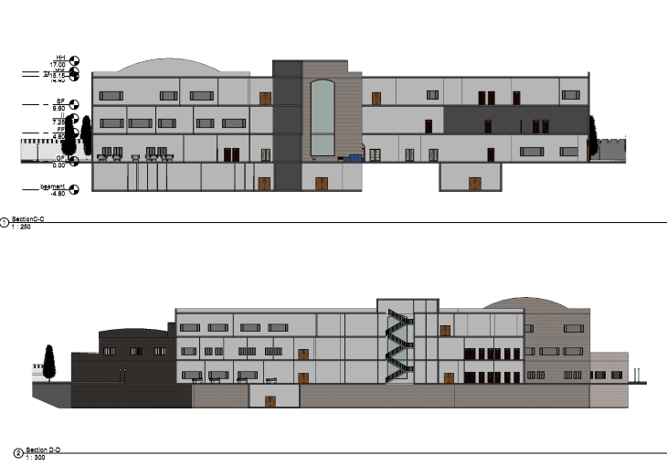
The Sections :-
Section C-C

Slide 20
The Sections :-
Section D-D

Slide 21
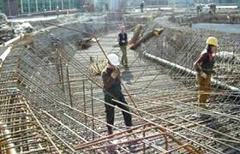
Structural Design

Slide 22
Design data :
Concrete compressive strength | f’c = 28 Mpa | Slab . beam , shear wall . tie beam
 | f’c= 48 Mpa | Columns , and footing
Yielding strength of steel | Fy = 420 Mpa
Bearing capacity of soil | 250 KN/m² | Soil profile is SD.
Load | Super imposed dead load=5 KN/m² | Live load = 5 KN/m²

Slide 23
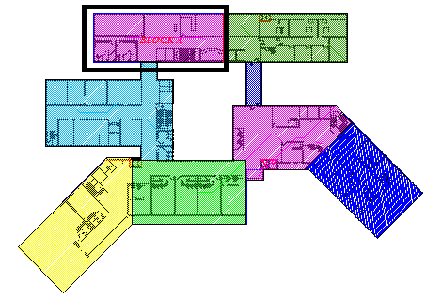
The building of our project consists of eight blocks . we design block A with fully Structural Design .

Slide 24
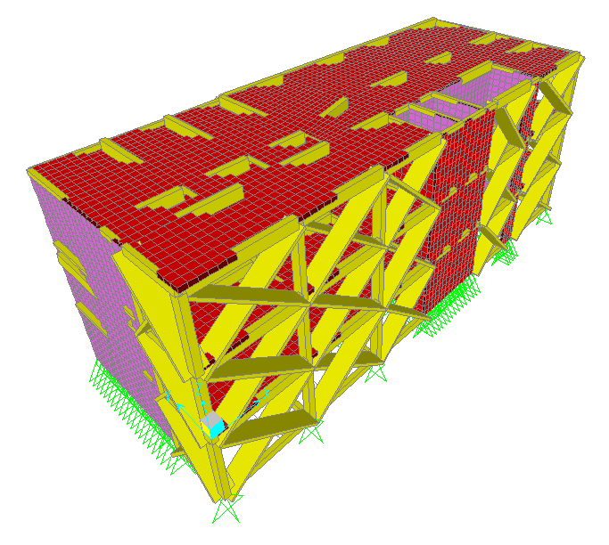
Slab model for block A :-

Slide 25
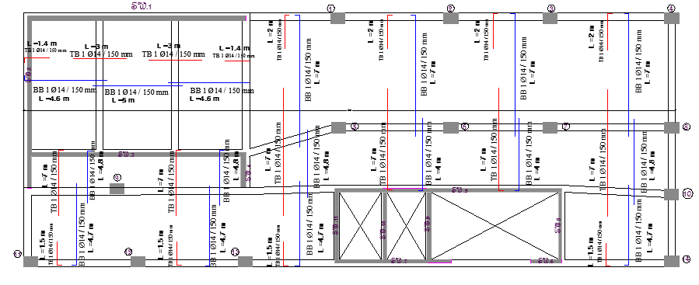
One way solid slab details :

Slide 26
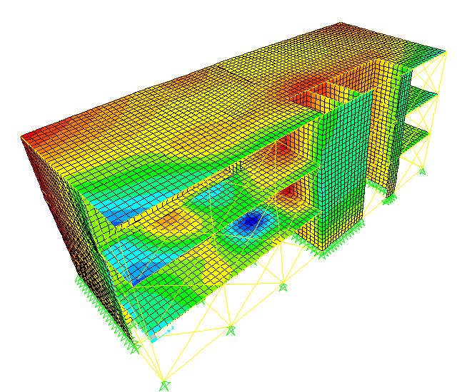
Check Model.
Compatibility check

Slide 27
Equilibrium Check > ok
Equilibrium from | Manual | SAP | The error %
live load | 7768 KN | 7786.23 KN | 1.48 % | accepted
super imposed dead load | 15286 KN | 15298.83 KN | 1 % | accepted
dead load | 21610.7 KN | 20989.9 KN | 2.8 % | accepted

Slide 28
Stress – Strain Check:
 | Manual result | SAP result | Error %
For the slab | 10 (KN.m) | 9.7 (KN.m) | 3.09 % | acceptable
the beam | 87.34 KN.m | 130.3 KN.m | 3.2 % | acceptable
Column 1 | 450 KN | 480 KN | 6.6 % | acceptable

Slide 29
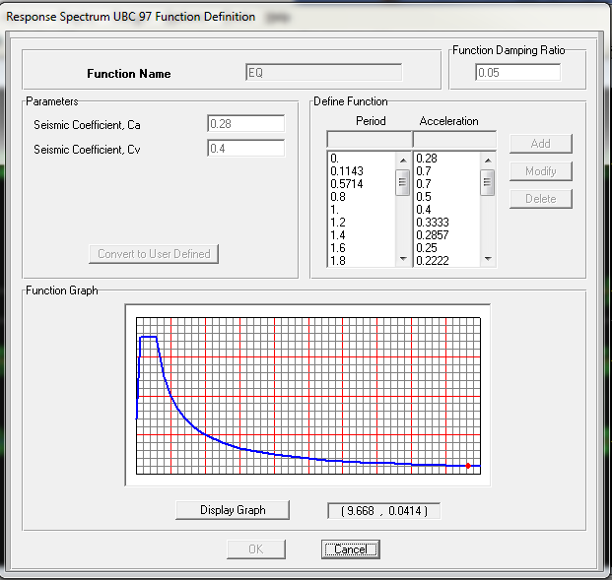
Seismic design using Response Spectrum – UBC 97: -
Soil type SD
C_{v} = 0.40
C_{a} = 0.28
T = 0.27 sec.

Slide 30
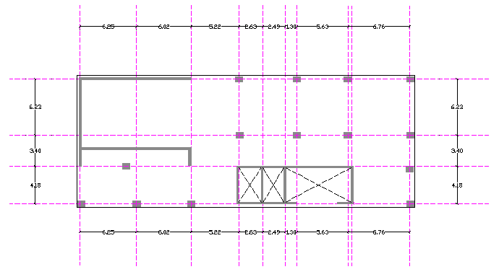
we use one type of column (60*80) cm .

Slide 31
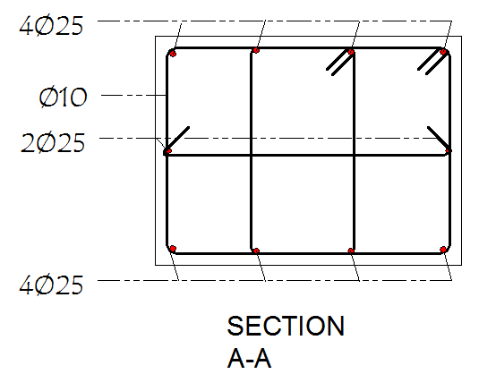
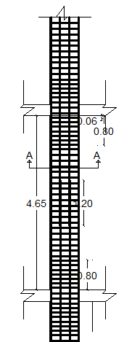
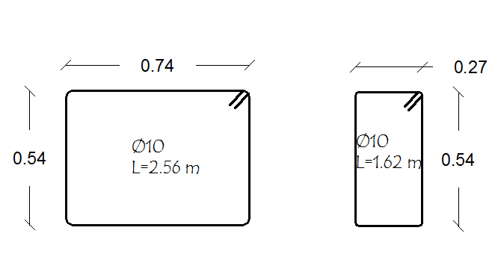
Reinforcement details in columns :-

Slide 32
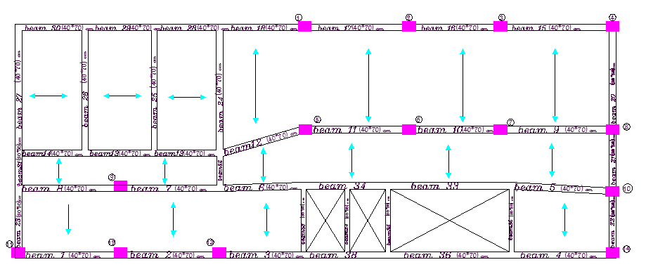
Types of beam .
the main beam in x direction =(40*70) cm .
beam (40*50) cm.
beam (30*30 )cm.

Slide 33
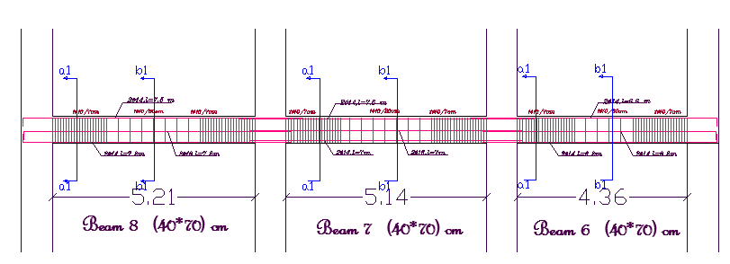
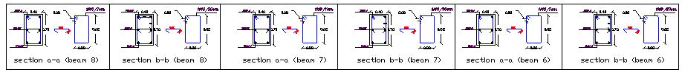
Reinforcement details in beams:-

Slide 34
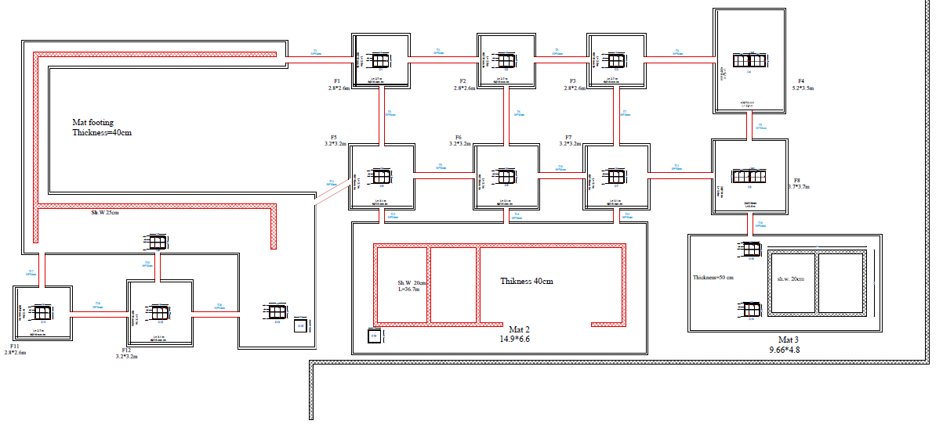
footing design :-
footing plane:

Slide 35
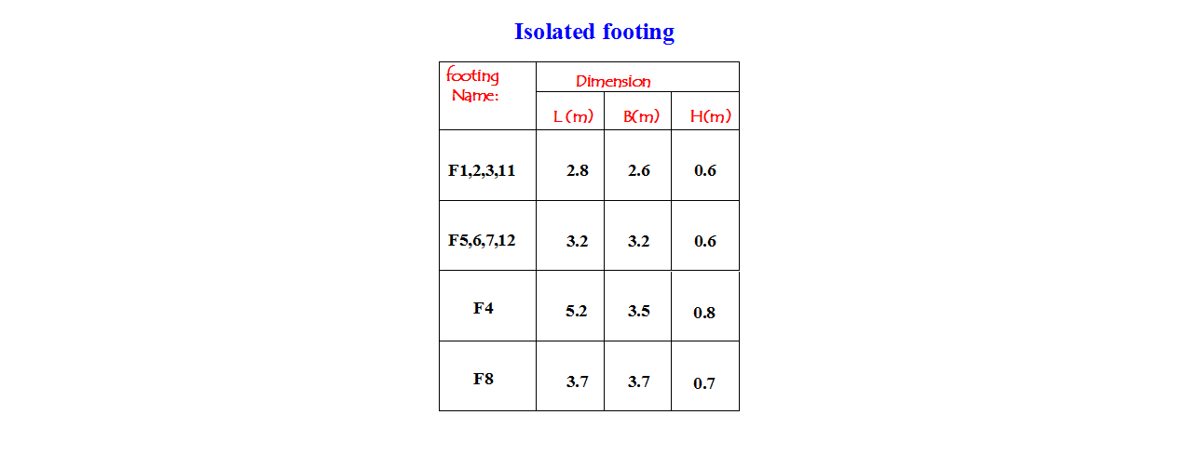
Isolated footing :-

Slide 36
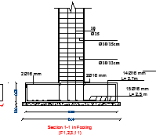
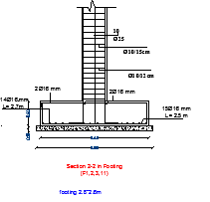
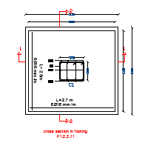
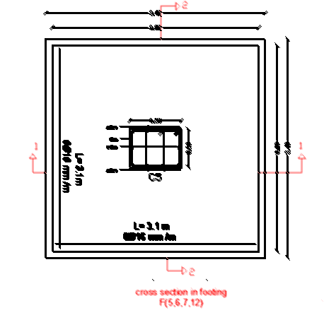
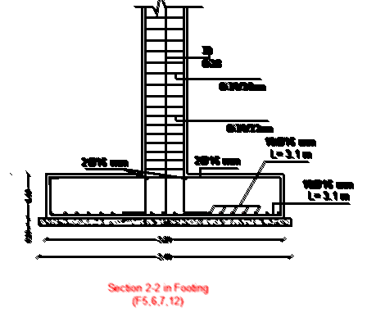
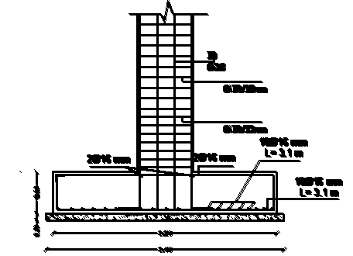
Reinforcement design for footing :-
footing 1,2,3 ,11.
footing 5,6,7,12.

Slide 37
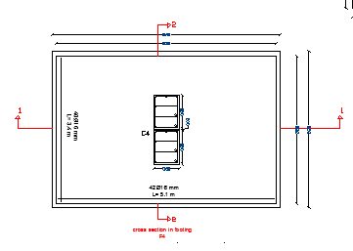
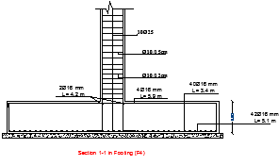
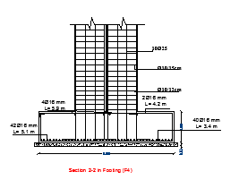
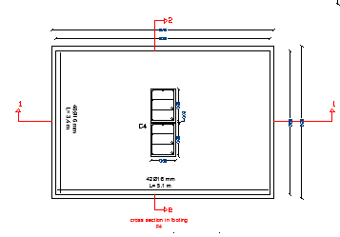
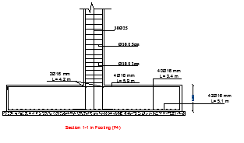
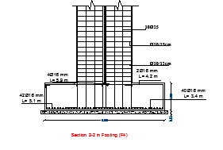
footing 4:-
footing 8:-

Slide 38
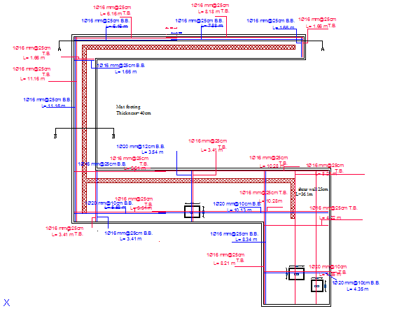
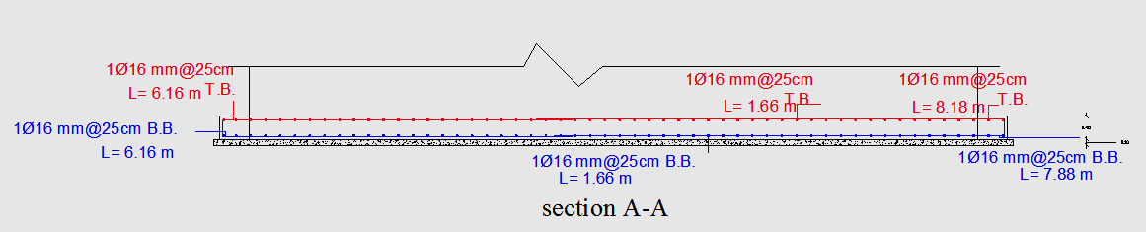
Mat footing (1) with 40 cm thickness :-

Slide 39
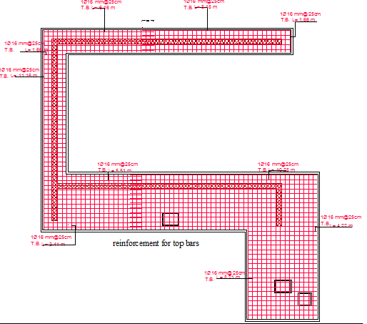
Top & bottom reinforcement for mat footing (1) :-

Slide 40
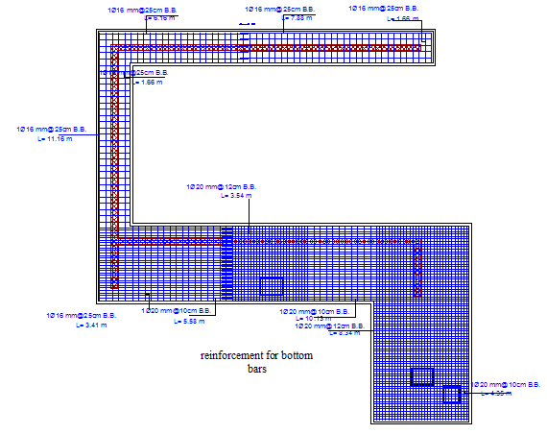
Top & bottom reinforcement for mat footing (1) :-

Slide 41
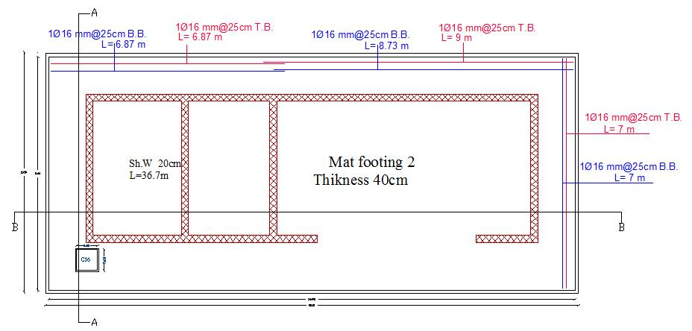
Mat footing (2) with 40 cm thickness :

Slide 42
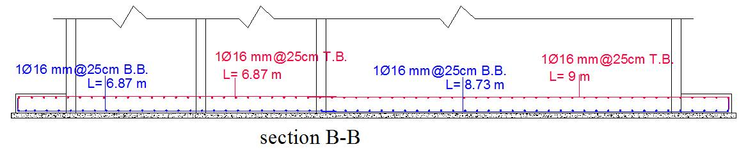

Mat footing (2) with 40 cm thickness :

Slide 43


Mat footing (3) with 50 cm thickness :

Slide 44

Design of tie beams:

Slide 45

Hydrotherapy pool:-
Design Data:-
Wall Thickness: tw=0.25m.
TS =1.11 s
SS=1.55
S1=0.93
I =1.25
Fa=1
FV=1.5

Slide 46


Hydrotherapy pool details :

Slide 47



Slide 48


Shear wall design :

Slide 49

Enviromental Design

Slide 50

This calculation only for one block for four floors of the hospital.

Slide 51

Annual sun path for January at 8 Am. :

Slide 52

Annual sun path for January at 12 pm. :

Slide 53

Annual sun path for January at 4 pm. :
Jan . 4

Slide 54

Annual sun path for July at 8 Am. :

Slide 55

Annual sun path for July at 12 pm. :

Slide 56

Annual sun path for July at 4 pm. :

Slide 57

Shading for elevations:

Slide 58


Daylight factor for Emergency in west elevation:
It has a daylight factor of 3.19% and daylight level of 289 Lux.

Slide 59


Daylight factor for Doctors room (north) :
It has a daylight factor of 3.83% and daylight level of 345 lux.

Slide 60


Daylight factor for Clinic(south-east):-
It has a daylight factor of 3.76% and daylight level of 339 lux.

Slide 61


Daylight factor for Bedroom (south-west):_
It has a daylight factor of 4.20% and daylight level of 378 lux.

Slide 62


Thermal Design:
Material used for external walls:
Material used for windows:
Thermal Conductivity (U) equal to 0.502W/m².k.
Thermal Conductivity (U) for windows
(Double glazed) equal to 1.689 W/m².K.

Slide 63


Materials used for floors:
Materials used for ceiling:
Thermal Conductivity (U) for floor
equal to 0.86 W/m².k.
Thermal Conductivity (U) for ceiling
equal to 0.623 W/m².k.

Slide 64

Monthly heating & cooling for the block:
Max. heating load= 5.35kwh/m2.
Max. cooling load= 5.01kwh/m2.

Slide 65

Annual heating and cooling for the block:
Heating load (Kw/m²) | Cooling load (Kw/m²)
20.69 | 22.73

Slide 66
Acoustical Design:
(Floor design)
Impact Sound Insulation of Floor-Ceiling between hospital units:
Apt. A` |  | Apt. B | IIC
Patient room | Above | Patient room | 46-49dB
corridor | Above | Patient room | 46-49dB
Patient room | Above | ICU or operation | 46-49dB
Corridor and meeting room | Above | operation | 54-57dB

Slide 67

STC between patient rooms equal to 31-41db.
STC | Layers
38 | 4-in. Dense hollow block
Plus 4 | Add plaster to both sides
42 | Total
Internal walls between patient room.

Slide 68

STC for doctors room:
The value of STC between doctors room and gym shall be about 54-59db.
The value of STC between corridors and doctors room shall be 31-42.

Slide 69


Material used for partition
between doctor’s room and gym.
Material used for partition between doctor’s room and corridor.
STC | Layers
48 | 8-in. Dense hollow block
Plus 3 | Add sand to cores of hollow blocks
Plus 10 | Add furring strips, lath and plaster to both sides
61 | Total
STC | Layers
38 | 4-in. Dense hollow block
Plus 4 | Add plaster to both sides
Plus 3 | Add sand to cores of hollow blocks
45 | Total

Slide 70

External walls:
STC equal 61db.
Since, the average noise out of the hospital about 59, so 61 db for this exterior wall is acceptable.

Slide 71



Acoustical Design: (RT60)
The required optimum values of RT₆₀ level in emergency is 0.6-1 sec.
Materials used for floor and beds
Materials used for ceiling.
Materials used for walls and door.

Slide 72

Acoustical Design: (RT60)
RT60 from ecotect

Slide 73



Acoustical Design: (RT60)
The required optimum values of RT₆₀ level in patient room is 0.4-0.8 sec.
Material used for ceiling
Material used for floor and furniture
Material used for walls and door

Slide 74

Acoustical Design: (RT60)
RT60 from ecotect

Slide 75



Acoustical Design: (RT60)
The required optimum values of RT₆₀ level in GYM is 1-1.25 sec.
Material used for ceiling
Material used for tiles and devices
Material used for walls and windows

Slide 76

Acoustical Design: (RT60)
RT60 from ecotect

Slide 77

Mechanical design

Slide 78


Hvac design:
Using DC-12 fan coil unit
Filters for operating and ICUs.

Slide 79

hvac:

Slide 80

hvac:

Slide 81

hvac:

Slide 82

hvac:

Slide 83

hvac:

Slide 84


After using about 65 fan coil unit with flow rate 952cmf (0.45m³/s) for the hospital, APX 90-2S chiller has to be used.
A large air handling unit used to get
a fresh air for basement, ground and
first floors in the hospital.

Slide 85

Water supply:
2.5 " steel pipe for vertical feeder
1.5" pvc pipe for main feeder.
0.75 pvc pipe for branch.

Slide 86

Sewage system:
Bathrooms

Slide 87

Gas lines:

Slide 88

Electrical Design

Slide 89



Waiting room 1:
E_{av} [lx] | u0 | UGR
288 | 0.746 | 10-16

Slide 90



X- ray room :-
E_{av} [lx] | u0 | UGR
347 | 0.815 | <10

Slide 91

Single bedroom:
E_{av} [lx] | u0 | UGR
346 | 0.685 | <10

Slide 92



Emergency room:
E_{av} [lx] | u0 | UGR
533 | 0.727 | 11-13

Slide 93

Sockets distribution for the ground floor.

Slide 94

Light distribution for the Ground floors.

Slide 95


Fire & Safety
Design

Slide 96

Distribution of stairs in hospital

Slide 97









Fire system used in the hospital:-
Safety signs:
Staircase sign
Right and left Exit
Fire extinguishers
Hose system
Use elevators
Fire exit
Sprinklers
Fire alarm
Smoke detectors

Slide 98

Cost estimation

Slide 99


COST ESTIMATION:
Total Price for our block | NIS
Structural system | 1158407
Electrical system | 41180
HVAC | 73421
Finishing: | 996053.5

Slide 100



