Slide 1

SVC Based Flexible AC Transmission System (FACTS)
Prepared by : Thana’ Hamdan
Hiba Jad-Allah
Supervised by: Dr. Kamel Saleh

Slide 2
content:
Why PF correction
Ordinary methods of PF correction
Static variable compensation method and its advantages
Methodology and Simulation of SVC
Close loop control
PF meter
Matlab simulation of the project
Result of matlab simulation
Zero crossing and result on hardwire

Slide 3
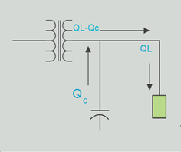
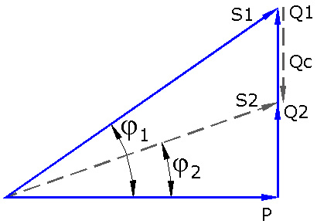


• Why PF correction ?

Slide 4
• Why PF correction ?
Until these goals are achieved :
Increase transmission efficiency
Increase voltage regulation
Reducing an apparent power (S) leads to reducing current
Reducing losses of electrical energy
Saving both of money and energy

Slide 5
• Methods of PF correction
1- Capacitor banks
The main disadvantage of this method is that it requires high load to sense the change on the power factor and its changes in a steps and not in smooth way , so it can’t be achieved a PF at some load
2- Synchronous Condenser
The main disadvantage of using this method is the high cost to be used in light load
3- Phase Advancer :
The main Disadvantage is that Using Phase advancer is not economical for motors below 200 H.P

Slide 6
• Static variable compensation method and its advantages
SVCs are part of the Flexible AC transmission system device family. This method uses only one capacitor bank and we control the PF by injected reactive power into the line other than controlling capacitance value.

Slide 7
Advantages of using SVC method:
Improved system transient and steady-state stability
Improved static and dynamic load
One capacitor bank only used
Cheaper than other methods
Reduced transmission losses
Simple controlling units

Slide 8
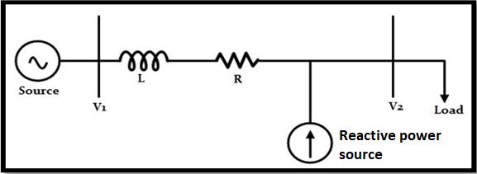
• Methodology and Simulation of SVC
SVC uses TSC (Thyristor Switched Capacitors) based on shunt compensation to controls the power flow in transmission system and improves the transient stability of power grids.
* shunt compensation:

Slide 9
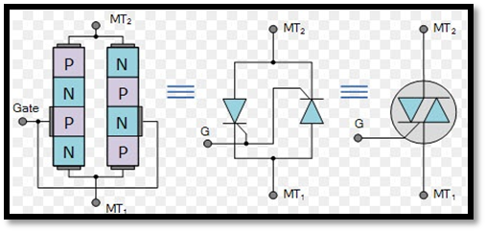
• Methodology and Simulation of SVC
Triac:
consists of two thyristors connected in inverse parallel ,and this The most important part in this method, where we get the variable voltage by controlling the value of the firing angle

Slide 10
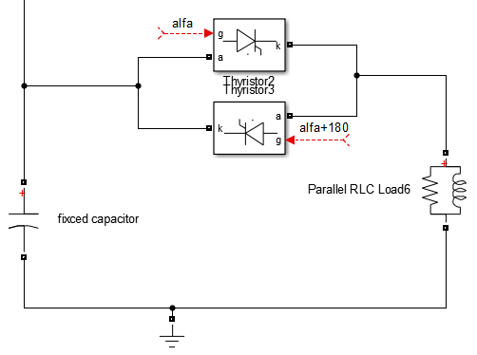
• Methodology and Simulation of SVC
This branch is parallel to the load and contributes the generator in supplying the load by reactive power

Slide 11
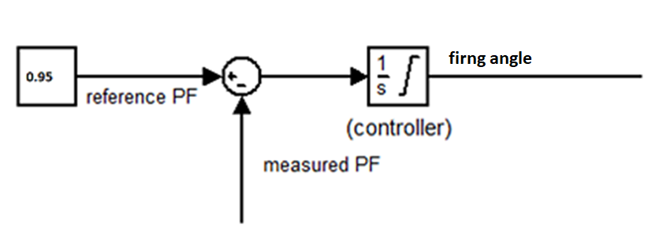
• Close loop control
the PF meter designed by using Matlab Simulink to measure the load factor, the measured value is then entered on a MC to be compared with a selected reference value , and through a closed loop improves the load PF to be equal to the reference value

Slide 12

• PF meter :
To calculate the PF,
we must first calculate
the time difference between the two signals and
convert it to the PF , as shown figure - next slide
according this equation:

Slide 13
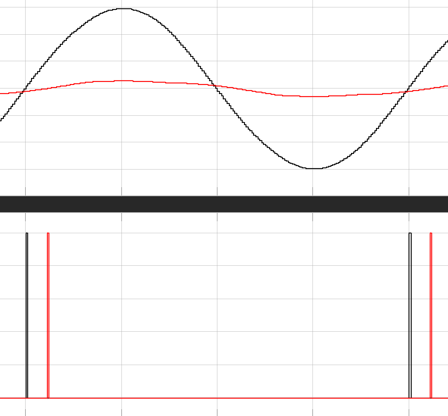
•PF meter:

Slide 14
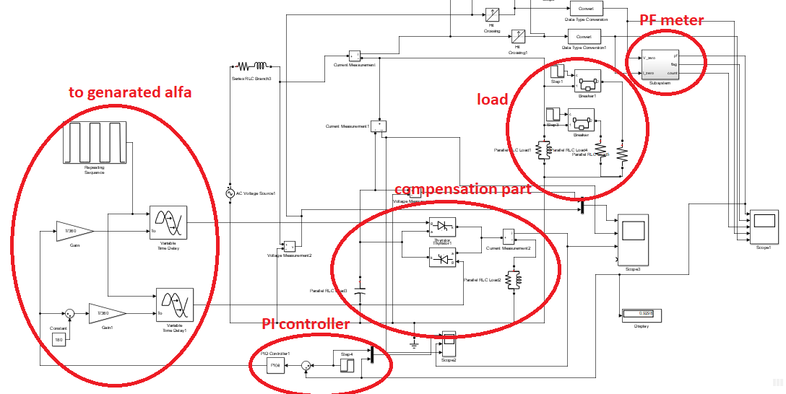
• Matlab simulation of the project

Slide 15
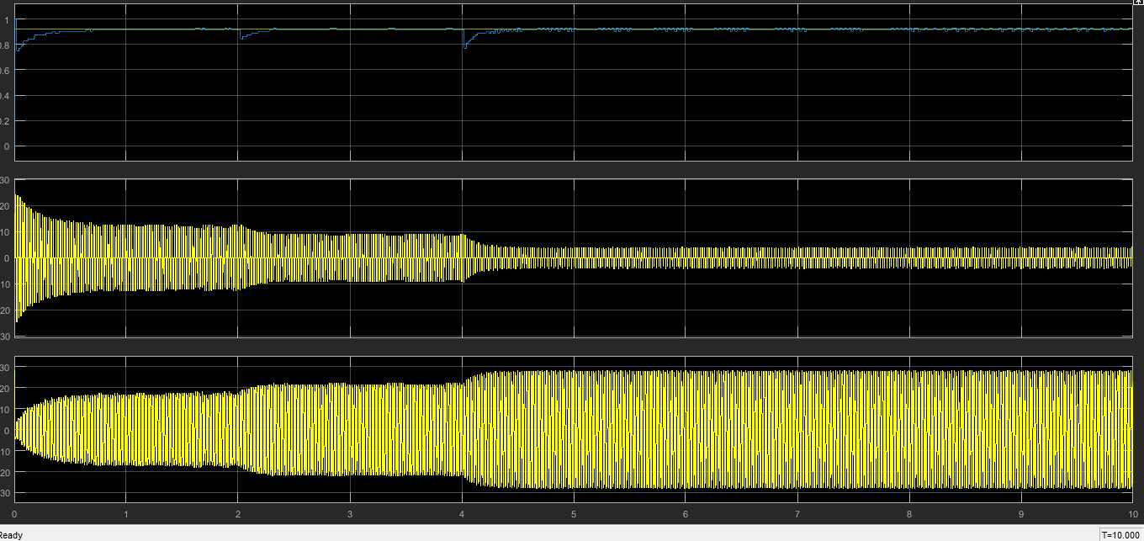
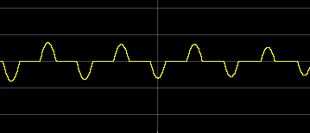

Slide 16
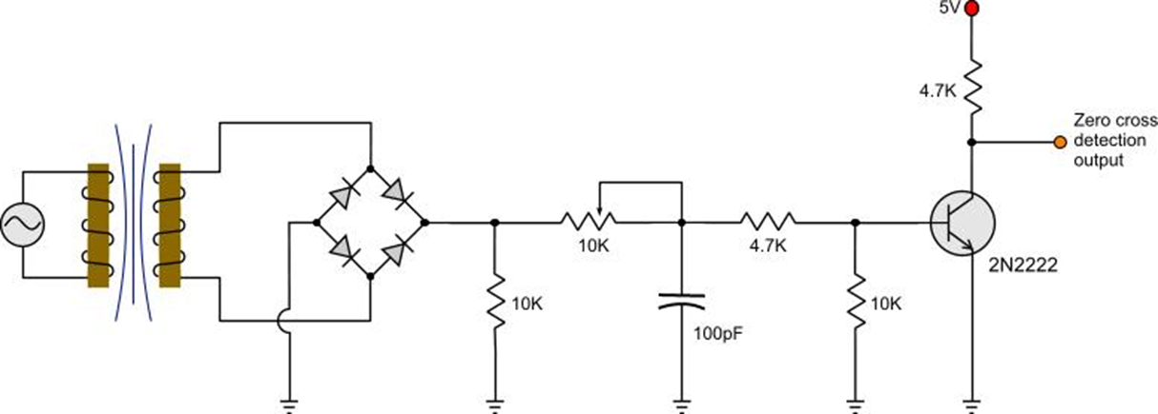
• PF meter
Zero Crossing Detector: The zero cross detection is a circuit that gives a pulse as indication when the input voltage waveform crosses the zero axis .and this is the first step to design PF meter.

Slide 17

The circuit of zero crossing on hardware :

Slide 18
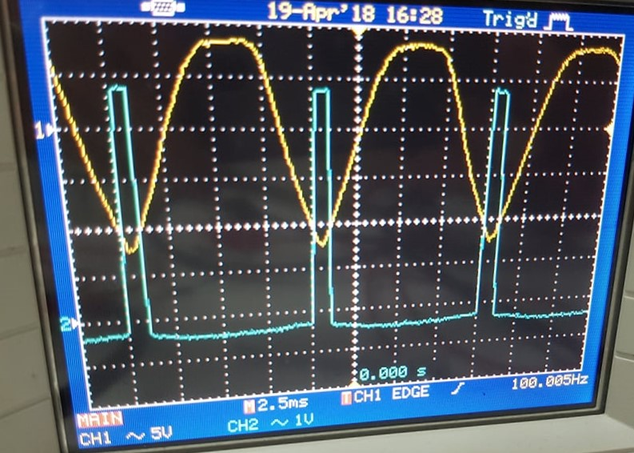
The result of zero crossing on hardware :

Slide 19


