Slide 1

Automated General Purpose
Safety and Security System
Sopervisor: Dr. Bashir Noari
Prepared by:
Moemen Atweh
Zaid Jaradat
Yousef Qasrawi

Slide 2
Outlines:
Introduction
Definition
Components
Methodology

Slide 3

Introduction
Some Statistics and numbers of the Palestinian Civil Defense:
4151 fire accidents
32 deaths
1038 injuries

Slide 4
The design system will be able to secure the working area and saves human lives by controlling hazard energy sources
The system exactly will be able to deal with:
• Fire accidents
• Gas leakage
• Incidents of theft

Slide 5
Design part
we can classify this part in 3 points:
External shape
Hardware part
Software part

Slide 6
Electrical part
Power supply
It is used to feed the system with electricity
The output voltage is 12 volt with max current ( )amp
Arduino mega feed sensors and equipments that don’t use 12 volt

Slide 7
External shape

Slide 8
Hardware part
We can divided to 5 points:
Detection components
Warning components
Control components
Other components
Electrical components

Slide 9
1. Detection components
The equipments can divide in three points:
Fire detectors
Gas detectors
Motion detectors

Slide 10
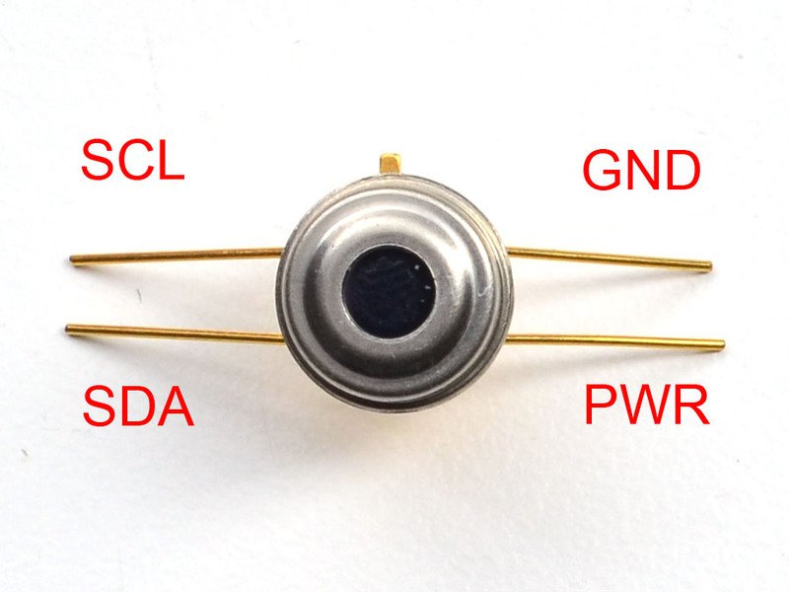
Fire detectors:
The system will use three kinds of sensors:
IR temp sensor (GY-906)

Slide 11
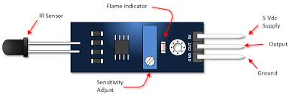
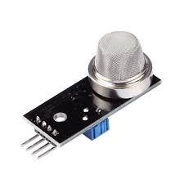
Flame sensor
Smoke sensor

Slide 12
Gas sensor (MQ2)

Slide 13
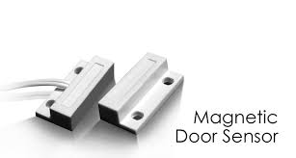
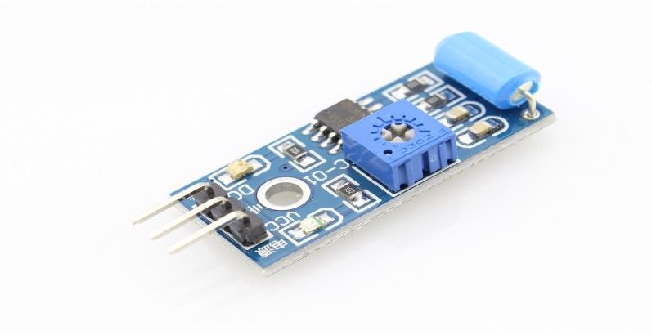
Motion detectors
The system will use tow sensors:
Magnetic door/window sensor
Window break sensor (vibration sensor)

Slide 14
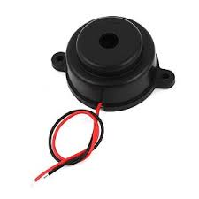
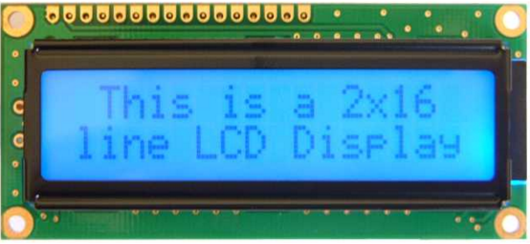
2. Warning and monitoring components
Piezobuzzer (beeper)
LCD Screen

Slide 15
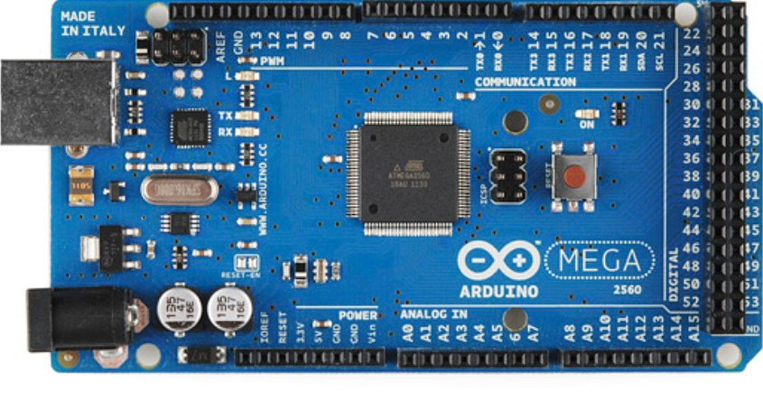
3. Control components
Arduino Mega

Slide 16
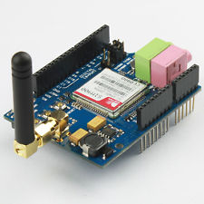
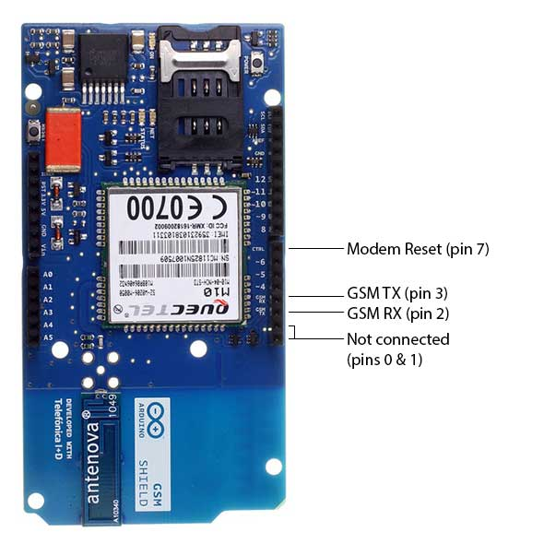
GSM shield

Slide 17
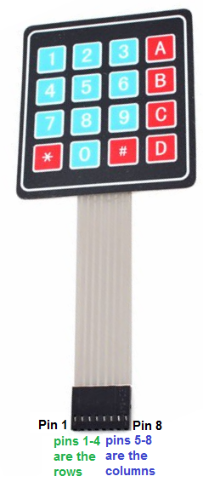
Matrix keypad

Slide 18
Other components
Fan
suction
led line
pump

Slide 19
Procedure and cases:
Case1: Fire control system
Case2: Gas leak control system
Case3: Theft control system

Slide 20
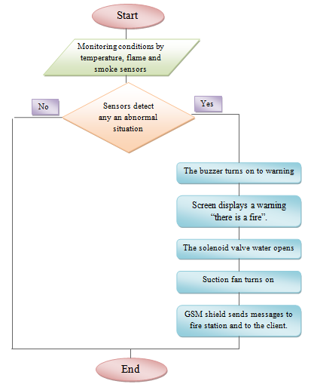
Case1: Fire control system

Slide 21
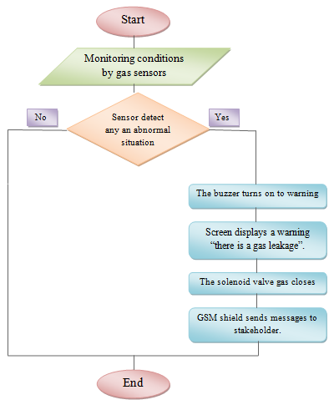
Case2: Gas leak control system

Slide 22
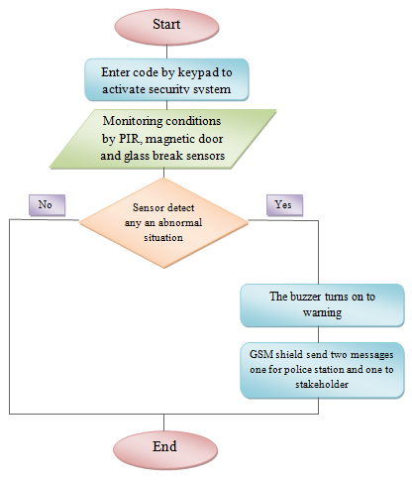
Case3: Theft control system

Slide 23
Thank you for lessening
Questions??

