Slide 1
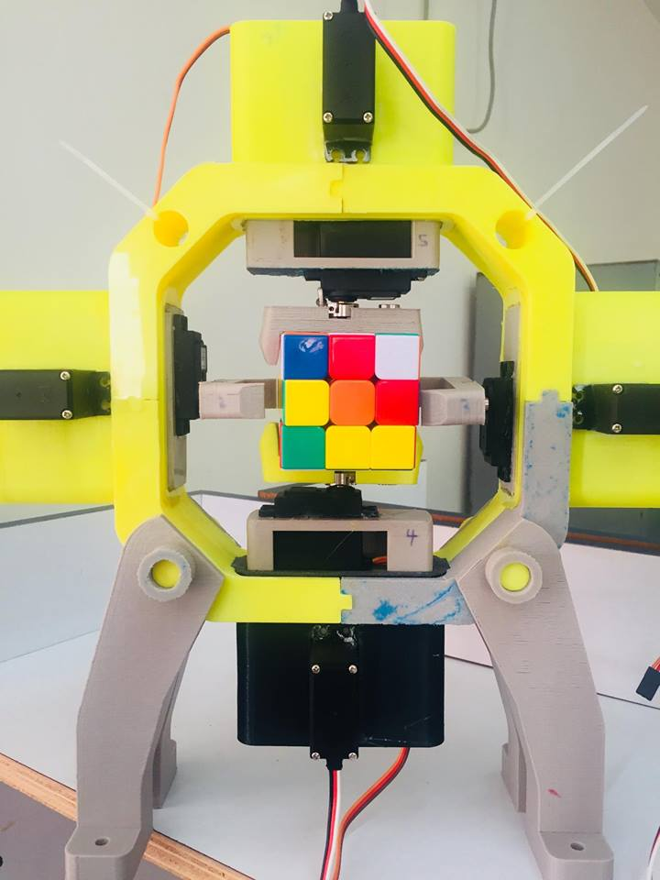
Rubik’s Cube Solver Robot

Slide 2
The Outline
Introduction
Tools
Development Parts
Demos
Constraints
Future work

Slide 3
Introduction
Rubik’s Cube Solver is a robot to solve 4*4 Rubik’s cube.
Its structure designed using 3D printer.
It use OpenCV for image processing .
It use Kociemba’s Algorithm for solving the cube

Slide 4
Tools
Arduino Mega
Raspberry pi
8 Servo Motors
Camera
Power Supply

Slide 5
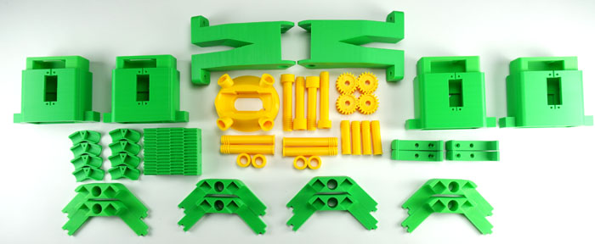
Tools
3D printed robot parts

Slide 6
Development Parts
Detecting the colors of each face
Solving Algorithm

Slide 7
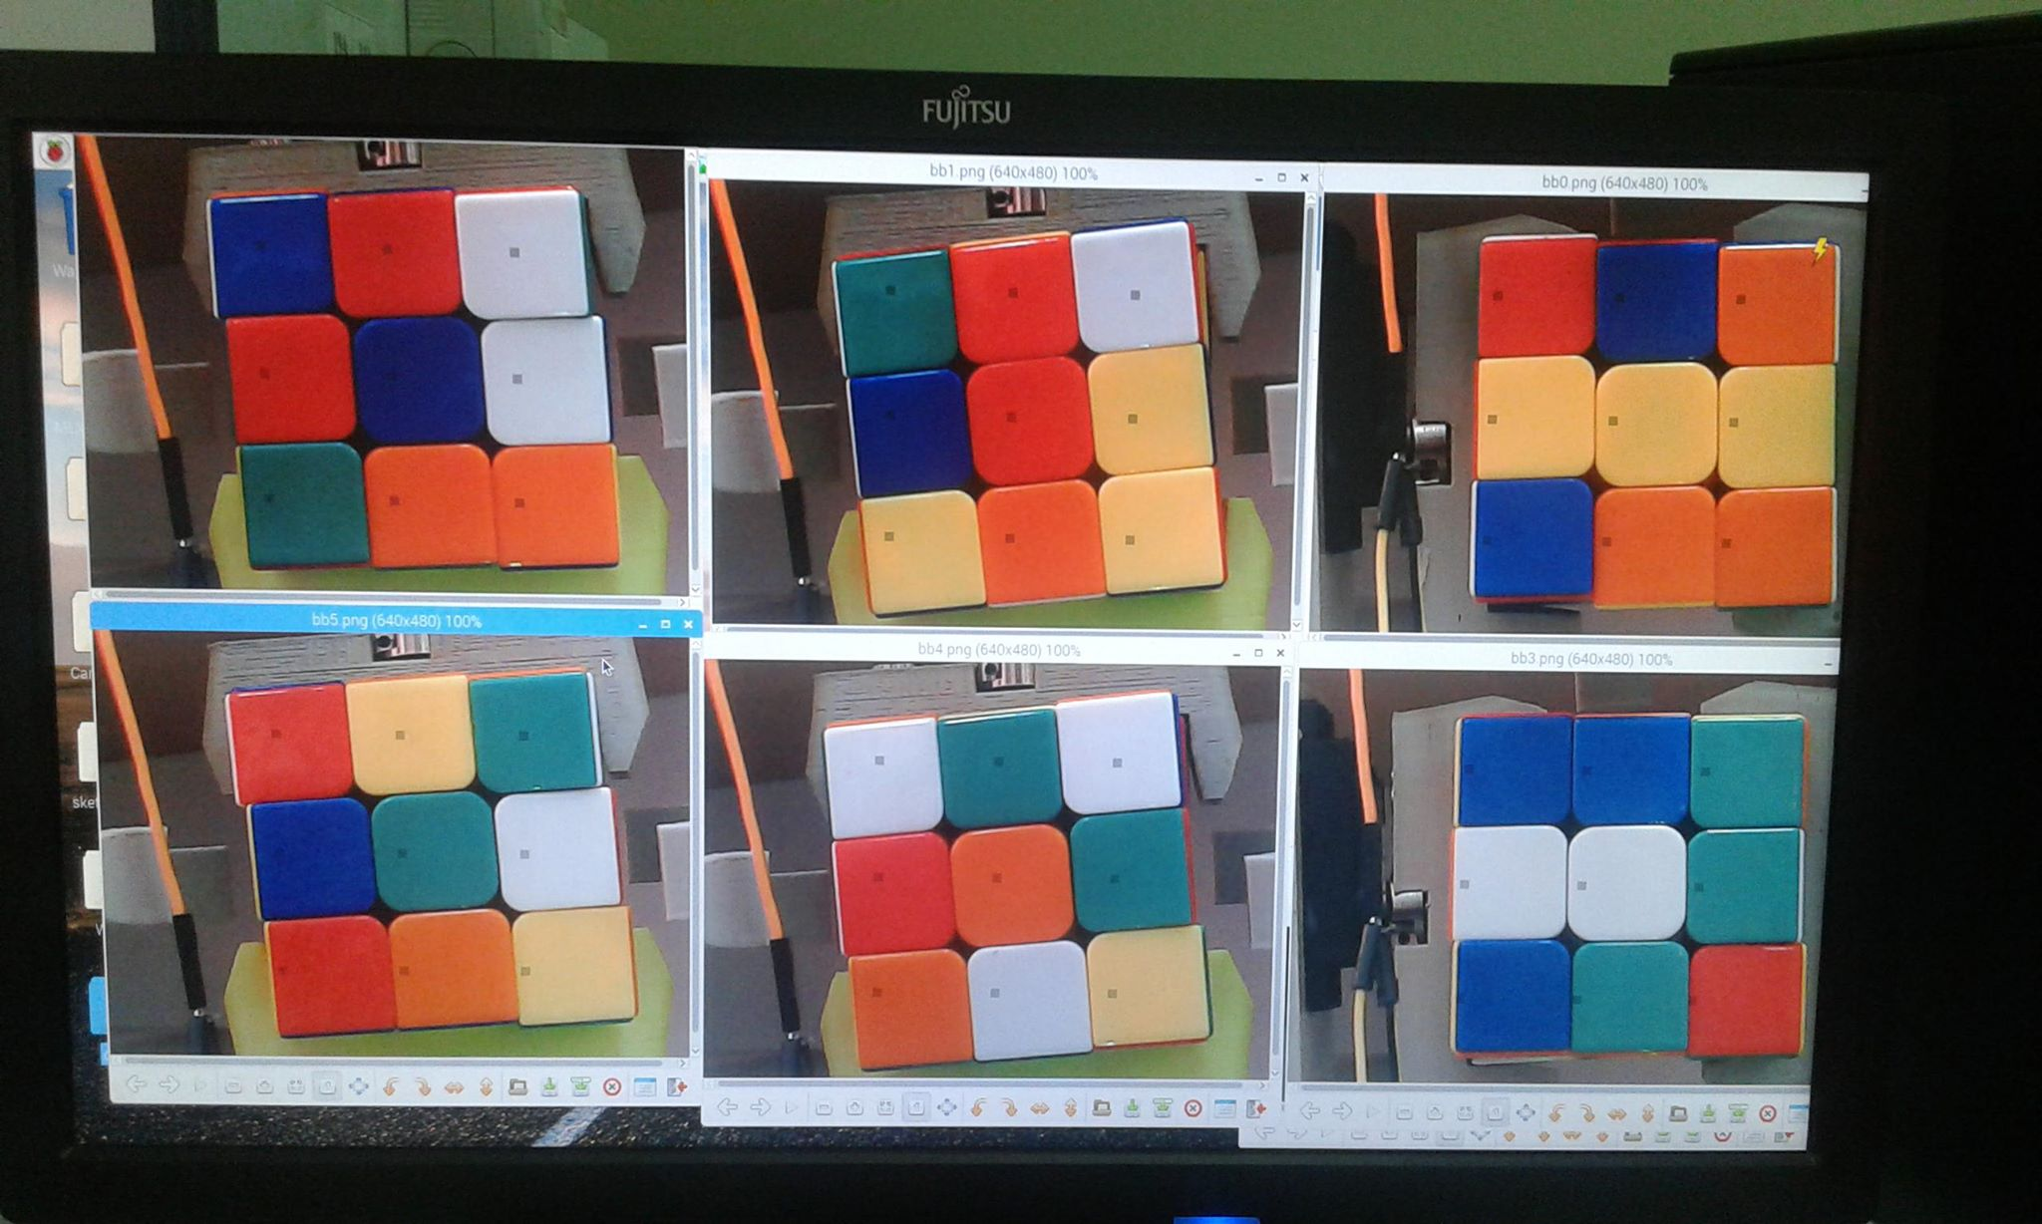

Slide 8
Demo 1

Slide 9
Kociemba’s Algorithm(Two-phase algorithm)
works by dividing the problem into only two subproblems(corners and edges).
G1 = <U,D,R2,L2,F2,B2>.
G2 = <R,R',L,L',F,F',B,B'>
This method applies an advanced implementation of IDA* search to be able to calculate, remove symmetries from the search tree, and solve the cube close to the shortest number of possibilities.

Slide 10
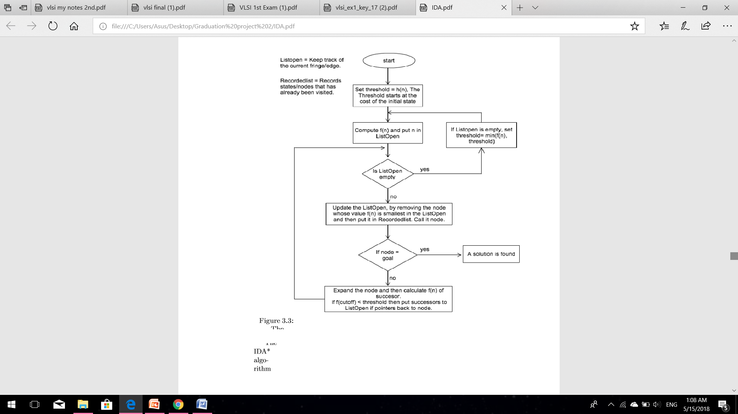
IDA* Flowchart

Slide 11
Demo 2

Slide 12
Constraints
High cost.
Time constraint.
Design constraints.

Slide 13
Future Work
We hope to make our robot faster and can solve the cube in just a few seconds by improving the solving algorithm
we wish to have an accurate motors degree which can move the cube without any problems or helping from the humans.

Slide 14
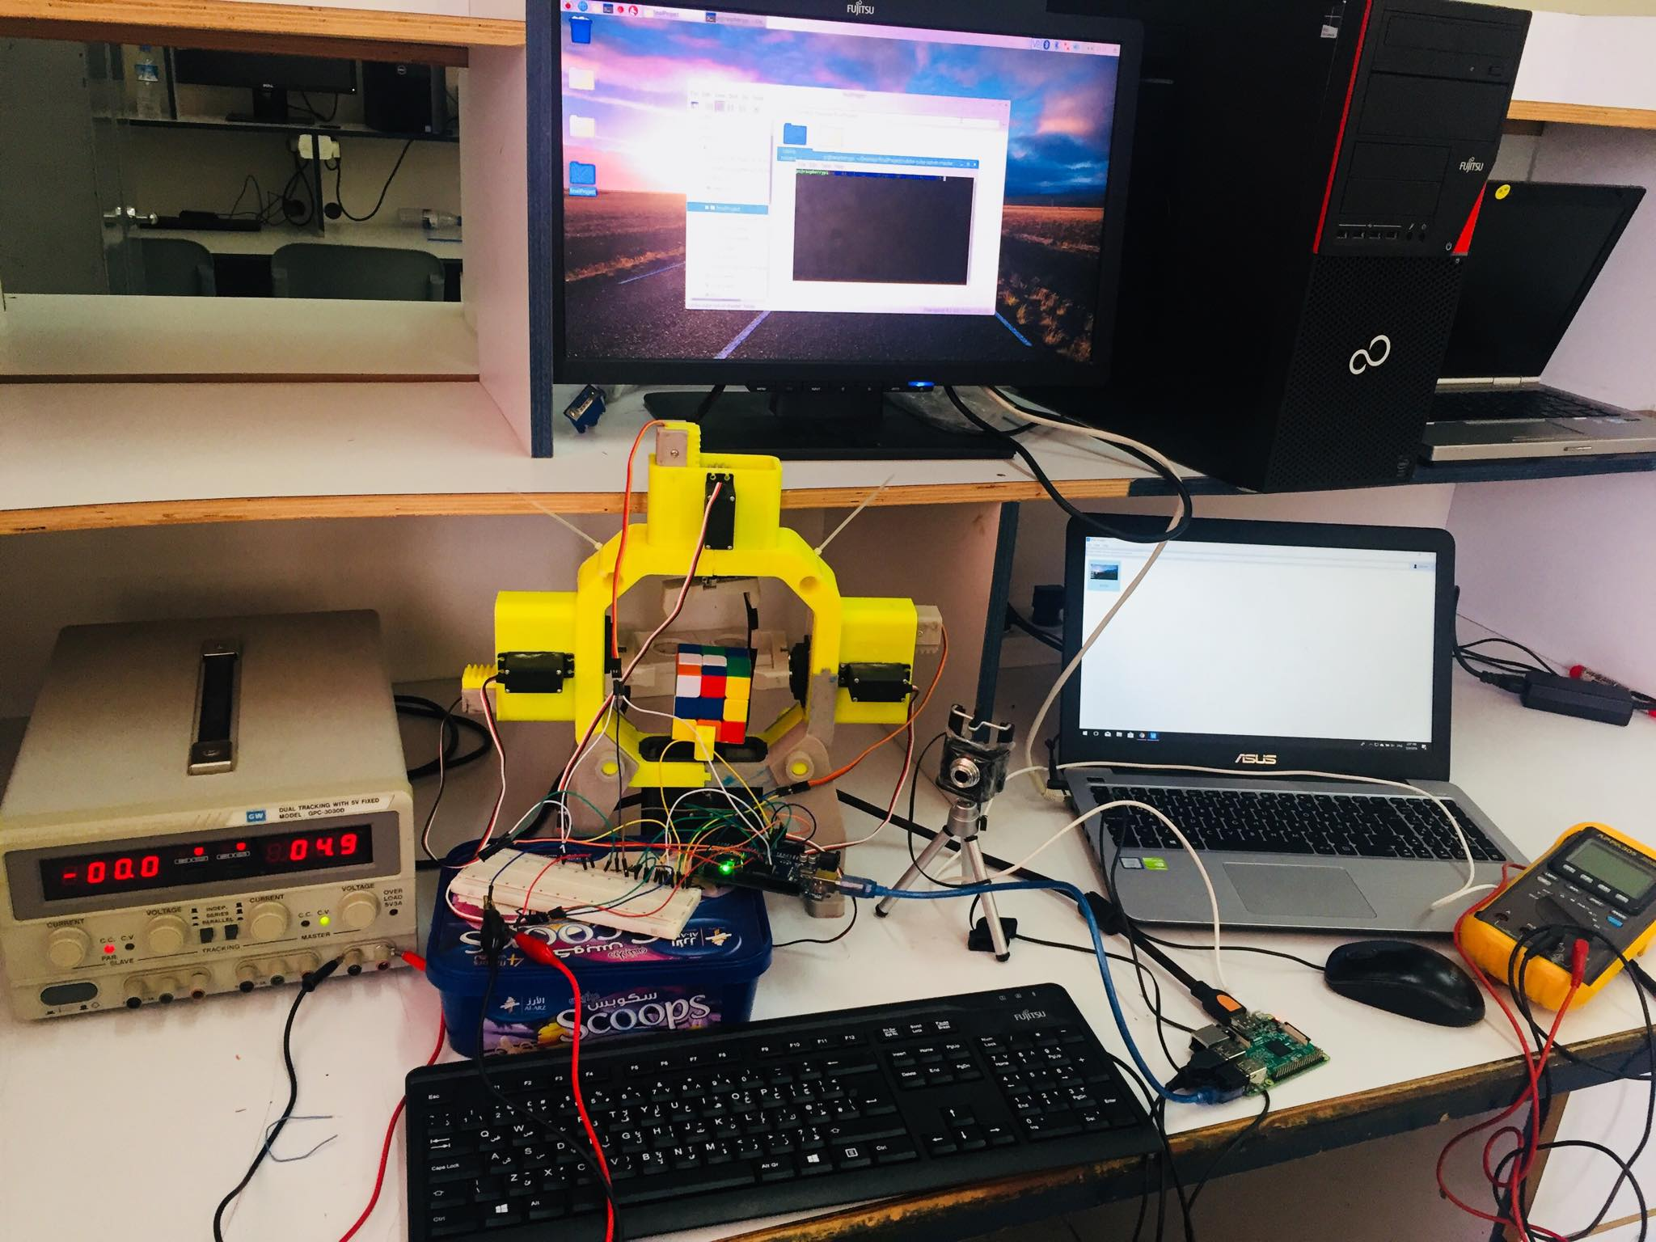

Slide 15


