Slide 1
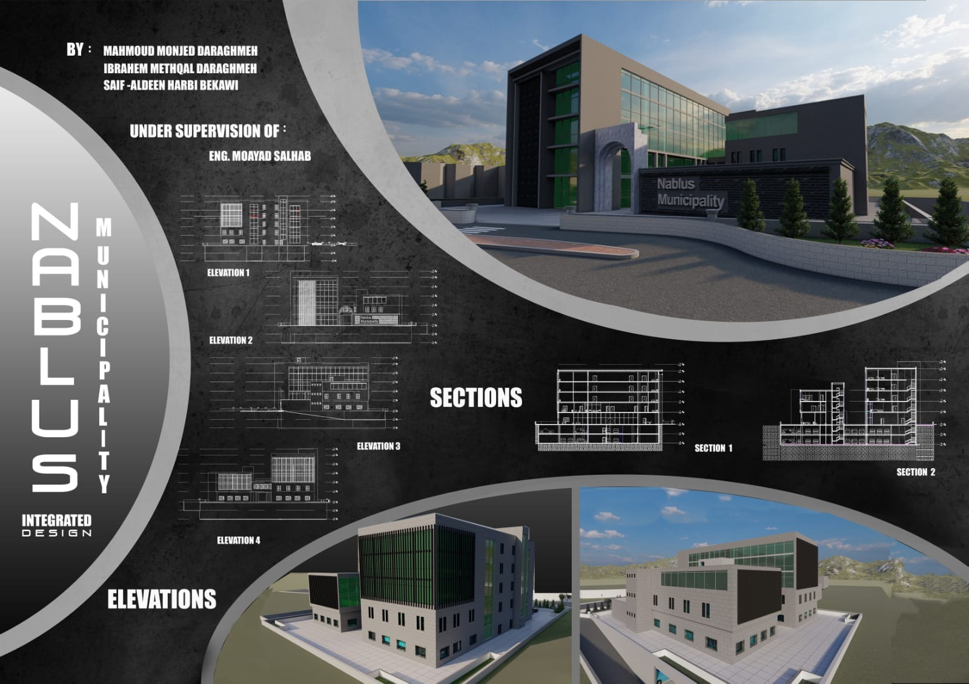


Slide 2
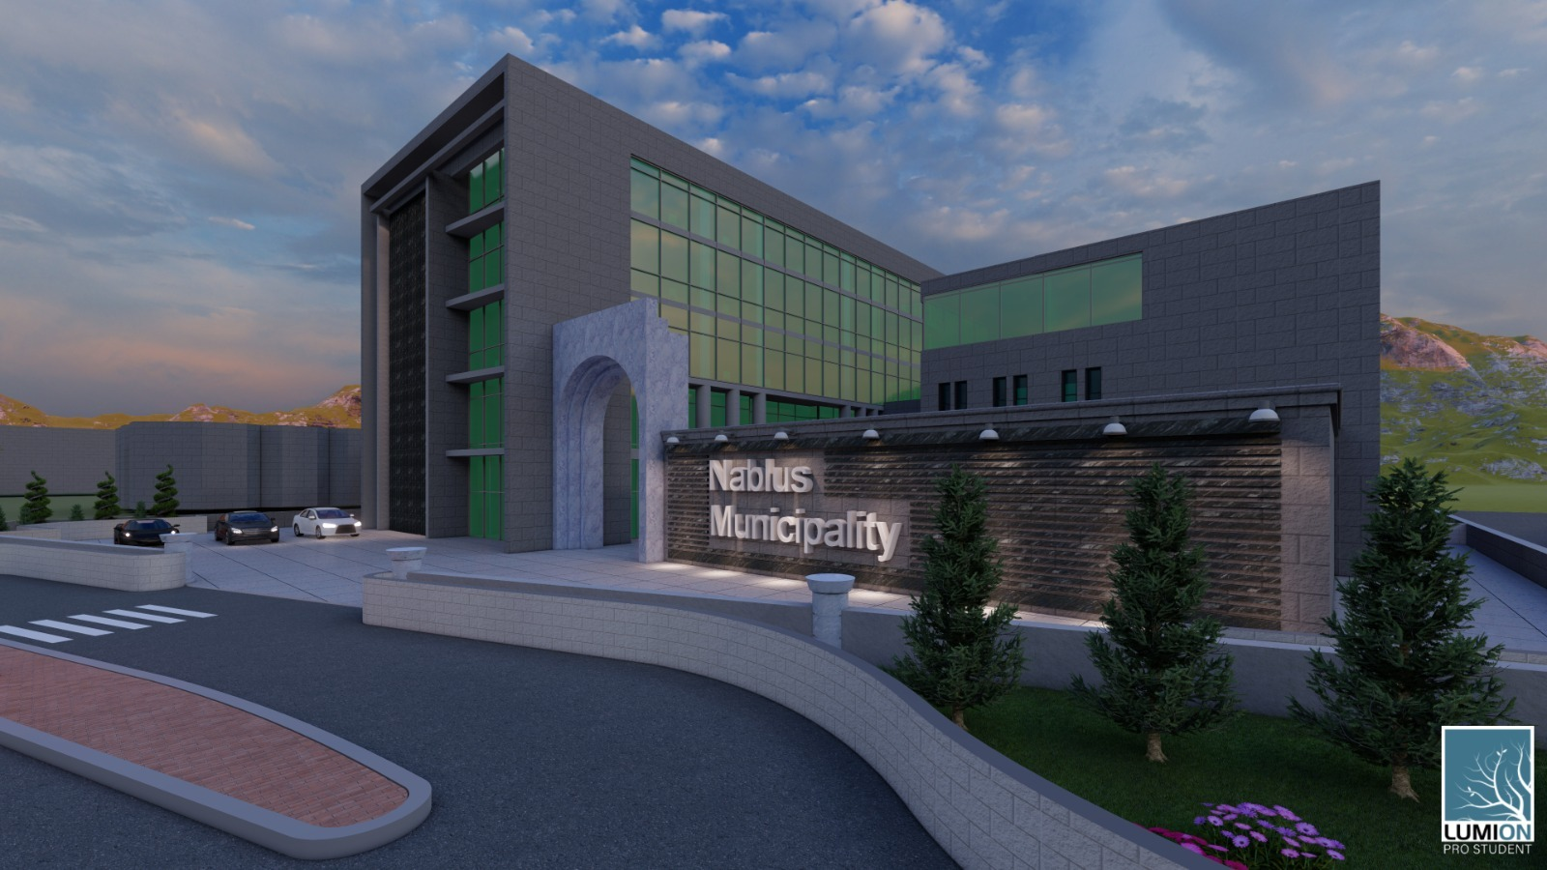
introduction.
Description of project.
Architectural Analysis.
Environmental Evaluation .
Structural Analysis.
Electromechanical.
Cost & Budget.
Outline:

Slide 3
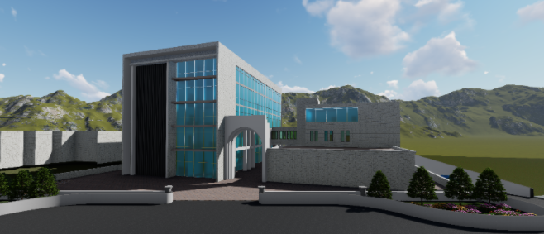
Introduction:
Our graduation project is an integrated design for the municipality of Nablus, near Jamal Abdel Nasser Park

Slide 4
introduction.
Description of project.
Architectural Analysis.
Environmental Evaluation .
Structural Analysis.
Electromechanical.
Cost & Budget.
Outline:

Slide 5
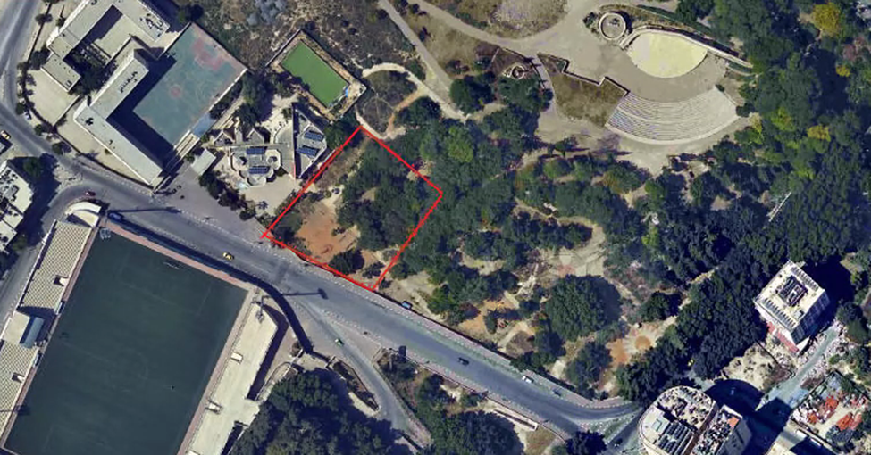
Our project locates in near Jamal Abdel Nasser Park in Nablus city with area 2369.42 meter square
Location and Site:

Slide 6
introduction.
Description of project.
Architectural Analysis.
Environmental Evaluation .
Structural Analysis.
Electromechanical.
Cost & Budget.
Outline:

Slide 7
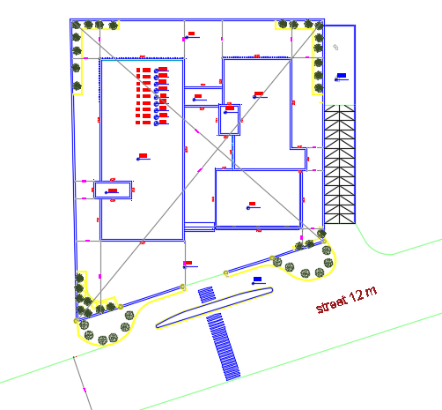
Architectural analysis and redesign
Site plan ground floor after modification

Slide 8
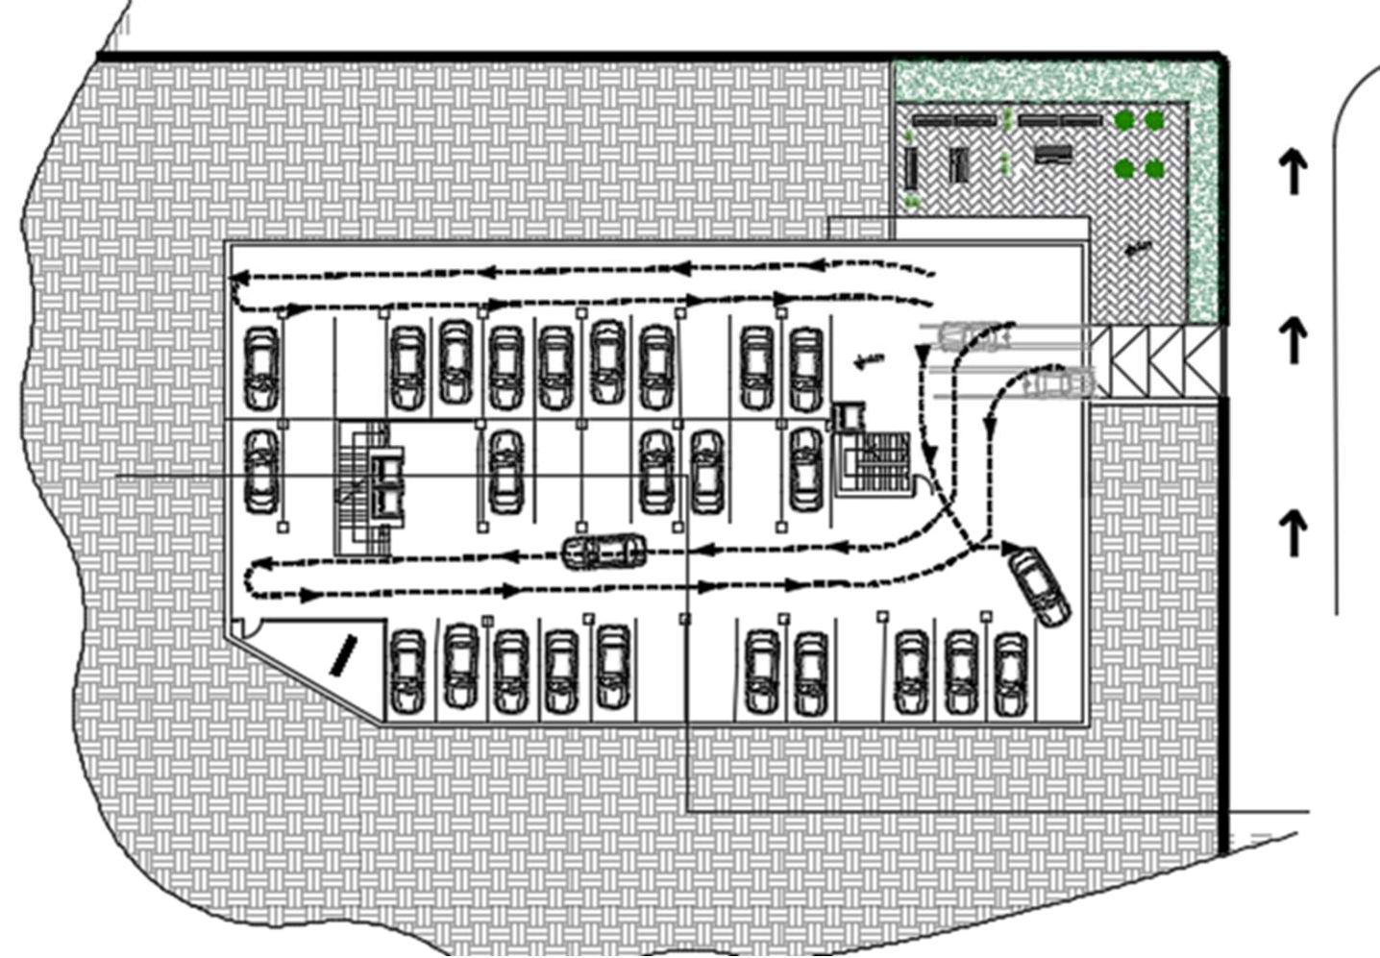
Architectural analysis and redesign
Parking plan before modification (B1).

Slide 9
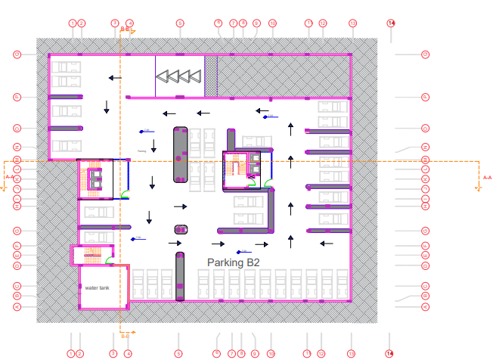
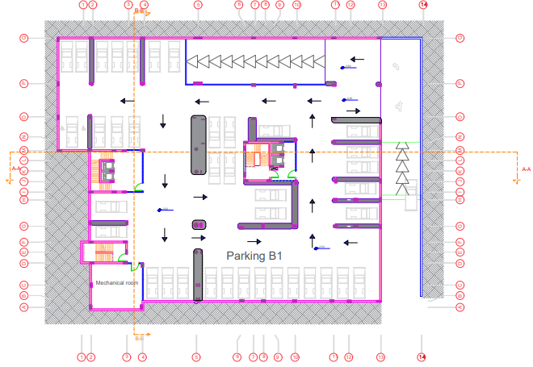
Architectural analysis and redesign
Parking plan after modification(B2) Parking plan after modification(B1) :

Slide 10
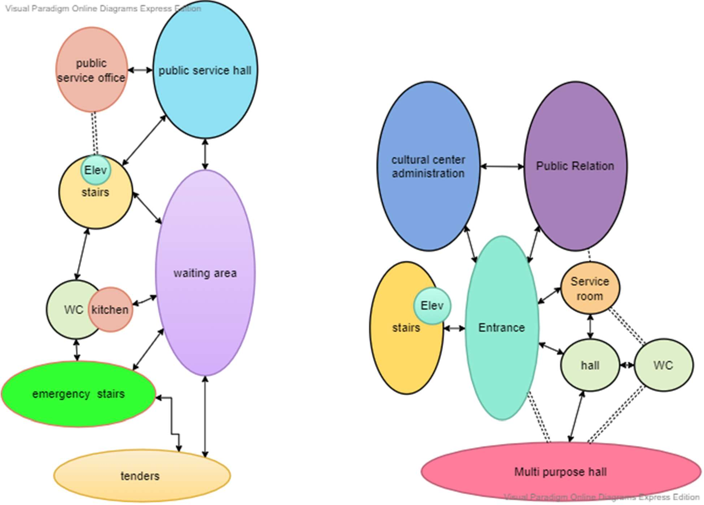
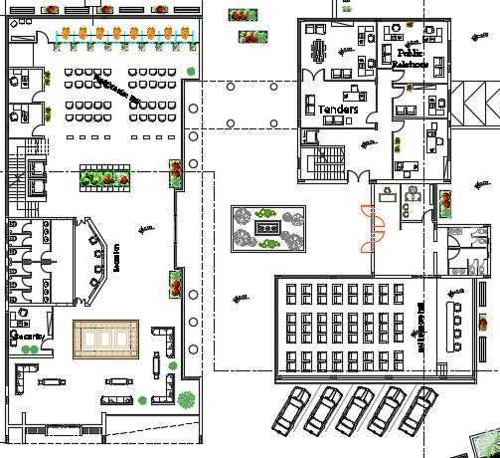
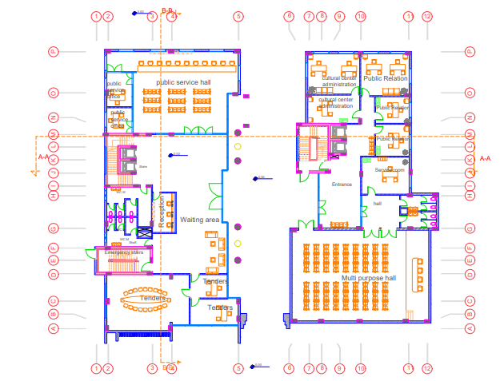
Architectural analysis and redesign
Ground floor before modification. Ground floor after modification

Slide 11
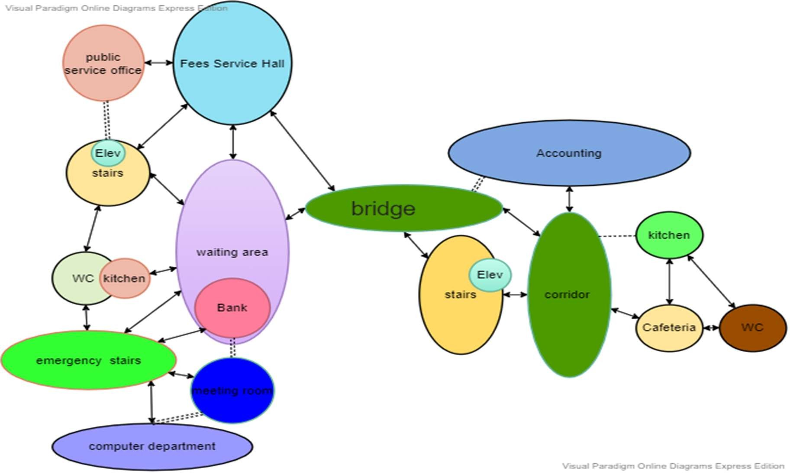
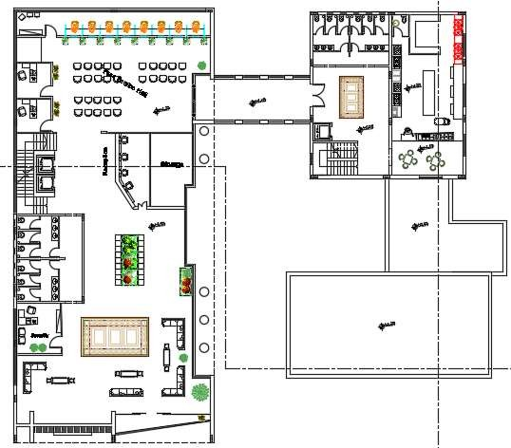
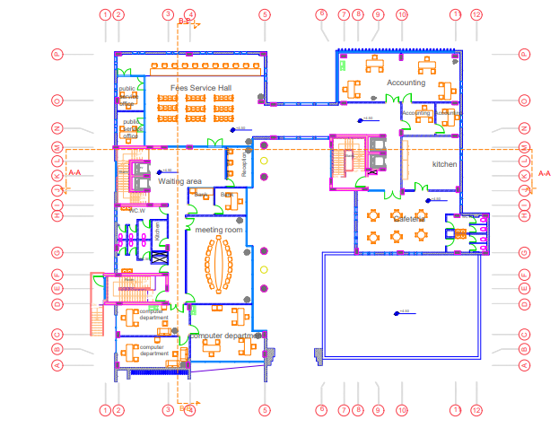
Architectural analysis and redesign
First before modification First after modification

Slide 12
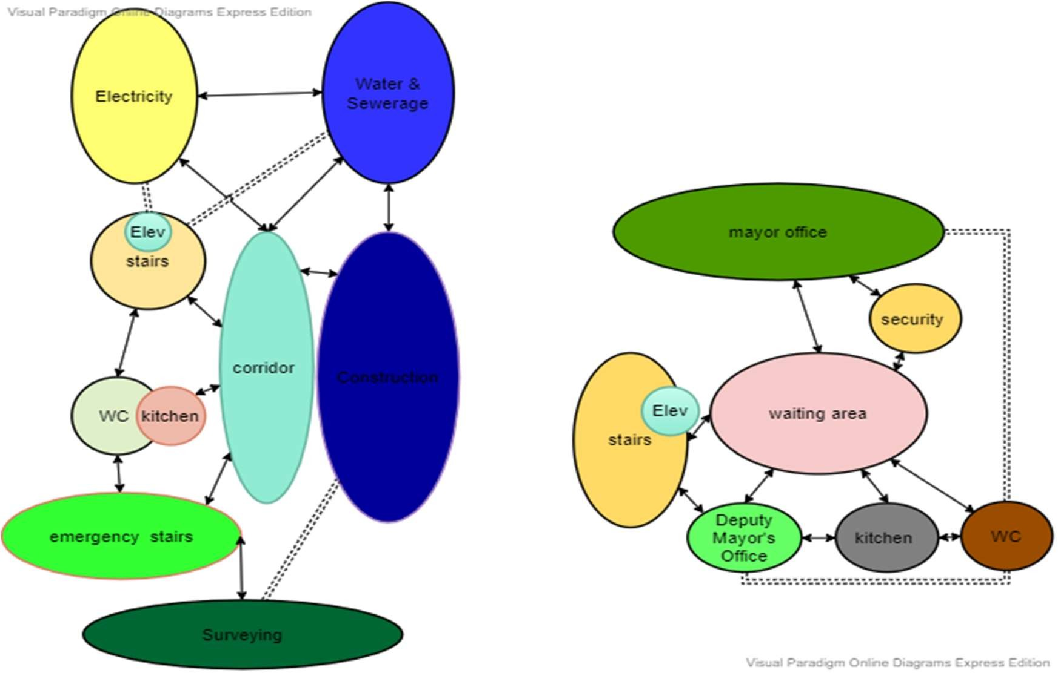
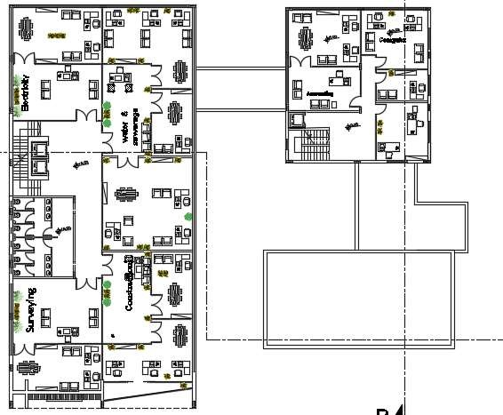
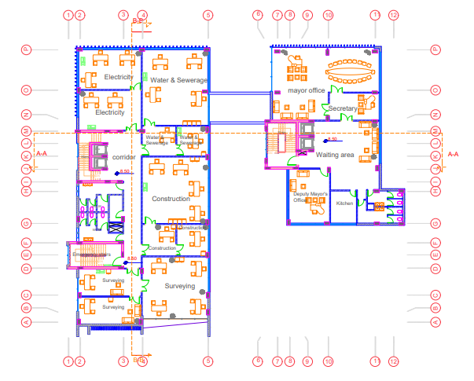
Architectural analysis and redesign
Second before modification Second after modification

Slide 13
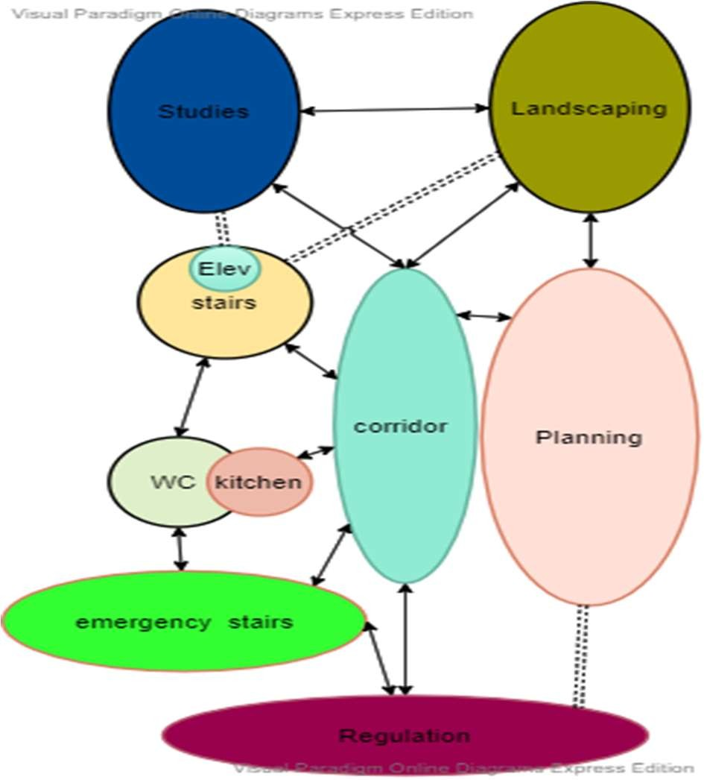
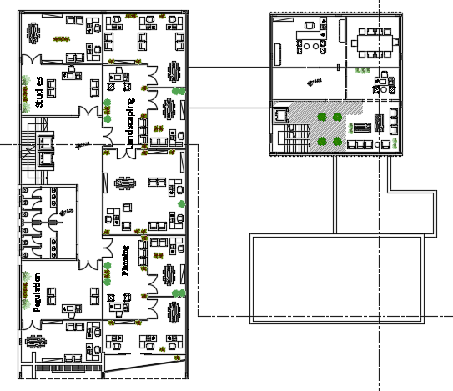
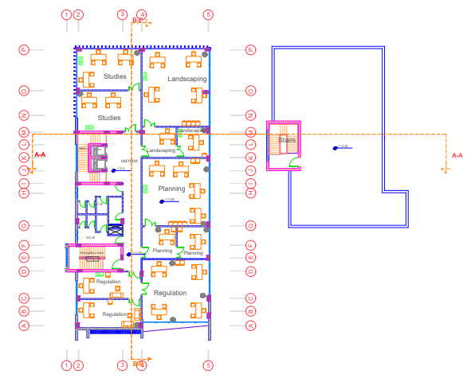
Architectural analysis and redesign
Third Floor before modification. Third Floor after modification

Slide 14
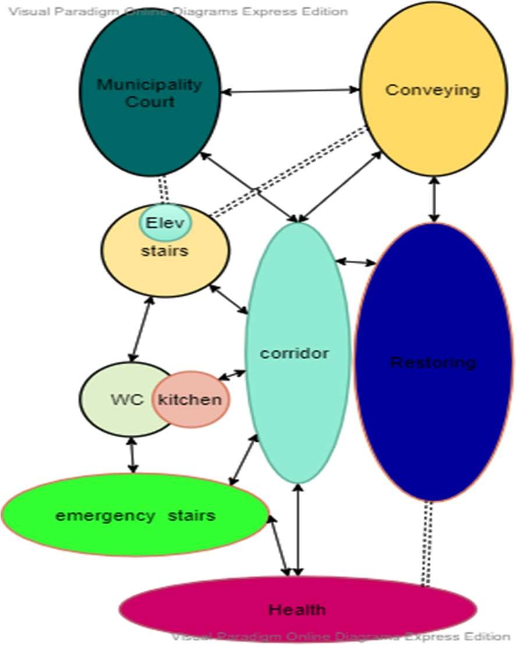
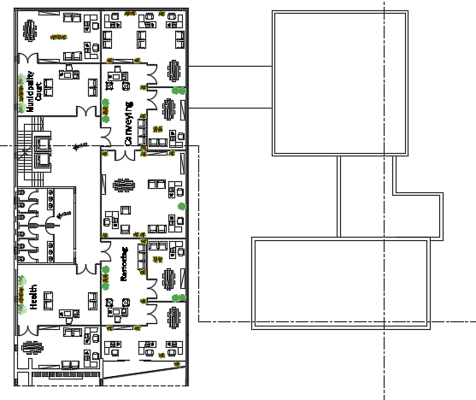
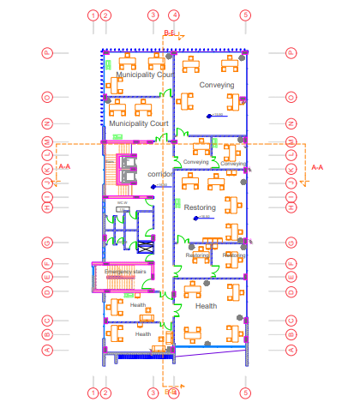
Architectural analysis and redesign
Fourth Floor before modification . Fourth Floor after modification

Slide 15
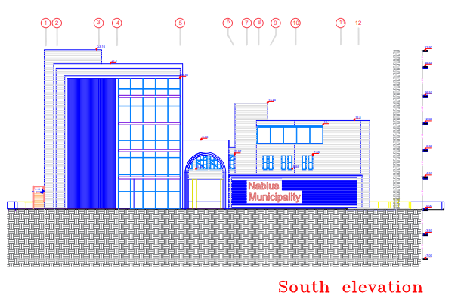
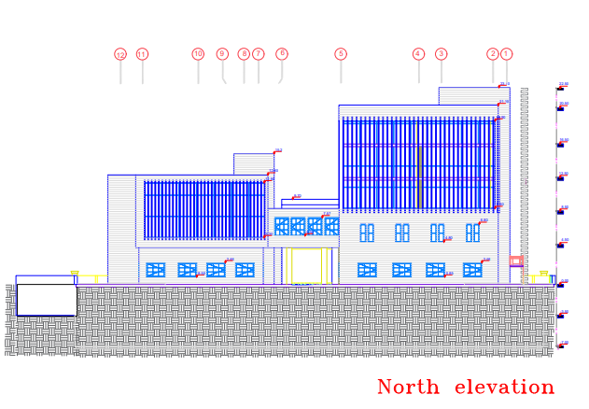
Architectural analysis and redesign
South elevation: North elevation:

Slide 16
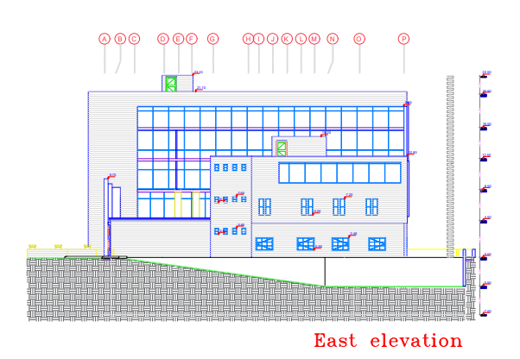
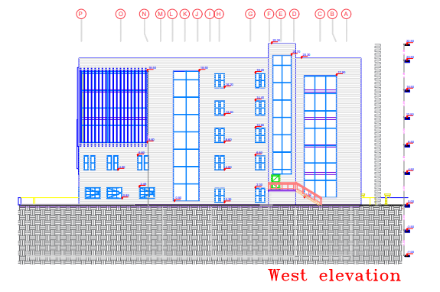
Architectural analysis and redesign
East elevation: West elevation:

Slide 17
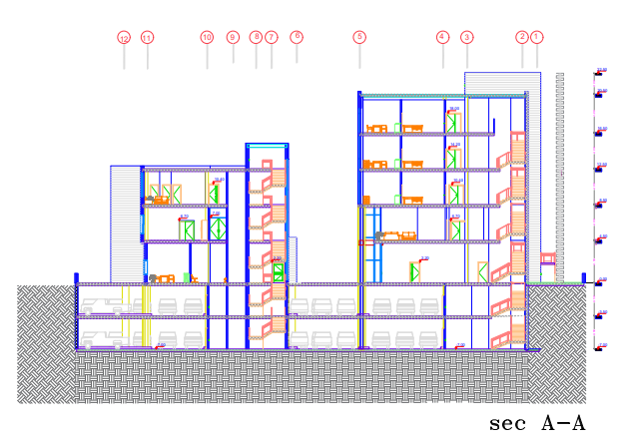
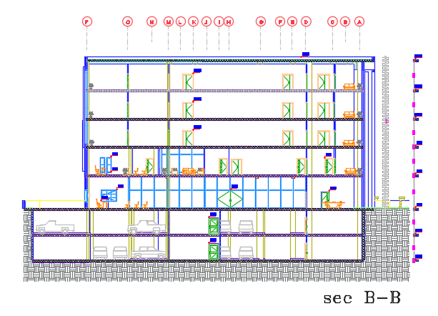
Architectural analysis and redesign
Section A-A: Section B-B:

Slide 18
introduction.
Description of project.
Architectural Analysis.
Environmental Evaluation .
Structural Analysis.
Electromechanical.
Cost & Budget.
Outline:

Slide 19
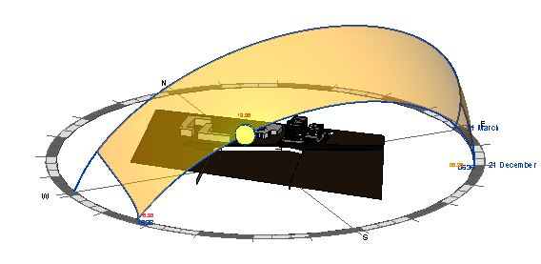
Environmental analysis and evaluated
Building orientation.
Shadowing.
Solar Radiation.
Daylight Factor.
Environmental Modification.
Acoustical analysis.

Slide 20
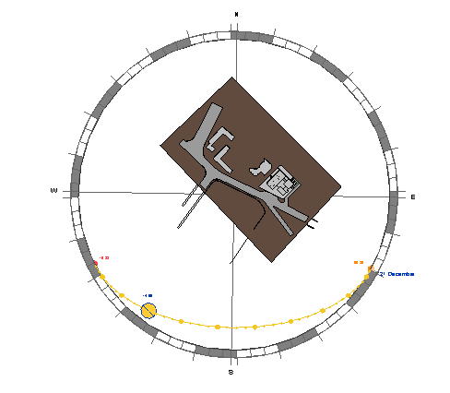
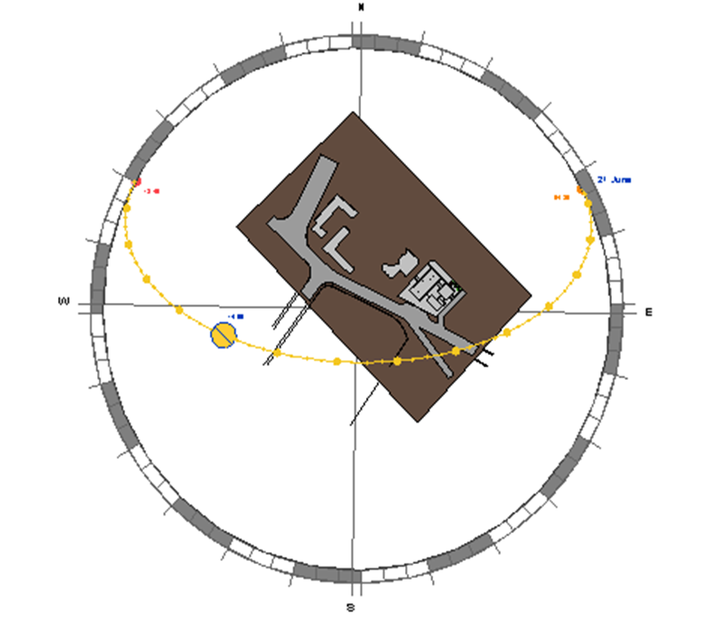
Building orientation:
The Orientation of the building is 43˚ from true north.
Sun path in Winter.
Sun path in summer.

Slide 21
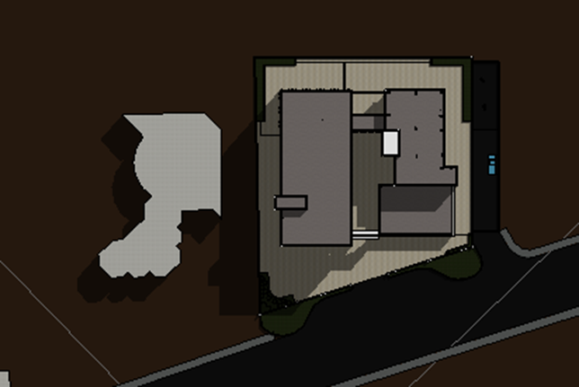
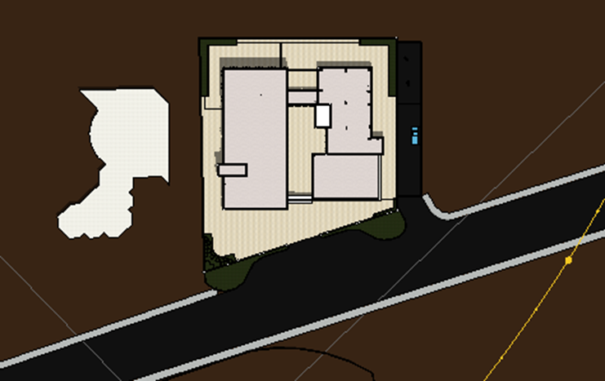
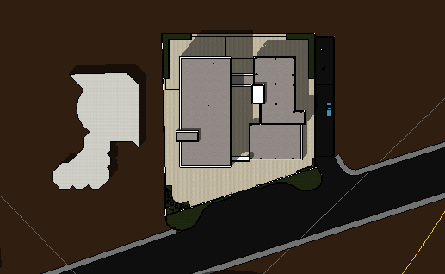
Shadowing:
As shown in the figures, we note that there is no shading from adjacent buildings, just shading from building itself.
8:00am in summer.
12:00pm in summer.
2:00pm in summer.

Slide 22
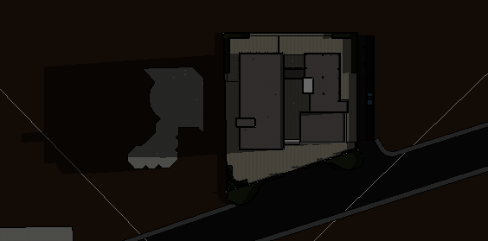
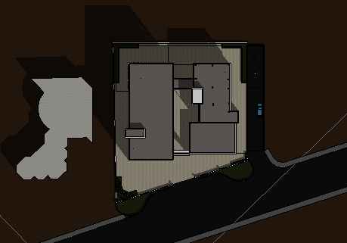
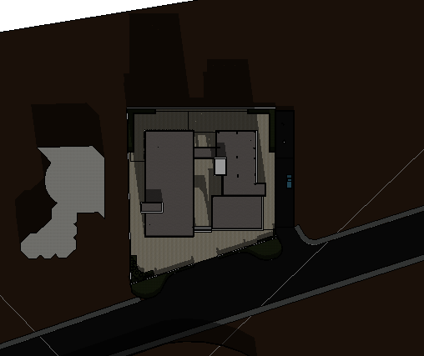
Shadowing:
8:00am in Winter.
12:00pm in Winter.
2:00pm in Winter.

Slide 23
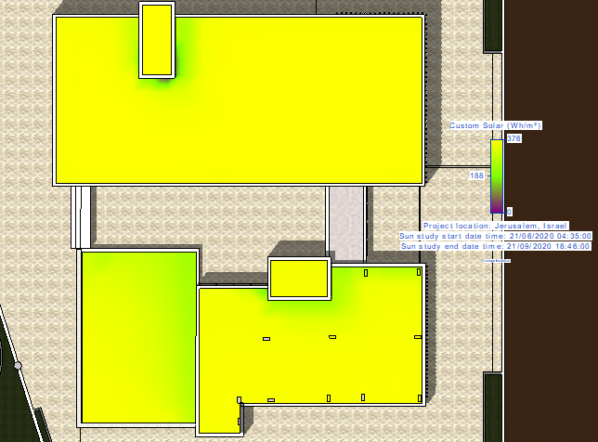
Solar Radiation in summer.
The solar gain in summer is high due to the long sunshine hours and the sun's altitude angle.

Slide 24
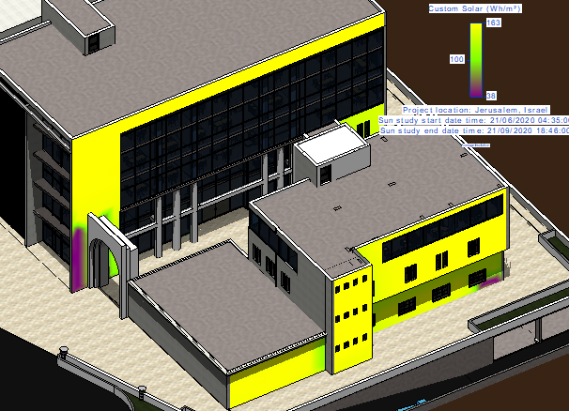
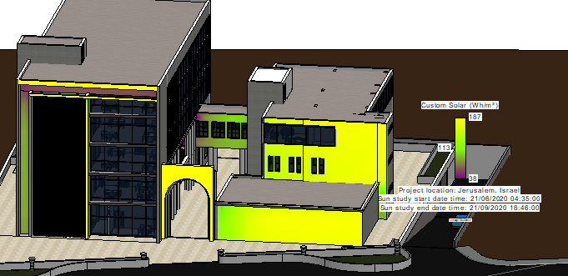
East-south elevation.
South-west Elevation

Slide 25
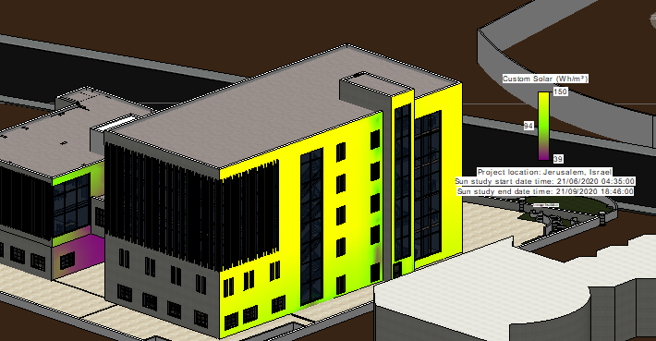
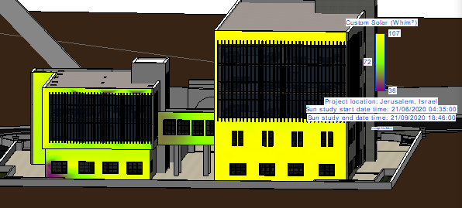
North-west Elevation.
East-north Elevation.

Slide 26
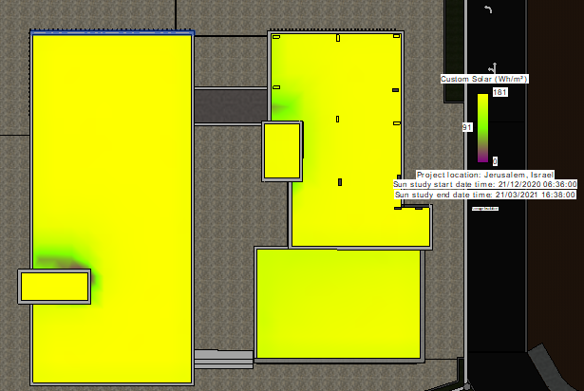
Solar Radiation in Winter.
In winter the solar gain is small. Because of the path of the sun and the shortness of the solar radiance.

Slide 27
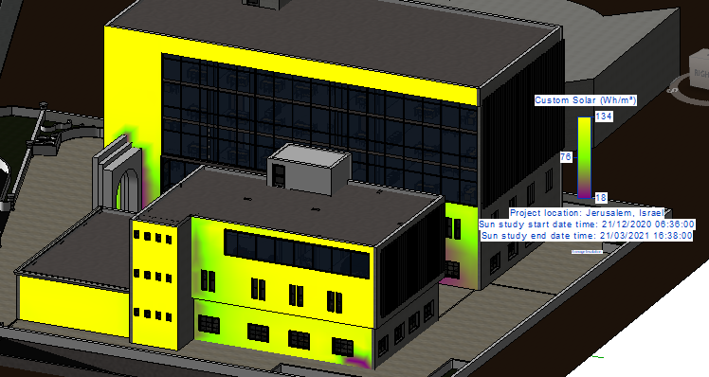
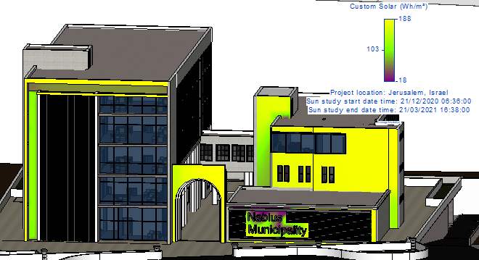
South-west Elevation

Slide 28
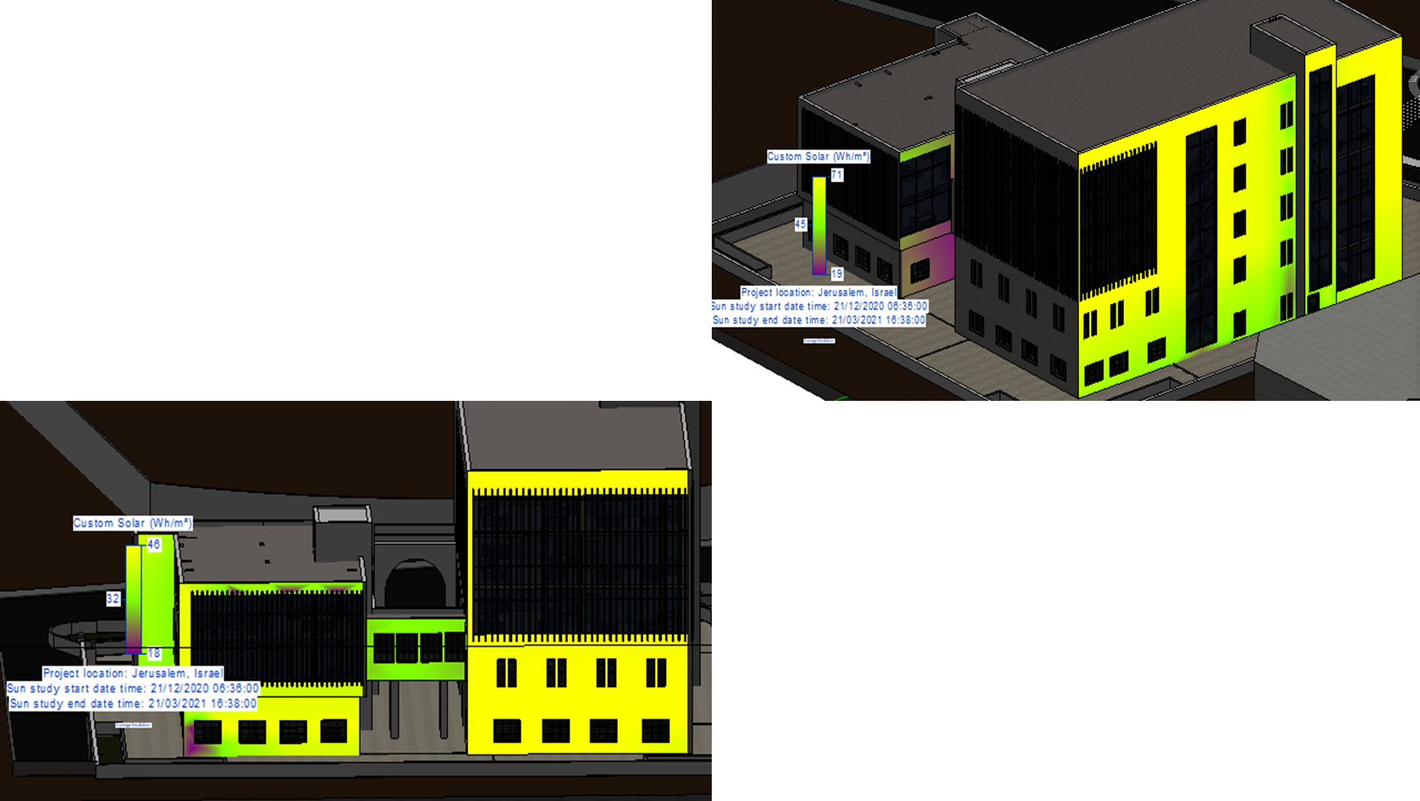
North-west Elevation.

Slide 29
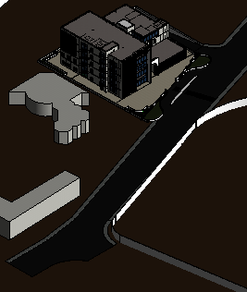
Daylight factor.
Revit program was used to determine daylight factor before and after modification.
In this type of building (Office) the percentage of daylight (2-6%)

Slide 30
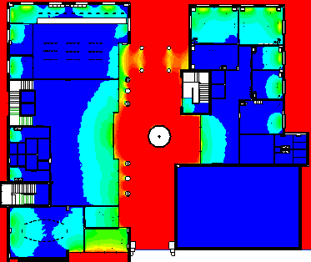
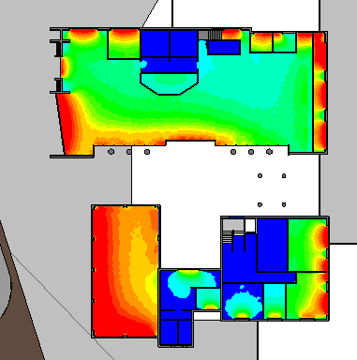


Daylight factor.
GF before Modification
GF after Modification

Slide 31


Daylight factor.
F1 before Modification
F1 After Modification

Slide 32


Daylight factor.
F2 before Modification
F2 after Modification

Slide 33

Daylight factor.
F3 before Modification
F3 after Modification

Slide 34


Daylight factor.
F4 before Modification
F4 after Modification

Slide 35


Environmental Modification
Vertical louvers were added to the eastern façade.
Modification of reflectivity and transmittance of external glass.
The exterior wall of the building was modified by the use of insulation and the use of stone facades.

Slide 36




Acoustical analysis
STC: use INSUL 9.0
external wall Internal Wall Curtain Wall IIC for floor

Slide 37

Acoustical analysis
RT60:
RT60 was calculated using the Ecotect program.
1) RT60 for Multipurpose hall:
o Volume: 758.950 m3.
o Surface Area: 644.184 m2.
o Occupancy: (112 x 0%).
o Optimum RT (500Hz - Speech): 0.76 s.
o Optimum RT (500Hz - Music): 1.36 s.
o Volume per Seat: 6.776 m3.
o Automatic: Millington-sette.
o Most Suitable: Millington-sette.

Slide 38

Acoustical analysis
2) RT60 for Meeting room:
o Volume: 305.490 m3
o Surface Area: 372.775 m2
o Occupancy: (20 x 0%)
o Optimum RT (500Hz - Speech): 0.64 s
o Optimum RT (500Hz - Music): 1.20 s
o Volume per Seat: 15.274 m3.
o Automatic: Millington-sette.
o Most Suitable: Millington-sette.

Slide 39

Acoustical analysis
3) RT60 for Mayor office:
Volume: 464.210 m3
Surface Area: 606.160 m2
Occupancy: 20
Optimum RT (500Hz - Speech): 0.70 s
Optimum RT (500Hz - Music): 1.28 s
Volume per Seat: 23.210 m3
Most Suitable: Millington-Sette (Widely varying)
Selected: Millington-Sette (Widely varying)

Slide 40

Acoustical analysis
4) RT60 for Fees hall:
Volume: 531.510 m3
Surface Area: 508.199 m2
Occupancy: 40
Optimum RT (500Hz - Speech): 0.72 s
Optimum RT (500Hz - Music): 1.30 s
Volume per Seat: 13.288 m3
Most Suitable: Millington-Sette (Widely varying)
Selected: Sabine (Uniformly distributed)

Slide 41
introduction.
Description of project.
Architectural Analysis.
Environmental Evaluation .
Structural Analysis.
Electromechanical.
Cost & Budget.
Outline:

Slide 42

Structural Analysis.
Slab:
Two way ribbed slab 0.35 m thickness with beams.
Column's dimension:
C1= 700 x 400
C2= 700*300
Radial diameter =800mm.
Beams :
Hidden beam: 350mm X 700mm
Drop beam:
500mm x500 mm
Shear wall with 0.30 M thickness

Slide 43

Structural Analysis.
Structural layout for main plan

Slide 44


Structural Analysis.
Expansion joint
Part 2
Part 1
Expansion joint detailing

Slide 45


Structural Analysis.
Etabs models :
Structural model from ETABS17 (part 1).
Structural model from ETABS17 (part 2).

Slide 46
Structural Analysis.
check’s
Analysis Checks
Check: | Result
Compatibility Check | Ok
Equilibrium check | Ok
Internal Force Check
Columns | Ok
Beams | Ok
Slab | Ok
Design Check
Check: | Result
Deflection | Ok
Beam | Ok
Shear Check | Ok
Tow way ribbed slab | Ok
Seismic Checks
Check: | Result
Period check. | Ok
Modal mass participation ratio | Ok
Base shear (scale factor) | Ok
Drift | Ok

Slide 47

Structural Analysis.
Sheet piles plan :

Slide 48

Structural Analysis.
Footing plan :

Slide 49




Structural Analysis.
Wall footing detailing.
Footing detailing:
combined footing detailing.

Slide 50



Structural Analysis.
Footing detailing:
Mat footing detailing.
isolated footing details

Slide 51



Structural Analysis.
column detailing:
rectangular column detailing. Circular column detailing.
Detailing converting column circular to rectangular:

Slide 52


Structural Analysis.
Slab and beam plan :
for the second basement floor. for the first basement floor.

Slide 53


Structural Analysis.
Slab and beam plan :
for the ground floor. for the first floor.

Slide 54


Structural Analysis.
Slab and beam plan :
for the second floor. for the third and fourth floor

Slide 55


Structural Analysis.
Hidden beam detailing:
Girder beam detailing :

Slide 56


Structural Analysis.
Slab detailing.(main plan) :
for the first basement floor.

Slide 57


Structural Analysis.
Water tank :
type of tank is vertical one way .

Slide 58




Structural Analysis.
water tank corner detailing
    Water tank Detailing:
Water stop.
Water stop.

Slide 59
introduction.
Description of project.
Architectural Analysis.
Environmental Evaluation .
Structural Analysis.
Electromechanical )Lighting Design(.
Cost & Budget.
Outline:

Slide 60
Lighting Design
An artificial simulation was done using DIALux software for one space of each functional, all lighting requirements achieved.
mayor office.
Meeting room.
Multi-purpose hall.
Public service hall.
Public Relation(office).
Reception(office).
Corridors.

Slide 61







Lighting Design
Type of luminaires was used:
luminaire from PHILPS: Spot :

Slide 62





Lighting Design
1- Results of lighting in mayor office:
:
According to calculation objects there no glare from artificial light in mayor office room.

Slide 63







Lighting Design
2- Results of lighting in meeting room:

Slide 64






Lighting Design
3- Results of lighting in Public service hall :
According to calculation objects there no glare from artificial light in Public service hall.

Slide 65
introduction.
Description of project.
Architectural Analysis.
Environmental Evaluation .
Structural Analysis.
Electromechanical
)Power design (.
Cost & Budget.
Outline:

Slide 66


Power design
The electrical load of the building was calculated. The electrical switches and sockets were distributed and the wires needed for the connections were calculated
Distribution of lighting wires and switches for the B2.
Distribution of lighting wires and switches for the B1.

Slide 67


Power design
Distribution of lighting wires and switches for the Ground floor.
Distribution of lighting wires and switches for the First floor.

Slide 68


Power design
Distribution of lighting wires and switches for the Second floor.
Distribution of lighting wires and switches for third and fourth floor.

Slide 69

Power design
sockets circuit breaker for B2

Slide 70

Power design
sockets circuit breaker for B1

Slide 71

Power design
sockets circuit breaker for GF.

Slide 72


Power design
sockets circuit breaker for F1 and F2.

Slide 73


Power design
sockets circuit breaker for F3 and F4.

Slide 74
introduction.
Description of project.
Architectural Analysis.
Environmental Evaluation .
Structural Analysis.
Electromechanical )Sound Speaker Design(.
Cost & Budget.
Outline:

Slide 75

Sound Speaker Design
Two types of audio systems are designed.
• PA system for Multi-purpose hall.
• Ceiling Sound System for fees hall and corridor.

Slide 76



Sound Speaker Design
Design for PA System Design using EASE.

Slide 77


Direct SPL:

Slide 78

AL Loss (%):
Max loss 2.69 …Excellent.

Slide 79

Sound Speaker Design
Ceiling Sound System for fees hall and corridor.
H=3.5m
Hs=1.2m.
h=3.5-1.2=2.3m
Tan(120/2)=1.73
R=4 m
coverage angle | 120⁰
Maximum SPL | 100 dB
Diameter | 113 mm

Slide 80
introduction.
Description of project.
Architectural Analysis.
Environmental Evaluation .
Structural Analysis.
Electromechanical
(Water supply Design).
Cost & Budget.
Outline:

Slide 81

Water supply Design
roof water tank
Part 1
Part 2
horizontal PVC pipes
vertical steel pipes
water tank in the second basement floor with pump system

Slide 82
Water supply Design
pipes design for part1:
floor | vertical design |  | horizontal design |  | branch design |  | total loss | NACHRAL LOESS | actual pressure | check pump
 | steel pipes dimeter | loss psi/100ft | PVC pipes dimeter | loss psi/100ft | PVC pipes dimeter | loss psi/100ft
GF | 1.5 | 14.1 | 1 | 3.2 | (1/2) | 2.9 | 20.2 | 32.99 | 12.79 | not need pump
f1 | 1.5 | 14.1 | 1 | 3.2 | (3/4) | 0.5 | 17.8 | 26.49 | 8.69 | not need pump
f2 | 2 | 4.3 | 1 | 3.2 | (3/4) | 0.5 | 8 | 20.7 | 12.7 | not need pump
f3 | 2 | 4.3 | 1.25 | 1.23 | (3/4) | 0.5 | 6.03 | 14.9 | 8.87 | not need pump
f4 | 2 | 4.3 | 1.25 | 1.23 | (3/4) | 0.5 | 6.03 | 9.18 | 3.15 | need pump
Site plan

Slide 83
Water supply Design
pipes design for part2:
floor | vertical design |  | horizontal design |  | branch design |  | total loss | NACHRAL LOESS | actual pressure | check pump
 | steel pipes dimeter | loss psi/100ft | PVC pipes dimeter | loss psi/100ft | PVC pipes dimeter | loss psi/100ft
GF | 1.5 | 4.6 | (1/2) | 5.2 | (1/2) | 0.69 | 10.49 | 21.47 | 10.98 | not need pump
f1 | 1.5 | 4.6 | (3/4) | 0.8 | (1/2) | 0.69 | 6.09 | 15.7 | 9.61 | not need pump
f2 | 1.5 | 4.6 | (3/4) | 0.8 | (1/2) | 0.69 | 6.09 | 9.95 | 3.86 | need pump
Site plan

Slide 84


Water supply Design
Water supply plan :
for the second basement floor. for the first basement floor.

Slide 85


Water supply Design
Water supply plan :
for the ground floor. for the first floor.

Slide 86


Water supply Design.
Water supply plan :
for the second floor. for the third floor

Slide 87

Water supply Design.
Water supply plan :
For the fourth floor

Slide 88
introduction.
Description of project.
Architectural Analysis.
Environmental Evaluation .
Structural Analysis.
Electromechanical
(Fire-fighting system).
Cost & Budget.
Outline:

Slide 89

Fire-fighting system
The appropriate system was designed for each space and the following was used:
Detecting system.
Suppression system.
Emergency lights and signs.

Slide 90




Fire-fighting system
1- Smoke detector:
2- heat detector :
3-Manual fire alarm:
Detecting system:

Slide 91




Fire-fighting system
1- fire extinguisher:
2- Fire hose:
3-Sprinkler:
Emergency lights and signs:
Suppression system:

Slide 92


Fire-fighting system
Fire-fighting system plan :
for the second basement floor. for the first basement floor.

Slide 93


Fire-fighting system
Fire-fighting system plan :
for the ground floor. for the first floor.

Slide 94


Fire-fighting system
Fire-fighting system plan :
for the second floor. for the third floor

Slide 95

Fire-fighting system
Fire-fighting system plan :
For the fourth floor

Slide 96
introduction.
Description of project.
Architectural Analysis.
Environmental Evaluation .
Structural Analysis.
Electromechanical
(Water Draining)
Cost & Budget.
Outline:

Slide 97
Water Draining system
In the beginning, several diameters of PVC pipes was used, arranged as in the following table:
Used for | diameters
Black water | 4”
Gray water | 2”
Rain water | 3”

Slide 98

Water Draining system
Water Draining system plan :
for the second basement floor.

Slide 99

Water Draining system
Water Draining system plan :
for the first basement floor.

Slide 100

Water Draining system
Water Draining system plan :
for the ground floor.

Slide 101

Water Draining system
Water Draining system plan :
for the first floor.

Slide 102

Water Draining system
Water Draining system plan :
for the second floor.

Slide 103

Water Draining system
Water Draining system plan :
for the third floor.

Slide 104

Water Draining system
Water Draining system plan :
for the fourth floor.

Slide 105
introduction.
Description of project.
Architectural Analysis.
Environmental Evaluation .
Structural Analysis.
Electromechanical
( heat simulation& HVAC)
Cost & Budget.
Outline:

Slide 106




heat simulation
This part was done by design builder program ,where a thermal simulation of the building was done before and after thermal insulation.

Slide 107



heat simulation
Material properties
Object | External wall | Internal wall | Roof | curtain wall
U- Value W/M^2 . K | 0.46 | 2.18 | 0.226 | 2.665

Slide 108

heat simulation
Design Builder Result
the thermal loads before and after the treatments were as follows

Slide 109



Hvac system
VRF system was used and two systems were used , cassette unit and fan coil unit from Mitsubishi, Where the company provided us with catalogs and blocks for the Revit program.

Slide 110


Hvac system
Havc system plan :
for the ground floor. for the first floor.

Slide 111


Hvac system
Havc system plan :
for the second floor. . for the third and fourth floor

Slide 112
introduction.
Description of project.
Architectural Analysis.
Environmental Evaluation .
Structural Analysis.
Electromechanical
(Reflected Ceiling)
Cost & Budget.
Outline:

Slide 113


Reflected Ceiling
Reflected Ceiling plan :
for the second basement floor. for the first basement floor.

Slide 114


Reflected Ceiling
Reflected Ceiling plan :
for the ground floor. for the first floor.

Slide 115


Reflected Ceiling
Reflected Ceiling
for the second floor. for the third and fourth floor

Slide 116
introduction.
Description of project.
Architectural Analysis.
Environmental Evaluation .
Structural Analysis.
Electromechanical.
Cost & Budget.
Outline:

Slide 117

Cost & Budget.
WORK
BREAKDOWN
STRUCTURE

Slide 118


Cost & Budget.
total cost
The cost of the project is 5,730,746$. The cost of each square meter is approximately 700$ (698.36$)

Slide 119
Thank you for listening

