Slide 1
Vacuum Forming Machine
VFM
Ibrahim Kayed
Hadi Jamal

Slide 2
Outline:
Introduction
Components
HMI output
Printed Circuit Board (PCB)
Blynk
Future work
Demo

Slide 3
Introduction :
What is vacuum forming?
How the process of vacuum forming is done?

Slide 4
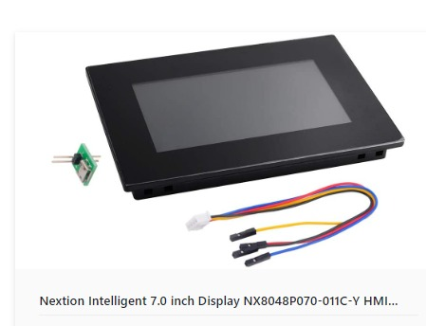
Components
HMI (Human Machine Interface)

Slide 5
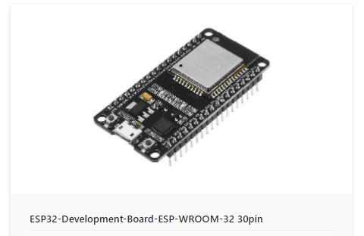
ESP32

Slide 6
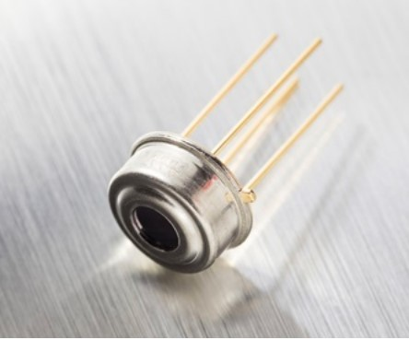
Sensors
MLX90614

Slide 7
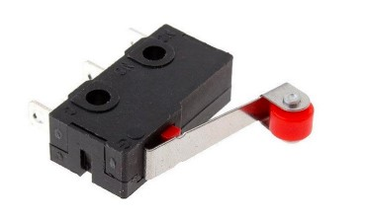
Limit switch

Slide 8
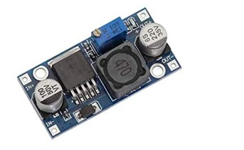
Adjustable Step Down Buck Converter

Slide 9
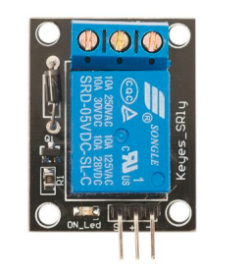
Relay

Slide 10
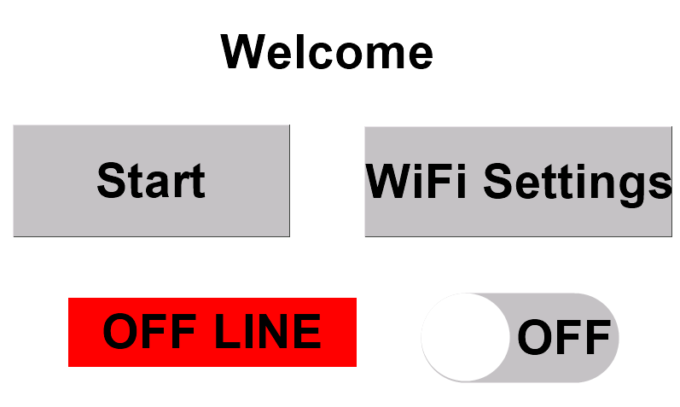
HMI output

Slide 11
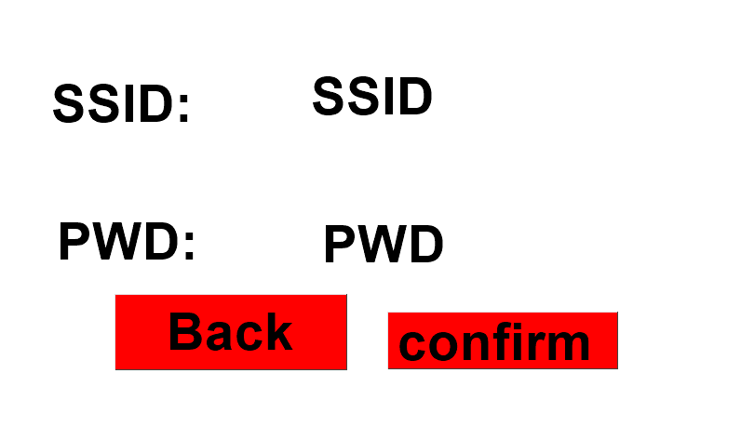

Slide 12
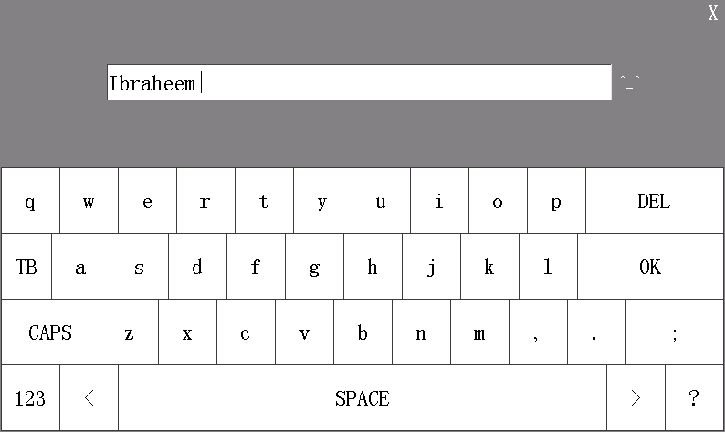

Slide 13
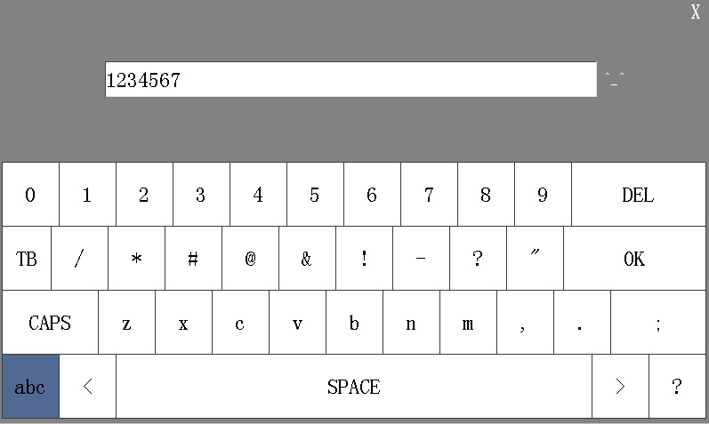

Slide 14
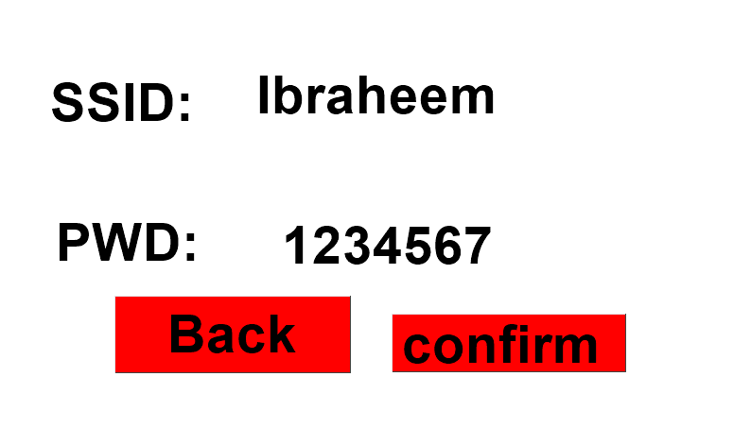

Slide 15
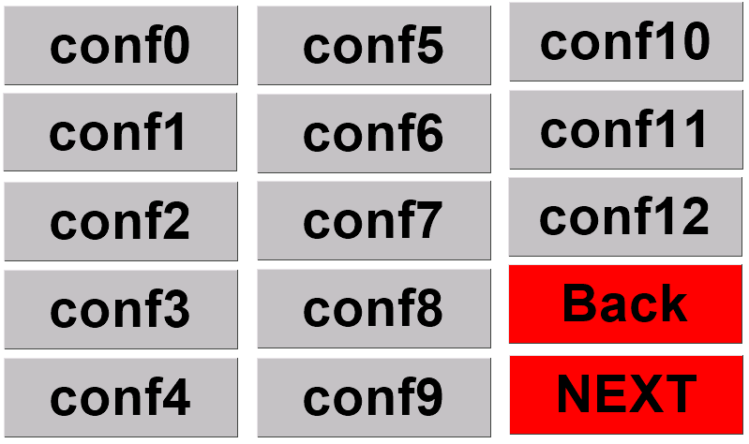

Slide 16
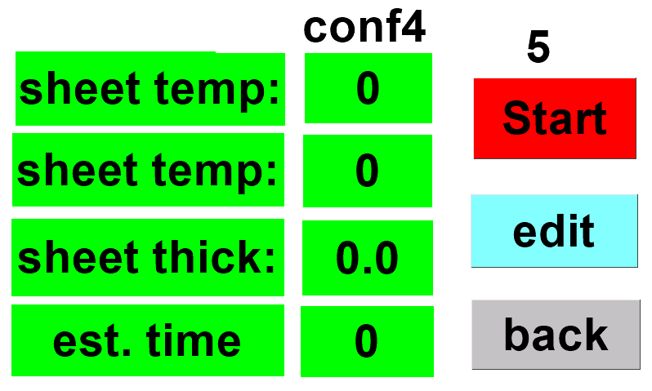

Slide 17
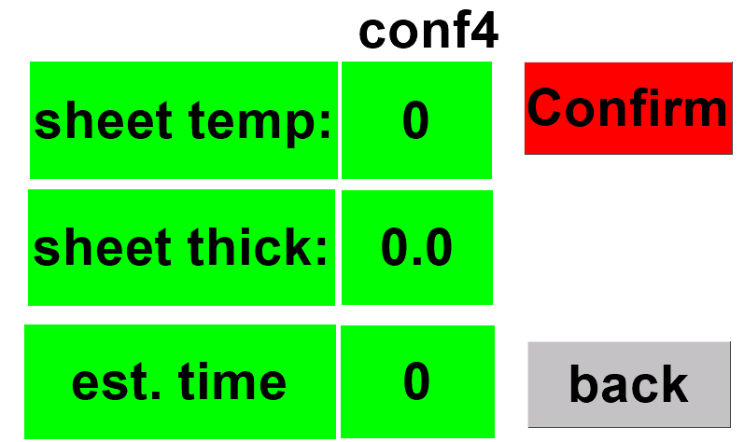

Slide 18
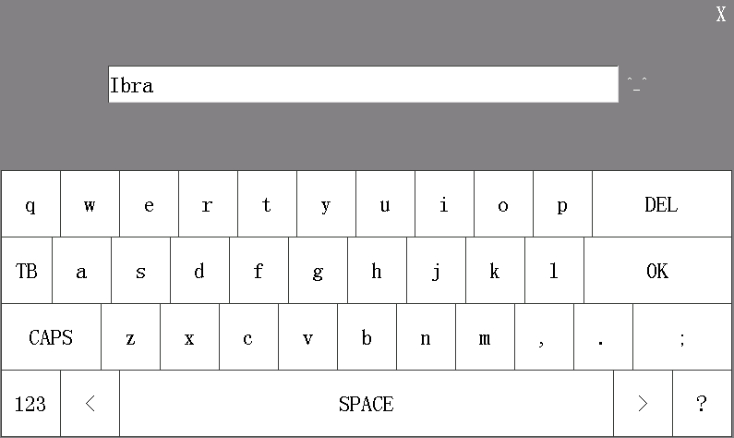

Slide 19
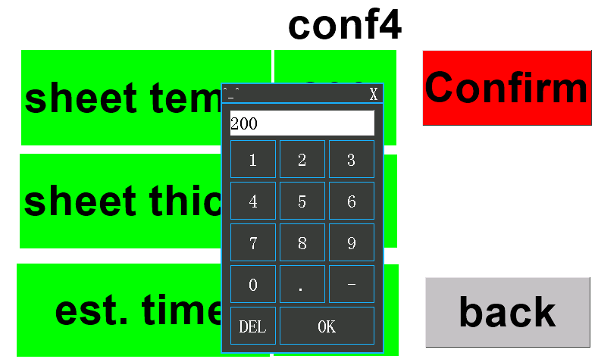

Slide 20
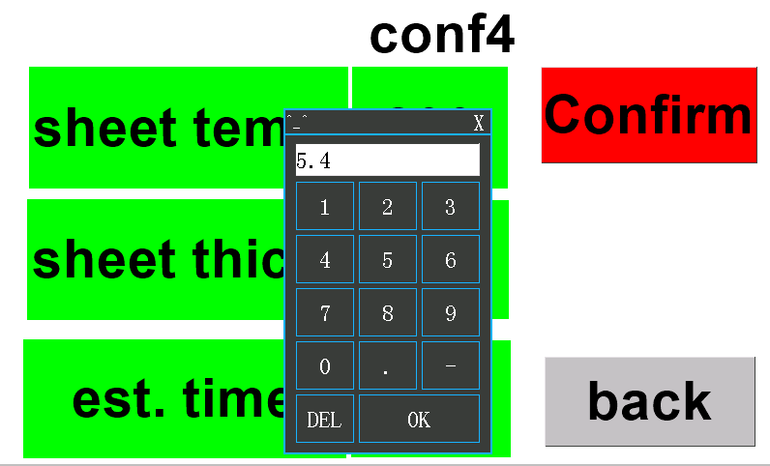

Slide 21


Slide 22
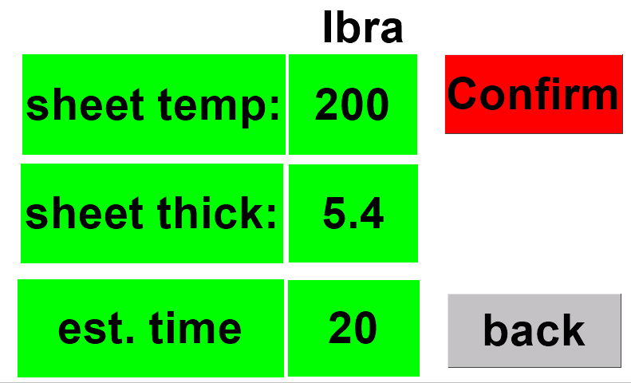

Slide 23
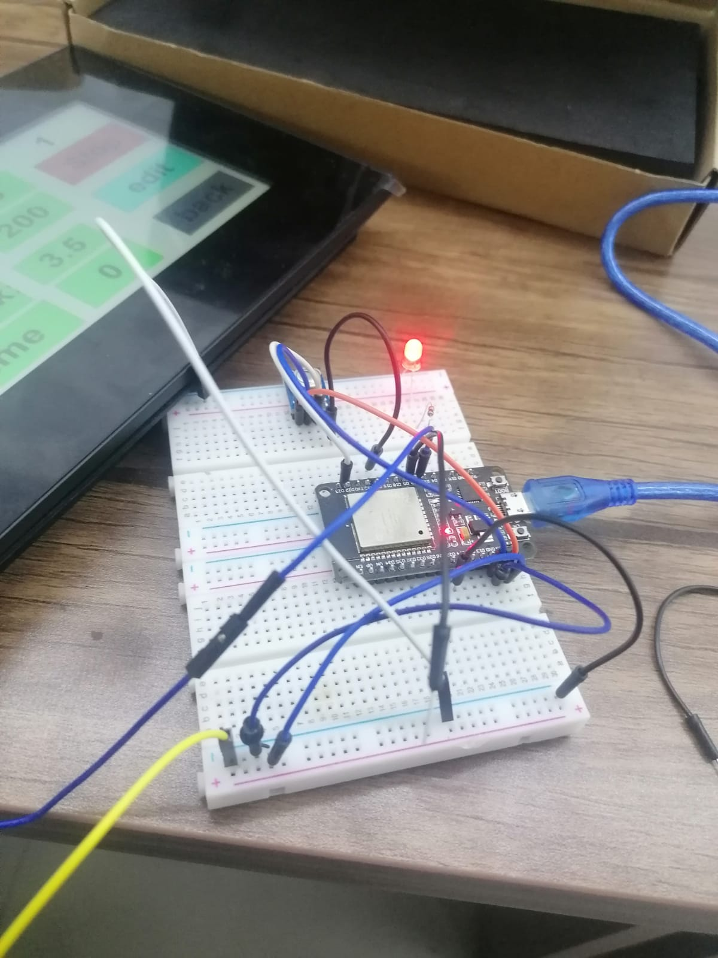

Slide 24
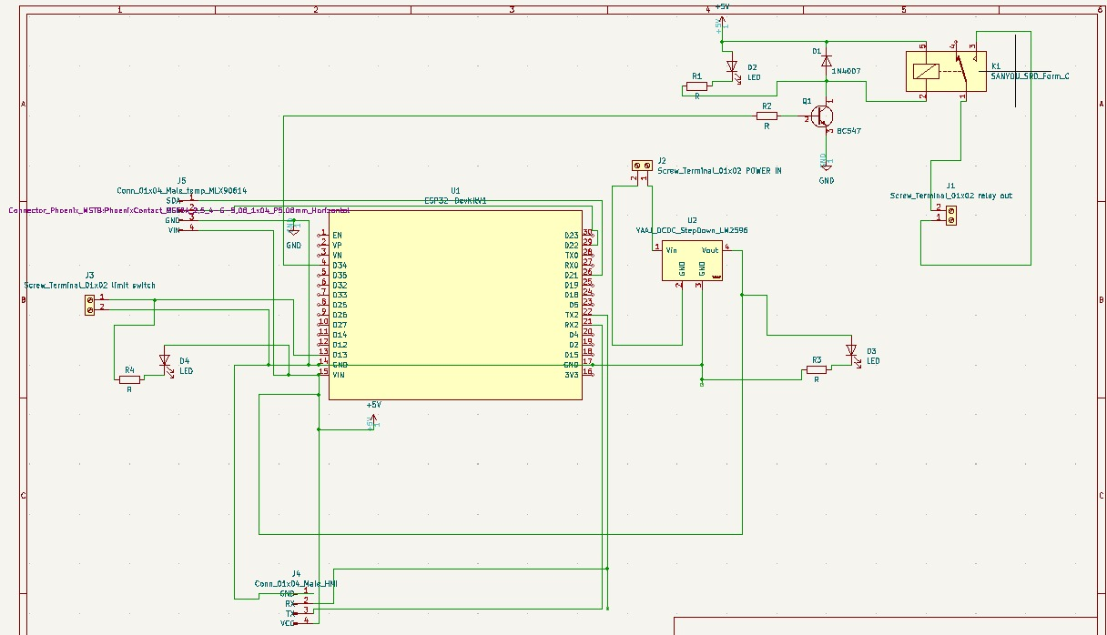
Printed Circuit Board (PCB)

Slide 25
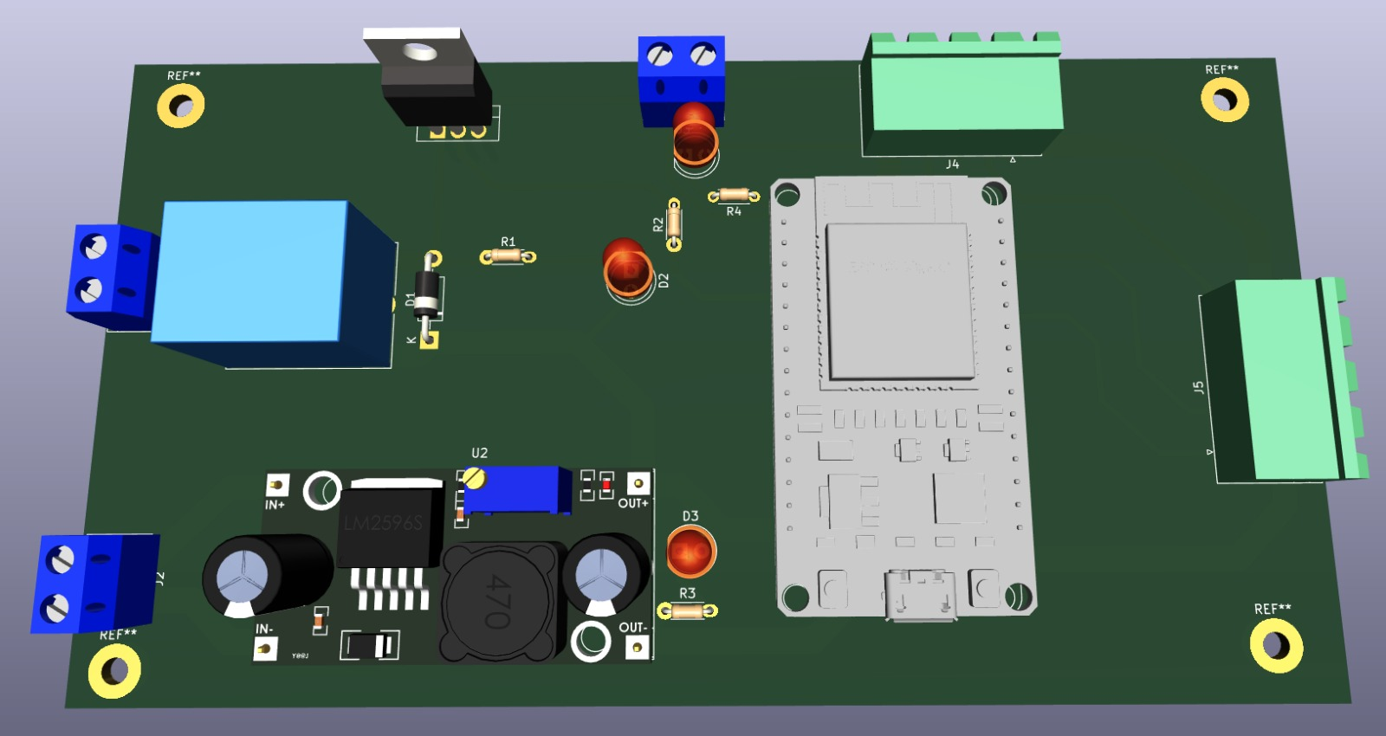

Slide 26
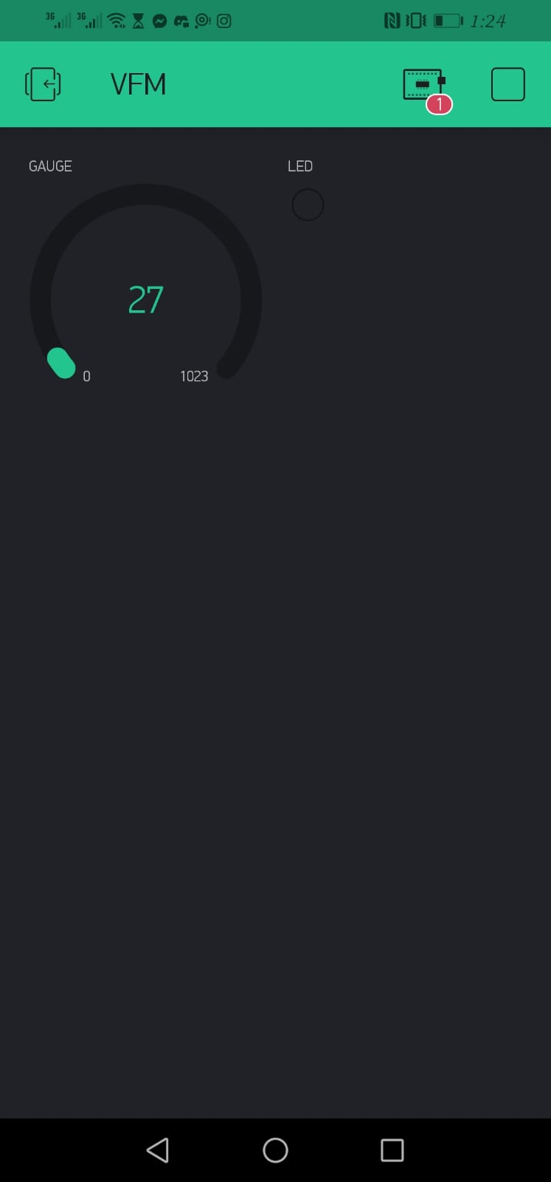
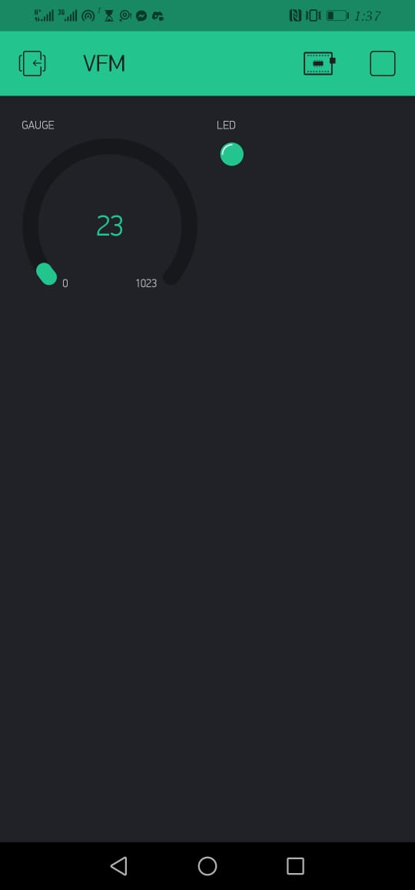
Blynk
Blynk is an application that we
used to show the temperature of
the sheet and the status of the
limit switch on mobile phones.

Slide 27
Future work
We aim to increase the number of plastic types that we can add.
We want to add more sensors to control the heater to decrease the power usage.
We also want to add a fan to cool down the plastic during and after the vacuum process.
We want to add stipper motores to control the plastic movement upwards and downwards.

Slide 28
Demo

Slide 29
Thank You All For Your Precious Time

