Slide 1
Study of the Effect of Quarry Dusts on the Respiratory System of People around Quarries and Stone Saws
By
Qasam Saleem – Reg. No: 11420529
Shahd Bishawi – Reg. No: 11419975
Hiba Hassan– Reg. No: 11316910
Under supervision of: Dr. Abdul Halim Khader

Slide 2
Stone Masonry
The craft of creating buildings, structures, and sculpture using stone from the earth, and is one of the oldest trades in human history

Slide 3
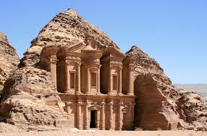
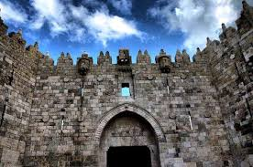
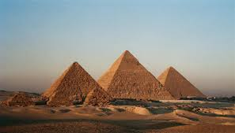
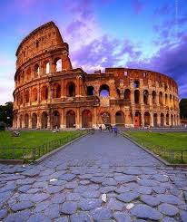
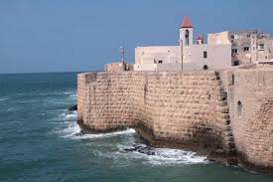

Slide 4
Stone is the DNA of Palestine
It composes 7% of the annual GDP and provides 20,000 jobs.
Estimates indicate that there are more than 720 saws and 250 quarries in the West Bank

Slide 5
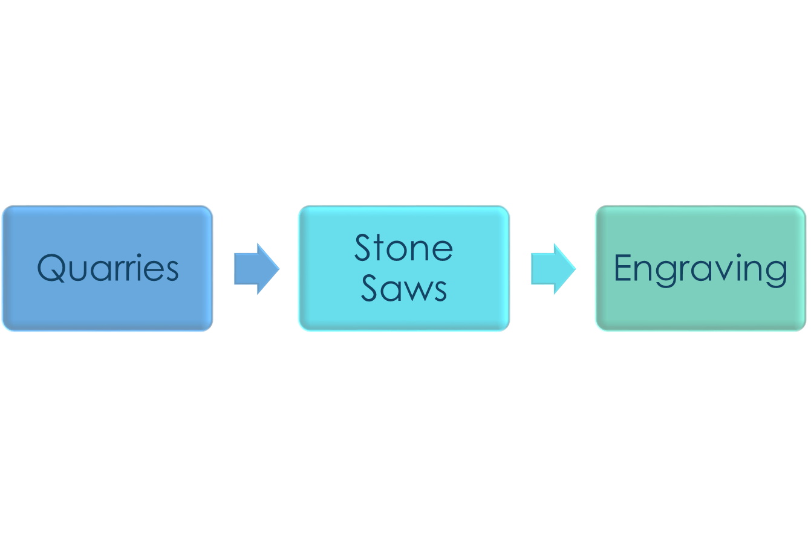
Stone Extraction

Slide 6
Contaminants resulting from the extraction of stone vary from liquid substances to dusts and gases

Slide 7
Particle Pollution
A general term for the mixture of solid and liquid droplets suspended in the air. It comes in many sizes and shapes and can be made up of a number of different components, including acids, inorganic compounds, organic chemicals, and soot, metals, and soil or dust particles

Slide 8
Particles of Concern
Coarse particles (PM_{10-2.5)}: particles with diameters generally larger than 2.5 µm and smaller than, or equal to, 10 µm in diameter.
Fine particles (PM_{2.5)}: particles generally 2.5 µm in diameter or smaller.

Slide 9
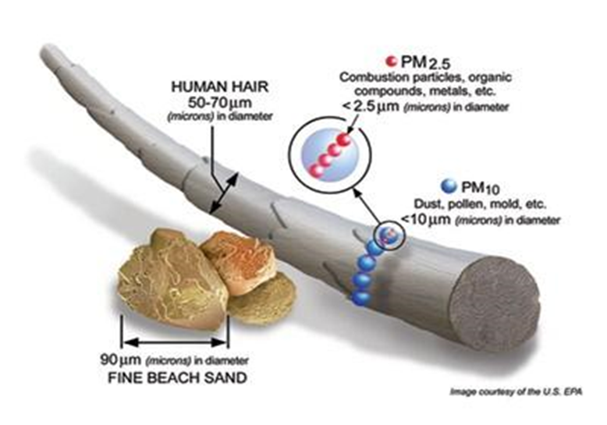

Slide 10
The type and size of a dust particle determines how toxic the dust is. However, the possible harm the dust may cause to your health is mostly determined by the amount of dust present in the air and how long you have been exposed to it.

Slide 11
Effects of Inhaling Dust
Irritation of the eyes
Coughing
Sneezing
Hay fever
Asthma attacks
Reduction in the lung function

Slide 12
Our Study

Slide 13
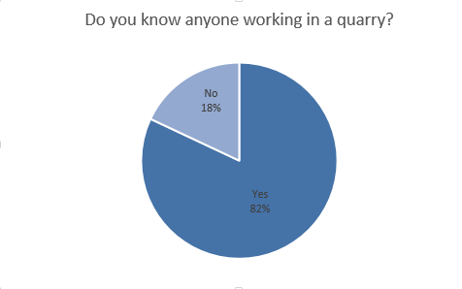
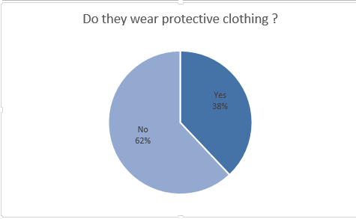
Survey

Slide 14
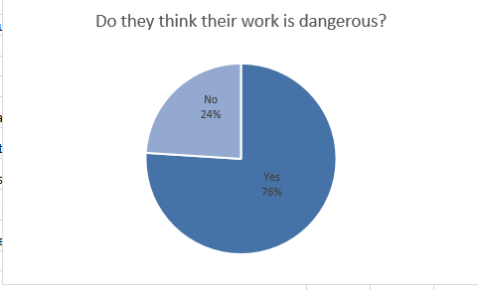
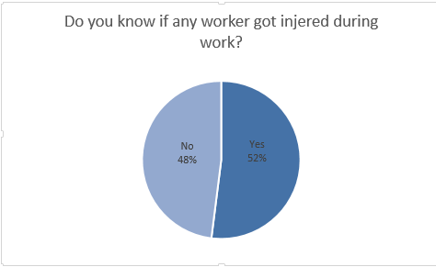

Slide 15
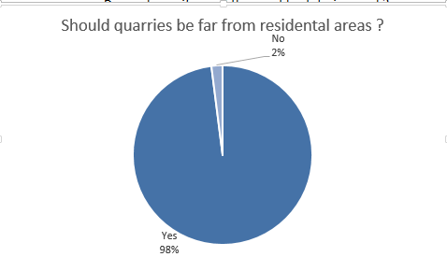
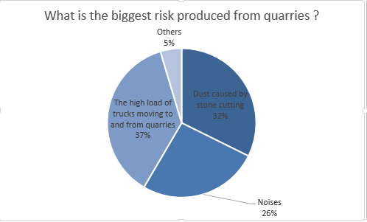

Slide 16
Spirometry
A standard test doctors use to measure how well your lungs are functioning. The test works by measuring airflow into and out of your lungs

Slide 17
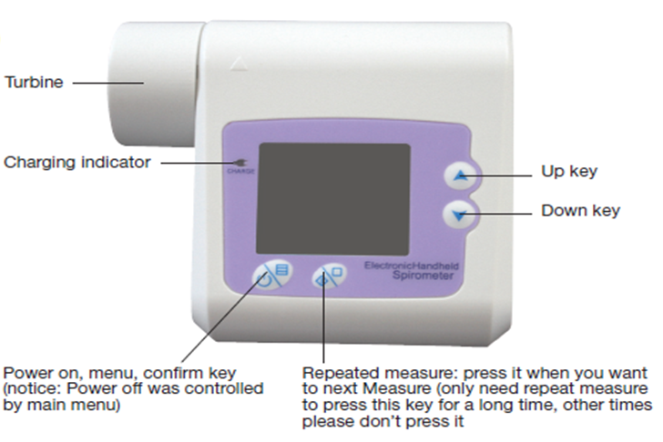
Spirometer

Slide 18
Spirometer Parameters
Forced vital capacity (FVC): This is the largest amount of air that you can forcefully exhale after breathing in as deeply as you can.
Forced expiratory volume (FEV1): The amount of air you can force out of your lungs in one second. It can help your doctor evaluate the severity of your breathing problems
Peak expiratory flow (PEF) : is a person's maximum speed of expiration

Slide 19
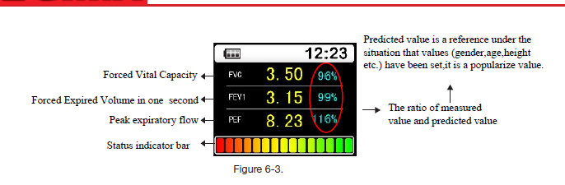

Slide 20
FEV 1 | Situation
Higher than 80% | Normal
50%-80% | Should be Noticed
Lower than 50% | Needs to be hospitalized

Slide 21
Examined Groups
Sample size | Study area
8 | Workers in a quarry
14 | Residents near a quarry
20 | Students in a school close to a stone saw
20 | People around a tile factory
15 | People very far from quarries

Slide 22
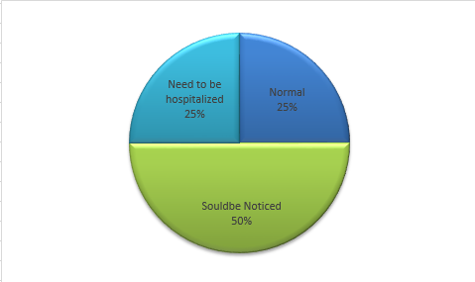
Workers in a quarry

Slide 23
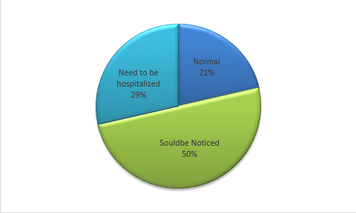
Residents close to the quarry

Slide 24
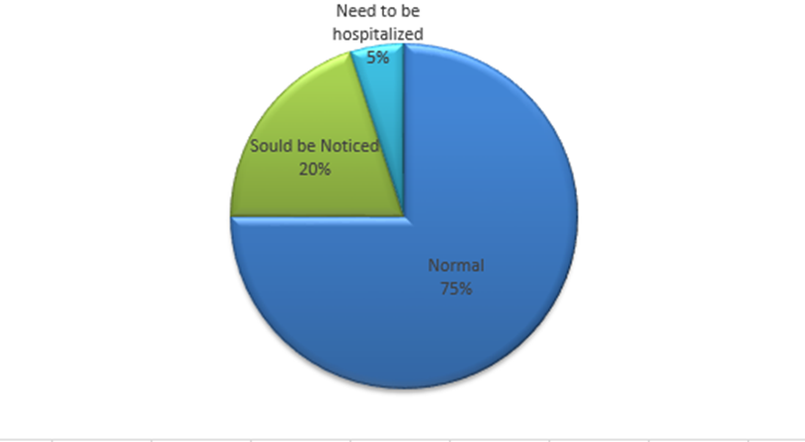
Students in a school close to the stone saw

Slide 25
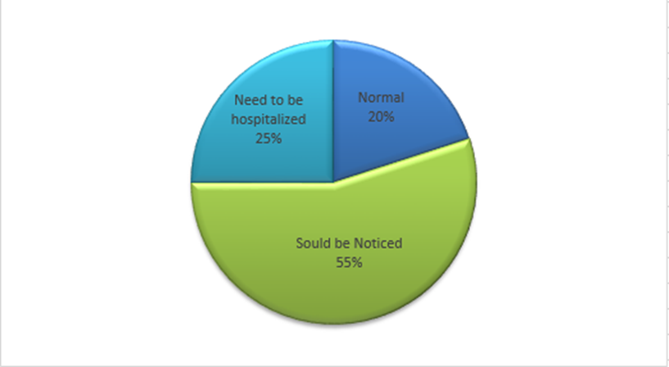
People in a tile factory

Slide 26
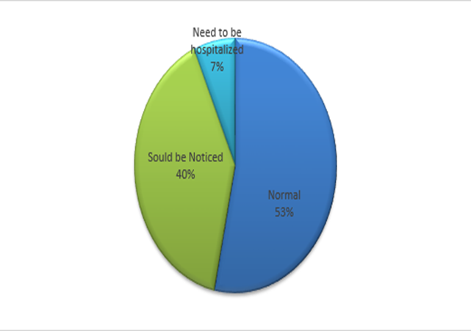
People far away from quarries

Slide 27
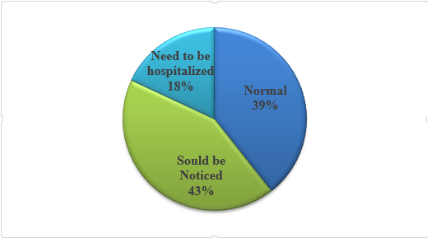
These results support the theory that the dust produced from quarries affects people’s lung functions badly, where 61 % need either to be noticed or hospitalized, while 39% are normal.

Slide 28
Sources of Error
26% of the people tested are smokers, and this lead to inaccuracy in their results, because smoking affects the lung function too
Incorrect breathing inside the device from some school students and elders also led to some inaccuracy in the results

Slide 29
Recommendations
Prevent the construction of new quarries near residential areas
Rehabilitation of quarries after finishing the extraction, where they become more productive to the surrounding, and some of the new land uses include parks, houses, recreational area and industrial.

Slide 30
To oblige quarry owners to provide protective clothing for workers
Paving roads leading to the quarries to reduce the dust.
Surrounding the quarry by trees to block emissions from the quarry

Slide 31
Thank You

