Slide 1



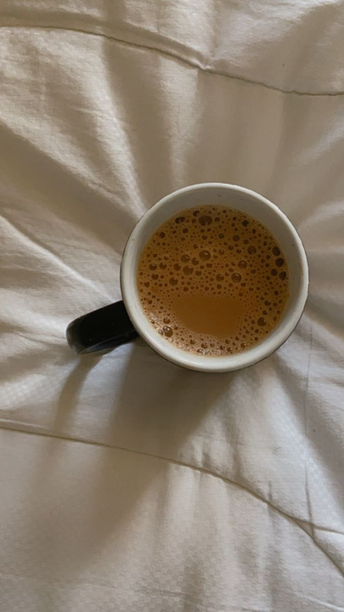
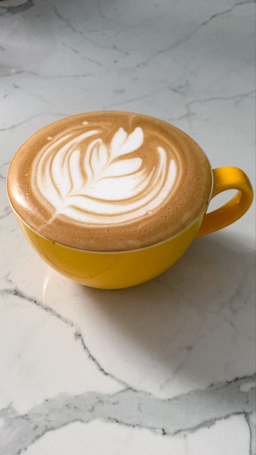
Luvy Coffee
Home
About
Service
Contact
WELCOME TO OUR SMART BEVERAGE MACHINE
Luvy Coffee
wafaa Hamed
lama Qwareeq
DR. Samer AL arndy
Page 01

Slide 2

Luvy Coffee
Home
About
Service
Contact
WELCOME TO SMART DRINKS
WELCOME TO OUR SMART BEVERAGE MACHINE
Smart Hot Beverage Machine
This project automates the preparation of various hot drinks like coffee, cappuccino, and Nescafé with full customization and easy control through keypad and Web Pages.
Our Vision
Our Mission
Our Values
Delivering a high-quality, fully automated hot drink experience.
Blending technology and taste to craft perfect drinks, anytime.
Smart design, user-friendly interface, and a touch of comfort.
Page 02

Slide 3
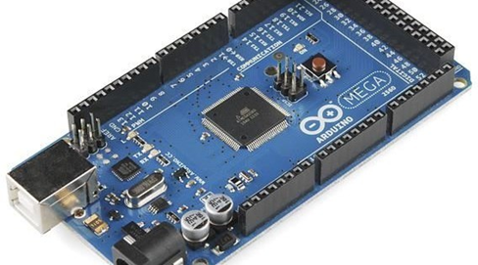
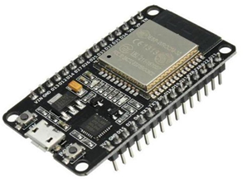
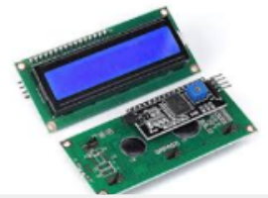
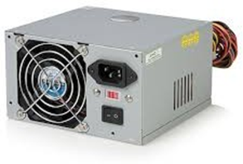
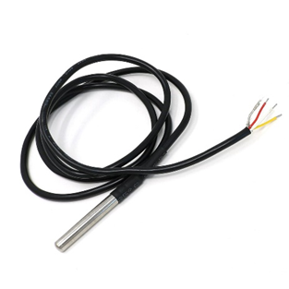
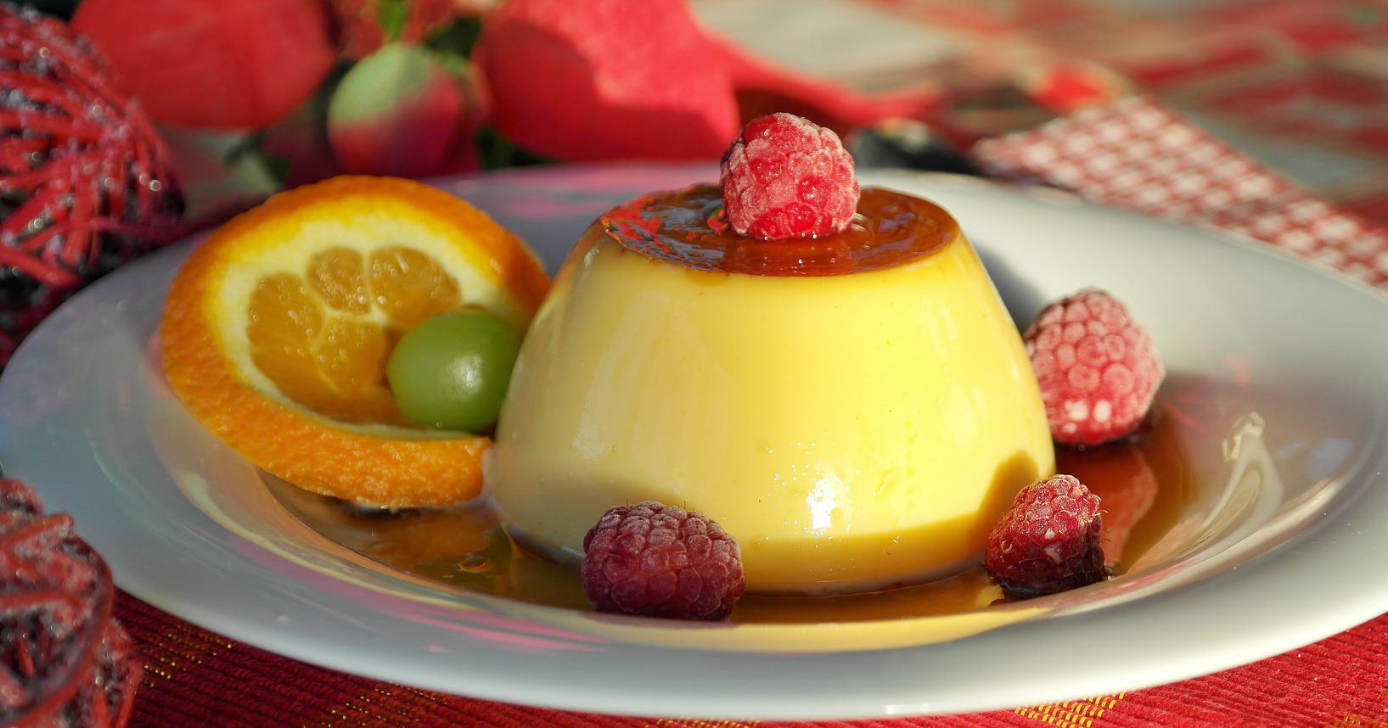
Luvy Coffee
Home
About
System
Contact
COMPONENTS AND MATERIALS USED IN OUR PROJECT
Components and Materials Used in Our Project
In this section, we present the main electronic, mechanical, and structural components that were carefully selected and integrated to build our smart beverage machine.
Frozen Desserts
Cool, refreshing, sweet
Arduino Mega 2560
Esp32-WROOM-32
LCD and I2C
Computer power supply
Temperature Sensor DS18B20

Slide 4
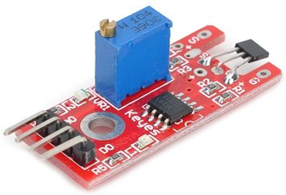
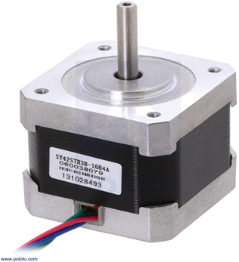
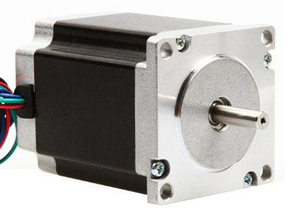
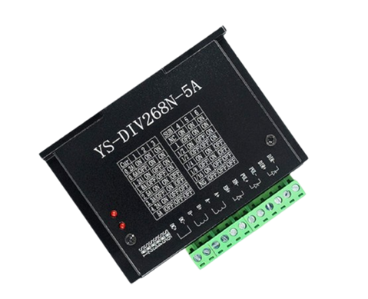
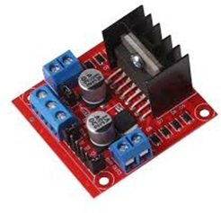
Luvy Coffee
Home
About
System
Contact
COMPONENTS AND MATERIALS USED IN OUR PROJECT
Components and Materials Used in Our Project
In this section, we present the main electronic, mechanical, and structural components that were carefully selected and integrated to build our smart beverage machine.
Frozen Desserts
Cool, refreshing, sweet
Hall effect sensor module
NEMA 17 Stepper Motor
NEMA 23 Stepper Motor
5A Motor Driver
H-Bridge Driver 4.21

Slide 5
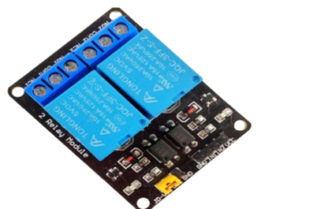
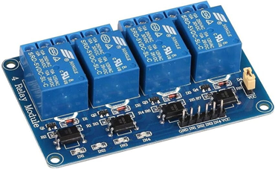
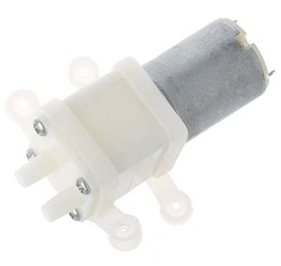
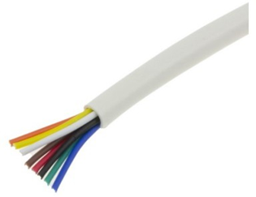
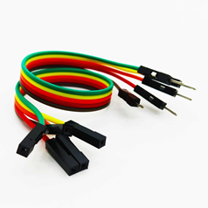
Luvy Coffee
Home
About
System
Contact
COMPONENTS AND MATERIALS USED IN OUR PROJECT
Components and Materials Used in Our Project
In this section, we present the main electronic, mechanical, and structural components that were carefully selected and integrated to build our smart beverage machine.
Frozen Desserts
Cool, refreshing, sweet
Soft, sweet, layered
Crunchy, savory, sweet
Mini Water Pump (DC Diaphragm Pump)
Intercom Wires
Arduino Wires

Slide 6
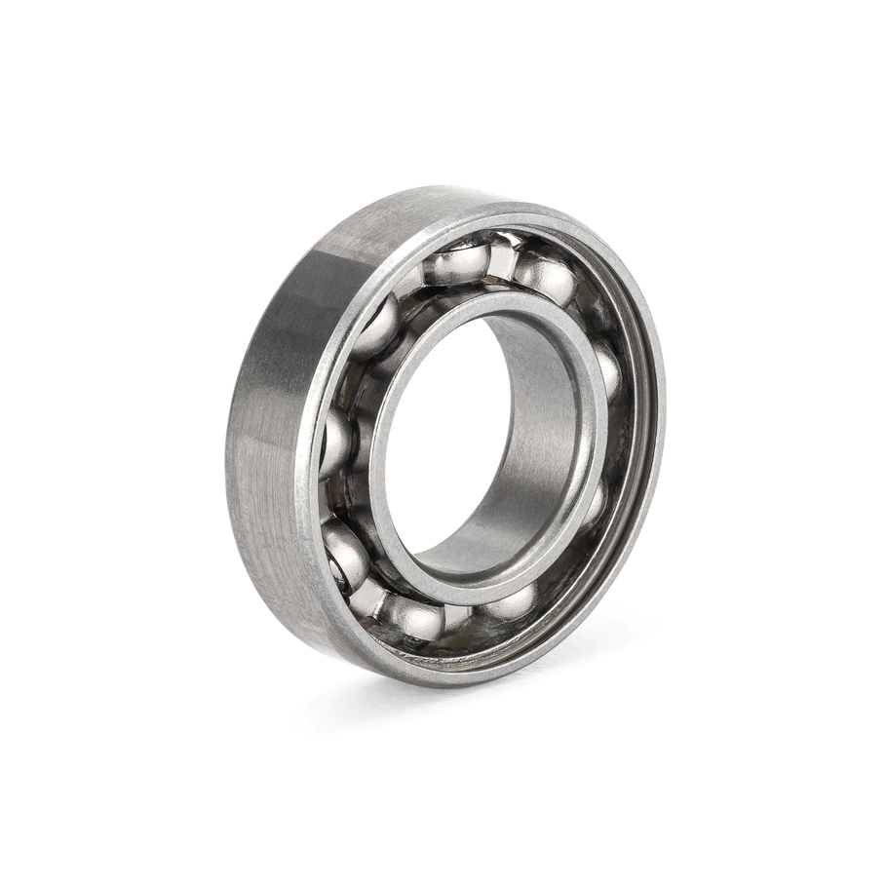
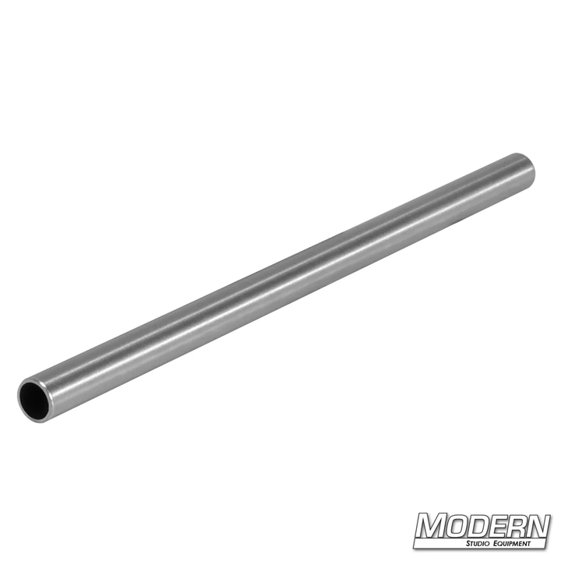
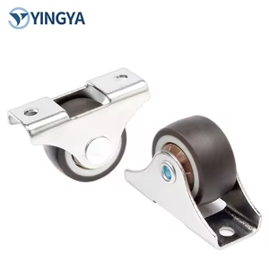
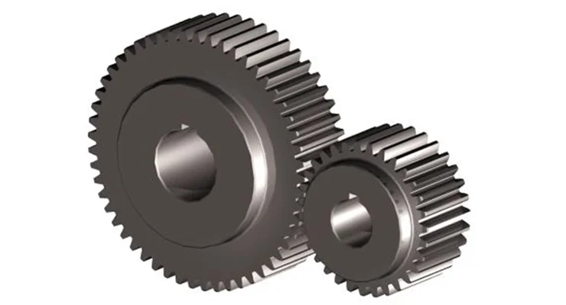
Luvy Coffee
Home
About
System
Contact
COMPONENTS AND MATERIALS USED IN OUR PROJECT
Components and Materials Used in Our Project
In this section, we present the main electronic, mechanical, and structural components that were carefully selected and integrated to build our smart beverage machine.
Crunchy, savory, sweet
Ball Bearing
Metal Rod
Caster Wheels
Gears

Slide 7
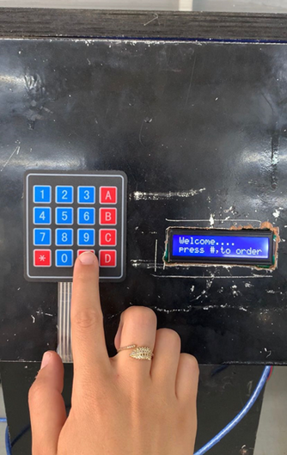
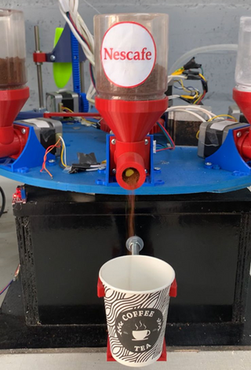
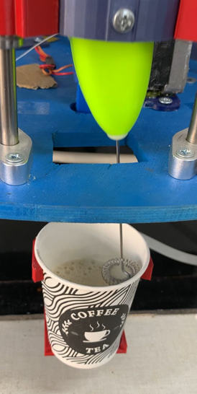
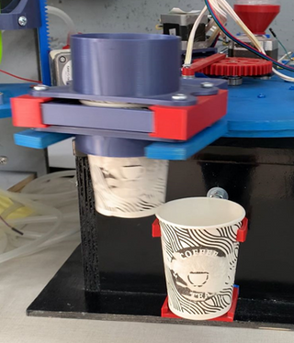
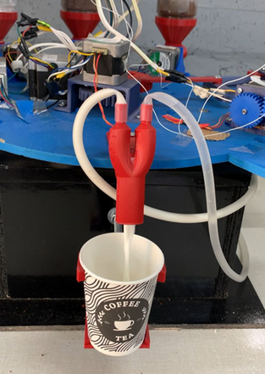
Luvy Coffee
Home
About
System
Contact
SYSTEM STRUCTURE
Selecting Drink Options using Keypad
Ingredient Dispensing
Blending
Cup Dispensing
Liquid Dispensing
Stage 1
Stage 3
Stage 5
Stage 2
Stage 4
Page 06

Slide 8
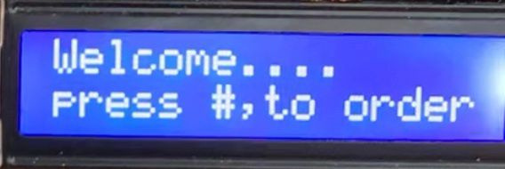
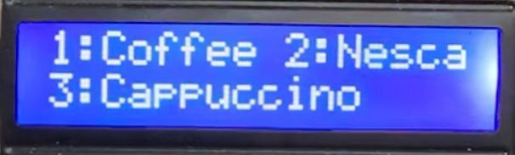
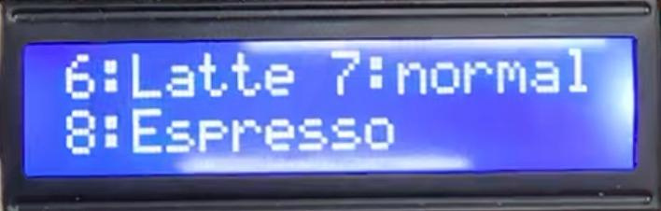
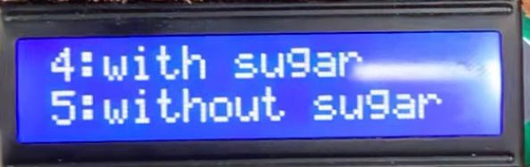
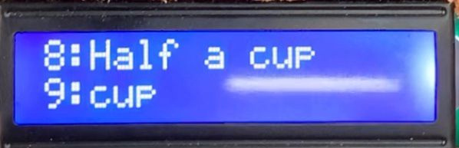
Luvy Coffee
Home
About
Service
Contact
4.5/5
Selecting Drink Options using Keypad
Stage 1
Stage 1
Page 06

Slide 9
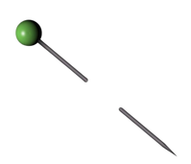
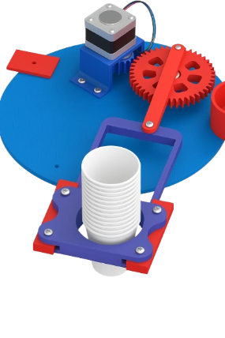
Luvy Coffee
Home
About
Service
Contact
Cup Dispensing
Stage 2
Page 06

Slide 10

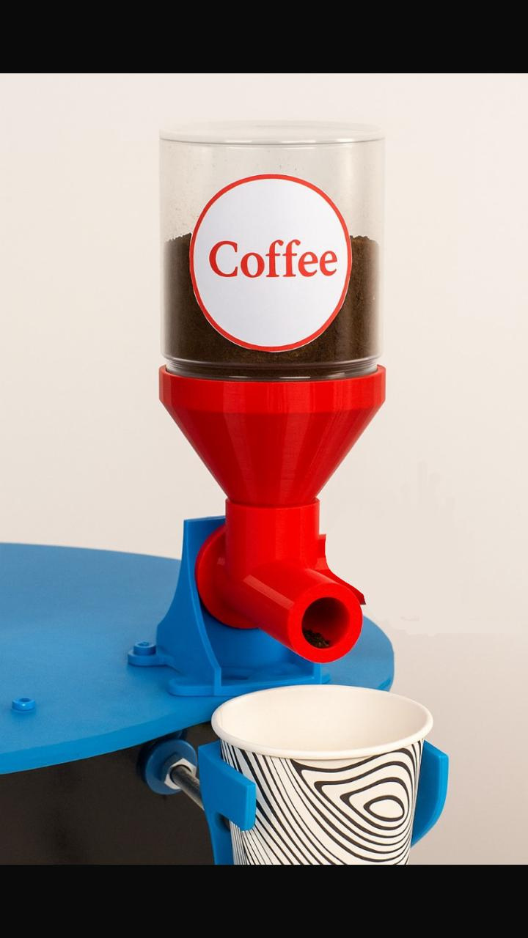
Luvy Coffee
Home
About
Service
Contact
The system was programmed to accommodate up to 15 cups. When the 14th cup is used, a notification is automatically displayed on the screen to alert the user that the supply is about to run out.
Ingredient Dispensing
Stage 3
Page 06

Slide 11
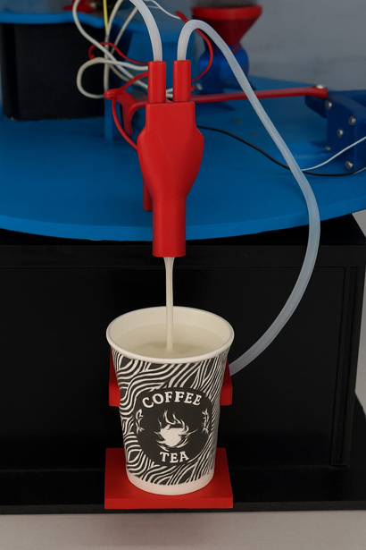
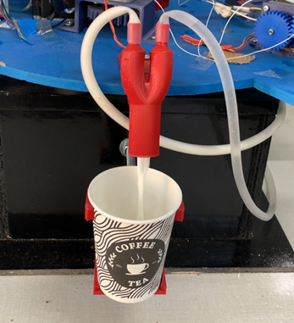
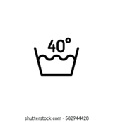
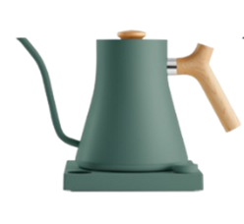
Luvy Coffee
Home
About
Service
Contact
The kettle was programmed to serve up to 10 cups. After the 10th cup, the system notifies the user that the water or milk has run out.
The system also includes a temperature sensor to monitor the liquid inside the kettle. If the temperature drops below 40°C, the system automatically activates the heating element to warm the liquid to the desired level.
Liquid Dispensing
Stage 4
Page 06

Slide 12
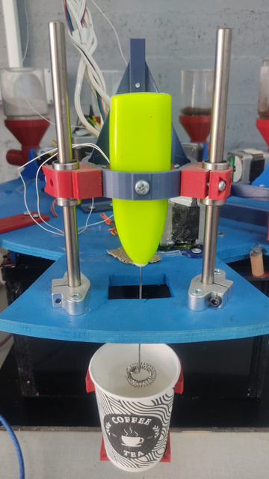
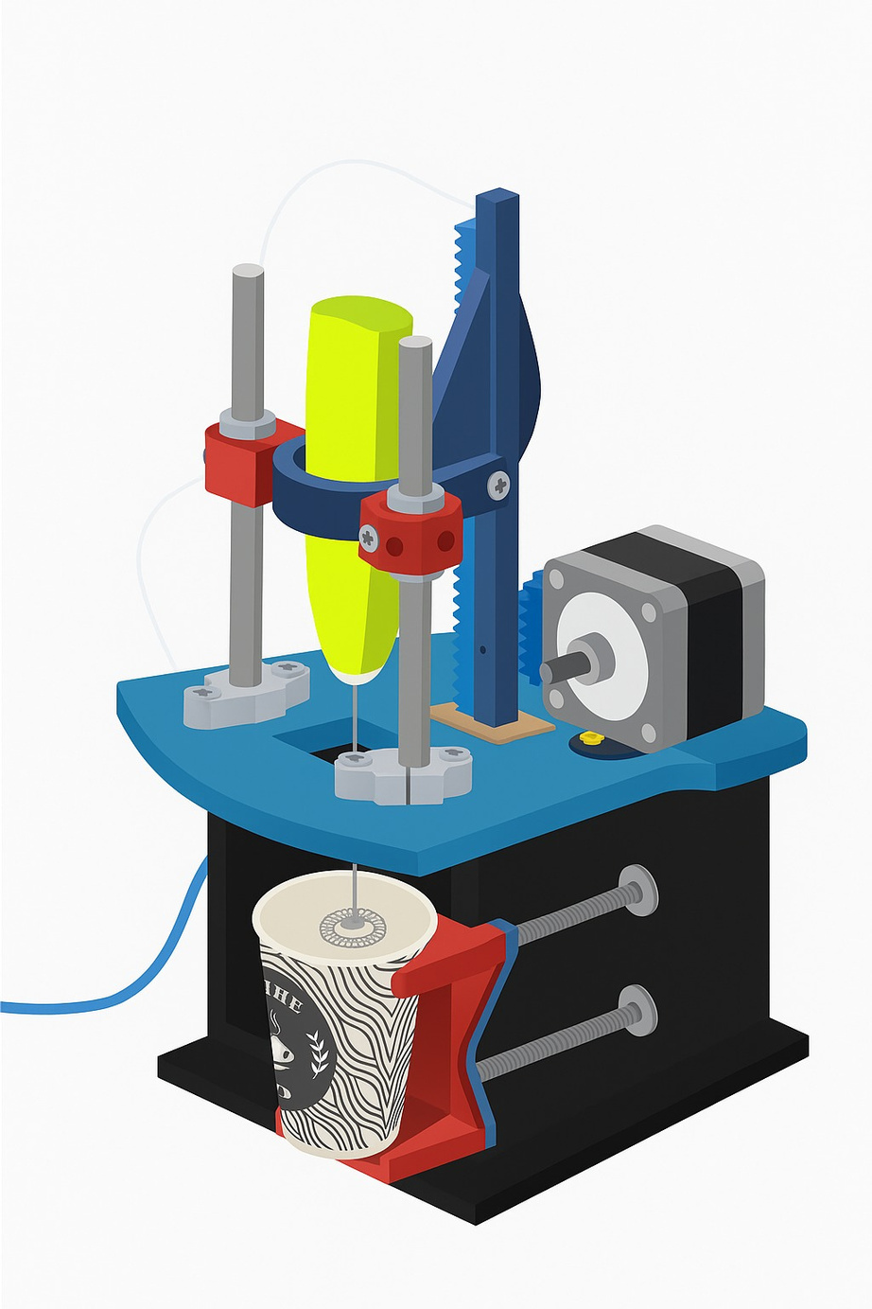
Luvy Coffee
Home
About
Service
Contact
·Blending
Stage 5
Page 06

Slide 13
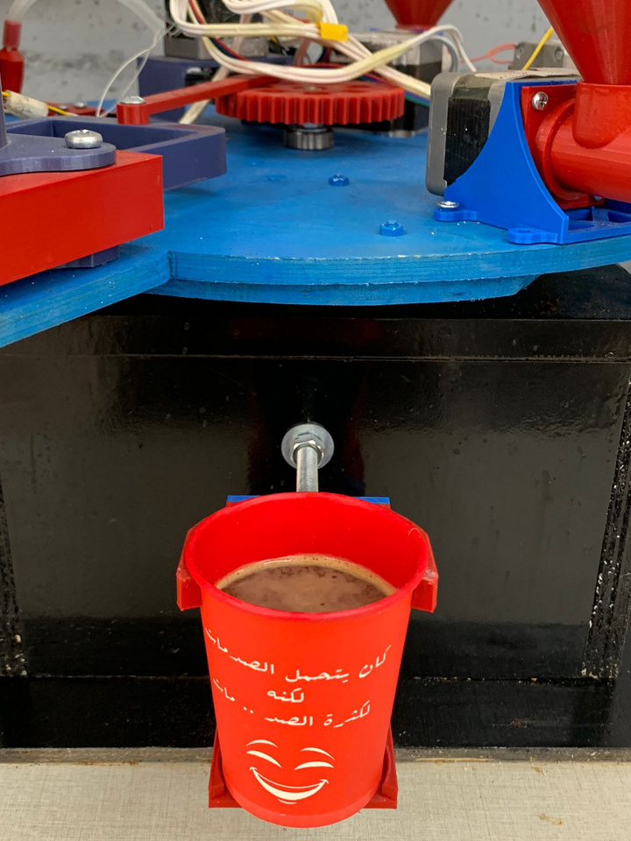
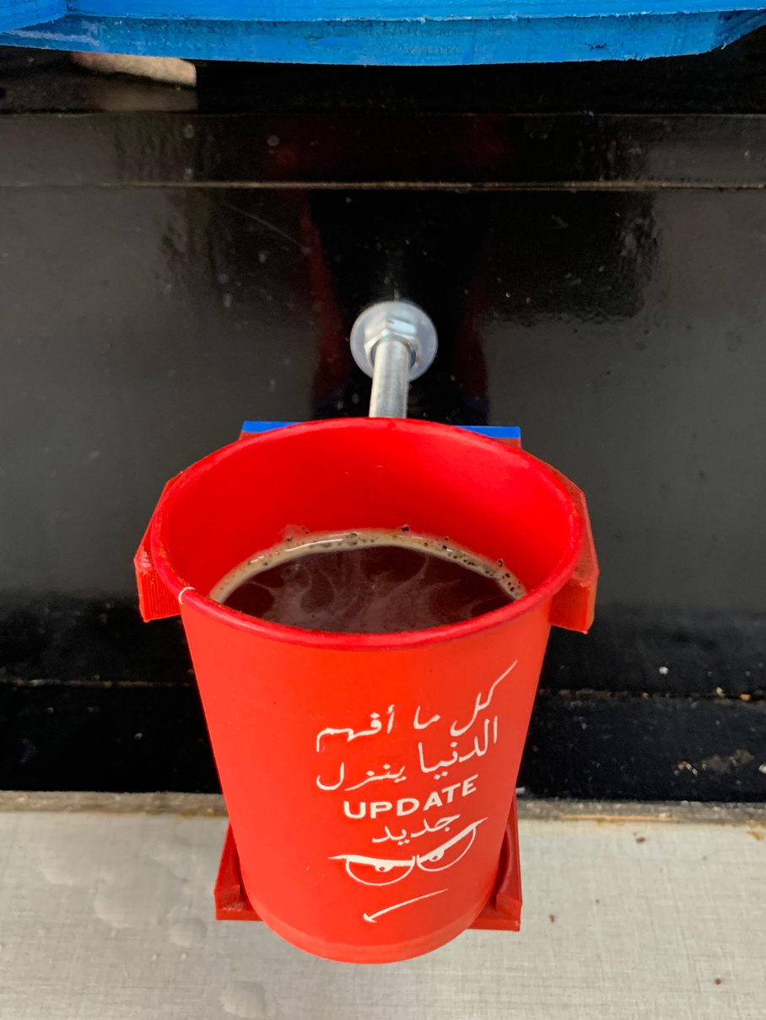

Luvy Coffee
Home
About
Service
Contact
THE OUTCOME OF OUR PROJECT
After months of effort, design, and programming, our machine successfully prepared a hot drink — fully automated, clean, and accurate.
This moment represents the heart of our project: transforming an idea into a working, smart beverage system.
Nescafe
Coffee
Page 07

Slide 14
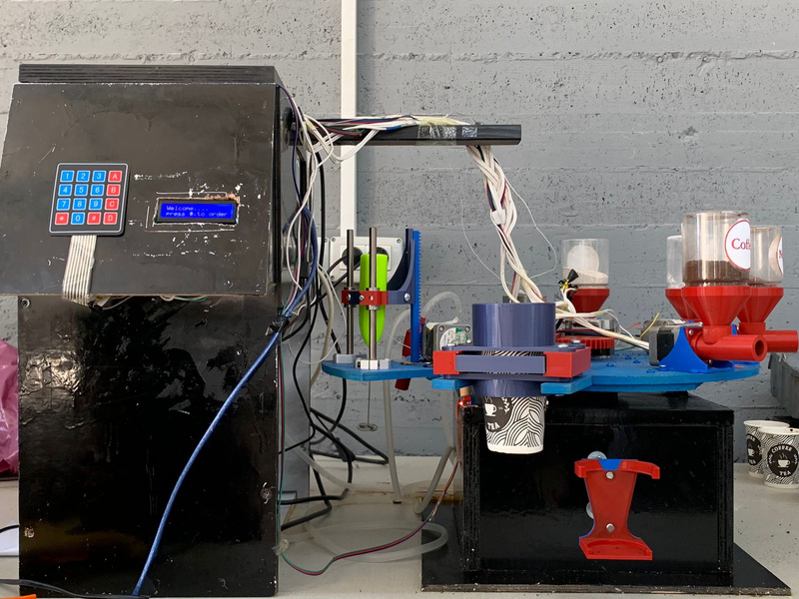
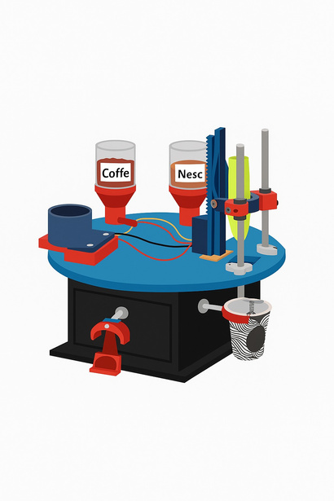


Luvy Coffee
Home
About
Service
Contact
PROJECT BODY
Our primary focus was dedicated to designing and constructing a small-scale structure, where we exerted all our effort and care to achieve this goal. We were keen to accurately replicate the real shape as closely as possible
3D plastic printing
Wood
⭐
All parts are connected to motors and some to sensors and are controlled by microcontroller and application
We used 3D printing to create plastic parts for our project
We also used wood in building the machine’s frame and external parts

Slide 15
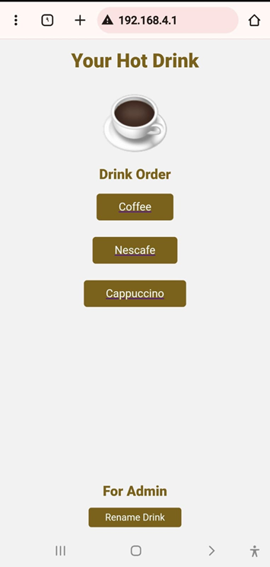
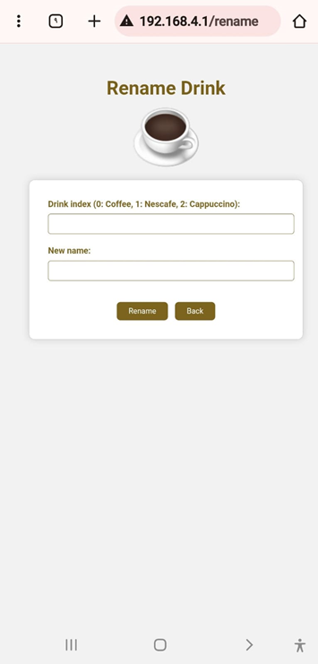
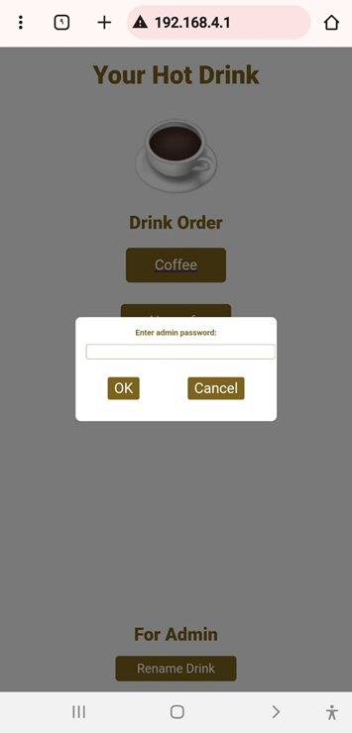
Luvy Coffee
Home
About
System
Contact
SYSTEM SOFTWARE CONTROL PAGES
Stage 1
Stage 2
Stage 3
Page 06

Slide 16

Luvy Coffee
Home
About
Service
Contact
CHALLENGES & LIMITATIONS!
Delay in starting work due to poor workshop equipment.
Poor mechanical experience at the beginning
and poor selection of appropriate parts
Problems in choosing the right torque &Electrical Safety Risks
Page 09

Slide 17
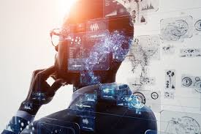
Problems in choosing the right torque &Electrical Safety Risks
Luvy Coffee
Home
About
Service
Contact
FUTURE WORK
Customizable Music Playback
Allow users to select their preferred music or playlists to be played during the beverage preparation process, enhancing the overall user experience and making the wait more enjoyable
Smart Scheduling
Integrated Payment System
The machine can be programmed to operate automatically at different preset times on various days of the week, adapting to the user's routine and preferences for optimal convenience.
Adding a secure payment method (e.g., contactless card or mobile payment) to allow users to purchase drinks easily and securely without manual intervention.
Page 09

Slide 18



Luvy Coffee
Home
About
Service
Contact
thank you
We hope our presentation met your expectations and earned your appreciation
✨✨☄️
Page 10

