Slide 1

Factors and problems affecting the determination of construction contract duration in Palestine
By
Tariq Judeh
Ahmad Wardan
Saleh Abed
Abdallah Jafer
Under supervision of: Eng. Reema Nassar

Slide 2
Contents
Introduction.
Objectives.
Research methodology.
Data required and data collection.
Techniques for determining contract duration.
Factors affect the determination of project duration.
Problems affecting the duration of construction projects.
Questionnaire analysis and results.
Discussion.
Software guide.
Conclusion and Recommendations.

Slide 3
Introduction

Slide 4
Objectives
Verify the factors used for the determination contract duration for any project in Palestine.
Verify the methods used for the determination contract duration for any project in Palestine.
Identify problems related to the contract duration.
Suggest solutions for the top ten problems that affect the duration of the projects.

Slide 5
Significance of study
Determination of the top ten factors that affect the determination of the contract duration in order to be taken into consideration.
Assist owners to deal with the top ten problems that may cause a delay in the project, or can affect the duration of the project by suggest the solutions that help them to override these problems.

Slide 6
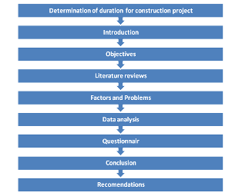
Research methodology

Slide 7
Data required
Current practice
Problems
Factors

Slide 8
Data collection
Literature review.
Questionnaire.
Pair wise comparison paper.

Slide 9
Techniques for determining contract duration
There are several techniques used to determine construction contract duration:
Estimated Cost Method
Bar Chart (Gantt chart)
Critical Path Method (CPM)

Slide 10
Time reduction techniques
There are two commonly techniques used for reducing time overruns:
Time Compression of Critical Path
Time Crashing Technique

Slide 11
Factors affect the determination of project duration.
Limited of the resources and supports
Mismanagement of construction project
Safety
The environmental factor
Construction labor productivity
Annoyances in residential areas
Weather conditions
Dependency between activities
Time to obtain necessary permits
Over time principle

Slide 12
Previous projects
Owner Experience
Availability of Resources
Local regulations & laws
Israeli occupation
Project management strategies
Material price Inflation
Project size
Project type& design
Required Quality of work

Slide 13
Problems affecting the duration of construction projects
Resource Restrictions
Mismanagement of construction project
Weak labor productivity
Bad weather conditions
Problems in obtain necessary permits
Low experience
Israeli occupation
Complex Project design
High risk
Missing data
Equipment restriction
Unsuitable site place

Slide 14
Sample size
Number Of Municipalities | District
9 | Nablus
7 | Jinen
11 | Tulkarm

Slide 15
Questionnaire analysis and results
96% of municipalities' engineers have a bachelor degree.
71% of the municipalities use the Bar chart method to represent the project planning and scheduling.
63% of the municipalities use Primavera in the determination of project duration.

Slide 16
Top ten factors
Weighted score (from 5) | Factors | Rank
4.0416 | Required quality of work | 1
3.9583 | Project size | 2
3.7501 | Limited resources | 3
3.6667 | Project type | 4
3.6667 | Project design | 5
3.4583 | Experience | 6
3.4583 | Safety | 7
3.3751 | The environmental condition | 8
3.3333 | Israeli occupation | 9
3.3333 | Labor productivity rate | 10

Slide 17
Top ten problems
Weighted score from 5 | Problem | Rank
4.0833 | Not adequate financial support | 1
3.9166 | Resource restrictions | 2
3.4583 | Mismanagement of construction project | 3
3.4583 | Weak labor productivity | 4
3.4583 | Obstacles to Israeli occupation | 5
3.3752 | Missing data (Design) | 6
3.2916 | Low experience | 7
3.2916 | Complex project design | 8
2.9167 | High risk | 9
2.7501 | Bad weather condition | 10

Slide 18
Analysis of the pairwise comparison papers
Weight | Accumulated score | Score from the second contractor (expert) (this score from 90) | Score from the first contractor (expert) (this score from 90) | Factors
0.672222 | 121 | 54 | 67 | Limited resources
0.6 | 108 | 42 | 66 | Required quality of work
0.55 | 99 | 63 | 36 | Experience
0.516667 | 93 | 43 | 50 | Project type
0.505556 | 91 | 36 | 55 | Labor productivity rate
0.483333 | 87 | 44 | 43 | Israeli occupation
0.483333 | 87 | 49 | 38 | Project design
0.438889 | 79 | 42 | 37 | Project size
0.422222 | 76 | 45 | 31 | Safety
0.327778 | 59 | 32 | 27 | The environmental condition

Slide 19
Discussion
Top ten factors discussion
Top ten problem discussion

Slide 20
Top ten factors discussion
Required quality of the work
Quality of the work due to the differences in cost and allowable time in construction projects.

Slide 21
Limited resources
Resources include the materials, equipments and labors that should be exist in the work place.

Slide 22
Project size
Project size The first factor comes to mind before the determination of construction contract duration is the size of the project.

Slide 23
Project design
This factor may be increase or decrease the duration.

Slide 24
Project type
this factors depends on the past experience and knowledge of the owners in this type of projects.

Slide 25
Experience
Experience consists of knowledge of or skill of something or some event gained through involvement in or exposure to that thing or event.

Slide 26
Safety
There is a positive relation between the safety on
the project with the duration needed to finish the project.

Slide 27
The environmental conditions
The environmental factor influence on each project separately.

Slide 28
Israeli occupation
Is one of the most important factors that affect the duration of the project.
where the Israeli occupation has a high risk on engineering projects.

Slide 29
Labor productivity rate
The productivity of the worker is define as the size or the number of units that can be produced during a certain period of time.

Slide 30
Top ten problems discussion
Not adequate financial support
Financial plan.
Look for other sources of funding.
Take some loans from banks.

Slide 31
Resource restriction
The owners should ask the contractors to deliver the resource profiles for the whole activities before the start of the project.

Slide 32
Mismanagement of construction projects
Employing a construction manager for the project to supervise the work of the project.
Making a prequalification for the contractors that needed in the project.

Slide 33
Weak labor productivity
This problem could be overridden by setting up several supervisors, improve payment process, and applying motivations methods.

Slide 34
Obstacles by Israeli occupation
Israeli Occupation is considered as force majeure.
It is possible to link it with a contingency plan will help us to predict the effect of the occupation on future projects.

Slide 35
Missing data (Design)
Several meetings between owner, contractor and designer assist to discuss and explain the construction project planning.
The integration between contractor and designer should be considered to override this problem.

Slide 36
Low experience
The owner should have past enough experience and knowledge in this field of work or he can consult a professional expert in this field.

Slide 37
Complex project design
The owner must have general courses in the design.
The designer can give extra information about the design to be easy to understand.
The best solution if the design is complex that is by the search for a professional expert who can understand the design and predict the needed time to implement this design.

Slide 38
High risk
Make a contingency plan which means the plan that suggests clear steps to deal with any problem at work and propose solutions that fit these problems.

Slide 39
Bad weather conditions
Using special equipments and clothes while working in a bad weather
Carefully choose a suitable time of day in a bad weather condition.
The allowance time should be considered previously in the plan.

Slide 40
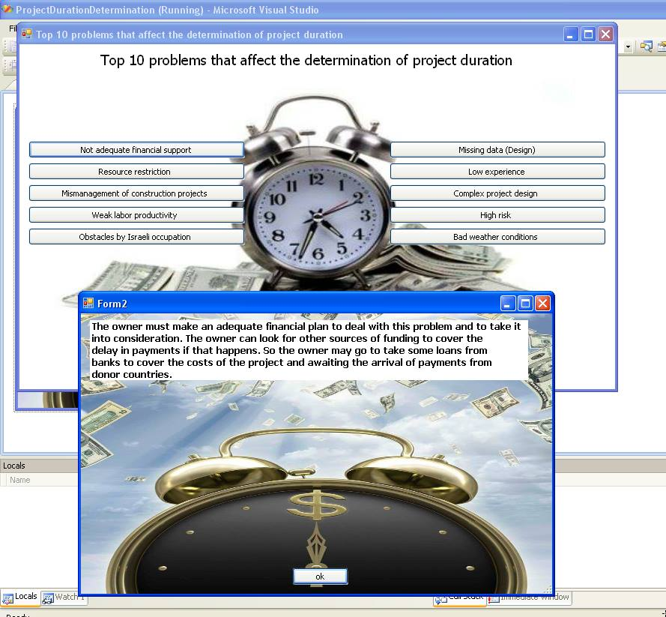
Software guide

Slide 41
Conclusion and recommendations

Slide 42


