Slide 1

Presented by: Naheel Sabbah & Salma Dweikat
Supervised by: Dr. Sufyan Samara

Slide 2
Outline:
Introduction.
Features.
How does it work.
Used Tools.
Constraints.
Future work.

Slide 3
Introduction :Introduction:
The main purpose of our application is to save time and effort of the pharmacists and people. With technological development it was very necessary to make an application makes our lives easier and developed so PharmEasy was done.
People in Palestine need a comprehensive application to help them get all information about any medicine or product from the pharmacy by easy method online . This application can deliver anything from the nearest pharmacies so it is very useful in emergent cases or if the person can't go to the pharmacy to get the medication. Also our application can show the percentage of sells to the pharmacy owners.

Slide 4
Features:
Notification system.
Chat system.
Map.
Rating system.
Cart.
Searching.

Slide 5
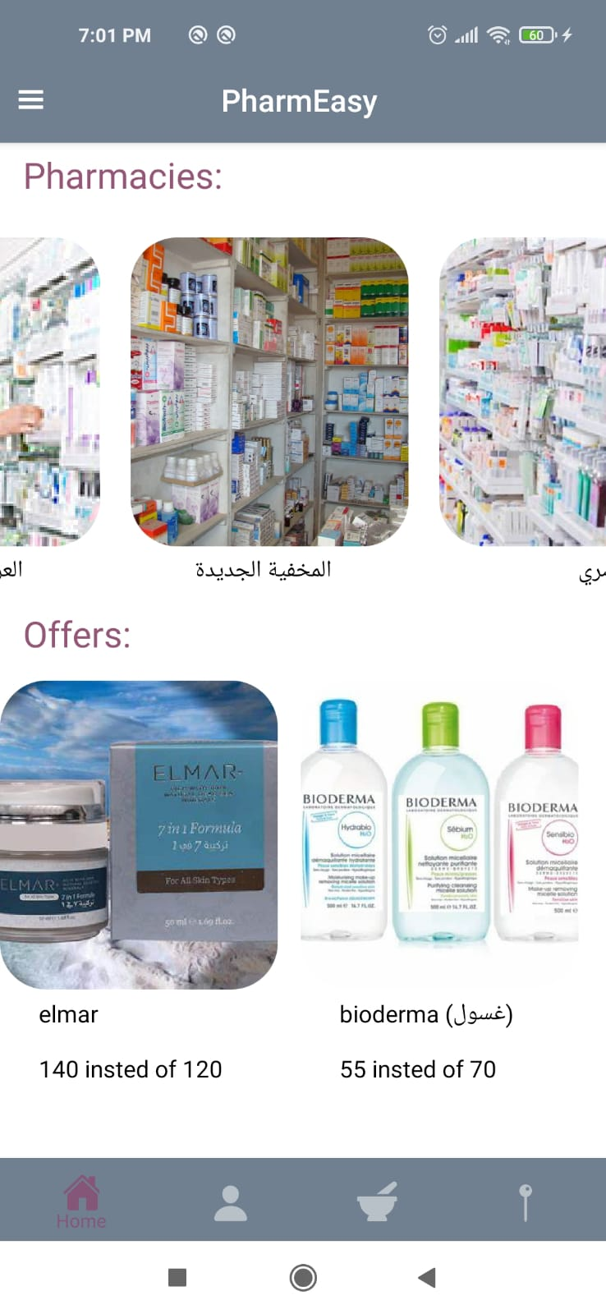
How does it work :
Customer :
See nearly pharmacy .
Search for the pharmacy he/she want.
Search for the products he/she want and can order it online .
Rate pharmacy and add comments .
Chatting with pharmacist to ask him about what he want.

Slide 6
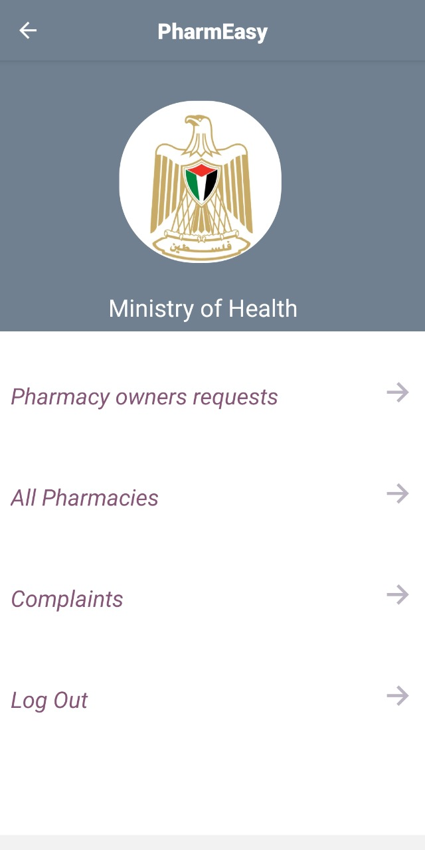
How does it work :
Ministry of Health:
Accept requests from pharmacy owner(manger) to create an account .
View or delete manger.
Provide a list of most of the products in all pharmacies to facilitate the addition of products for the manger.
Receive complaints from customers.
Chatting with manger.

Slide 7
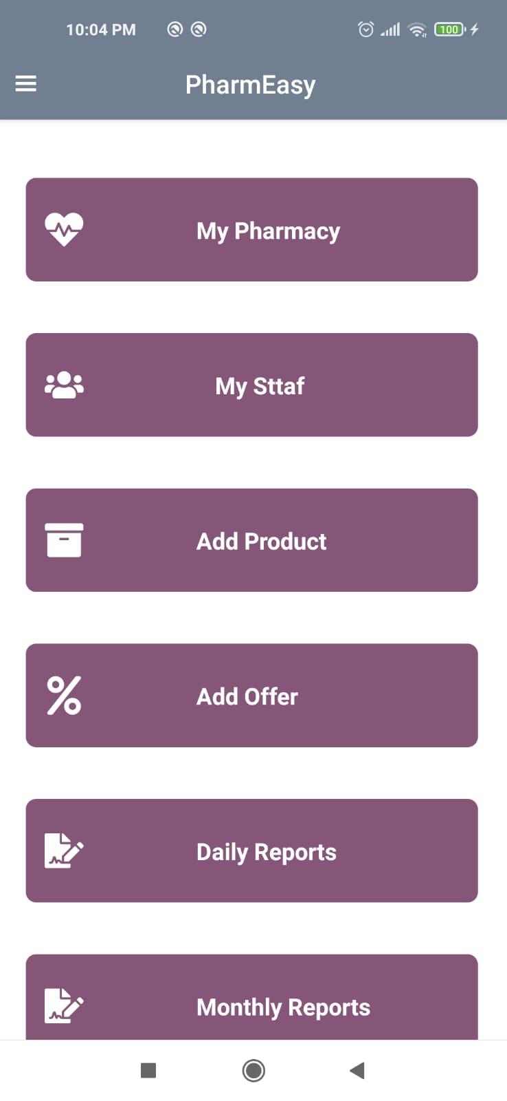
How does it work :
Manger:
Add and view their staff.
Add product and offer.
View Daily, monthly reports.
Chatting with ministry of health and their staff .

Slide 8
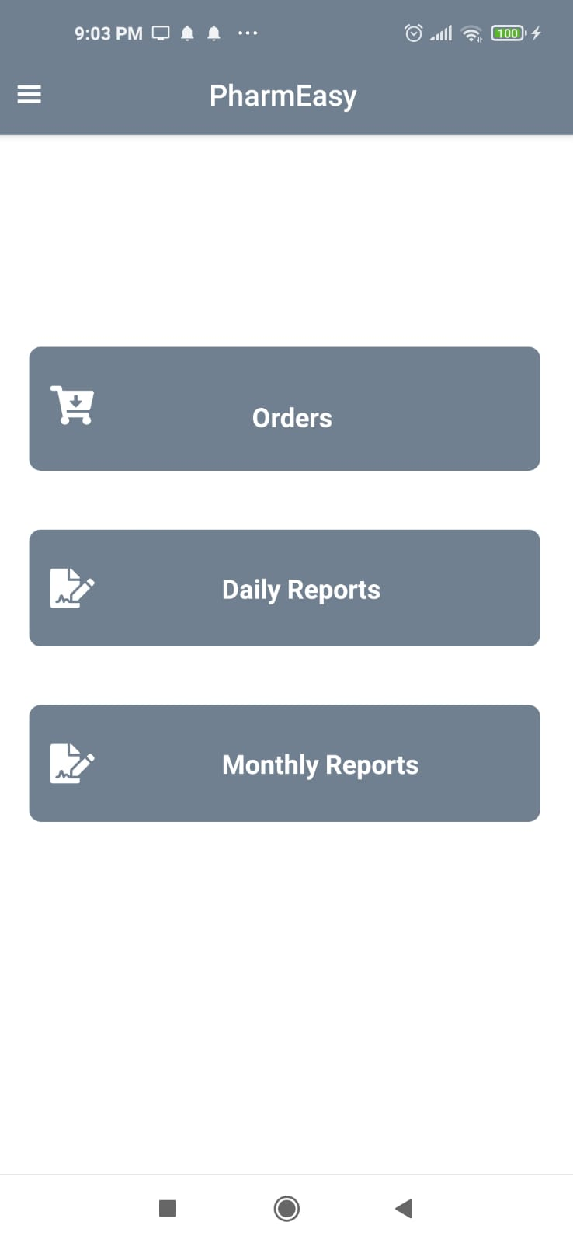
How does it work :
Staff:
Receive notification when someone order the product and can accept or delete it .
Prepare daily and monthly report to manger about pharmacy selling.
Chatting with manger.

Slide 9




Used Tools:

Slide 10
Constraints:
COVID-19 crisis
Limited resources.
Shortage of time

Slide 11
Future work:
The customer can add an alarm to remind him of when to take the medication at specified time.
Customer can track his/her order.

Slide 12
Demo

Slide 13


