Slide 1


Slide 2
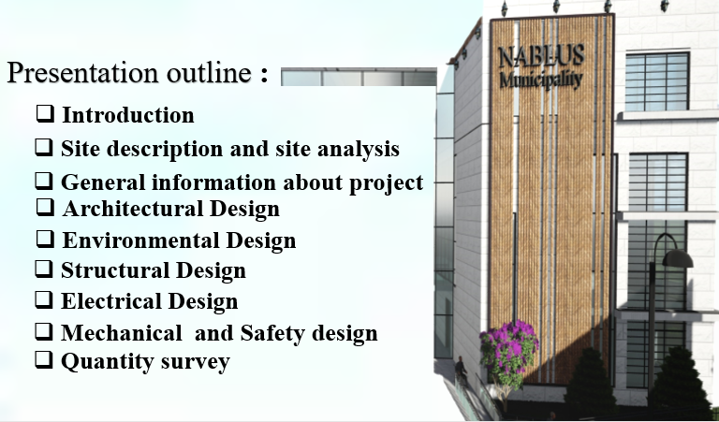
2

Slide 3

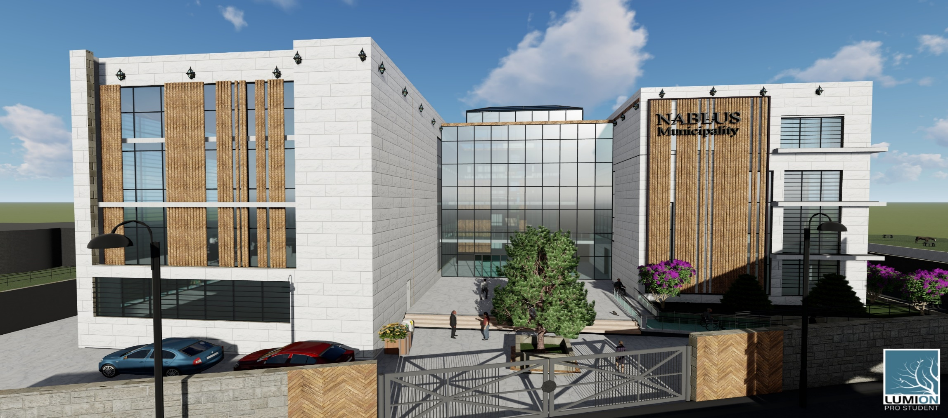
Introduction
The Project present a new design of Nablus municipality. The basic goal of this project is to concentrate on designing a new building for the Nablus municipality that wants to provide all the necessities For employees and citizens, so that it is an integrated building from all architectural, structural, environmental, mechanical and electrical aspects.
Final Design For Nablus Municipality
3

Slide 4
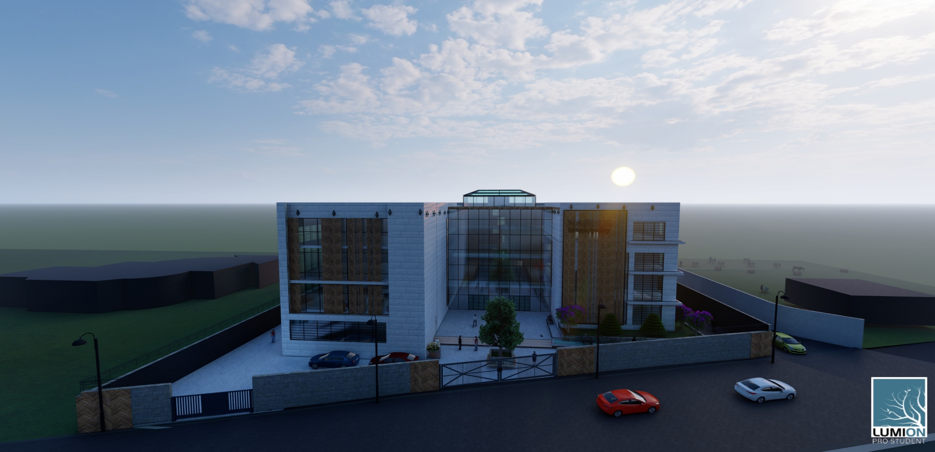
3D views for project :
4

Slide 5
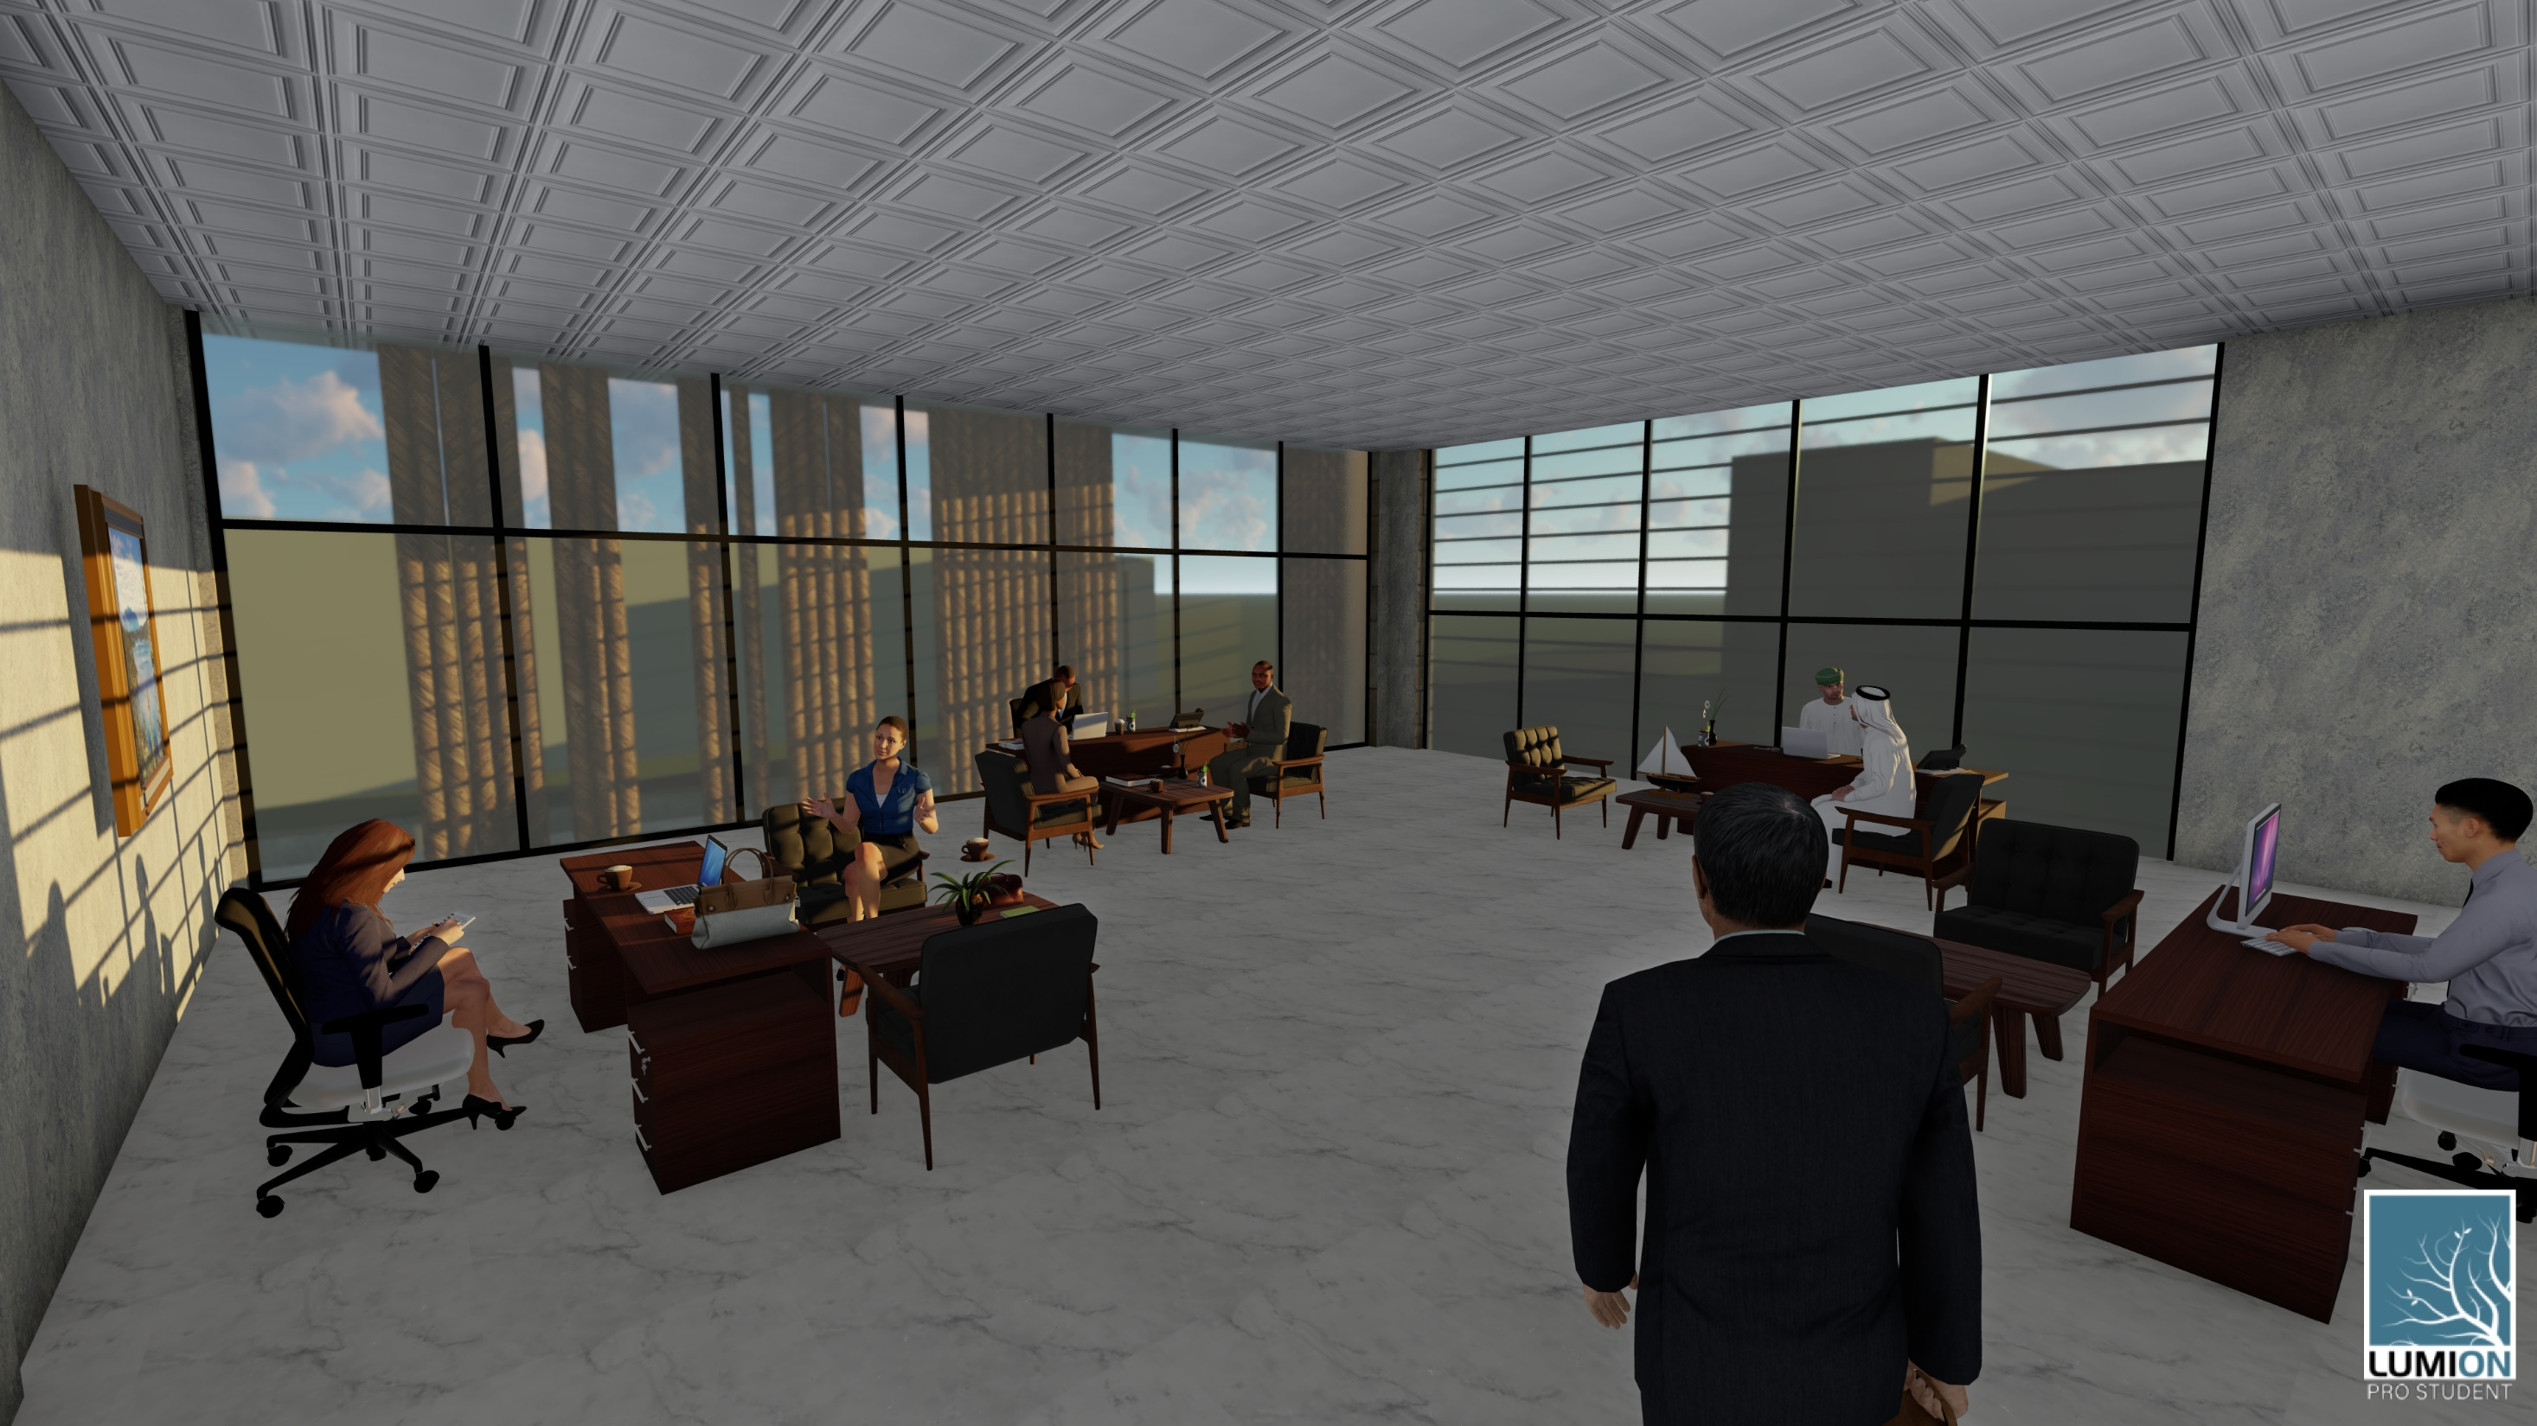
5

Slide 6
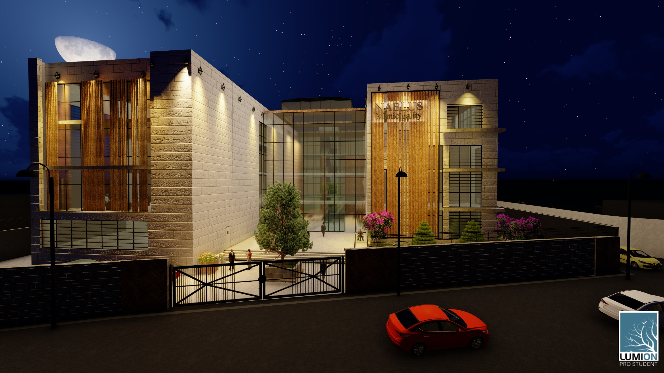
6

Slide 7
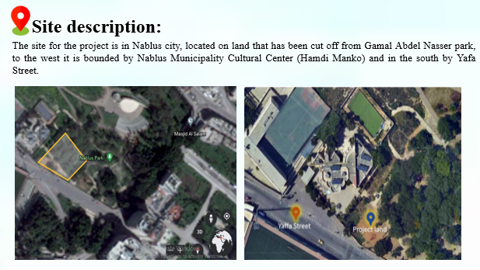
7

Slide 8
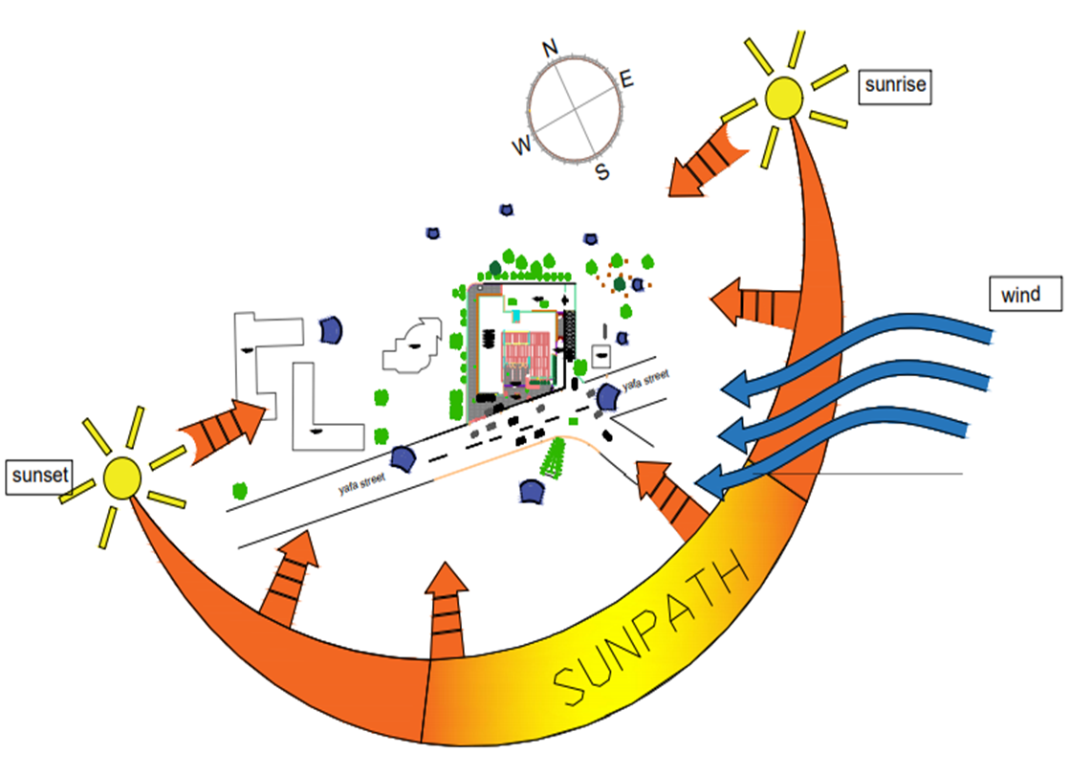

Environmental information about the site :
General information about project :
Average of humidity =67%
Maximum temperature(hot season) =26-35C°
(cold season)=10-18C°
The wind direction is northwest.
Noise level in the site 44 dB
Total site area = 3335 $m^{2}$.
Total Project area = 11141 $m^{2}$.
The municipality Building consists of six floors.
basement 1, basement 2, ground, first, second and third floor.
Q allowable for soil = 180 kN/$m^{2}$
8

Slide 9
Methodology
Collection Of Data And Analysis
Computer Simulation
Architectural , Environmental, and Structural Design
Environmental Design
Structural Design
Design Builder
INSUL & EASE
Etabs
SAP
Prokon
Electrical Design
Dailux Program
Mechanical Design
Revit
9

Slide 10
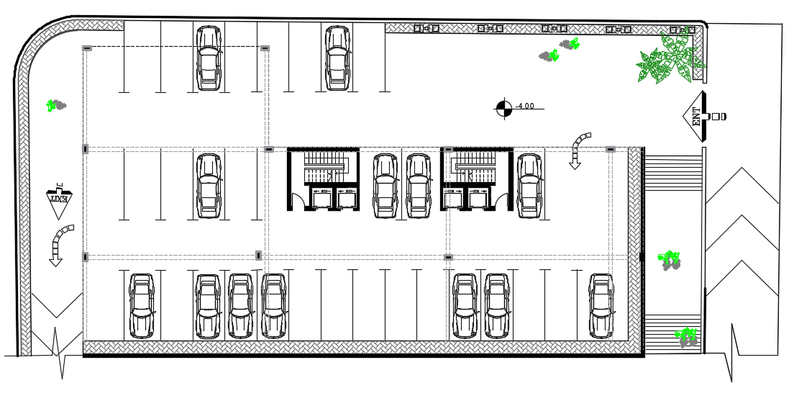
Architectural Design
Problem and modifications: basement:
Before modification
10

Slide 11
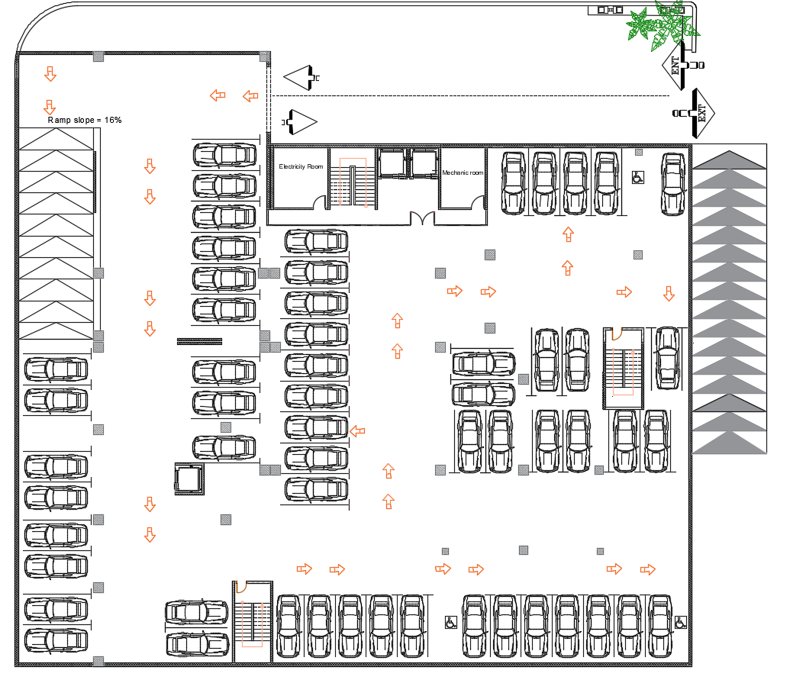
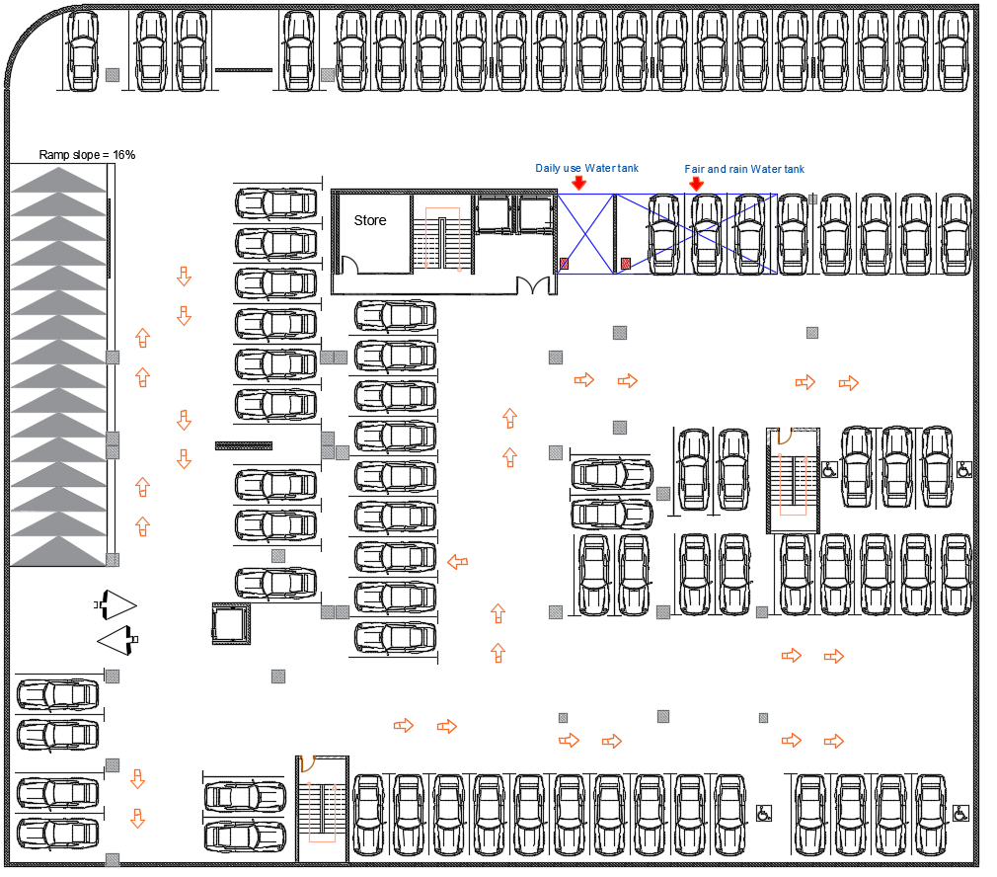
basement:
After modification
11

Slide 12
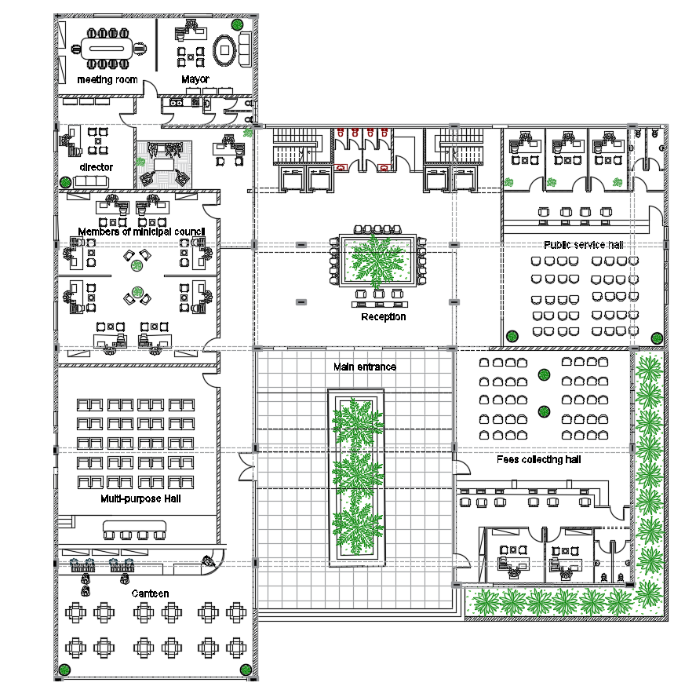
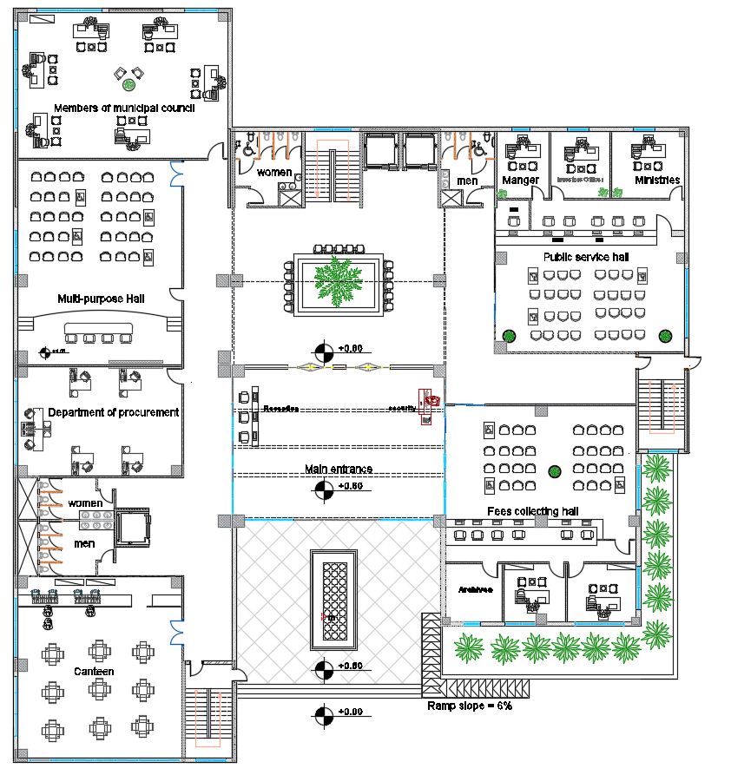
Ground floor:
Before modification
After modification
12

Slide 13
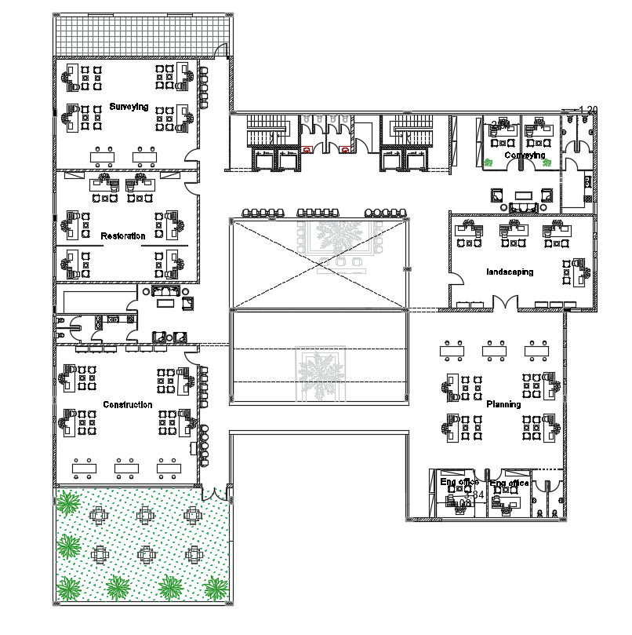
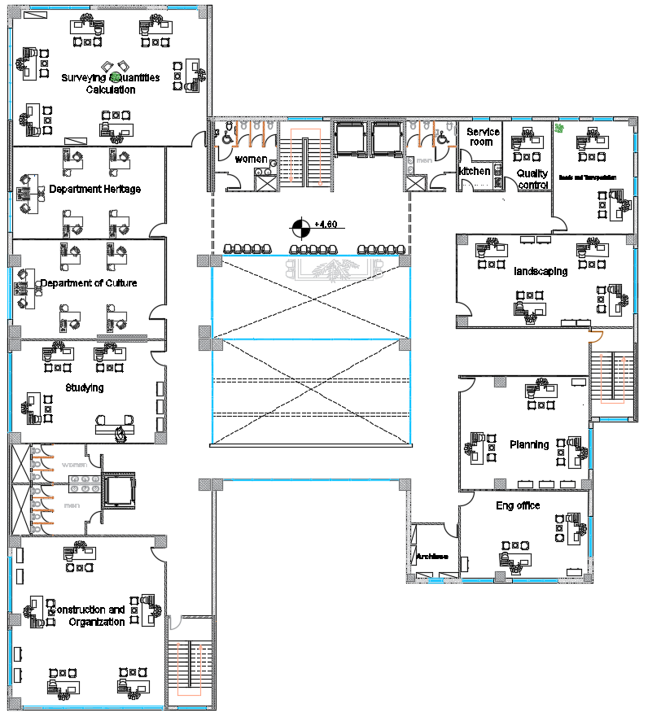
First floor:
Before modification
After modification
13

Slide 14
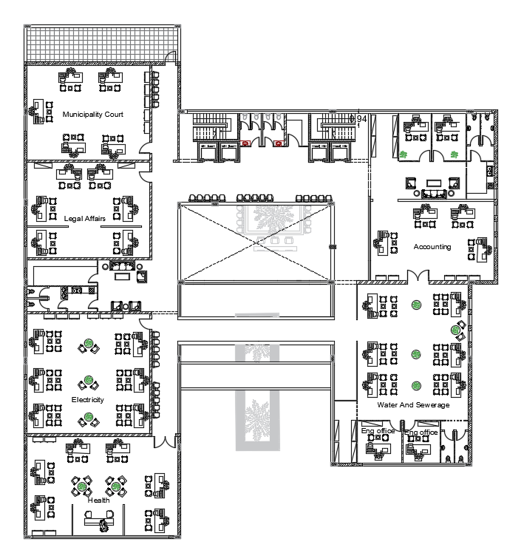
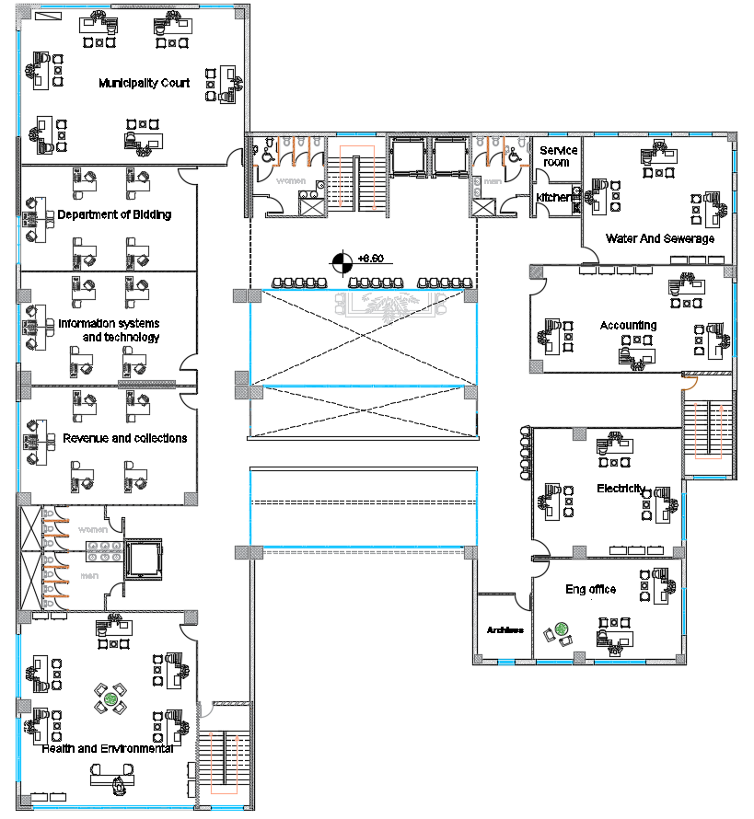
Second floor:
Before modification
After modification
14

Slide 15
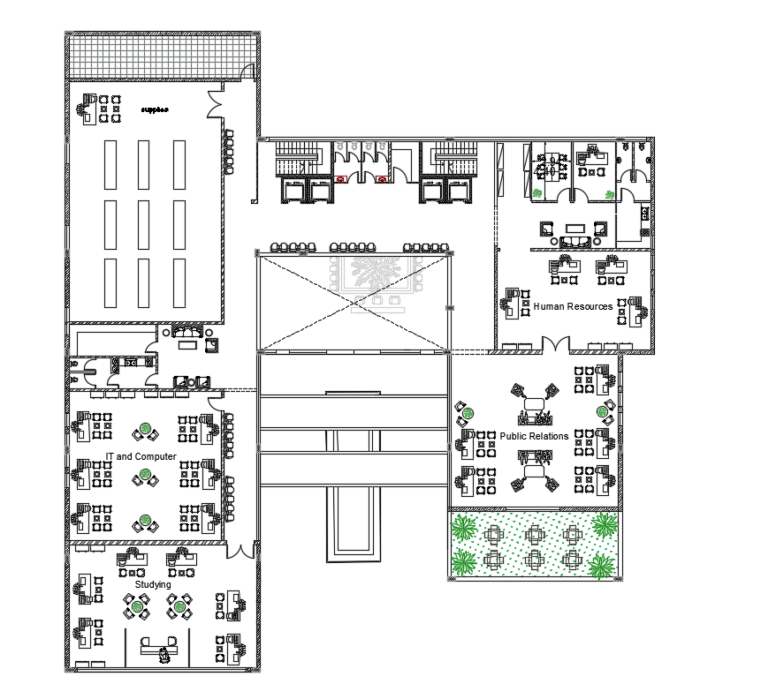
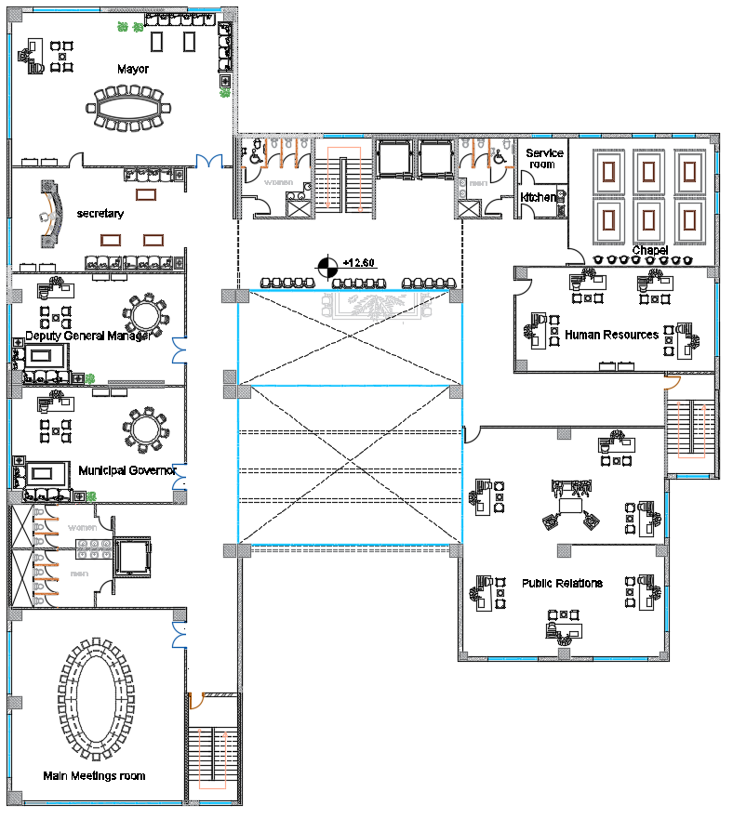
Third floor:
Before modification
After modification
15

Slide 16
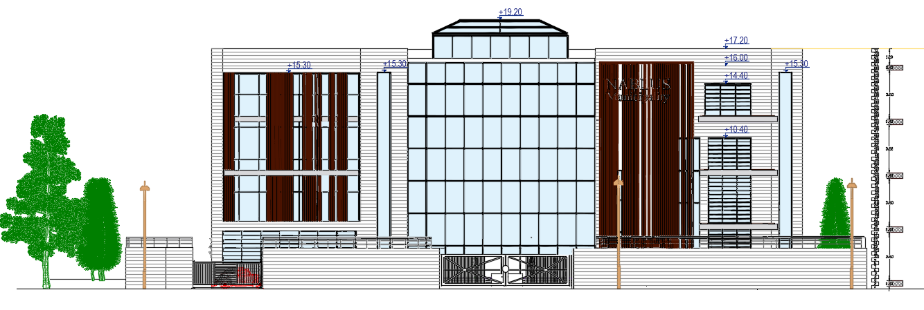
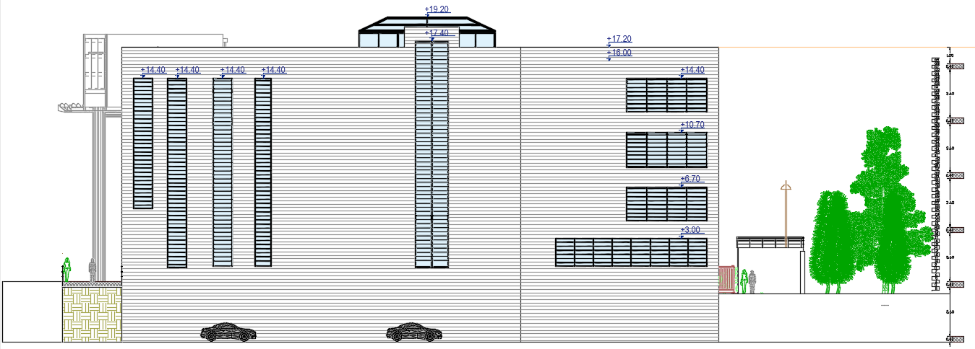
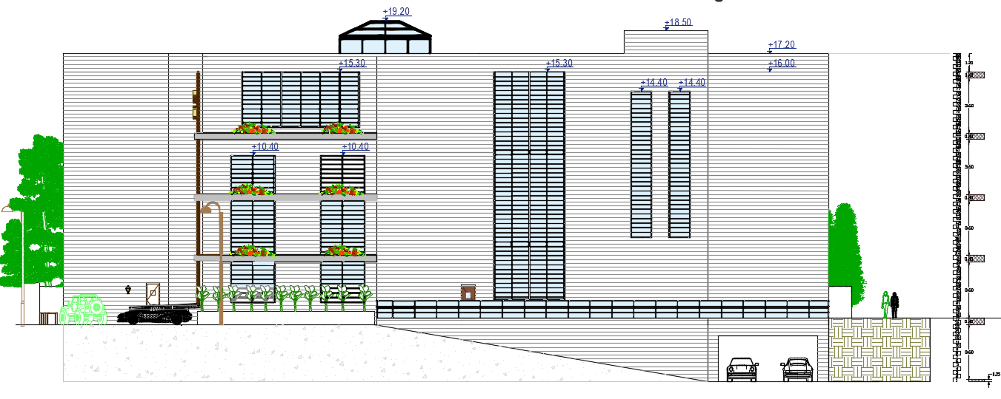
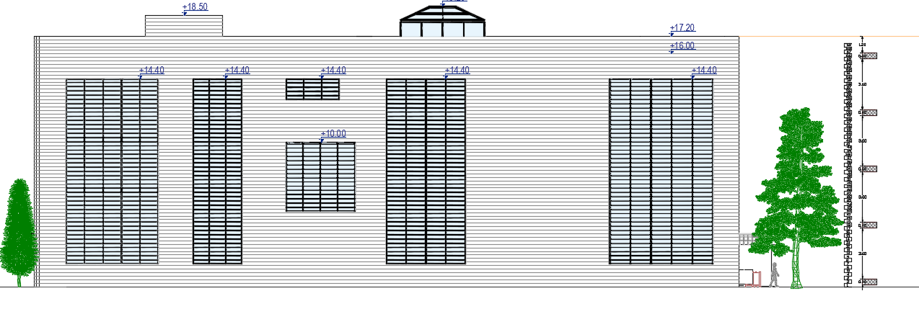
Elevations:
Southwest elevation
Northeast elevation
Northwest elevation
Southeast elevation
16

Slide 17
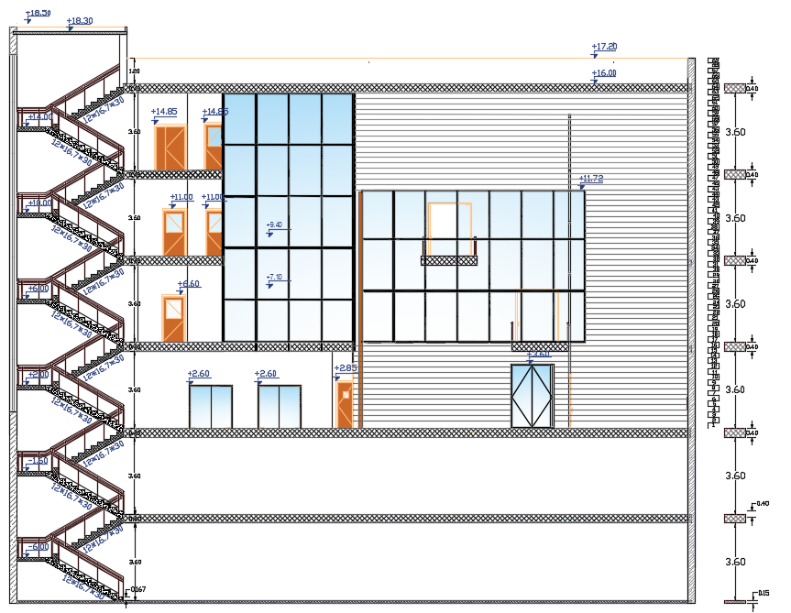
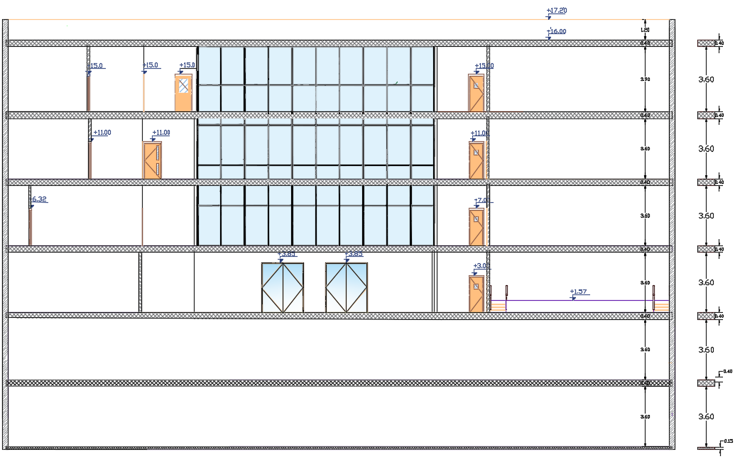
Sections :
SEC. A-A
SEC. B-B
17

Slide 18
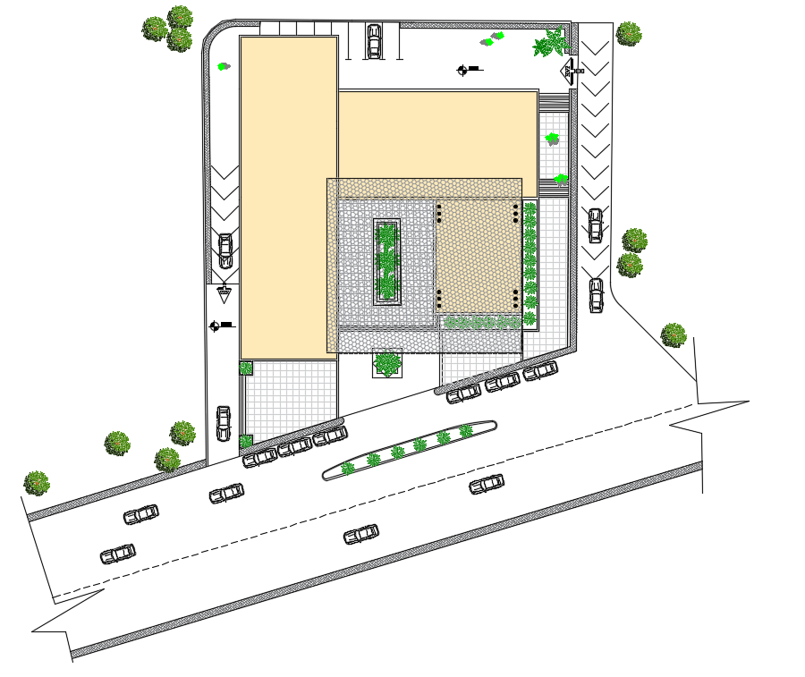
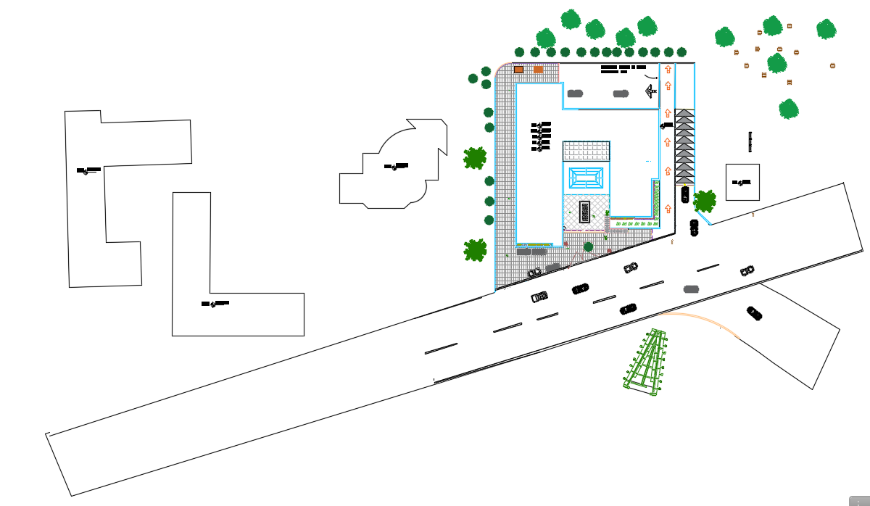
Site plane :
Before modification
After modification
18

Slide 19
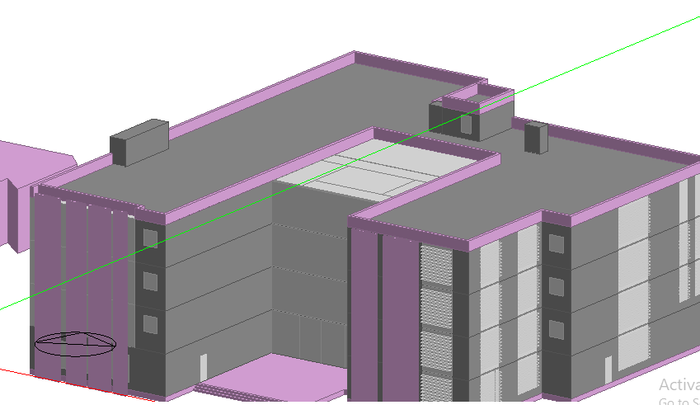
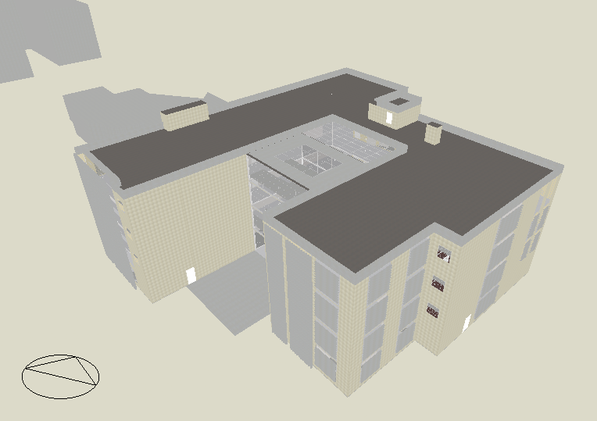
Environmental Design :
We make an analyses on design builder program to study this factor:
Daylight factor
Heating and Cooling
Thermal comfort
Shading system
Photovoltaics system
Computational fluid dynamics (CFD)
Oriantation
19

Slide 20
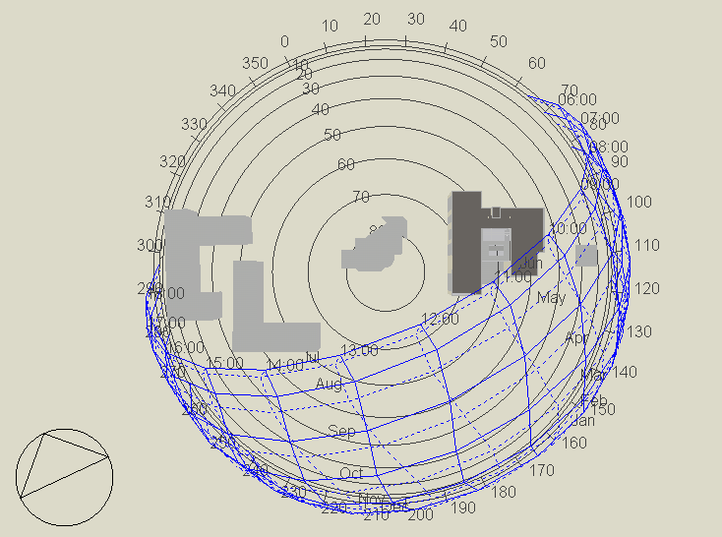
Orientation:
The orientation of our building is inclined by 25 degree from the north as shown in the figure below :
19
20

Slide 21
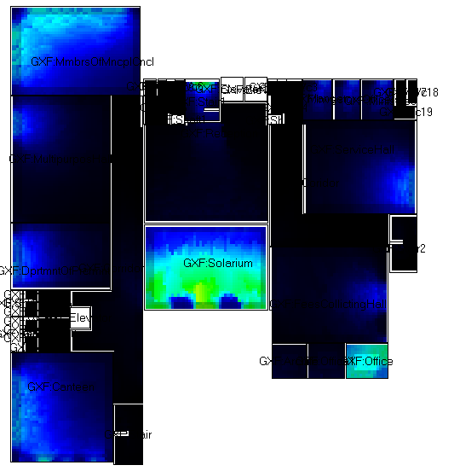
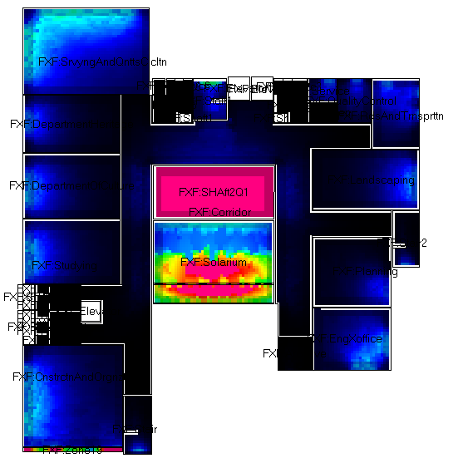
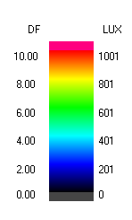
Daylight analysis:
Daylight analysis for our building using design builder program:
Ground floor
First floor
21

Slide 22
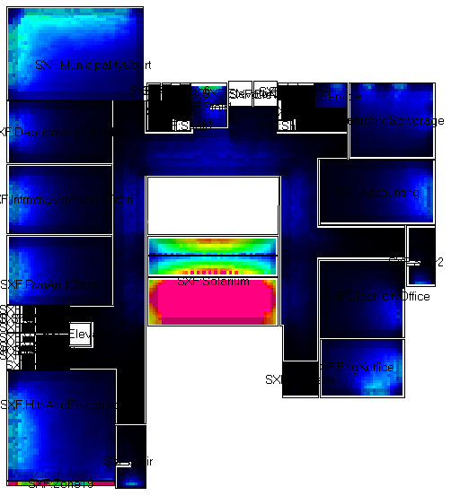
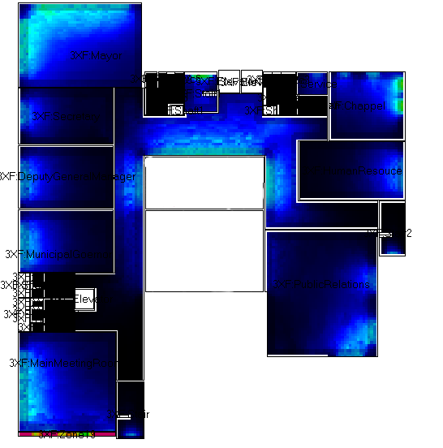
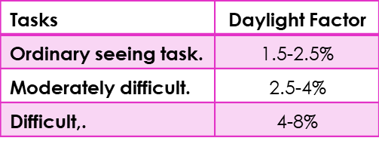
Second floor
Third floor
We found that the daylight factor is in some region we need to artificial lighting but in the region close to the windows the lighting is in the range from 2.5 to 4 %
22

Slide 23
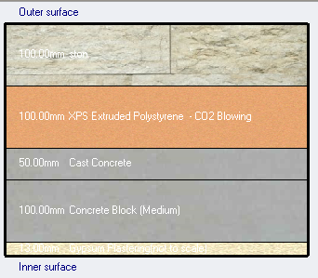
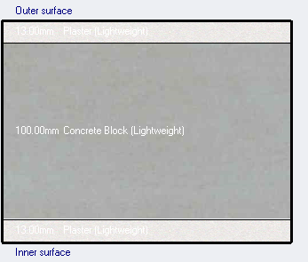
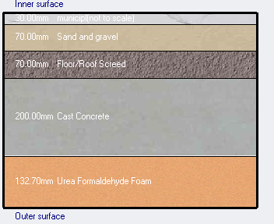
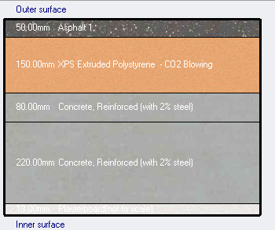
Thermal analysis :
External wall :
Internal wall:
Ground floor construction:
Roof layers:
U-value = 0.291 (W/m²-K)
U-value = 0.202(W/m²-K)
U-value =1.054(W/m²-K)
U-value = 0.254(W/m²-K)
Heating design:
Total heating load capacity=224.22 kW
Cooling design:
Total cooling load capacity=233.94 kW
23

Slide 24
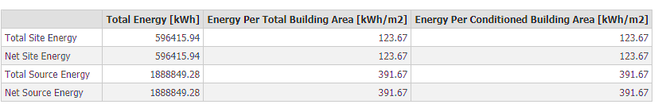
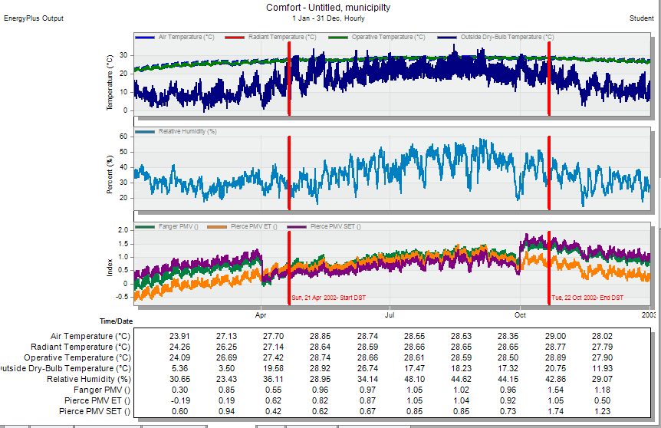
Thermal comfort:
Site source energy:
The building achieve the thermal comfort when the PMV graph be in range (-0.7 _ +0.7) as shown in the figure below:
Approximate consumption energy for our municipality as shown in the figure:
The site energy for our building =123.67kwh/m², the standard annual energy for offices=212kwh/m² (Portfolio Manager) so it’s ok for the municipality.
24

Slide 25
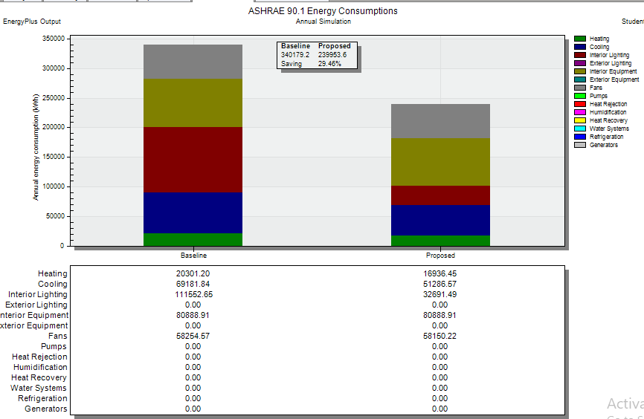
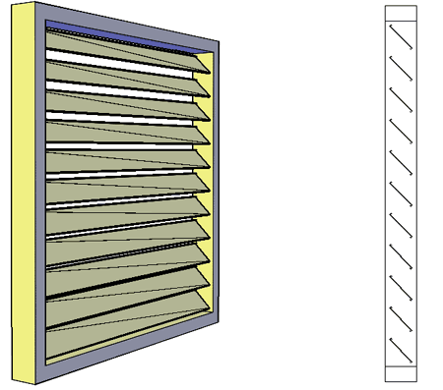
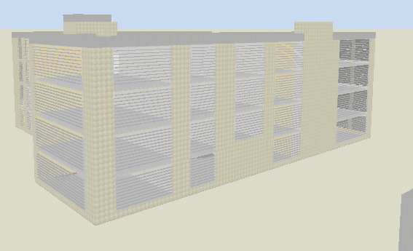
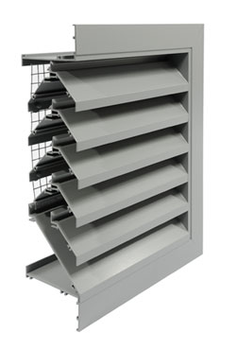
ASHAE 90.1 Energy consumption and saving percent for proposed and baseline building:
Shading system:
As shows in the figure the percent of saving was 29.46%
25

Slide 26
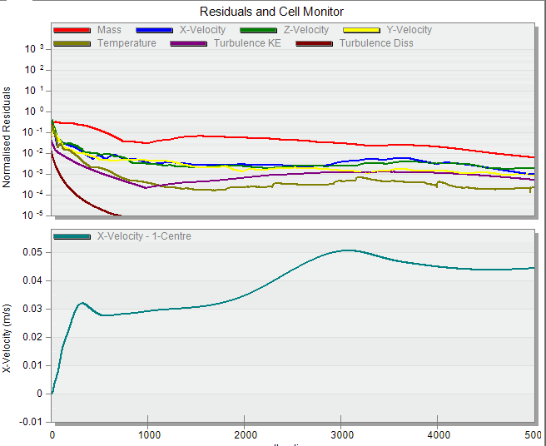
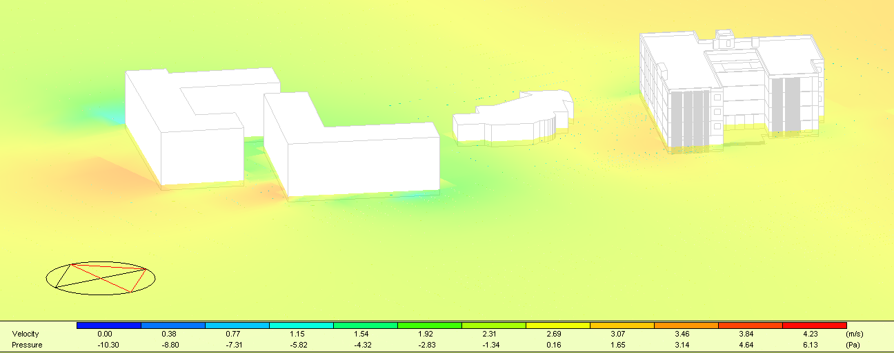
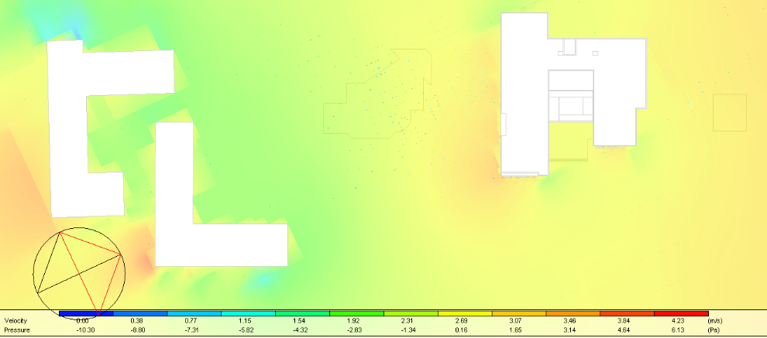
Computational Fluid Dynamic (CFD) analysis:
External CFD:
26

Slide 27
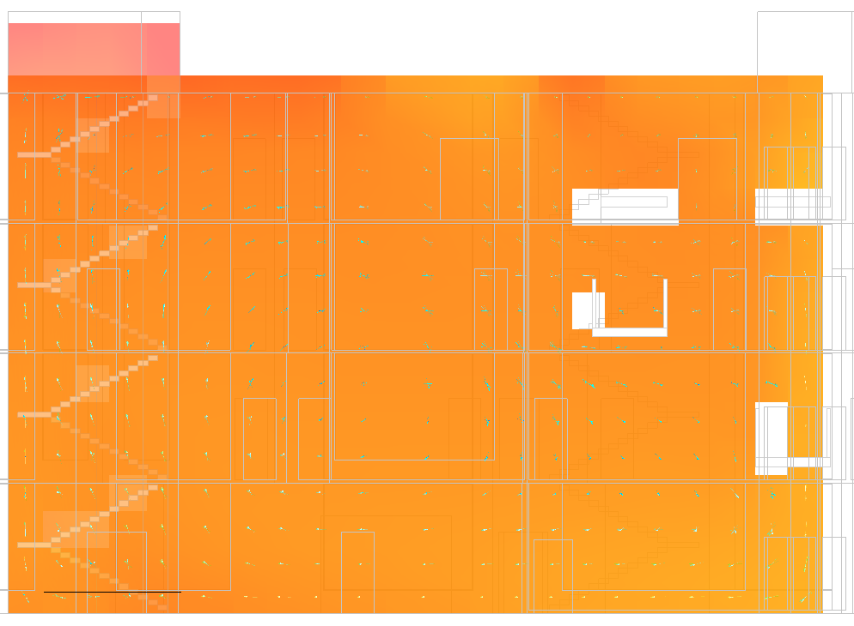


Internal CFD:
Treatment to increase the solarium room:
We have been add two fans (artificial ventilation)
Decrease the area of sky light in the solarium room follow:
27

Slide 28


Photovoltaic analysis and design :
PV distribution on the roof :
from zeversolar
Three inverters with capacity = 19.5KW
For two string each have 18 modules each module have 465 wp
from Sandi Electric
inverter with capacity = 7 kW
for two strings each have 8 modules each module have 465 wp
28

Slide 29

Initial cost = 2537.71 $/ kW.
Inverter price (15kw) = 2830.4 $.
Inverter price (7kw) = 1632.3 $.
Maintenance and operating cost = 33.31$/kW – year.
the pay pack period equals 6.5 years
29

Slide 30
Acoustical
two component we should to take into consideration :
spaces we design by using insul and ease programs:
Architectural side
Office
Electro- acoustic side
Component we was studied:
Public service hall
Reverpration time(RT60)
Canteen
Sound transmission loss
Articulation loss
Sound pressure level
Sound transmission class(STC)
Speech transmission index (STI)
30

Slide 31



Architectural side:
Reverberation time (RT60):
Canteen:
Office:
Public service hall:
The result is less than one
(within the standard so ok).
The result is between 0.4-0.6
(within the standard so ok).
The result is between 0.5-1
(within the standard so ok).
31

Slide 32



Sound Transmission Loss (STC):
External wall:
STC for combined:
42 dB > 38 dB (standard), so it is ok.
32

Slide 33



Internal wall:
Impact Insulation Class (IIC):
space | Adjacent space | Normal STC | Calculated STC
Office | Office | 38 | 48
Office | Corridor | 38 | 48
Conference room | Corridor | 40 | 48
Floor-ceiling assemblies IIC > 52
IIC (60)>52(standard), so it is ok
The calculated STC is more than the limit, so it is ok .
33

Slide 34

Electro acoustic side: Load speaker design: We was designed the load speaker in different spaces as shown in the figure below:
Corridor
Multi purpose hall
The load speaker was used in the building from JBL Company for corridors (ceiling speakers-8100 series ceiling with stylized grille-8128) as shown in the figure below:
34

Slide 35



The figure below show section in loud speakers:
The load speaker was used in the building from JBL Company for multipurpose hall (in-wall speakers-control contractor 100 series in-wall speakers-) Control 128 WT as shown in the figure below:
The figure below show the distribution for loud speakers for corridor:
35

Slide 36




Ease program results:
Sound pressure level (SPL) :
Multi-purpose hall:
Corridor:
All the value more than 70 so its ok.
More than 70dB so it’s ok.
36

Slide 37


Articulation loss:
Multi-purpose hall:
Corridor:
In this, space the value approximately 7% so its status was good.
In this, space the value approximately 3% so its status was excellent.
37

Slide 38


Sound transmission loss (STI):
Multi-purpose hall:
Corridor:
In this space the value approximately 0.6 so its status was good.
In this space the value approximately 0.75 so its status was excellent.
38

Slide 39

Structural design :
Building Structural Blocks:
The building has divided three blocks A,B,C , By the use of a seismic separator. Each block has a specific structural system.
39

Slide 40

The American concrete institute code ACI -318 for reinforced concrete design.
Uniform Building Code -UBC-97 for seismic design and load combinations.
Design Data:
Compressive strength of Concrete (fc̀)= 28 MPa for columns and shear wall, fc̀ = 24 MPa for slabs and beams.
Yielding strength of steel Fy = 420 MPa.
Loads:
Super imposed dead load = 4 kN/$m^{2}$
Live load = 3 kN/ $m^{2}$ for each floor slabs, except basement floor slabs = 5 kN/ $m^{2}$
Design codes:
40

Slide 41



Building modeling for blocks :
Block A
Block B
Block C
41

Slide 42
Structural System :
Block A:
Used one-way ribbed slab reinforcement in X-direction 40 cm,
for all floors.
Drop beam (50/80)
Girder beam (60/80)
Drop beam (40/80)
Column 80*80 cm
Block B:
Used one-way ribbed slab reinforcement in X-direction 40 cm, for all floors.
Drop beam (50/80)
Girder beam (60/80)
Drop beam (40/80)
Column 80*80 cm
Block C:
Used one-way ribbed slab reinforcement in X-direction 40 cm, for all floors.
Drop beam (50/80)
Girder beam (60/80)
Hidden beam (80/40)
Column 80*80 cm
Column 70*70 cm
Column 50*50 cm
42

Slide 43

Seismic design data according to UBC-97 code
Seismic zone is 2B (Z=0.2) because the building is on Nablus.”\
Importance factor I =1”
Force reduction factor, R = 5.5 (Building frame system)
Soil profiles in the project is (SD)
Acceleration-dependent seismic coefficient, Ca =0.28
Velocity dependent seismic coefficient, Cv = 0.4
43

Slide 44



Model checks for blocks :
Compatibility check:
Block A,B,C it’s a compatible. Check OK
44

Slide 45
Equilibrium Checks
Block | Type load | ETABS (KN) | Manual (KN) | % Error
Block (A) | Dead load | 20431.04 | 20659.41 | 1.10
 | Live load | 9214.44 | 9214.42 | 0
 | SID load | 14771.41 | 14771.47 | 0
Block (B) | Dead load | 25208.37 | 25708.89 | 1.93
 | Live load | 9296.58 | 9338.81 | 0.45
 | SID load | 17474.15 | 17474.31 | 0
Block (C) | Dead load | 63563.21 | 64056.81 | 0.77
 | Live load | 26456.19 | 26475.73 | 0.07
 | SID load | 37860.31 | 37859.00 | 0
Percentage of error dose not exceed 5%, so equilibrium check it’s OK.
45

Slide 46

Internal forces checks
Check of axial load on columns for blocks :
Block | Column label | ETABS (KN) | Manual (KN) | % Deference
Block (A) | Internal column (C1),7 | 4730.36 | 4589.95 | 3.05 %
 | corner column (C1),13 | 2154.60 | 2025.46 | 6.37 %
 | Corner column (C1),8 | 3448.80 | 3420.47 | 0.83%
Block (B) | Internal column (C1),26 | 4438.69 | 4181.76 | 6.14 %
 | Edge column (C1),32 | 1634.33 | 1667.61 | 1.99 %
 | Internal column (C1), 31 | 5192.53 | 5493.36 | 5.47%
Block (C) | (C1),24 | 6260.54 | 6151.32 | 1.77 %
 | C2 (25) | 4853.43 | 4986.12 | 2.66 %
 | C2 (29) | 4674.52 | 4876.77 | 4.14%
Percentage of Deference dose not exceed 10%, so check it’s OK
46

Slide 47
Check of bending moment on beams for blocks :
Block | Beam label | ETABS (KN) | Manual (KN) | %Deference
Block (A) | Beam (80*60) cm | 176.44 | 179.50 | 1.70%
 | Beam (80*50) cm | 509.01 | 495.06 | 2.82%
 | Beam (80*40) cm | 75.23 | 68.69 | 9.51%
Block (B) | Beam (80*60) cm | 278.58 | 296.16 | 5.94 %
 | Beam (80*50) cm | 166.64 | 173.56 | 3.98 %
 | Beam (80*40) cm | 413.03 | 384.24 | 7.49 %
Block (C) | Beam (80*60) cm | 414.59 | 388.13 | 6.81 %
 | Beam (80*50) cm | 112.45 | 107.86 | 4.25 %
 | Beam (80*60) cm | 398.34 | 370.50 | 7.51%
Percentage of Deference dose not exceed 10%, so check it’s OK.
47

Slide 48
Check of bending moment on slabs for blocks:
Block | Slab section | ETABS (KN) | Manual (KN) | %Deference
Block (A) | Slab (1) | 45.30 | 46.74 | 3.06%
 | Slab (2) | 94.53 | 96.73 | 2.27%
Block (B) | Slab (1) | 65.25 | 70.57 | 7.53%
 | Slab (2) | 32.31 | 30.13 | 7.23%
Block (C) | Slab (1) | 80.55 | 74.33 | 8.37 %
 | Slab (2) | 72.83 | 70.17 | 3.64 %
Percentage of Deference dose not exceed 10%, so check its ok
48

Slide 49
Seismic load analysis for blocks :
Check modal participation mass ratio
Block | Case | Mode | Period | UX | UY | UZ | Sum UX | Sum UY
Block (A) | Modal | 11 | 0.057 | 0.0088 | 0.0572 | 0 | 0.9484 | 0.91
Block (B) | Modal | 12 | 0.055 | 0.0103 | 0.0375 | 0 | 0.9577 | 0.9368
Block (C) | Modal | 21 | 0.06 | 0.0052 | 0.0282 | 0 | 0.9213 | 0.9203
Time period check”
Block (A)
T from ETABS < 40 % from method "A" , “0.711 < 1.4*0.513 = 0.718.” So that check is OK.”
Block (B)
T from ETABS < 40 % from method "A" , 0.709 < 1.4*0.513 = 0.718.”So that check is OK.”
Block (C)
T from ETABS < 40 % from method "A"”, 0.704 < 1.4*0.513 = 0.718.”So that check is OK
49

Slide 50

Base shear check
Block | Axis | T | T-Limit | T-Used | V-Manual | V-ETABS
Block (A) | X | 0.711 | 0.711 | 0.711 | 3859.83 | 3860.25
 | Y | 0.577 | 0.711 | 0.577 | 4756.22 | 4756.46
Block (B) | X | 0.709 | 0.709 | 0.709 | 4669.10 | 4669.54
 | Y | 0.545 | 0.709 | 0.545 | 5793.18 | 5793.61
Block (C) | X | 0.704 | 0.704 | 0.704 | 11204.75 | 11207.96
 | Y | 0.48 | 0.704 | 0.48 | 13804.26 | 13807.64
Vx and Vy from ETABS greater than V manual calculated, so check its ok
Drift check
 | Block (A) |  | Block (B) |  | Block (C)
Story # | Delta-X (∆m) | Delta-Y (∆m) | Delta-X (∆m) | Delta-Y (∆m) | Delta-X (∆m) | Delta-Y (∆m) | Delta Limitation (∆story)
0 | 0 | 0 | 0 | 0 | 0 | 0 | 0
B2 | 5.39 | 4.23 | 3.60 | 2.75 | 2.96 | 2.43 | 80
B1 | 9.24 | 9.62 | 7.72 | 5.53 | 2.73 | 5.47 | 80
GF | 18.09 | 20.40 | 15.94 | 13.59 | 18.13 | 11.94 | 80
F1 | 18.09 | 19.25 | 19.48 | 16.21 | 22.10 | 13.48 | 80
F2 | 15.78 | 18.09 | 21.25 | 16.17 | 19.17 | 14.168 | 80
F3 | 11.55 | 16.17 | 1.04 | 1.19 | 14.90 | 13.78 | 80
All ∆m in X, Y direction less than (∆story), so check is OK
50

Slide 51




Design Basement 2 Slab and reinforcement for block A
Zoom In reinforcement one-way ribbed slab for basement floors
Section In one-way ribbed slab for basement floors
Section In one-way ribbed slab for other floors
Basement 2 Slab and reinforcement for block A
51

Slide 52


Design Basement 2 Slab and reinforcement for block B
Zoom In reinforcement one-way ribbed slab for basement floors
Section In one-way ribbed slab for basement floors
Section In one-way ribbed slab for other floors
52
Basement 2 Slab and reinforcement for block B

Slide 53



Design Ground floor Slab and reinforcement for block C
Section In one-way ribbed slab for All floors
Zoom In reinforcement one-way ribbed slab for Ground floor
Ground floor Slab and reinforcement for block C
53

Slide 54


Second floor Beam Plan for block C
Second floor Beam Plan for block B
54

Slide 55


Design Frame (1) in second floor for Block C
55

Slide 56


Design Frame (4) in second floor for Block B
SECTION IN B5,C14,C19,C26,C31,C32, 2 nd floor ,block B (Frame 4 )
56

Slide 57



Design Columns for all Block
Section in column (80*80)
Section in column (70*70)
Section in column (50*50)
57

Slide 58

Longitudinal Column section
58

Slide 59



Shear wall Reinforcement
59

Slide 60


Stair case Reinforcement
60

Slide 61

Plan of Foundation for all block
61

Slide 62




Mat Foundation analysis for block A
Base :( IF 50% < $\frac{\sum{P}}{q allawable}$ < 60%), mat foundation is an option.
According to the previous base in block A, ratio = 51.41%. Used mat foundation in block A.
Checks that need to ETABS:
Deflection shape
wide beam shear
Check punching shear
For critical column Pu = 7622.36 kN
“Ø Vcp = 0.75* $\frac{1}{3}∗\sqrt{fc̀}$*b˳*d”
“= 0.75* $\frac{1}{3}∗ \sqrt{28}$* 3400* 1800 *10^{^-3} = 8095.6 KN”
Compare this value with maximum axial load on a column as a conservative value.”
Pu = 7622.36 kN < 8095.6 KN → So, check punching shear it is ok.
Ø Vc = $\frac{0.75}{6}$ * $\sqrt{f\overset{̀}{c}}∗B∗d∗{10}^{−3}$”
Ø Vc = $\frac{0.75}{6}$ * $\sqrt{28}∗1000∗1800∗{10}^{−3}$
$=1190.6 KN/m$”
Maximum value of V13 equals 871 maximum value of V23 equal 866 (From ETABS) which are less than the shear capacity equals 1191 KN/m → Shear check is ok.”
Zoom in Deflection check of mat footing for block A
62

Slide 63



Mat Foundation Reinforcement
63

Slide 64




Mat Foundation Reinforcement in X-direction
Zoom in Mat Foundation Reinforcement from block A
Zoom in Mat Foundation Reinforcement from block B
Zoom in Mat Foundation Reinforcement from block C
64

Slide 65


Mat Foundation Reinforcement in Y- direction for one strip
Zoom in Mat Foundation Reinforcement from block C
65

Slide 66

66

Slide 67



Design of daily use water tank
Materials properties
Fy = 420 Map. fc̀ = 28Mpa (B350).”
This tank designed underground; thus, it has two cases of Loading the first one is to be full liquid without soil exposed, and the second case is to be empty Case with soil exposed
3D model in SAB
Section A-A with dimensions
Detailing and reinforcement for underground water tank”
67

Slide 68



Basement wall design
Bulk density (Ɣ) = 18 KN/m³”, q _{allowable} = 180 kN/m² , Fc’ = 28 Map , Fy = 420 Map, $∅$= 30° , For at rest case K˳”= 0.5”
Design basement wall in basement floor 2, so h for basement wall = 4m , Thickness of basement wall 30 cm.”
Used PROKON program to calculate shear and moment, then design basement wall according to the value of moment and check thickness shear according to the value of shear from Prokon
load on basement wall by PROKON program
Basement wall reinforcement
68

Slide 69



Electro-mechanical design
Artificial lighting: - illuminance - glare -uniformity
Office (Members of municipal council
Calculation surface | Lux | Required lux | Glare | Required glare
Cafeteria | 460 | 300-400 | 10 | < 19
69

Slide 70


Cafeteria
Calculation surface | Lux | Required lux | Glare | Required glare
Cafeteria | 521 | 300 | 14 | < 22
70

Slide 71





Fees collecting hall
71

Slide 72




Meeting Room
Calculation surface | Lux | Required lux | Glare | Required glare
Meeting Room | 642 | 500 | 14 | < 19
72

Slide 73





Mayor office
Calculation surface | Lux | Required lux | Glare | Required glare
Mayor office | 651 | 500 | 14 | < 19
73

Slide 74


Distribution board
74

Slide 75



The electrical load of power
75

Slide 76


The electrical load of HVAC and elevators system:
EDB-2 | I load Amp | I C.B Amp | I cable Amp | C.B Amp | Cable (IEC )
Total | 428.20 | 492.43 | 566.30 | 800
Each phase | 142.73 | 164.14 | 188.77 | 266.66 | 310 A 185 mm²
 | M.D.B 1 | Total power | I load | I C.B | I cable | C.B | Cable (IEC )
EDB-1 |  | Watt | Amp | Amp | Amp | Amp
 | 3-phase | 110935 | 177.91 | 204.60 | 235.29 | 250 | (225A ) .125 mm²
Lighting wires distribution
76

Slide 77



Mechanical system :
The daily average of fresh water consumption = 15 L/day/person
Volume of basement water tank =18 m³
77

Slide 78
The pipes diameter selected
 | Vertical (steel) | horizontal (PVC) | branch
diameter | 2 | 1 ¼ | 1/2
Losses | 4.18 | 1.57 | 6.54
Total losses | 12.29
The pipes diameter selected
 | Vertical (steel) | horizontal (PVC) | branch
diameter | - | 1 | 1/2
Losses | - | 8.68 | 2.14
Total losses | 10.82
Final selection for collector No. 1 in the ground floor
Final selection for collector No. 2 in the ground floor
 | Vertical (steel) | horizontal (PVC) | branch
diameter | 2 | 1 | 1/2
Losses | 1.34 | 1.97 | 1.77
Total losses | 5.08
The pipes diameter selected
 | Vertical (steel) | horizontal (PVC) | branch
diameter | 2 " | 1" | 1/2"
Losses | 2.76 | 1.97 | 1.97
Total losses | 6.70
Final selection for collector No. 3 in the ground floor
Final selection for collector No. 4 in the ground floor
78

Slide 79





Water drainage
79

Slide 80





Safety Design:
-Notification system
-Emergency Lighting and signs:
Manual fire alarm
Automatic Fire Alarm
Fair Suppression System :
1-Manual suppression system
2-Automatic suppression system
Extinguishers
Sprinklers:
Space | Extinguishers
Canteen , Corridors , service room | Water extinguishers
All offices and meeting room | Dry powder extinguisher
Kitchen | Chemical extinguisher
Multi-purpose hall , Fees collecting hall , and public service hall | Both water extinguishers and dry powder extinguishers
-Hose station
-Dry Stand pipe
80

Slide 81


Fair system on the ground floor :
81

Slide 82

Evacuation from the building
82

Slide 83




Heating, ventilation, and air conditions system design (HVAC)
The system used for HVAC design is VRF system Variable refrigerant flow with cooling load capacity = 233.94 kW
Outdoor unit:
Fan coil:
Cassatt unit:
Diffuser:
Capacity= 73.6 kW
Flow rate equal 0.28m³/s
Flow rate equal 0.1m³/s
supply: flow rate equal 0.13m³/s
return: flow rate equal 0.36m³/s
83

Slide 84

Filter design that controls and kills corona virus and other:
84

Slide 85


HVAC design :
Ground floor
First floor
85

Slide 86


Second floor
Third floor
86

Slide 87

This figure below shows the duct distribution for multipurpose hall:
87

Slide 88


Derange design :
Ground floor
First floor
88

Slide 89


Second floor
Third floor
89

Slide 90
Quantity Surveying and Cost Estimation
-Summery of each work total cost inn Nablus municipality :
The total cost of the Nablus municipality 11168472 NIS and the total area of Nablus municipality is 11141 m2 which means that the total unit cost per m2 is 1002 NIS/ m2.
Type of work | Total cost of work (NIS)
Earth work | 362409.00
Substructure work | 1135599.00
Superstructure work | 8278659.00
Electrical work | 326910.00
Fire system | 96150.00
Mechanical work | 70672.00
HVAC system | 619935.00
PV System | 21026.00
Elevator System | 225000.00
Total project cost | 11168472 NIS
90

Slide 91


