Slide 1

بسم الله الرحمن الرحيم
Water Resource Management of
Jenin Governorate
Prepared by
Furat Nassar Khalid Sobeh
Ra’fat Bsharat Razan Atwa
Supervisor
Dr. Anan Jayyousi

Slide 2
Contents of the Presentation:
Objectives
Study area
Water supply resources.
Existing population and population growth rate.
Consumption rates for localities in Jenin Governorate.
Clustering Approach
Future water demand and water Gap
Future potential water resources.
The investment plan.
Provision of wastewater systems.
Conclusions

Slide 3
Water Resource Management of Jenin Governorate
Project Objective
To develop a water resource management plan for Jenin Governorate through:
Analyze water resources system.
Study the existing conditions and the estimated future water gap for the next 20 years.
Decide whether the existing water resources are sufficient for the future demand.

Slide 4
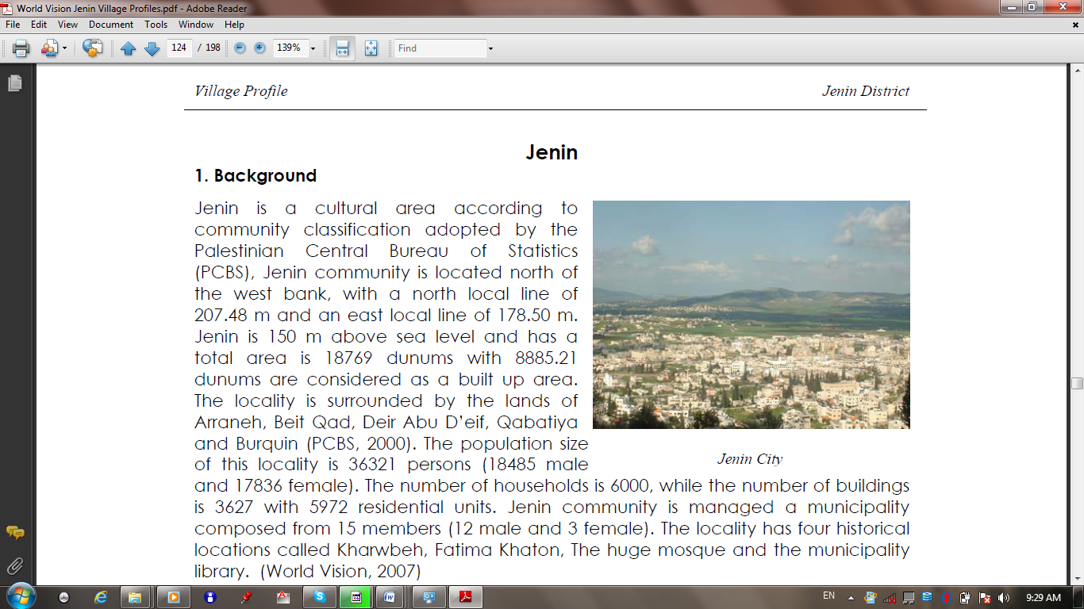
Facts about Jenin Governorate
The current water resources are not enough.
Present per capita water consumption is less than WHO standard.
The population is increased therefore the demand will increased.
Population of Jenin Governorate use water in three main purposes :
Domestic supplies.
Industrial supplies.
Agricultural supplies.

Slide 5
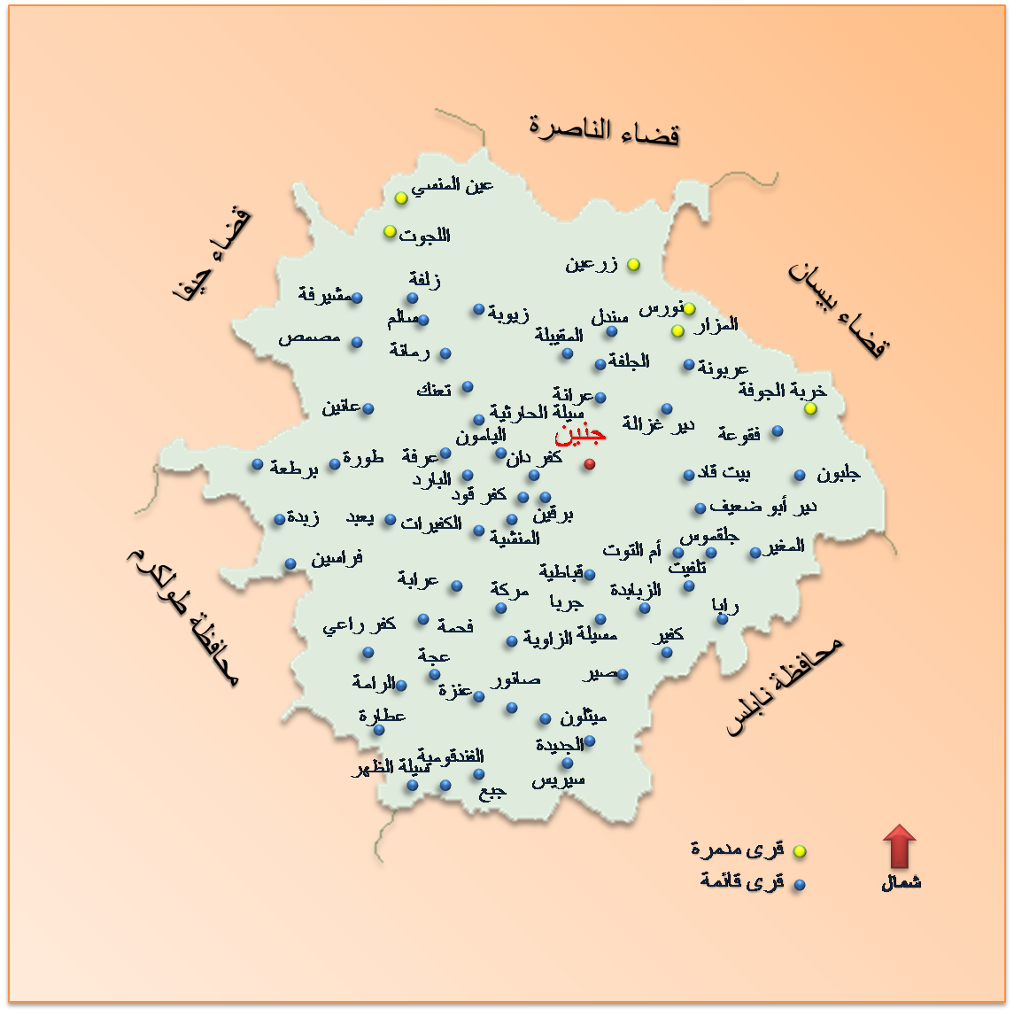
Study Area
Jenin Governorate has 82 localities and one camp.
Jenin city is the largest city in the Governorate.

Slide 6
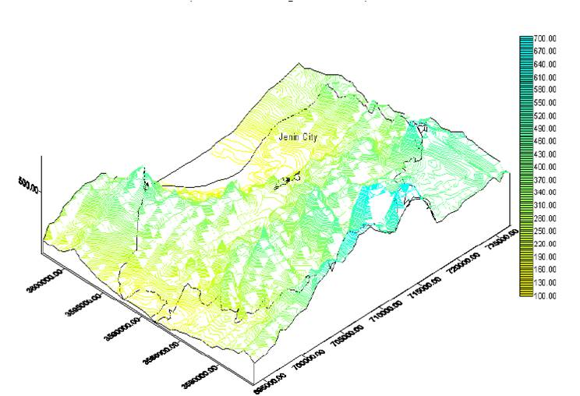
Study Area (cont.)
Land use:
Built up Areas.
Military Bases.
Forests.
Industrial Areas.
Agricultural Areas.
Dumping Sites.
Quarries.
Roads.

Slide 7
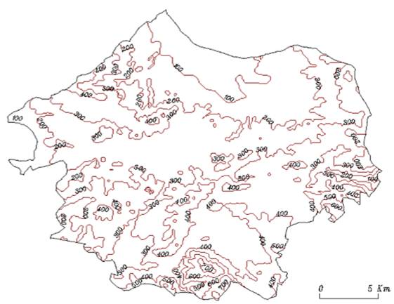
Study Area (cont.)
Topography :
Divided into three areas:
The eastern slopes.
Mountain crests.
Western slopes.
Have elevation ranges
between 90 m and 750 m
above sea level.
N

Slide 8
Water Supply Resources
Groundwater Wells:
*Note: 0.4 million m³/year of water are from illegal wells.
Springs : 0.152 Mcm/year.
Mekorot : 2.0 Mcm/year.
Purpose | Quantity(Mcm/year)
Domestic | 3.6
Agricultures | 4.0
Total | 7.6

Slide 9
Served and un-Served Area
Served
65 localities which form 80% from Jenin Governorate.
Jenin, Qabatiya, Birqin … etc.
Un-Served
17 localities which form 20% from Jenin Governorate.
These localities get their needs of water by developing a new source of water.
Jalbun, 'Arrana,… etc.

Slide 10
Assumed Population growth rate
Period | Population growth rate
2007-2010 | 3.3 %
2010-2015 | 3.0 %
2015-2020 | 2.5 %
2020-2030 | 2.0 %

Slide 11
Existing and Future Population
The existing population of the year 2010 is 274670 capita
Estimated population of the year 2030 is about 440000 people

Slide 12
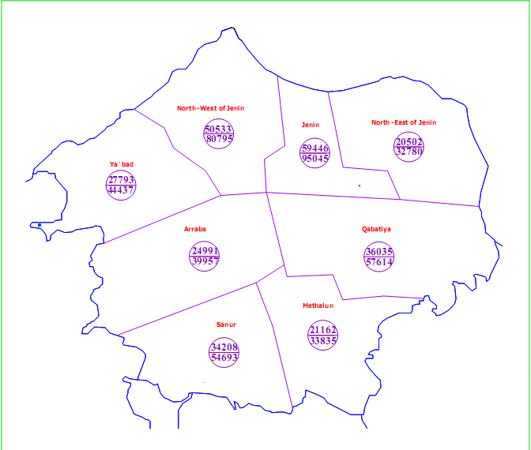
Existing and Future Population (Cont.)
N

Slide 13
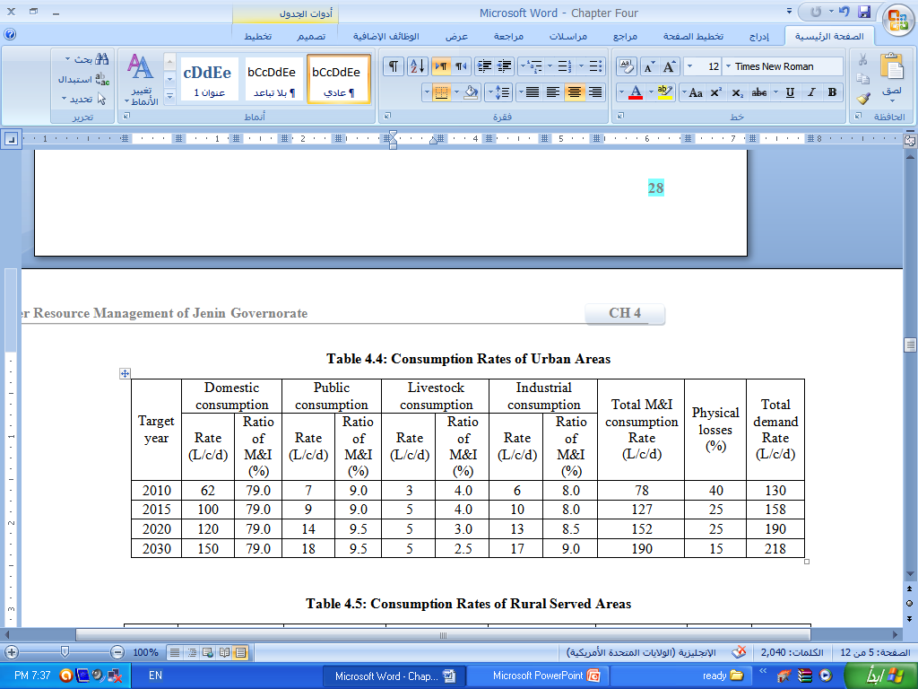
Consumption Rates of Urban Areas

Slide 14
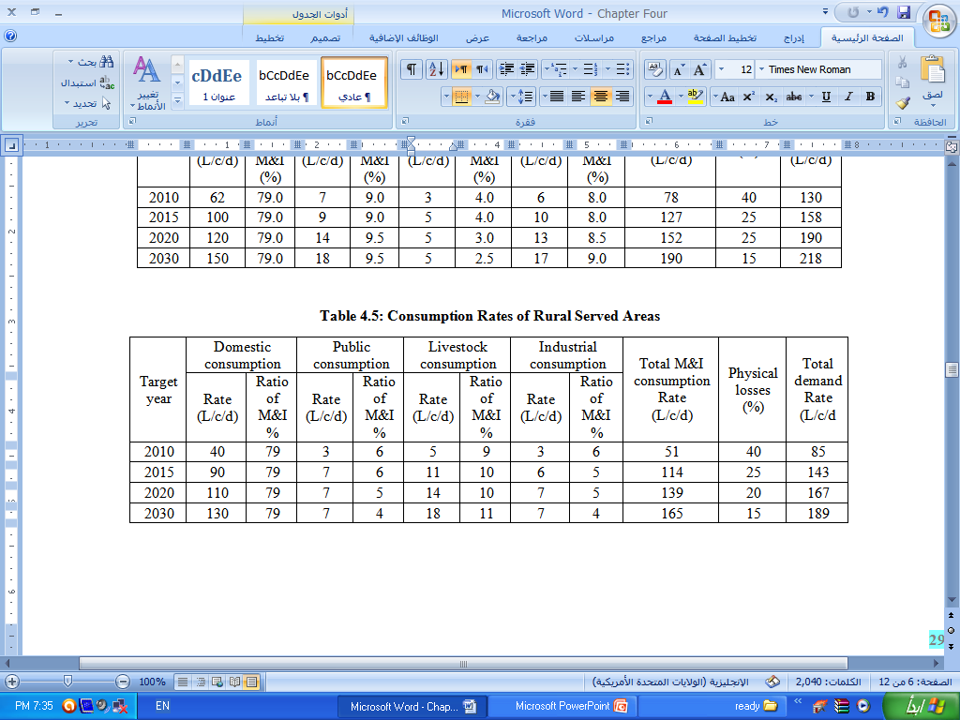
Consumption Rates of Rural Served Areas

Slide 15
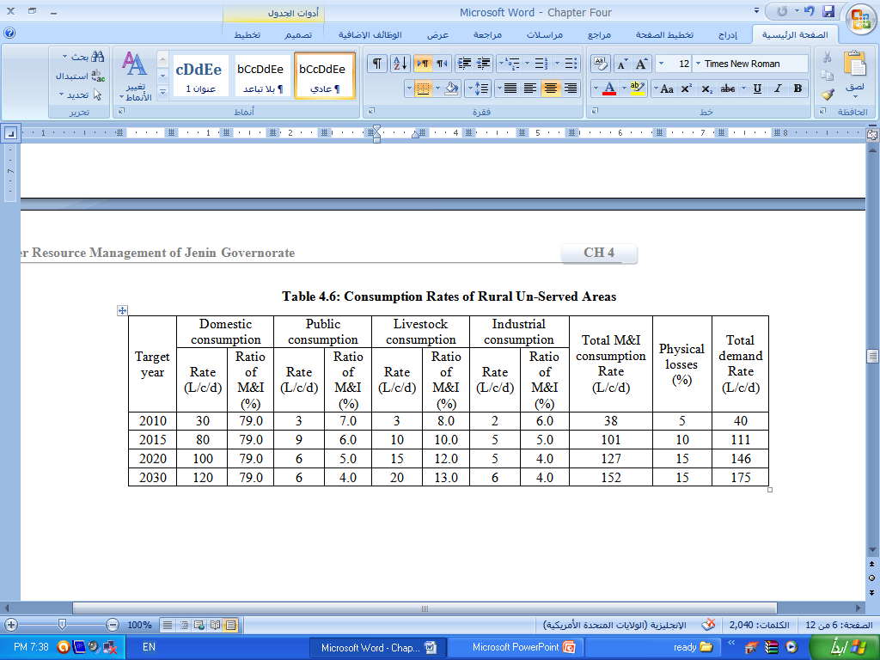
Consumption Rates of Rural Un-Served Areas

Slide 16
Clustering Approach
The governorate has been divided into 8 clusters :
North-East of Jenin cluster
Jenin cluster
North-West of Jenin cluster
Ya'bad cluster
Arraba cluster
Sanur cluster
Methalun cluster
Qabatiya cluster

Slide 17
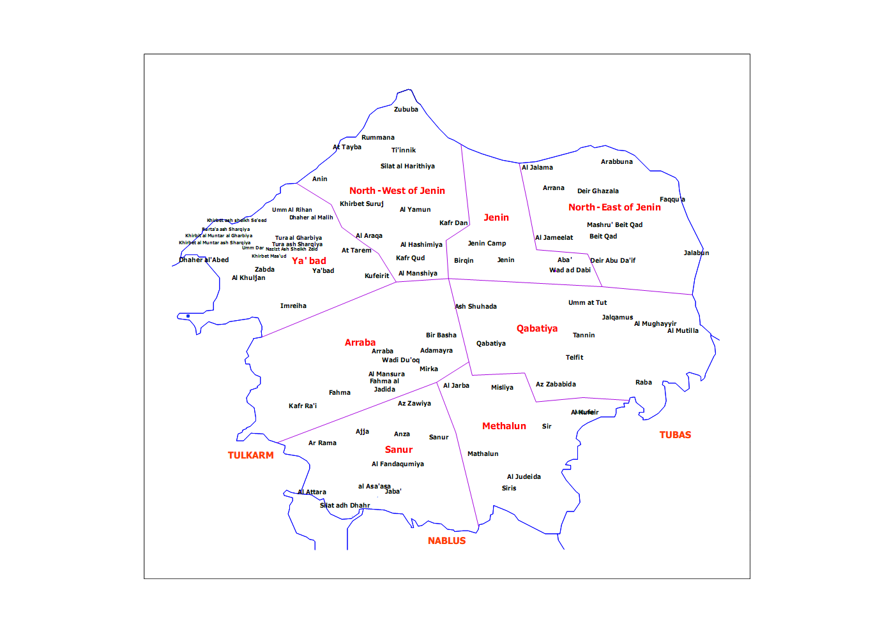
Clustering Approach
N

Slide 18
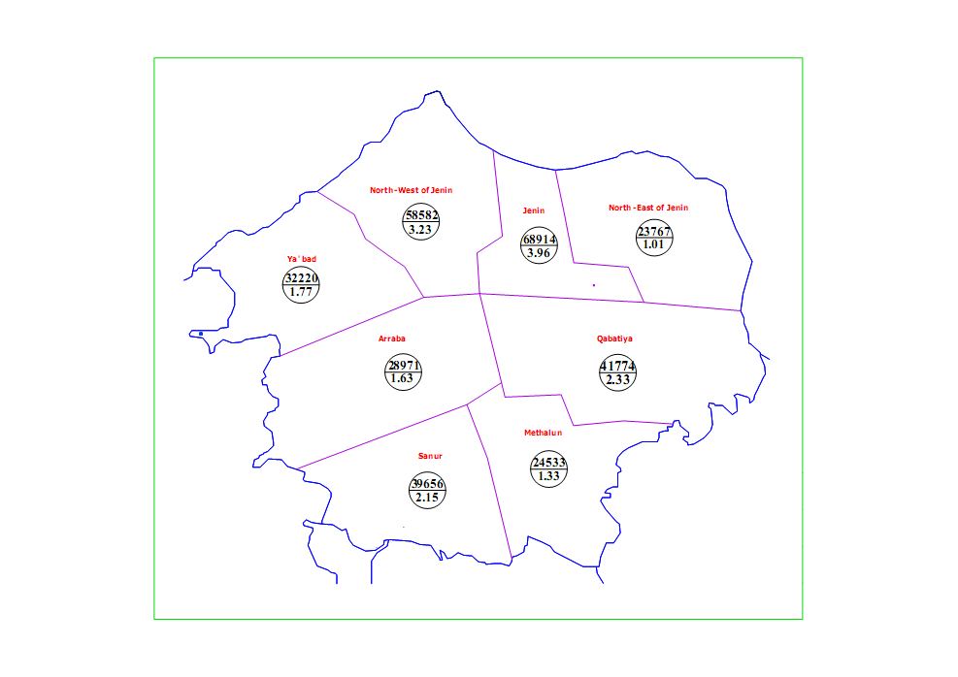
Future Water Demand
Demand of Year 2015
The total demand of water in year 2015 are 17,41Mcm/year
N

Slide 19
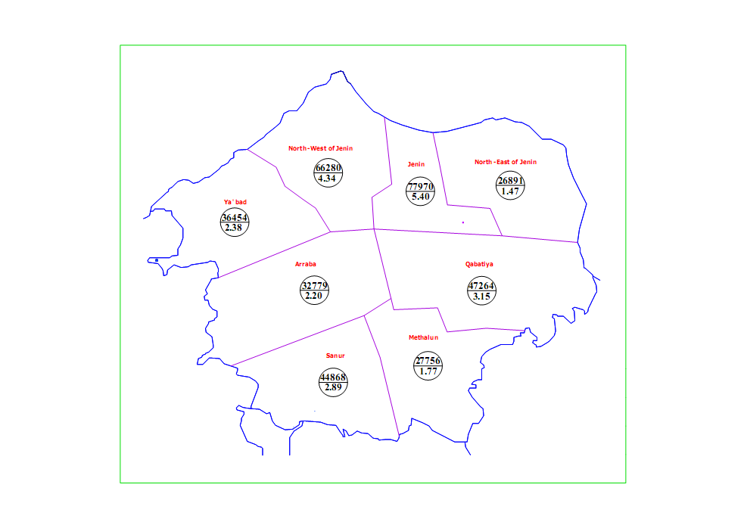
Future Water Demand (cont.)
Demand of Year 2020
The total demand of water in year 2020 are 23.59 Mcm/year
N

Slide 20
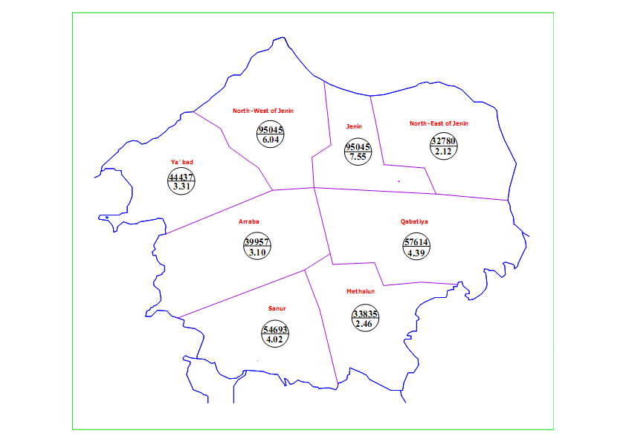
Future Water Demand (cont.)
Demand of Year 2030
The total demand of water in year 2030 are 32.98 Mcm/year
N

Slide 21
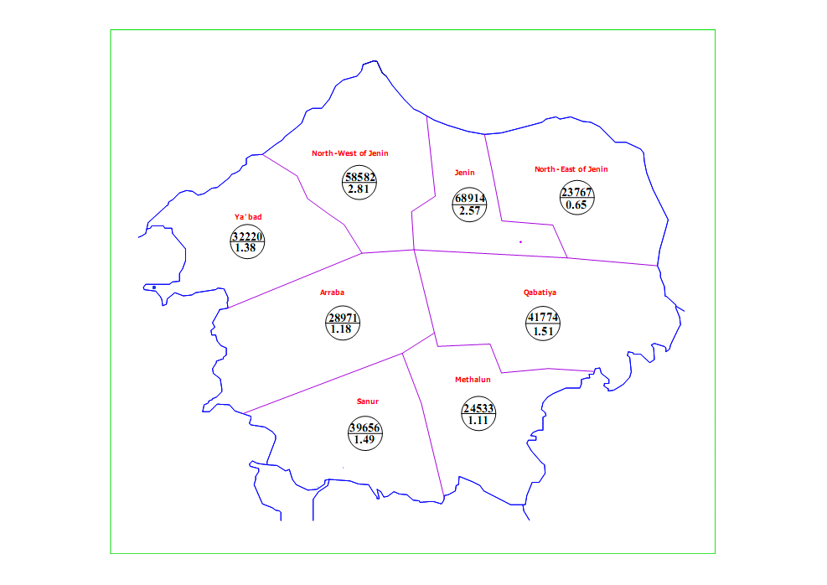
Future Water Gap
Gap defined as additional amount of water needed to fit the demand.
Gap of Year 2015
The gap of water in year 2015 are 12.78 Mcm/year
N

Slide 22
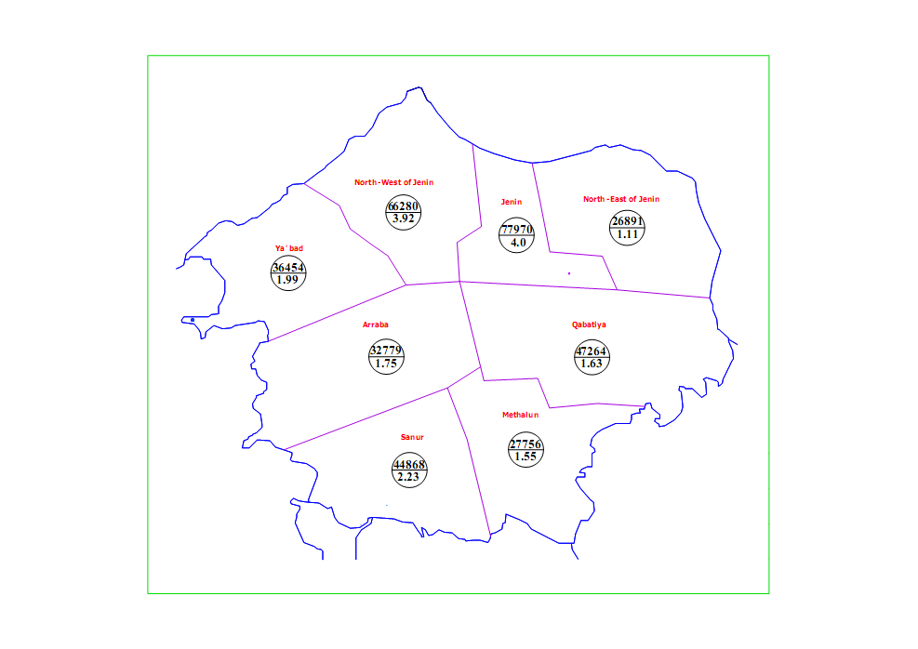
Future Water Gap (Cont.)
Gap of Year 2020
The gap of water in year 2020 are 18.96 Mcm/year
N

Slide 23
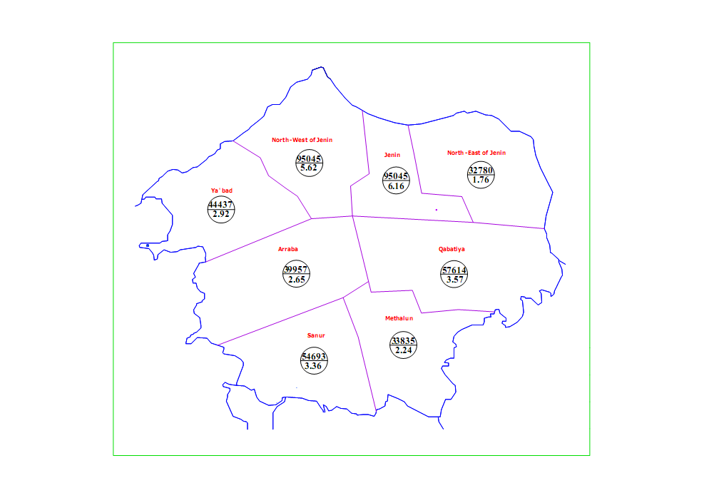
Future Water Gap (Cont.)
Gap of Year 2030
The gap of water in year 2030 are 28.35 Mcm/year
N

Slide 24
Future Potential Water Resources
To bridge the estimated water gap for each cluster. Four potential water resources are considered. Those are:
Rainwater Harvesting.
Rehabilitation of Existing Water Networks.
Groundwater Wells.
Imported water

Slide 25
Rainwater Harvesting
Rainwater harvesting is the accumulating and storing of rainwater from roofs of houses, tents and local institution.
By using this formula, the volume of cisterns for can be calculated.
Volume of rainwater harvesting = No. of building* Average houses area* Average rainfall rate
The amount of 3 Mcm/year can be collected from rainwater harvesting.

Slide 26
Rehabilitation of Existing Water Networks
The percent of loss can be reduced by improving the existing networks in Jenin Governorate.
The amount of water that can be saved by rehabilitating of existing water networks is calculated by using this formula
Saved amount of water = Water supplied in 2010* (% losses in present - % losses in future years)
The amount of 0.58 Mcm/year can be saved from rehabilitation of existing water networks.

Slide 27
Groundwater Wells
Remaining gap is approximately 25 Mcm/year.
According to PWA, many wells can be drilled in Jenin Governorate.
Drilling new wells will provide about 18 Mcm/year

Slide 28
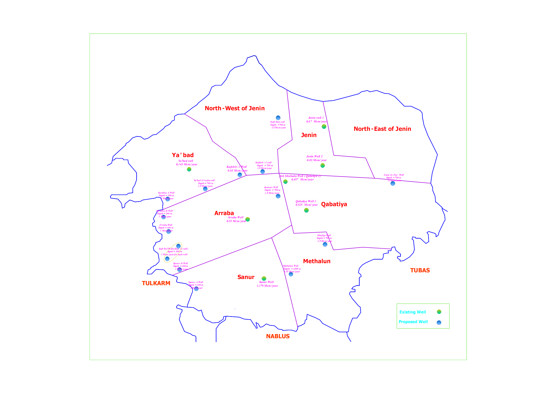
Groundwater Wells
N

Slide 29
Imported water
The remaining future water gap of Jenin governorate is around 7 Mcm/year
The remaining water gap will be taken from Palestinian water rights in the Western Aquifer and/ or from desalination as imported water ( at present through Israeli companies) near Zbuba and Jalami localities to cover the future water demand.

Slide 30
Packages of Investment Plan
Based on estimated future water demand for the next 20 years, Different projects will be implemented to cover this demand.
Each package consists of ground water well with booster station, transmission pipeline, pumps and reservoir. In order to determine the diameter of the transmission pipeline, the pump power and the reservoir volume, many assumption and calculation are made.

Slide 31
Packages of Investment Plan
Determine the diameter of transmission pipeline using continuity equation.
Q = V * A
The head loss in transmission pipelines is calculated using the following equation.
H_{L} = 0.01 L
The pump head calculated using Energy Conservation principle (Bernoulli Equation).
Z₁ + H_{P} = Z₂ + H_{L}

Slide 32
Packages of Investment Plan
The pumps power calculated by using following equation.
γ : Specific weight of water ( 9810 N/m³).
µ : Pump efficiency (assumed to be 70%).

Slide 33
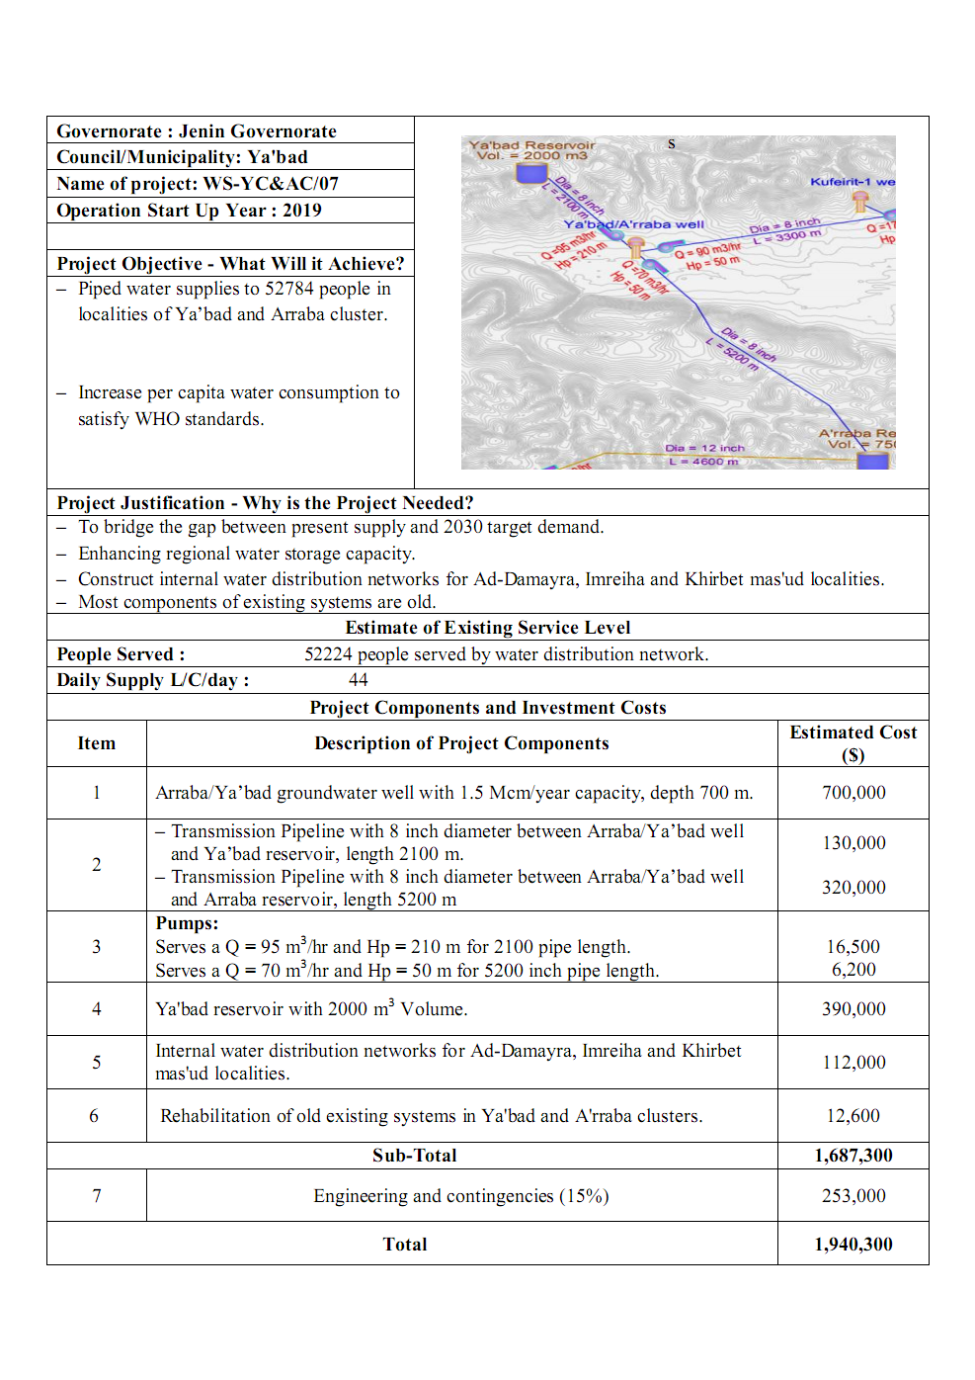
Sample of Proposal Projects

Slide 34
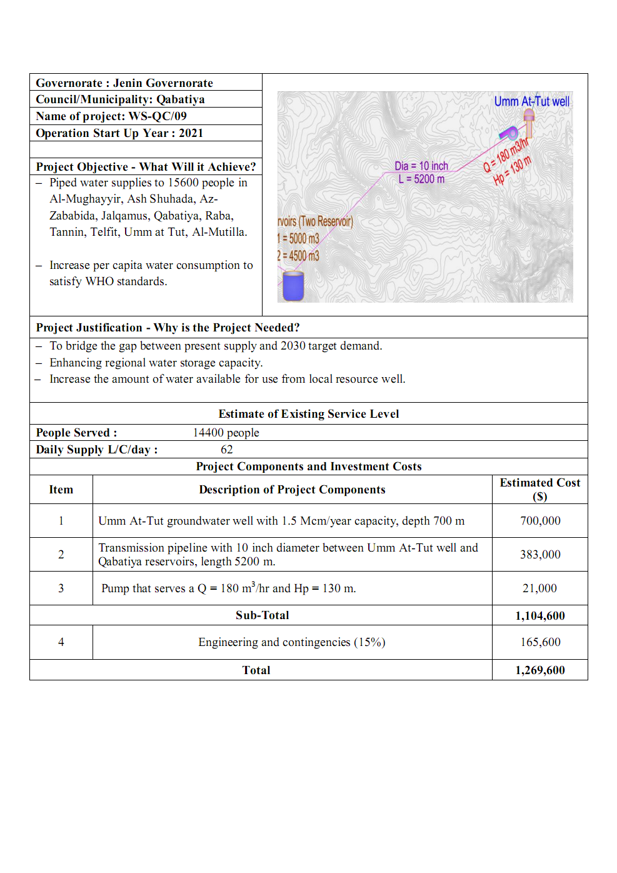
Sample of Proposal Projects

Slide 35
Cash Flow of Investment Plan
The following cash flow shows the headed investment to implement the plan.

Slide 36
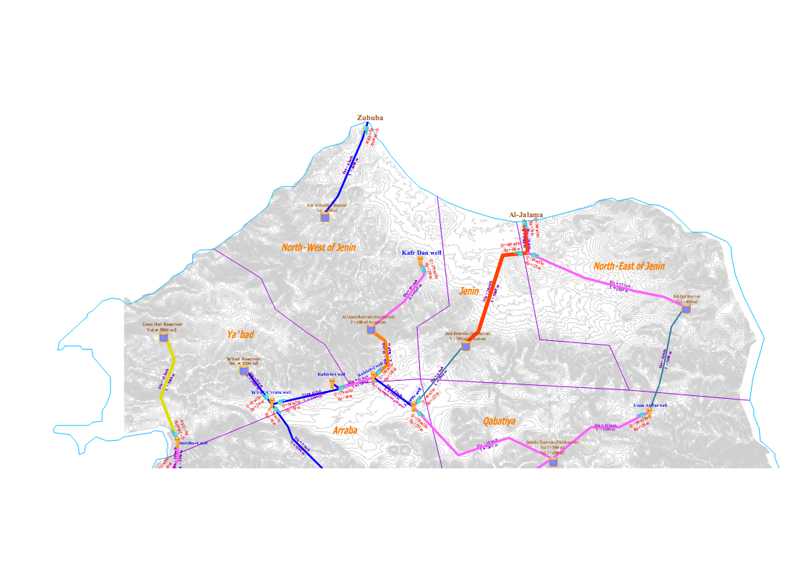
Proposed Projects of Jenin Governorate
N

Slide 37
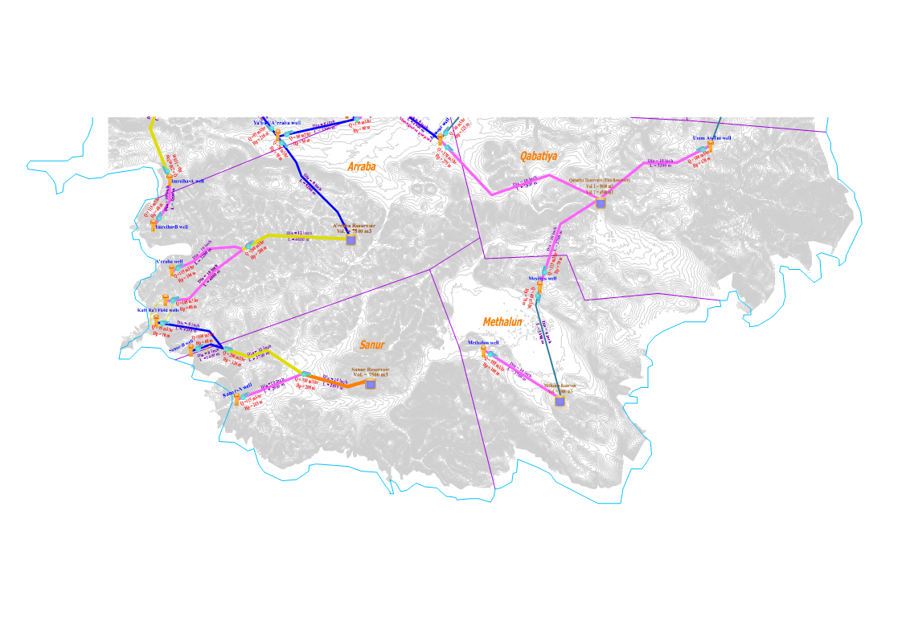
Proposed Projects of Jenin Governorate

Slide 38
Provision of Wastewater System
In Jenin Governorate, most of wastewater is generated from industrial and residential areas.
Approximately 45% from Jenin City connected by wastewater disposal system and its formed 6% from whole Governorate.
Sewer networks and treatment plants should be constructed in order to reuse a huge amount of water, which is estimated to be 85% of the drinking water.
The amount of wastewater generated from Jenin Governorate in 2030 is approximately 28 Mcm/year.

Slide 39
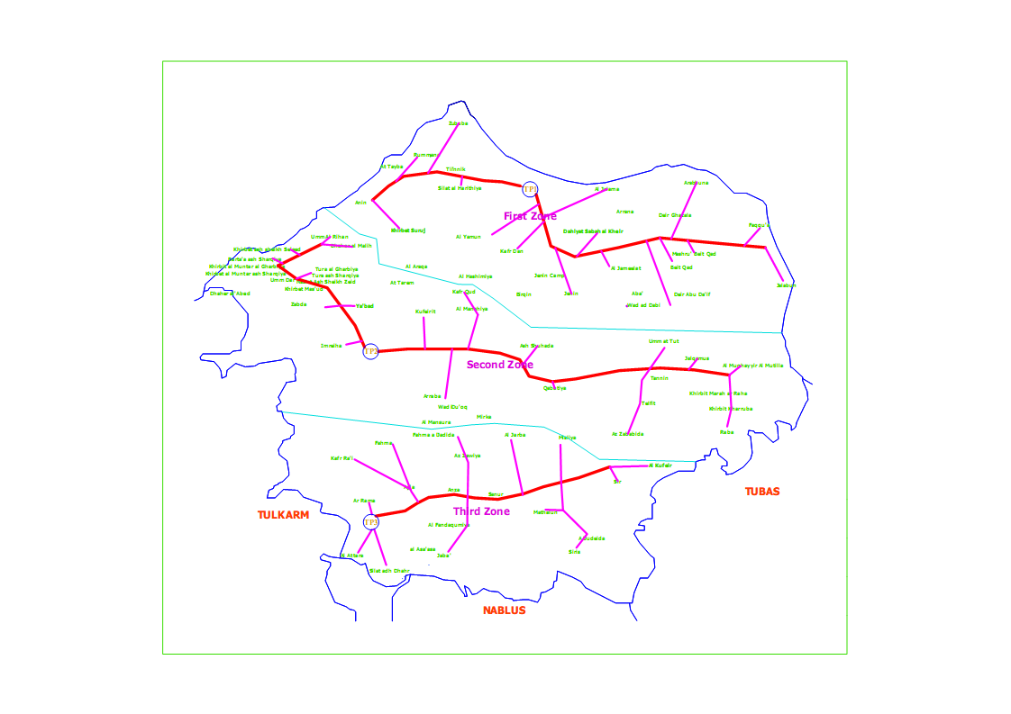
Provision of Wastewater System
According to PWA, the Sewerage plan of Jenin Governorate divide into three zones.
N

Slide 40
Conclusion
The population of Jenin Governorate will become about 440,000 capita in 2030
The gap of water is about 28 Mcm/year in year 2030
To bridge this gap use :
3 Mcm/year from Rainwater Harvesting
0.6 Mcm/year from Rehabilitation of Existing Water Networks
18 Mcm/year from Groundwater Wells
6.8 Mcm/year from Imported water

Slide 41
Conclusion
The total investment costs is considered to be around 34 Million dollar, which approximately equal 129 Million NIS
The average investment per year around 1.7 Million$/year
The amount of wastewater generated from Jenin Governorate is approximately 28 Mcm/year in 2030
The estimated cost for wastewater collection and treatment is approximate 484 Million US dollar of year 2030

Slide 42


