Slide 1
An-Najah National University
Faculty of Engineering and Information Technology
Building Engineering Department
Graduation Project -11
Rawabi English Academy
Students:
Hala Houmran
Reem Hamdan
Aseel Abd Aljawwad
Amr Taneeb
Supervisor:
Dr. Alaa Shaheen.

Slide 2
Contents:
Architectural Aspects
Structural Aspect
Environmental Aspect
Quantity surveying & Cost Estimate
Introduction

Slide 3
Contents:
Architectural Aspects
Structural Aspect
Environmental Aspect
Quantity surveying & Cost Estimate
Introduction

Slide 4
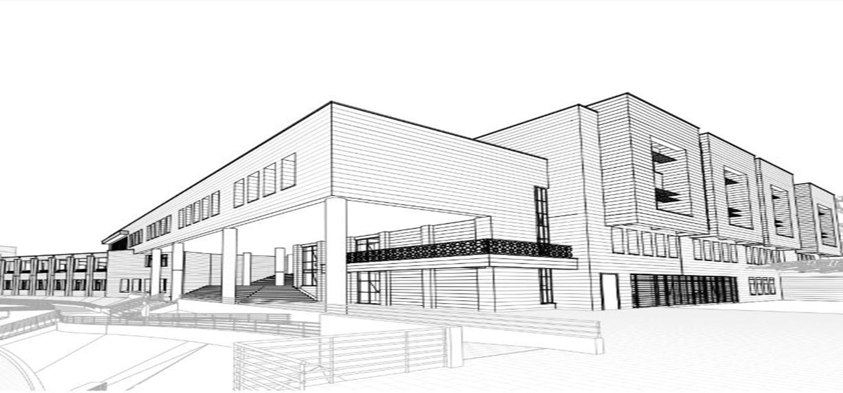
Introduction
Rawabi English Academy locates in Rawabi city , with an area of 3300 m2, and consists of four floors.

Slide 5

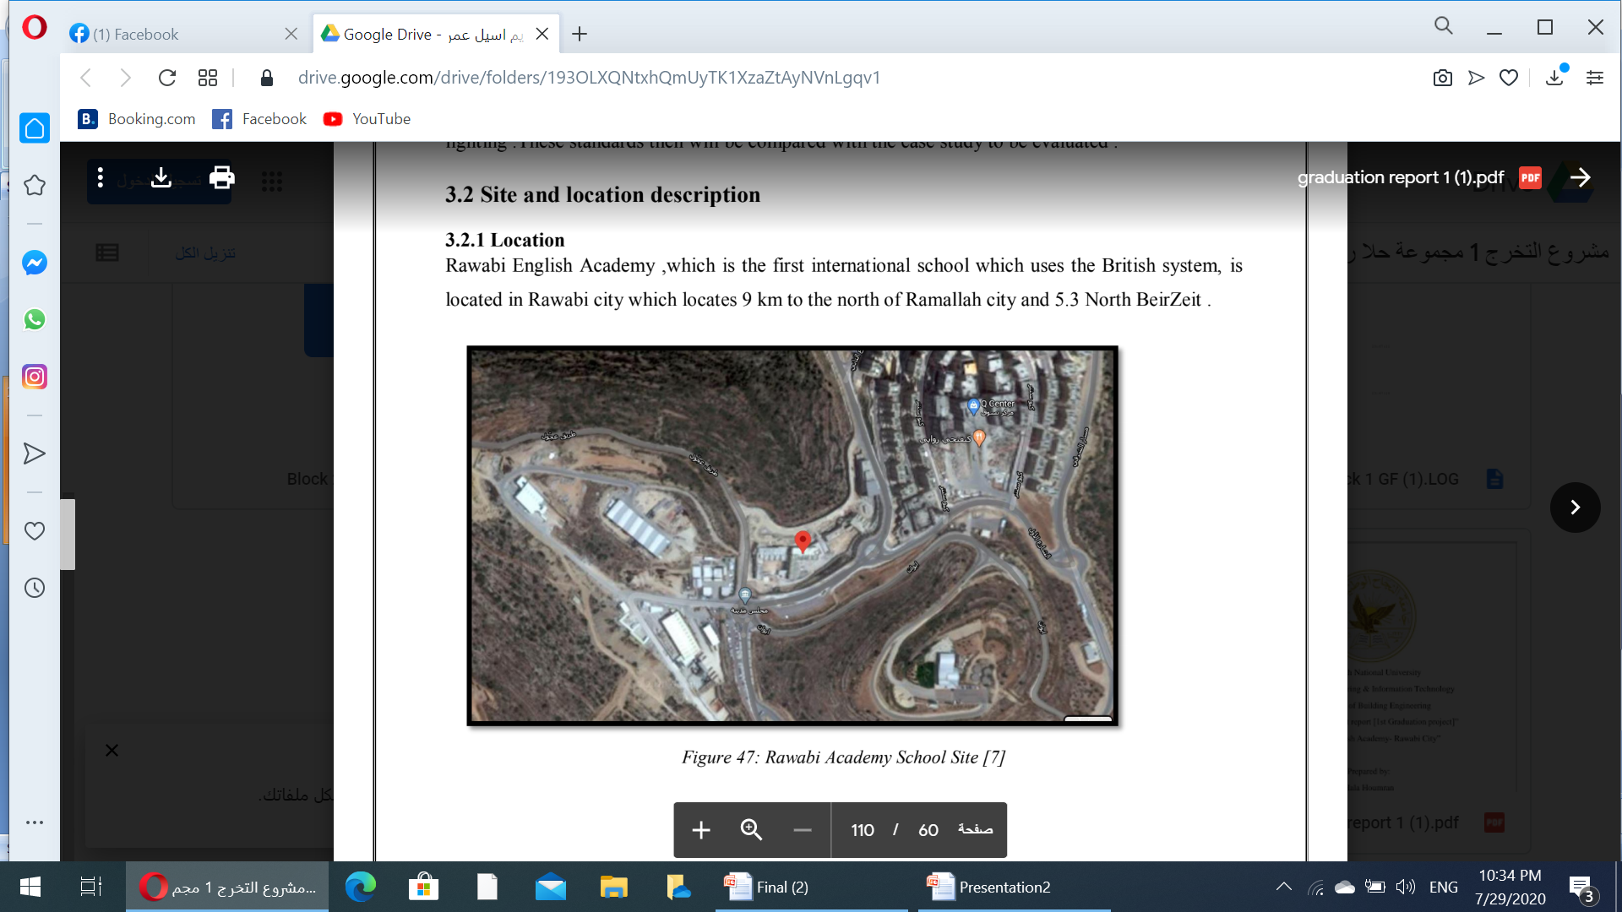
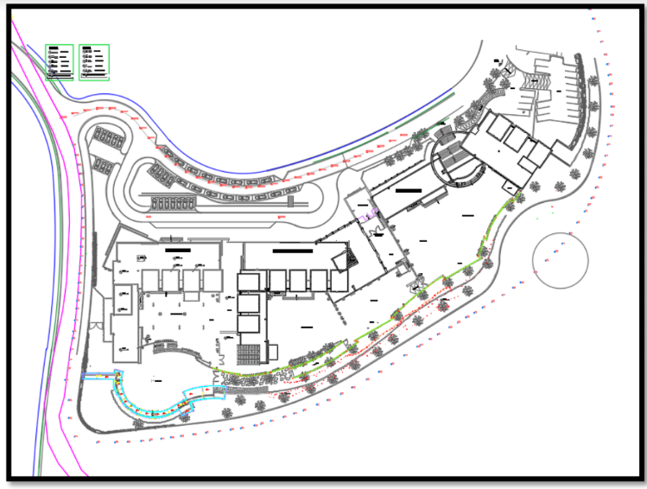
Site Analysis
The building is located in Rawabi city which locates 9Km to the North of Ramallah City and 5.3 Km North of Beir Zeit village .

Slide 6
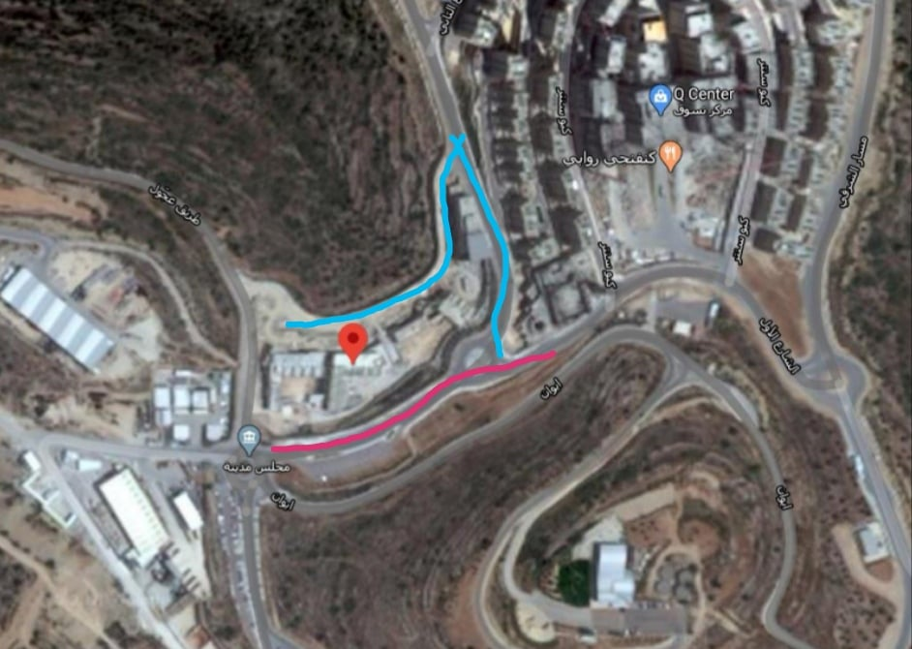
Site Analysis
There are three main streets ,lower street ,upper street and left street.

Slide 7
Contents:
Architectural Aspects
Structural Aspect
Environmental Aspect
Quantity surveying & Cost Estimate

Slide 8
Architectural Aspects
Architectural Aspects
Areas and dimensions
Areas Ratios
Plans

Slide 9
Architectural standards
Architectural Aspects
Areas and dimensions
Areas ratios
Plans

Slide 10
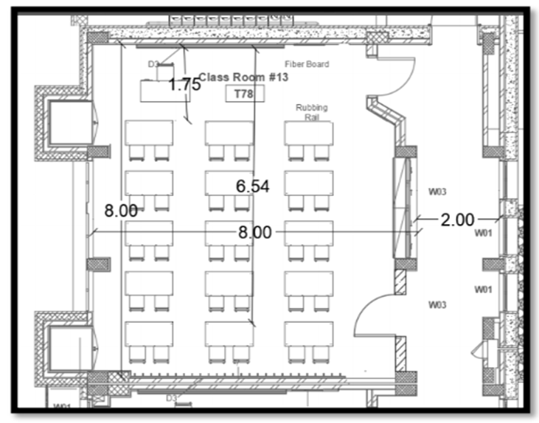
Areas and dimensions
Classrooms
Usually classes hold 30 students, 1.8-2 m² for each student, so area of each class in minimum equals 65 -70 m²
the height should not be less than 2.7, but for appropriate lighting and ventilation requirements is should not be less than 3.2m.

Slide 11
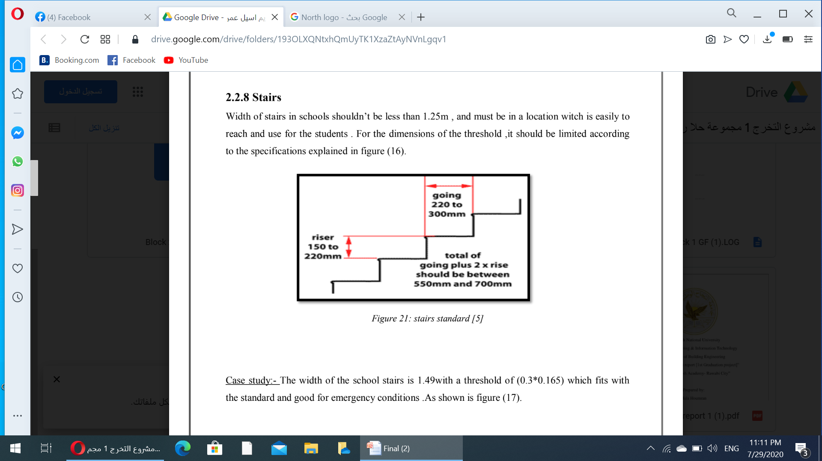
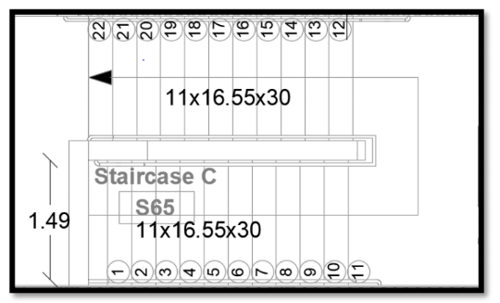
Areas and dimensions
Stairs
stairs width 1.49m and threshold dimensions are 30 x 16.55 cm, which is acceptable .

Slide 12
Architectural standards
Architectural Aspects
Areas and dimensions
Areas ratios
Plans

Slide 13
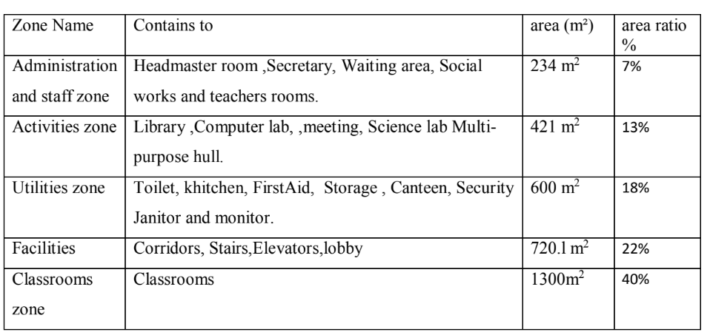
Area ratios

Slide 14
Architectural standards
Architectural Aspects
Areas and dimensions
Areas ratios
Plans

Slide 15

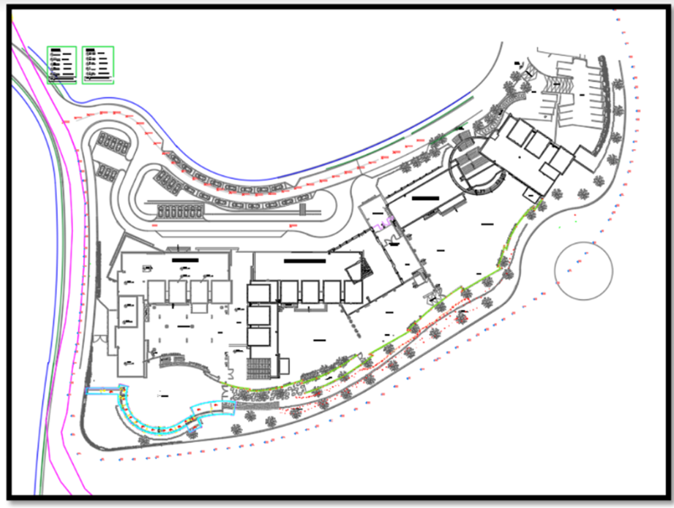
Plans site plan

Slide 16
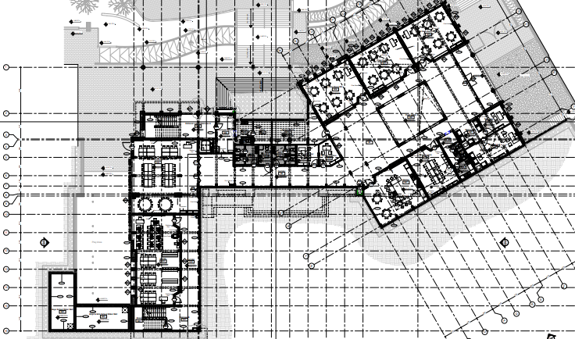
Plans
Ground floor (before modification)

Slide 17
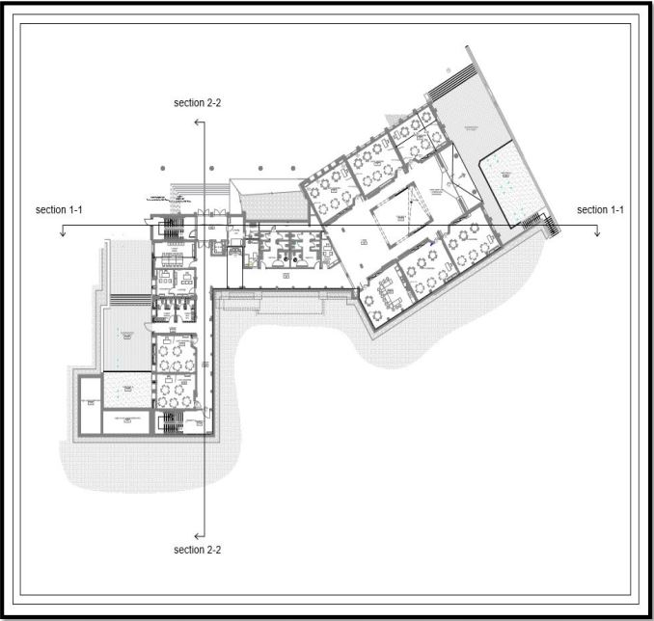
Plans
Ground floor (after modification)

Slide 18
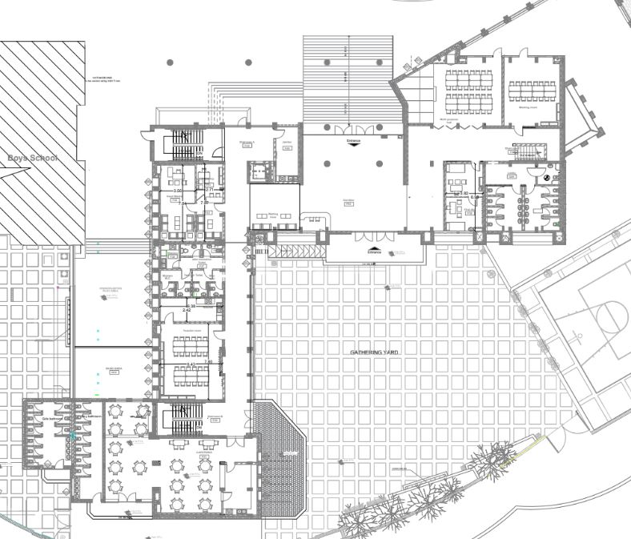
Plans first floor (before modification)

Slide 19
Plans
First floor (After Modification)

Slide 20
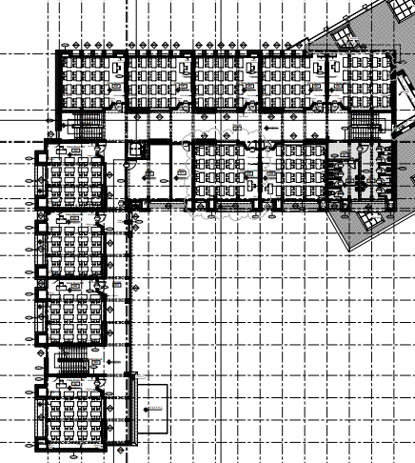
Plans second floor (before modification)

Slide 21
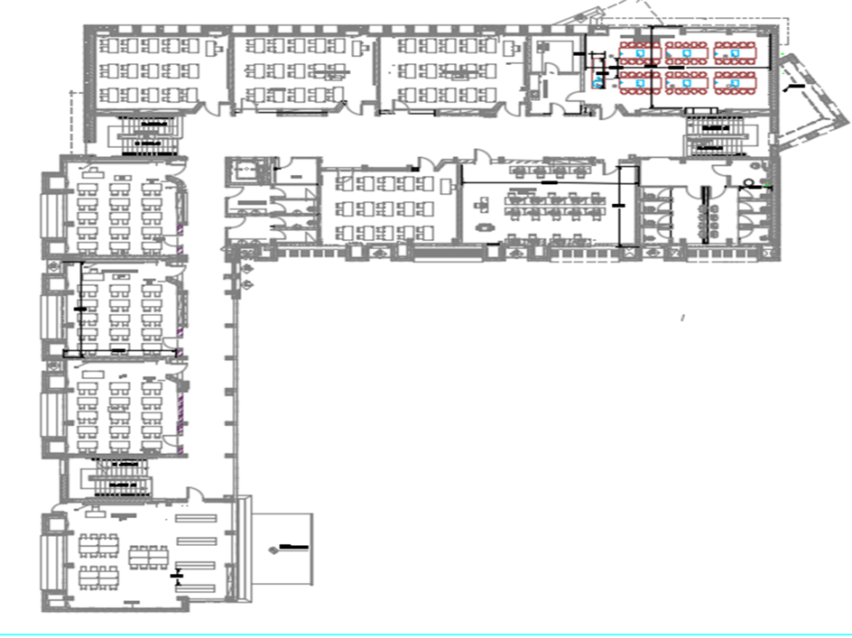
Plans second floor (after modification)

Slide 22
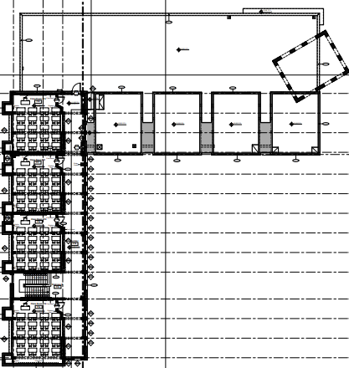
Plans
Third floor (before modification)

Slide 23
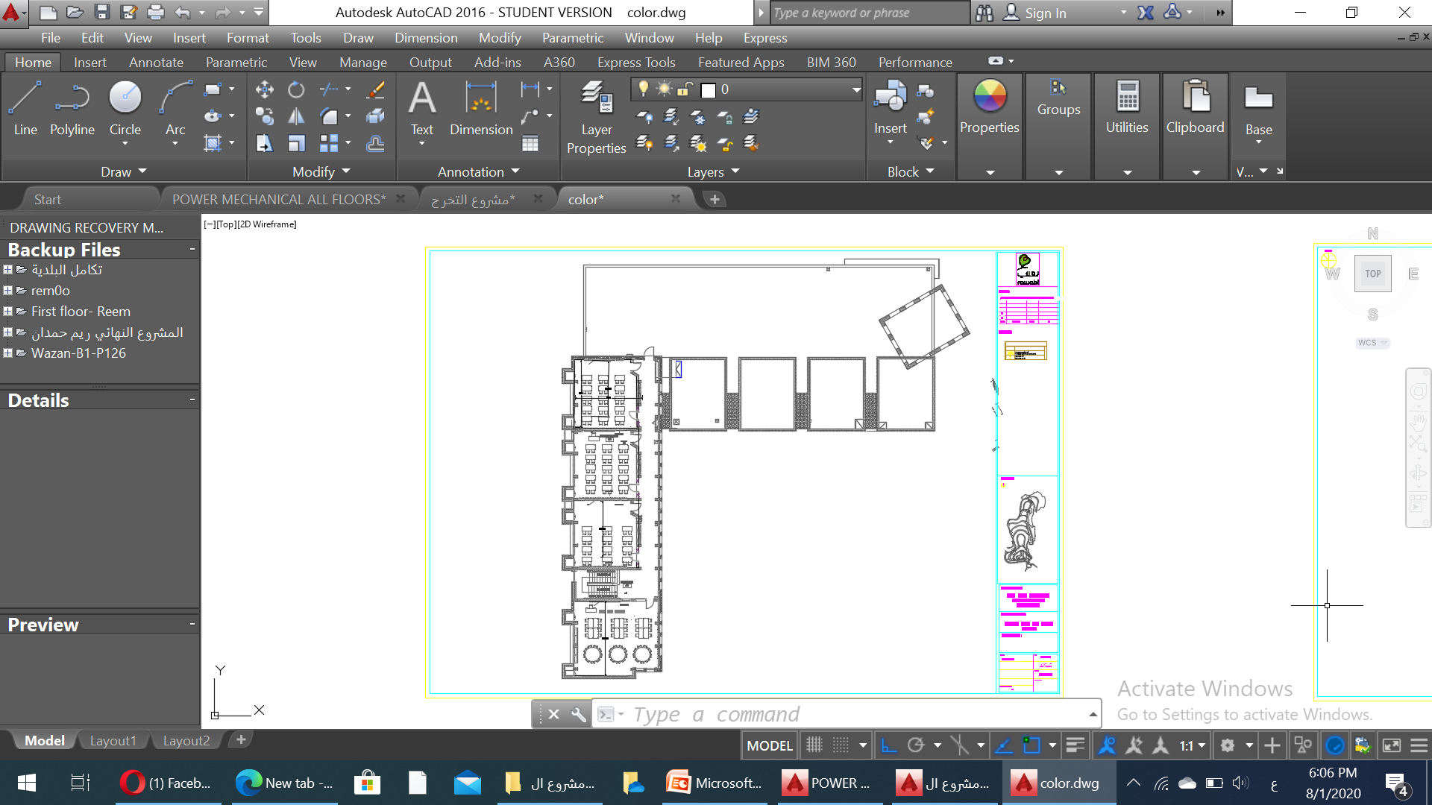
Plans
Third floor (after modification)

Slide 24
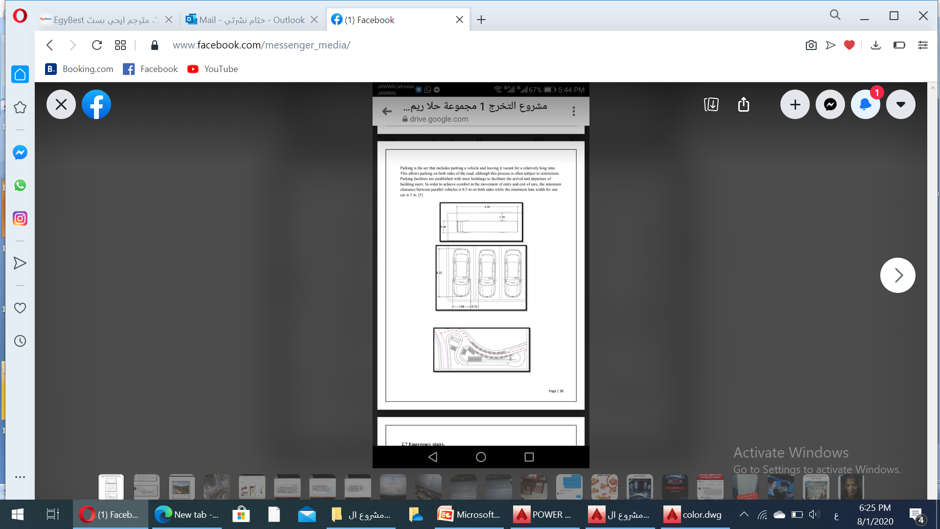
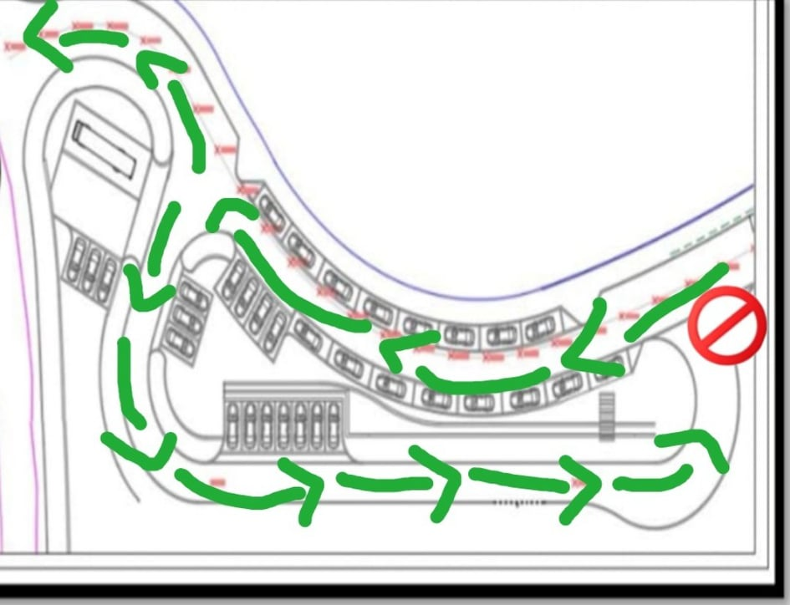
Parking

Slide 25
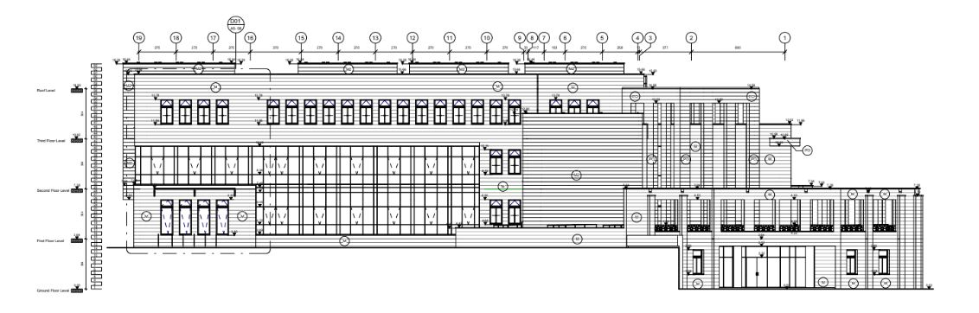
Elevations
West elevation

Slide 26
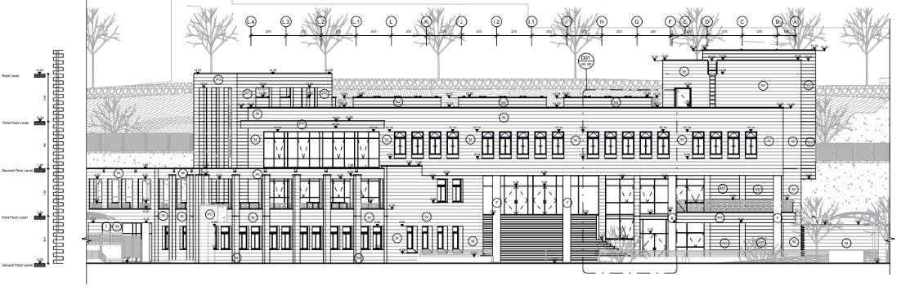
Elevations south elevation

Slide 27
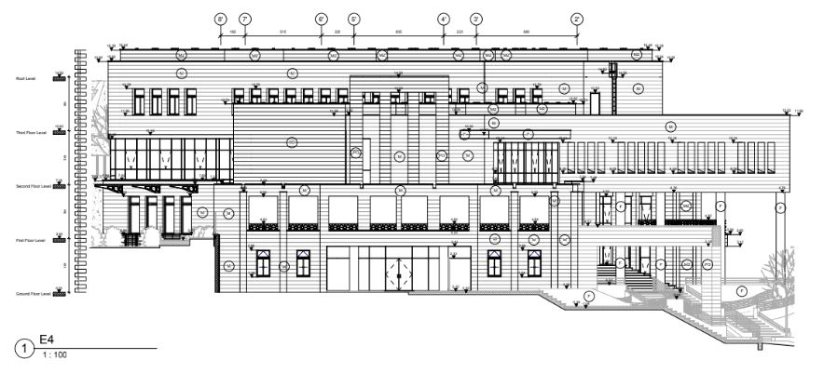
Elevations north elevation

Slide 28
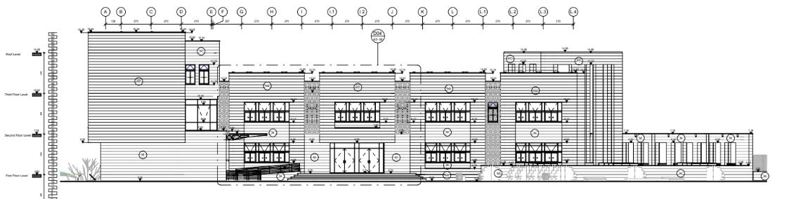
Elevations east elevation

Slide 29
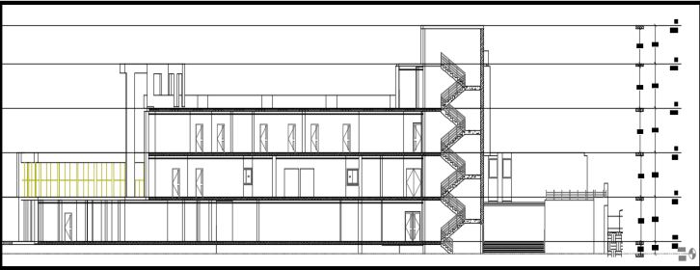
Section A-A

Slide 30
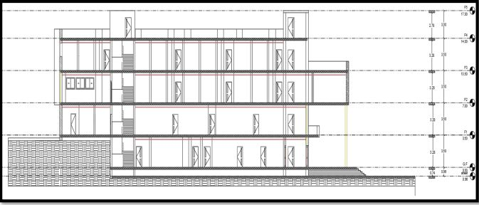
Section B-B

Slide 31
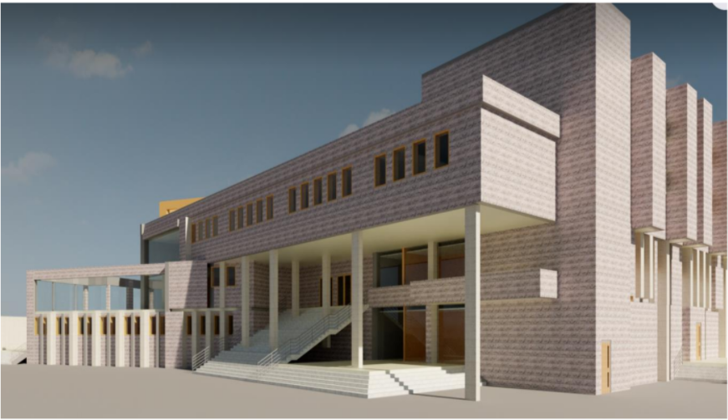
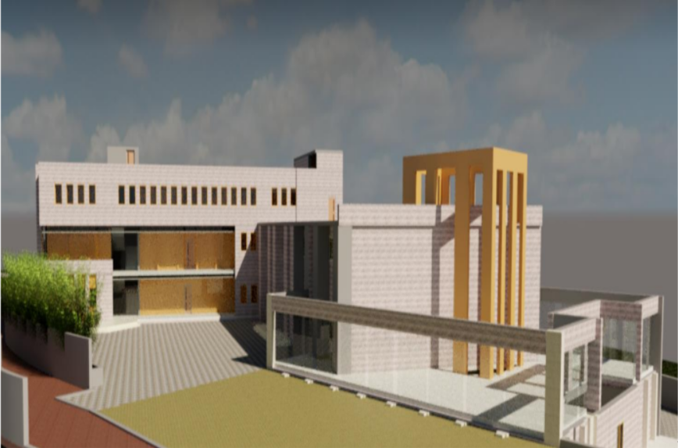
Render Photos

Slide 32
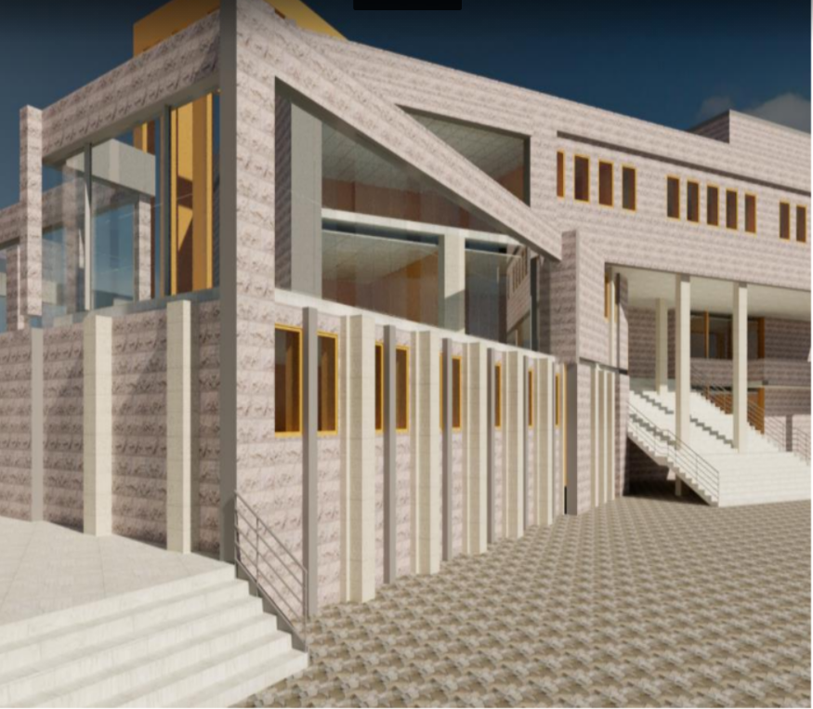
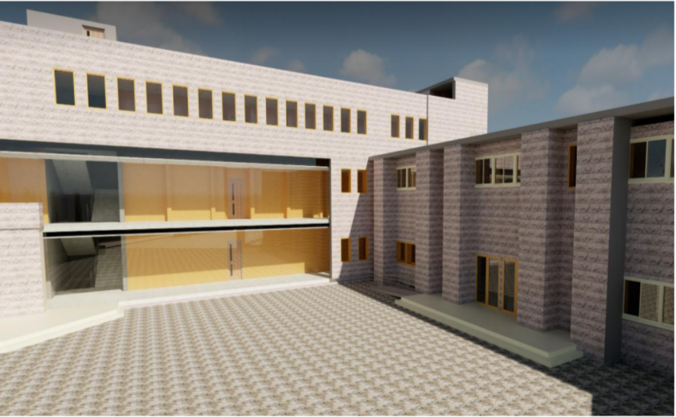

Slide 33
Contents:
Architectural Aspects
Structural Aspect
Environmental Aspect
Quantity surveying & Cost Estimate

Slide 34
Structural Aspects
Materials
Code
Loads
ACI 318-14
Seismic design UBC 97
ASCE for load design
Live load = 5 kN/m²
SID load = 4 kN/m²
F’c equals 28 MPa for the whole elements.
Steel Fy equals 420 MPa.
Specific weight Concrete equals 25 KN / m³.

Slide 35
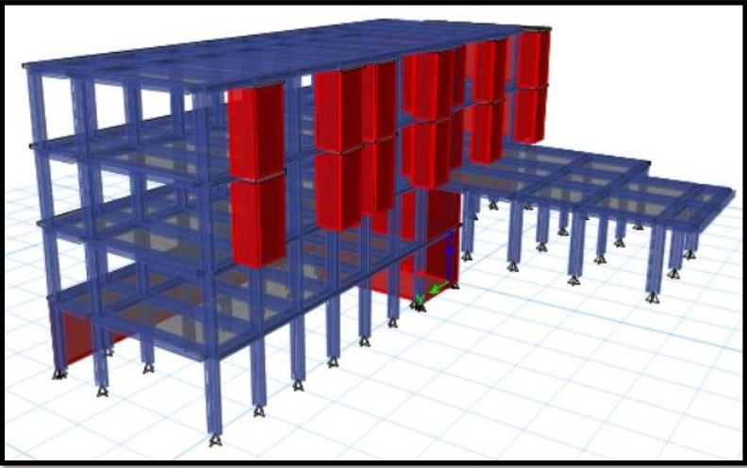
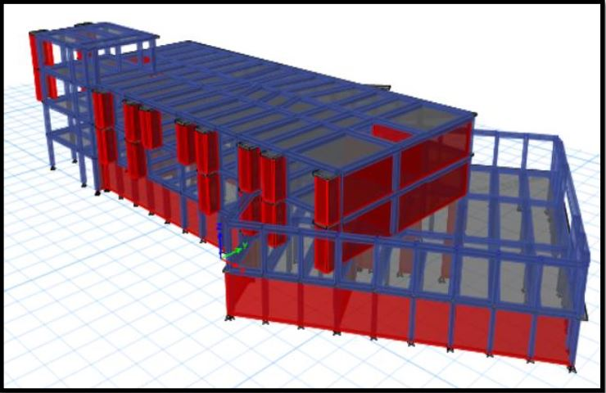
Structural Aspects
Our building contains four floors (G.F, first, second and third).
Two blocks ,first block and second block.
Figure 5: block 1
Figure 5: block 2

Slide 36
Structural Aspects
Slab
one way ribbed slab
(The thickness of slab’s first block equals 30 centimeters (300 millimeters).
(The thickness of slab’s second block equals 32 centimeters (320 millimeters).

Slide 37
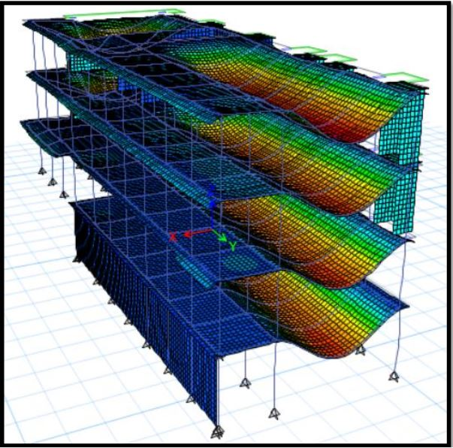
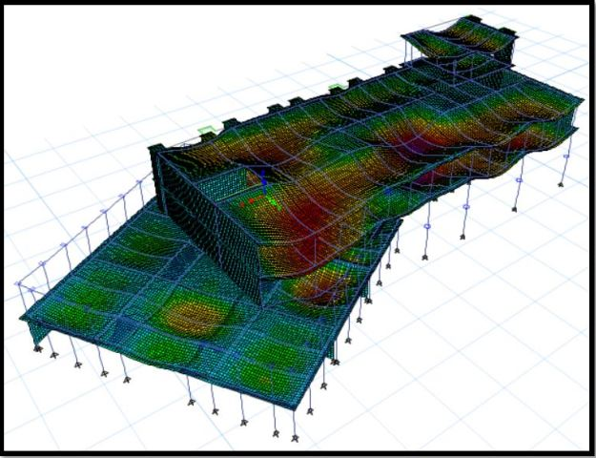
Structural Aspects
Checks:
1-Compatibility check.
Compatibility check for the two blocks is OK.
Figure 16: Deformed shape of block 1
Figure 17: Deformed shape of block 2

Slide 38
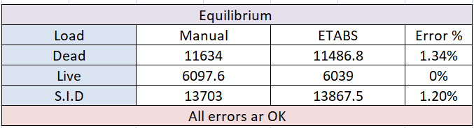
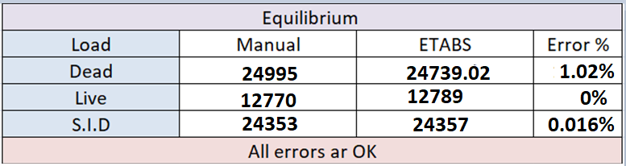
Structural Aspects
2-Equilibrium check.
Block 1 :- Equilibrium check is Ok
Block 2 :- Equilibrium check is Ok

Slide 39
Structural Aspects
3-Stress strain check .
Stress strain check for block 1 and block 2 OK.

Slide 40
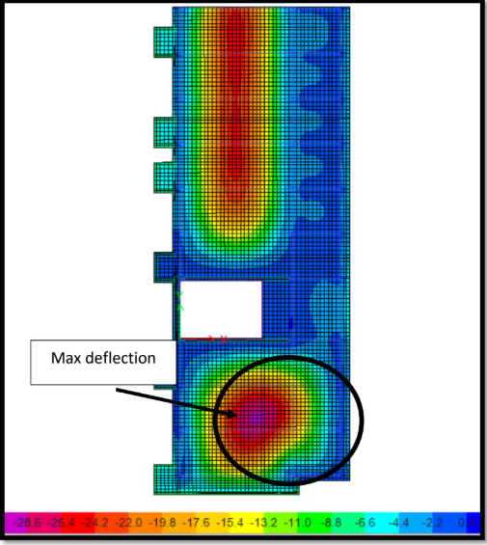
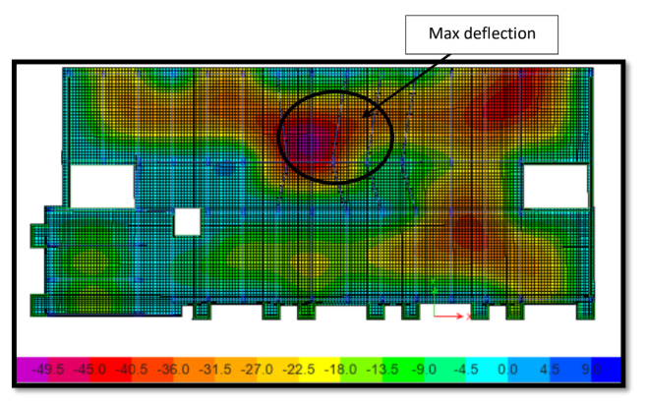
Structural Aspects
4-Deflection check.
Deflection in ETABS = 13.8 <22.7 from the deflection limit
Deflection in ETABS = 17.45 < 22.5 from the deflection limit
Deflection check for two blocks OK.

Slide 41
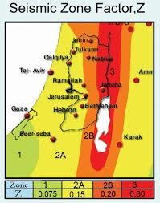
The parameters for seismic analysis
  Mass source: 100% for dead loads and SID , 25% for live loads
  Seismic zone : The directorate is located in Rawabi city Therefore, the seismic zone is 2A and the Z value is equal to 0.15.
  Soil profile: the soil profile is Sc .
  Force Reduction Factor R = 5.5
  Importance Factor I = 1
  Acceleration-Dependent Seismic Coefficient Ca = 0.18
  Velocity-Dependent Seismic Coefficient Cv = 0.25

Slide 42
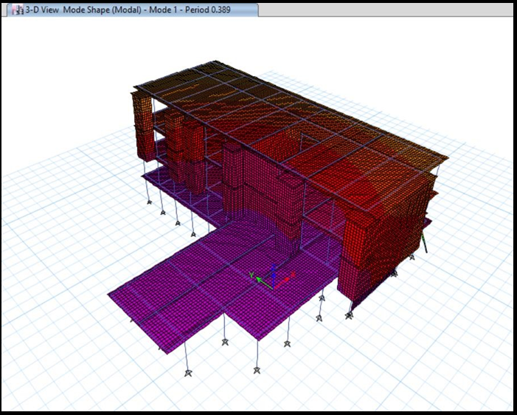
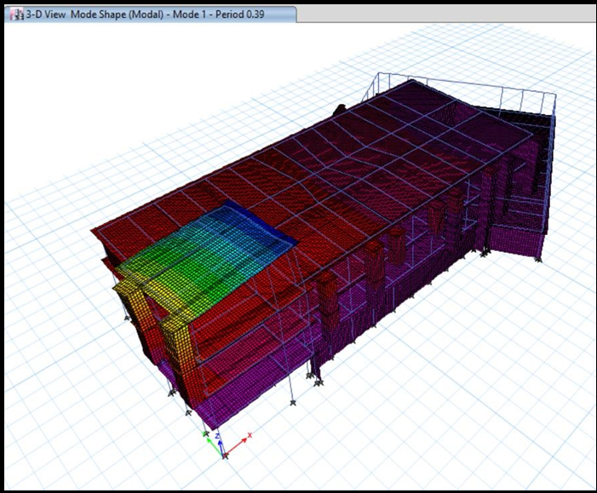
Structural Aspects
5- Period check.
T from ETABS = 0.389 <0.495 from method A T limit
Deflection in ETABS = 0.39 < 0.495 from method A T limit
Period check for two blocks OK.

Slide 43
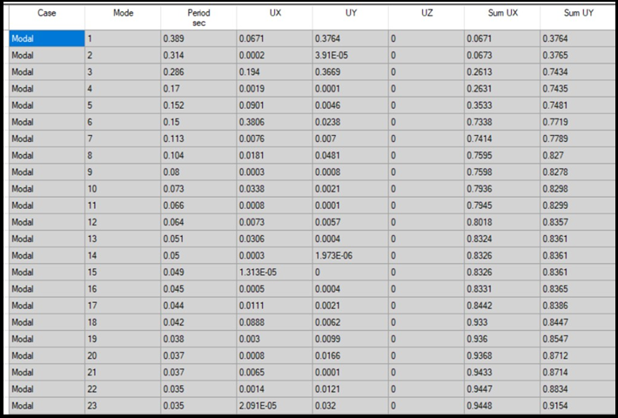
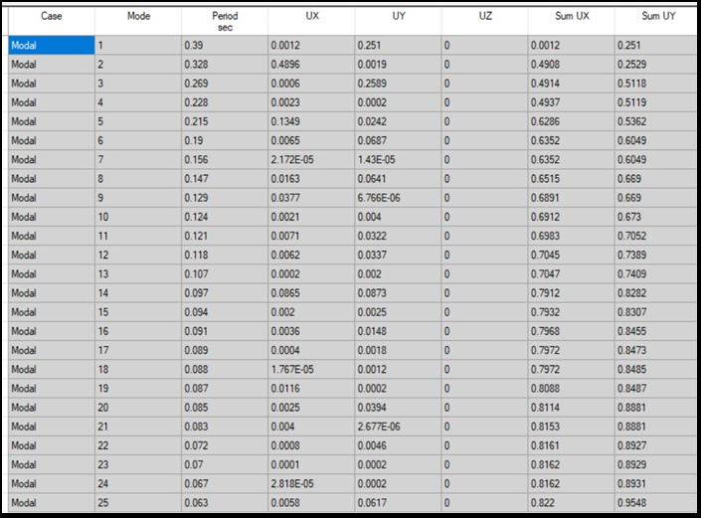
Structural Aspects
6- Modal mass participate ratio check-MPMR

Slide 44
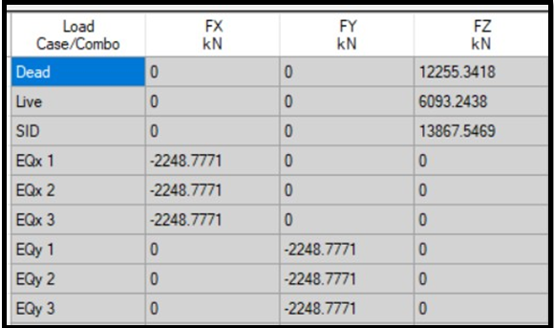
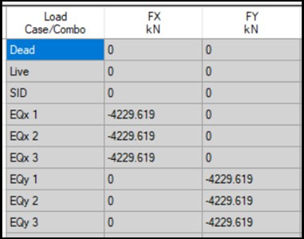
Structural Aspects
7- Base shear check
Base shear from ETABS = 2248.77 <2261 from manual
Base shear from ETABS = 4229 < 4280 from the deflection limit
Base shear for two blocks OK.

Slide 45
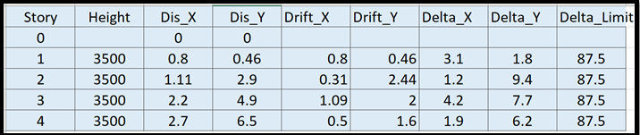
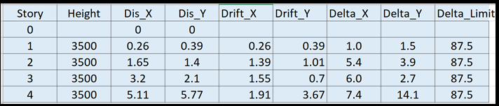
Structural Aspects
8- Drift check
Drift check for two blocks OK.

Slide 46
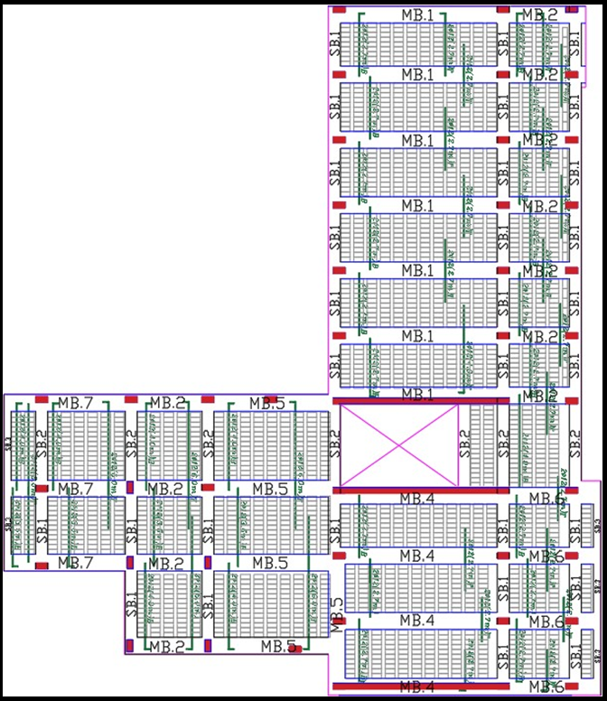
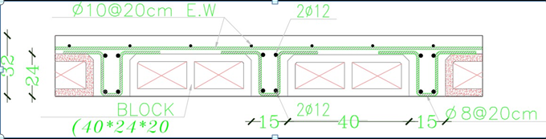
G.F Slab( First Block)
Slab Cross Section
Slab Reinforcement

Slide 47
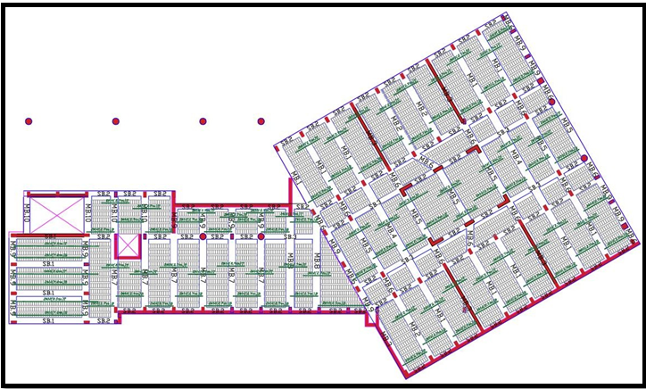
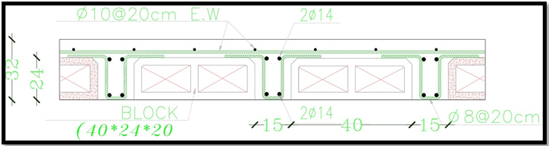
G.F Slab( Second Block)

Slide 48
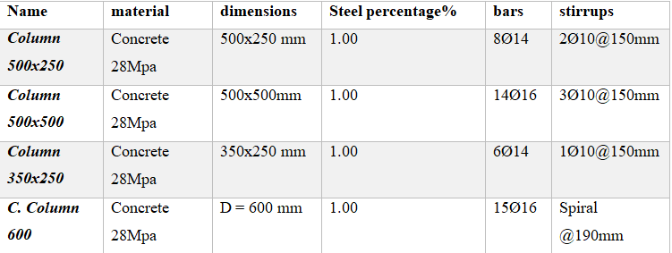






Columns Dimensions and sections

Slide 49


Beams reinforcement and layout for G.F(First block)

Slide 50

Beams reinforcement and layout for G.F(second block)

Slide 51



Isolated footing
Footings
Mat Foundation

Slide 52

Design of retaining wall

Slide 53
Design of retaining wall
Material | Properties
Concrete | fˋc = 28 Mpa
 | Ɣconcrete = 25 Kn/m³
Water | (ɣ_{water}) = 10 Kn/m³
 | Level = 2.00 m
Soil | Bearing Capacity (qall) = 250 KN/m²
 | Fraction angle (Ø) = 30 ̊
 | Unit weight for soil (ɣsoil) = 18 KN/m³
Reinforcement steel | Fy = 420 Mpa

Slide 54
Design of retaining wall
Design criteria:
PROKON program was used to analyze and design retaining wall.
Coulomb Theory method used in design.
(BS8110/ 1997) Code used in design.
Type of retaining wall: Cantilever.

Slide 55


Design of retaining wall
Preliminary dimension

Slide 56


Design of retaining wall
Overturning:
2 ≤ FS ≤ 3
Sliding:
1.5 ≤ FS ≤ 2
Bearing capacity:
σ ≤ q_{all}

Slide 57

Design of retaining wall

Slide 58

Design of retaining wall

Slide 59

Design of water tank

Slide 60
Design of water tank
Design code
ACI350 (American concrete Institute code)
Loads:
Live load on the roof = 5 KN/m².
Dead load on the roof = 3.5 KN/m².
Materials properties:
ɣ_{concrete} =25 KN/m³
Fc =28 Mpa
Fy = 420 Mpa.
ɣ_{soil} = 18 KN/m³.
ɣ_{water}= 10 KN/m³.
Friction angle (Ø (= 30°
Allowable bearing capacity of soil (qall) = 250 kN/m²
Load combination:
1.4D
1.2D + 1.6LL
Service = 1D + 1LL
Long term = 2D + 1.5LL

Slide 61
Design of water tank
Design and calculation
SAP2000 program used to design this water tank
Dimensions:
Underground (with roof)
Length = 8.00m
Width = 4.00m
Height = 4.00m

Slide 62

Design of water tank

Slide 63
Design of water tank
Wall reinforcement thickness = 300mm
Slab reinforcement thickness = 300mm
Direction | Horizontal reinforcement | Vertical reinforcement
Interior face | 6 ∅20/𝑚 | 5 ∅ 16 /m
Exterior face | 5 ∅ 14 /m | 4 ∅ 12 /m
Direction | Longitudinal reinforcement | Transverse reinforcement
Bottom | 6∅10/m | 6∅10/m
Top | 6∅10/m | 6∅10/m

Slide 64

Design of water tank
Base reinforcement
Base thickness = 650mm
Direction | Longitudinal reinforcement | Transvers reinforcement
Bottom | $$6∅16/m$$ | $$6∅16/m$$
Top | $$6∅16/m$$ | $$6∅16/m$$

Slide 65

Design of water tank

Slide 66
Contents:
Architectural Aspects
Structural Aspect
Environmental Aspect
Quantity surveying & Cost Estimate

Slide 67
Contents:
Architectural Aspects
Structural Aspect
Environmental Aspect
Quantity surveying & Cost Estimate

Slide 68
Environmental Aspect
Environmental Aspect
Cooling and heating
Artificial lighting design
Power design
Acoustical design
Fire alarm and Firefighting systems
Vertical transportation
Water supply
Drainage

Slide 69
Environmental Aspect
Environmental Aspect
Cooling and heating
Artificial lighting design
Power design
Acoustical design
Fire alarm and Firefighting systems
Vertical transportation
Water supply
Drainage

Slide 70


Cooling and heating

Slide 71



Cooling and heating

Slide 72




Cooling and heating

Slide 73

Cooling and heating
Class room

Slide 74


Cooling and heating

Slide 75

Cooling and heating
Solar radiation falling on window of class room (South elevation)

Slide 76

Environmental Aspect
Environmental Aspect
Cooling and heating
Artificial lighting design
Power design
Acoustical design
Fire alarm and Firefighting systems
Vertical transportation
Water supply
Drainage
Inside
Outside

Slide 77


Inside the building :
The selected luminaires
1- Philips -DN295B which used in WC
2- Philips lighting (china) investment co. Ltd

Slide 78

Artificial lighting in Ground Floor

Slide 79
Ground floor
Result from DIALUX evo form artificial only
Function | Standard min. (E) lux | (E) used lux | Uniformity
Classroom | 300 | 517 | 1.92
Head master | 500 | 575 | 1.69
secretary | 300 | 381 | 1.78
Teachers room | 300 | 426 | 1.51
Staircase | 100 | 135 | 1.28
W.C | 100 | 107 | 1.18
Corridor | 150 | 237 | 3.1
First aid | 300 | 373 | 1.43
Kitchen | 500 | 500 | 1.82
Cafeteria | 200 | 218 | 2.01
Waiting area | 300 | 412 | 1.37
Meeting room | 400 | 552 | 1.70
Multipurpose hall | 500 | 572 | 1.83
lobby | 150 | 163 | 1.24
Laboratory | 500 | 599 | 1.94
store | 150 | 156 | 1.30
library | 300 | 347 | 1.98
Computer lab | 400 | 411 | 2.28
janitor | 300 | 321 | 1.67
Security | 400 | 462 | 1.41
Stair

Slide 80
Environmental Aspect
Environmental Aspect
Cooling and heating
Artificial lighting design
Power design
Acoustical design
Fire alarm and Firefighting systems
Vertical transportation
Water supply
Drainage

Slide 81
Environmental Aspect
Environmental Aspect
Cooling and heating
Artificial lighting design
Power design
Acoustical design
Fire alarm and Firefighting systems
Vertical transportation
Water supply
Drainage

Slide 82
Acoustical design
The spaces that were designed acoustically in the building
1- Class room
2- Library
3- Teacher room
4- Multipurpose room
5- Computer lab
6- Cafeteria

Slide 83

Reverberation time curve for classroom( Ecotect software 2011)
Material used in classrooms
Partition | Material
Walls | concrete block plaster
 | Maulstick MA 20 Fine
Floor | Concrete Slab Tiles On Ground
Ceiling | Plaster Insulation Suspended
window | Double Glazed Aluminum Frame
Doors | Foam Core Plywood

Slide 84

RT60 Values for classroom( Ecotect software 2011)
RT60 standard values (EGUEZ, 2017)
 | TOTAL | SABINE | NOR-ER | MIL-SE
REQ. | ABSPT. | RT(60) | RT(60) | RT(60)
63Hz | 20.350 | 0.96 | 1.14 | 0.83
125Hz | 17.826 | 1.05 | 1.19 | 0.94
250Hz | 10.839 | 1.12 | 0.96 | 1.09
500Hz | 14.559 | 0.95 | 0.71 | 0.87
1kHz | 24.027 | 0.66 | 0.45 | 0.42
2kHz | 19.603 | 0.65 | 0.52 | 0.54
4kHz | 25.218 | 0.51 | 0.43 | 0.42
8kHz | 26.571 | 0.37 | 0.33 | 0.31
16kHz | 29.350 | 0.36 | 0.33 | 0.30

Slide 85



Sound Transmission Loss (STC)
This figure shows the STC value of the interior wall of the building, equivalent to 43, and this value is greater than the required STC value, which is equal to 42 thus the value is acceptable.

Slide 86



Sound Transmission Loss (STC)
This figure shows the STC value of the exterior wall of the building, equivalent to 56, and this value is greater than the required STC value, which is equal to 50 thus the value is acceptable

Slide 87


Impact Insulation Class (IIC)
This figure shows the STC value of the roof of the building, equivalent to 68, and this value is greater than the required STC value, which is equal to 50 thus the value is acceptable

Slide 88
Environmental Aspect
Environmental Aspect
Cooling and heating
Artificial lighting design
Power design
Acoustical design
Fire alarm and Firefighting systems
Vertical transportation
Water supply
Drainage

Slide 89

Fire alarm and Firefighting systems
There are two types of firefighting systems used in this building:
Fire extinguisher. This type of fire extinguisher is used in certain locations in the building and is exposed to fire at any time, and is placed in an easily accessible place near the entrance to the room, and in this building they have been used in corridors, kitchens and some security rooms and employees.
FM200: This system is used in places that contain important files, sensitive electronic devices, and high-risk places, and in this building it was used in most places such as the classroom, the principal’s office, the teachers’ room, in addition to the chemistry, physics, biology, the computer laboratory and the library.

Slide 90

distribution of fire extinguishers for ground floor

Slide 91

FM200 distribution for second floor

Slide 92
. Room Name (Space) : COMPUTER LAB
Hazard Level : Class “C” (Of Electrical)-MANUALLY ACTIVATED-Medium Hazard
Area = 68.5 m2 // Height = 3.25 m // Volume(V) = 222.625 m3 // Concentration Ratio (C) = 7.6 %
Design Temperature = 20°C // Specific Volume (S) = 0.1373 kg/m3
Altitude = 1094 m, From Sea Level // Altitude Correction Factor = 0.1373
[ w = (V/s) X (c/(100-c) ] kg w = 133.365 kg/w

Slide 93
Environmental Aspect
Environmental Aspect
Cooling and heating
Artificial lighting design
Power design
Acoustical design
Fire alarm and Firefighting systems
Water supply
Drainage
Vertical and horizontal transportation

Slide 94
Water supply system:
Daily water consumption
Based on the quantities of water consumed for this building, it became easy to know the size of the water tank on the roof in addition to the size of the underground water tank, with taking into considerate on the provision of water for two days.

Slide 95
Environmental Aspect
Environmental Aspect
Cooling and heating
Artificial lighting design
Power design
Acoustical design
Fire alarm and Firefighting systems
Vertical and horizontal transportation
Water supply
Drainage

Slide 96


Drainage system:
Black line
Pipes were used with 4 inch and slope ¼ “inch per foot”.
Gray Line
Pipes were used with 2 inch and slope 1/8 “inch per foot”.

Slide 97
Contents:
Architectural Aspects
Structural Aspect
Environmental Aspect
Quantity surveying & Cost Estimate

Slide 98
Quantity surveying & Cost Estimate
The project is Rawabi school for the boys and the girls with an area of 3300 m² , the cost of the project was calculated by evaluating the price for the material and labor for the components of the project and its number which was cost around 6440068 ILS as total and 1952 ILS /meter square unit cost, which equals 610 $ /meter square
Earth work = 166200 NIS
Foundation = 738020.5 NIS
Building (construction) = 2619832.7 NIS
Finishing = 2240938.3 NIS
Site Plane work = 518372.4 NIS
Electrical = 522489 NIS
Mechanical = 890608.1 NIS

Slide 99
Percentage for each work from total cost of the building

Slide 100
Thank you for listening

