Slide 1

An-Najah National University
Faculty of engineering and information technology
Civil Engineering Department
Graduation project:
Design of
Foundation Systems

Slide 2
Outline :
Introduction and Site Description.
Structural System.
Design of foundations.
Quantity and Cost.
Conclusion.

Slide 3
Introduction :
Aim of the Project
This project aims to design a foundations for a residual building on several types
of soil then make a relation between the allowable bearing capacity of soil and the cost of foundation.
Building Description
The building consists of 9 stories all of them have the same area ,height and uses , The area for each floor is 450 square meter ,the height of each floor in this building is 3 m.

Slide 4
We design 5 foundations on 5 types of soil which are very hard rock , hard rock ,weak rock , limestone and improved clay soil. Then we find the relation between the allowable bearing capacity of soil and the cost of foundation needed to give suitable and safe foundation for this structure.

Slide 5
Structural System
Foundation design must support different kinds of loads. Such as dead load, live loads, snow loads, wind loads and seismic loads. Foundation should be design in the way which meets building requirements.

Slide 6
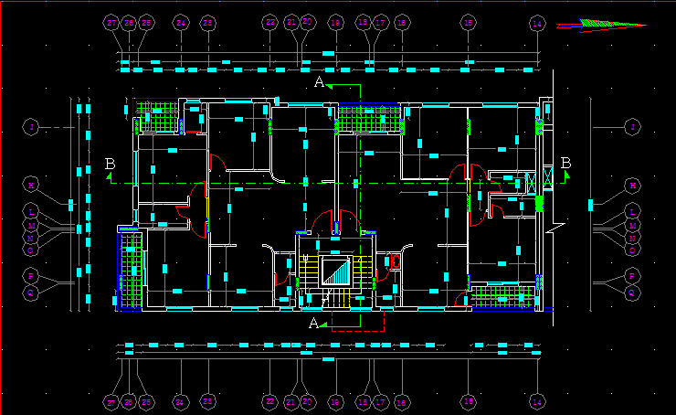
Figure 4.3 Plan of the residential building

Slide 7
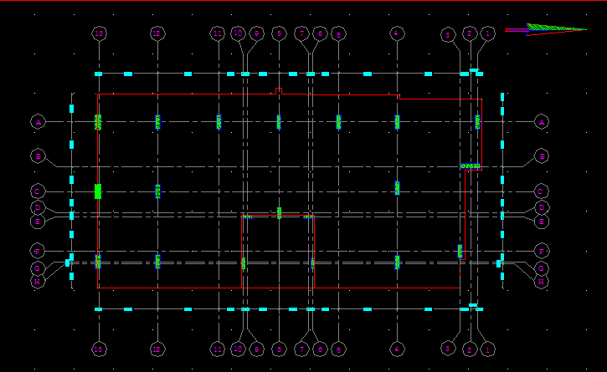
Figure 4.4 Center lines of columns

Slide 8
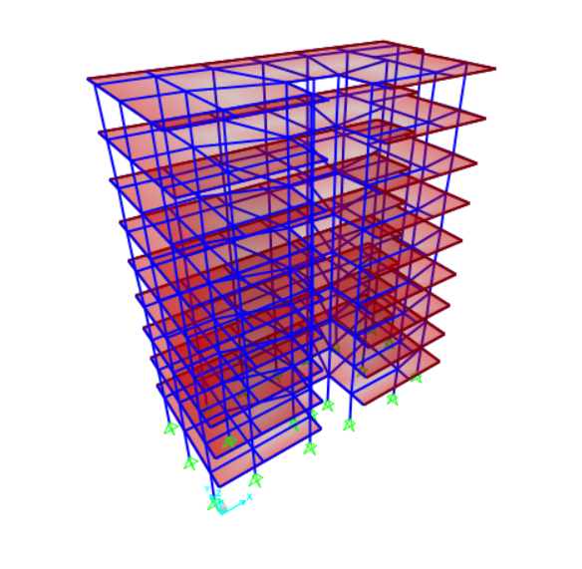
Figure 4.6 3D Modeling for building

Slide 9
Table 4.2 Reactions of each column from different load cases
Column # | Dead | SD | Live | Service | Ultimate
C1 | 780 | 1821 | 513 | 3114 | 3943
C2 | 882 | 879 | 76 | 1837 | 2235
C3 | 1009 | 779 | 7.4 | 1796 | 2158
C4 | 1019 | 777 | 8.5 | 1805 | 2169
C5 | 1012 | 792 | 1 | 1805 | 2166
C6 | 1051 | 1181 | 60 | 2292 | 2774
C7 | 732 | 1908 | 506 | 3146 | 3978
C8 | 682 | 2363 | 898 | 3942 | 5090
C9 | 846 | 708 | 151 | 1706 | 2108
C10 | 564 | 905 | 594 | 2062 | 2712
C11 | 472 | 736 | 488 | 1696 | 2231
C12 | 568 | 953 | 631 | 2152 | 2836
C13 | 810 | 338 | 93 | 1242 | 1527
C14 | 692 | 942 | 61 | 1695 | 2058
C15 | 750 | 1683 | 474 | 2907 | 3678
C16 | 1006 | 1260 | 249 | 2516 | 3119
C17 | 586 | 1532 | 875 | 2994 | 3943
C18 | 565 | 1393 | 798 | 2756 | 3626
C19 | 1052 | 1460 | 310 | 2821 | 3509
C20 | 760 | 1906 | 444 | 3110 | 3910

Slide 10
Design of foundations
Types of soil | Allowable Bearing Capacity
Very hard Rock | 1000 KN/m²
Hard Rock | 500 KN/m²
Weak Rock (Marl and stones) | 300 KN/m²
Marl soil | 225 KN/m²
Improved Clay Soil (clay with rock fill + Base course) | 150 KN/m²

Slide 11
First design option (Very Hard Rock)
Take very hard rock with bearing capacity 1000 KN/m2 as a supporting soil for footing in design.
Since we have different values of reactions we are going to make grouping for footings:
Group1 (1527 – 2235) KN
Group2 (2712 – 3678) KN
Group3 (3943 - 5090) KN

Slide 12
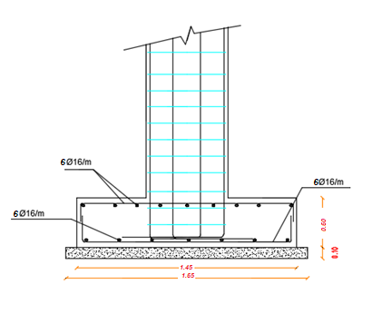
Figure 5.1 Detailing of footing1 (F1)

Slide 13
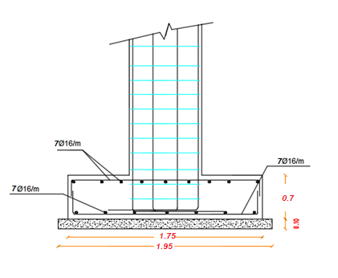
Figure 5.2 Detailing of footing 2 (F2)

Slide 14
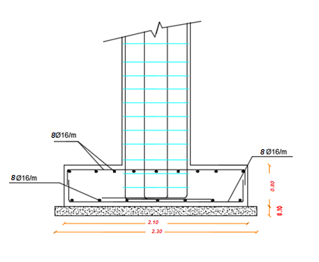
Figure 5.3 Detailing of footing 3 (F3)

Slide 15
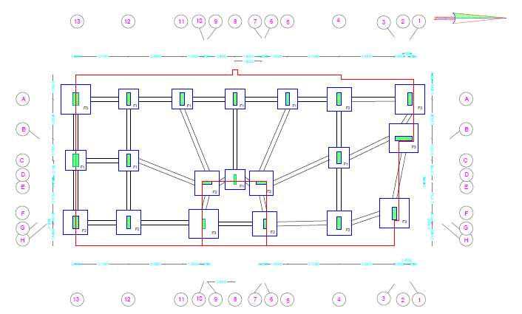
Figure ‎5.4 Footing Layout for first design option

Slide 16
Second design option (hard rock)
Take hard rock with bearing capacity 500 KN/m2 as a supporting soil for footing in design.
There are three Groups:
Group1 (1527 – 2235) KN
Group2 (2712 – 3678) KN
Group3 (3943 - 5090) KN

Slide 17
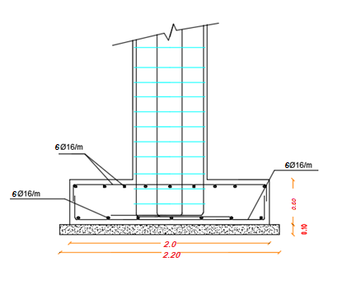
Figure 5.5 Detailing of footing 4 (F4)

Slide 18
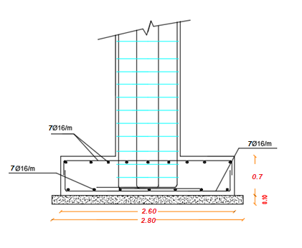
Figure 5.6 below shows the detailing of footing 5 (F5)

Slide 19
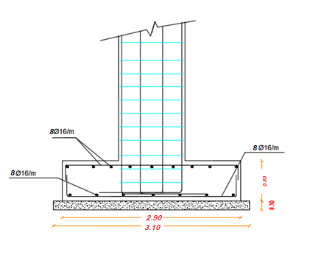
Figure 5.7 Detailing of footing 6 (F6)

Slide 20
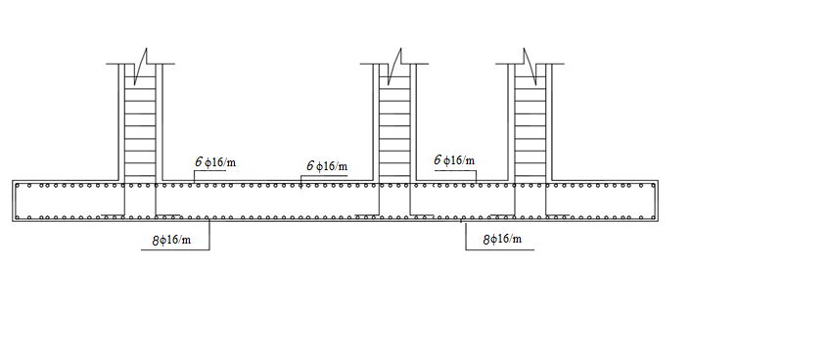
Figure 5.8 Detailing of footing 7 (F7)

Slide 21
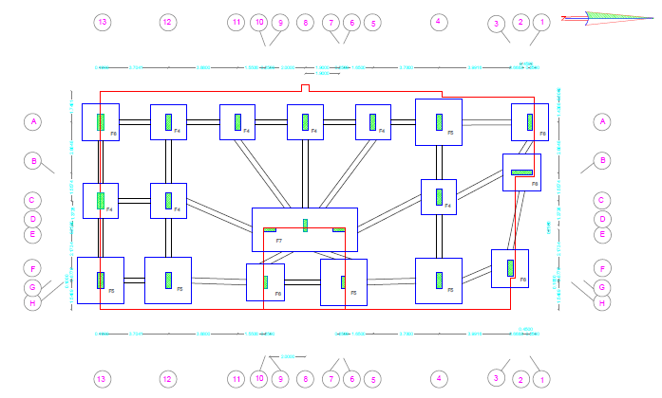
Figure ‎5.9 Footing Layout for Second Option.

Slide 22
Third design option (weak rock)
Take weak rock with bearing capacity 300 KN/m2 as a supporting soil for footing in design.
There are three Groups:
Group1 (1527 – 2235) KN
Group2 (2712 – 3678) KN
Group3 (3943 - 5090) KN

Slide 23
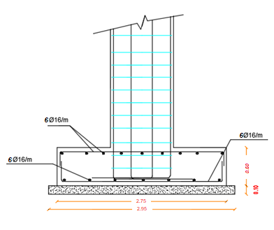
Figure 5.10 Detailing of footing 8 (F8)

Slide 24
Figure 5.12 Detailing of footing 10 (F10)

Slide 25
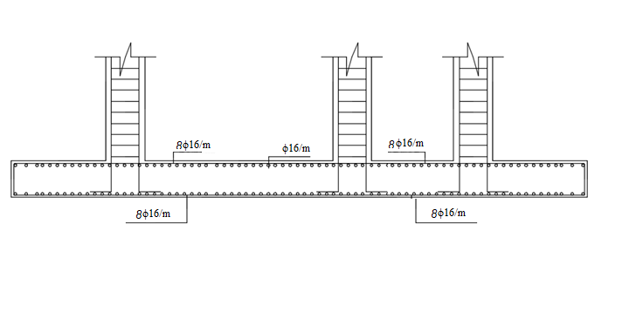
Figure 5.13 Detailing of footing 11 (F11)

Slide 26
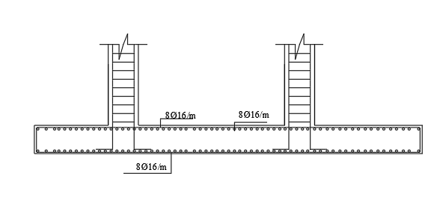
Figure 5.14 Detailing of footing 12 (F12)

Slide 27
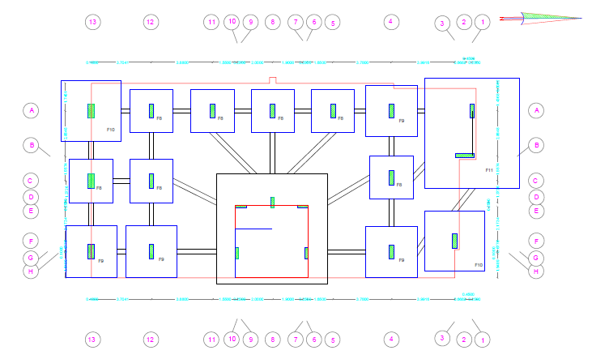
Figure ‎5 15 footing layout for third design option

Slide 28
Fourth design option (Marl soil)
Take marl soil with bearing capacity 225 KN/m2 as a supporting soil for footing in design.
Since the soil is a weak soft soil it is better to use Raft foundation in order to reduce the stresses on the soil and settlement too.
Area of footing(A_{f}) = 226.5 m2

Slide 29
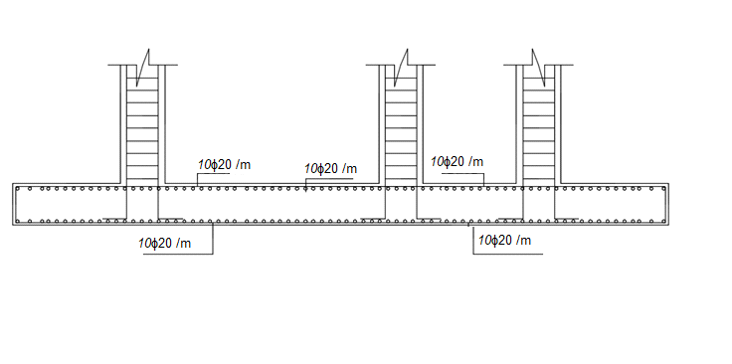
Figure 5.16 Detailing of mat foundation

Slide 30
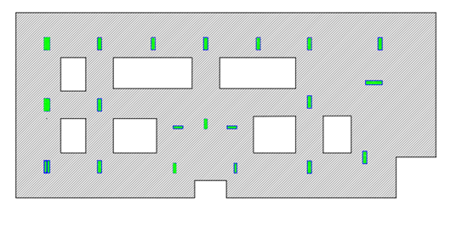
Figure 5.17 mat foundation layout for fourth design option

Slide 31
Fifth design option (clay soil)
Take clay soil with bearing capacity 150KN/m2 as a supporting soil for footing in design.
Since the soil is a very weak soft soil it is better to use Raft foundation in order to reduce the stresses on the soil and settlement too.
Area of footing(Af) = 286 m2.

Slide 32
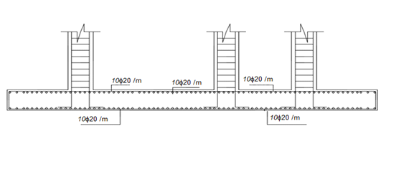
Figure 5.18 Detailing of mat foundation

Slide 33
Quantity and Cost
First design option (Very Hard Rock):
1.
Excavation for footings
Footing | Number | Excavation volume (m³)
F₁ | 8 | 84.32
F₂ | 7 | 91.35
F₃ | 5 | 76.8
Total | 20 | 252.47

Slide 34
2.
3.
Weight of reinforced steel
Footing | Number | Reinforced steel[ ϕ 16] (kg)
F₁ | 8 | 768.512
F₂ | 7 | 1070.608
F₃ | 5 | 1289.28
Total | 20 | 3128.4
Volume of concrete for footings
Footing | Number | Length | Width | Depth | Volume of R.C (m³) | Volume of plain concrete (m³)
F₁ | 8 | 1.45 | 1.45 | .6 | 10.092 | 2.178
F₂ | 7 | 1.75 | 1.75 | .7 | 15.008 | 2.6614
F₃ | 5 | 2.1 | 2.1 | .8 | 17.64 | 2.645
Total | 20 |  |  |  | 42.74 | 7.4844

Slide 35
4.
Second design option (hard rock):
1.
Cost
L | M | E | Total
2763 | 24,363 | 6,312 | 33,438 NIS
Excavation for footings
Footing | Number | Excavation volume (m³)
F₄ | 8 | 122.88
F₅ | 7 | 151.62
F₆ | 2 | 50.43
F₇ | 1 | 44.73
Total | 18 | 369.66

Slide 36
2.
3.
Weight of reinforced steel
Footing | Number | Reinforced steel[ ϕ 16] (kg)
F₄ | 8 | 1362.592
F₅ | 7 | 2293.844
F₆ | 2 | 931.568
F₇ | 1 | 1030.713
Total | 18 | 5618.717
Volume of concrete for footings
Footing | Number | Length | Width | Depth | Volume of R.C (m³) | Volume of plain concrete (m³)
F₄ | 8 | 2 | 2 | 0.60 | 19.2 | 3.872
F₅ | 7 | 2.6 | 2.6 | 0.70 | 33.124 | 5.488
F₆ | 2 | 1.40 | 1.40 | 0.45 | 9.464 | 1.568
F₇ | 1 | 5.9 | 3 | .6 | 10.62 | 2.44
Total | 18 | - | - | - | 72.408 | 13.368

Slide 37
4.
Third design option (weak rock):
1.
cost
L | M | E | Total
4,249 | 42,339 | 9,242 | 55,830 NIS
Excavation for footings
Footing | Number | Excavation volume (m³)
F₈ | 7 | 163.821
F₉ | 4 | 119.350
F₁₀ | 2 | 50.43
F₁₁ | 1 | 100.86
F₁₂ | 1 | 88.56
Total | 15 | 523.021

Slide 38
2.
3.
Weight of reinforced steel
Footing | Number | Reinforced steel[ ϕ 16] (kg)
F₈ | 7 | 2265.088
F₉ | 4 | 1294.336
F₁₀ | 2 | 375.56
F₁₁ | 1 | 2589.62
F₁₂ | 1 | 2252.764
Total | 15 | 8777.368
Volume of concrete for footings
Footing | Number | Length | Width | Depth | Volume of R.C (m³) | Volume of plain concrete (m³)
F₈ | 7 | 2.75 | 2.75 | .6 | 31.763 | 6.097
F₉ | 4 | 3.26 | 3.26 | .7 | 29.76 | 4.304
F₁₀ | 2 | 2.9 | 2.9 | .8 | 9.075 | 1.742
F₁₁ | 1 | 7 | 7 | .6 | 29.4 | 5.184
F₁₂ | 1 | 7 | 6 | .6 | 25.2 | 4.464
Total | 15 | - | - | - | 125.198 | 21.791

Slide 39
4.
Fourth design option (Marl soil):
1.
2.
cost
L | M | E | Total
8,637 | 70,298 | 13,076 | 91,411 NIS
Excavation for footings
Footing | Number | Excavation volume (m³)
F₁₃ | 1 | 543.348
Weight of reinforced steel
Footing | Number | Reinforced steel[ ϕ 20] (ton)
F₁₃ | 1 | 25

Slide 40
3.
4.
Volume of concrete for footings
Footing | Number | Length | Width | Depth | Volume of R.C (m³) | Volume of plain concrete (m³)
F₁₃ | 1 | 26.88 | 10.9 | .8 | 185.618 | 30.059
Cost for Fourth Option
L | M | E | Total
9,710 | 135,267 | 13,584 | 158,561 NIS

Slide 41
Fifth design option (clay soil):
1.
2.
3.
Excavation for footings
Footing | Number | Excavation volume (m³)
F₁₄ | 1 | 543.348
Weight of reinforced steel
Footing | Number | Reinforced steel[ ϕ 20] (ton)
F₁₄ | 1 | 32
Volume of concrete for footings
Footing | Number | Length | Width | Depth | Volume of R.C (m³) | Volume of plain concrete (m³)
F₁₄ | 1 | 26.88 | 10.9 | 0.8 | 234.394 | 30.059

Slide 42
4.
Cost for the Fifth Option
L | M | E | Total
11,901 | 169,425 | 13,585 | 194,911 NIC

Slide 43
Conclusion
Table 7.1 B.C of the soil and Cost of the foundation for each design option.
design option | B.C (KN/m²) | Cost (NIS)
1 | 1000 | 33,400
2 | 500 | 55,800
3 | 300 | 91,400
4 | 225 | 158,600
5 | 150 | 195,000

Slide 44
Figure 7.1 Relation between B.C_{all} and Cost

Slide 45

Cost= 3*${10}^{7}$*q_{all}^{-0.978}
B.C_{all}(KN/m²) | Cost (NIS)
50 | 653926
100 | 331987.1
150 | 223307.9
200 | 168544.2
250 | 135498.9
300 | 113369.6
350 | 97504.06
400 | 85567.05
450 | 76256.95
500 | 68790.52
550 | 62668.1
B.C_{all}(KN/m²) | Cost (NIS)
600 | 57555.83
650 | 53222.1
700 | 49501.16
750 | 46271.26
800 | 43440.94
850 | 40940.16
900 | 38714.36
950 | 36720.41
1000 | 34923.78
1050 | 33296.46
1100 | 31815.53

Slide 47


