Slide 1
Smart Car to reduce risk of accident
Anas Mahmoud
Ahmad Alqasim
Samer Salameh

Slide 2
Outline
Result
Question's
Introduction
Design of our project
Methodology
Conclusion
Constraints

Slide 3
Introduction
The main aims of an accident avoidance system are to avoid a loss of life and provide a safety mechanism for the driver.
Avoidance accident is intended to be an installable safety system for existing cars that can aid the operator in avoiding hidden obstacles.

Slide 4
Methodology

Slide 5
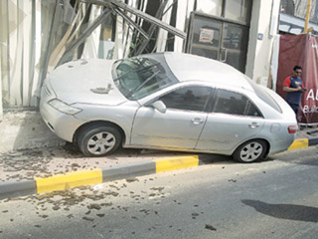
Problems:
Deviation of the vehicle:Problem 1

Slide 6
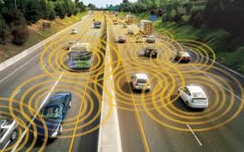
Problem 2:Distances between the Vehicles

Slide 7

Problem 3: Fog weather

Slide 8
Design of our project

Slide 9
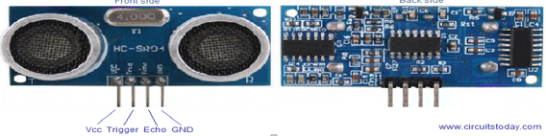
Components:
Ultrasonic sensor()

Slide 10
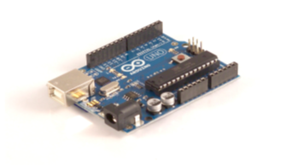
Components:
Arduino UNO

Slide 11
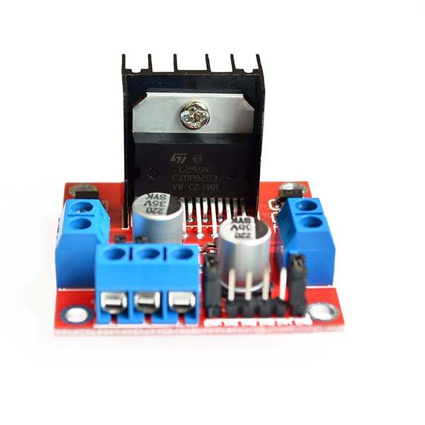
Components:
Dual h bridge

Slide 12

Components:
DC Motor

Slide 13
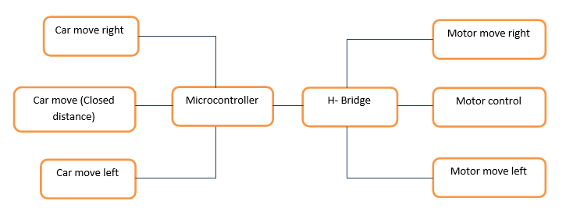
Functional Flow Chart

Slide 14
Result

Slide 15
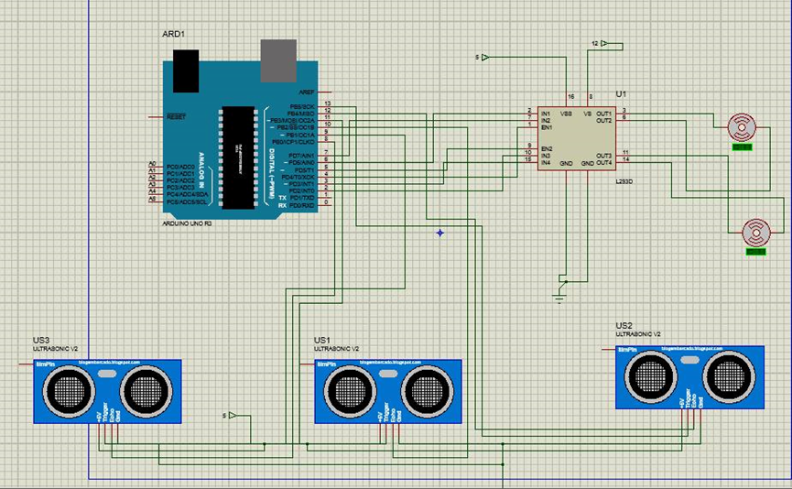

Slide 16
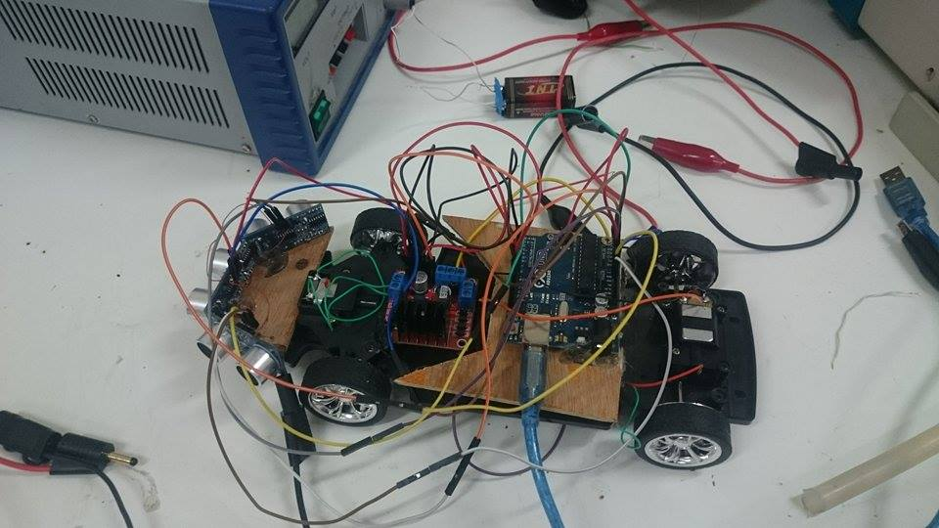
This model has achieved the desired objectives of the project so that the vehicle had been able to avoid the obstacles side and reduce speed front Obstacle

Slide 17
Constraints

Slide 18
Conclusion:
Reduce accidents is a global goal that every country seeks to achieve. So we design smart car, we sought through design to reduce the most dangerous and the most frequent accidents! So we tried to underestimate the impact of two types of accidents, first when vehicle deviation from the road and the other case when lack of vision on the road. The probability of success of the system in the return of the vehicle back on track, depend on the vehicle speed and the speed of system response ,therefore, the system will help reduce accidents or reduce the impact of the incident , finally the system got a high efficiency.

Slide 19
Question's ??

