Slide 1

Prepared by: Areen Jondi
Diala Hamadneh
Supervised by: Dr. Raed Alqadi
Dr. Luai Malhis

Slide 2
Outline
Introduction
Motivation
Background
Design process
Developing the software application
Demo
Future work
Conclusion

Slide 3
Introduction
Paint mixer is an amazing machine that gives you the ability to get any degree on the colors scale that may be expensive or even not be available in your neighborhood stores, all you need is 3 basic colors –cyan, magenta, and yellow- with black and white for brightness and intensity.

Slide 4
Motivation
Mixing paint to have custom colors is more convenient and affordable way to find the color you need in the exact shade you prefer, not to mention more fun.
Customized paint colors more expensive than regular colors Red, yellow, blue, black and white. Also the exact color and shade you want may not be available in your neighborhood.

Slide 5
Background
PIC microcontroller: we used PIC18ls4620 as the main controller for connecting Bluetooth and controlling the motors rotations and durations.
Motors: We used stepper motors for controlling the syringes of paints.

Slide 6
CMYK or RGB

Slide 7
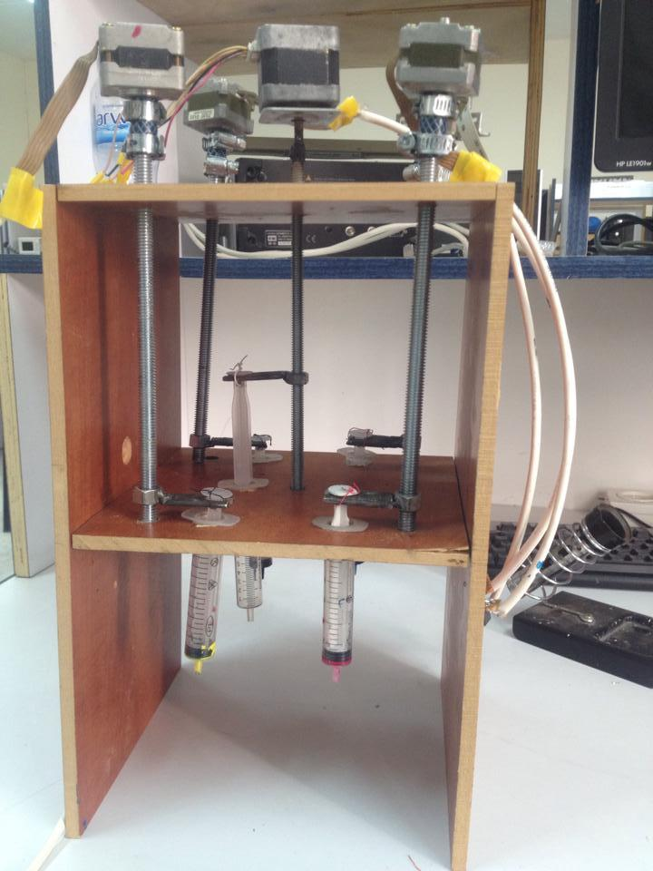
Design process
the main body structure is made
from wood with holes for syringes
and motors’ screws.

Slide 8
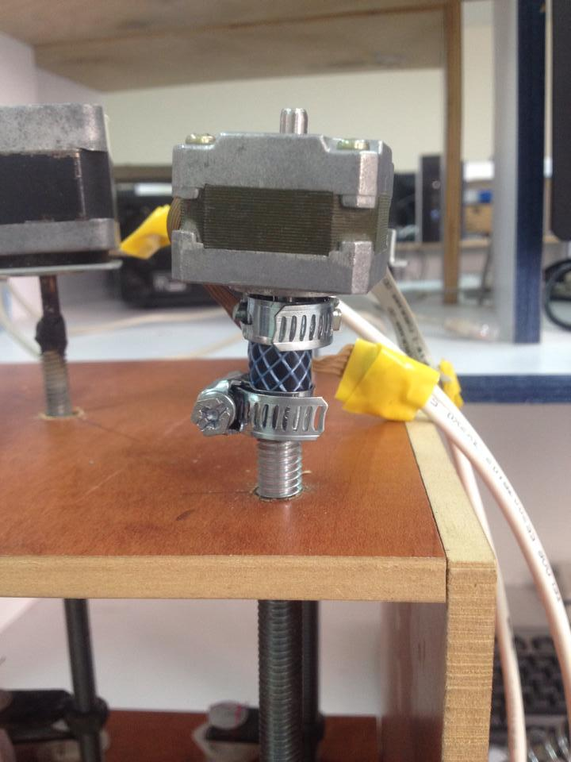
Design process
We connected motors with screws,
pass the screws through holes
and connect it with syringes.

Slide 9
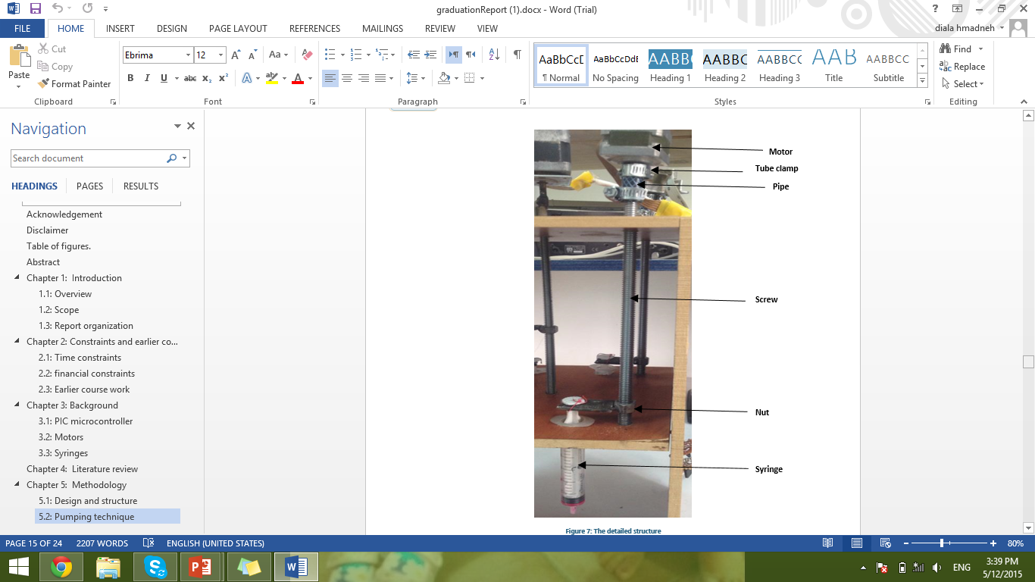
Pumping technique
So we had to use syringes
connected with stepper motors.

Slide 10
Pumping technique
Driver
Motor rotations--→syringes
Fill
mixing

Slide 11
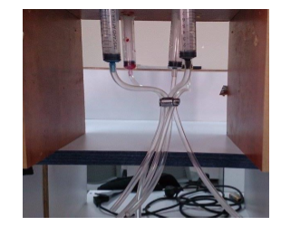
Pumping technique
Because the syringes were so far from each other,
we used small pipes to combine
the paint in one place smoothly.

Slide 12
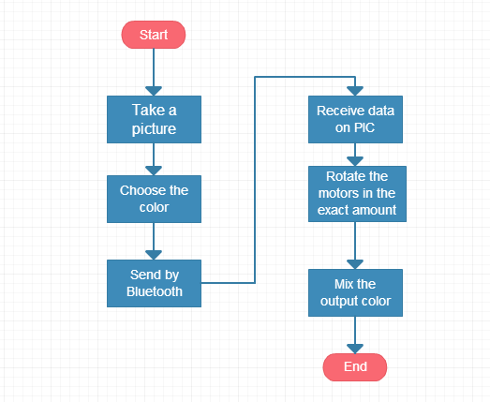
Flow chart

Slide 13
Developing the software application
The software application is the basic tool for specifying the color.
The user will take a picture of any object, then choose the wanted color

Slide 14
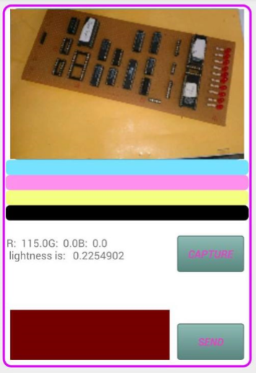
Developing the software application

Slide 15
Developing the software application
On each touch the RGB values are taken and CMYK values are determined based on these equations:
R ' = R /255 G ' = G /255 B ' = B/255
The black key (K) color is calculated from the red (R'), green (G') and blue (B') colors:
K = 1-max( R ', G ', B ')

Slide 16
Developing the software application
The cyan color (C) is calculated from the red (R') and black (K) colors:
C = (1-R ‘-K ) / (1-K )
The magenta color (M) is calculated from the green (G') and black (K) colors:
M = (1-G ‘-K ) / (1-K )

Slide 17
Developing the software application
The yellow color (Y) is calculated from the blue (B') and black (K) colors:
Y = (1-B ‘-K ) / (1-K )

Slide 18
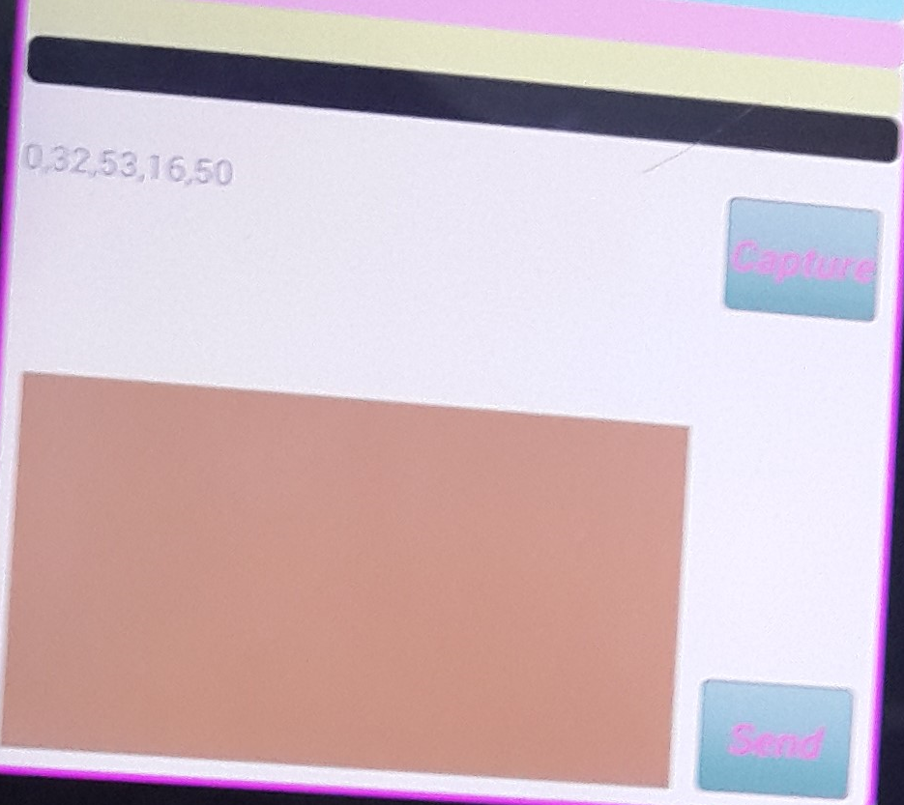
Developing the software application
After confirming the exact color,
the CMYK values will be sent
by Bluetooth to the PIC

Slide 19
Developing the software application
On Pic side, after receiving the CMYK values as a string, it is split by ‘,’ into an array of integers each element represents a different color value.

Slide 20
Demo

Slide 21
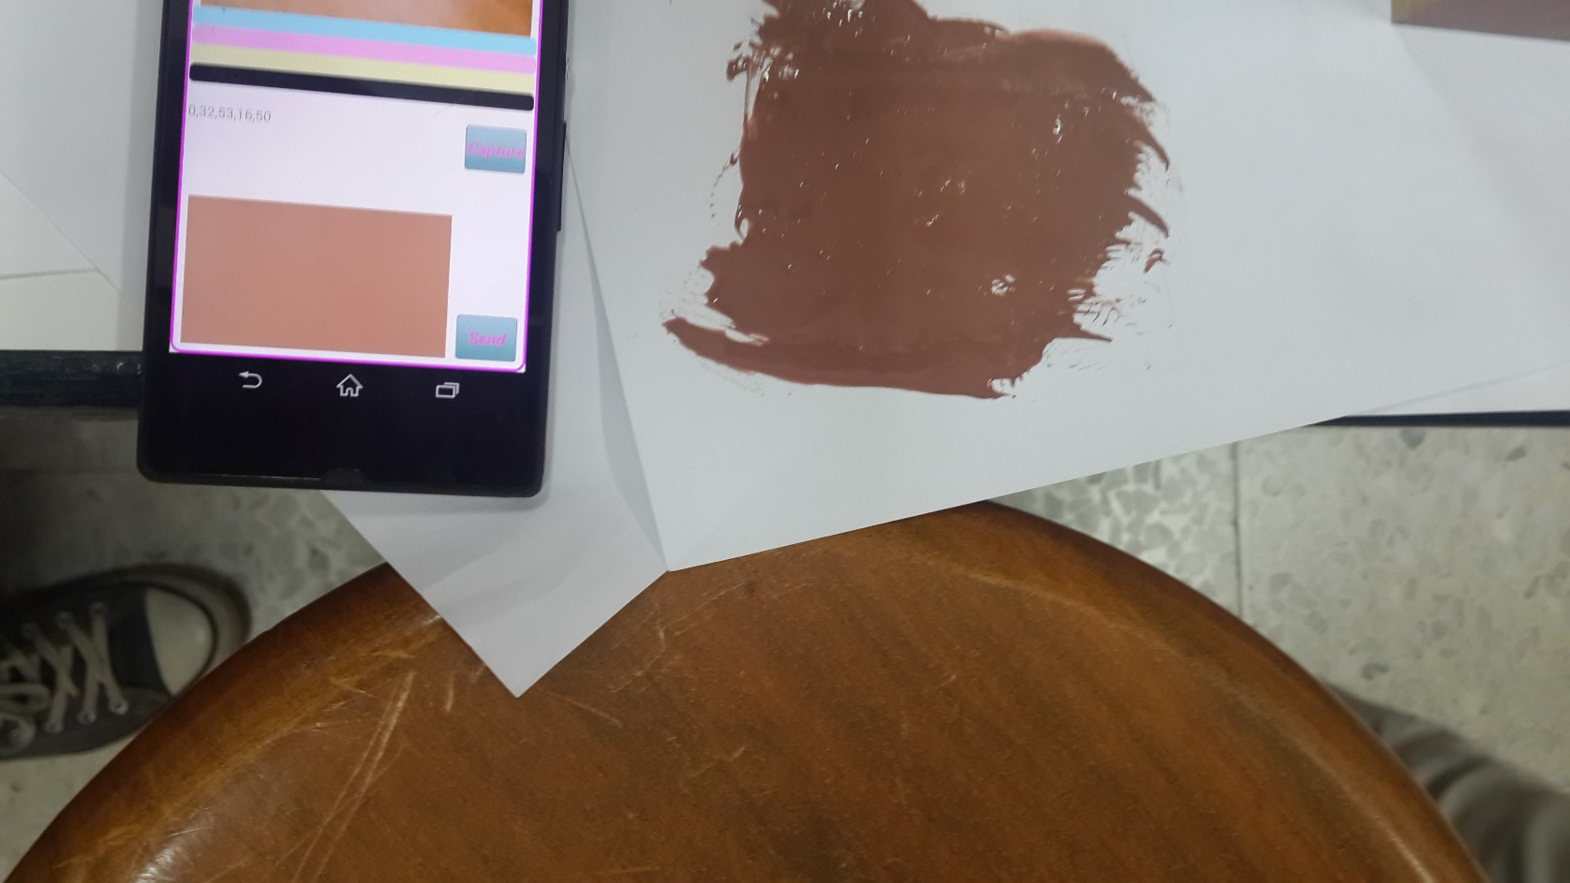
Result

Slide 22
Future work
Before filling the syringes the system should detect if the same color exists at the end of the syringe.
Rotate a plate under the syringes containing the paint instead of the tubes and shake it at the same time.

Slide 23
Conclusion
Paint Mixer is a machine that anyone can have in homes, companies or in paint shops.
We achieved the main idea, but we believe that we need a hard effort to improve its functionality

Slide 24
References
http://www.rapidtables.com/convert/color/rgb-to-cmyk.htm

