Slide 1
NDN OVER IP
Named Data Networking Over Internet Protocol

Slide 2
Outline
Problem of current caching
What’s NDN Over IP
NDN and SDN
Implementation of controller
Testing and results

Slide 3
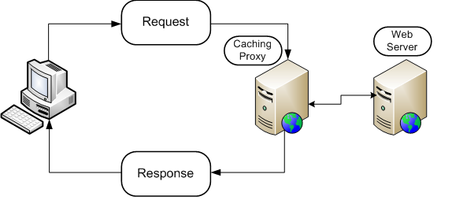
Current caching
current network caches require configuration of each user's browser which is a costly and un-scalable management task .

Slide 4
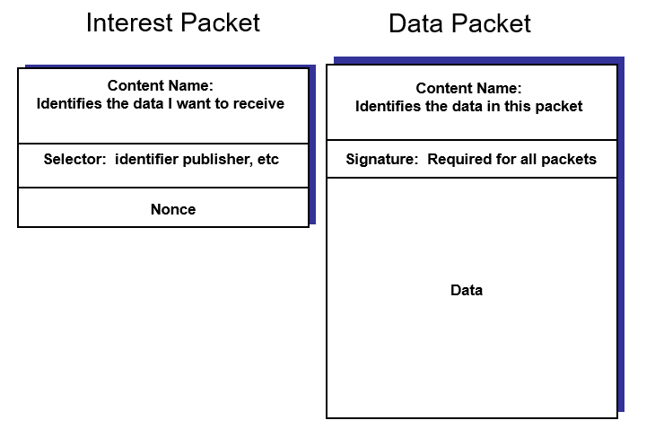
NDN Packets

Slide 5
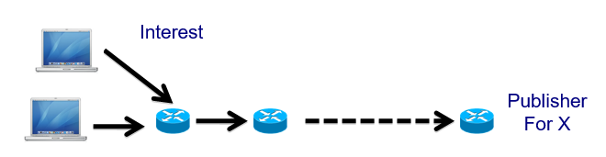

NDN Forwarding

Slide 6
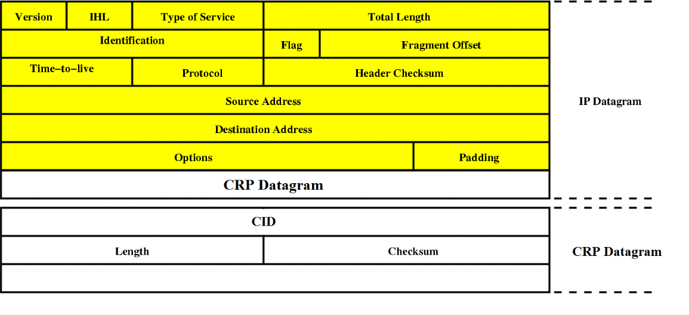
Content Request Protocol (CRP)

Slide 7
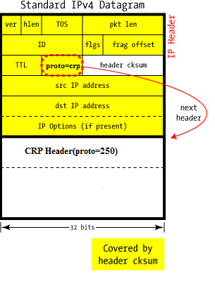
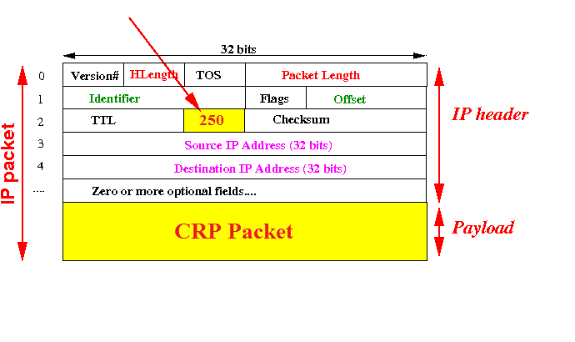
Content Request Protocol (CRP)

Slide 8
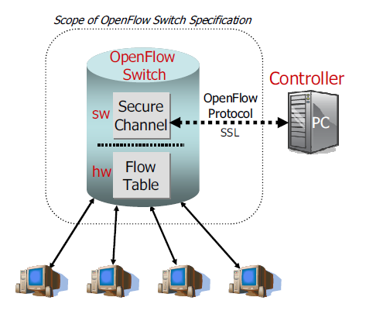
Software Defined Network(SDN)

Slide 9
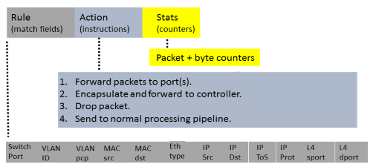
OpenFlow Protocol

Slide 10

Client ,Server and Cache

Slide 11
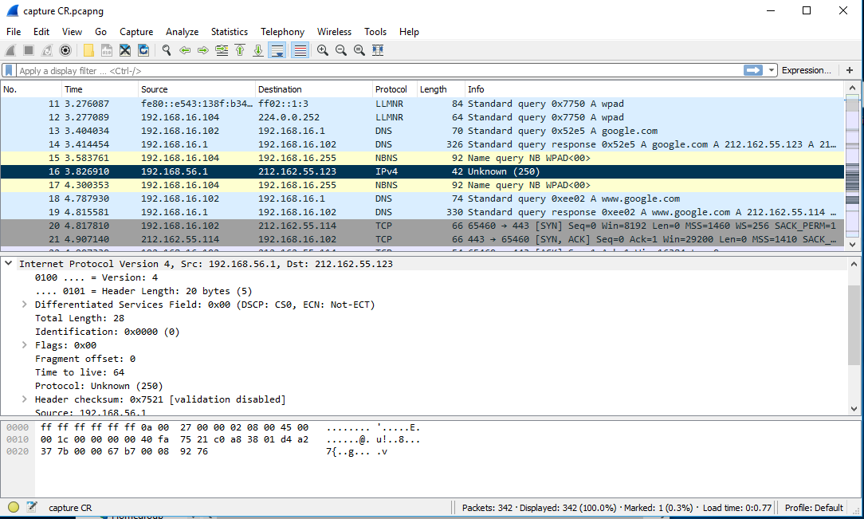
Wireshark

Slide 12
Wireshark

Slide 13
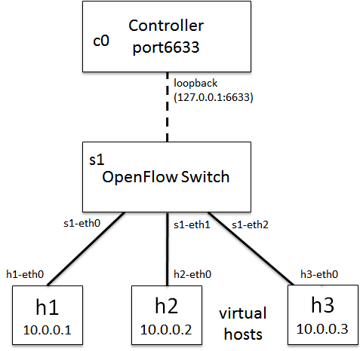
Controller –floodlight-

Slide 14
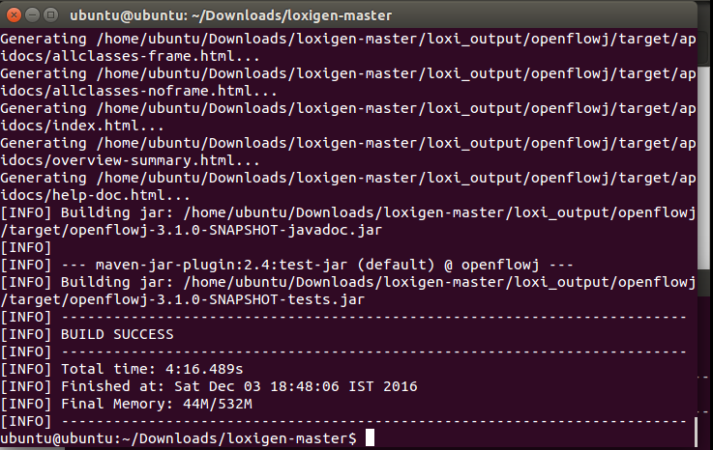
Add CRP to openflowj library

Slide 15
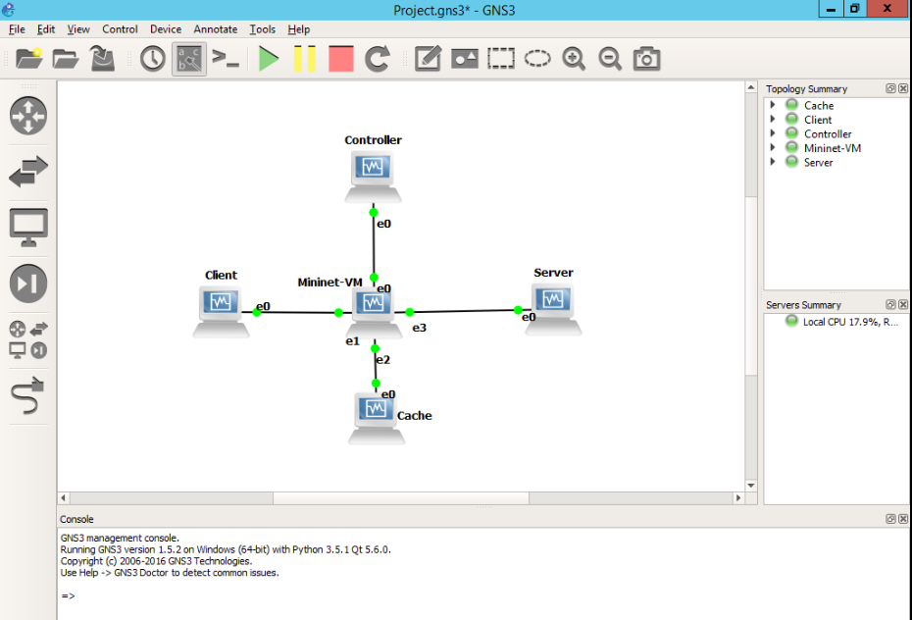
Testing on GNS3

Slide 16
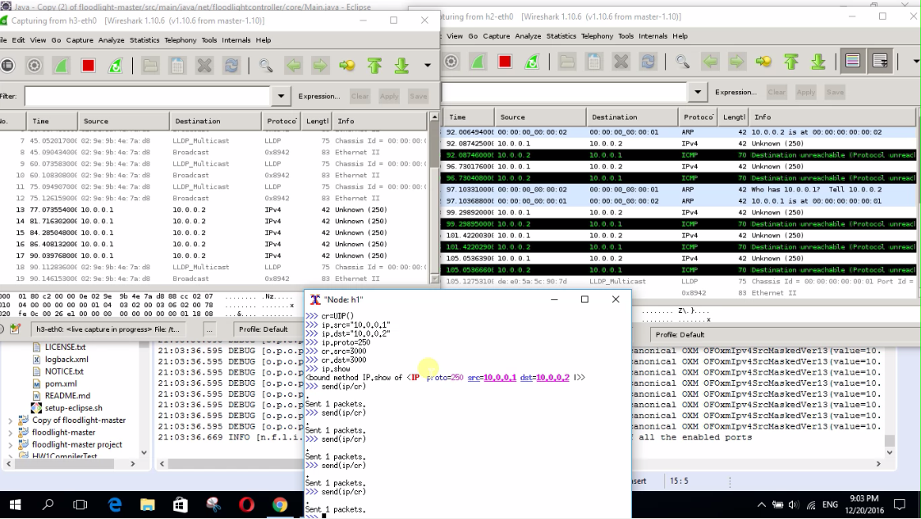
Testing using scapy

Slide 17
Conclusions
Software Defined Network
Named Data Network
Open Flow Protocol
Java Network and JNetPcap
Floodlight controller project
Mininet and a lot of tools

Slide 18
Future work….
we aspire to write a research paper for this caching design and improve our product to be used all over the world.

