Slide 1

Graduation Project 2
Structural Analysis and Design of Public health center
An-Najah National University
Faculty of Engineering
Civil Engineering Department
Supervisor: Dr. Munther Diab.
Prepared By:
Haya Omariah Sora Salman Farah Hamadoni

Slide 2
Outlines:
Vertical load analysis
Lateral load analysis
Dynamic design

Slide 3
materials
1. Reinforced concrete
Unit weight of reinforced concrete = 25 KN/m3.
Slabs , beams 24f’c
Columns 28 f’c
2. Reinforcement Steel:
Yielding strength (fy) = 420MPa.

Slide 4
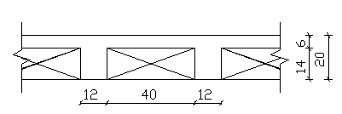
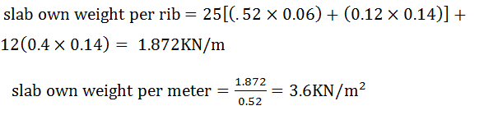
Load assumptions
Dead load

Slide 5
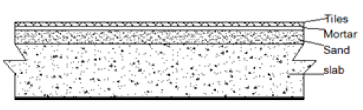
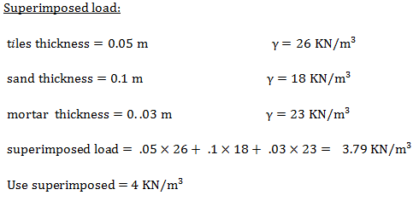
Super imposed load

Slide 6
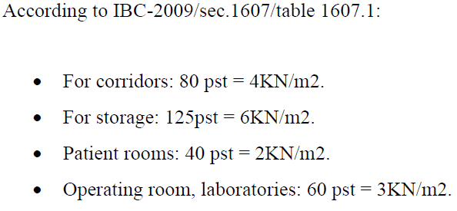
Live load

Slide 7
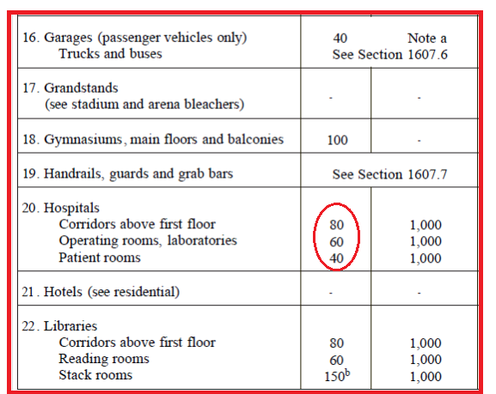
Live load

Slide 8
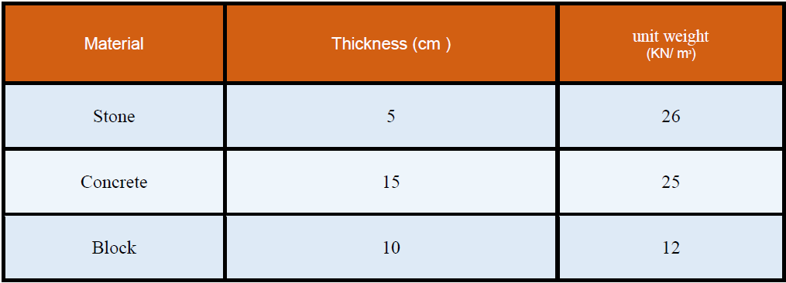
Weight of wall
The wall height = 3.64 m
Wall weight = wall height *Σ (thickness of layer * unit weight for each layer)
= (0.05) (26) + (0.15) (25) + (0.1) (12) =6.25 KN /m2 =3.64 *6.645 KN /m =22.75 KN/m

Slide 9
Modifiers
Slab Modifiers
Beams Modifiers
Column Modifiers

Slide 10
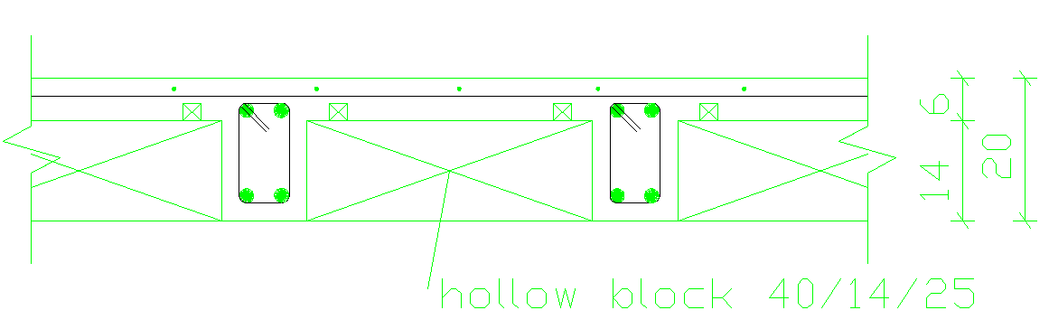
Slab Modifiers
To convert the ribbed slab into solid slab.
To make it one way instead of two way.

Slide 11

Slab Modifiers
Finding equivalent slab thickness
Determining the ratio of actual slab to existing (SAP)slab.

Slide 12
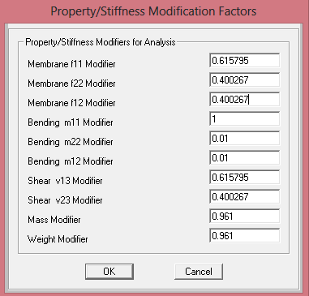
Slab Modifiers

Slide 13



Slab Modifiers
For example:

Slide 14
Beams Modifiers
Main Beams
Secondary Beams

Slide 15
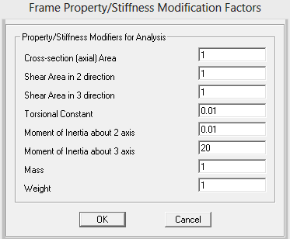
Main Beam Modifiers

Slide 16
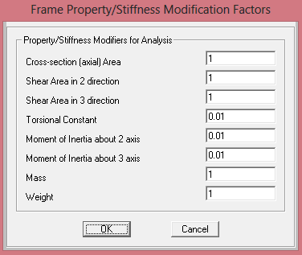
Secondary Beam Modifiers

Slide 17
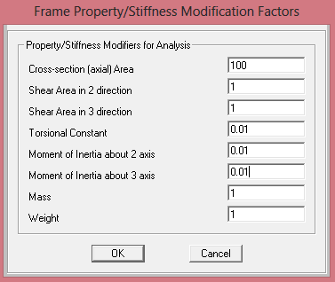
Column Modifiers

Slide 18
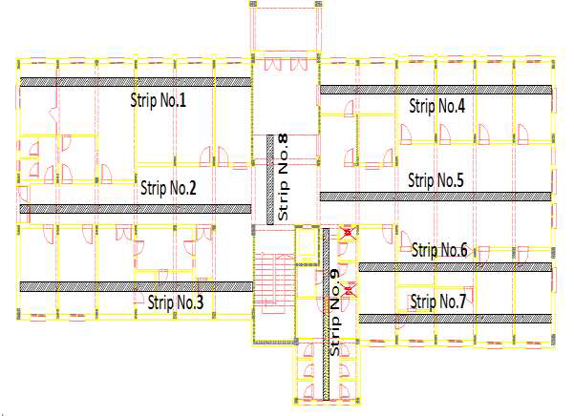
SLAB :

Slide 19
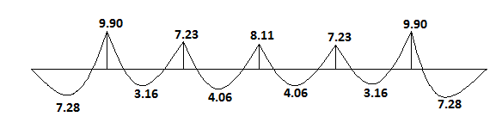
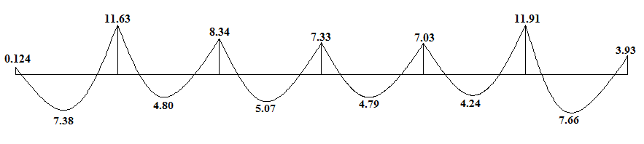
SLAB :
Strip NO.3:
The resulting moment (KN.m):
1D
3D

Slide 20
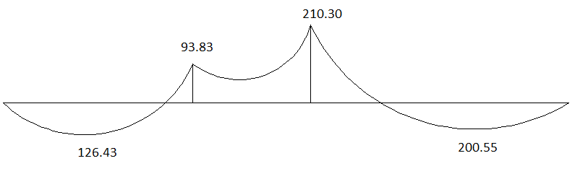
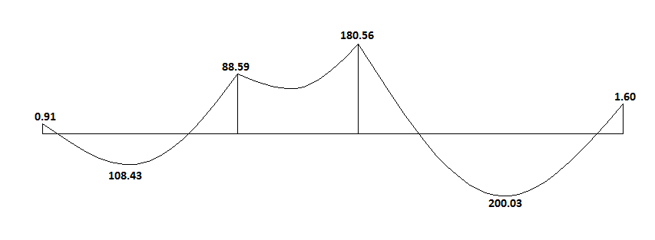
BEAM :
BEAM NO.1:
The resulting moment (KN.m):
1D
3D

Slide 21
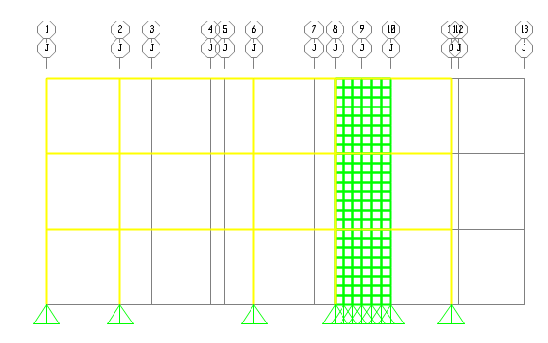
BEAM :
BEAM NO.6:

Slide 22
Dynamic Analysis
Introduction

Slide 23
Codes
IBC
UBC 97
Euro code

Slide 24
Dynamic Analysis Methods
Equivalent Static Method.
Response Spectrum Analysis (Modal Analysis).
Time History Analysis.

Slide 25
3D Model Modifiers
Slab Modifiers : to convert it to ribbed slab and one way slab
Beams Modifiers : to prevent replication , to reduce the mass.

Slide 26
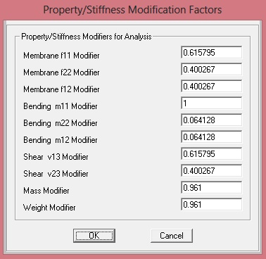
Slab Modifiers

Slide 27
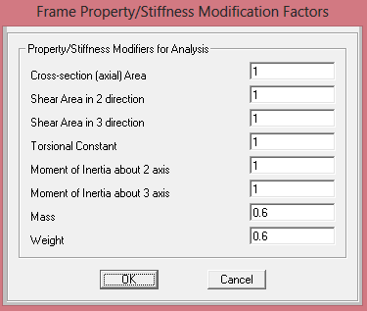
Main Beams Modifiers

Slide 28
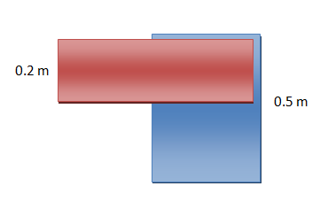
Main Beams Modifiers
For example:
Mass modifier for a beam = (0.5 – 0.2)/0.5 = 0.6

Slide 29
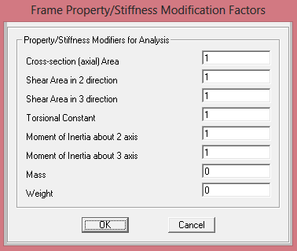
Secondary Beams Modifiers

Slide 30
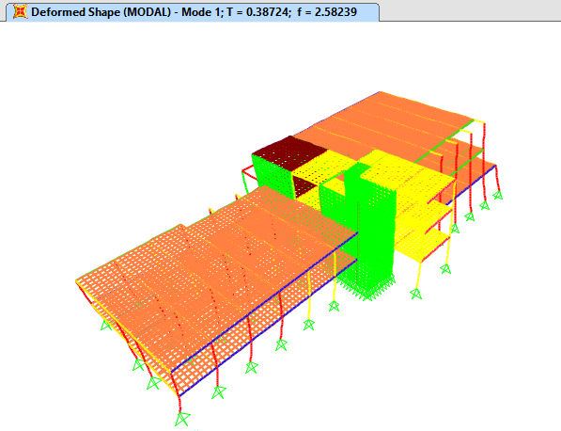
Period of 3D Model

Slide 31
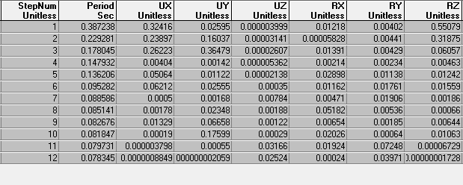
Modal Mass Participation Ratio

Slide 32
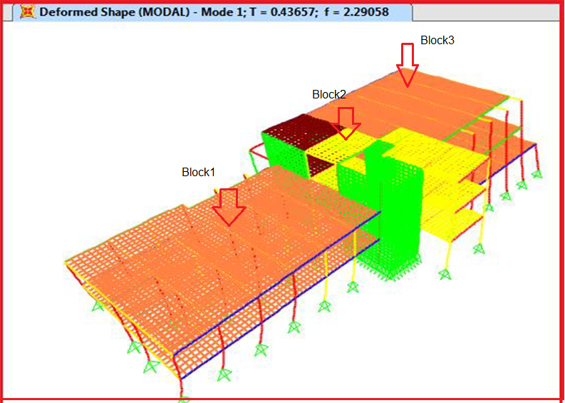
Equivalent lateral force method

Slide 33
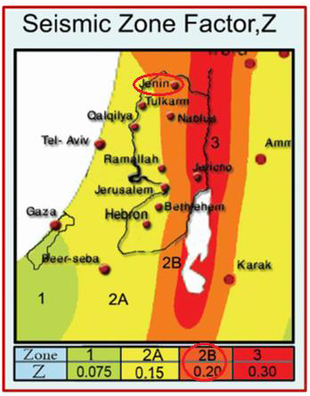
Steps to determine base shear
Determine Z:
Z = 0.20

Slide 34
2. Determine Ss and S1:
Ss =mapped 5% damped, spectral response acceleration parameter at 0.2sec.≈2.5Z = 2.5*0.2 = 0.5
S1 =mapped 5% damped, spectral response acceleration parameter at period of 1sec.≈1.25Z = 1.25*0.2 = 0.25

Slide 35
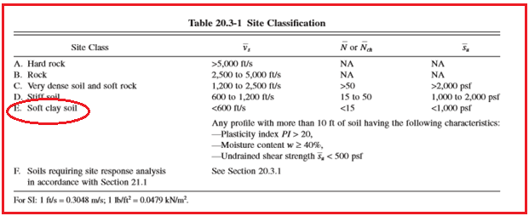
3. Determine Site Soil Classification: soft clay soil → Soil type E.

Slide 36
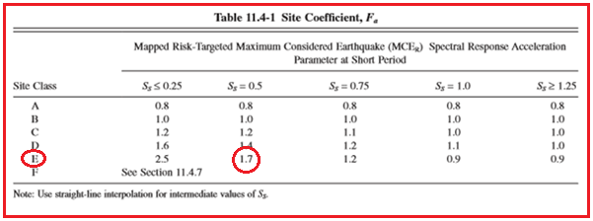
4. Determine Fa and Fv based on site Soil Classification

Slide 37
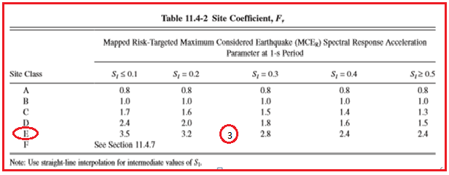
4. Determine Fa and Fv based on site Soil Classification

Slide 38
5. Determine SMs and SM1
SMs = the maximum considered earthquake spectral response accelerations for short period.
SMs = Fa *Ss = 1.7*0.5=0.85
SM1 = the maximum considered earthquake spectral response accelerations for 1- second period.
SM1 = Fv*S1 = 3*0.25 = 0.75

Slide 39
6. Calculate the design spectral response acceleration (SDS, SD1):
SDs , is the design ,5% damped,spectral response acceleration for 0.2sec period.
SDs = SMs = 0.85
SD1 , is the design ,5% damped,spectral response acceleration at aperiod of 1sec..
SDs = SM1 = 0.75

Slide 40
To be noted that values obtained from SAP are not the same as ours, and this is due to errors in SAP 16 programming, to overcome this problem, SAP values are been taken.
Fa= 0.9, Fv= 2.4
SMS = Fa × SS = 0.9×0.5 =0.45
SM1 = Fv × S1 =2.4 × 0.25 = 0.6
SDS = SMS =0.45
SD1 = SM1 =0.6

Slide 41
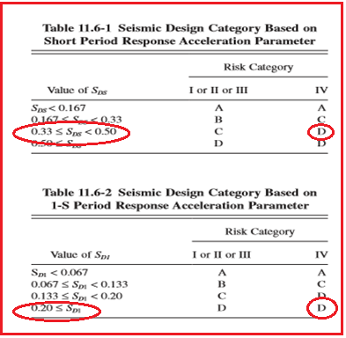
7. Determine the Seismic Design Category: Seismic design category is D.

Slide 42
Categories D (high seismicity): Ss and S1 should not be less than 1.5g and 0.6g (to be modified for 10%) respectively.
Ss and S1 less than 1.5g and 0.6g (to be modified for 10%) respectively, So use 1.5g and 0.6g
(2% probability of exceedance)
Ss = 1.5
S1 =0.6
SMS = Fa × SS = 0.9×1.5 = 1.35
SM1 = Fv × S1 =2.4 × 0.6 = 1.44

Slide 43
(To be modified for 10% probability of exceedance)
SDS =(2/3) × SMS = 0.9
SD1 =(2/3) × SM1 =0.96

Slide 44
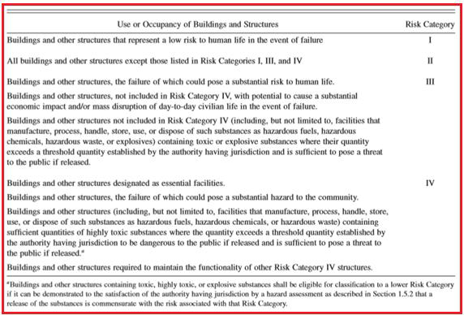
8. Determine risk category:

Slide 45
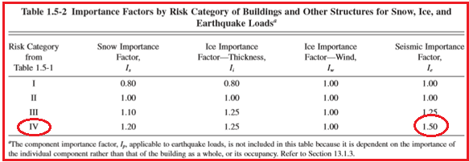
9. Importance Factor ( I )

Slide 46
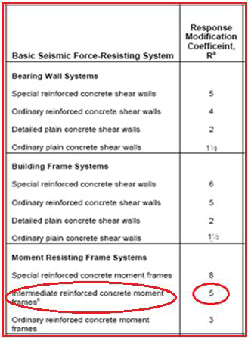
10. Determine response modification factor (R)

Slide 47
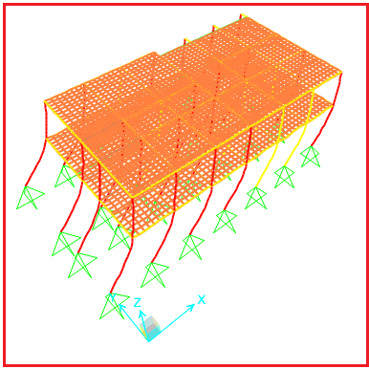
Block 1:

Slide 48
V= Cs*W
Cs =seismic response coefficient = SDs*I/R .
Cs = 0.9*1.5/5=0.27sec.
W = 8077.7365 KN.
V=0.27*8077.7365=2180.99 KN.

Slide 49
V | Fx | WΧ h_{n}^{K} | h_{n}^{K} | Weight | Story
1272.5 | 1272.5 | 24222.1 | 7.28 | 3327.2095 | 2
2180.95 | 908.45 | 17291.9 | 3.64 | 4750.527 | 1
 |  | SUM=41514

Slide 50
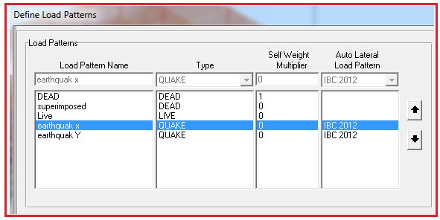
By SAP:

Slide 51
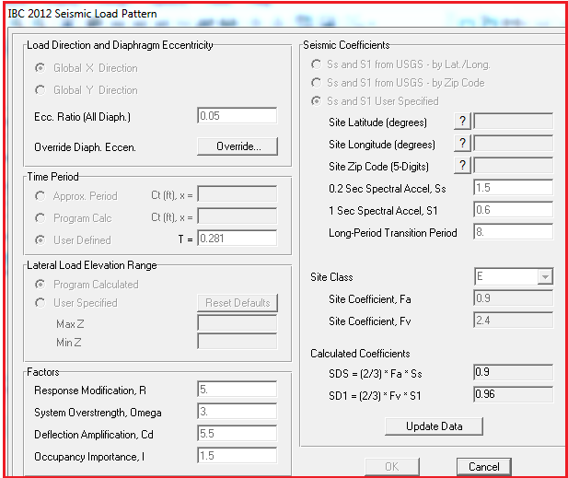
By SAP:

Slide 52
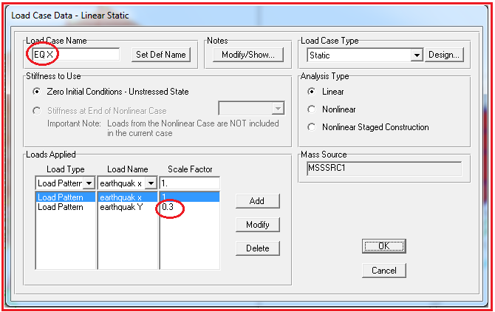
By SAP:

Slide 53
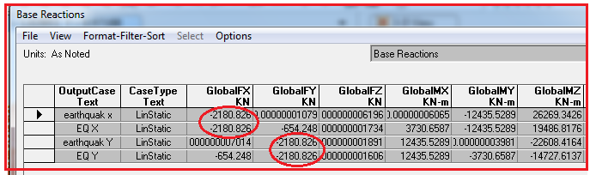
VSAP = 2180.826KN. Vnanual=2180.99KN.
%of differences = 0.0075%

Slide 54
% of differences | Base shear manual | Base shear(SAP) | Story
3 | 1272.5 | 1235.518 | 2nd floor
0.009 | 2180.95 | 2180.75 | 1st floor

Slide 55
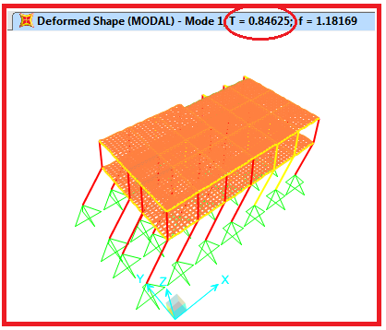
Period (T)Check:
TSAP =0.84625 seconds

Slide 56
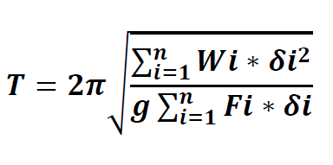
Rayleigh method
T=0.8497sec.
%of differences=0.4%

Slide 57
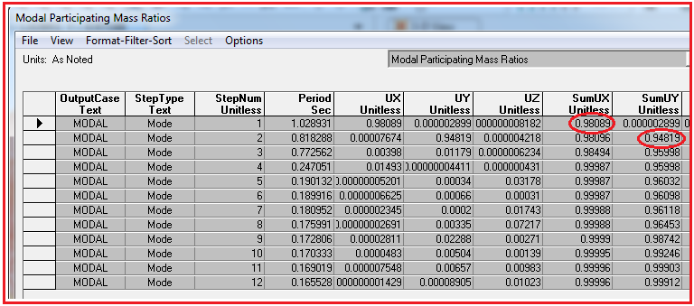
Modal mass participation ratio

Slide 58
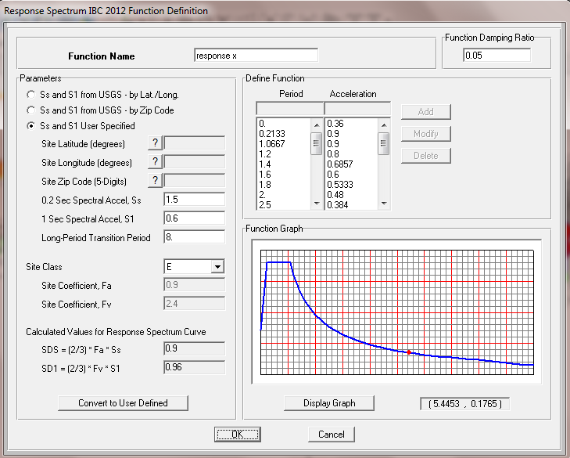
Response spectrum analysis method
Response spectrum function:

Slide 59
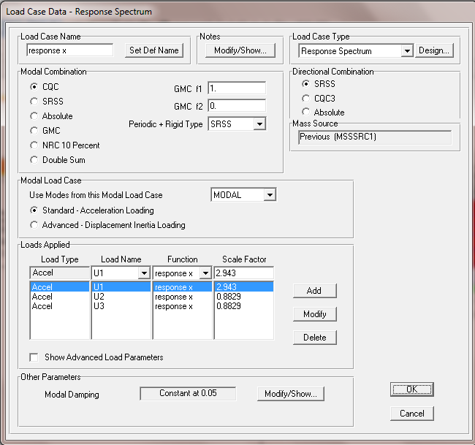

Response spectrum analysis method
Load cases :
Earth quake –x
* Scale factor= $\frac{gI}{R}$ =2.943 for U1

Slide 60
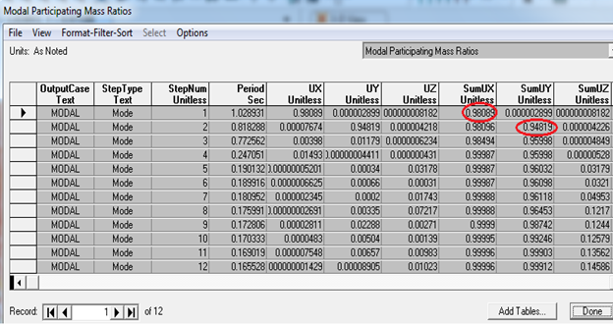
Response spectrum analysis method
Modal mass participating ratio

Slide 61
Response spectrum analysis method
More than 90% of modal mass participation ratio
For regular structure VRS ≥ 0.9 VSF
For irregular structure VRS ≥ VSF

Slide 62
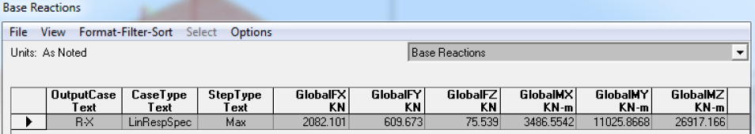
Response spectrum analysis method
Base shear from SAP = 2082.101 KN

Slide 63
Response spectrum analysis method
Story | Base shear (response spectrum) | Base shear (equivalent )
2nd floor | 924.585 | 1235.518
1st floor | 2082.1 | 2180.75

Slide 64
Dynamic Design

Slide 65
  Assumptions for Design:
Analysis and design are according to ACI-318-11.
IBC 2012 code for seismic loads (Using Equivalent lateral force method)
Loads are gravity and seismic loads.

Slide 66
  Clarification for the SAP default combinations
Load combinations :
combination 1 = 1.4D
combination 2 = 1.2D+1.6L
combination 3 = 1.2D+1L+1 eq-x
combination 4 = 1.2D+1L+1 eq-y
combination 5= 1.2D+1L-1 eq-x
combination 6 = 1.2D+1L-1 eq-y
combination 7 = 0.9D+1 eq-x
combination 8 = 0.9D+1 eq-y
combination 9 = 0.9D - 1 eq-x
combination 10 = 0.9D - 1 eq-y

Slide 67
    Structural Materials:
Concrete:
* Slabs and beams → fc` = 24 MPa
*Columns → fc` = 28 MPa
Steel (Rebar, shrinkage mesh and stirrups):
*Yielding strength (Fy) = 420 MPa

Slide 68
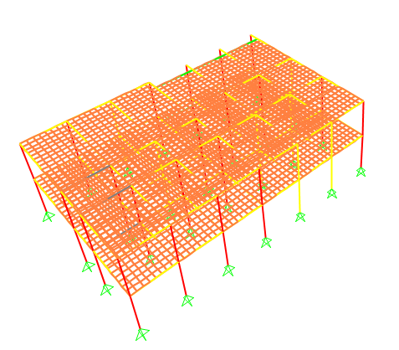
    3D Model :
    Block 1:

Slide 69
Slab modifiers
To convert it to ribbed slab
One way slab
Cracks
*Torsional constant: 0.35
*Moment of inertia about 2 axis: 0.35
*Moment of inertia about 3 axis: 0.35

Slide 70
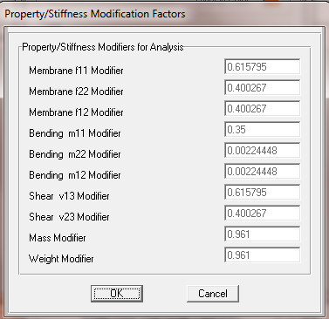
Slab modifiers

Slide 71
Beam and Column modifiers
Also, for beams and columns the modifiers are as follows:
Beams:
Torsional constant: 0.35
Moment of inertia about 2 axis: 0.35
Moment of inertia about 3 axis: 0.35
Columns:
Torsional constant: 0.7
Moment of inertia about 2 axis: 0.7
Moment of inertia about 3 axis: 0.7

Slide 72
Design of slabs
The structural system of the Public health center is one way ribbed
slab(20 cm) with drop beams.

Slide 73
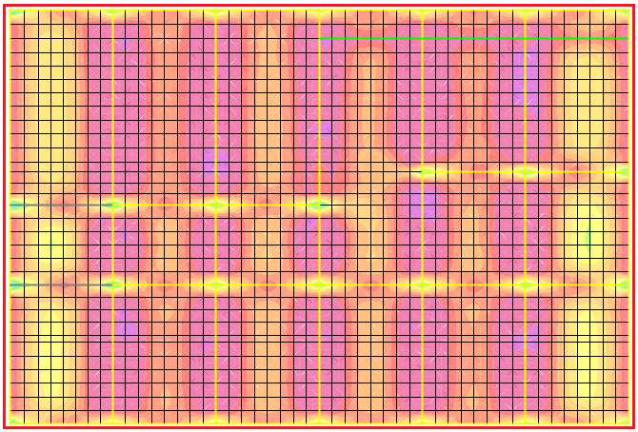
Design of slabs
Analysis and Design for flexure
The values of M11 for the first floor

Slide 74
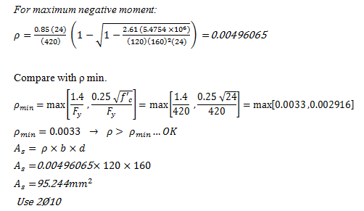
Design of slabs
Analysis and Design for flexure
Strip NO.1 :

Slide 75

Design of slabs
Analysis and Design for flexure
Strip NO.1 :

Slide 76

Design of slabs
Analysis and Design for flexure
Section in slab :

Slide 77

Design Beams for Flexure

Slide 78

Design Beams for Flexure

Slide 79


Design Beams for Flexure
For maximum negative moment.

Slide 80
Design Beams for Flexure
For maximum positive moment.
Compare with SAP results.

Slide 81

Design Beams for Flexure

Slide 82
Design Beams for Flexure
Now we can trust SAP results in flexure.

Slide 83

Design Beams for Shear
Frame 6 :
Vu is obtained from SAP = 210.212 kN.

Slide 84


Design Beams for Shear
Frame 6 :
compare with SAP results
SAP in Shear !!!

Slide 85
Design Requirement
Bottom steel at face of joint ≥ 1/3 top steel at face of joint.
Bottom or top steel at any section ≥ 1/5 top steel at face of joint .
Stirrups shall be computed based on shear force Vu and shall have a maximum spacing as shown in the figure .

Slide 86
Design Requirement

Slide 87

Design Requirement
where:
s₂ = d/2
d = effective depth of beam.
d_{s} = diameter of steel bar used for stirrup.
d_{b} = diameter of steel bar.
l_{d} = development length of steel bars in tension

Slide 88
Example : Frame 6
Frame No.6
Span No. | Location | Area of Steel (mm²) | No. of bars
Span No. 1 | Left End (Top) | 2064 | 7Ø20
 | Left End (Bottom) | 1328 | 7Ø16
 | Middle End (top) | 527 | 3Ø16
 | Middle End (Bottom) | 708 | 4Ø16
 | Right End (Top) | 1969 | 7Ø20
 | Right End (Bottom ) | 807 | 4Ø16

Slide 89
Example : Frame 6
Bottom steel at face of joint ≥ 1/3 top steel at face of joint.
As 1 = 2064
1/3 As 1 = 688
1328 > 688 … ok
As 2 = 1969
1/3 As 2 = 656.33
807 > 656.33 … ok

Slide 90
Example : Frame 6
Bottom or top steel at any section ≥ 1/5 top steel at face of joint .
1/5 As 1 = 412.8
1/5 As 2 = 393.8
527 and 705 are lager than 412.8 … ok

Slide 91



Example : Frame 6

Slide 92


Example : Frame 6
Determining the spacing

Slide 93



Example : Frame 6
Check max spacing

Slide 94
Example : Frame 6
S₁ = 100 mm for Ø12 and S₁ = 110 for larger diameters
use S₁ =100mm for both cases.
Use 1 Ø 10 @ 10 cm
S₂ = d/2 = 440/2 = 220 mm
Use 1Ø10 @ 22cm

Slide 95

Column design

Slide 96

Column design

Slide 97

Column design

Slide 98
LS =1.3Ld=1.3*765=994.5mm≈1m which is the distance of splicing.
Use 2Ø10/250mm stirrups in the middle of column.
Use 2Ø10/100mm stirrups in the ends of column (550)of height for each end).

Slide 99


