Slide 1


Establishing an Environmentally Friendly Waste Incinerator and Generating Electrical Energy in Nablus City
By
Sarah Shobash
Dalya Abadi
Rayan Tayeh
Reem Alawneh
Under Supervision of: Dr. Abdelhaleem Khader

Slide 2
OUTLINE
01
02
03
Introduction
SELECT LOCATION
INCINERATOR AND GAS TREATMENT
04
05
WASTE MANAGEMENT COST AND REVENUE
RESULTS AND DISCUSSION

Slide 3

INTRODUCTION
1. General background
2. Objective
3. Location
4. Study area
01

Slide 4


Project Idea
The idea of the project is to establish a municipal solid waste incinerator, so that it is environmentally friendly by purifying the smoke emitted from it through high-quality filters and economically beneficial through the use of incineration to generate energy. The energy was calculated in the form of electrical energy due to the deficit in electrical capacity in the city of Nablus.

Slide 5

Objectives
Choose the appropriate type of filters to treat the air from the combustion process.
Selecting the best location for a waste incinerator according to the criteria.
Calculate the cost of transporting the waste to the specified site.

Slide 6
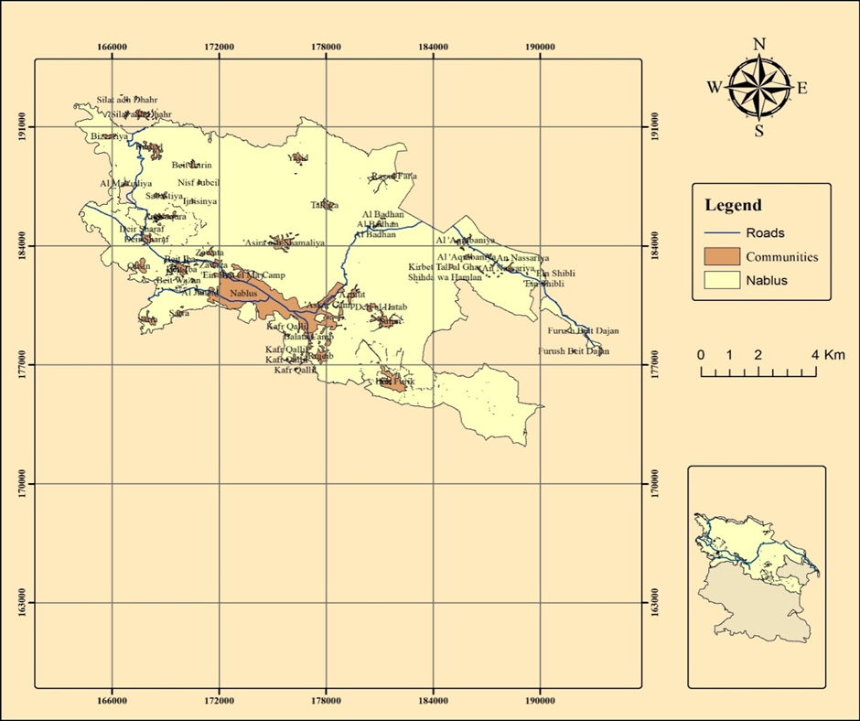
Study area
In this study, the city of Nablus and its northern boundary city, which consisted primarily of old historical regions like Al-Bathan, Sabastiya, and An Nassariya were discussed
Figure 1 Study Area

Slide 7
INCINERATOR AND GAS TREATMENT
1. Incinerator
2. Gas and fly ash treatment
02

Slide 8
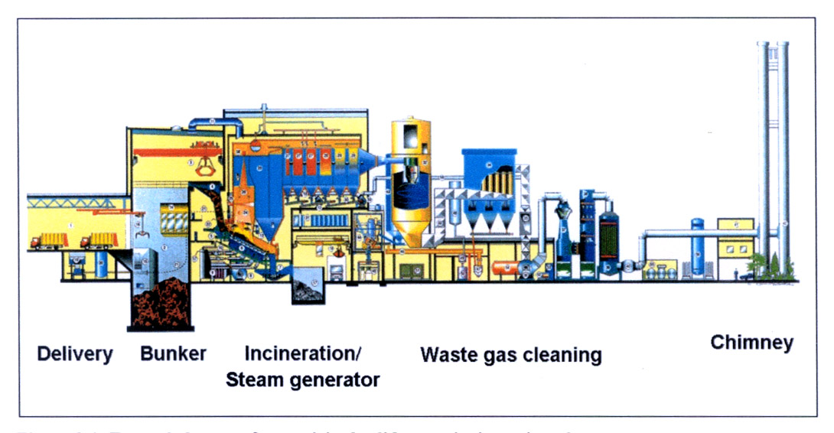
Incinerator

Slide 9

Gas treatment
Environmental Emissions from Incineration of MSW
Final Product | Percentage (%)
Flying Ash | 1-3
Settled Ash | 25-42
Dry Acid Gas | 2-5
Semi Dry Acid Gas | 1.5-4

Slide 10
Gas treatment
Environmental Emissions from Incineration of MSW
WTE process | Gaseous effluent | Mass percentage
Incineration | CO₂ | 7.31 wt%
 | NO_{x} | 0.134wt%
 | SO₂ | 0.0335 wt%
 | HCL | 0.00672 wt%
 | CO | 0.0336 wt%
 | Dioxins and furans | 0.0672 wt%

Slide 11
- Dust removal techniques (fine suspended particles)
Dust removal from flue gases is necessary for all processes in a waste incineration furnace. Electrostatic precipitators and fabric filters have been shown to be effective as trapping techniques for fine particulate matter in incinerator flue gases.
In order to more efficiently remove mercury from the flue gas, electrostatic precipitators and fabric filters are used in combination with other technologies.

Slide 12
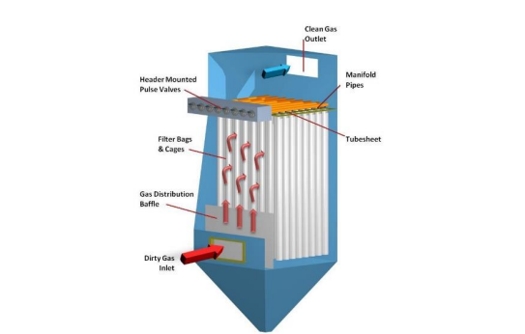
Fabric Filters
The advantages of this type of filters
High efficiencies – even for very small particles.
Operate over a wide range of flow rates.
Low costs.
The disadvantages of this type of filters
Fabrics can be harmed by excessive temperatures.
The particles must be dry.
The possibility of a fire. Therefore, suitable materials must be chosen according to the expected conditions
Figure 9 Fabric Filters

Slide 13
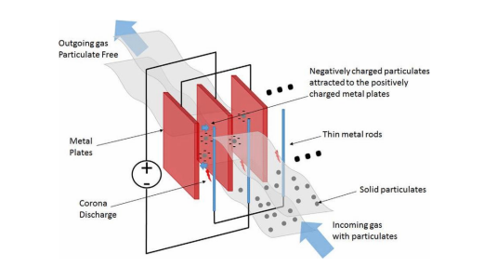
Electrostatic Precipitators
Advantages
Able to achieve very high efficiency.
Low operating costs.
durable, long service life.
Low maintenance costs.
Disadvantages
Sensitive to dust resistivity
changes in dust conditions can drastically affect performance.
Difficulty anchoring it.
Figure 10 How the Electrostatic Precipitators work

Slide 14
This ash can be reused in construction and road construction materials after pretreatment.
The use of ash and mixed waste incineration residues for construction purposes poses potential environmental risks due to heavy metal contamination .
Bottom ash or fly ash from waste incinerators should never be used as a soil conditioner in agricultural or similar applications if the mercury concentration in the ash exceeds levels of concern because adding ash to the soil may harm it.
On the other hand, there are advantages to using this ash in construction work, as the price of ash is 30% less than the price of sand used in construction, and the use of this ash in the brick industry has several advantages, including that it reduces the weight of the bricks and that these bricks are fire-resistant.
Use of ash from waste incineration:

Slide 15
Location
One of the important measures to ensuring the proper establishment of such a plant is the site selection of municipal solid waste incineration power plants. Site selection for a particular activity typically involves a suitability review that requires a variety of criteria depending on the type of activity.
In general, the key purpose of the suitability evaluation is to define the best location for suitable land use by classifying different parts of the area under evaluation according to their suitability for a given criteria

Slide 16

03
SELECT LOCATION
1. Identifying sitting criteria
2. Data preparation
3. Giving Weight for each criteria
4. Determine the suitable site using GIS
5. select the best site

Slide 17

Sitting criteria
sitting criteria
Criteria | Description
Topography | The study area has a flat topography (horizontal slope) and the contour surfaces are very less( slope are neglected).
Soil Type | Site has a clay zone which is one of the best sites for landfill sitting because clay can prevent leach ate problems
Land sensitivity | Not to be located in nature reserves
Archeology and heritage value | Not to be located in areas identified as archaeological sites.
Ownership | Preferred to be owned by the LGU or to be governmental land.
Land use | Land with no or low agricultural and commercial value Distance to sensitive land uses (e.g., residential, educational services, medical services, etc.)The more distant sites are better to avoid noise, odor. And other annoying factors.
Accessibility | Accessibility to site is available or planned and there be an Electrical network
Future expansion | Site has extra space to accommodate future expansion of the plant
Proximity to surrounding houses and service facilities | Site to be away from residential houses by at least 500 m
Social acceptance | This needs proper measures to reach the citizens; public consultation, awareness raising, and outreach campaigns.

Slide 18
Data preparation
This step involves representing each assessment criterion spatially in a GIS layer.
Giving Weight for each criteria

Slide 19
These are the finalized weights for the criteria and the weights overall sum should be equal to one.
The poll criteria weight and final criteria weighted
Criteria | Avg. weighted%
Topography | 9.3
Soil type | 10.7
Land sensitivity | 10
Dumping site | 13.3
Ownership | 5.7
Land use | 11.7
Accessibility | 7.7
Future expansion | 5
Proximity to surrounding houses and service facilities | 10
Social acceptance | 16.6
Sum | 100

Slide 20
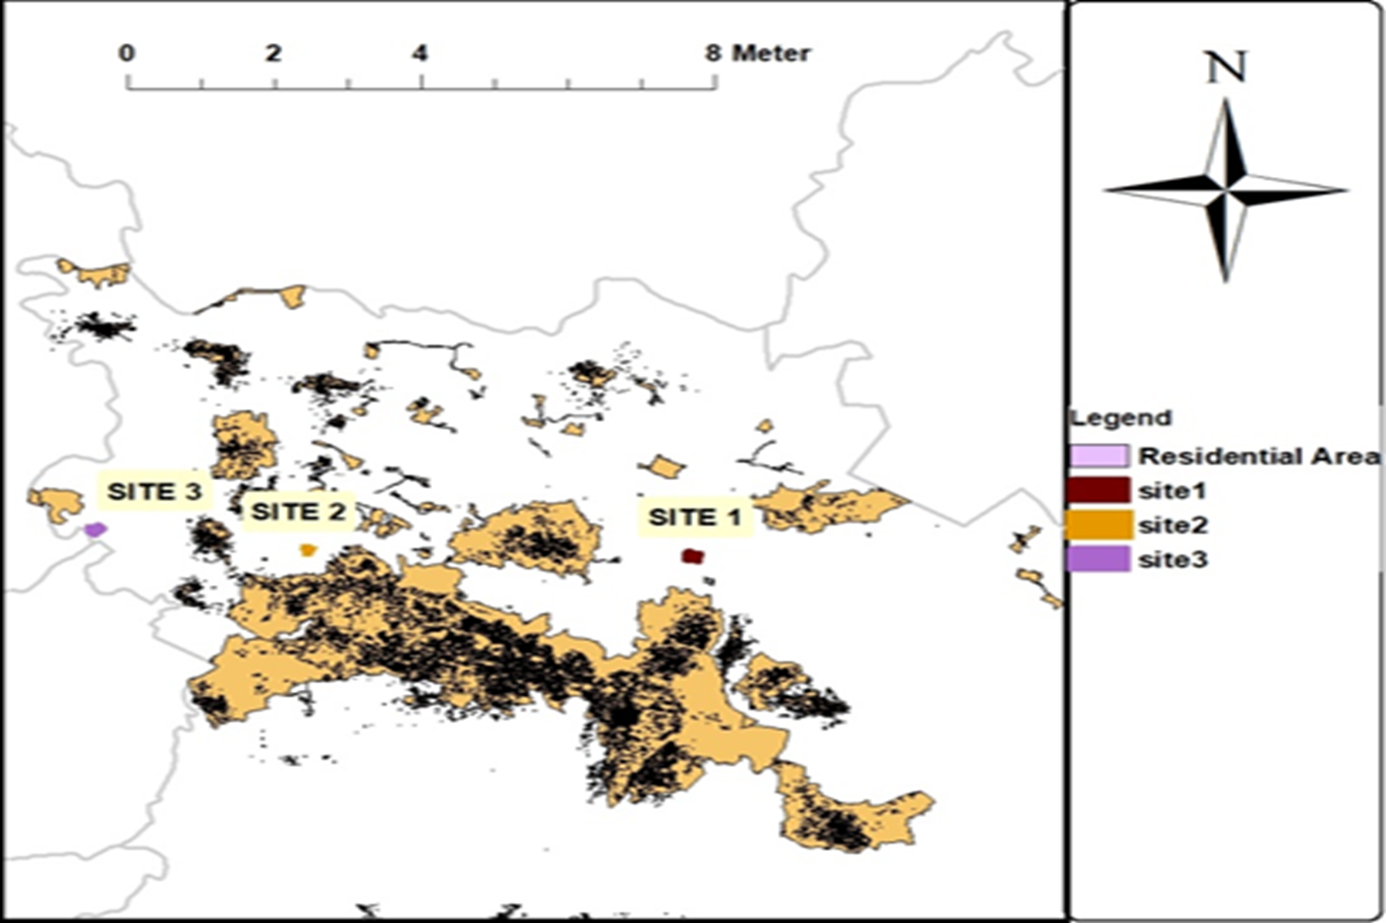
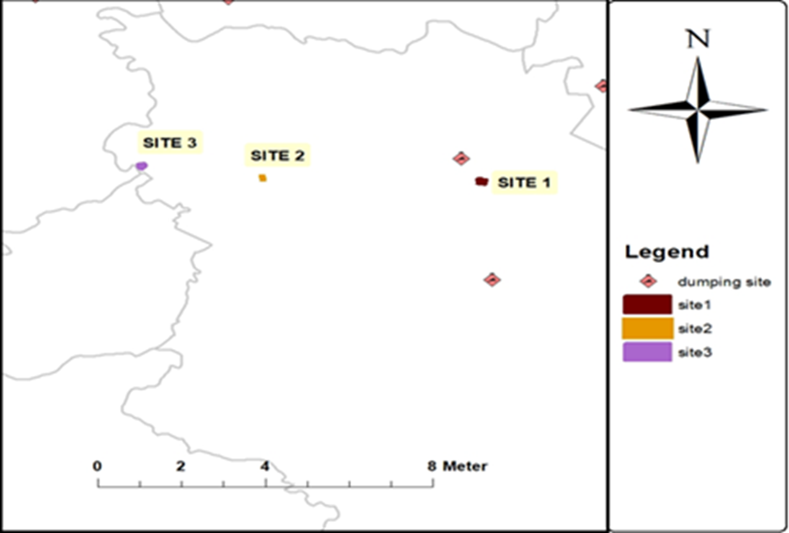
Determine the suitable site using GIS
Residential area
Dumping site
Figure 3 Building Area concentration area in Nablus Government.
Figure 2 Dumping site

Slide 21
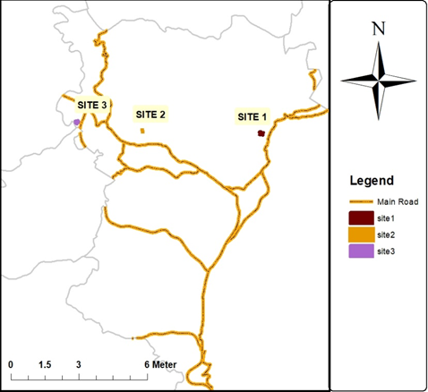
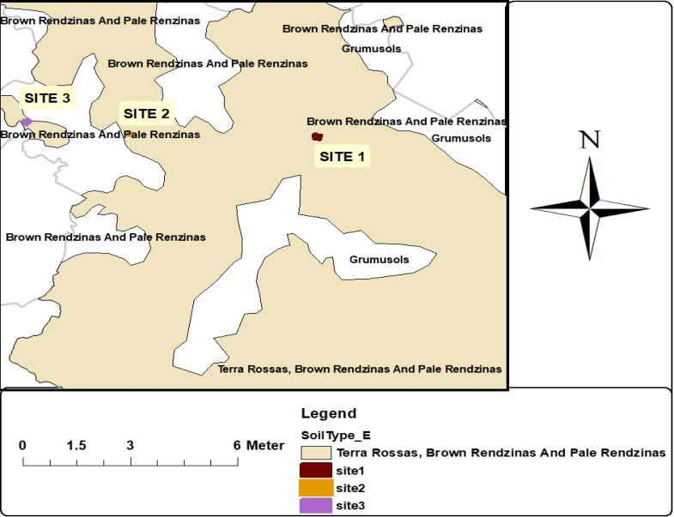
Accessibility
Soil Type
Figure 3 Road Network distribution
Figure 4 Soil type

Slide 22
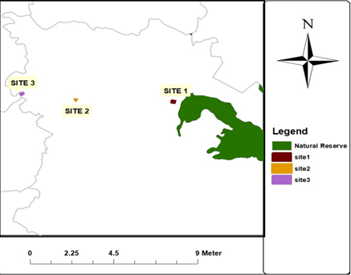
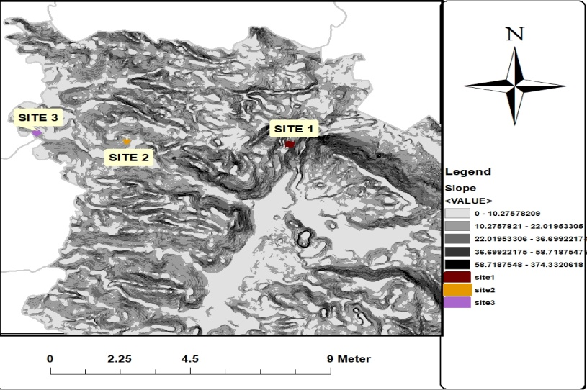
Natural Reserve
Slope
Figure 5 Natural Reserve Location
Figure 6 Slope

Slide 23
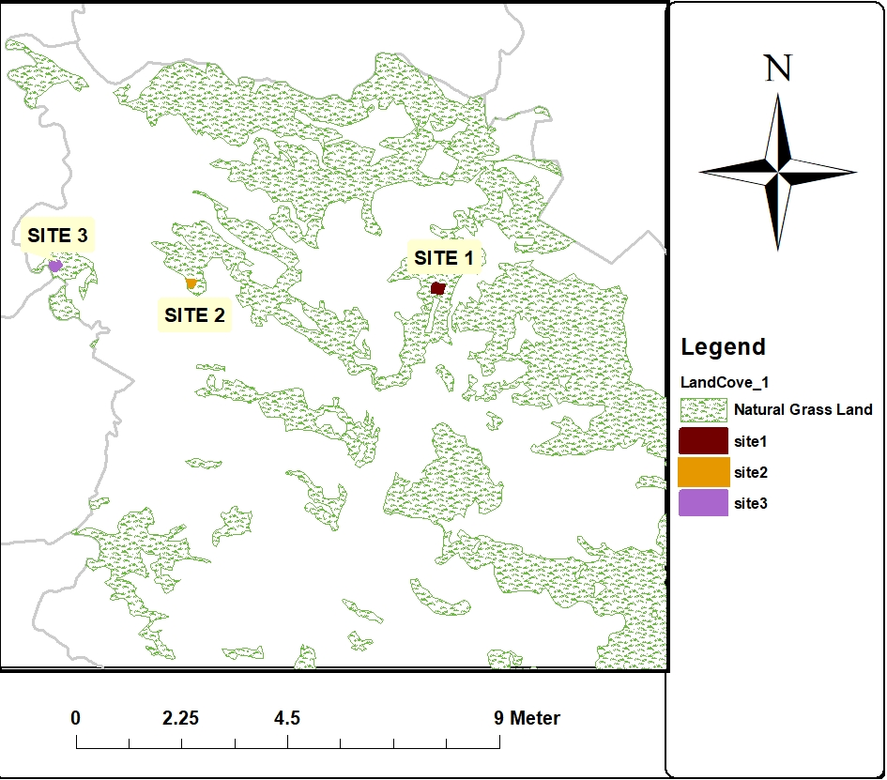
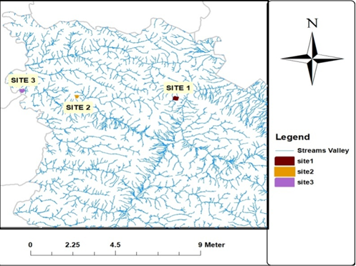
Land use distribution
Streams
Figure 7 land use distribution
Figure 8 Streams Network

Slide 24
select the best site
Criteria | Site1 | Site2 | Site3
Topography(slope %) | 17 | 8 | 10
Soil type | Clay | Clay | Clay
Land sensitivity (natural reserves) | Ok | Ok | Ok
Dumping site (km) | 1.422 | 7.68 | 12.2
Ownership | Ok | Ok | Ok
Land use | Natural Grass Land | Natural Grass Land | Natural Grass Land
Accessibility (km) | 0.593 | 0.381 | 0.235
Future expansion | Ok | Ok | Ok
Proximity to surrounding houses and service facilities (km) | 2.3 | 1 | 2.4
Social acceptance | Ok | Ok | Ok

Slide 25
The weights and the criteria values
Criteria | Site1 | Site2 | Site3 | Criteria weighted%
Topography(slope) | 8/17=0.47 | 8/8=1 | 8/10=0.8 | 9.3
Soil type | 1 | 1 | 1 | 10.7
Land sensitivity (natural reserves) | 1 | 1 | 1 | 10
Dumping site (km) | 1.422/1.422=1 | 1.422/7.68=0.185 | 1.422/12.2=0.12 | 13.3
Ownership | 1 | 1 | 1 | 5.7
Land use | 1 | 1 | 1 | 11.7
Accessibility (km) | 0.235/0.593=0.39 | 0.235/0.381=0.62 | 0.235/0.235=1 | 7.7
Future expansion | 1 | 1 | 1 | 5
Proximity to surrounding houses and service facilities (km) | 2.3/2.4=0.96 | 1/2.4=0.42 | 2.4/2.4=1 | 10
Social acceptance | 1 | 1 | 1 | 16.6
site 1 is selected as the best alternative. (Based on the high value)

Slide 26
WASTE MANAGEMENT COST AND REVENUE
04
1. Calculating the costs of waste disposal in Nablus.
2. Calculation of energy generated from waste incineration.

Slide 27
Calculating the costs of waste disposal in Nablus
Calculating the amount of waste in study area
 | Population | Average number of individuals per household | Average daily household production (Kg) | The amount of waste (ton\day)
Study Area | 264,075 | 4.9 | 3.2 | 172.457
As a result of saving in transportation cost, the cost of MSW management will be 32dollar/ton.

Slide 28
The table shows the calculation of the total cost of MSW management.
Total cost of MSW management
Cost of MSW ($/ton) | The amount of waste (ton/year) | Total cost of MSW management ($/year)
23.6 | 63000 | 1,486,800

Slide 29
The costs of operating solid waste incineration plant are divided into two sections:
Filters operating costs, two type of filters were used in project.
Operating costs of Electrostatic Precipitators equal to 1.6 (Million Euro\Year).
Operating costs of fabric filters equal to 2.2 (Million Euro\Year).
As a result, the total of Filters operating costs in the incantation plant will be according to amount of solid waste calculated
( 63000ton\year ) is shown in table below.
The total cost of Filters operating costs
Electrostatic Precipitators Operating costs (million $\year) | fabric filters Operating costs (million $\year) | Filters operating costs (million $\year)
0.59 | 0.84 | 1.43

Slide 30
there is another operating cost which represents the costs of labor, drivers, maintenance of equipment and diesel fuel related to municipal solid waste collection, operating and maintenance cost can be estimated by the following formula:
→$A=0.0744∗C^{0.8594}$
The total costs of operating MSW
Filters operating costs (million $/year) | Another operating costs (million$/year) | The total costs of operating MSW (million $/year)
1.43 | 0.0157 | 1.45

Slide 31
The resulting ash is estimated from 5% - 15% of the total amount of waste, so 10% assumed as a percentage of ash amount.
Then fly ash and bottom ash were be ( 10% * 63000 = 6300 ton).
Fly ash assumed that could use in construction work so could sell (2/3 from fly ash amount and the remaining will disposal in Zahrat Al Finjan.
Fly ash price is less than the price of sand amount 30%, where the price of sand per ton approximately amounts 16.8 NIS (5.208$).
Revenues from fly ash price = ( 23 * 6300 * 5.208 * 70%) = 15311.52$ revenue\year.
14.5$\ton for transport and 8.5$\ton for disposal were had to transport the remaining fly ash
The total fund expended from transporting remaining fly ash = 13 * 6300 * (14.5 + 8.5) = 48300$expender\year.
Revenue and expended fund from fly ash
Total revenue price from fly ash ($/year) | Total fund expended from transporting fly ash ($/year)
15311.52 | 48300

Slide 32
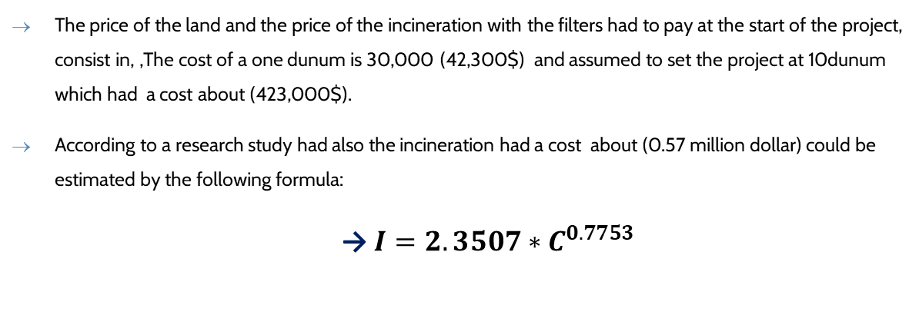
The price of the land and the price of the incineration with the filters had to pay at the start of the project, consist in, ,The cost of a one dunum is 30,000 (42,300$) and assumed to set the project at 10dunum which had a cost about (423,000$).
According to a research study had also the incineration had a cost about (0.57 million dollar) could be estimated by the following formula:
→$I=2.3507∗C^{0.7753}$
As a result, the cost had to pay at years of project life shown in the table below:
The cost we have to pay once at the start of project.
The cost of a 10 dunum ($) | The cost of incinerations (million $) | The total costs (million $)
423,000 | 0.75 | 1.173

Slide 33
Calculation of energy generated from waste incineration
According to a research study one ton of waste produces 465 kilowatt hours of electricity
The price of electricity that the Palestinian Authority pays to the IEC Electricity Company, which is estimated at 0.17236 $/kWh
As a result, revenue from electricity = 465 kWh\ton * 36000ton\year * 0.17236 $\kWh = 5049286.2$\ year.
Calculating the amount and price of energy generated from burning solid waste
Amount of electricity produced by waste (kWh\ton) | The amount of waste (ton\year) | The price of electricity ($\kWh) | Revenue from electricity ($ \ year)
465 | 36000 | 0.17236 | 5049286.2

Slide 34
05
RESULTS AND DISCUSSION

Slide 35
A much more accurate site suitability study revealed that a site in the city's northeast, at Asserah Alshamaleah, south of Wadi Al Badhan, covering an area of around 87 Km², used only 10 dunum from the area, was considered to be the best location for the incinerator power plant.
As conclusion had a cost from project which summary in table below:
The total cost of the project every year
Cost from | Value (million $/year)
MSW management cost | 1.4868
total costs of operating MSW | 1.45
Total fund expended from transporting fly ash. | 0.0483
Total | 2.985

Slide 36
The revenue from selling the fly ash and producing the electricity summarized as shown in the table below:
So, the revenue in coming years will be 2.0789 million $/year and the costs of price of land and incinerator equal to 1.173 million $ and usually paid over first five years.
Total revenue of project every year
Total revenue price from fly ash (million $/year) | 0.0153
Revenue from electricity (million $ \ year) | 5.049
Total | 5.064

Slide 37

The End
Thank You

