Slide 1

Wasel Website

Slide 2
Why Wasel ?
The Legacy

Slide 3
Before Wasel
This faculty suffers from three problems:
Inefficient halls reserving.
Booking exam supervisors problems.
Manual official correspondences.

Slide 4
Development Tools
The selection of tools was based on our experience in web application development, which are:
Front-end:
  Basic HTML and CSS
  JavaScript
Back-end:
  PHP
Database:
  MySQL

Slide 5
Development Tools
In our seek to make this project reaches the heights in both design and functionalities, we used the following tools :
JQuery: to add well designed features from open source libraries.
JavaFX libraries: as a helping hand from collecting and organizing data from Zajel website.

Slide 6
Halls Reservation
The core idea is to choose the date that you wants to book your reservation in, either for exams or activities. After that you will get a variety of searching tools. They could be summarized into:
Choosing the hall number or description of the halls you wants to lookup.
Choosing the time of the booking which will enable the choice of multiple available halls at selected time.
Going ahead without choosing the time which will give you a list of halls, after choosing one it will present you with the hall visual schedule.

Slide 7
Halls Reservation
If the reservation was for exam you will need to specify the following:
Course name and number.
Type of exam.
Chooses who will book the supervisors.

Slide 8
Halls Reservation
The reservation could be done by three users:
Administrative user: allowed to reserve, lookup and edit any hall reservation.
Deanship user: same authorities as administrator.
Head Department: allowed to reserve, lookup and edit only his reservations.

Slide 9
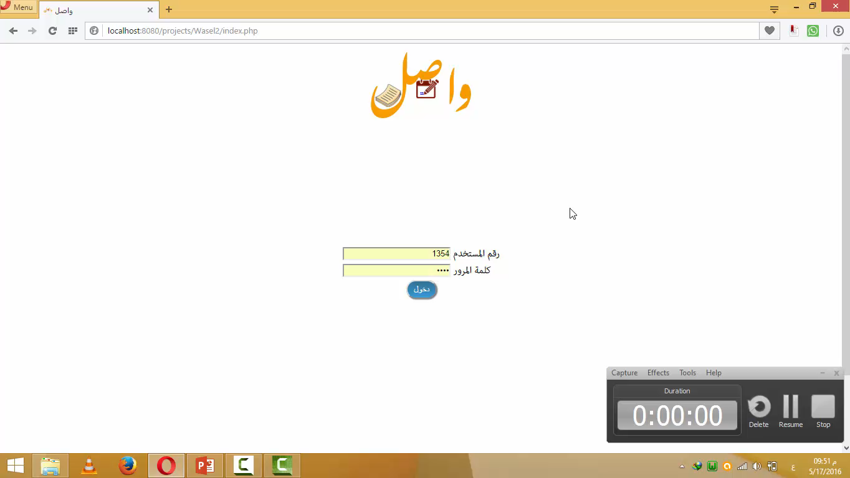

Slide 10
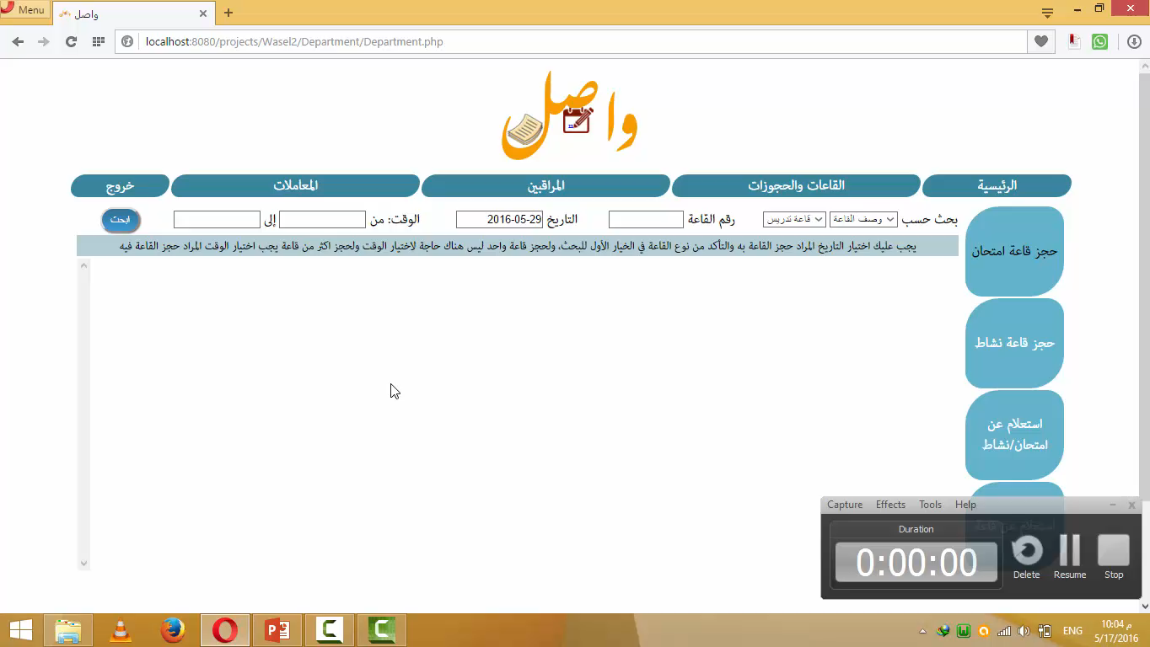

Slide 11
Booking Exam Supervisors
There are three scenarios:
The booking request was by deanship, then the deanship will get the request.
The booking request was done by the user himself, then he must go and book them.
The booking request was not directed to anyone, then the user book them outside of Wasel.

Slide 12
Booking Exam Supervisors
There are two ways for booking:
Manually: he will be presented with searching tool that gives him a list of the available instructors in the specified time and date that he can choose from.
Automatically: the system will book them depending on the number of the requested supervisor, the selection will start with the available instructors in the same department of the exam if they are not enough the system will go and seek from another department, all these choices depends on the priority and the number of times this user have been booked.

Slide 13
Booking Exam Supervisors
Each supervisor will be notified in the user home page and by an email from the system.
The process of accepting and denying will be shown in this.

Slide 14
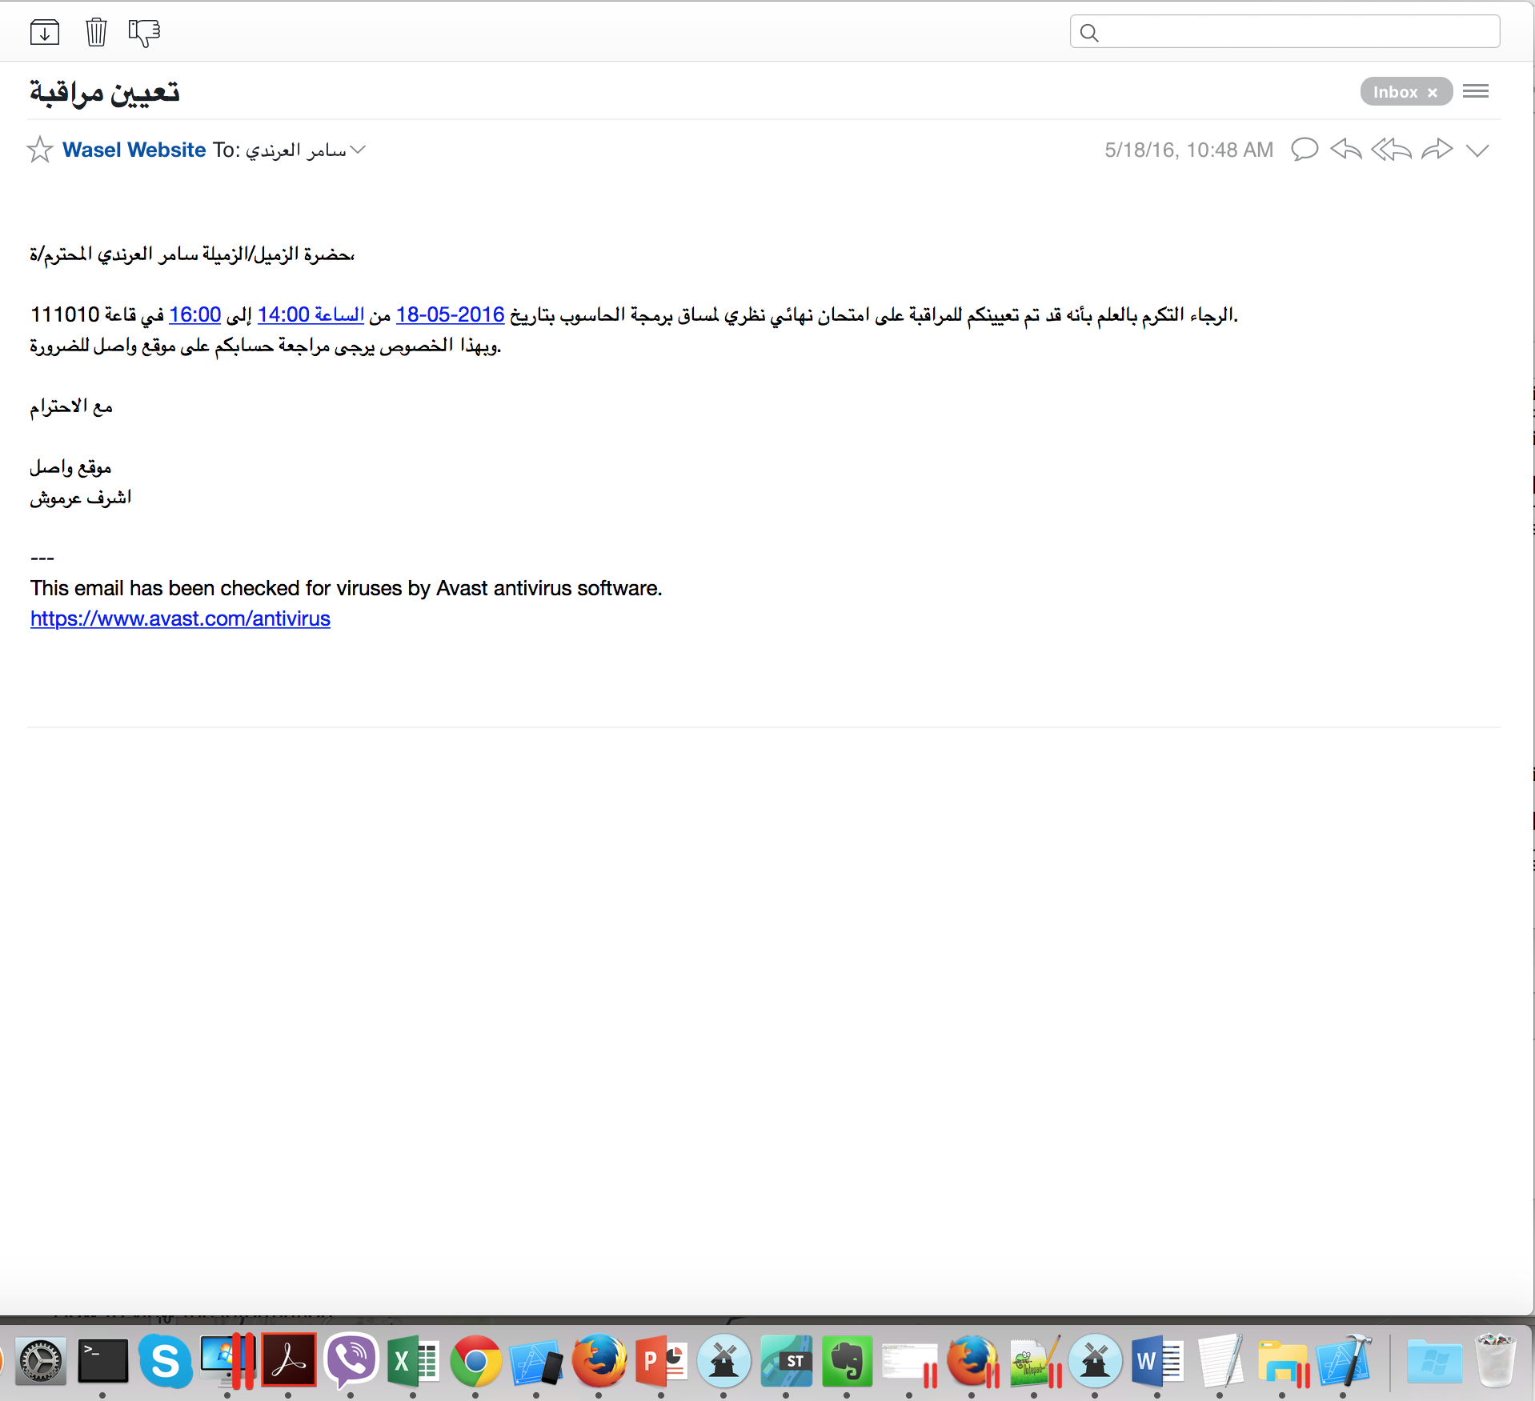

Slide 15
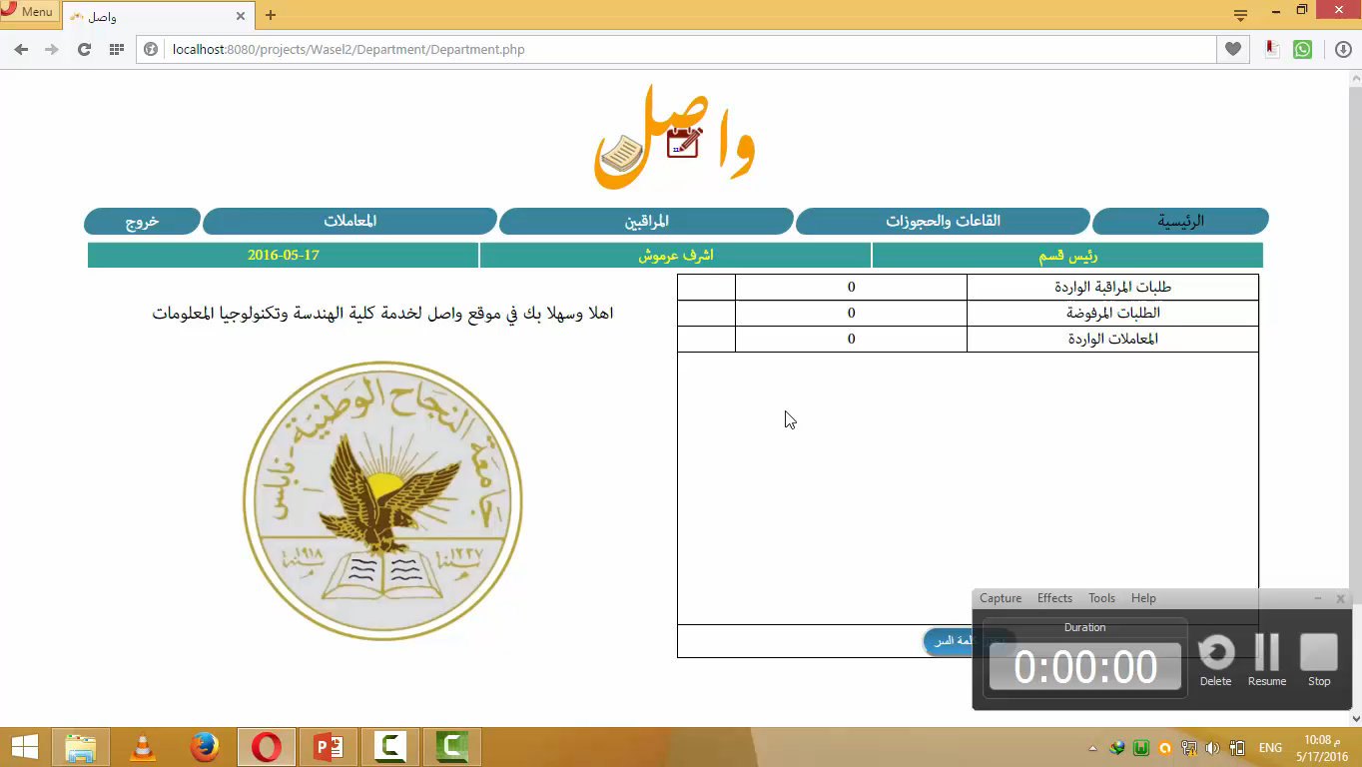

Slide 16
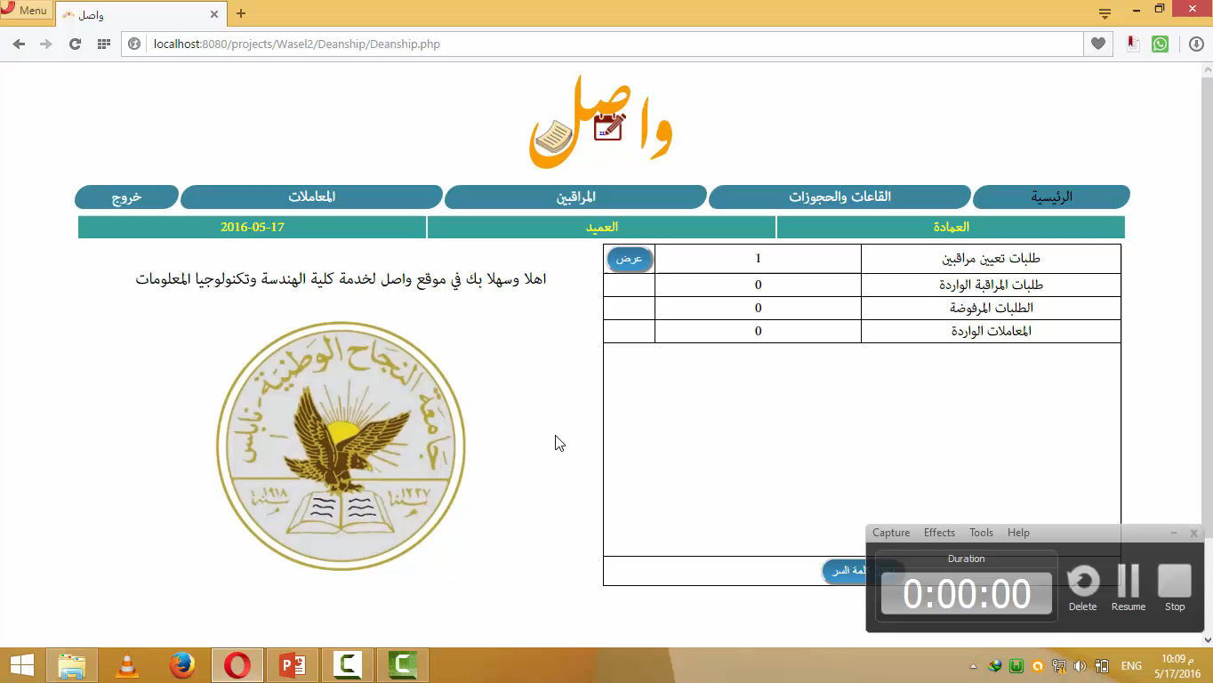

Slide 17
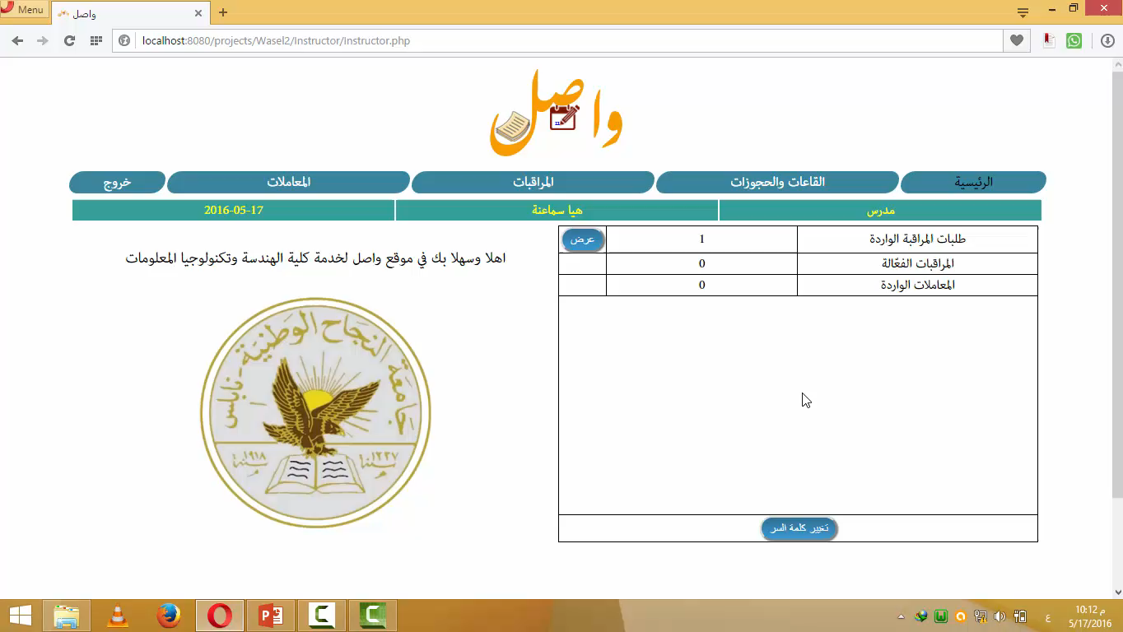

Slide 18
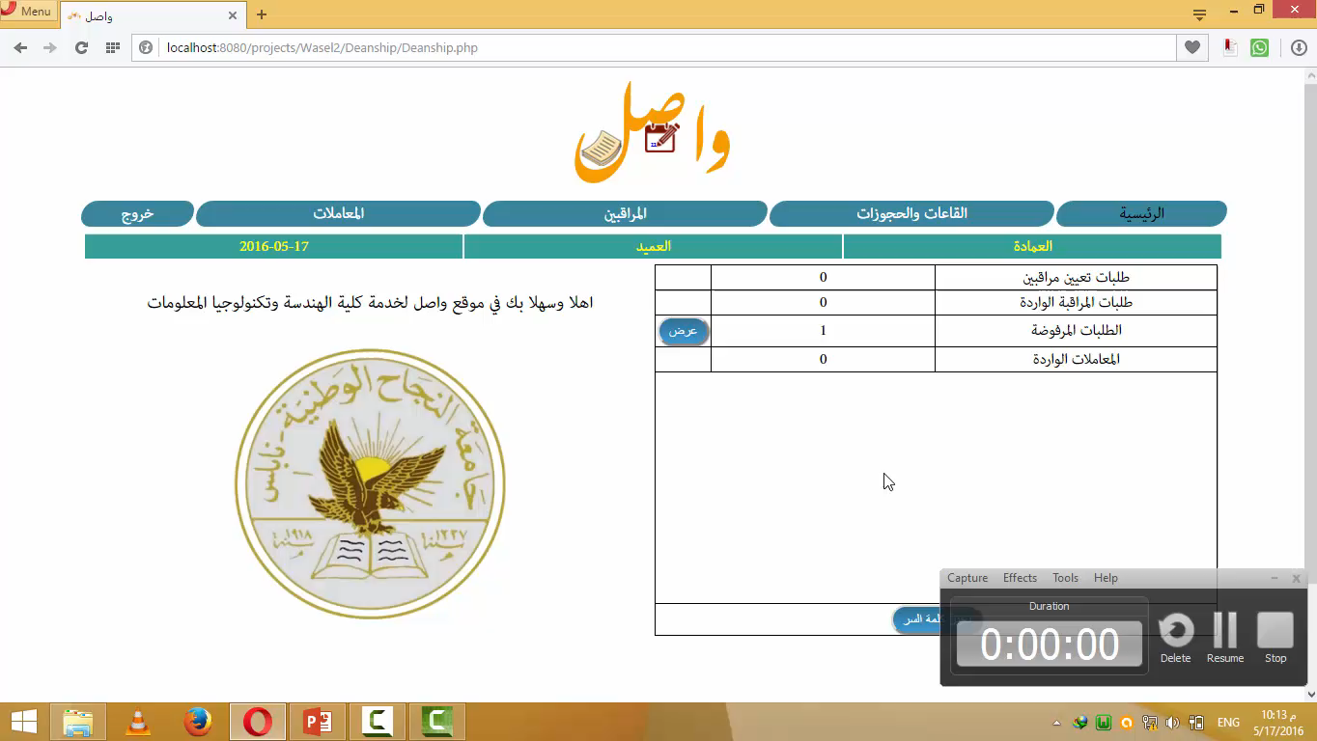

Slide 19
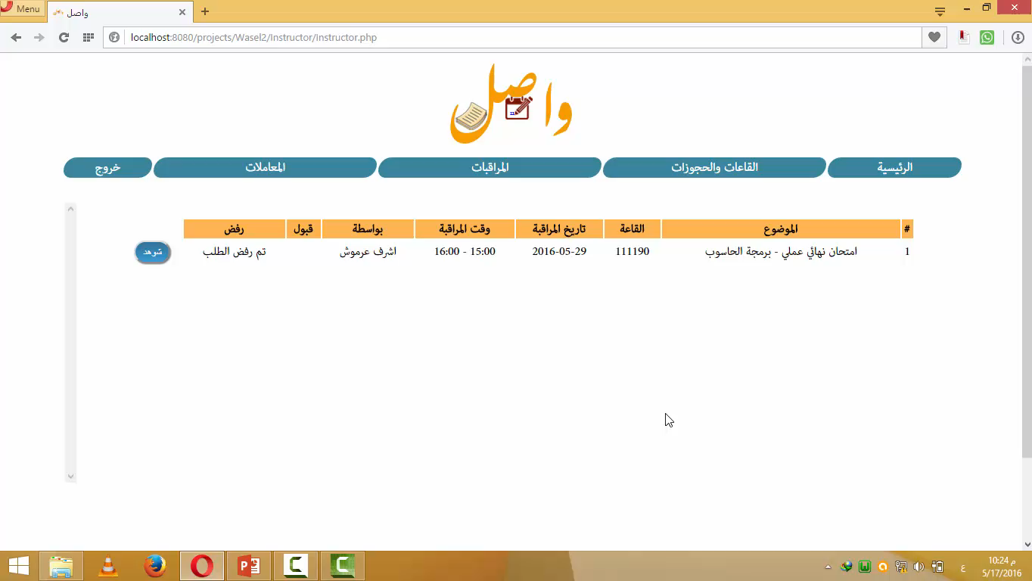

Slide 20
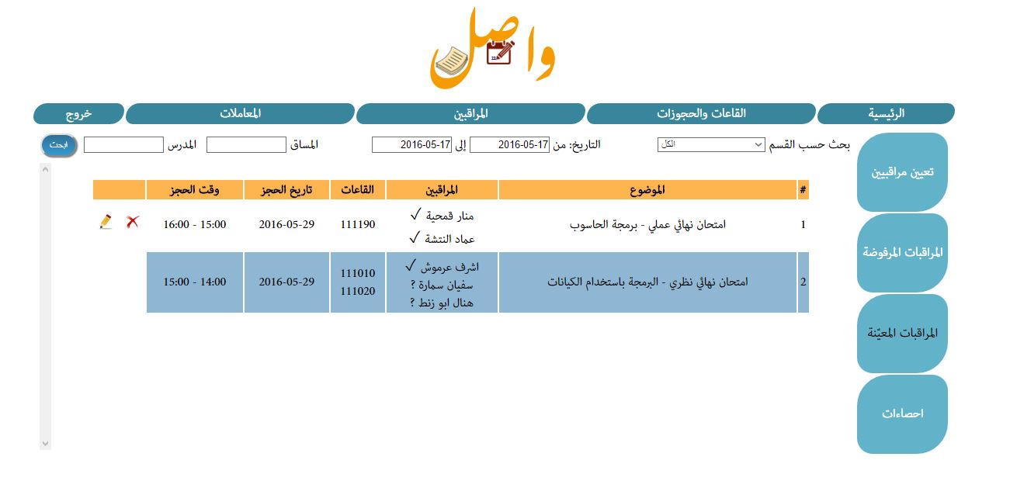

Slide 21
Official Correspondences
This is the most important creation in our project from creating new one to trade them and track their status.
The best way to illustrate this is by going step by step in its process.

Slide 22
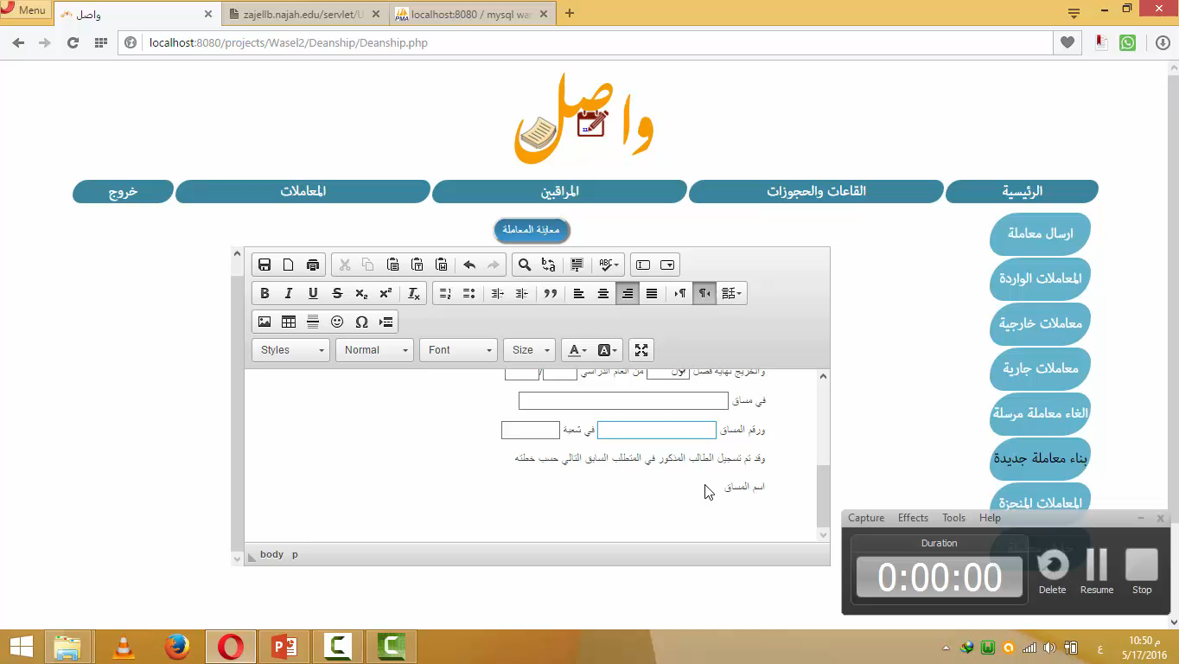

Slide 23
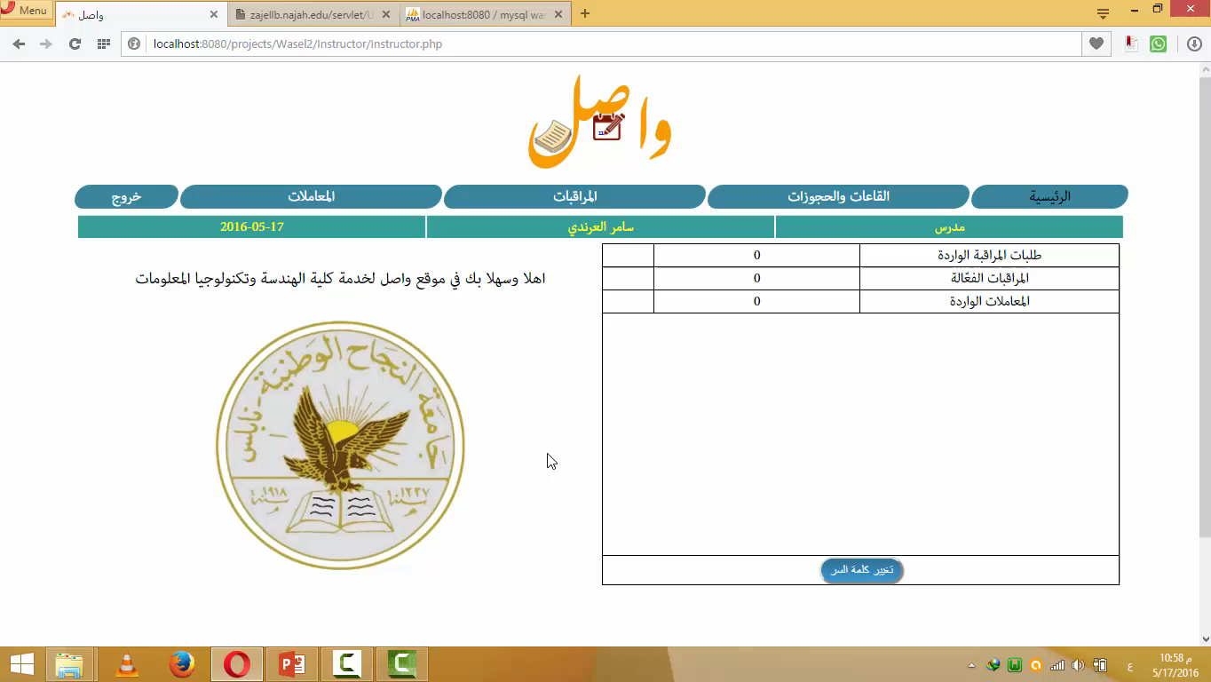

Slide 24
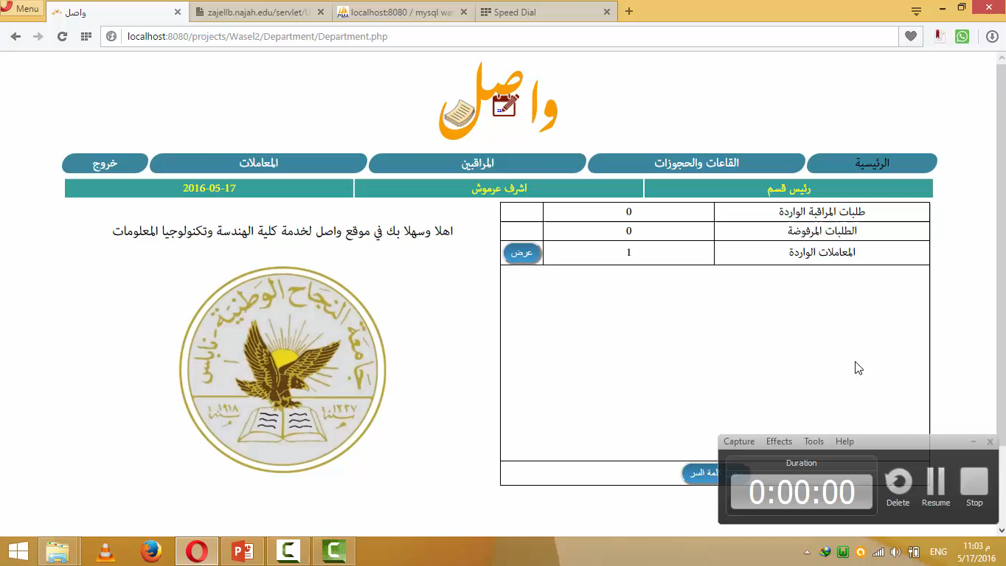

Slide 25


Slide 26
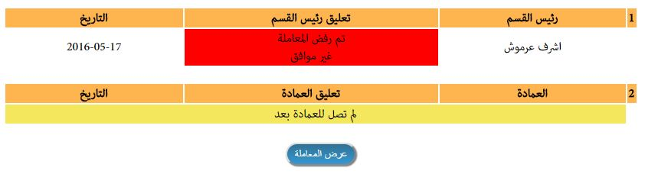

Slide 27
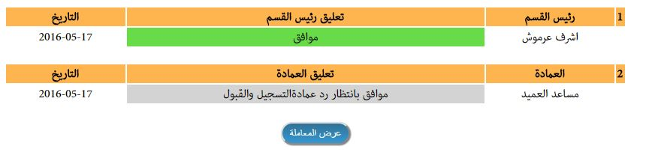

Slide 28
Control Panel
Of course there must be an administrative authority to control the whole process from editing to adding any given entity.

Slide 29
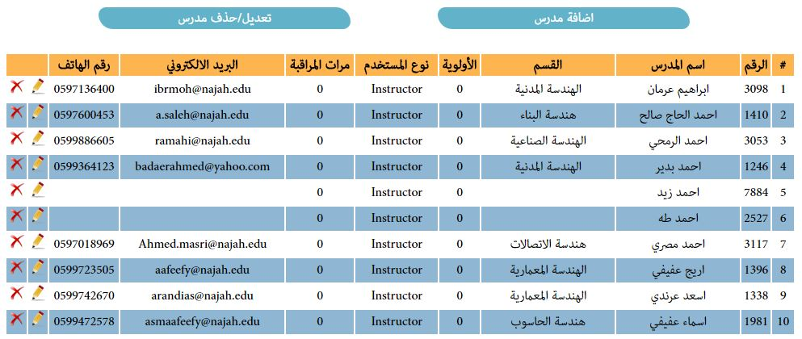

Slide 30
Collecting The Data
The administrator selects the dates he wishes to book this semester in and the type of the semester.
The data collection was done using JavaFX libraries (webview) as this program opens each hall from Zajel website and retrieves the data from it, then it organize it in text files to be uploaded to database by using PHP.

Slide 31
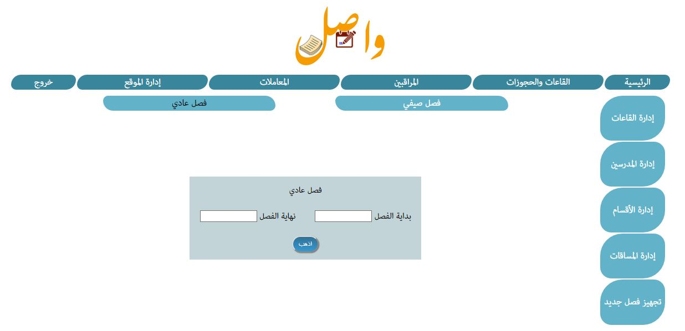

Slide 32
Hazards
Time to upload the data in the first of each semester.
Security
Zajel changes.

Slide 33
At The End
This site was built on the bases that at some point it will be expanded to cover all the faculties in the university and as efficient as its today.
And we were pleased that we got the chance to test a version of this application and received positive feedback.

Slide 34
Thanks for your attention

