Slide 1
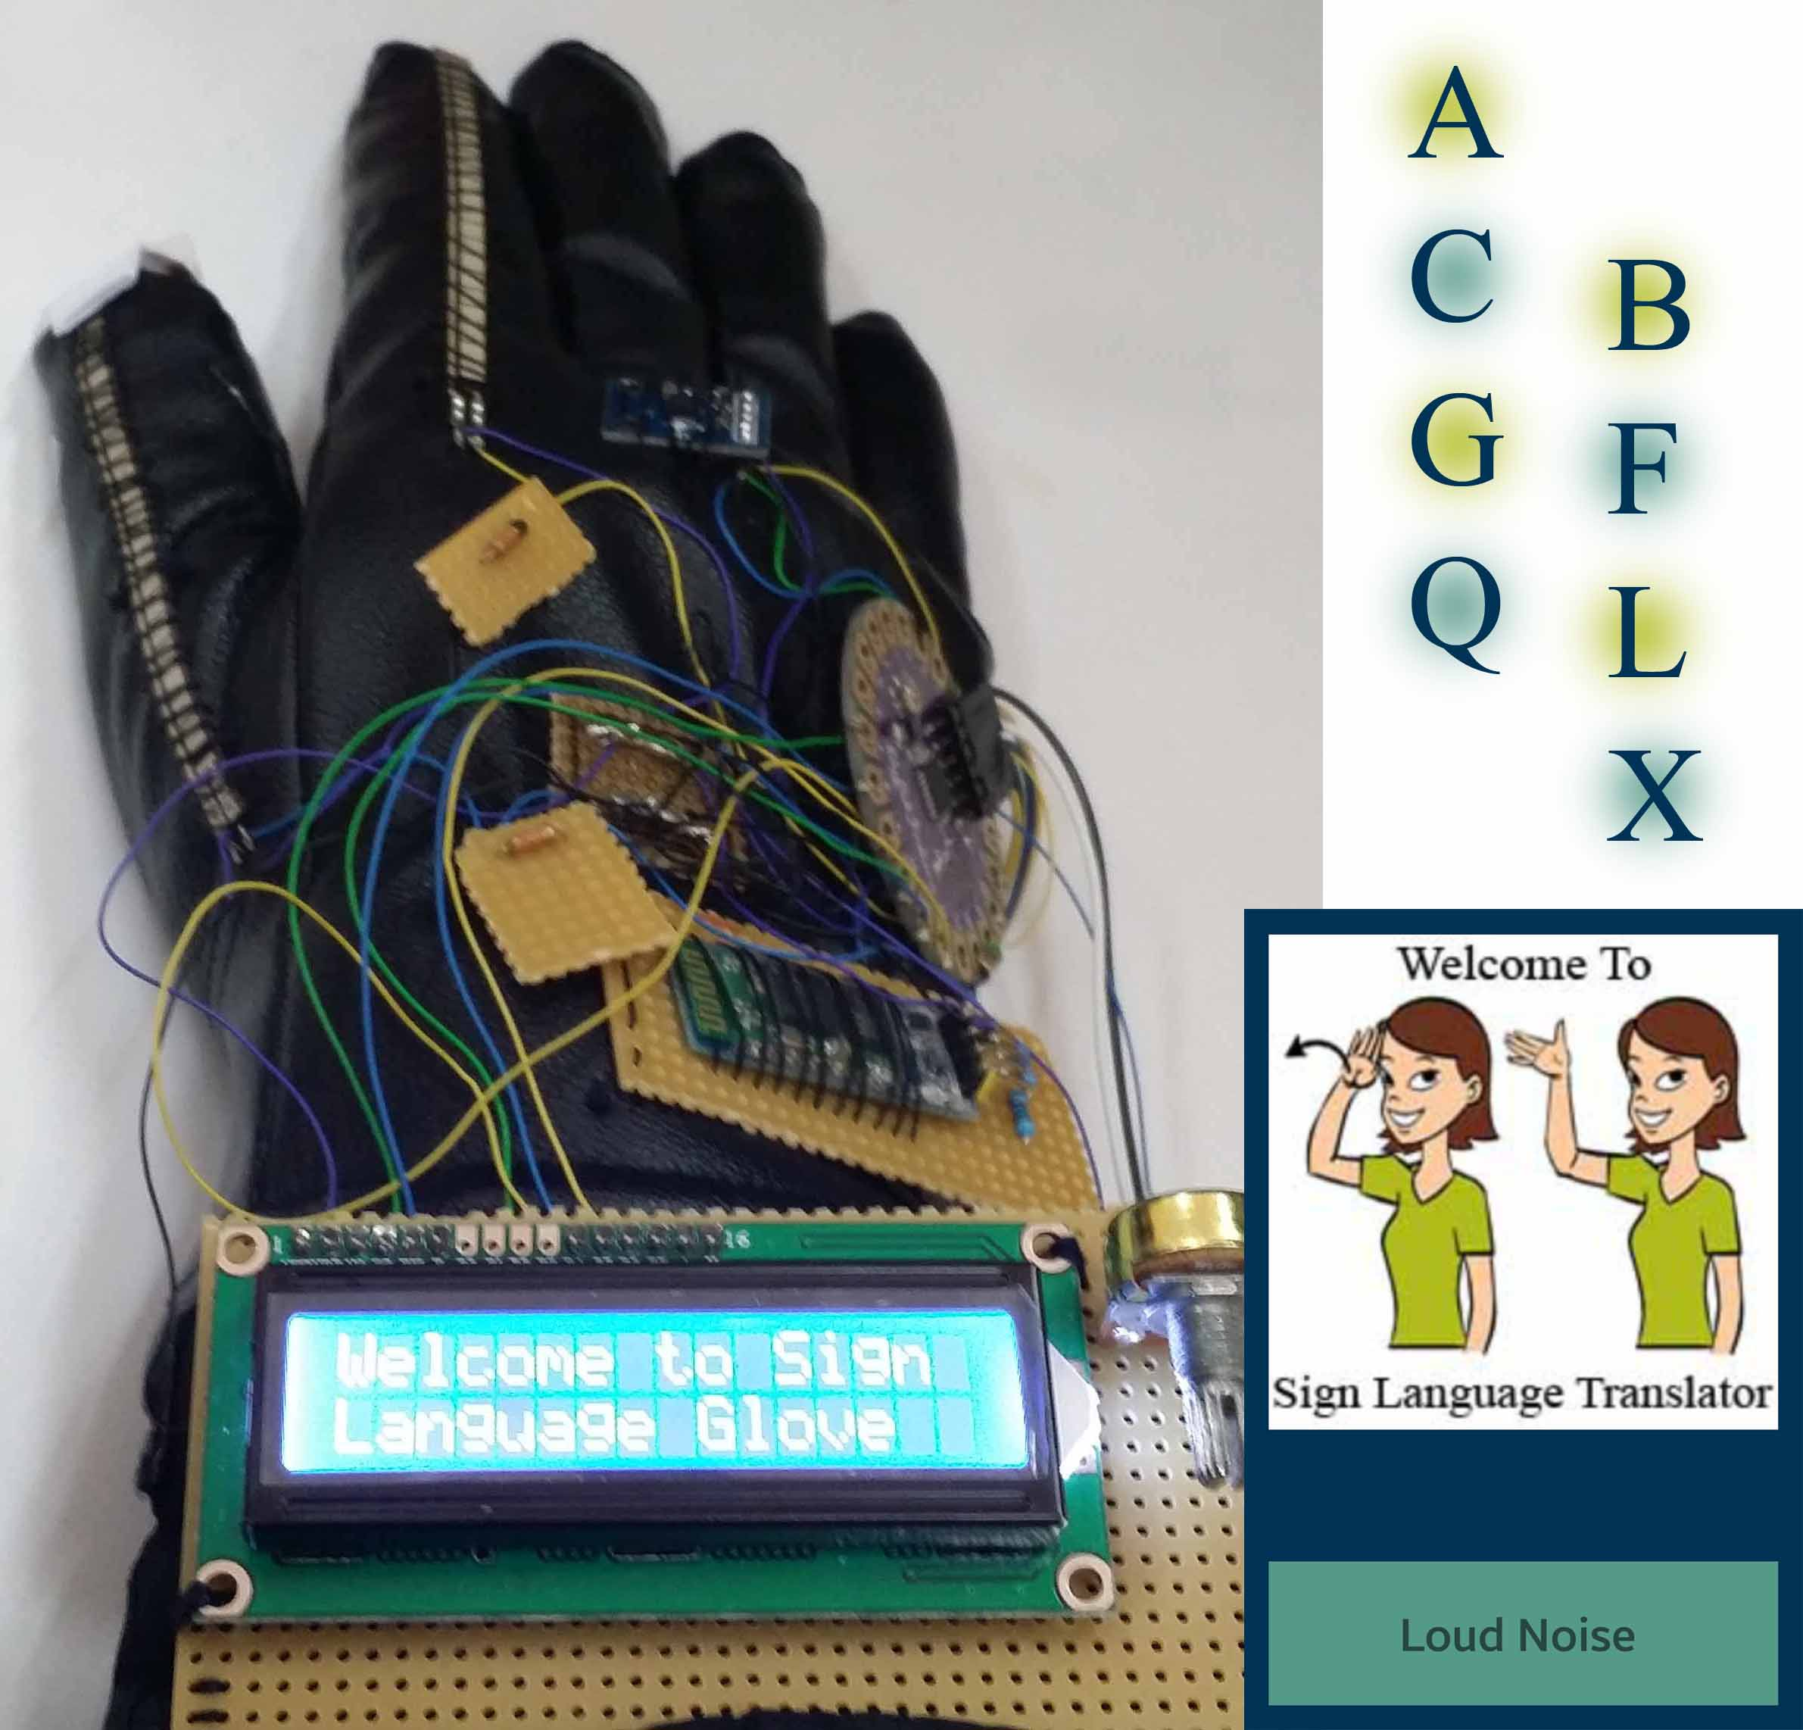
Sign Language
Glove
----------
Prepared By:
Aya Dwikat
Weam Obaid

Slide 2
Outline
Introduction
Motivation
Objectives
Standards & Equipment
Methodology
Results & Analysis
Conclusion & Future Work

Slide 3
Introduction
An electrical glove which could be worn by a deaf-mute person.
The glove will help the deaf-mute person translate his/her sign language into text and audio which could be visualized and heard by people without a disability.

Slide 4
Introduction
The project with a sound recognition feature to help deaf-mute people visualize noise levels on the mobile application.

Slide 5
Motivation
Miscommunication between people with and without disability.
Awareness of the surrounding environment

Slide 6
Objectives
Help deaf-mute people integrate into society.
Warn deaf-mute people in the case of a very loud noise that could be an indication of something dangerous.

Slide 7
Standards & Equipment
Tools and Applications:
Arduino 1.0.5
Android Studio
Equipment

Slide 8
Equipment
LilyPad Arduino Main Board
Bluetooth HC-06
Accelerometer ADX335
Flex Sensor 4.5
LCD 16x2

Slide 9
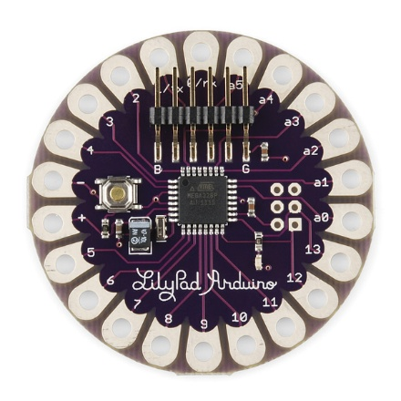
LilyPad Arduino Main Board
The LilyPad Arduino is designed
for e-textiles and wearables projects. It can be sewn to fabric and similarly mounted power supplies and sensors with conductive thread.

Slide 10
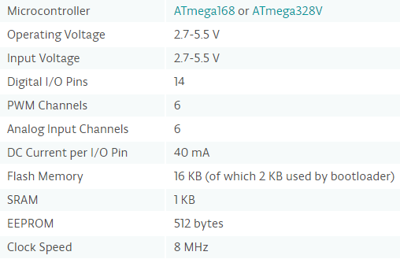
LilyPad technical specs

Slide 11
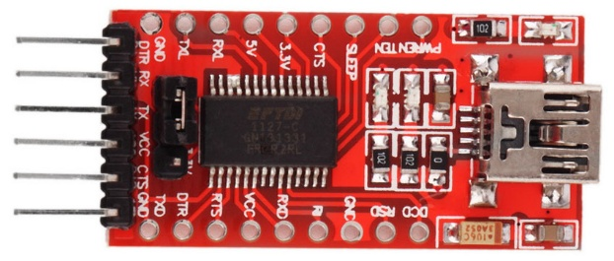
FT232R-FTDI
FTDI is used to program the Lilypad arduino

Slide 12
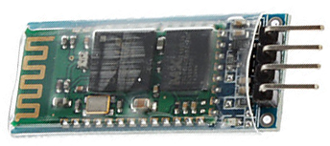
Bluetooth HC-06
Bluetooth is used to receive messages and commands from the arduino and relay it to the mobile, and vice versa.

Slide 13
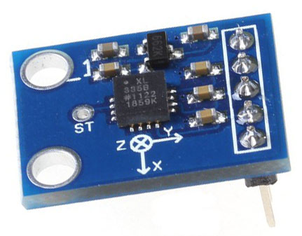
Accelerometer ADX335
Accelerometer is used to sense simple orientation, it measures the acceleration and gives three readings for the x, y, and z axis

Slide 14

Flex Sensor 4.5
The flex sensor changes its resistance when flexed so we can measure that change using one of the Arduino’s analog pins.

Slide 15
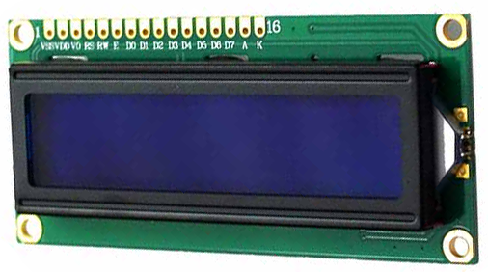
LCD 16x2
We used a 16x2 LCD to display the letters sent by the arduino

Slide 16
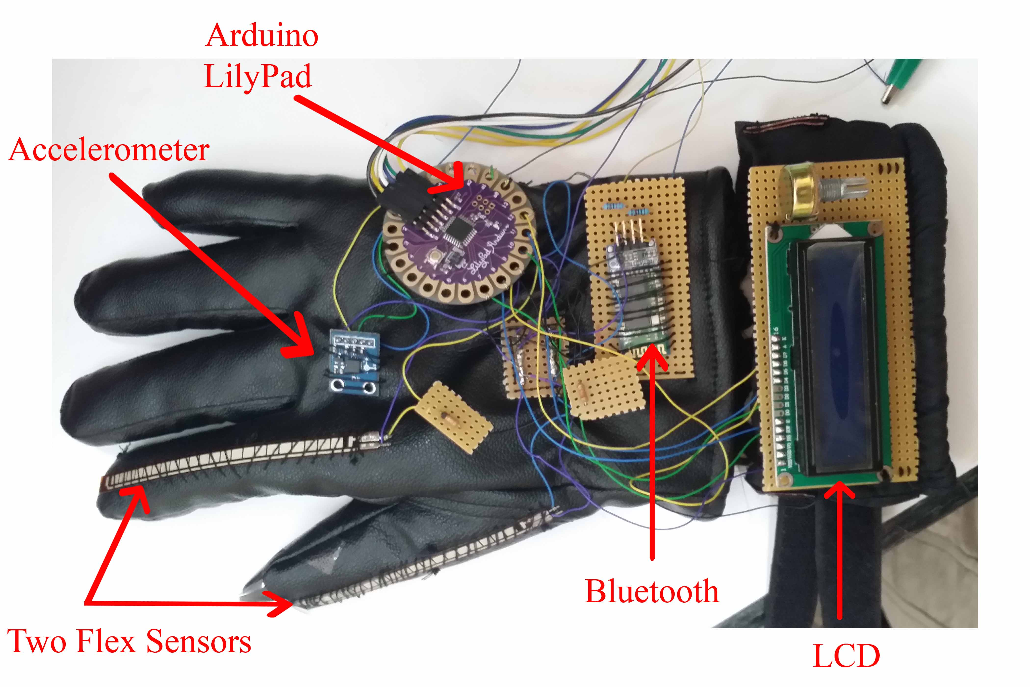
Methodology

Slide 17
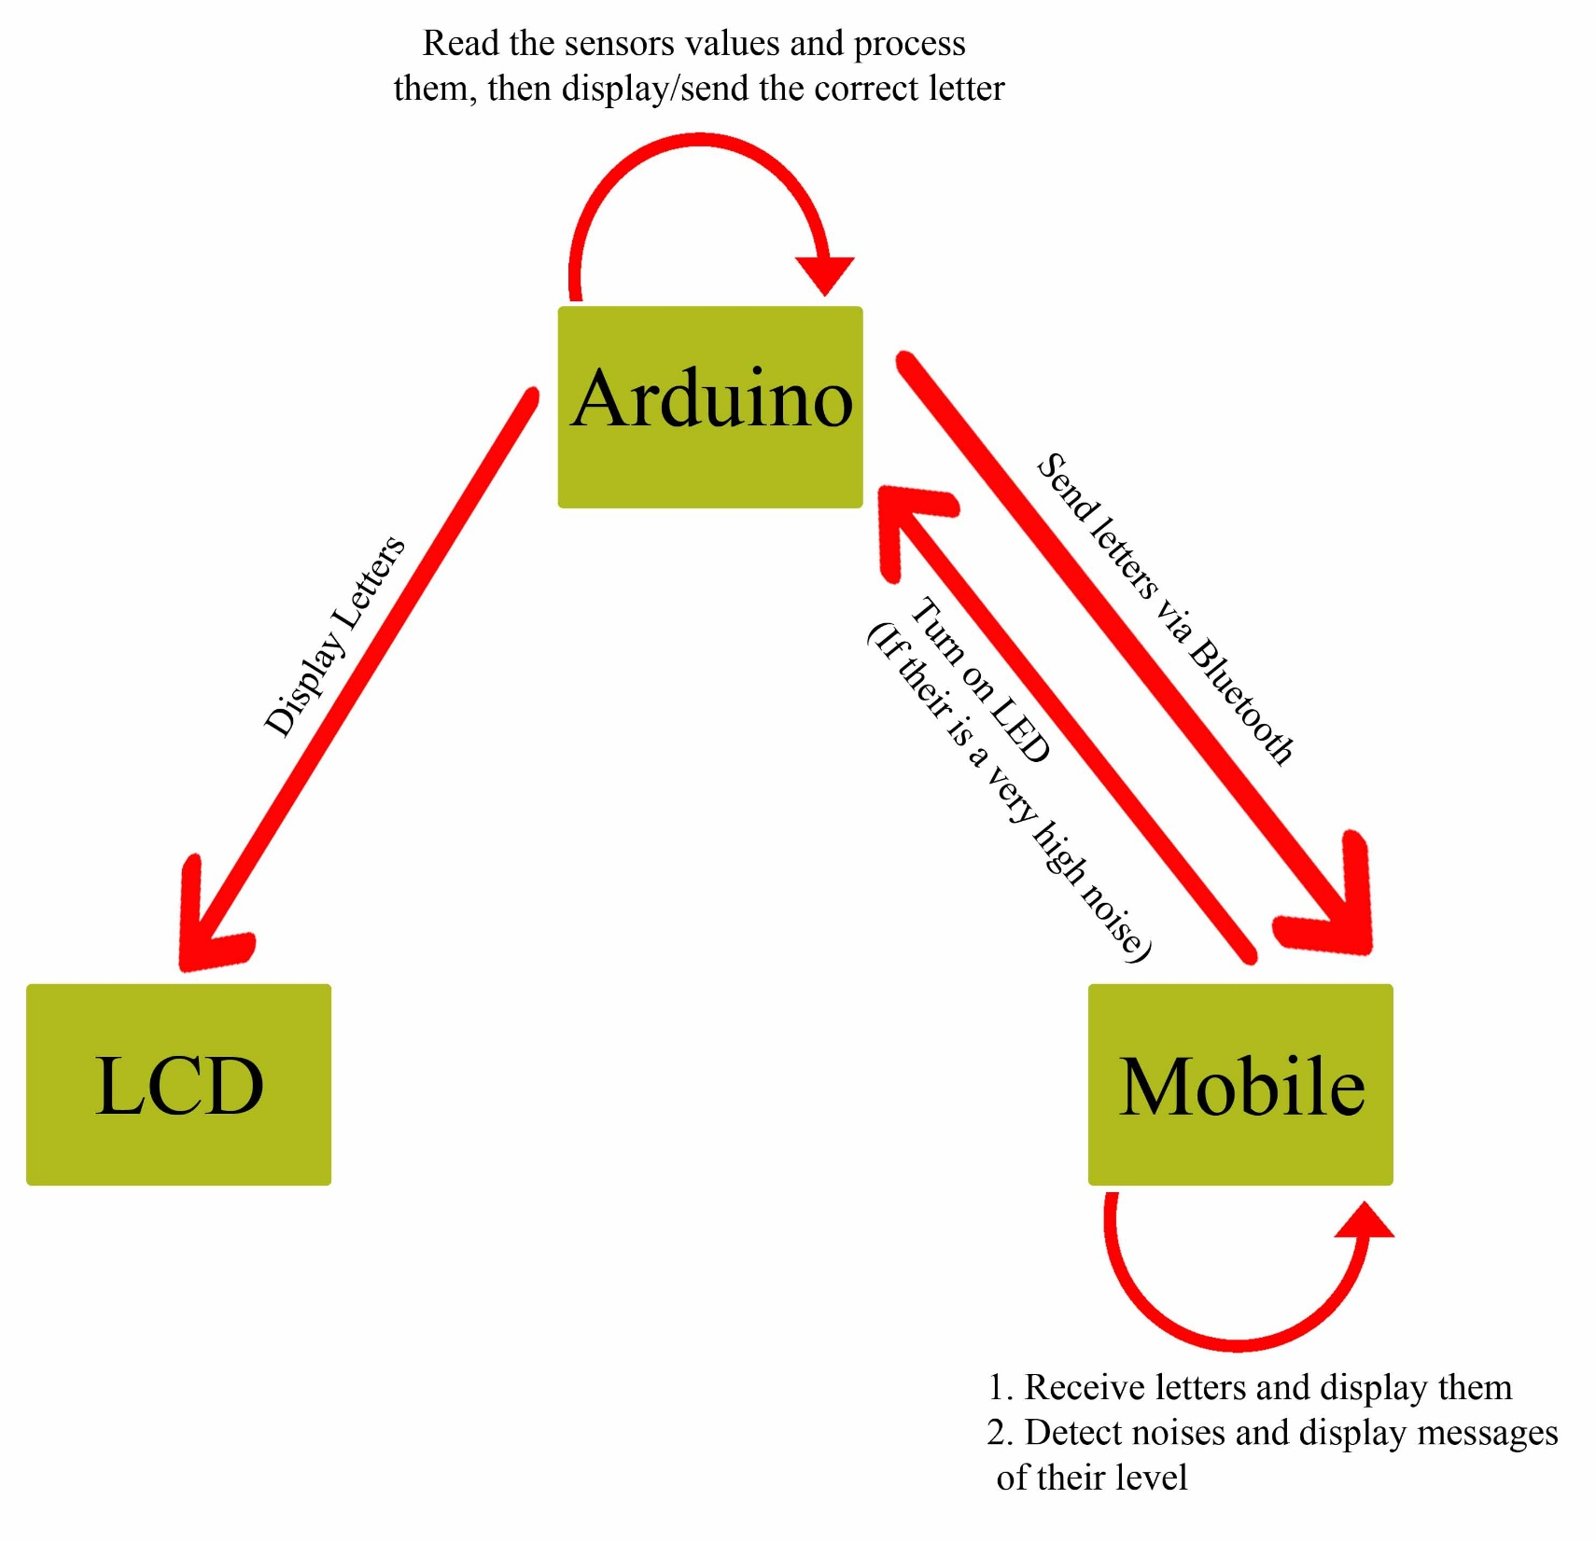

Slide 18
Sensors Inputs Calibration
take sensors readings of the two flex sensors and the accelerometer for five seconds, and track the highest and lowest values it gets.

Slide 19
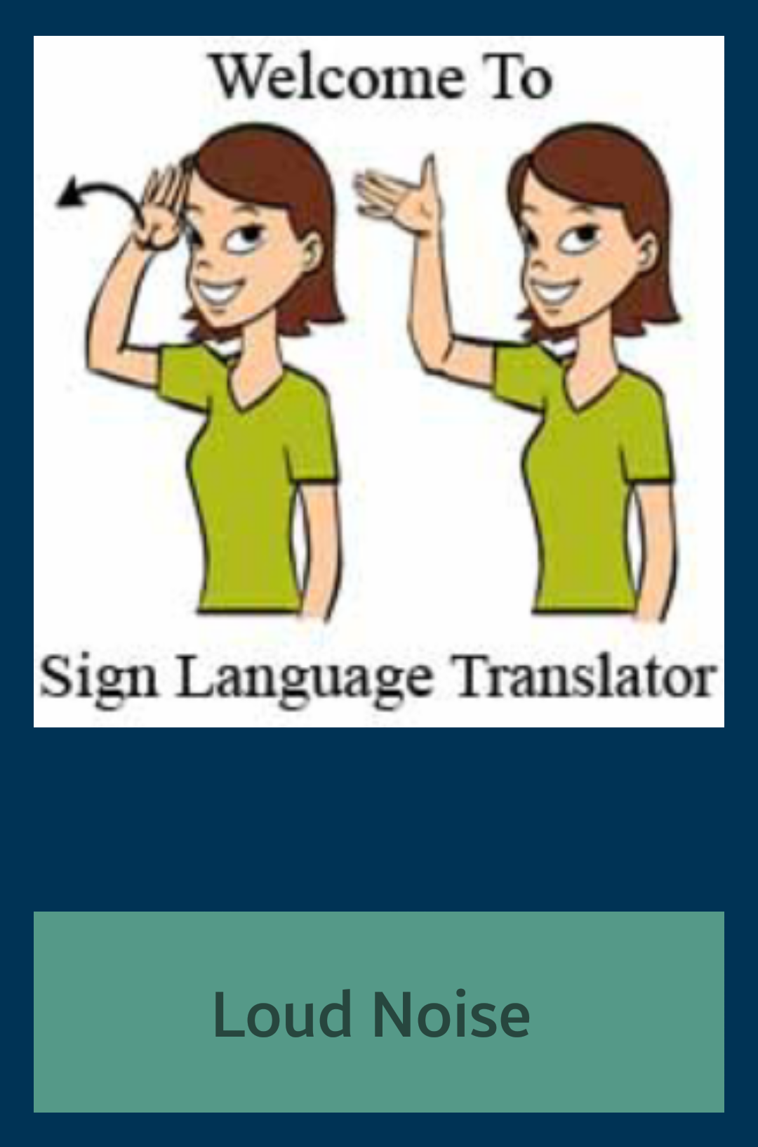
Voice System
Calm
Low Noise
Loud Noise
A Bell or a V. Loud Noise

Slide 20
Conclusion
A project to enable deaf-mute people communicate well with others.
Translate eight letters: A, B, C, F, G, L, Q, and X into text and audio.
Voice detecting system.

Slide 21
Future Work
Include more letters, words, and different languages.
Add the speaker and voice system to the glove.
Make a more appealing glove.

Slide 22
Thank You ☺

