Slide 1

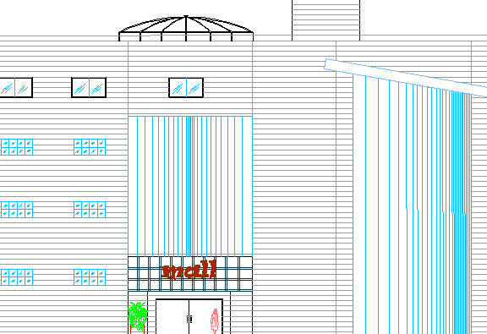
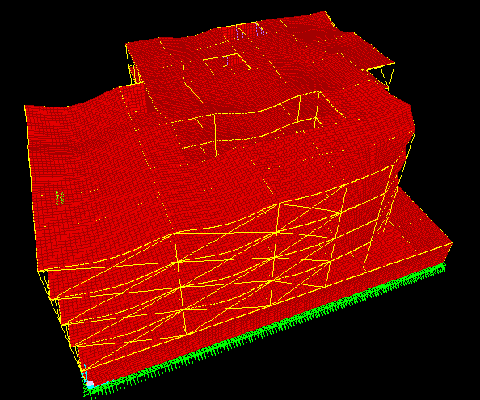
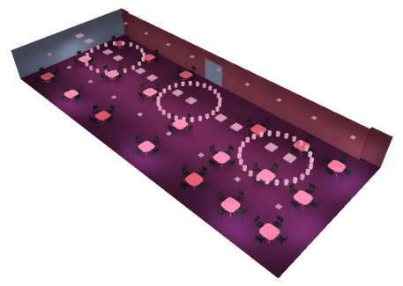
Designing Commercial Building
Prepared by
Rawan T. Barhoush
With
Alaa' Sawalmeh
&
Abrar Nawahda
Supervisor:
Dr. Ihab Hijazi
Department of Building Engineering
College of Engineering
An- Najah National University
Notes:
Good morning every body … thank you all for coming to our presentation
today me and my partners ala2 and barer we will talk about our graduating project which is Designing commercial building

Slide 2
Out line :
Introduction
Architectural design
Environmental Design
Structural Design
Mechanical Design
Electrical Design
Notes:
Let me start with the out line of our presentation :

Slide 3
Introduction
Location
Notes:
Ok , now let me introduce our project starting with the location
The location of our project is in nablus –Bet wazan

Slide 4
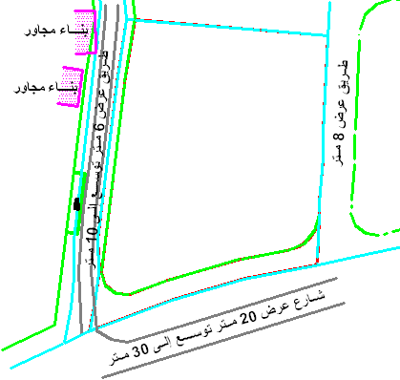
The Land
Notes:
The land of our project surrounded by three streets one of them is a main street

Slide 5
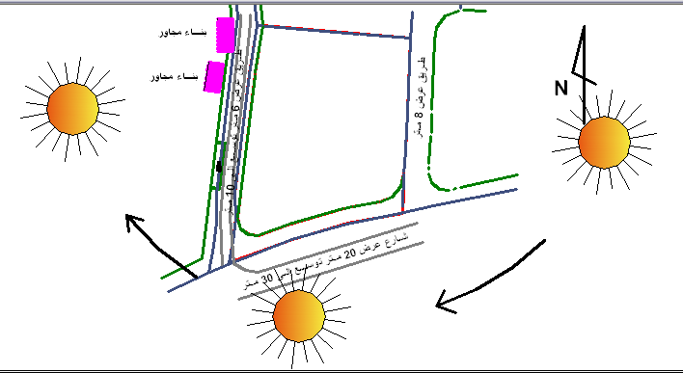
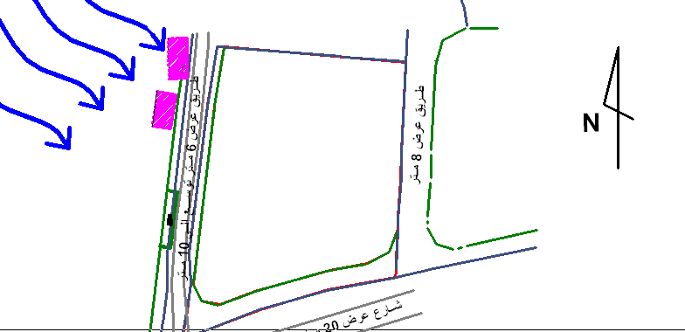
Analysis of the location
Notes:
This pic’s show the sun path during the day and also show the wind direction

Slide 6
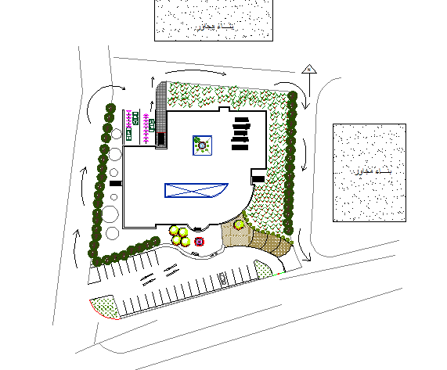
Architectural design
Notes:
Our project contains of 4 floor and basment
The basment using as a parking fot more than 30 car
Where the ground floor contains of ….
And the first ….
Now the second is
While the third is

Slide 7
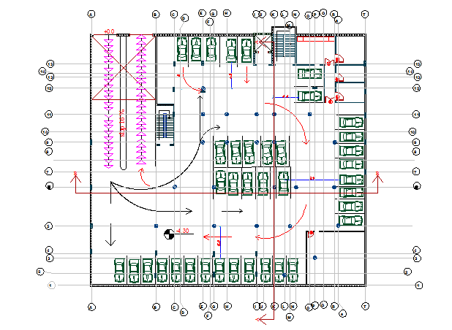
Basement floor

Slide 8
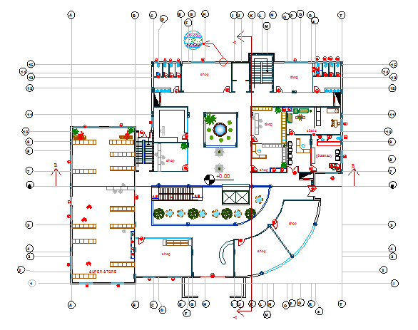
Ground floor

Slide 9
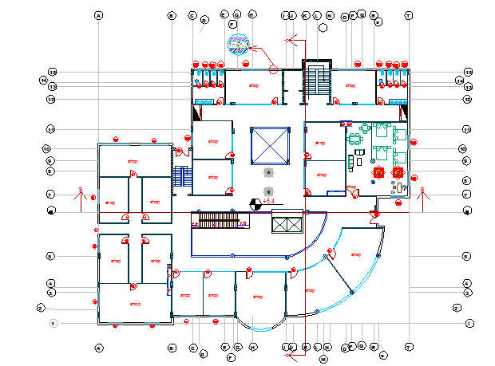
First floor

Slide 10
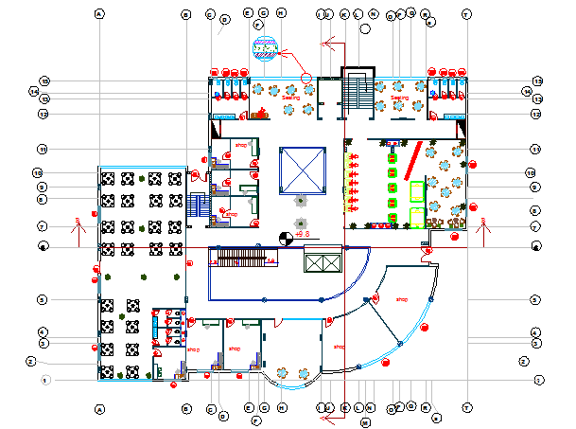
Second floor

Slide 11
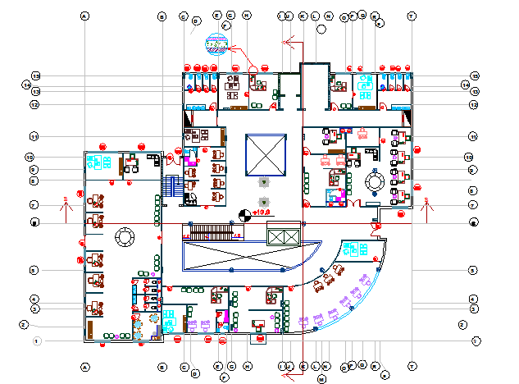
Third floor

Slide 12
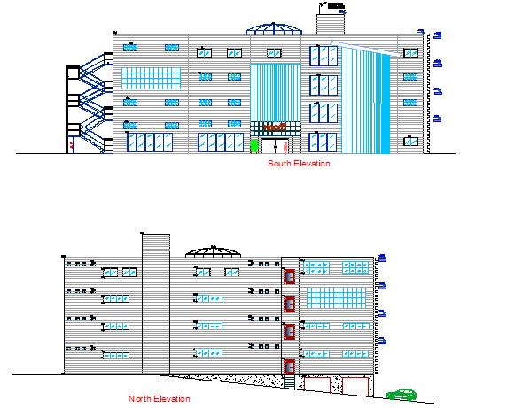
Elevations

Slide 13
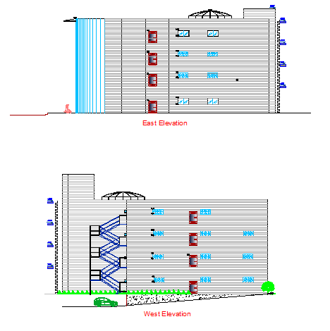
Elevations

Slide 14
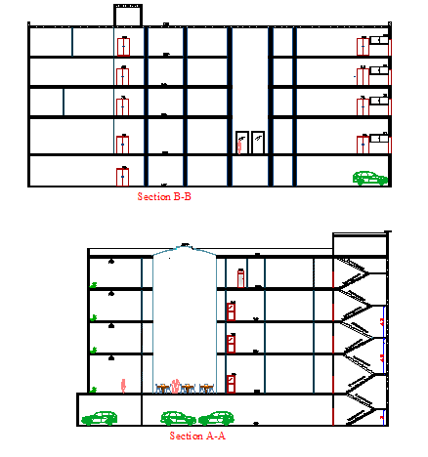
Sections

Slide 15
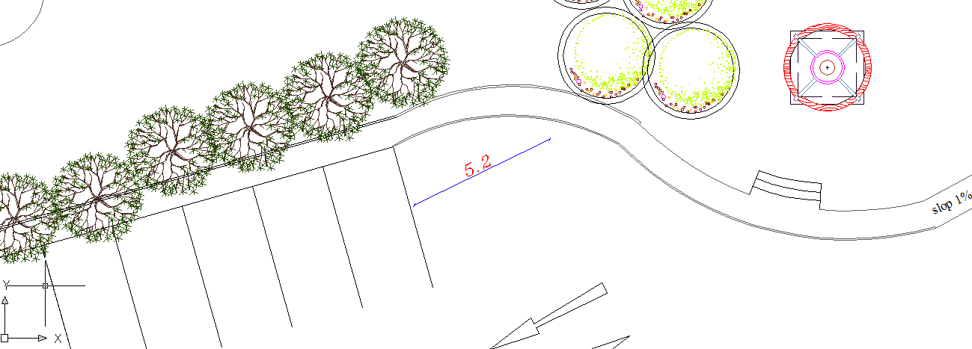
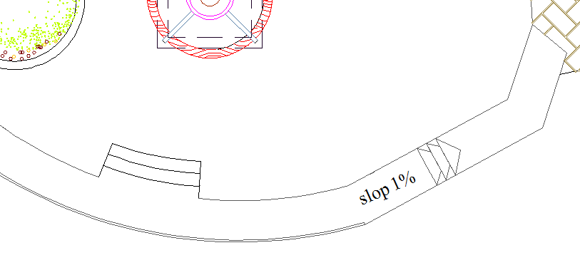
The safety consideration is
Notes:
Commercial building Is a puplic survice ..
Special entrance for people With a disability
Has a slop of 1%
Also a special parking with 3.6*5.5 dimention

Slide 16
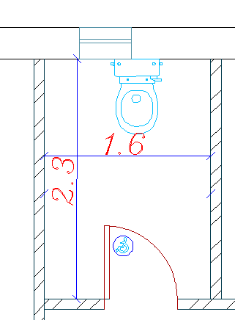
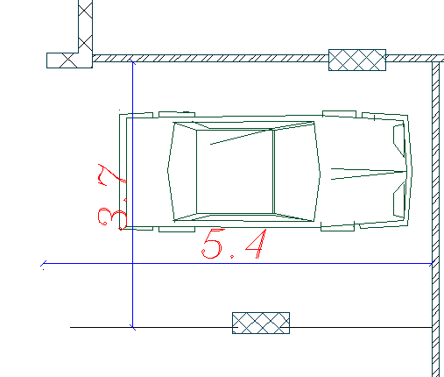
The safety consideration is
Notes:
The W.C is 1.6*2.3 for people with special need

Slide 17
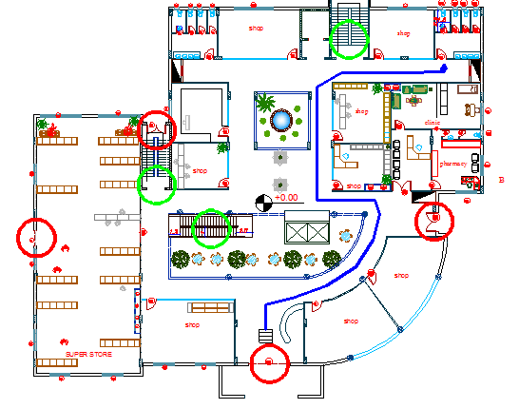
The safety consideration is
Notes:
Since the ‘birth’ of buildings, the damage from both natural and unnatural disasters never stops. And when that’s happened an Urgent reaction must be taken which is Evacuate the people inside building to save life's
And there is some considration should take in the acount to make this process easy such as
The figure show the way that the people with display use to arrive to W.C it’s easy with no barriers
width of corridor range between 2.64m and 4.30m.
The travel distance from the farthest store in first floor to the exits is =27.39 m and the distance to main entrance is 14.86 m . Other stores the travel
distance ranges between 3m and 10m
Number of exits in the building is 4(in all directions of building) in addition to the main entrance (in the east direction at the middle of building).
The mall includes two stairs one of them is major used to go to the upper floor , while the 2nd is used to escape (main exit). Also it contains an escalator in both direction . the width of stair is 1.6m for each .

Slide 18
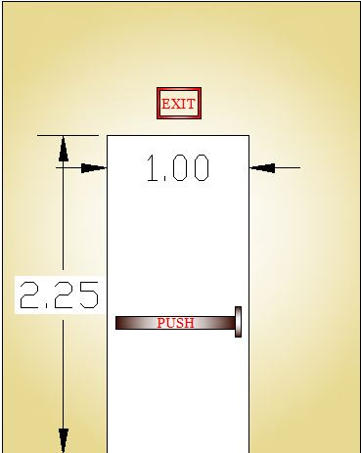
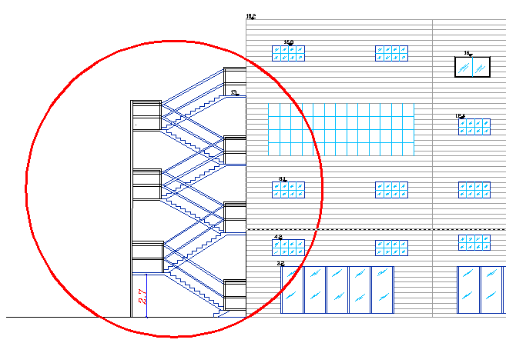
The safety consideration is
Notes:
Stairs used to escape made of special metal

Slide 19
Environmental Design

Slide 20
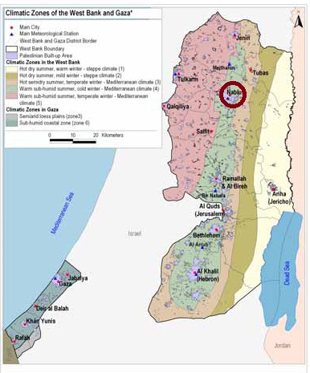
:
General View
The Project was designed in Nablus, and it's located in the 3d climate zone "Zon3" and the below Fig. shown the classified climatic zones of the West Bank and Gaza

Slide 21
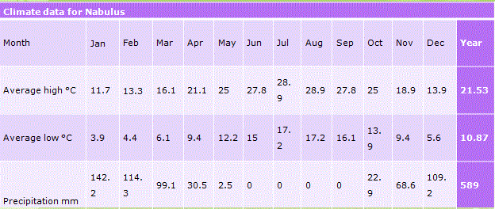
The climate data for Nablus shown in below Table

Slide 22
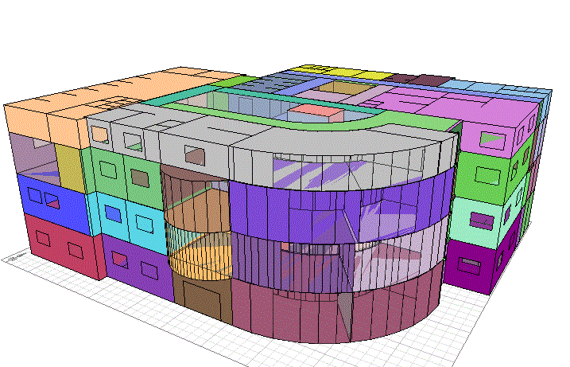
ECOTECT is an Autodesk building analysis program that allows designers to work easily in 3D and apply all the tools necessary for an energy efficient and sustainable Design, Ecotect depends on dividing the model to zones to dealing with every zone alone shown in below figure

Slide 23
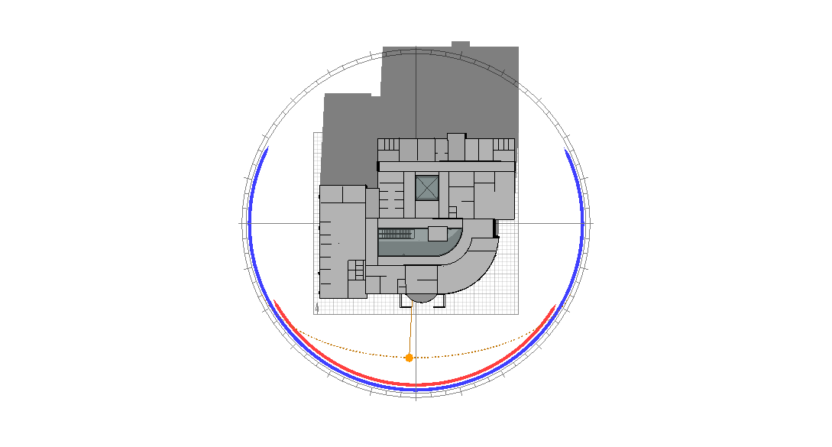
The building was oriented to the south as possible as, and compatible with the selected site to build the project to gain the largest amount of solar energy in winter

Slide 24
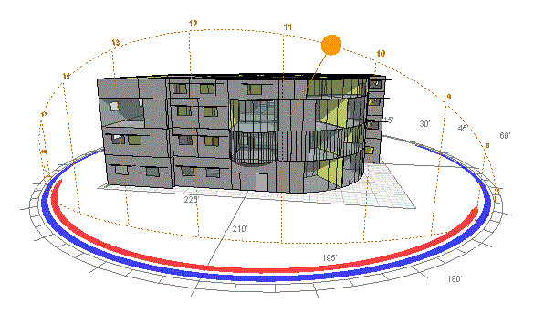
The sun path around the building in 21-Jan. and 21-July shown in below figures
A- In 21- January

Slide 25
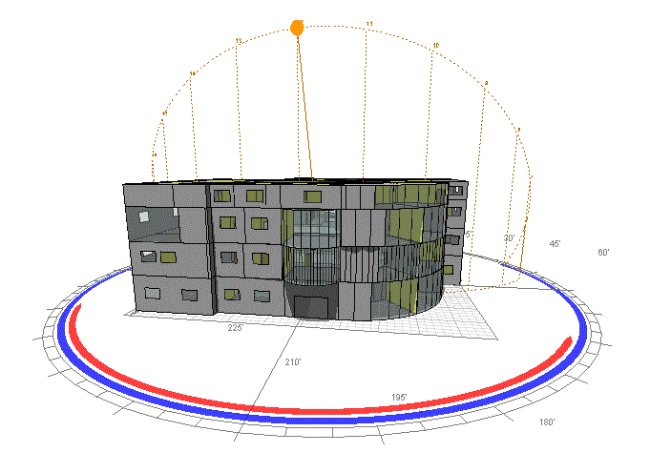
B- In 21- July

Slide 26
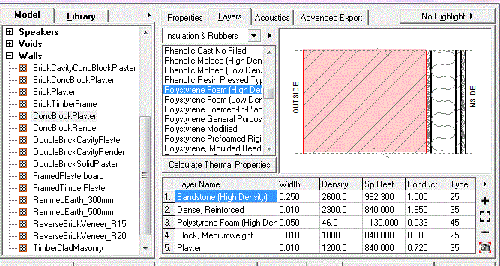
Thermal Insulation and Simulation :
Simulation the Model with insulation:
1- External Walls Section:
Insulation used was Polystyrene Extruded (5cm Thickens)

Slide 27
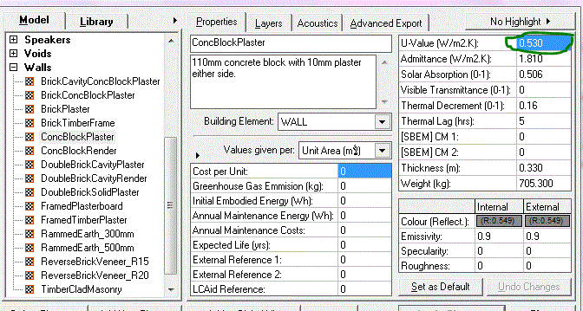
Simulation the Model with insulation
U Value (Kw/m2) for the External Wall after Insulation

Slide 28
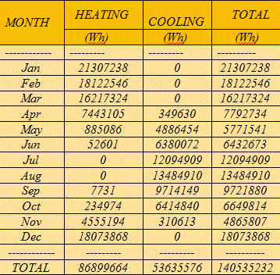
Simulation the Model with insulation
Heating and Cooling Loads With Insulation

Slide 29
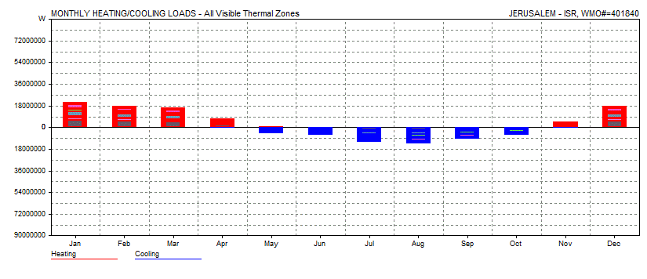
Simulation the Model with insulation:
Heating and Cooling Loads With Insulation:

Slide 30
Natural lighting

Slide 31
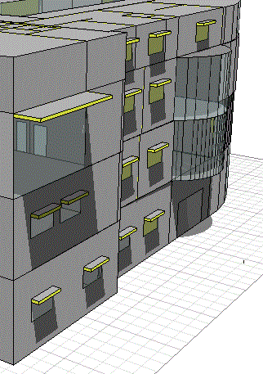
Shading
Cantilever for Shadow on the south windows

Slide 32
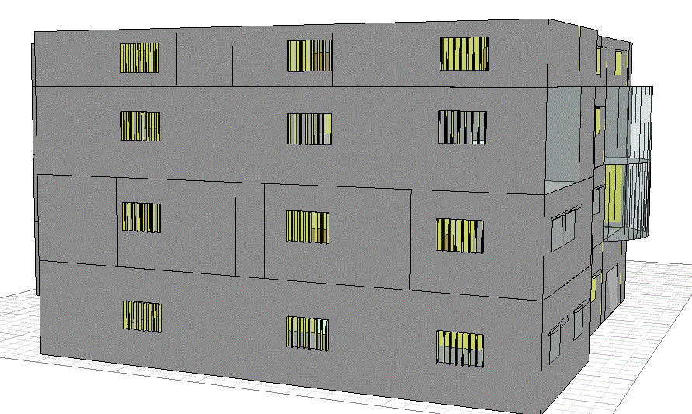
shutters for Shadow on the west windows

Slide 33
Structural Design

Slide 34
Ways of analysis and design
Using Sap 14
Hand calculation

Slide 35
Design Codes:
1) the American Concrete Institute code ACI 318-08 .
2) the seismic design according to UBC-97.
Design will include the following elements :
1) slab ( two way rib slab/one way ribbed slab both direction).
2) beam ( main beam /secondary beam/tie beam) .
3) column .
4) shear wall.
5) Stairs.
6) footing.

Slide 36
Materials
Material | Unit weight(k N/m3)
Reinforced concrete (beams) | 28
Reinforced concrete (columns) | 30
Brick | 12.5
Masonry stone | 27
Sand | 18
Aggregate | 17
Polystyrene | 0.3
mortar | 2.3
Tile | 12

Slide 37
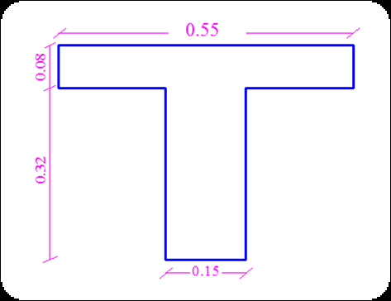
Preliminary Design
Slab Thickness
Beams Thickness
(60*60)
(50*60)
(70*60)
Column dimensions
C1 80*40
C2 = 60*60

Slide 38
Loads
Superimposed dead load=4 kn/m²
Live load =5 kn/m²
Weight of external walls=25 Kn/m

Slide 39
The error in result is less than 5% so it's acceptable.
Check of Sap model
Compatibility check
Reaction check
Load | Hand calculation | SAP | Error %
Dead Load | 116363.3 | 117129 | 0.6 %
Live load | 36240 | 35126.6 | 3%

Slide 40
  Internal forces check
M | Manual | Sap | Error
1 | 92.46 | 82.258 | 11%
2 | 184.9 | 141.75 | 23%
3 | 147.9 | 128.1 | 13.38%
4 | 119 | 103.6 | 12.9 %
5 | 67.2 | 94.5 | 40 %
6 | 35 | 30.3 | 13.4%
7 | 38 | 36.2 | 4.7%
8 | 98.2 | 107.45 | 9.4
9 | 27.9 | 31.2 | 11.8%

Slide 41
Dynamic Design
Soil type
Sc
Z = 0.2
C v=0.32
Ca =0.24
Response function Scale factor "in main direction (Y)"= 1.75
"in secondary direction (x)"= 0.58
T- calculation | T- Sap
0.569 S | 0.427 S

Slide 42
Design of elements

Slide 43
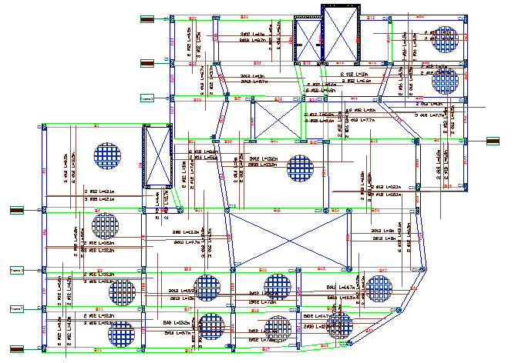
Slab design .
All moment value from the sap
Check shear in both direction

Slide 44
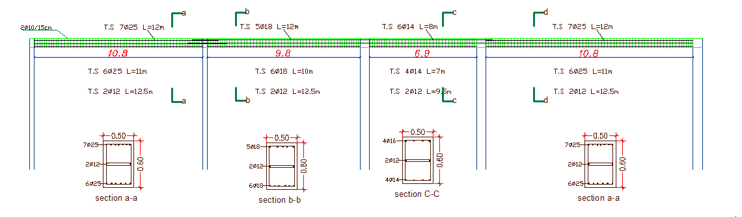
Section in frame contain main beams

Slide 45
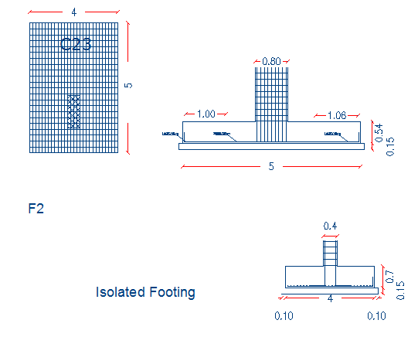
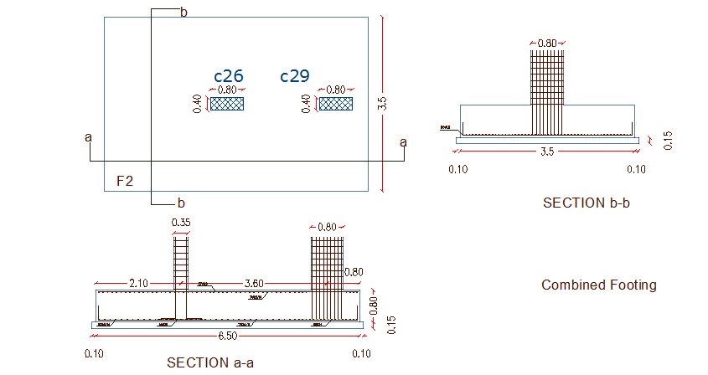
Footing
Combined
Isolated

Slide 46
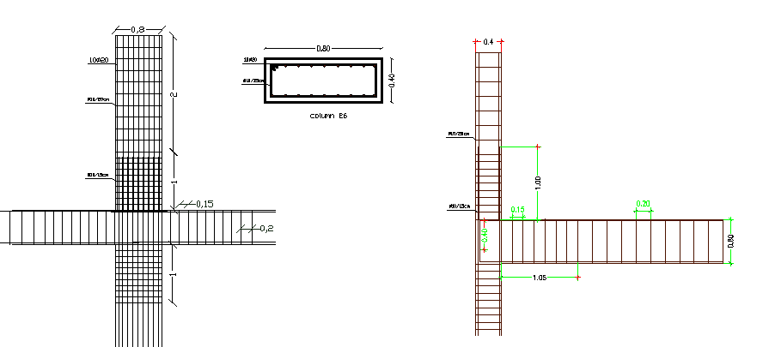
Column

Slide 47
Mechanical
design

Slide 48
Mechanical Design
Water Supply System
- Cold Water
- Hot Water
Drainage System .
Fire System
Hvac

Slide 49
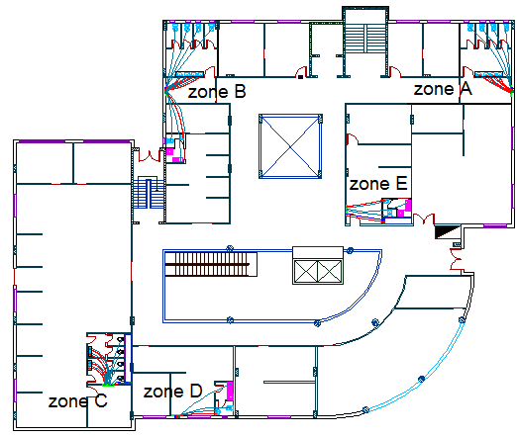
Water Supply System

Slide 50
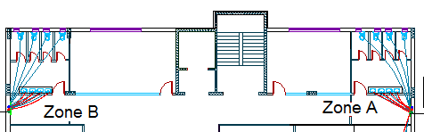
Water supply in ground floor in zone A and B

Slide 51
Cold Water Supply System
              Number of Fixture unite in ground Floor Zone A
Total | F.U | # of unit | Fixture
50 | 10 | 5 | W.C
7.5 | 1.5 | 5 | lavatory
75.5 |  |  | Total
55 G.P.M |  |  | Demand

Slide 52
Critical point in zone A
Diameter selected
Demand | Critical point
27 G.P.M | W.C | Zone A
Diameter selected :-
Main Vertical feeder = 2’’
Horizontal feeder = 1.5 ‘’

Slide 53
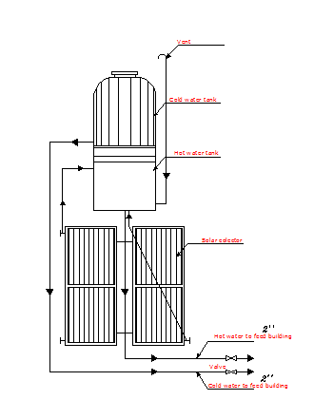
Hot water supply system

Slide 54
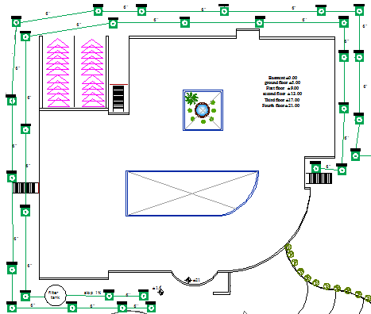
Drainage System

Slide 55
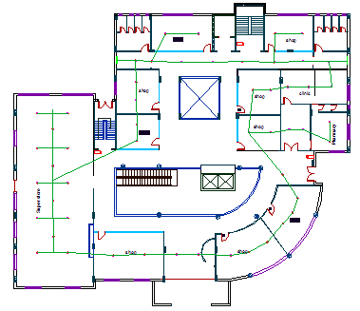
Fire system : sprinklers Distribution in ground floor

Slide 56
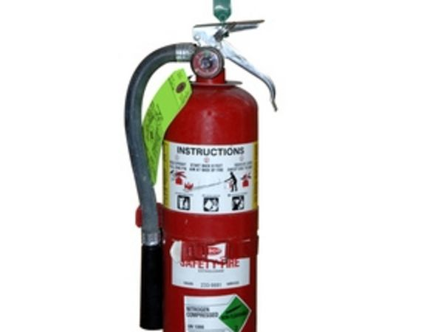
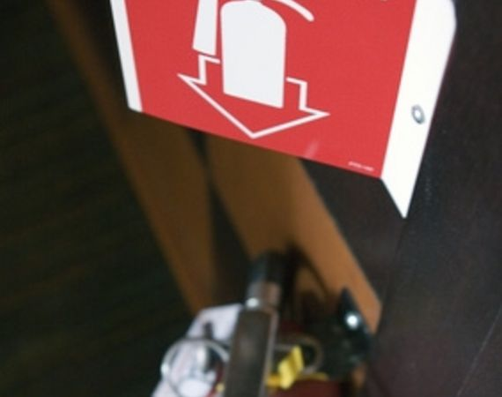
Extinguisher

Slide 57
Electrical Design

Slide 58
Source of lighting
1- Natural Lighting
2. Artificial lighting

Slide 59
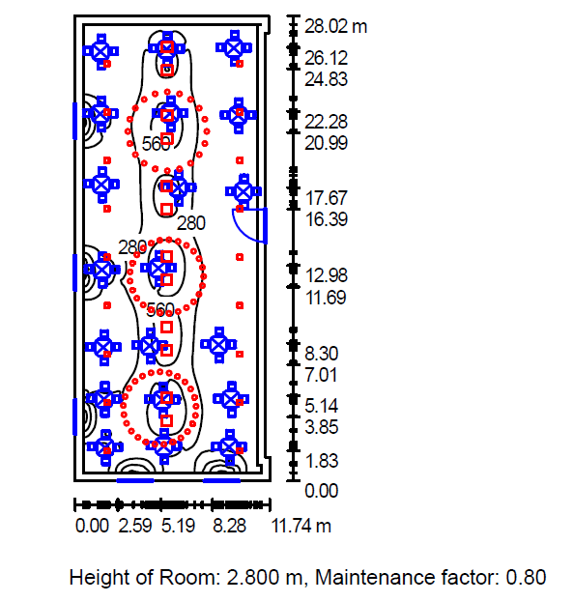

Artificial lighting

Slide 60
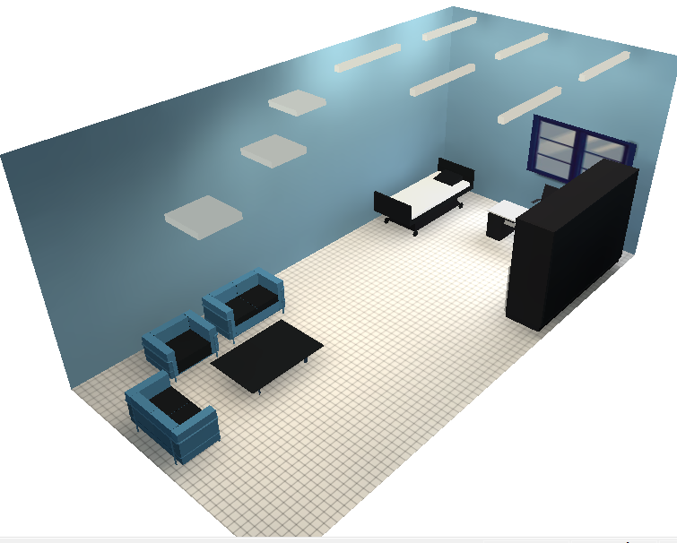
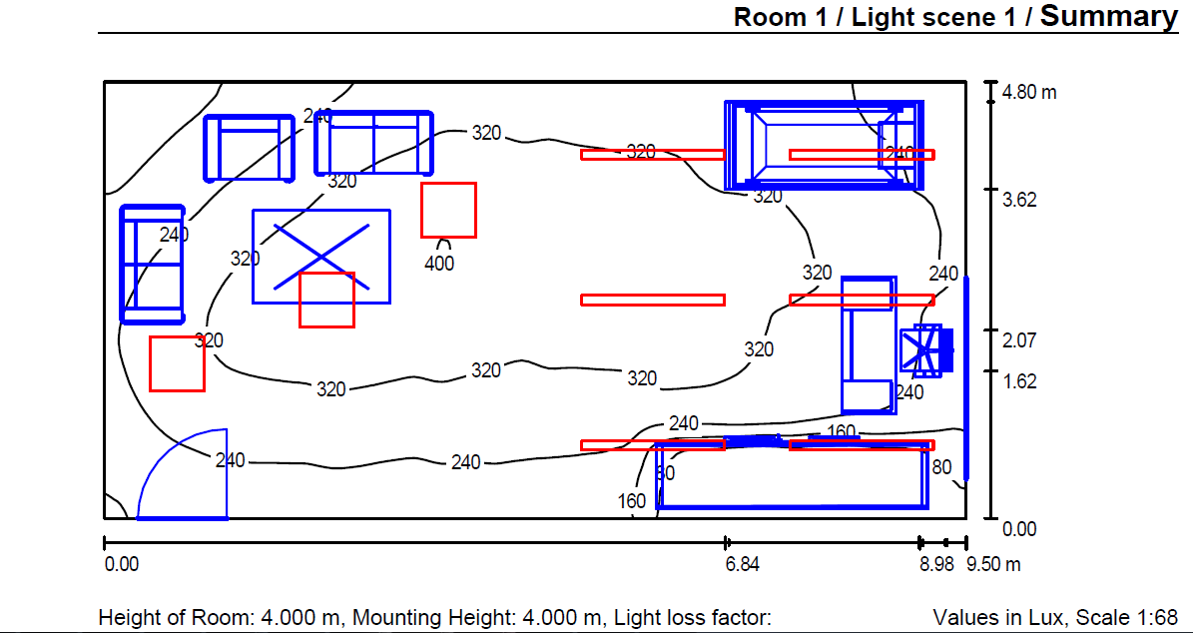

Slide 61


