Slide 1
Electronic Car Via Mobile & Traffic Lights
Prepared By :
Sufyan Tahseen Mustafa Ramadan
Arkan Tawfeeq Taher Deeb

Slide 2
About . . .
This Project is about a car which motion can be controlled by Mobile.
Also mobile can control the speed of the car
Car can check the traffic light on the road and send feedback about it (Red ,Green ,Yellow) to the Mobile .
The car motion is restricted by the traffic light case, if it is RED then it is forced to stop

Slide 3
Parts of Project
A traffic light circuit which communicates with the moving car using Radio Frequency of 27MHz.
Mobile (Controller) which controls the car motion using Bluetooth
A microcontroller (PIC 18f4620) circuit by which the car will receive from traffic light circuit and the Mobile.

Slide 4
How can Car detect traffic ?
First we think to use Graphics processor but it is difficult to be used since it requires lots of Hardware and may not be available.
Then try to make the traffic light send Signals to the moving car either by Infrared with 38KHz frequency or by Radio Frequency of 27Mhz frequency

Slide 5
What happens if traffic light acts as transmitter ?
Each traffic light is represented by a code of signals.
Parts of the Code is:
a start part which informs the receiver that new data is being transmitted
the data part which contains the information to be analyzed(determine the traffic case).
Tail which express the end of code transmission.

Slide 6
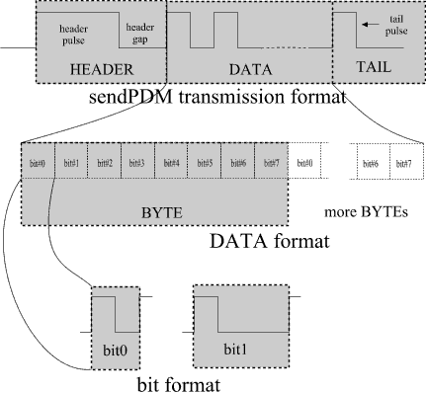
Code protocol:

Slide 7

How to send the suggested Code?
The Infrared sender & receiver was the first choice .
Then start to build our own protocol. But it was hard to do then try to use other protocols as Sony protocol RC5.
While working we found that Infrared is not the right choice .

Slide 8
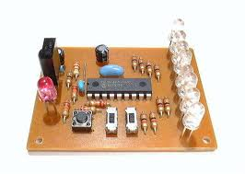
IR Circuit:

Slide 9
Problems of IR:
Sender must be directed to the receiver. This rarely happens.
The distance is small and this is not applicable
High intensity light considered as Noise and cause interference with other signals .
It is suitable for indoor areas not in streets.
This might cause of misunderstanding of the code.so wrong behaviors might be taken.

Slide 10
How to send the suggested Code?
So we moved to study the Radio Frequency possibility .
As a result :It passed the problems of Infrared with additional vital advantage:
One sender can be used for different receivers.
By getting RF sender & receiver which works on 27MHz frequency we analyze its code by the Oscilloscope. And get the following:

Slide 11
How it send Data?
The transmitter send a specific series of electronic pulses with 2.1 MS length for the first Four pulses to inform receiver that new data is sent and they are separated by 700 microseconds pulses
Then If the traffic is red then 16 pulses is sent, else if it is green the transmitter sends 40 pulses and for yellow it sends nothing.

Slide 12
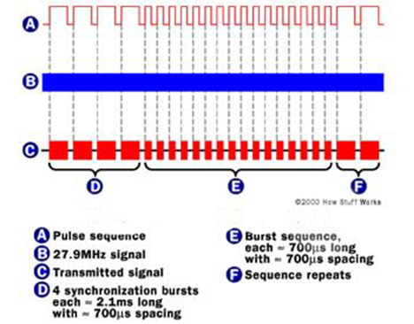
Code Analysis for RF:

Slide 13
How the project works?
After switching the car on & connecting the mobile to the car through Bluetooth. User can control the car motion using an application written in JAVA
Also user can control the car speed by increase it or decrease it.
Also the traffic sends RF signals to the car and the car analyze the code and send the case of the traffic to the car
So the mobile receives from the car about the traffic light case.
But if the traffic light is red the car stops .

Slide 14
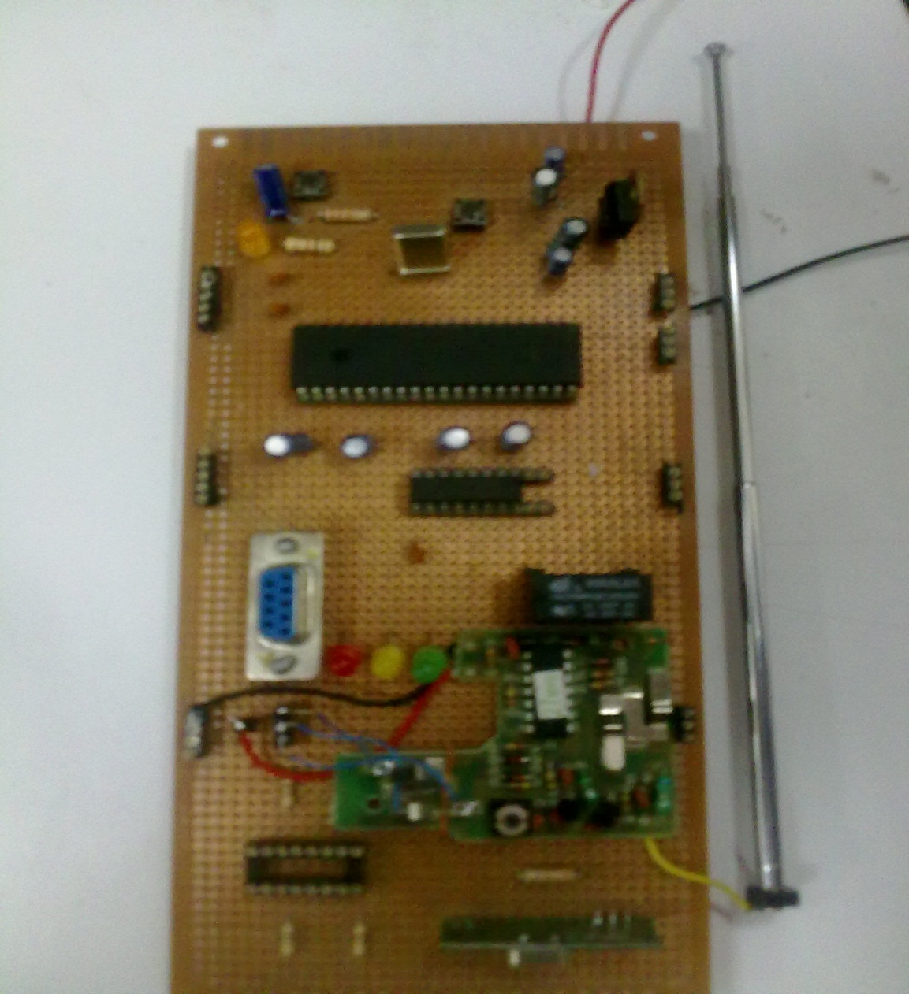
The traffic light Circuit:

