Slide 1

An-Najah National University
Faculty of Engineering
Walking Robot
Prepared by :
Abdullateef Zamel Mohammad Sukker Saber Thaher
Supervisor:
Dr. Bashir Nouri

Slide 2
Content:
Introduction.
Mechanical Part.
  Robot Parts.
  Motors .
  Positions of motors.
Electrical and Control Part.
  Closed loop system.
Walking mechanism.
Problems.

Slide 3
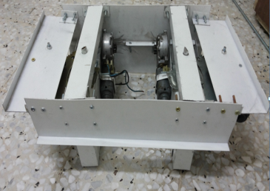

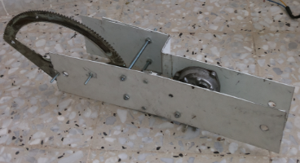

Robot Parts
Waist Hip joint Thigh Knee.

Slide 4
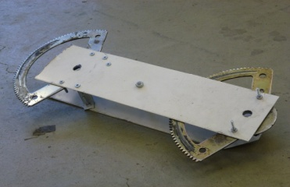
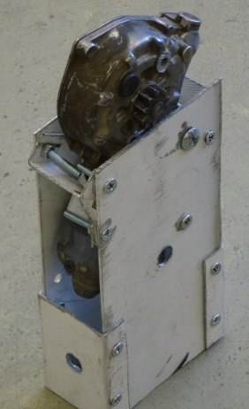
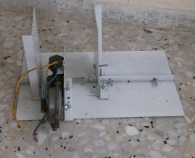
Robot Parts
Shank Ankle Foot

Slide 5
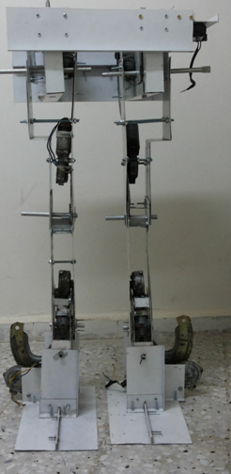
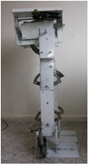
Robot Parts

Slide 6
Motors and There positions
DC-Motors are used to build the robot.
Each motor is car window motor.
Each motor has external gear.

Slide 7
Motors and There positions
Motors are distributed on the robot body :
To increase the stability of robot.
To avoid high inertia forces.

Slide 8
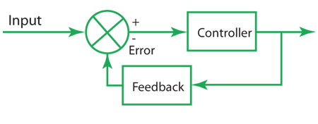
Closed loop system
Notes:
Closed loop system consist of main 3 parts that is microcontroller ,motor and potentiometer
In our project we have ardweno microcontroller , 10 motors and 10 potentiometer that make closed loop for all motors
This system operate by sending output signal from arwino to motor until the desired angle measured by potentiometer is reaches

Slide 9
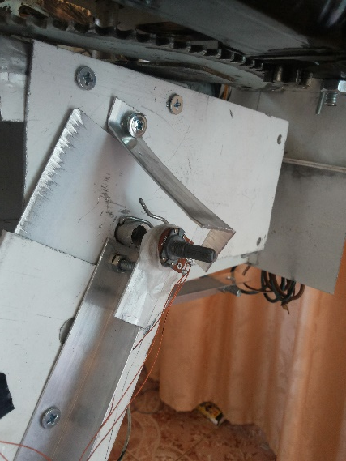
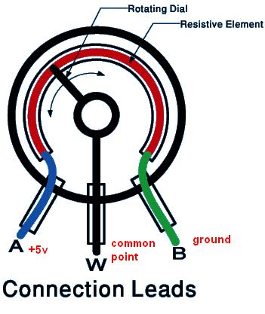
Potentiometer
Mechanical configuration
Lay on axes of each joint
Connecting to tow links
Electric circuit
rotating side is connect to Arduino
Other tow sides are connected to voltage source and GND

Slide 10
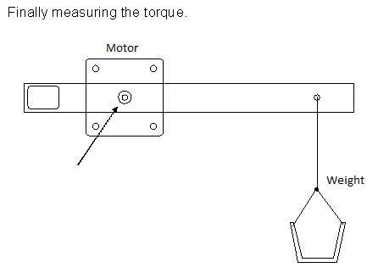
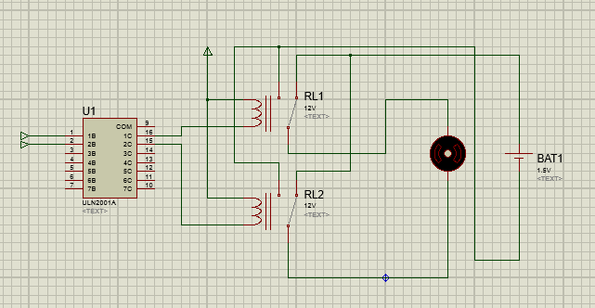
Electric motor
Motors torque test
Apply constant weight
along calculated distance.
Motor control circuit
Notes:
We have multi choices to select type of motor.
The main factor for selecting motor is the torque , so we test ability of different motor to lift the weight along distance L
And select motor of car window with external gear.
As shown here motor control circuit consist of ULN ic that connect from input to microcontroller and from output to 2 relays to protect microcontroller from e.mpact emf current ,2 relays here connect to motor to rotate it clockwise and counterclockwise

Slide 11
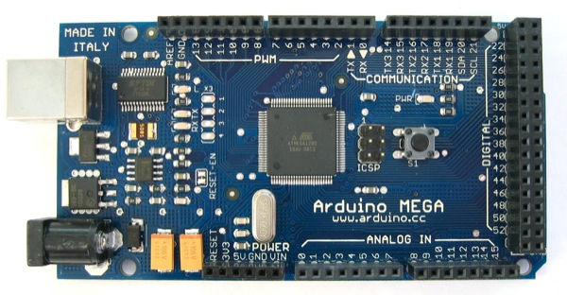
Arduino MEGA microcontroller
Notes:
Arduino microcontroller is the brain of the system to control direction and measure Angele of each motor,
That have 20 output bin connected to previous circuit and 10 analog input connected to potentiometers

Slide 12
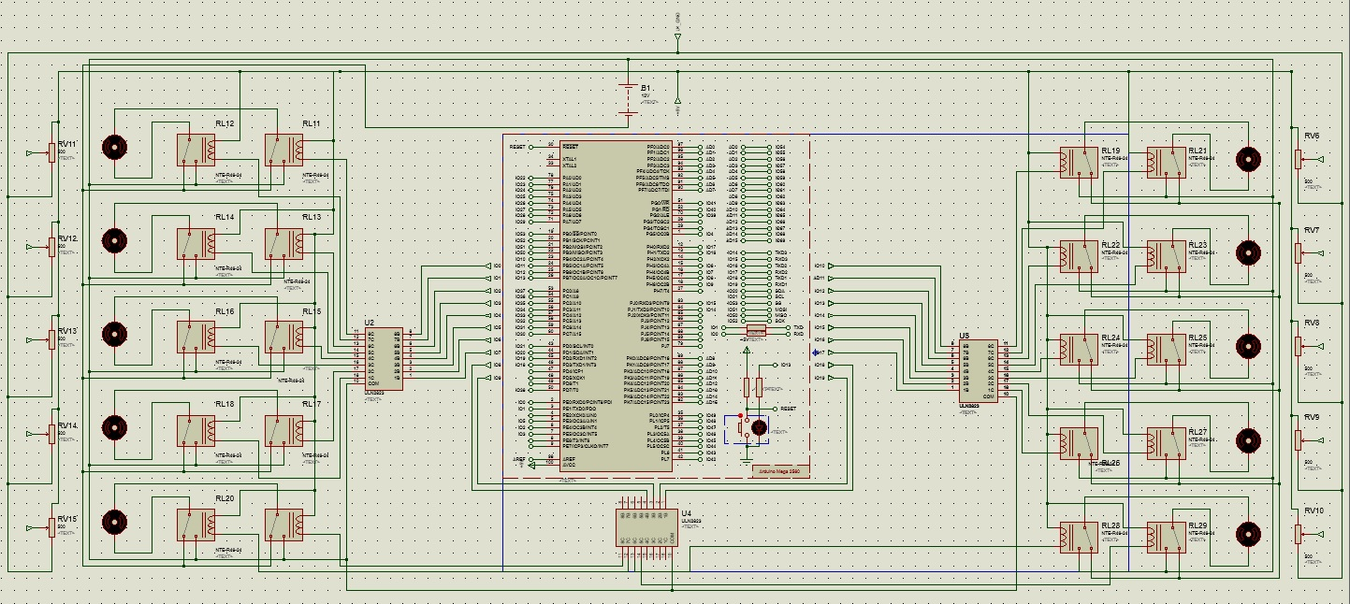
Notes:
As shown here this is complete circuit for all closed loop system

Slide 13
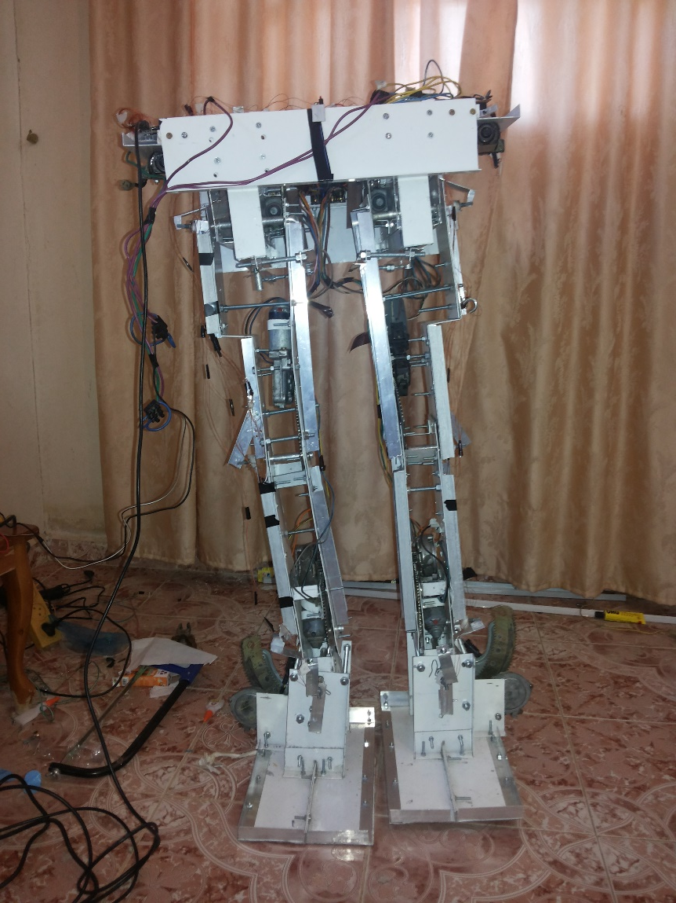
Walking Mechanism
Step1:
Rotating ankle joint to keep
the mass center point within
the support polygon.

Slide 14
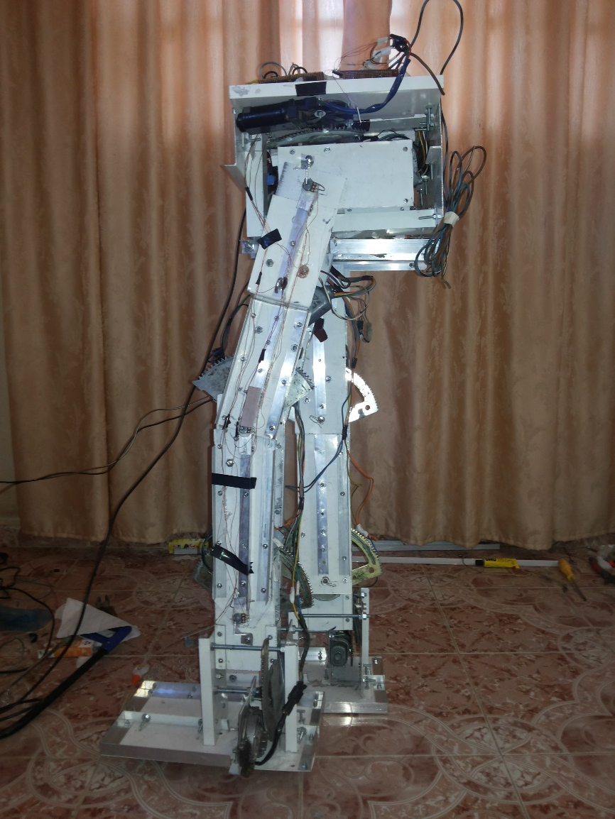
Walking Mechanism
Step2:
Lifting up the left leg by
moving hip joint and knee
joint.

Slide 15
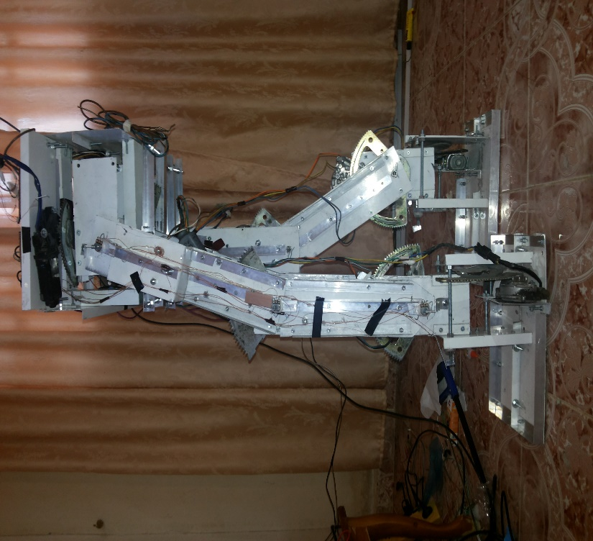
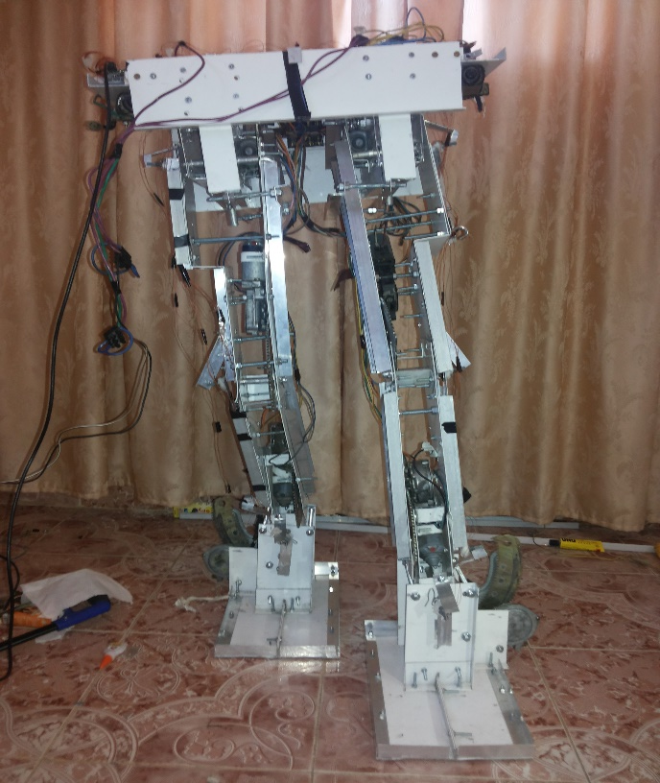
Walking Mechanism
Step3:
Lifting down the right leg by moving knee joint and ankle joint until the left leg reach the ground.

Slide 16
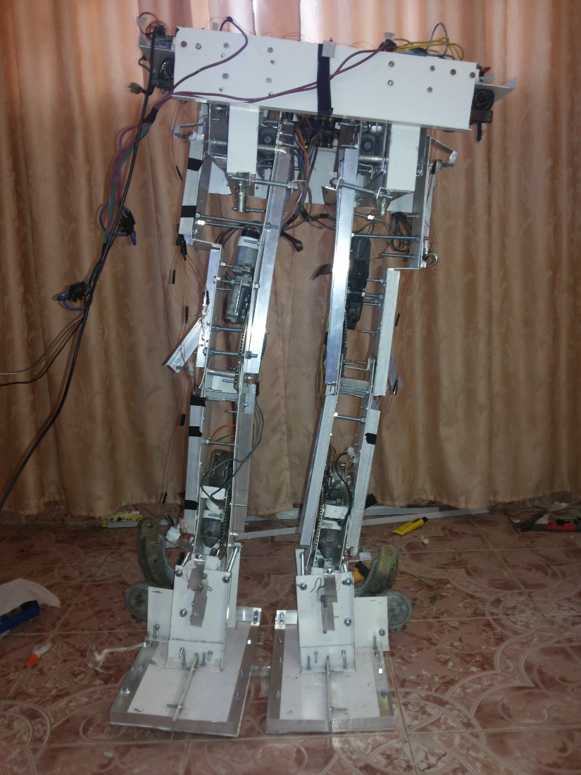
Walking Mechanism
Step4:
Moving the center point to the
left leg preparing for repeating
the previous movement.

Slide 17
Problems
Time .
Parts.
-Big motors.
- Material.
Battery (power + connection).
Gears and center.
Angles.

Slide 18
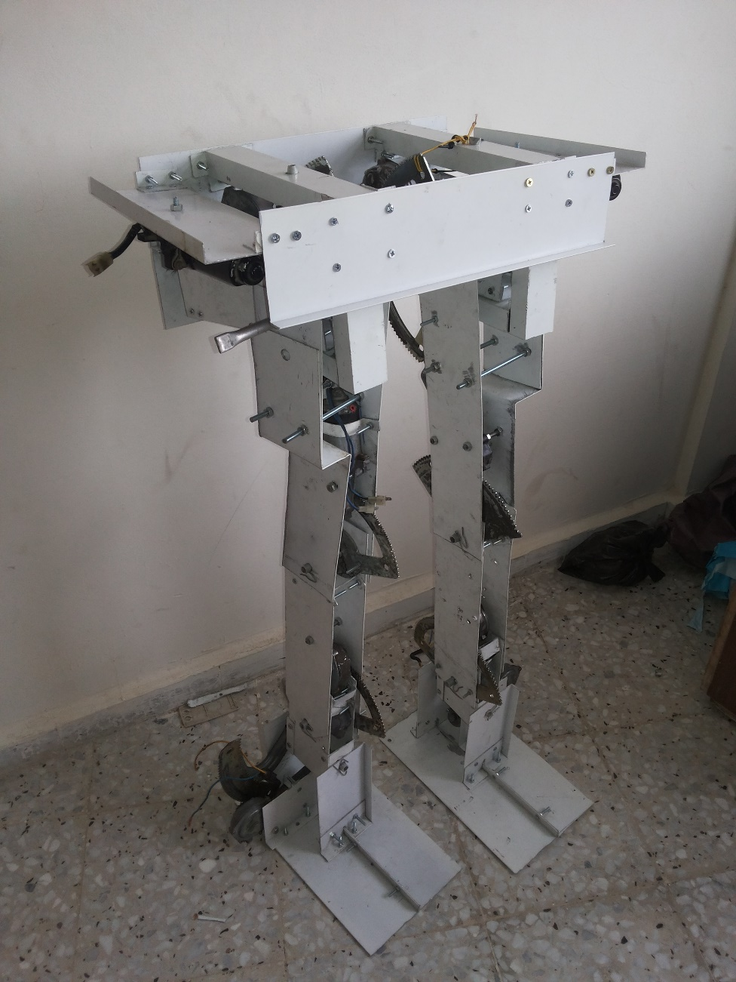
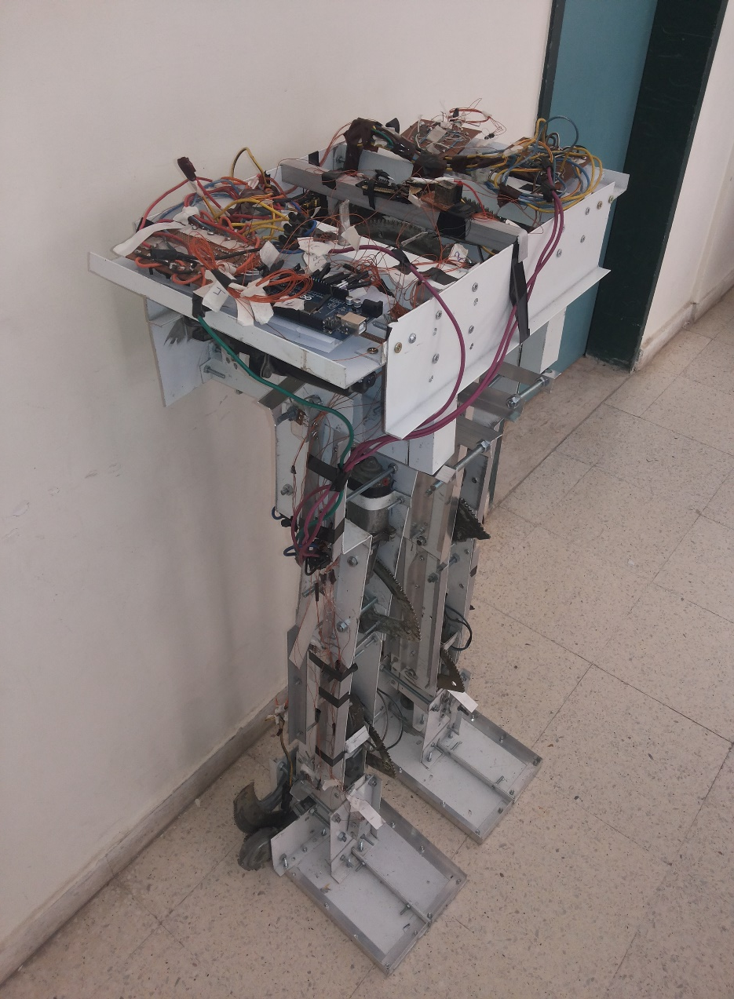

Slide 19
Thanks for listening
Any Question ?

