Slide 1
Safety Car
Prepared by : Zaina Hammouz
Sajeda Khdair
Supervisors : Dr. Alaadin Masri
Dr. Sufyan Samara

Slide 2
Out Lines:
Problem Statement
What's Safety Car ?
Methodology and Demo
Problems and Difficulties
Conclusion

Slide 3
Problem Statement
In our lives we noticed many problems that related to drivers includes car accidents for example in rainy weather. My project Safety Car helps to solve this problem in many ways.

Slide 4
What's Safety Car ?
It’s a car that has many features in order to avoid accidents with drivers while they are driving in different modes.

Slide 5
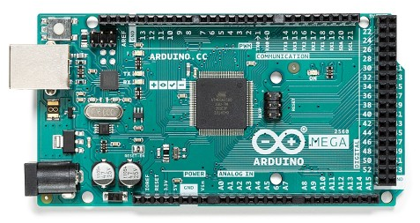
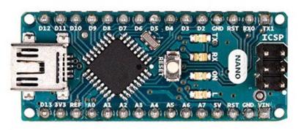
Vehicle Structure
Arduino Mega
The main controller of the project
Arduino Nano

Slide 6
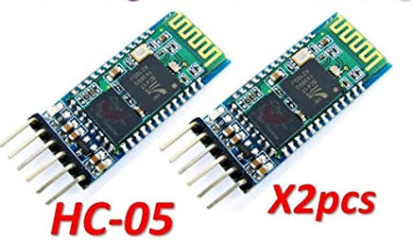
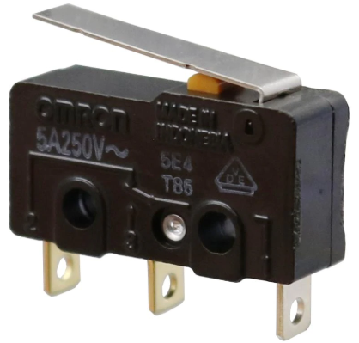
HC05
limit switch

Slide 7
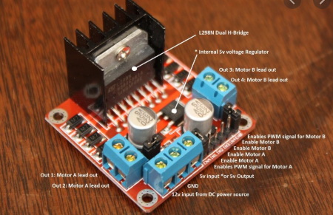
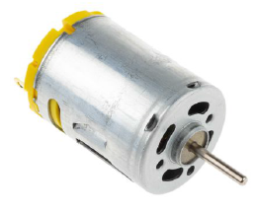
H-Bridge Motor Drive
DC Motor

Slide 8
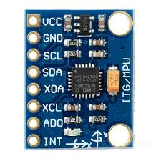
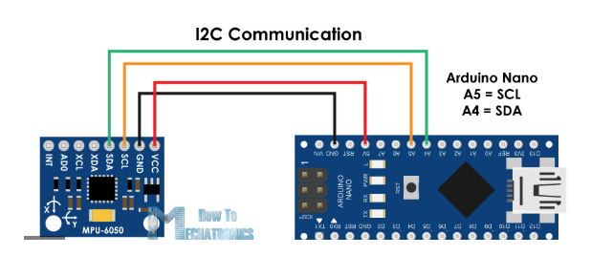
Smart Hat
MPU

Slide 9
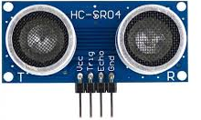
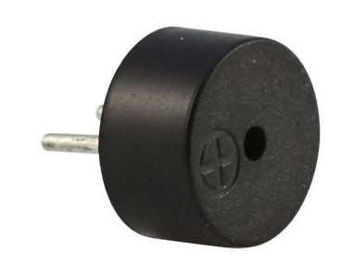
Distance Structure
Ultrasonic sensor
Buzzer

Slide 10
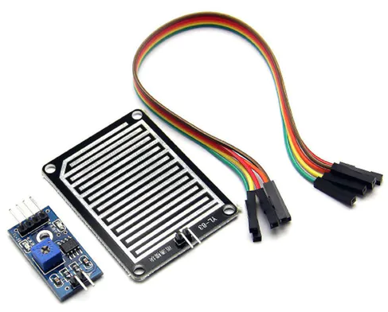
Rain Part
Rain Sensor

Slide 11
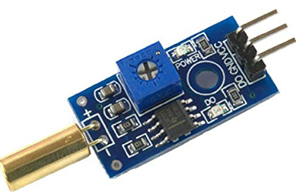
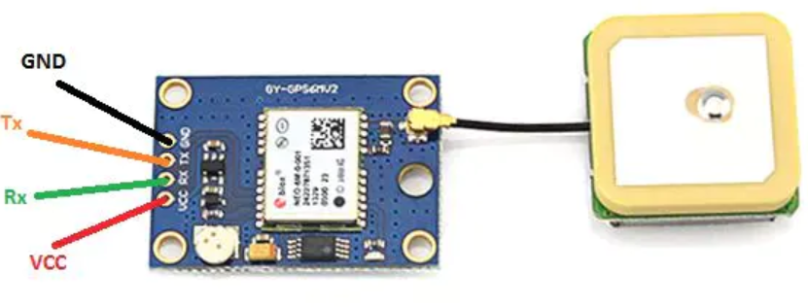
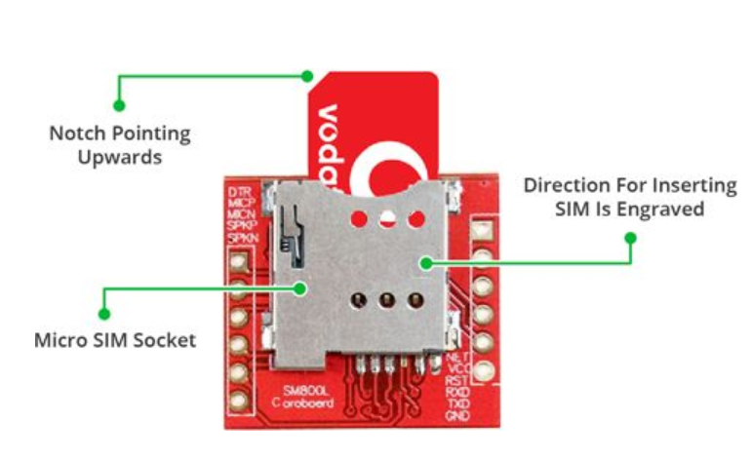
GPS and GSM system
Tilt Sensor Module
GPS
GSM

Slide 12
Demo

Slide 13
Problems and Difficulties
During the work of the project, we faced many problems such as :
Energy problem, Battery charging quickly relieves.
Corona Viruse and transportation.

Slide 14
Conclusion
At the end of the project we learned a lot of things
Dealing and controlling DC motors, many sensors as rain sensor and ultrasonic sensor.
Dealing with Arduino and implementing codes for electronic parts and controlling them

