Slide 1

Smart chair for people with special needs
Prepared By : Ikhlass ramadan
Sumaya abu nasser
Supervisors : sufyan samarah
Eng.asma’ afefh
Dr.hanal abu zannet

Slide 2
OUTLINE
What is smart chair?
Motivation
Components
Methodology
Constrains
Demo

Slide 3
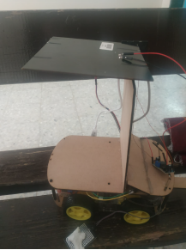
What is smart chair?
A chair has a features to facilitate the lives of people with special needs.

Slide 4
Motivation
People with special needs, can be creative and do their jobs, so think about them…

Slide 5
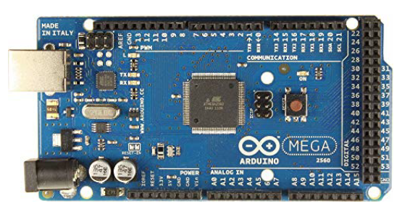
Arduino mega Microcontroller

Slide 6
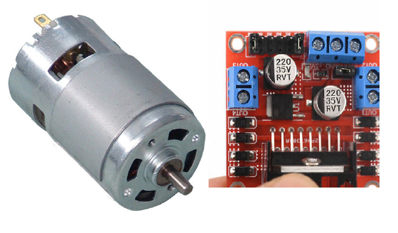
Dc motor with h-bridge

Slide 7
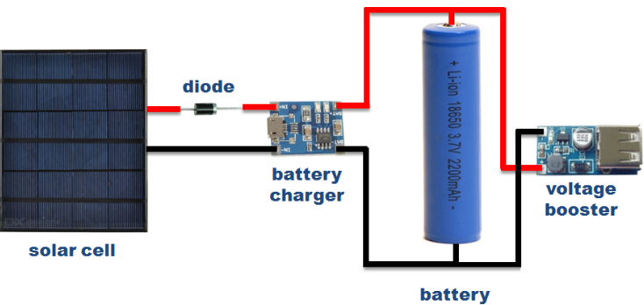
solar cell &
Step Down dc-dc

Slide 8
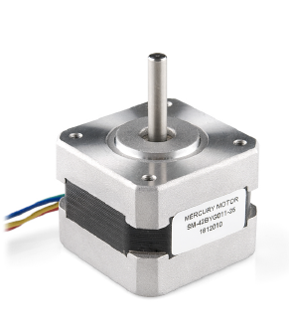

stepper motor

Slide 9
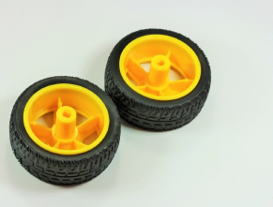
FOUR wheels

Slide 10
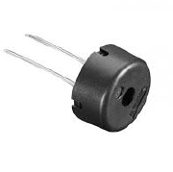
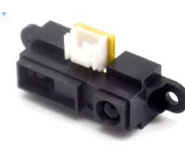
IR sensor & buzzer

Slide 11
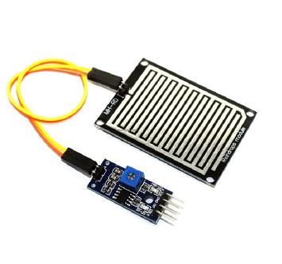
Humidity sensor

Slide 12
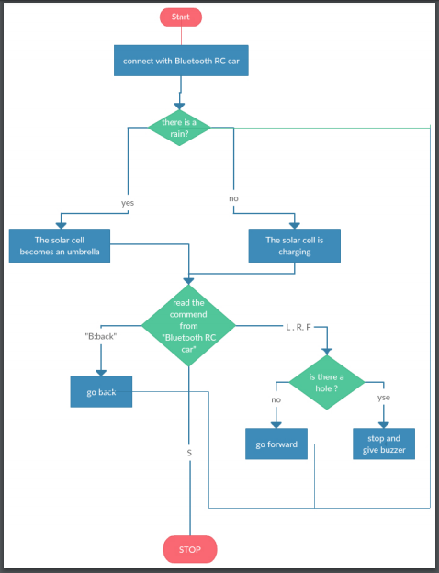
Flow Chart

Slide 13
Constraints
Designing Model.
Power.
Soler cell.
Stepper moter
when moveing the cell.

Slide 14
Future Work >>> so much!
move the chair by
the sound.
vibrations on the side of the chair.
GPS system.
Airbag.
More than one IR.

Slide 15

.

Slide 16
Thank You

