Slide 1
Fatigue testing machine
Fatigue Group :-
Abed Al Salam Hammouz
Ahmad Abaza
Ala’ Mustafa
Mohammad Bahish
Supervised by :-
Dr. Ahmad Al Ramahi

Slide 2
Outline
Part one Review.
Design stage.
Manufacturing and Assembly
Testing and documentation
Cost analysis and further work

Slide 3

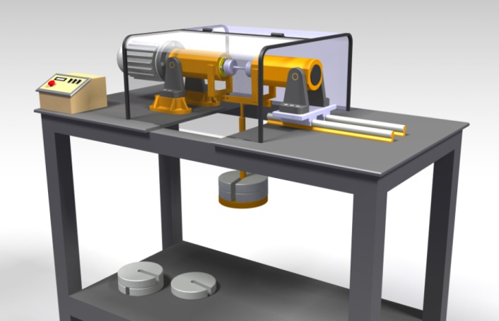
Part One Review
Literature review about fatigue
Preliminary design
Notes:
What we did in first project?? search about fatigue

Slide 4
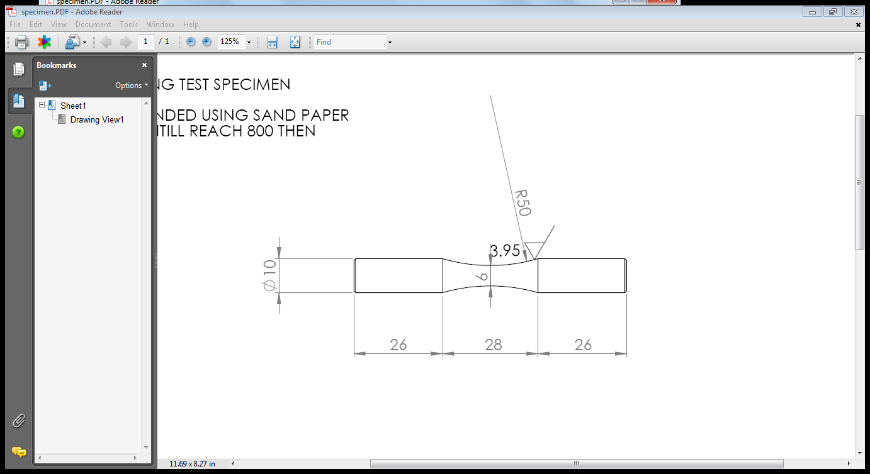
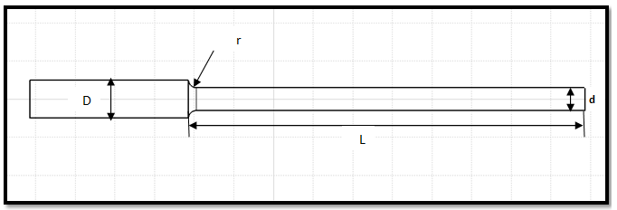
Preliminary Design - Specimens
Four point clamping test specimen .
Three point clamping test specimen .

Slide 5
Preliminary Design – Life Estimation
Stress based approach :

Slide 6
Project Stages
Fatigue Testing Machine
Design
Fabrication
Testing

Slide 7
Design stage
Machine Functions and Layout.
Design Calculation.
Notes:
Three main things
1-Here you have to illustrate what is the machine and how it is work
Main mechanisms
1- CAD drawing for the machine
2- theoretical calculation
Video for assembling the machine
3-functions of the machine

Slide 8
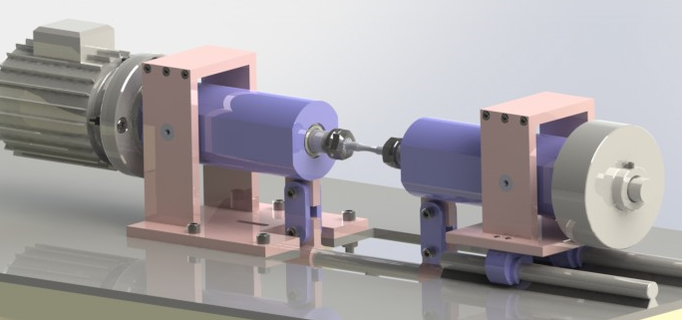
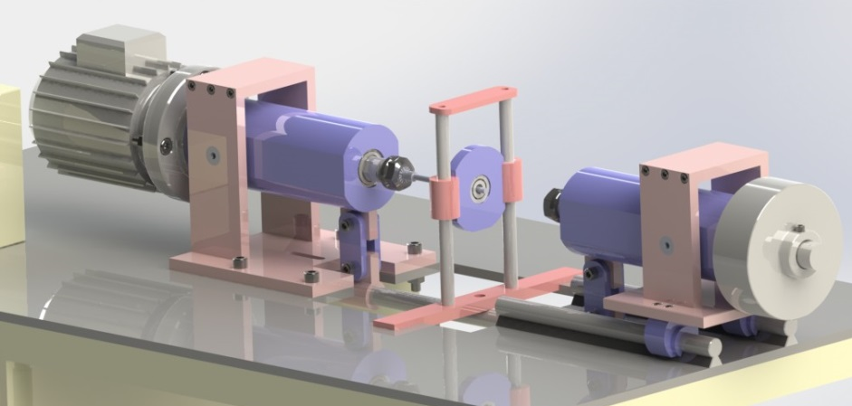
Machine Functions and Layout
Rotating bending
Cantilever
Notes:
May be a

Slide 9
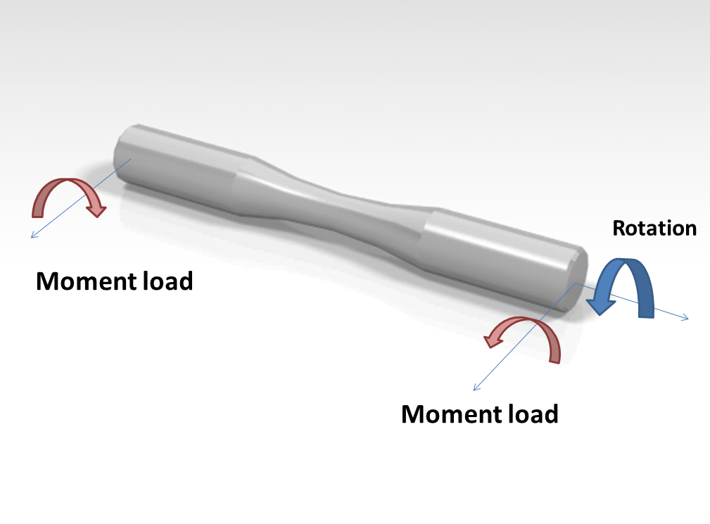
Rotating bending test
Put the specimen under pure bending moment

Slide 10
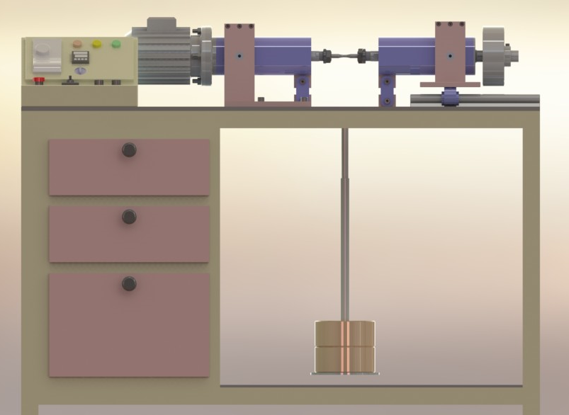
Rotating bending test
F/2
F/2
Forcing method using dead weights.

Slide 11
Rotating Bending

Slide 12
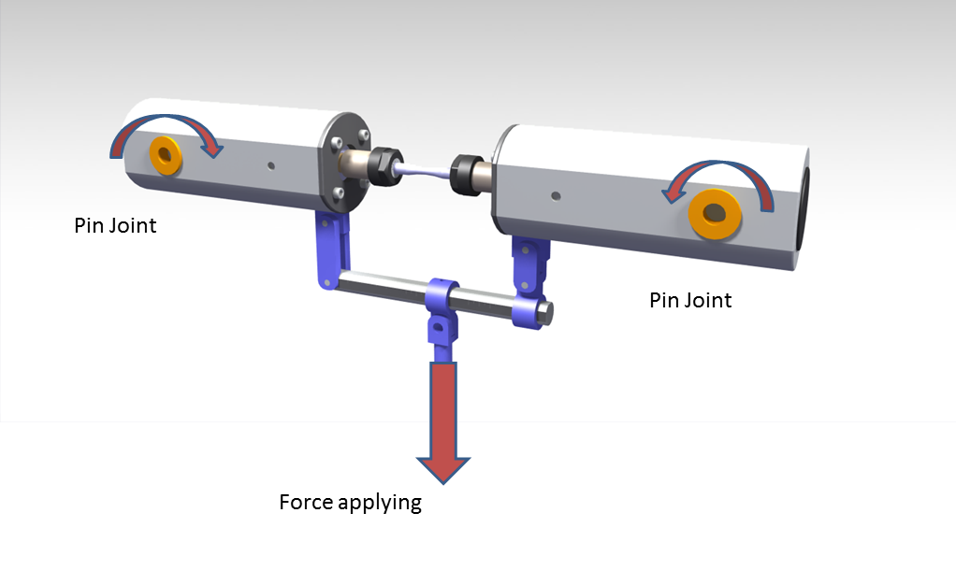
Rotating Bending

Slide 13
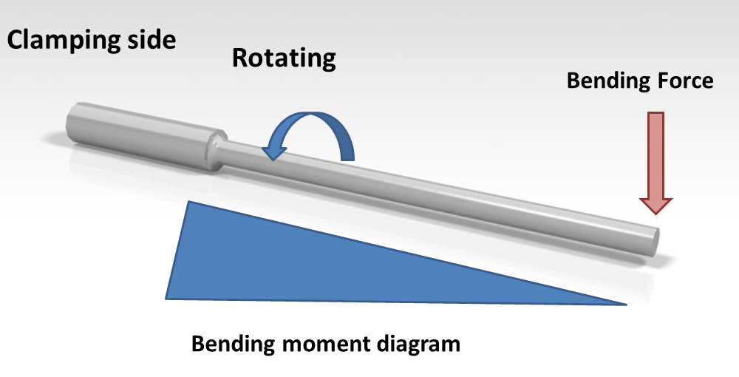
Cantilever

Slide 14
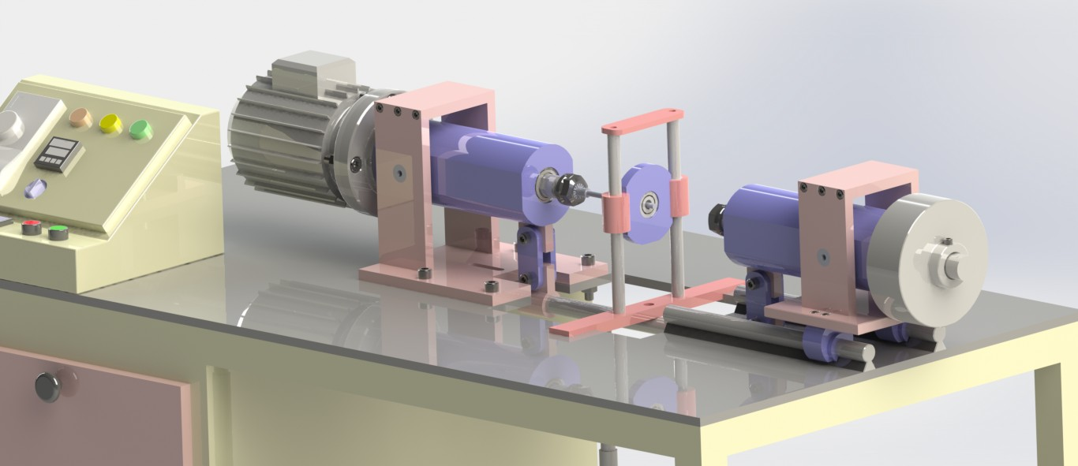
Cantilever

Slide 15
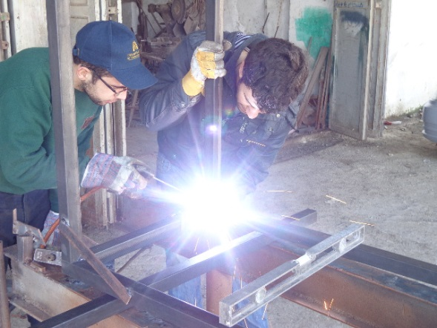
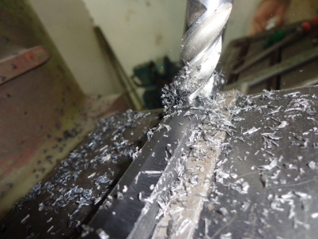
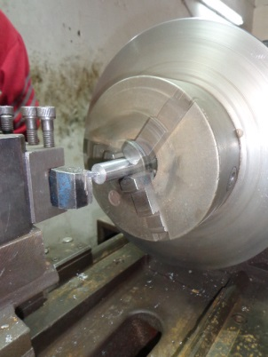
Manufacturing and Assembly
Used Manufacturing processes
Turning
Welding
Milling
Notes:
Abood role

Slide 16
video

Slide 17
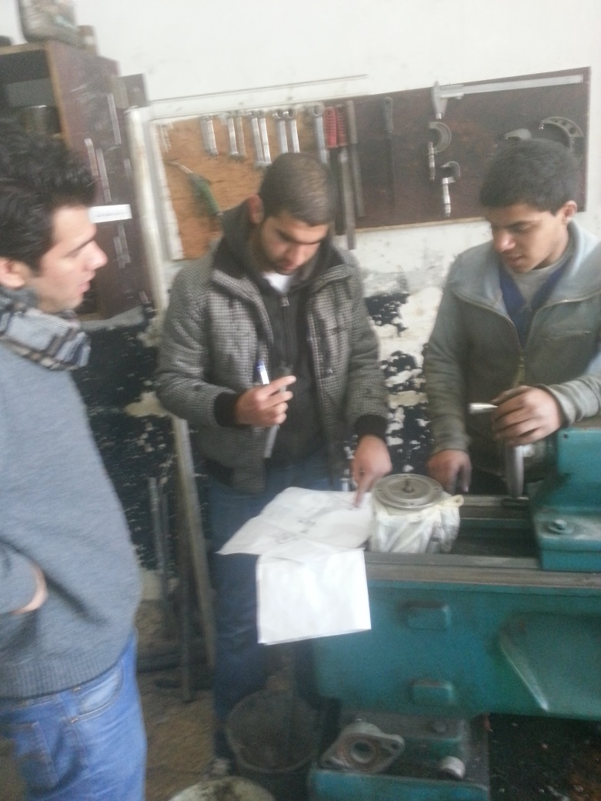
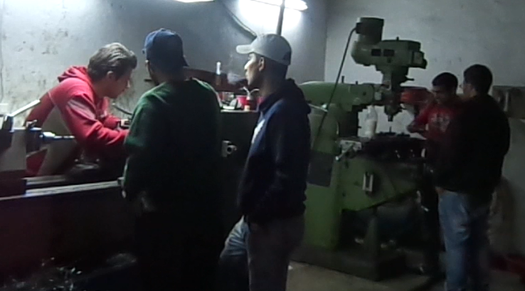
Manufacturing Challenge

Slide 18
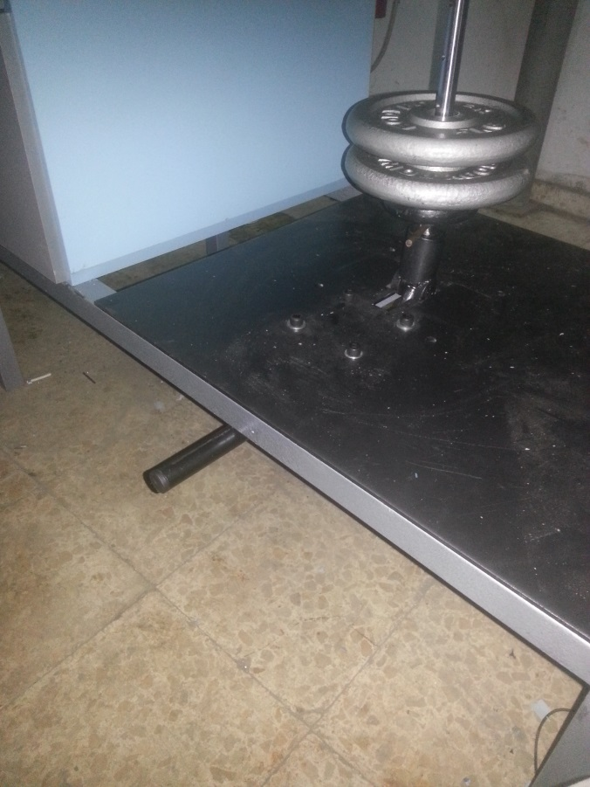
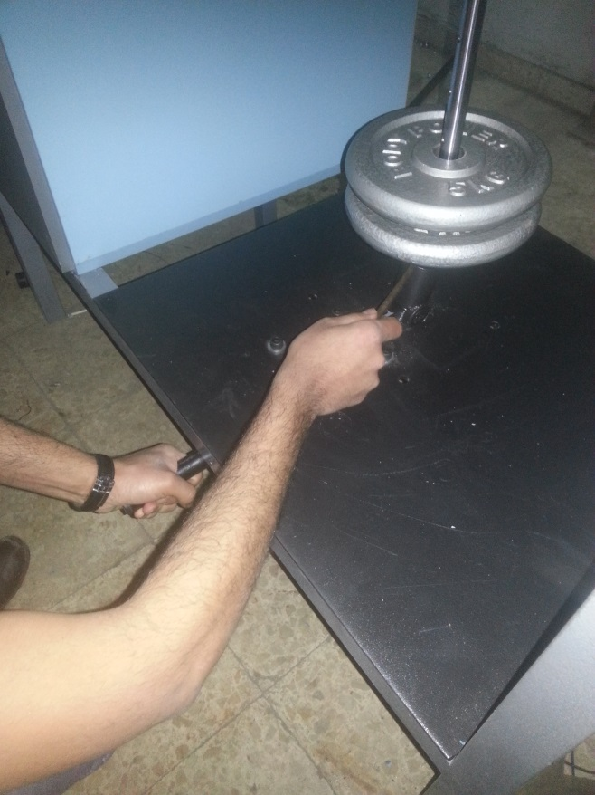
Machine Features
Ease of use.

Slide 19
Machine Features
It has a good flexibility.

Slide 20
Electrical Circuit
Ease of operate machine.
Control the time of experiment .
Give accurate results for number of cycles to failure .
Support safety for both user and machine .

Slide 21
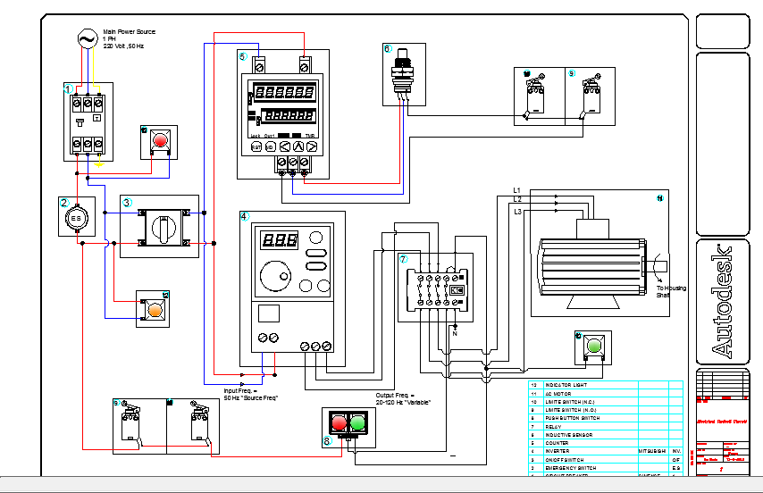
Electrical Circuit

Slide 22
Electrical Circuit
Safety mode
The motor does not work until:
The main switch is ON.
Emergency switch and (ON/OFF switch) are ON.
Cover of the motor is completely closed.

Slide 23
Electrical Circuit
Accuracy in reading results
To get the accuracy in results.
The normally open limit switches are ON.
The normally closed limit switches are ON.
Then sensor feeds signals.

Slide 24
Electrical Circuit
Open limit switches are ON means the cover of the motor is closed, the house is not aligned, does not happen any failure in the specimen.
Closed limit switches are ON means, the contactor start connecting, and there is a load affecting on the specimen.

Slide 25
Electrical Circuit
When start getting signals from the sensor,
counter counting until the specimen fails, then:-
The motor stop rotating,
Sensor stop feeding with signals,
And the counter holds the values on.

Slide 26
Cost analysis and similar machines
Comparison criteria | Our Fatigue Testing Machine (FTM) | Other manufacturer (OM) | Marks
Cost | 2500 $ | 12,000 $ | FTM
Machine functions | Three types of tests. | One type. | FTM
Productivity experience | Lake of experience, first trial. | Professional work. | FTM

Slide 27
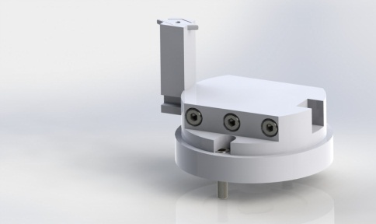
Specimen Forming

Slide 28
Specimen Forming
video

Slide 29

Polishing

Slide 30
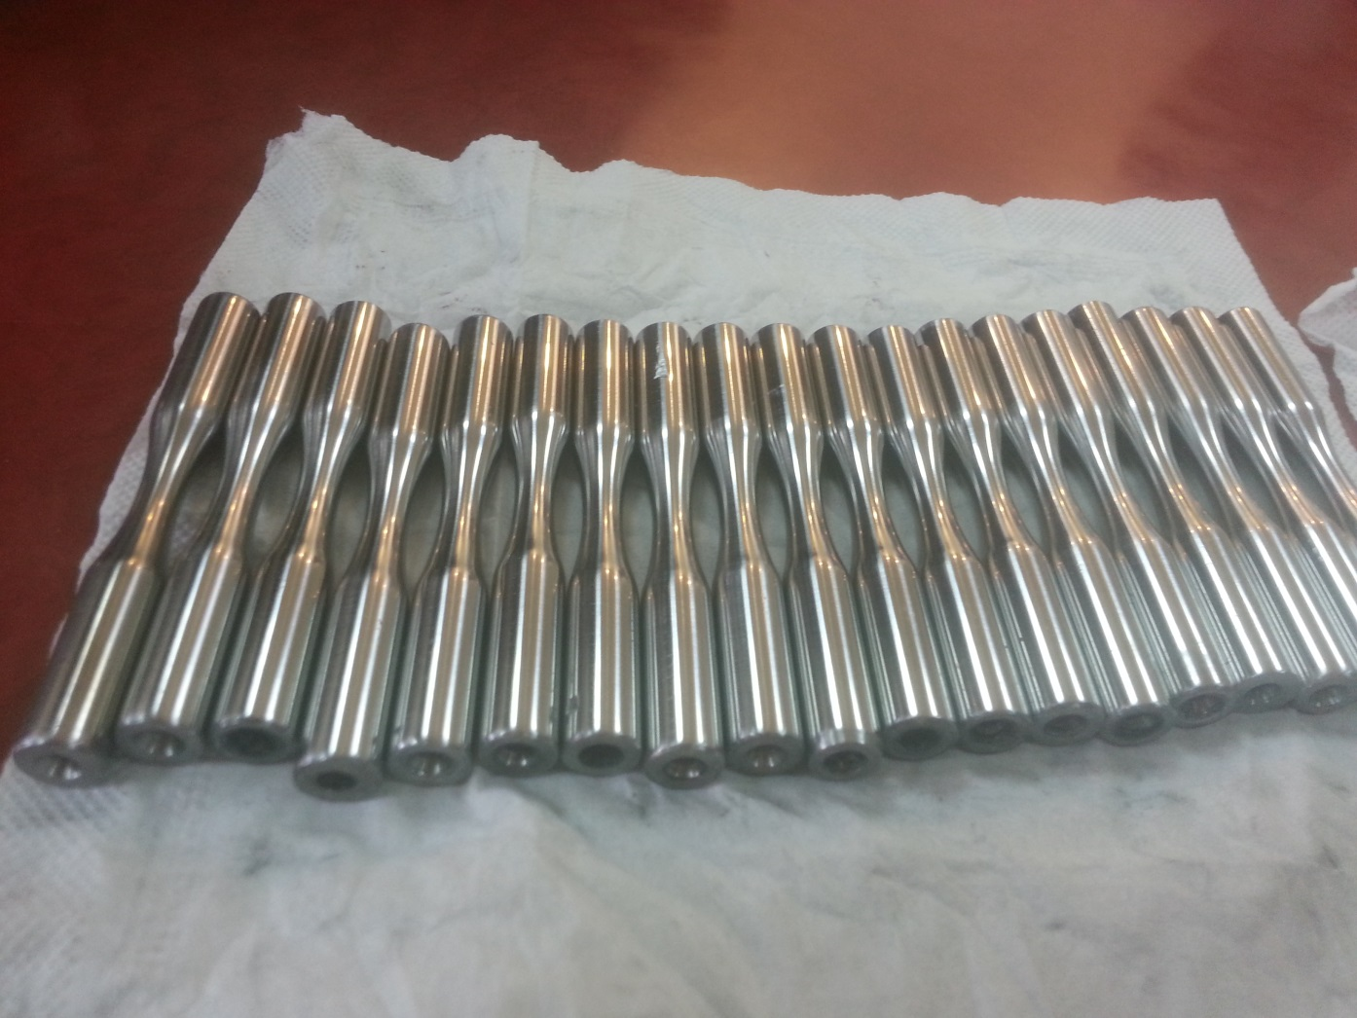
Testing and Documentation
Testing operation

Slide 31
Testing and Documentation

Slide 32
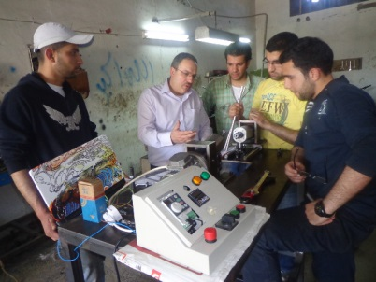
Thanks

