Slide 1
IoT enabled Autonomous Smart Water-meter Networking
ya
Supervisor: Dr. Othman.M.Othman
Students:
Yara Alqadah
Tharwat A’raj
Lama Abu-Zahid

Slide 2
Index:
What is IoT
Motivation and Goals
Architecture of the smart-Water meter
Design of the Autonomous networking of smart-water meter
Evaluation
Conclusion

Slide 3
Internet of Things (IoT)
The world is moving towards automating things using IoT
IoT build a network of connected physical objects that are accessible through the internet.
This enables these objects to connect and exchange data

Slide 4
Motivation and Goals
Build a autonomous, self organizing network, connecting smart water meters
Use two networks that work in a complete harmony as if they are a one network

Slide 5
Similar projects
Many papers were written on this topic:
    Research on Water Meter Reading System Based on LoRa Communication
      Drawbacks: LoRa communication has limited network size based on parameter called as duty cycle.
    A Novel Smart Water-Meter based on IoT and Smartphone App for City Distribution Management .
      Drawbacks: Focus on the hardware more than the communication between meters.
    An IoT based 6LoWPAN enabled Experiment for Water Management
      Drawbacks: 6LoWPAN protocol could not be deployed easily because it requires extensive knowledge of stack and the workability of IPv6.
Notes:
[1] proposes a wireless meter reading system by using both the multilevel relay and the concentrator based on LoRa communication.
[2] to perform automated water-meter reading for updating the consumption information from field to the database utility for billing and payment. This smart water-meter approach differs from traditional methodologies by using simple IoT hardware in conjunction with smartphone app
[3]developed communication in wireless systems for water metering by using ZigBee which provides more accuracy than the traditional analog water meters , but it's much expensive
Also, using 6LoWPAN protocol which 6LoWPAN allows the transmission of IPv6 packets over IEEE 802.15.4 links

Slide 6
Technology
RF technology
  Low power consumption.
  Cheap.
WiFi technology
  High availability in homes and large coverage area.
  Act as a sink to send the data directly to server on the internet.

Slide 7
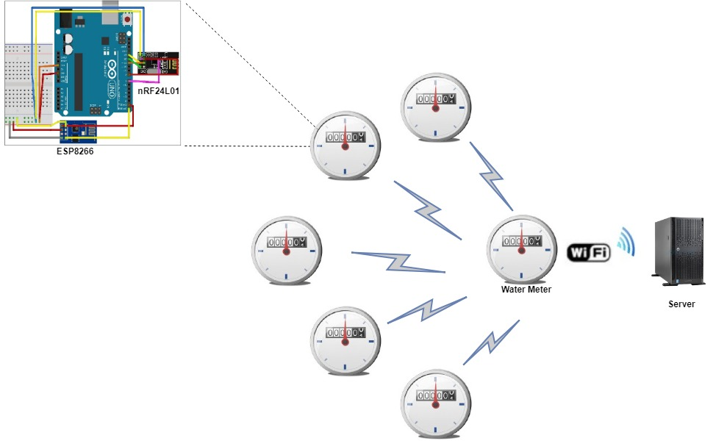
Architecture of the smart-Water meter

Slide 8
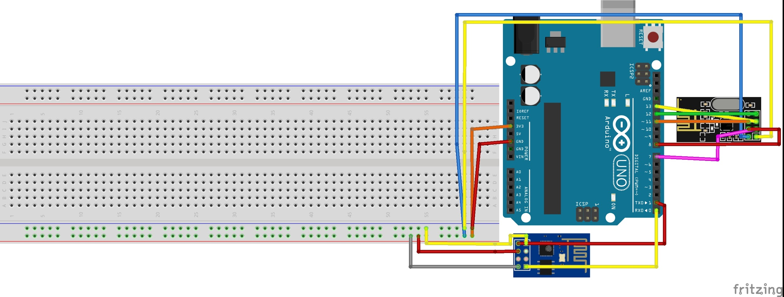
nRF24l01
ESP8266

Slide 9
Architecture of the smart-Water meter
What hardware is needed for project?
  Radio module ( nRF24L01) :
    2.4 - 2.5 GHz ISM band
    current consumption only 9.0mA
    range of 100 meters.
  Wifi module ( ESP8266) :
    self-contained SOC with integrated TCP/IP protocol stack
    work on 3-3.6V
    366 meters
  Arduino Uno

Slide 10
assumption
Assume that the power will be supplied to the modules using water generator.
Consider number of connected node and wifi availability.

Slide 11
Node Types
Original Node
Initial Node: the node that select the initial CH
Initial CH: the node that select te CH node and form clusters
CH: the main node that collect the data from intermediate node & send it to server.
Intermediate node:the node connected directly to CH
Secondary CH: node connected with intermediate node.

Slide 12
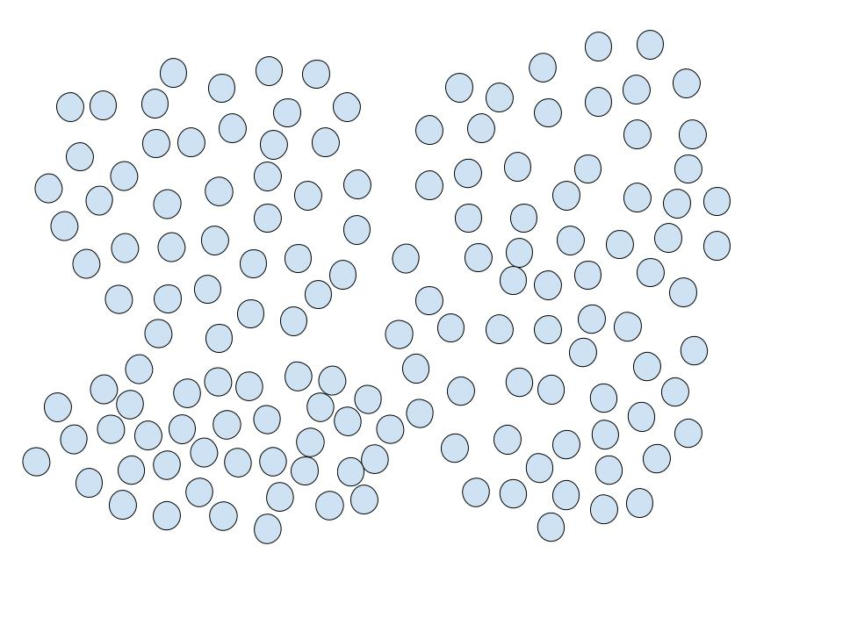
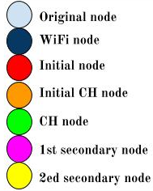

Slide 13
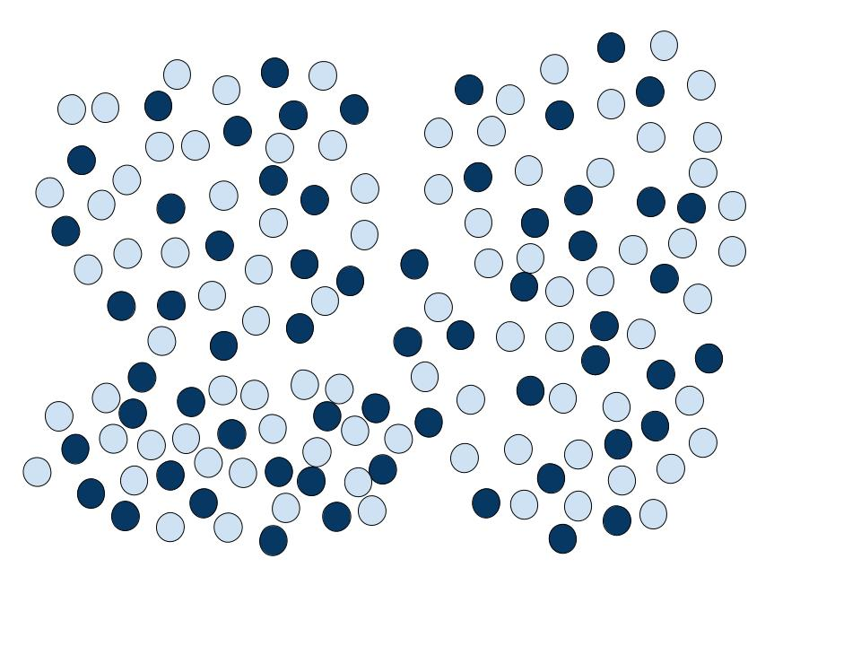

Slide 14
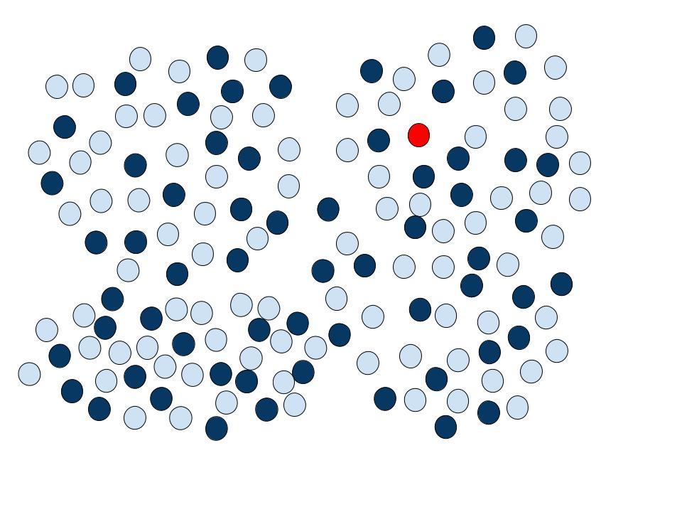

Slide 15
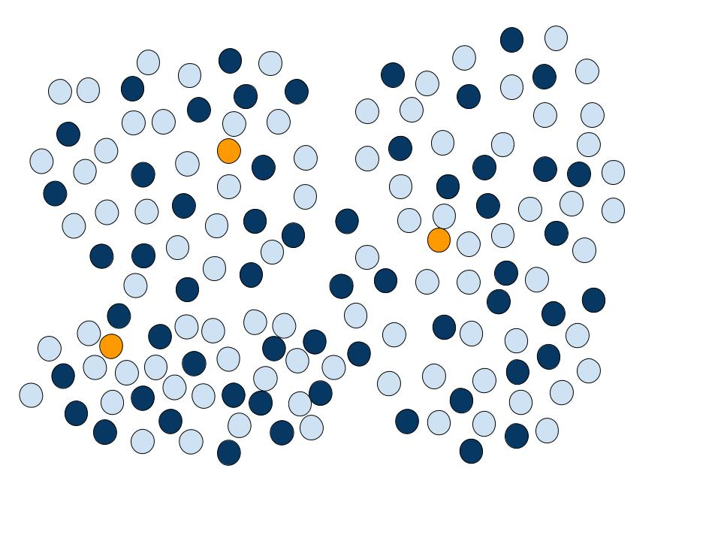

Slide 16
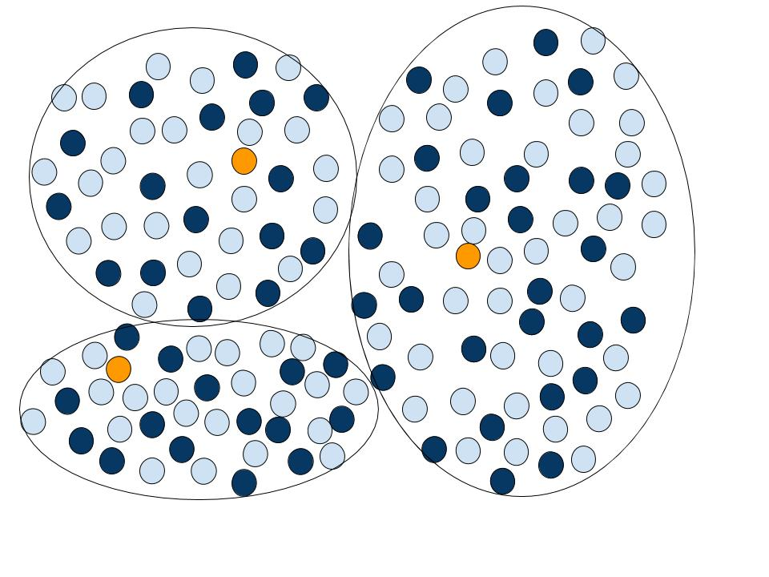

Slide 17
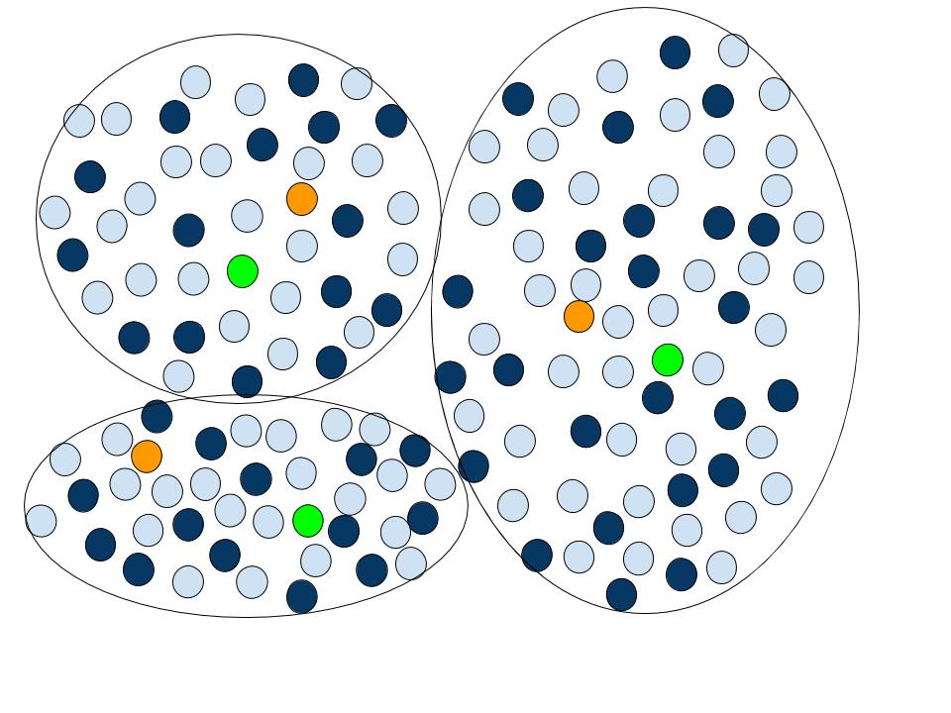

Slide 18
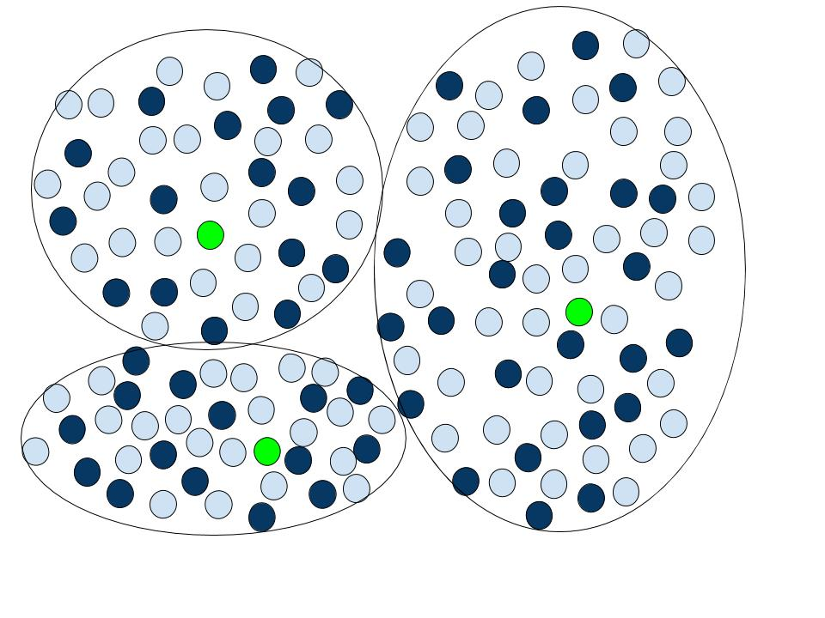

Slide 19
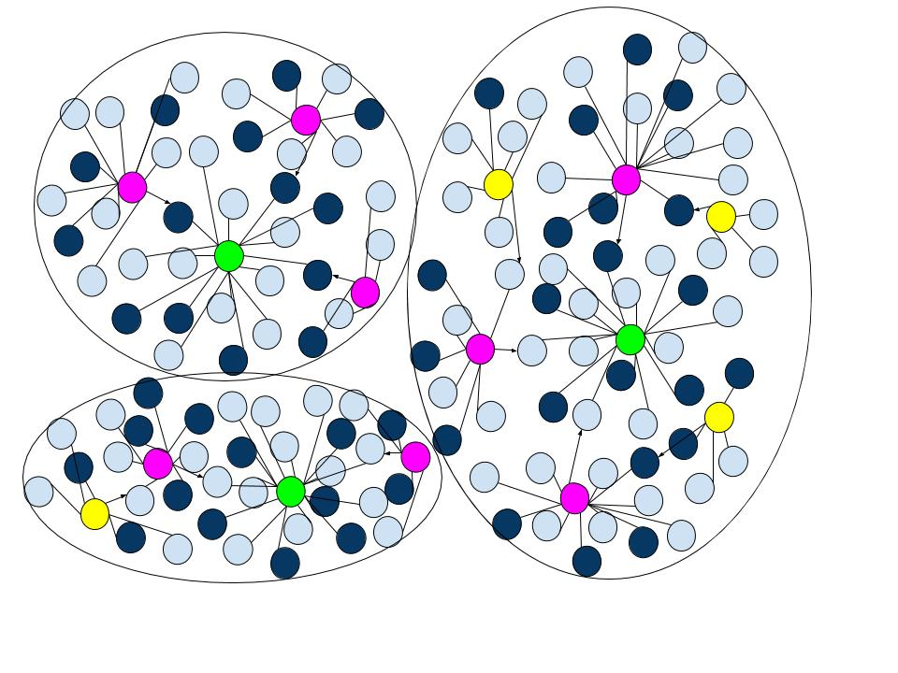

Slide 20
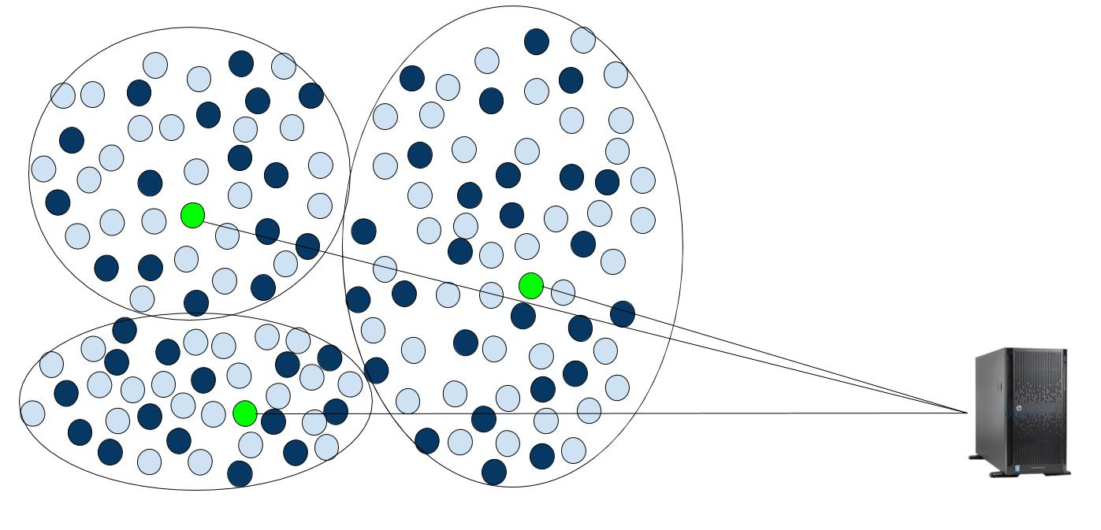

Slide 21
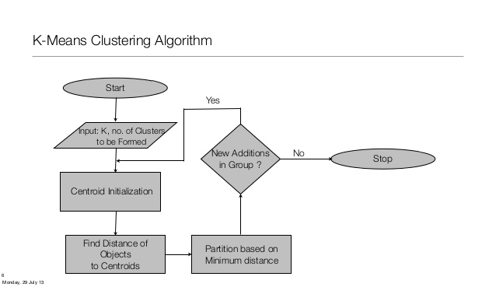

Slide 22
Advantages
Easy to implement
Disadvantages:
need to specify k
Selection of the initial cluster is random.

Slide 23
Messages
In this protocol there are 4 main messages exchanged:
Broadcast
Connectivity
Cluster head
Data

Slide 24
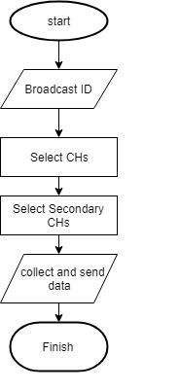
Node Flowchart:

Slide 25
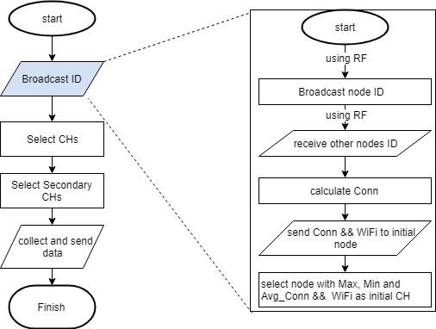
Flowchart: Broadcast ID

Slide 26
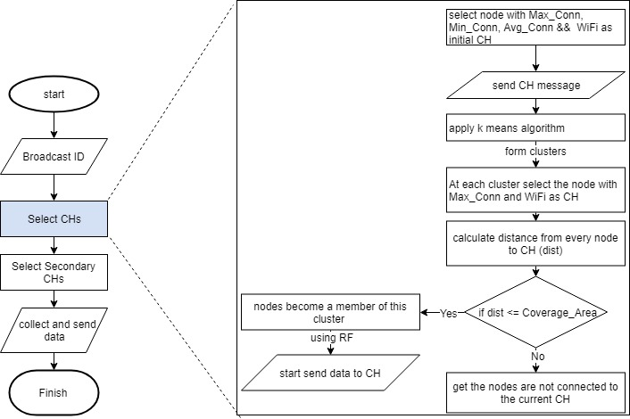
Flowchart: Select CH

Slide 27
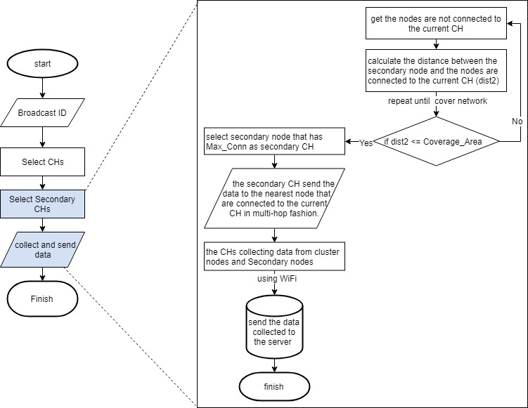
Flowchart: Select Secondary CH, collect and Send Data

Slide 28
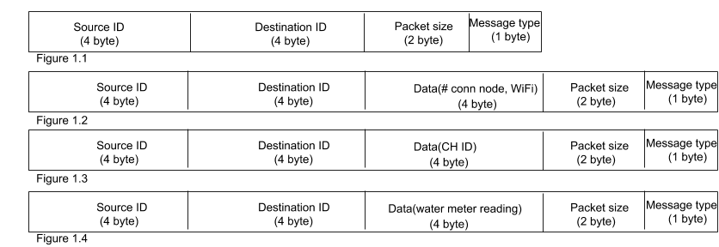
Messages
Broadcast
Connectivity
Cluster head
Data

Slide 29
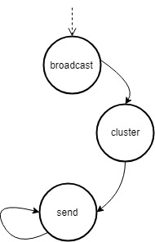
State Machine of node

Slide 30
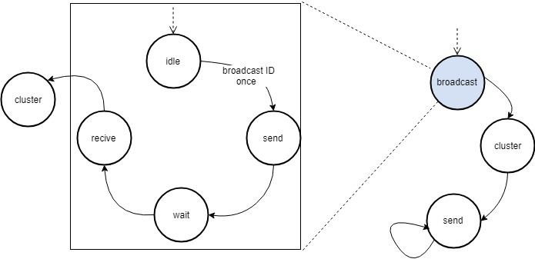
Broadcast: Original Node

Slide 31
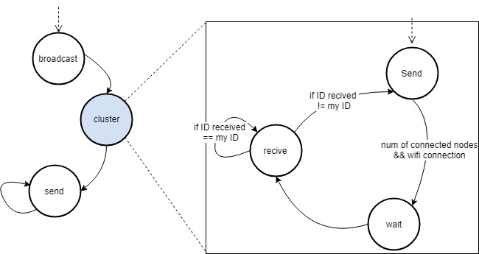
2. Cluster: Original Node

Slide 32
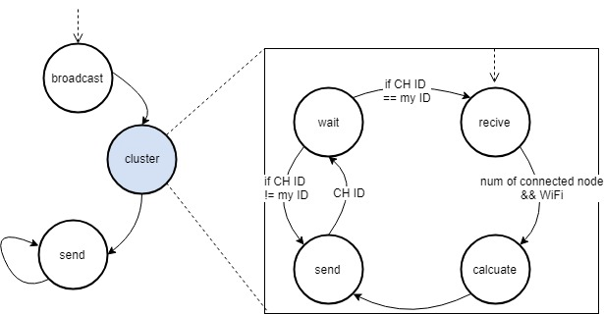
3. Initial CH

Slide 33
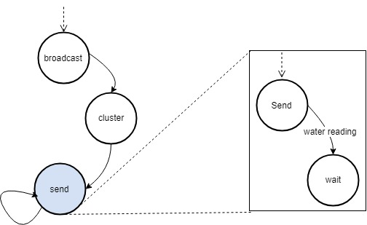
4. Original Node

Slide 34
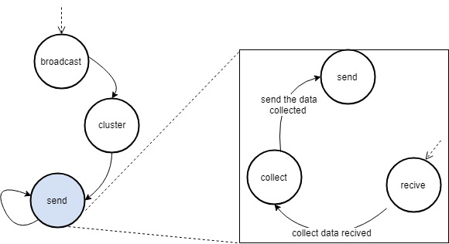
Cluster head, Secondary and intermediate node

Slide 35
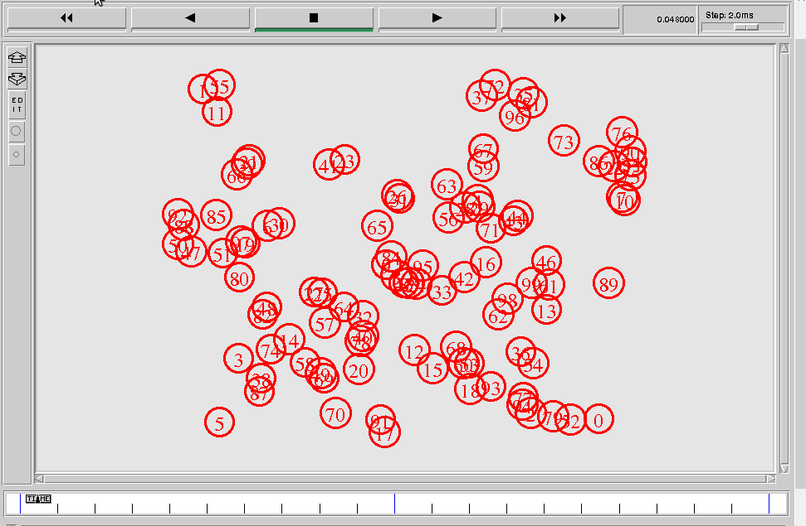
Simulator

Slide 36
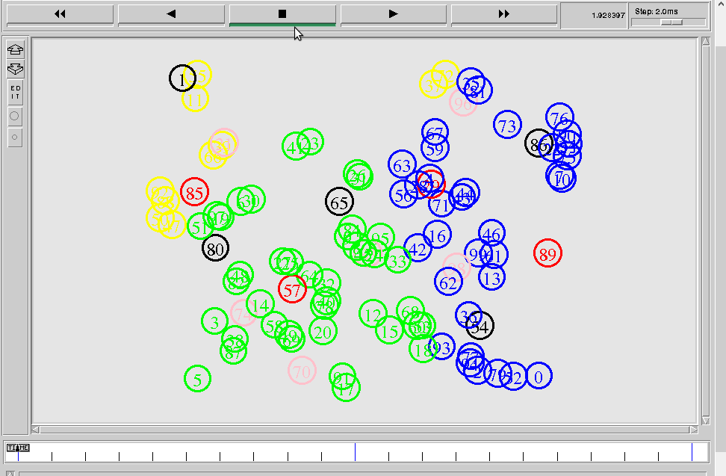

Slide 37
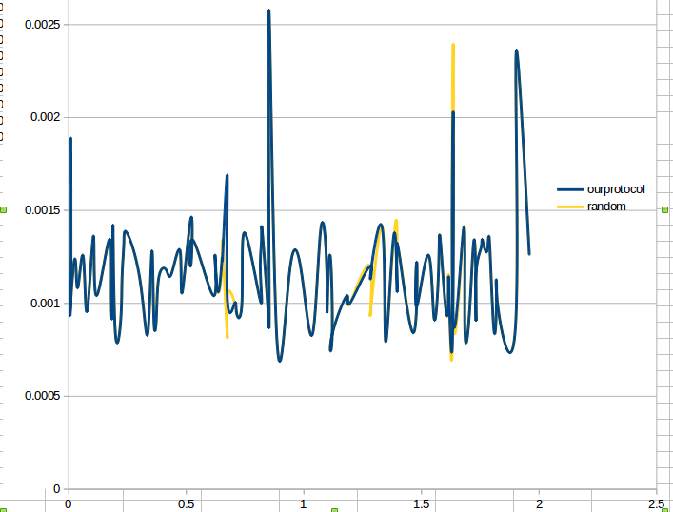
Evaluation
end-to-end delay
Our protocol
Random

Slide 38
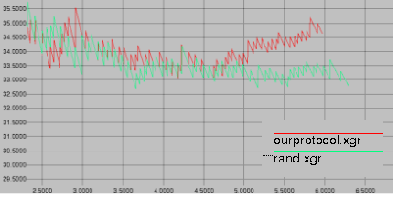
Delivery ratio
Our protocol
Random

Slide 39
Future work
Sometimes there will be isolated area that we can't reach
We are thinking to solve this problem by using mobile car to collect data
Improve the algorithm to select number of clusters by itself

Slide 40
Conclusion
This project was applied by configuring two heterogeneous network
The nodes was divided into clusters using k-means algorithm
evaluated in terms of delay and delivery ratio and as we saw the results was better for our protocol.

Slide 41
Thank You

Slide 42
References
[1]Research on Water Meter Reading System Based on LoRa Communication
[2] M Suresh, U. Muthukumar and Jacob Chandapillai, “A Novel Smart Water-Meter based on IoT and Smartphone App for City Distribution Management ”, Data Acquisition Systems Laboratory, Centre for Water Management Fluid Control Research Institute. Palakkad, Kerala. 678 623. INDIA.
[3]An IoT based 6LoWPAN enabled Experiment for Water Management
[4]http://www.teomaragakis.com/hardware/electronics/how-to-connect-an-esp8266-to-an-arduino-uno/
[6]https://www.sparkfun.com/datasheets/Components/nRF24L01_prelim_prod_spec_1_2.pdf
[7]https://www.espressif.com/sites/default/files/documentation/0a-esp8266ex_datasheet_en.pdf
[8]https://www.farnell.com/datasheets/1682209.pdf

