Slide 1


An-Najah National University
Chemical Engineering Department
Bioconversion of Whey to Lactic Acid Using Lactic Acid Bacteria (LAB)
Submitted by: BARAA AMER HIBA SARSOUR
MOUNTAHA ESHTAYA NOOR YASEEN
Supervisor: Eng. MAJD SHHADI
5/25/2011

Slide 2


Contents
Introduction
Lactic Acid Bacteria LAB Isolation from dairy- by products.
LAB Growth rate.
Lactic Acid Production from Whey.

Slide 3


Objectives
Lactic Acid Bacteria LAB Isolation from dairy product.
Study LAB Growth Rate.
Study the Effect of Whey concentration on the Lactic Acid production by batch
fermentation.

Slide 4
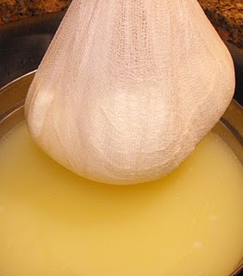
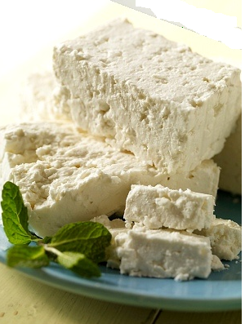
What is the Whey?
It is the watery part of milk remaining after separation of the curd, which results from the coagulation of milk proteins by acid or proteolytic enzymes.
It is the by-product of cheese and casein manufacture.
1Kg of cheese
9 L of whey

Slide 5
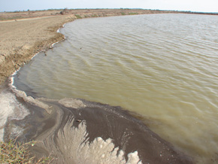

Whey and Environment
Whey is considered as a pollutant.
50% of 115million tons of whey
produced yearly disposed to rivers
and lakes.
70 g/l COD.
50 g/l BOD

Slide 6

Lactic Acid
Lactic acid (2-hydroxy prop ionic acid) is the most widely occurring carboxylic acid in nature C₃ H₆ O₃.
Lactic acid is produced by:
Biologically.
Chemically.

Slide 7
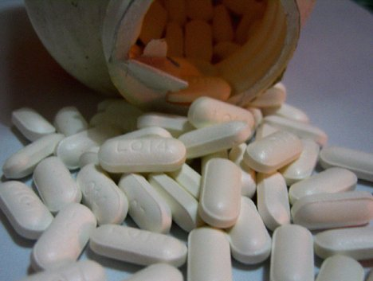


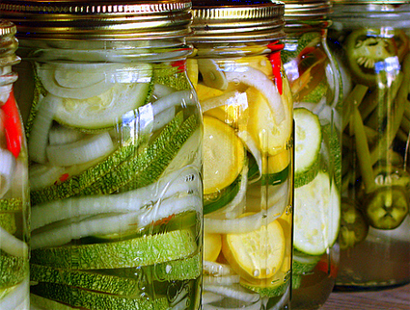

Pharmaceutical Industry
chemical industry
Cosmetic Industry
chemical feed stock
Food Industry
Lactic Acid

Slide 8
Experimental Work
Part One
Isolation of LAB from dairy product
Part Two
Study Growth Rate
(Growth Kinetics)
Part Three
Lactic Acid Production from Isolated LAB
- Whey Pretreatment
- Batch fermentation)

Slide 9

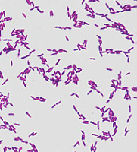
LAB Isolation
Screening of LAB from naturally occurring processes which is useful for obtaining useful cultures for scientific and commercial purposes.
gram positive.
non-spore forming.
facultative anaerobe group.
produce lactic acid.

Slide 10
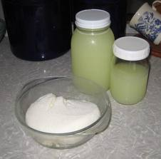
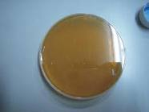
LAB Isolation
Sources
1. Yogurt.
2. Whey (cheeses)
3. Whey (Labanh)
Media
Nutrient Ager
Method

Slide 11
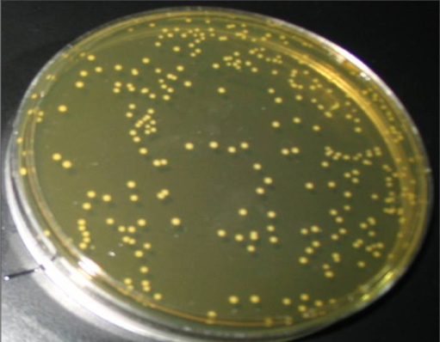
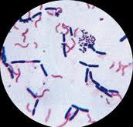
LAB Isolation
The main results of LAB isolation are
G(+) , G(-)
G(+)
Isolated colonies
LAB Cells with other cells.
Pure LAB.

Slide 12
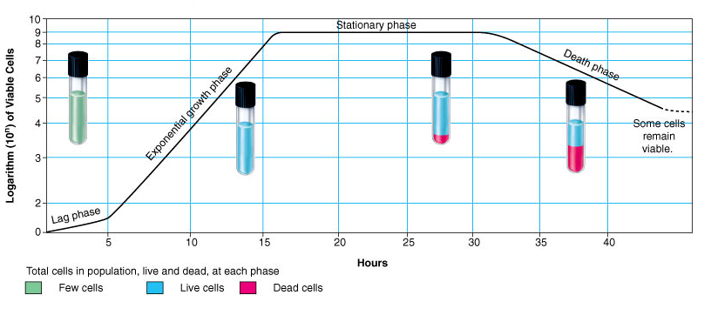
LAB Growth Rate
:
Adaptation
Bacteria's Growth
Growth Rate = Death Rate
Lose Growth Ability

Slide 13
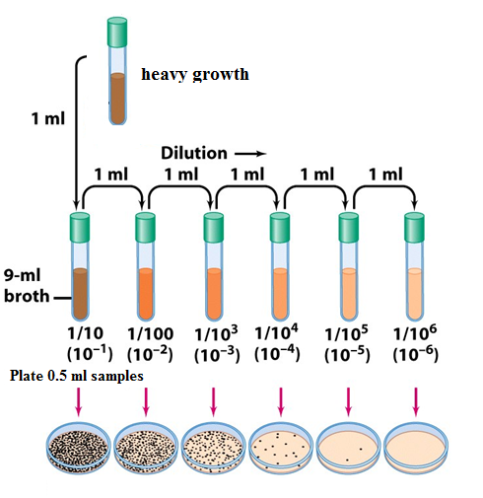
LAB Growth Measurement
Two methods were used:
1. Plate Counting Method
LAB Heavy growth
Serial Dilution
OD
Plating
Counting
Curve Number of cells vs. OD
OD recoding vs. time
Curve Number of cells vs. time

Slide 14
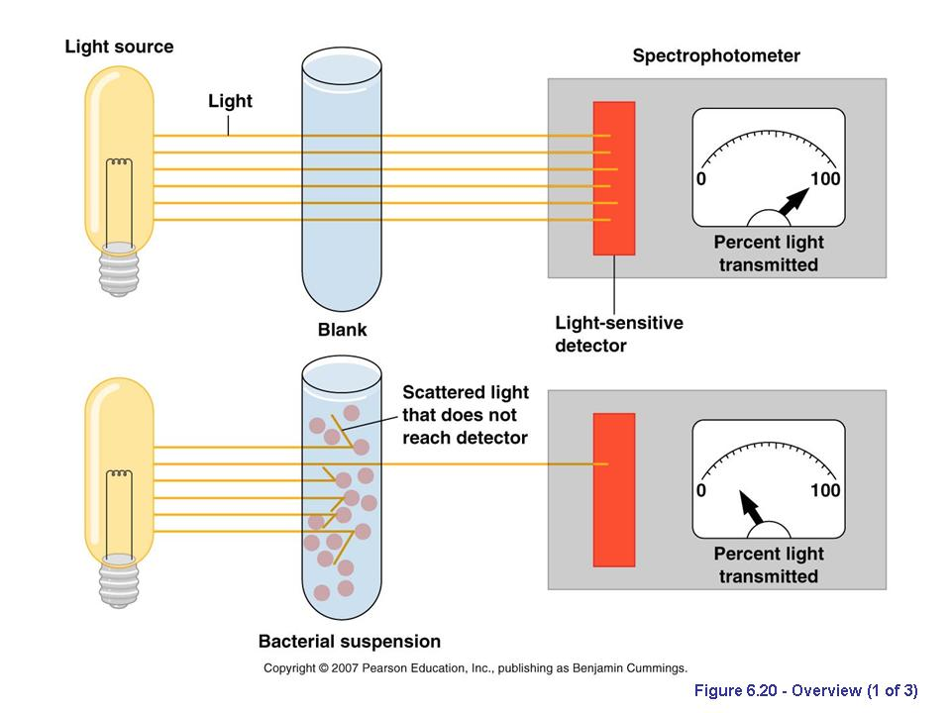
LAB Growth Measurement
2-Optical Density
This method based on the increase in incubation media turbidity.
OD increases as LAB growth increases with time.
Every one hour the OD is taken for the incubation .

Slide 15
Bacterial Growth Measurement
Graphical G (h) | 1.1
k (h⁻¹) | 0.64
Figure (1):LAB growth rate

Slide 16

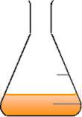
Lactic Acid Production from Whey
Experiments
First experiment
10 g/l whey
Second Experiment
20 g/l whey
Salts
KH2PO4 0.5g/L
MgSO4.7H2O 0.2 g/L
MnSO4.4H2O 0.05g/L
Whey 10g/L (C)
Yeast extract 10g/L (N2)
10 ml LAB heavy
growth
(batch) 500 ml
Working volume 250 ml

Slide 17

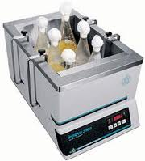

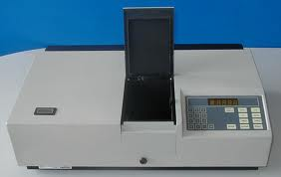
Lactic Acid Production From Whey
Analysis:
0.1M NaOH
Every 1h
pH test
Incubation at 37ºC
Every 1h
Every 1h
Titration to
pH 8
Total acidity
OD test 600nm

Slide 18
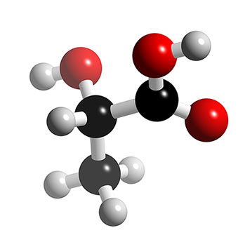
Lactic Acid Production from Whey
Results
Figure(2): Lactic acid production if 10g/l whey used.

Slide 19
Lactic Acid Production from Whey
Results
Figure (3): Lactic acid production if 20g/l whey used.

Slide 20
Lactic Acid Production from Whey
Results

Slide 21


CONCLUSION…..
Production of valuable chemical such as lactic acid from whey has been considered as an attractive option because of the rich nutrient contents.
LAB can be isolated from dairy product.
Whey concentration effect upon the lactic acid production; 20 g/l whey concentration has more lactic acid yield than 10 g/l medium.

Slide 22

RECOMENDATION…..
MRS should be used.
Lactic acid fermentation needs a long and continuous time.
The isolated LAB should be indentified to improve its growth rate study.
Further experiments must be done to study parameters that affecting lactic acid production, such as:

Slide 23
RECOMENDATION…..
- Whey concentration.
- Whey source.
Intensive corporation between the Biotechnology Department, Chemical Engineering Department and the Scientific Centers in the university.

Slide 24

Acknowledgment
Our Supervisor Eng. Majd Shhadi
Chemical Engineering Department
Biotechnology Department

Slide 25




