Slide 1
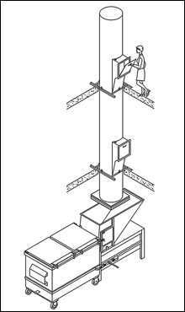
Waste Chute System
By: Ashar Abu Ghnaim, Rana Baker, Huda Hmady.
Under supervision:
Dr. Abdelhaleem Khader

Slide 2

introduction

Slide 3
Outline:
What is the chute system?
Chute system around the world.
The components of chute system.
Current situation in Nablus city.
Nablus city and Chute system.
The questionnaire.
Recommendation.
References.

Slide 4
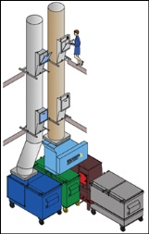
What is the chute system?
Is the system that transferring waste to the ground level in multi-story buildings.

Slide 5

Chute system around the world

Slide 6
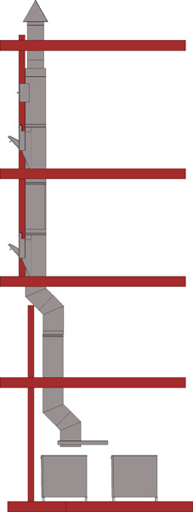
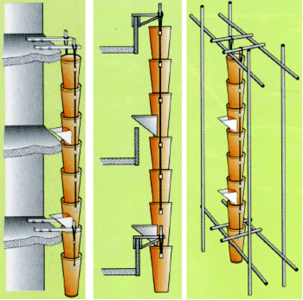
The components of chute system
Chute pipe

Slide 7
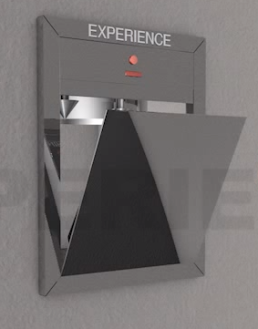
The components of chute system
Doors:

Slide 8
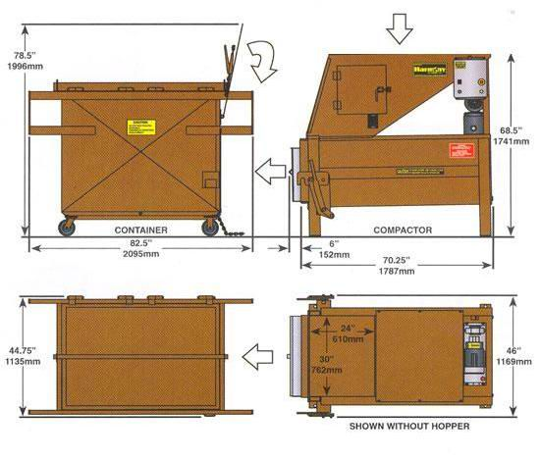
The components of chute system
Service room:

Slide 9
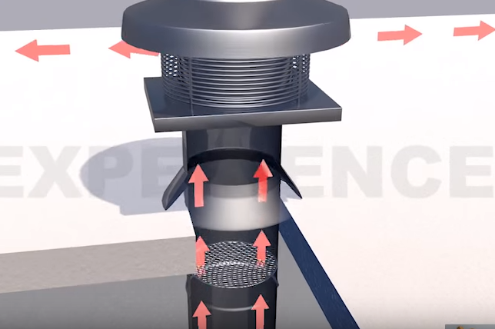
The components of chute system
Ventilation system:

Slide 10
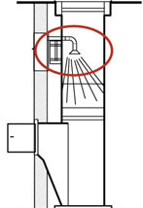
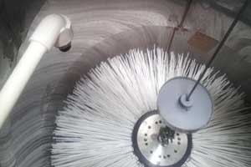
The components of chute system
Cleaning system
hygiene
soapy solution via nozzle
one minute
manually or automatically
to prevent diseases

Slide 11
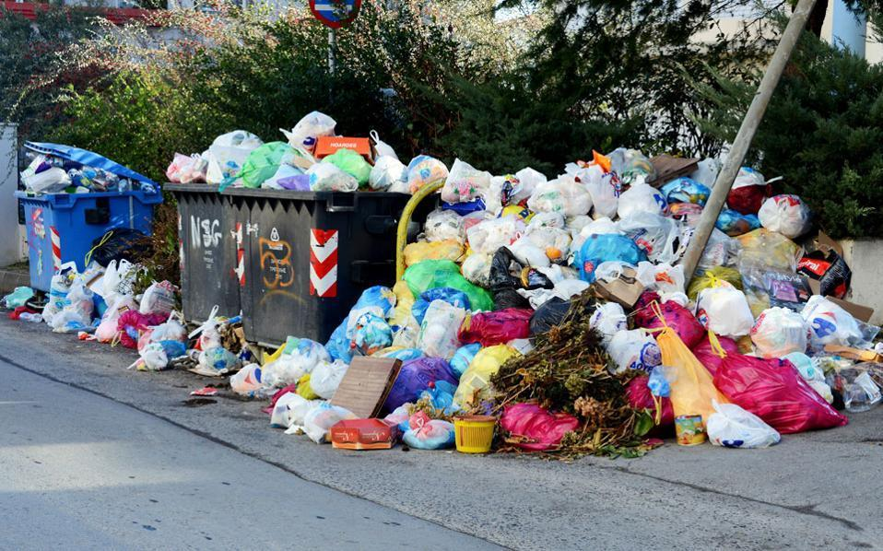
Current situation in Nablus city

Slide 12

Current situation in Nablus city

Slide 13


Current situation in Nablus city

Slide 14
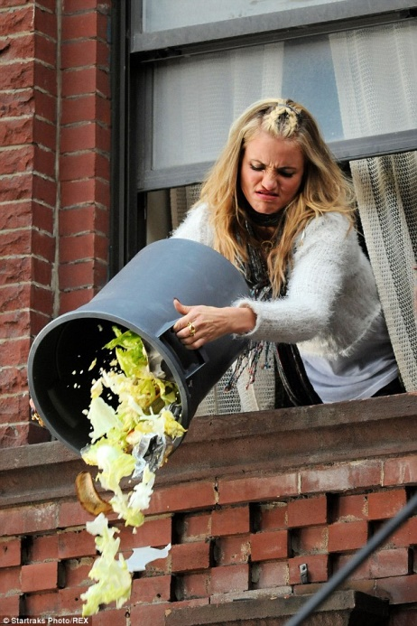
Current situation in Nablus city

Slide 15
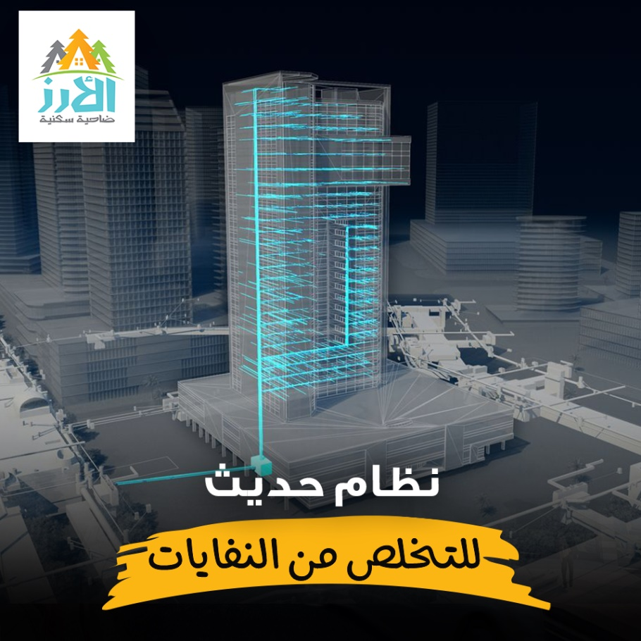
Palestine and Chute system
AL-Arz Residential Suburb in Nablus
special channels then container
medium-cost
municipal worker will empty the container
Motivation to make residents comfortable

Slide 16

The questionnaire

Slide 17
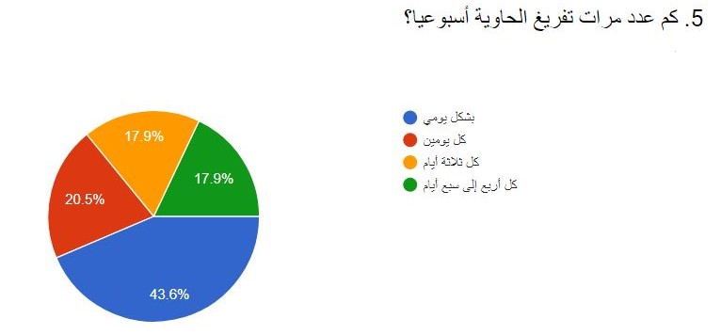
The questionnaire

Slide 18
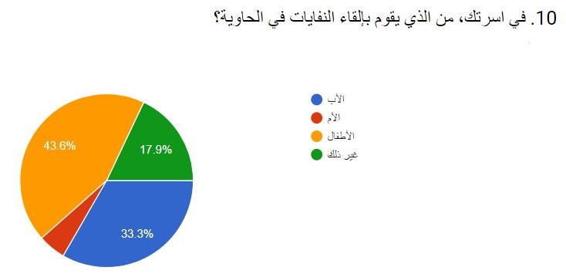
The questionnaire

Slide 19
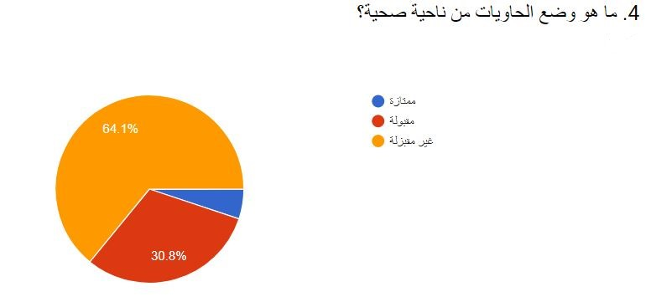
The questionnaire

Slide 20
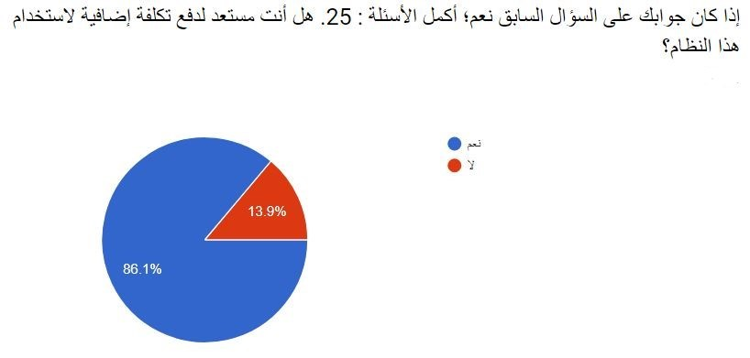
The questionnaire

Slide 21
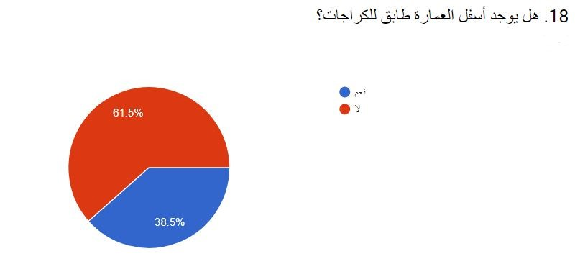
The questionnaire

Slide 22
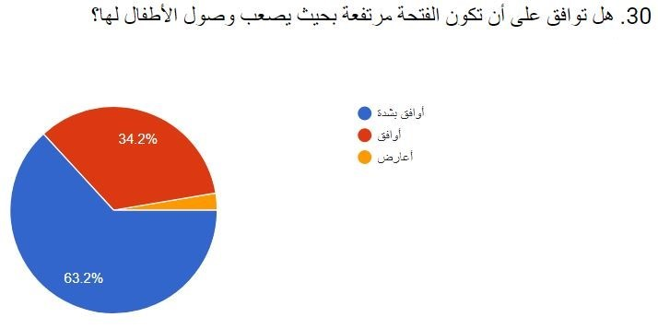
The questionnaire

Slide 23
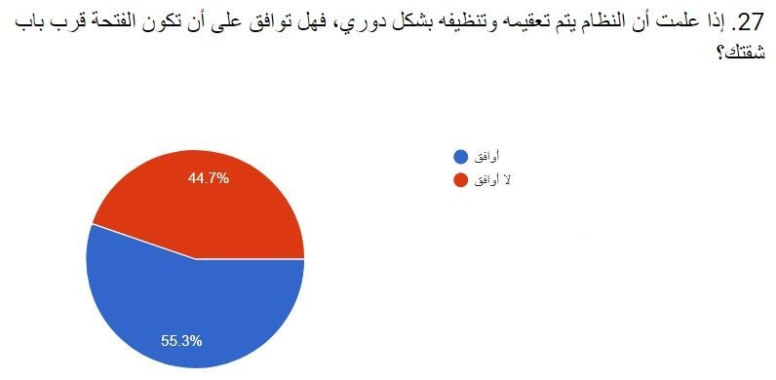
The questionnaire

Slide 24
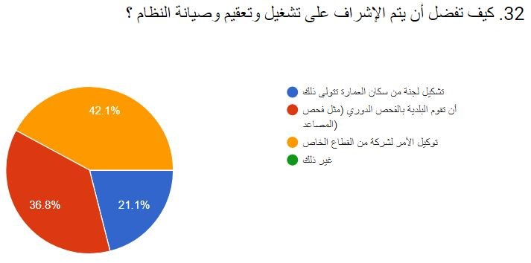
The questionnaire

Slide 25
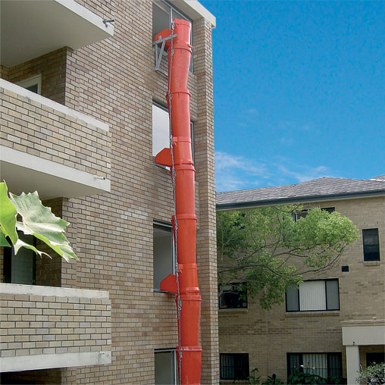
Recommendation
Chute system only applies on new buildings.

Slide 26

Recommendation
Chute system needs worker.

Slide 27

Recommendation
Municipality involvement .

Slide 28
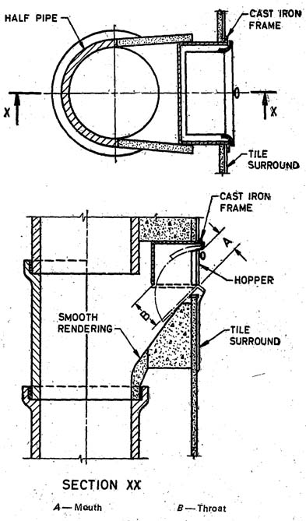
Recommendation
Chute system has a custom size.

Slide 29



Slide 30
References
Dr.Abdelhaleem Khader Eng.Mohammed Abu-Baker waste management in high buildings [Report]. - 2005.
ECCO [Online]. - January 2010. - https://goo.gl/vWfP3t.
Group 2010 The Gale The Great Soviet Encyclopedia [Online]. - 3rd Edition (1970-1979).
K. Sasikumar Sanoop Gopi Krishna solid waste managment [Book]. - 2009.
Municipality Nablus اهل نابلس - اصدقاء نابلس [Online]. - March 22, 2018. - https://goo.gl/y3YZeY.
Nablus Municipality of اهل نابلس - اصدقاء نابلس [Online]. - March 25, 2018. - https://goo.gl/A6bwsA.
Rick LeBlanc An Introduction to Solid Waste Management [Report]. - 2017.
UNITECH for building and construction material [Online]. - 2008. - https://goo.gl/NMWJjL.

