Slide 1


An-Najah National University
Faculty Of Engineering
Industrial Engineering Department
Implementation Of Quality Function Deployment
On Engineering Faculty of An-Najah University
By : Ibrahim Sanjaq Tha’er Bezreh
Mahran Ramahi Hind Khabbas
Supervised By : Eng. Tamer Haddad

Slide 2
QFD Definition
Quality: What the customer/user needs or expects
Function: How those needs or expectations are to be satisfied
Deployment: Making it happen throughout the organization

Slide 3
House of Quality
  do customers want and need from your product or service?
  (Customer requirements).
What
HOQ
HOQ
  will your company achieve the what?
  (Technical requirements).
How

Slide 4
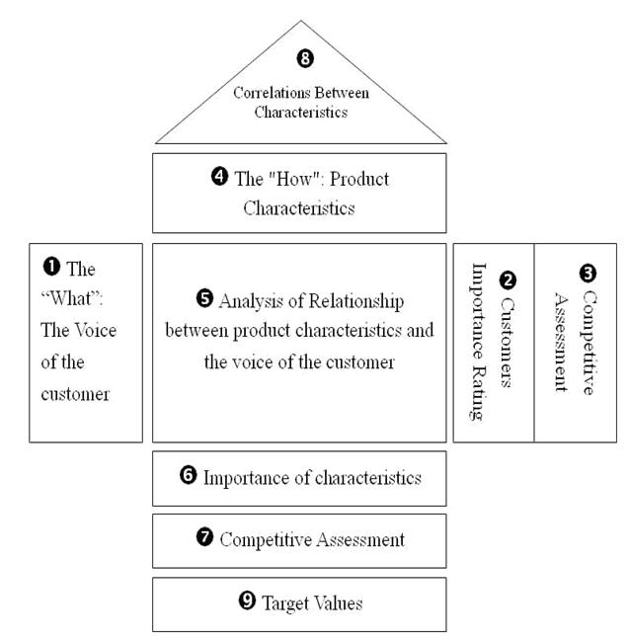
HOQ

Slide 5
Case Study
The aim of this project is to build a structured approach to service development through the House of Quality (HOQ) with application to faculty of engineering of An-Najah National University. QFD uses voice of customers (what) and voice of company(How) in order to join them and reach measurable objectives that contribute in service development.

Slide 6
PROJECT OBJECTIVES

Slide 7
OBJECTIVES
Modify attributes to improve perception of quality.
Show our performance
benchmarking
relative importance
Define the key attributes

Slide 8
Working Methodology

Slide 9
A scientific study was performed to have an excellent theoretical background about QFD.
1
Chose the Faculty of Engineering at An-Najah National University a case study to investigate the implementation of QFD .
2
Complete information about the faculty was gathered about its services, its specializations, and competitors.
3
Segmenting the faculty’s customers as: 4th and 5th year students in order to identify their requirements and priorities.
4

Slide 10
Voice of customers or Customer requirement (What) was determined through distributing a questionnaire among them and make interviews
5
Customers’ needs and requirements was identified through taking a sample of customers as an input for building HOQ
6
Importance and scoring for each need was identified from both An-Najah and competitor customers.
7

Slide 11
Questionnaire

Slide 12
Scoring and Importance Survey
 | Requirement | Importance (0-10) | Scoring (1-5)
1 | Qualified for learning
2 | Committed
3 | Use simple language
4 | Quality of learning
5 | Staff availability
6 | Presentation skills
7 | Communication skills
8 | well organized slides
9 | Technological skills
10 | Clear notes
11 | Improve research skills
12 | Language skills
13 | Books availability in library.
14 | Ability to distance learning
15 | Up to date material
16 | Easier to understand
17 | More practical experience
18 | Appropriate education environment in the class
19 | internet access availability
20 | Availability of computer labs
21 | Exams schedules

Slide 13
Voice of Engineering Faculty (How or technical specification) was determined through meetings with the Engineering Faculty staff.
The HOQ was built and all relationships between voice of customers and voice of Engineering Faculty were showed in addition to any comparisons between the Faculty and the competitor.
8
9

Slide 14
The whole HOQ was analyzed quantitatively and some improvement activities were suggested to improve quality elements.
Further recommendations was built for future improvement.
10
11

Slide 15
RESULTS

Slide 16
Customer Needs (VOC)
Through survey to the most important customers. We got these most frequently points about customer requirements.
Voice of Customer
Qualified for learning. | Ability to distance learning.
Committed. | Up to date material.
Use simple language | Easier to understand
Quality of learning | More practical experience
Staff availability | Appropriate education environment in the class
Presentation skills | internet access availability
Communication skills | Availability of computer labs
well organized slides | Exams schedules
Technological skills | Material Grades distribution
Clear notes | Creativity motivation
Improve research skills | Ability to improve and design engineering Sys.
Language skills | Ability of solving engineering problem's in real life.
Books availability in library. | The continuity of communication with the university

Slide 17
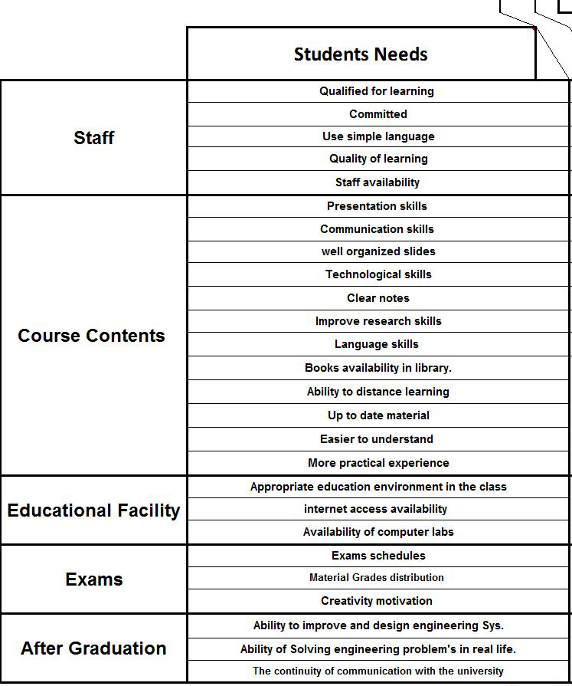
Needs Categories

Slide 18
Survey Sample
After collecting & processing data , this is a part of the final average results

Slide 19
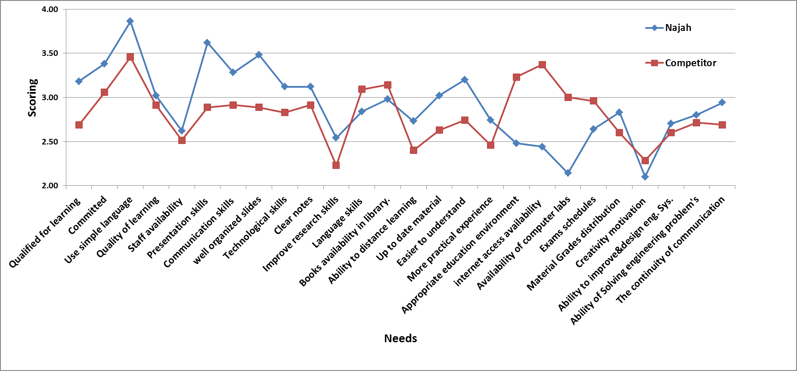
Comparison Chart

Slide 20
Voice of Engineering (HOW)
These technical specifications that are related and have effects of products quality aspects are called (voice of company)

Slide 21
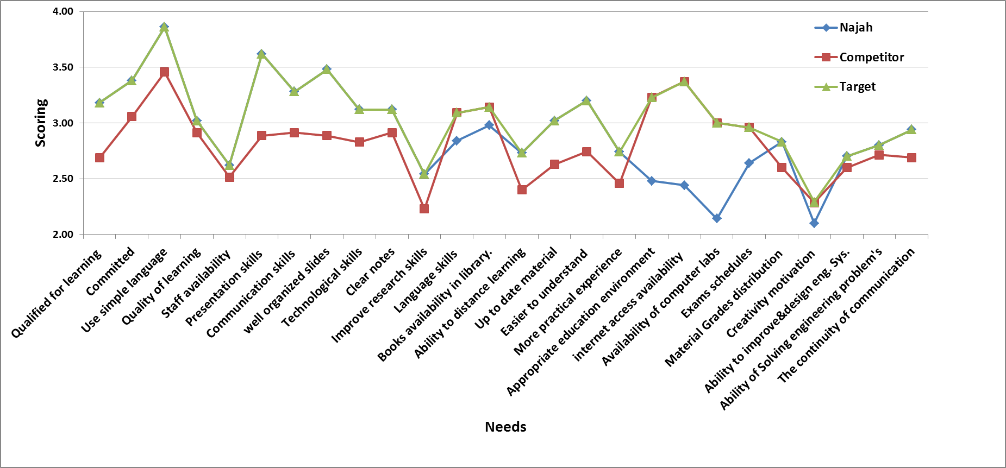
Target Value

Slide 22
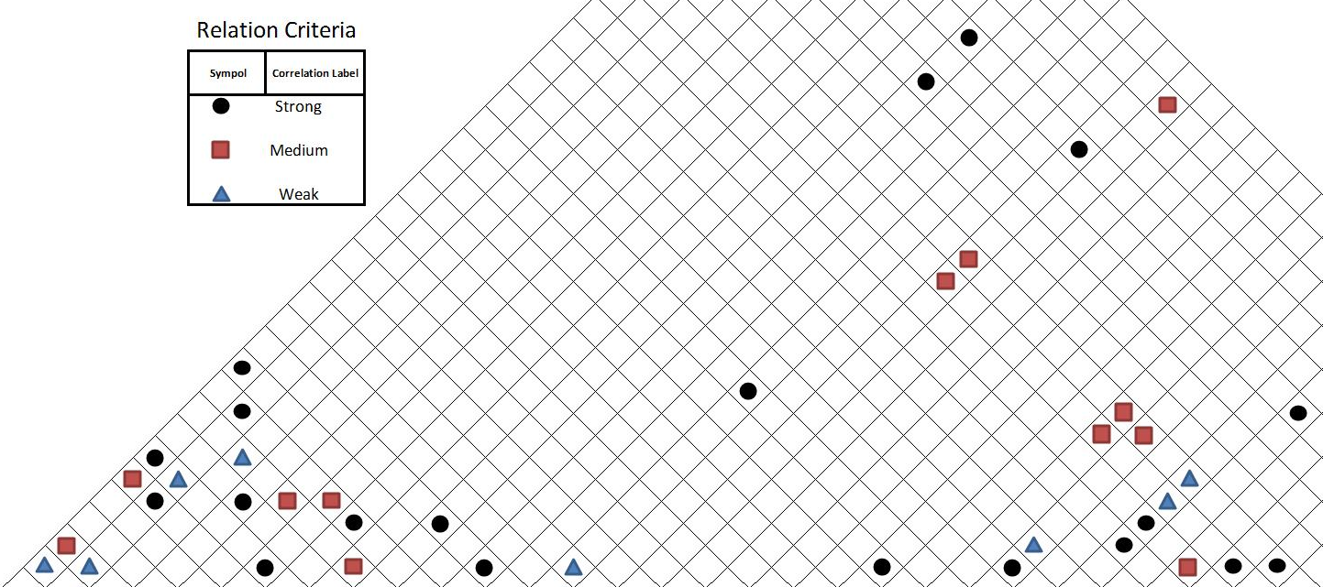
The Correlation Matrix
It is also called roof matrix because it lies over voice of company row. It was designed to determine the effect of one technical feature on the others.

Slide 23
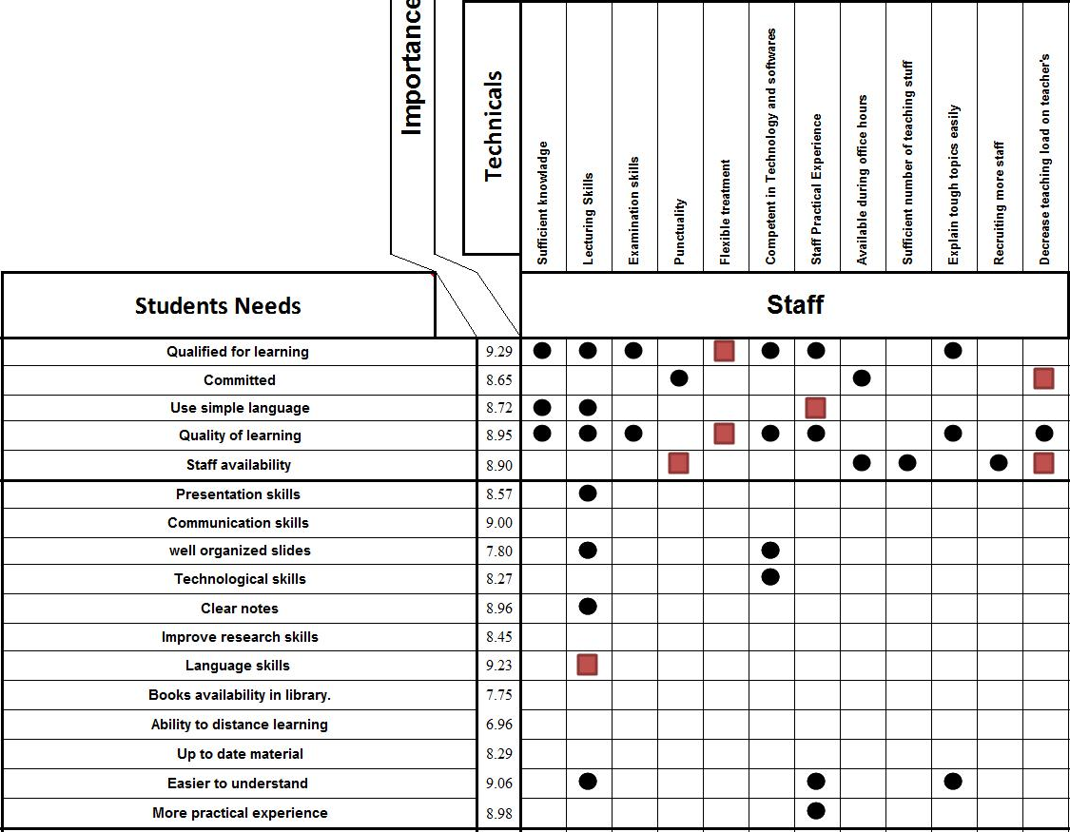
The Relationship Matrix
The aim of this matrix is to convert customer requirements into solutions that meet those needs.

Slide 24
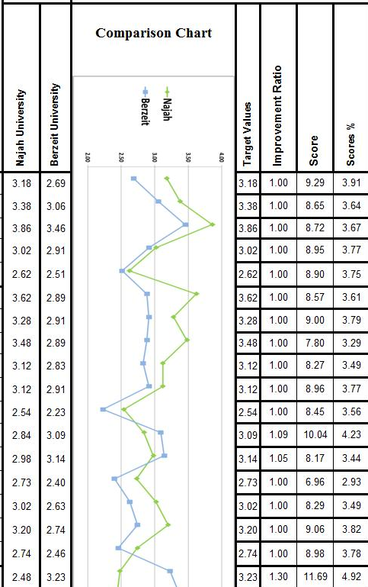
The Planning Matrix
It was designed to show the objective measures which are include a comparison of customer requirement degree of satisfaction against the proposed degree
required By
An-Najah National
University.
Planning Matrix

Slide 25
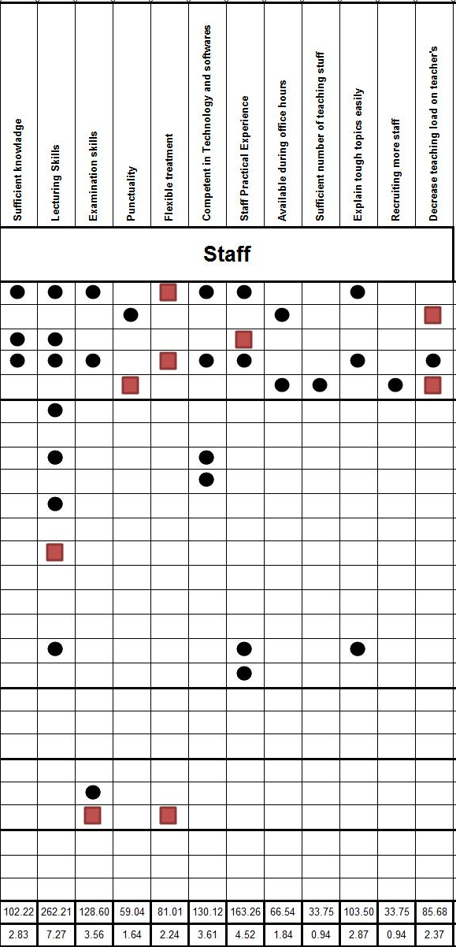
Technical Scoring
Technical scores depends on the relationship matrix between voice of customers and voice of quality.
Technical scoring

Slide 26
Sample Calculation
Improvement ratios were calculated by dividing the proposed target value over the current rate
For example,
the first point has an improvement ratio (1.00 ) calculated by
(3.18 / 3.18) = 1.00
Scores were calculated by multiplying the importance of each customer need with its improvement ratio.
For example,
the first point has a score equals to ( 9.29) calculated by
(1.00*9.29) = 9.29
Technical scores was calculated by summing of multiplying the value of each the relationship with score % of each need related.
For example,
the first technical a score equal to (102.2) calculated by 9*3.19+9*3.67+3.77= 102.2

Slide 27
Recommendations

Slide 28
Books availability
Electronic learning.
Large library resources.
Class discussion.
Group presentations and homework and project assignment.
Lecturing skills.
Language skills

Slide 29
Appropriate education environment in the class
Appropriate size of classes
Sufficient lighting system in the class
Conditioning and heating system in the class
Comfortable chairs in the class
LCD’s in each class
Isolate classes from student gathered places
Specific number of students in the class (Max. 35 students).
More restrictive rules in education area’s
Availability of computer labs and internet access ability
Number of computer labs (One lab for each department)
Flexible computer labs work hours
Specify special labs used for lecturing and software’s sessions.

Slide 30

Conclusions

Slide 31
QFD is a powerful tool in service and industry.
Can be applied in education activity at every stage.
Identify weaknesses in educational process in Engineering Faculty and our position with respect to competitors .
Successful in determining policies, which would result in a better satisfaction of the students.

