Slide 1

Faculty of Engineering and Information Technology
Civil Engineering Department
Design of Om-Salama Street in Nablus City
Prepared by:
Jinan Turkman
Sahar Antari
Hadeel Yassin
Under Supervision of:
Prof. Sameer Abu-Eisheh
Dec-2019

Slide 2
Study Area
1
2
Objectives and Importance of the project
3
Methodology
4
Data collection and analysis
5
Design control and criteria
Geometric design of roads facilities
6
7
Cost estimation
8
Conclusion and Recommendations

Slide 3
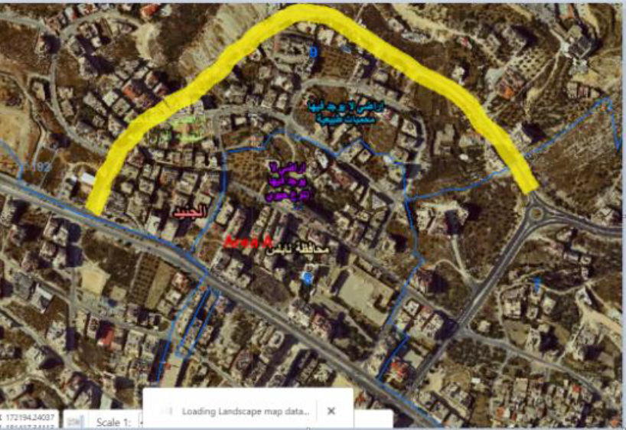
Study area
Om- Salama street
Rafedia-PALTEL Intersection
Om-Salama Roundabout

Slide 4
Objective
The main objective of this project is to propose a proper new design for the planned Om-Salama Street, but not yet totally opened starting from Om-Salama roundabout on Tunis Street to Rafedia main Street.

Slide 5
Importance of the project
Reduction in traffic volumes and the resulting congestion and delay on both Tunis and Rafedia Streets.
2) The opened sections have low design standards, which need to be upgraded to solve the associated challenges.
3) By designing Om-Salama Street a new access for Rafedia main Street will be provided, as well as for nearby developments.

Slide 6
Collecting available information and data
Analysis and evaluation of traffic existing conditions
Geometric design of road facilities
Conducting field studies
Identify the design criteria
Estimating the quantities
and the cost of implementation
Reconnaissance visit to the street location

Slide 7
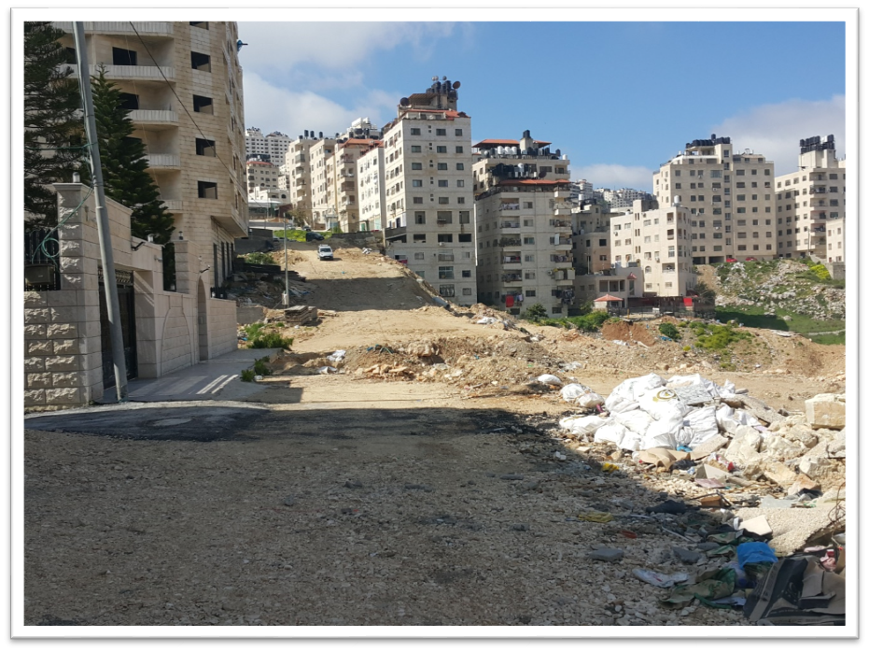
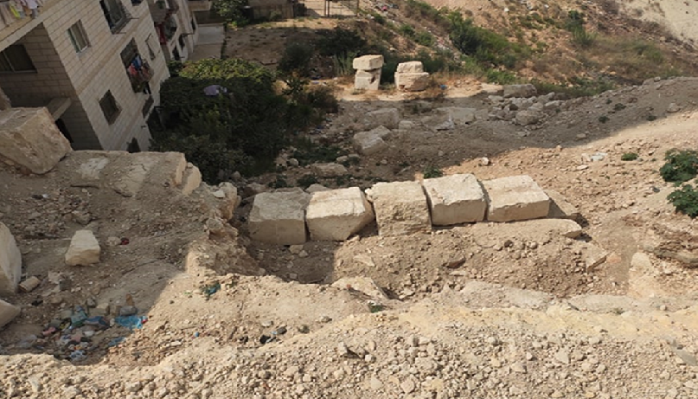
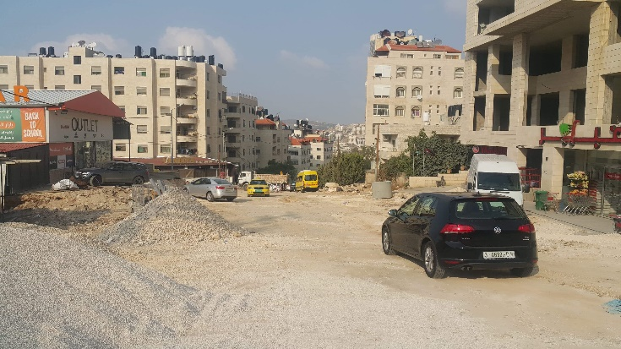
Reconnaissance visit

Slide 8
Results of PHV
Intersection | Peak Hour | PHV (vph)
Om-Salama Roundabout | 7:30-8:30 a.m. | 1200
Rafedia intersection | 7:30-8:30 a.m. | 2860
Intersection 1 | 7:30-8:30 a.m. | 291
Intersection 2 | 7:30-8:30 a.m. | 433
Intersection 3 | 7:30-8:30 a.m. | 198

Slide 9
Origin-Destination study
Section of the study starts from Rafedia PALTEL intersection to Tunis Street through Arabic Bank.
The results as follow:
Downward direction | Upward direction
Cars passing through Rafedia and Tunis Streets in the peak hour =185 vehicle. | Cars passing through Tunis to Rafedia Street in the peak hour =250 vehicle
Cars passing through Rafedia then Tunis Street in the peak hour =115 vehicle | Cars passing through Tunis to Rafedia Street in the peak hour =166 vehicle
Percent of cars that use both streets= 62.84% | Percent of cars using both streets= 62.74%

Slide 10
ICU Level of service
Name of intersection | LOS
Rafedia-PALTEL intersection | H
Intersection 1 | A
Intersection 2 | A
Intersection 3 | A
Om-Salama roundabout | D

Slide 11
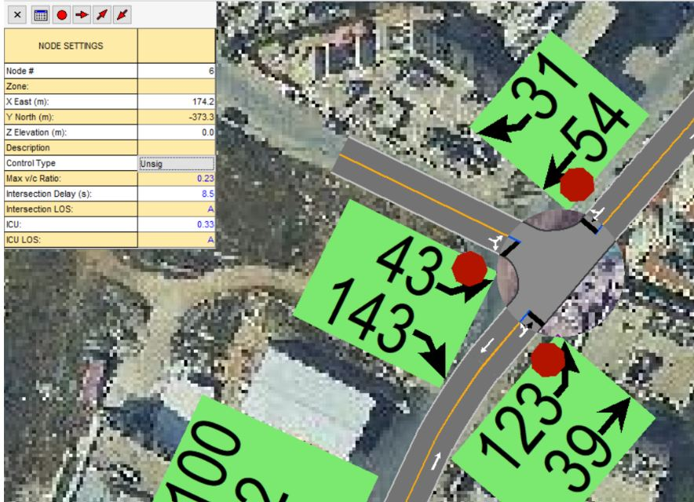
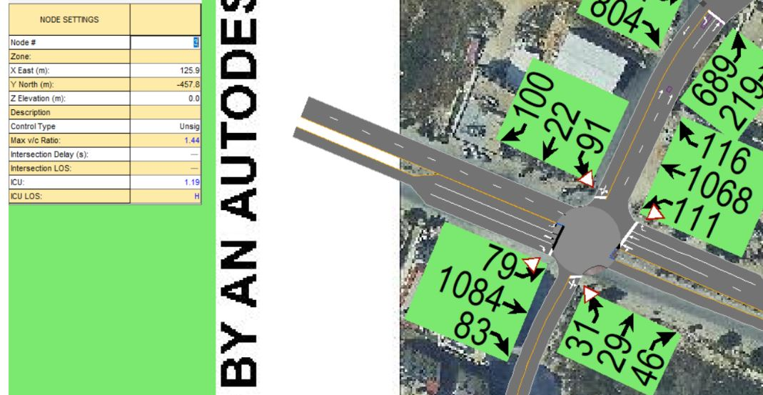

Slide 12
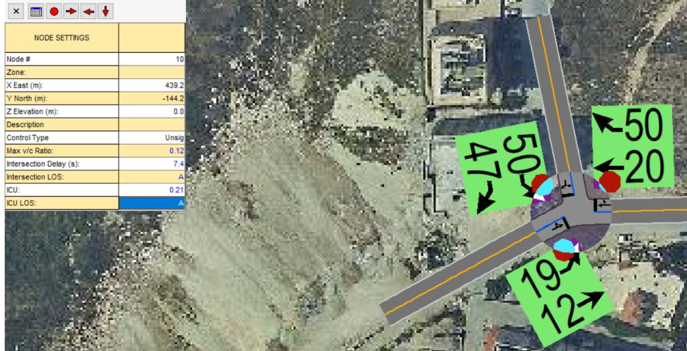
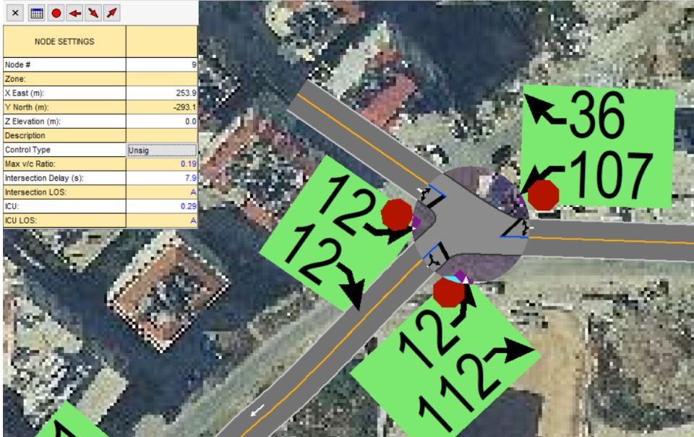
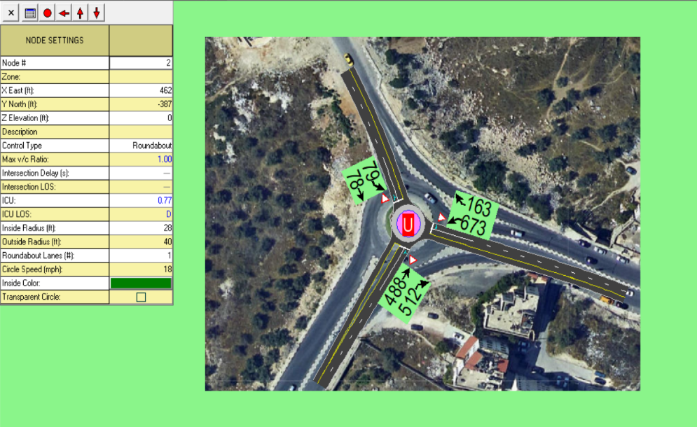

Slide 13
Delay and travel time
Travel time starting from Rafedia PALTEL intersection through Arabic Bank on Tunis to the center of city= 5:14
Actual travel time for the same previous intersection= 7:60
Delay =2:46 minutes.
Travel time starting form center of city through Om-Salama to Rafedia main Street at Rfedia PALTEL intersection = 4:47
Actual travel time= 7:15
Delay approximately= 3:32 minutes

Slide 14
Future traffic volume on Om-Salama Street
The design volume=V₀*(1+r) ^{n}
=656*(1+0.056)²⁰
=1950 vehicle/hr for first direction.
The design volume=V₀*(1+r) ^{n}
=360*(1+0.056)²⁰
=1070 vehicle/hr for second direction.

Slide 15
Design Criteria
Item No | Item Description | Used
1 | Functional Classification | Urban Collector Road
2 | Design Speed | 50 Km/hr
3 | Design Vehicle | SU-9
4 | Stopping sight distance | 65 m
5 | Max Grade | 11% and 12%
6 | Supper elevation | 6%
7 | Width of Lane | 3.5
8 | No. of Lanes/ direction | 2
9 | Cross Slope | 2%
10 | LOS (after 20 years) | D
11 | ROW | 20m

Slide 16
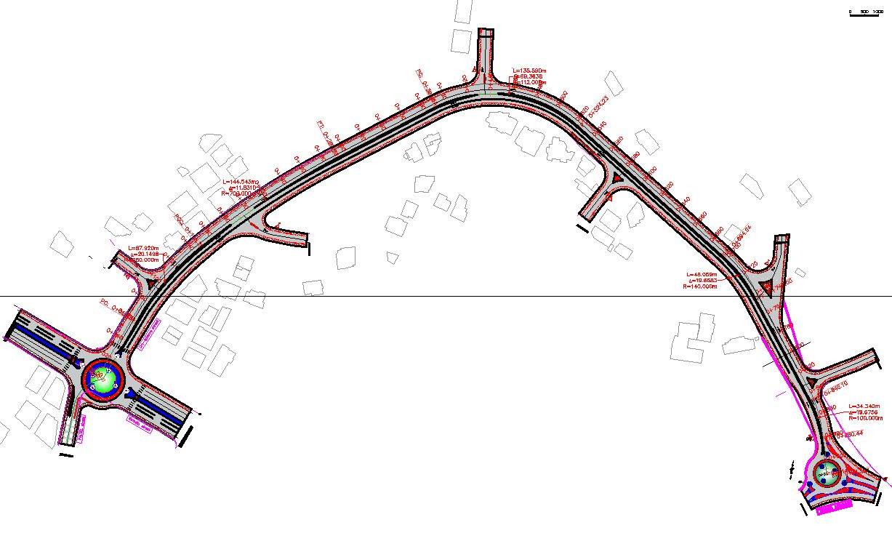
Geometric design of road facilities
Design of the horizontal alignment:

Slide 17
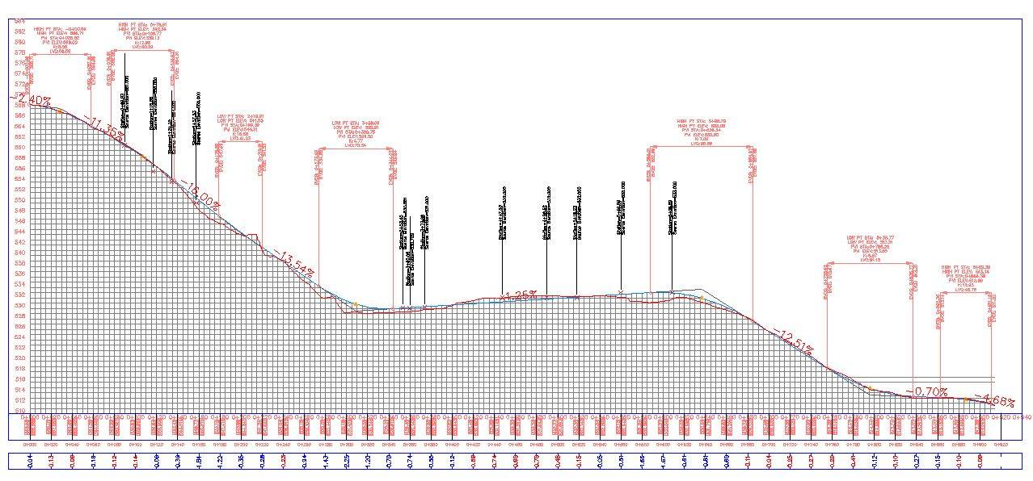
Geometric design of road facilities
B. Design of the vertical alignment

Slide 18
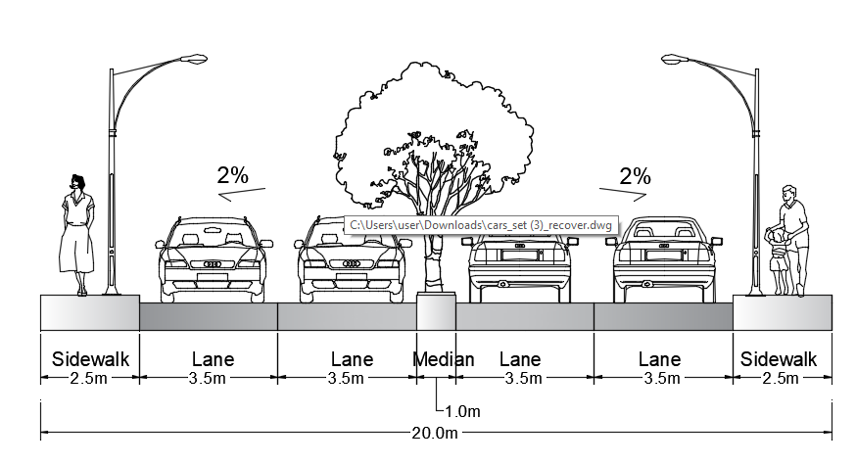
Geometric design of road facilities
Typical cross section
Two main cases are used along Om Salama Street.
First Case: From station (0+0.0 to 0+840)

Slide 19
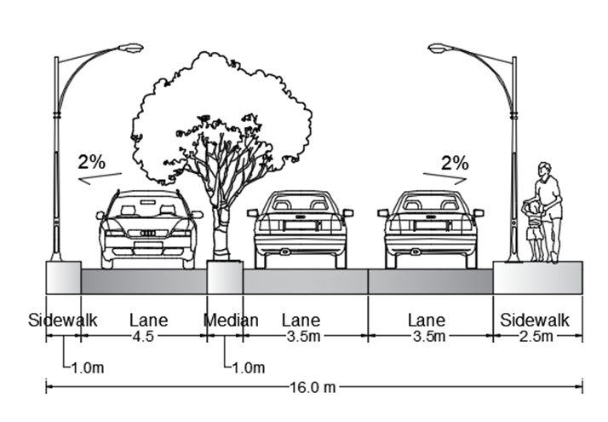
Geometric design of road facilities
Typical cross section
Second Case: from station (0+840) to (0+914)

Slide 20
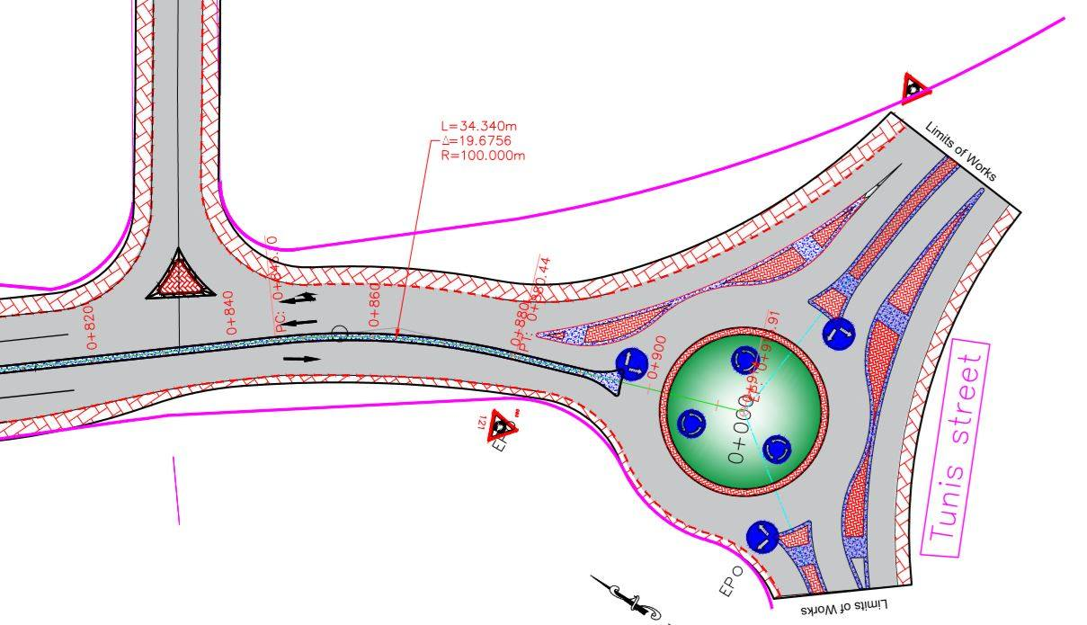

Slide 21
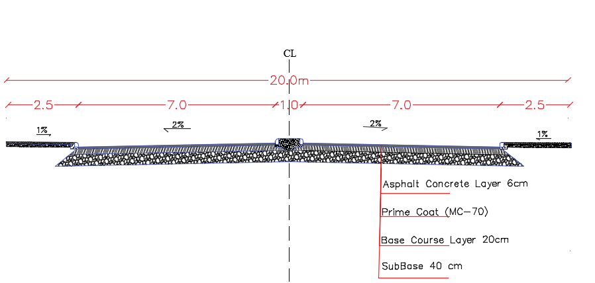
Pavement design
Sub Base coarse= 40 cm.
Base coarse= 20cm.
Asphalt= 6cm.

Slide 22
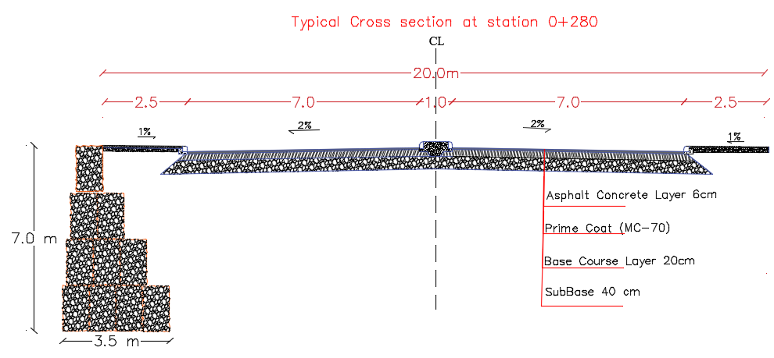
Retaining Wall

Slide 23
Intersections and Roundabouts Design
There were six internal intersections along the street, as they are at grade with three legs.
Two roundabouts, at the beginning and end points.
Minimum turning radius equal 12.5m was used.
Note: Using Civil 3D software, vehicle tracking (single unit truck SU-9) during design process.

Slide 24
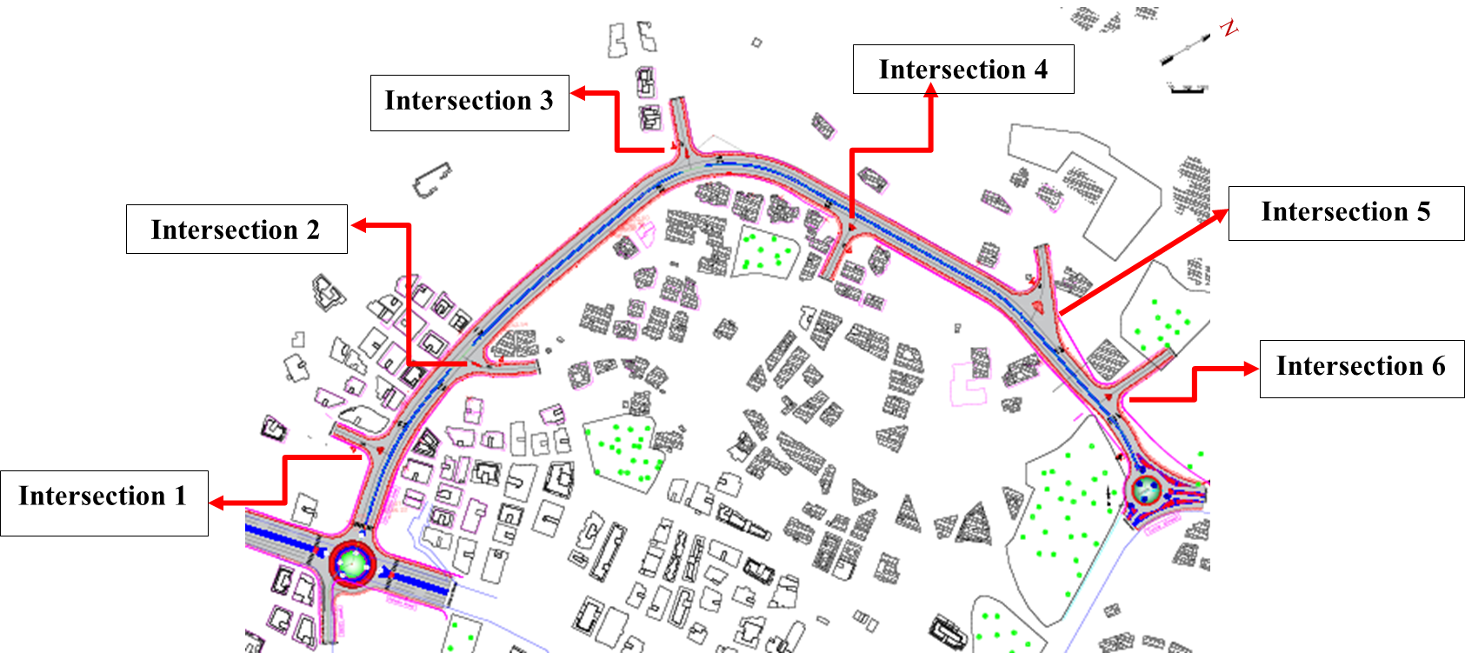
Locations of intersections (1-6)

Slide 25
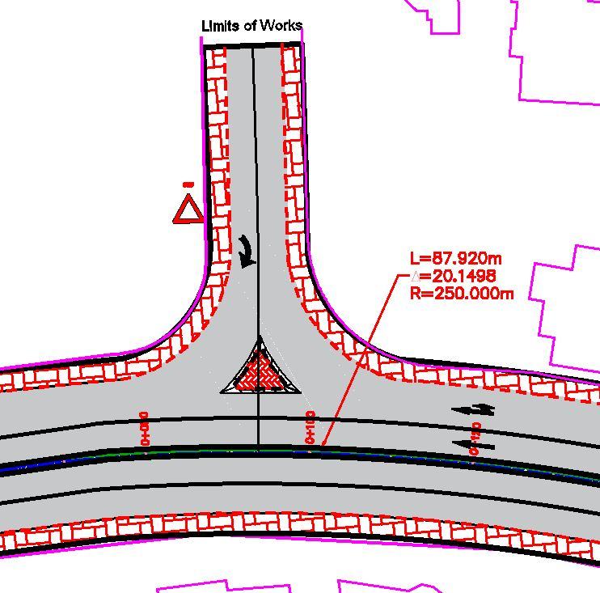
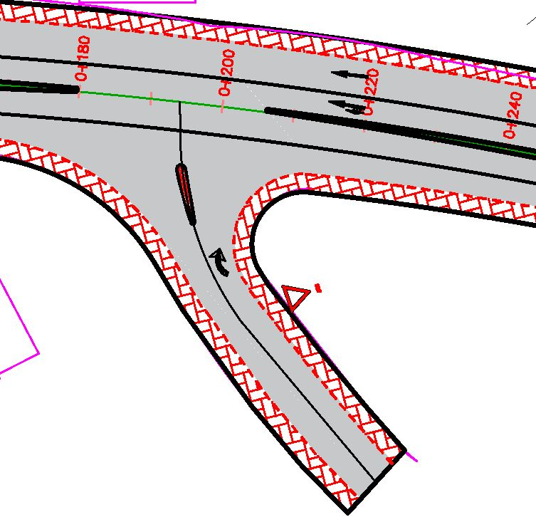
Intersection 1
Intersection 2

Slide 26
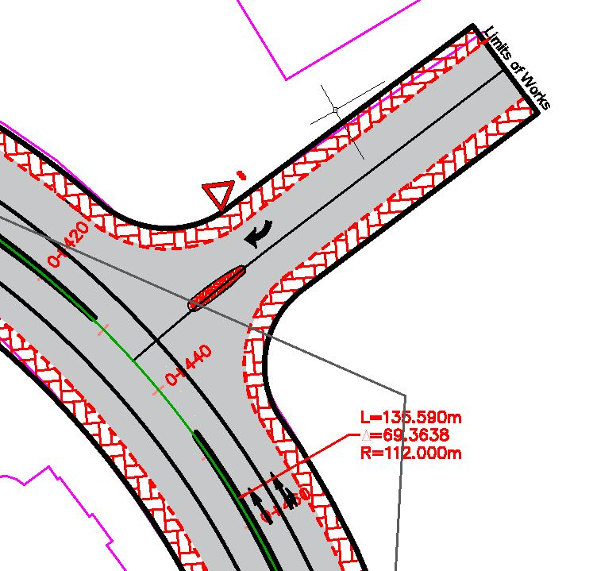
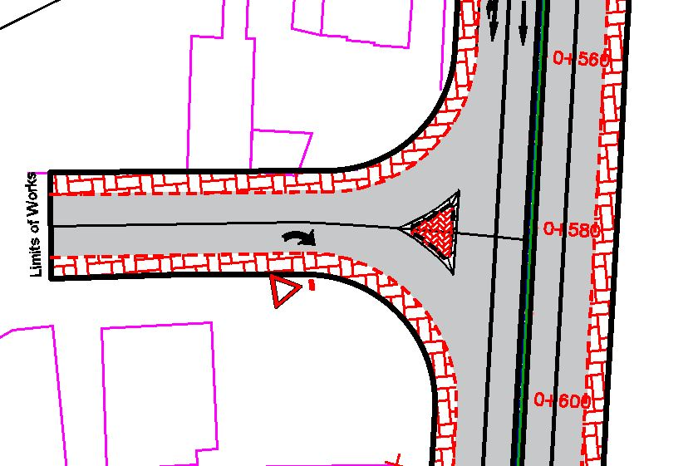
Intersection 3
Intersection 4

Slide 27
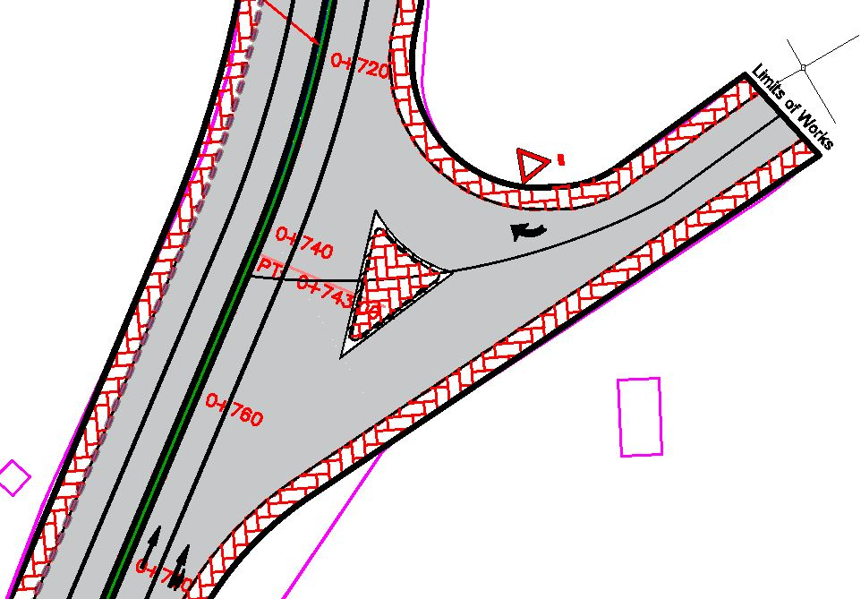
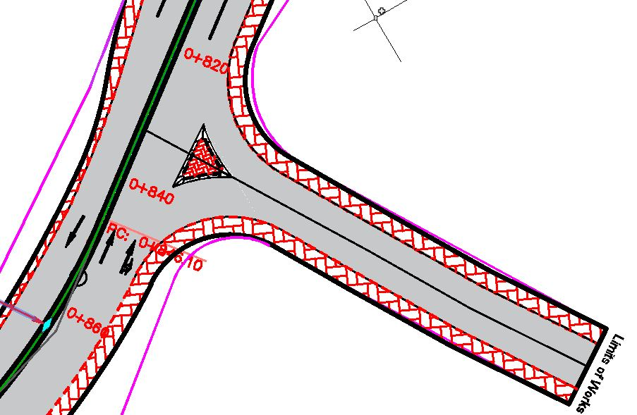
Intersection 5
Intersection 6

Slide 28
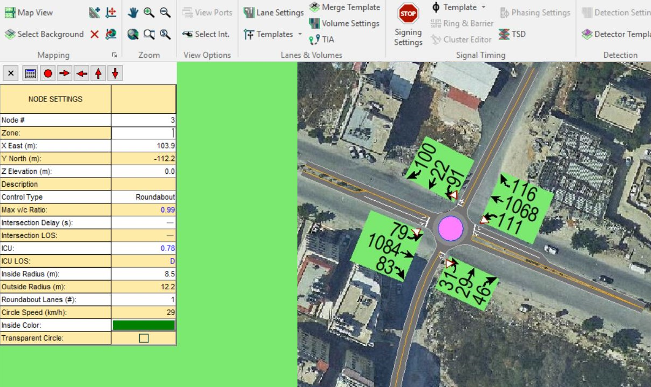
Rafedia-PALTEL Roundabout
If a roundabout is placed at the intersection of Rafedia-Paltel, the ICU LOS will improve from H to D

Slide 29
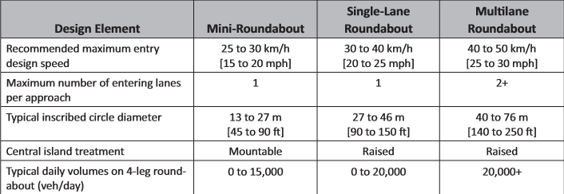
Rafedia-PALTEL Roundabout

Slide 30
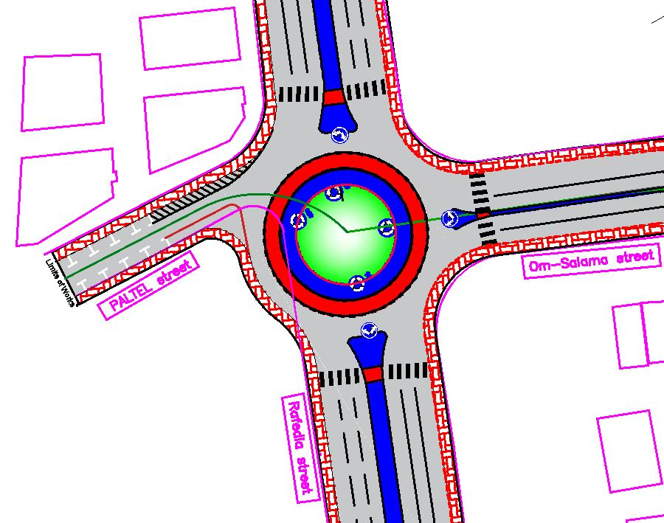
Rafedia-PALTEL Roundabout

Slide 31
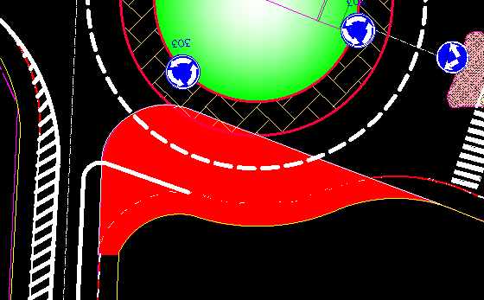
Rafedia-PALTEL Roundabout
An area 310.2 m² is needed to be taken from the owners of a nearby plot at PALTEL road

Slide 32
Cost Estimation
Description | Unit | Quantity | Cost/Unit (NIS) | Total (NIS)
Cut | m³ | 240 | 15 | 3600
Fill | m³ | 460 | 15 | 6900
Sub-base course | m² | 17680 | 15 | 265200
Base course | m² | 17680 | 18 | 318240
Asphalt layer | m² | 14260 | 36 | 513360
Guard rail | m | 280 | 350 | 98000
Retaining wall | m² | 1470 | 875 | 1286250
Curbstone | m | 4660 | 50 | 233000
Sidewalk interlocking blocks | m² | 6752 | 70 | 472640
Traffic signs | no. | 13 | 300 | 3900
Pavement marking | m | 2500 | 18 | 45000
Total Cost of Project |  |  |  | 3,246,090

Slide 33
Conclusion
The project will reduce the large traffic volume, congestion and delay on Tunis and Rafedia street specially at their intersection, as Rafedia Street is considered as one of most important streets in Nablus City.
The project will provide a new access point for Rafedia main street and the nearby development.
It is expected this road will facilitate the development in the nearby area.

Slide 34
Recommendations
Nablus Municipality is encouraged to allocate the needed funds to reconstruct and develop the whole Road.
Design a proper drainage system (especially at the low points on the street) in order to avoid acceptable future problems in the road layers.
Design the boulders retaining wall.
Street lighting should be installed along the street, as this is an urban road and where two sag curves design criteria (Minimum K for headlight Sight distance) could not be achieved on the street.

Slide 35
References
Bentley. (2017).Synchro Software version 10.1.
AASHTO Green Book. (2011). A Policy on Geometric Design of Highways and Streets 6th edition (SI Units).
AUTODESK. (2019). Civil 3D Software version 2019.
Federal Highway Administration. (2000).Roundabouts: An Informational Guide, US Department of Transportation

Slide 36
Thank you

Slide 37
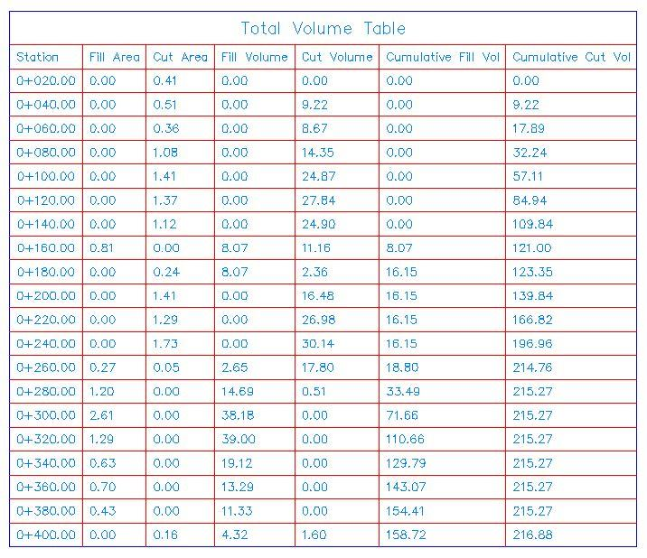
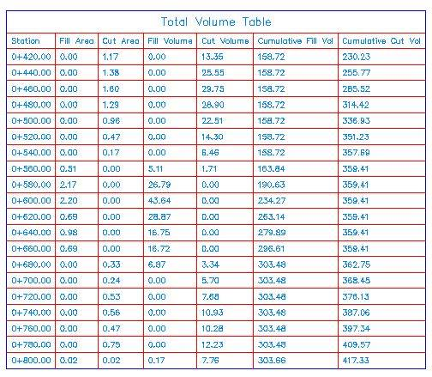
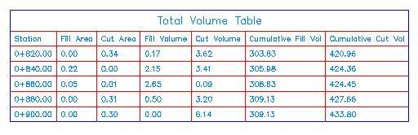
Cut and Fill volumes

