Slide 1

Tracking and Booking Taxi
Supervisors :
Done by:
Dr. Raed Al-qadi
Dr. Luai Malhis
Graduation Project 2013

Slide 2
Project Outline
GPS System
Project Overview
Tracking System Overview
Tracking System Implementation
Booking System Overview
Booking System Implementation
Demo

Slide 3
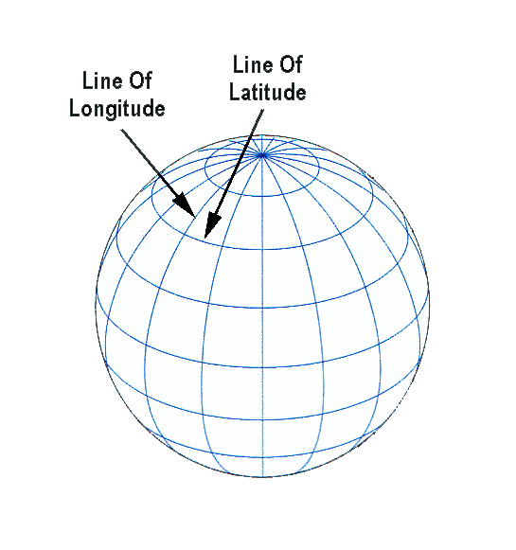
GPS System
GPS system uses geographic coordinates which is called
Latitude and longitude.
Under this system an exact location on the earth can be express as asset of number.

Slide 4
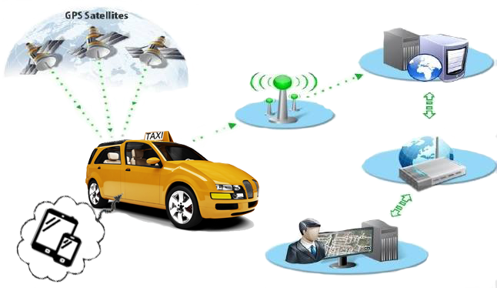
Tracking System Overview
Web Application
GPRS/3G
network
Internet
Customer
GPS Receiver

Slide 5
Tracking System
Taxi Tracking System consists from two components:
Web Application (Taxi office side).
Android Application (Taxi car side).

Slide 6
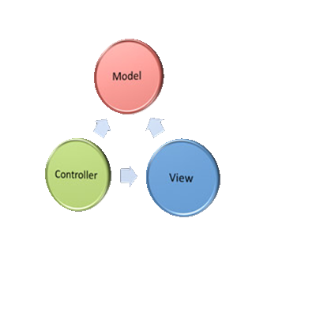
MVC Framework
MVC (Model-View-Controller):
  is a design pattern that simplifies application development and maintenance.
MVC divides the application into three logical components :
  Model layer
  View layer
  Controller layer

Slide 7
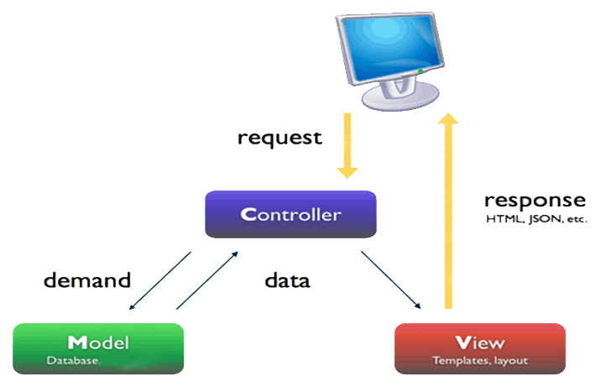
MVC Workflow

Slide 8

Front-end implementation(Interface)
Bootstrap:
Bootstrap is a free and powerful front-end framework for faster and easier web pages design
Bootstrap contains HTML,CSS and JavaScript based design templates for forms, buttons, navigation bar, slider, image, table and other interface components.

Slide 9
Advantages Of Bootstrap
compatible with all browsers such that chrome, Firefox, Opera, IE.
compatible for all devices such PC, tablet, smartphone.
supports responsive design so the layout adjusts dynamically

Slide 10
OpenStreeMap In Web
"OpenStreetMap” is a free editable map of the whole world.
We used Google map JavaScript API V3 in the application and we used the following JavaScript classes of this API to develop the application:
google.maps.Marker Class : we used this class to draw marker on map .
google.maps.Infowindow Class : we used this class add info window.
Geocoder Class: Allows for the conversion between an address and geographical coordinates.

Slide 11
OpenStreeMap In Android
In android system “osmdroid” Java library is provides Tools / Views to interact with OpenStreetMap-Data.
This library has two main class :
MapView class:
which is an (almost) full replacement for Google's MapView class.
MapController class:
which use to set some functionality of map such zoom, center, marker, etc.

Slide 12
Driver Android App
This application has two main function.
Tracking : get GPS coordinate form GPS every 10 meters and send its coordinate to the server by put the latitude and longitude of GPS and Driver ID in JSON string and send it by POST request to server.

Slide 13
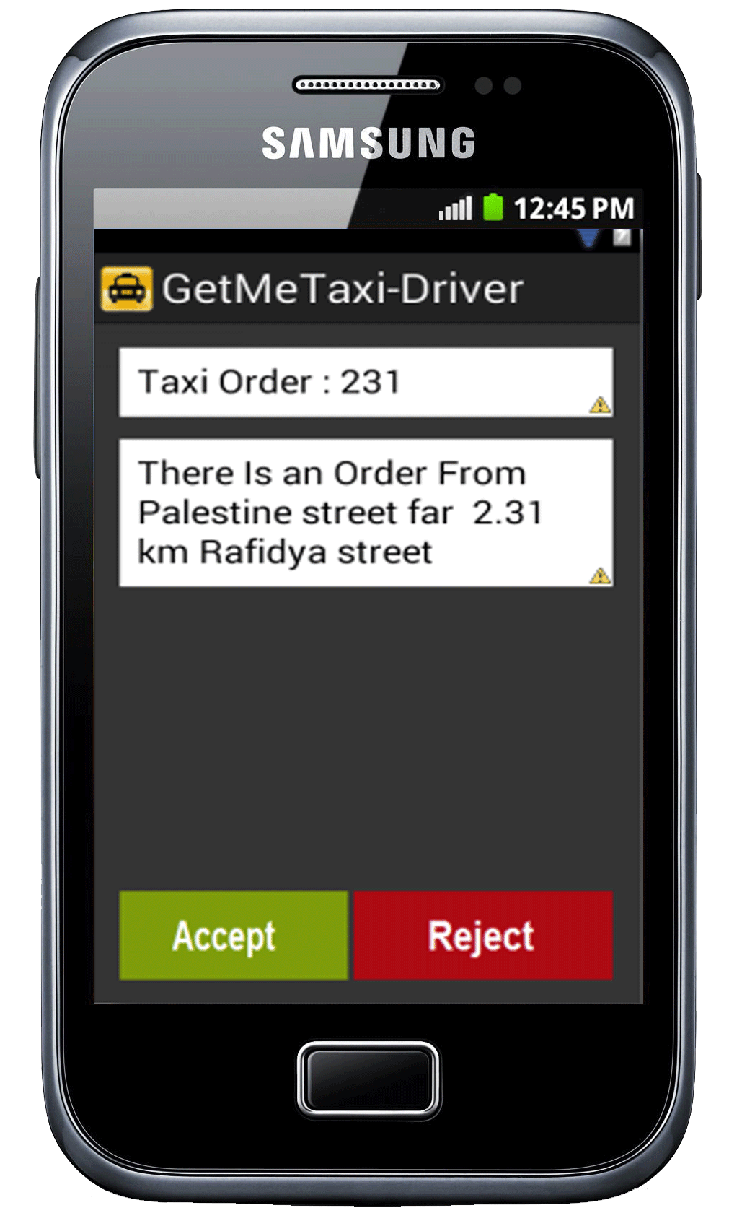
Driver Android App
Receive booking request: This is to make application as a listener to booking request from server, if the application receive request from server the driver can be accept it or reject it in a one minuet or less, if no action from driver then the request will be kill.

Slide 14
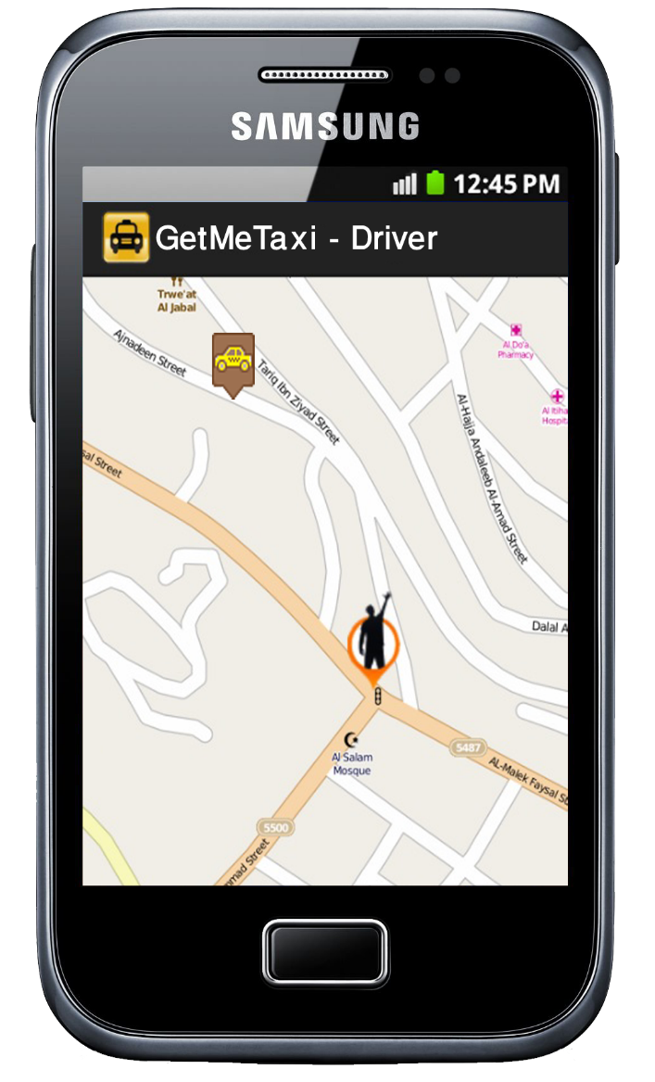
Driver Android App Cont.…
So, if the driver accept request then the application open the map and set the location of the passenger and Driver on map, so the driver can easy find passenger.

Slide 15
Booking System

Slide 16
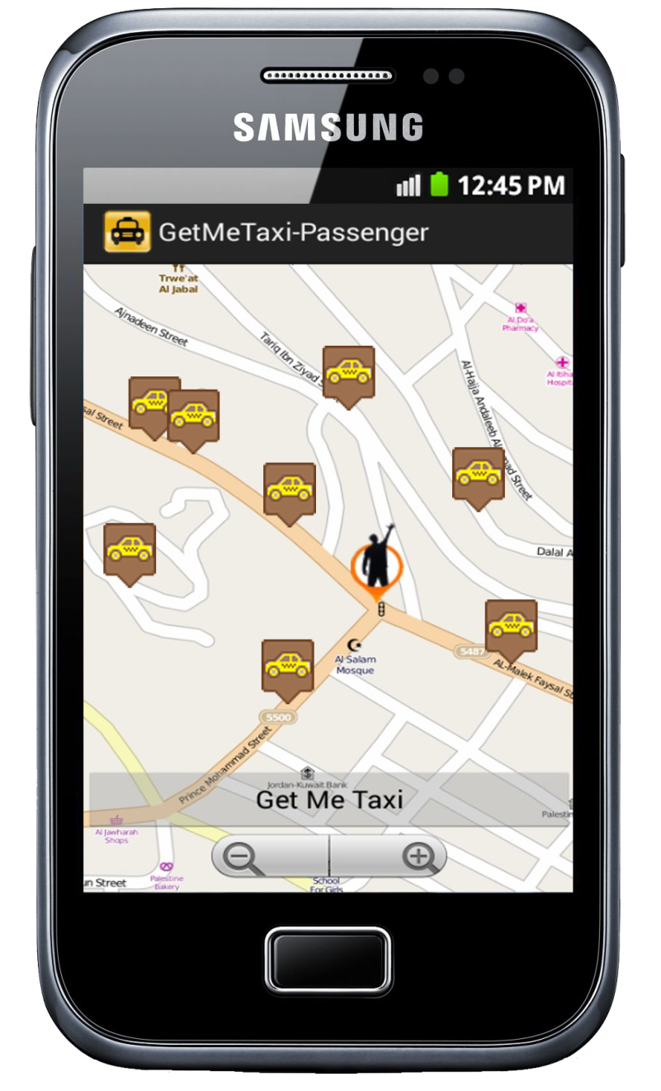
Passenger Android App
The main function in this application is allow the passenger to booking taxi from taxi office.
when you start application you can see all taxi near.

Slide 17
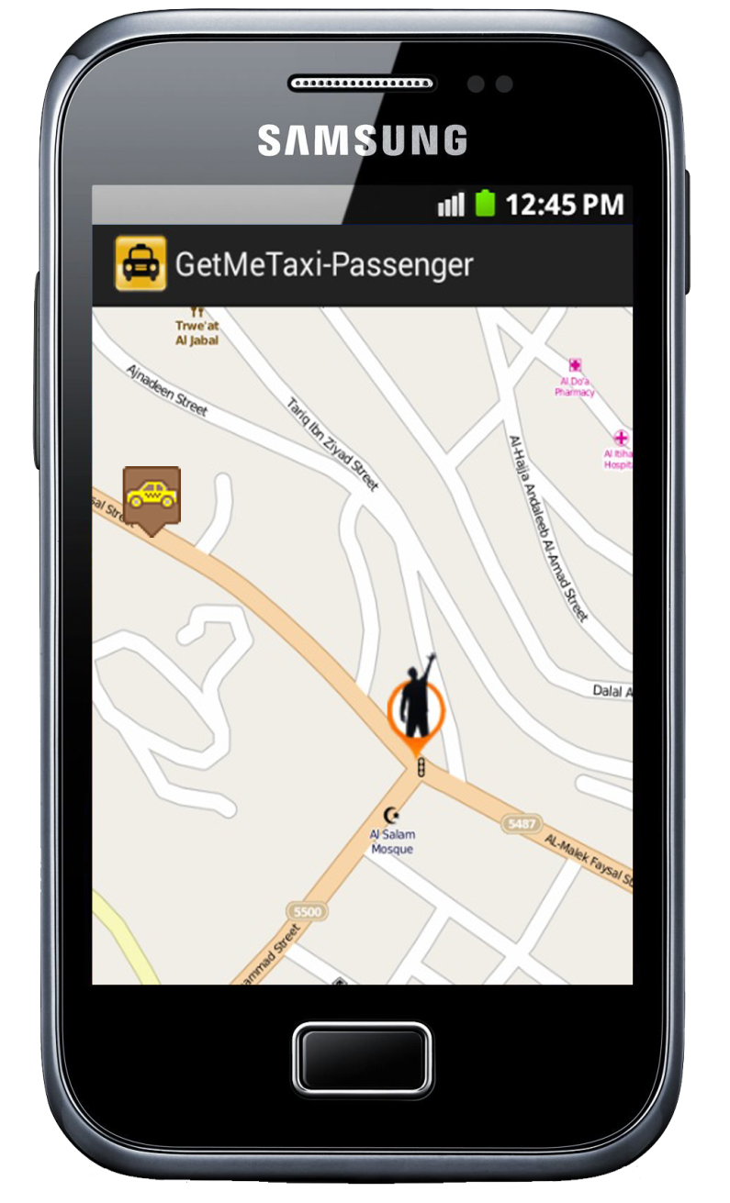
Passenger Android App
When you successful booking taxi from server we can show on map your location and driver location who accept your request and your can tracking the driver on map until driver Reach you.

Slide 18

Google Cloud Message (GCM)
GCM is a free service form Google that helps developers to send data from your servers to their Android applications which run on Android devices.
Google Cloud Message

Slide 19
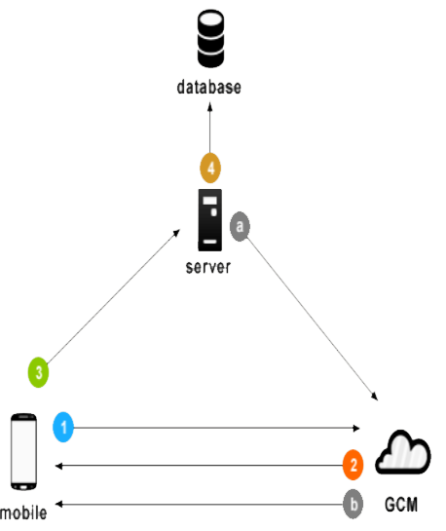
GCM Life Cycle
1. First android device sends sender id, application id to GCM server for registration.
Google Cloud Message
2. upon successful registration GCM server issues registration id to android device.
3. After receiving registration id, device will send registration id to our server.
4. Our server will store registration id
in the database for later usage

Slide 20
GCM Life Cycle
Whenever push notification is needed, our server a message to GCM server along with device registration id (which is stored earlier in the database)
Google Cloud Message
GCM server will delivers that message to respected mobile device using device.

Slide 21
PHP Server In Booking System
PHP Server Responsible for :
  Handle booking requests from Passenger application.
  Determine the nearest driver to the passenger by using MapQuest API web service .
  Send booking Notification to Driver application by using GCM

Slide 22

MapQuest API
The MapQuest Directions API allows you to access the patented routing algorithms through simple HTTP requests.
  Features use in this API:
    Reverse Geocoding Web Service.
    Route Matrix Web Service .

Slide 23
Demo

Slide 24
Thank You

