Slide 1
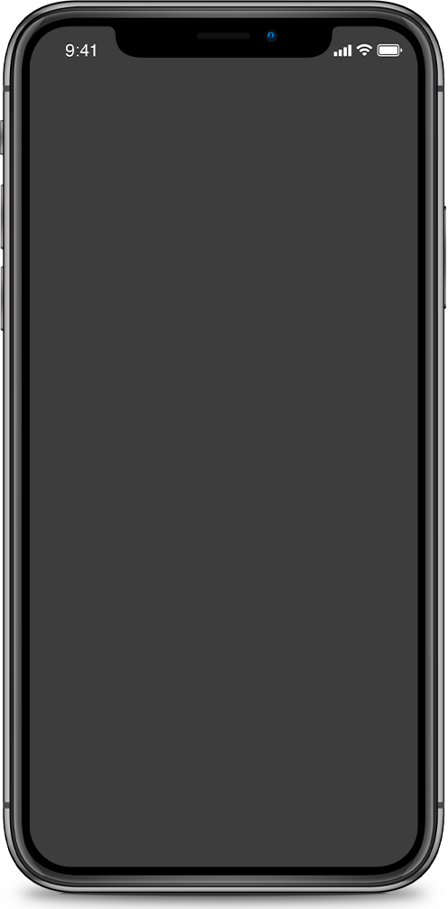
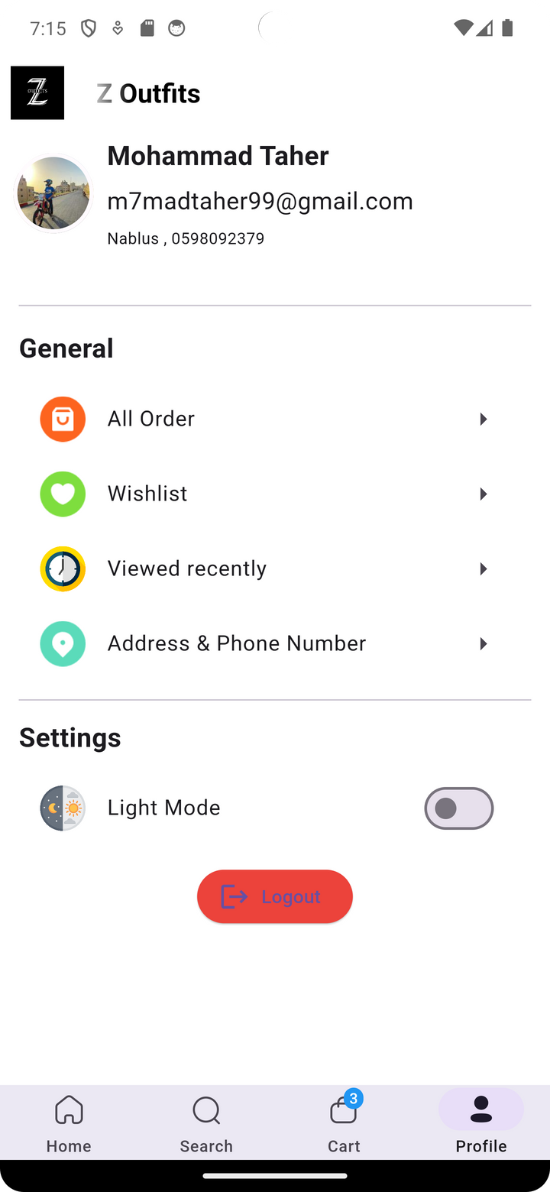
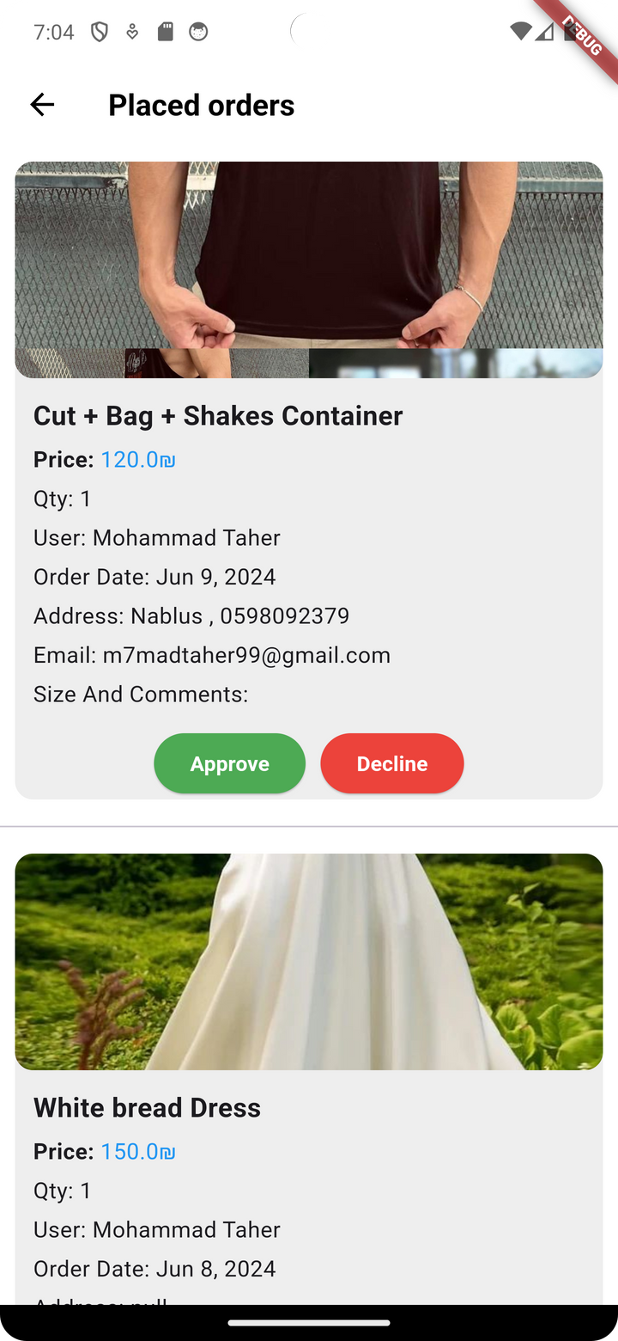
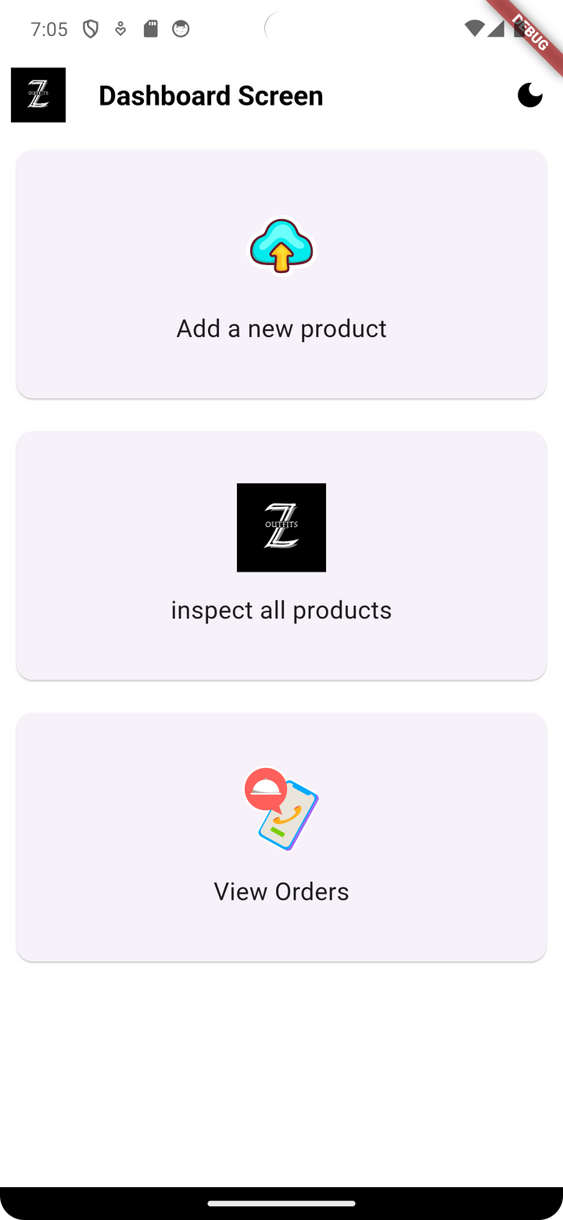
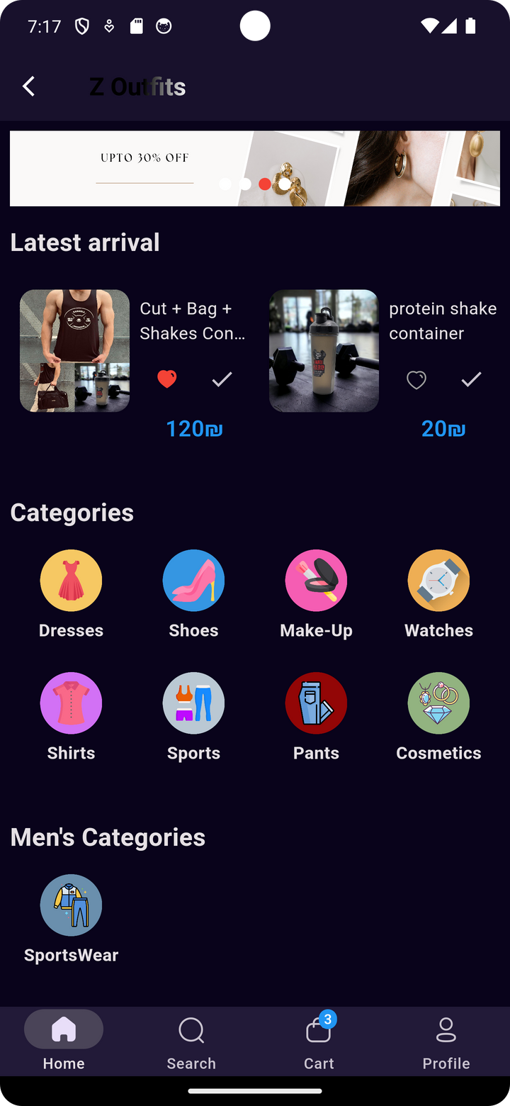
Z-outfits
Mobile Application
Team Members:
Mohammad Taher
Ezz Shoubi
11819190
11927183

Slide 2



CONTENT LIST
01.
02.
03.
04.
05.
OPENING
FEATURES AND ADDED VALUE
Practical Part
FUTURE DEVELOPMENT
ENDING
about the app and How the application been made
a journey on the application in a practical form
what is the future work we will do for the application
All the features in the application
Q&A Session

Slide 3

Introduction
Welcome to Z Outfits, the game-changer in women's shopping apps! Our app, crafted with Flutter, is here to revolutionize your shopping experience on both iOS and Android devices.
What We Offer
Explore a handpicked collection of stylish outfits for every taste. No more endless scrolling – finding your perfect look is easy with us!

Slide 4
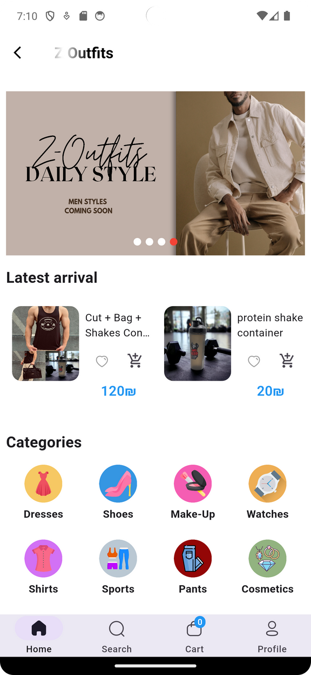


Application Service
User-main app (shop)
Admin panel
easy navigation and easy checkout process for a hassle-free shopping experience, Receive special deals and discounts directly through the app, Save your favorite items and what viewed recently.
Admins can manage products, inventory, and orders directly from their mobile device, Make quick updates and see changes instantly reflected in the user app.

Slide 5



Development
  Intro
Our application was developed using the powerful combination of Flutter and Firebase, all within the Android Studio environment.
  Flutter for Beautiful UI
Flutter, Google's UI toolkit, enabled us to create stunning user interfaces that look and feel great on Android devices. Its fast rendering engine and customizable widgets made UI development a breeze.
  Firebase for Backend
Firebase, Google's mobile and web application development platform, provided a range of backend services that we seamlessly integrated into our app. These services include authentication, real-time database, cloud storage, and more.

Slide 6

Flutter and Firebase make a great team for building mobile apps. Flutter helps make the app look nice and work smoothly on different devices. Firebase provides tools to add features like user sign-in, storing data.

Slide 7
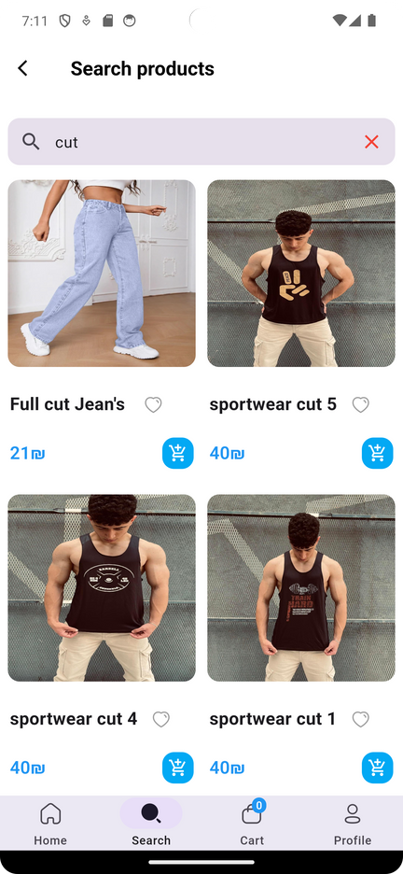

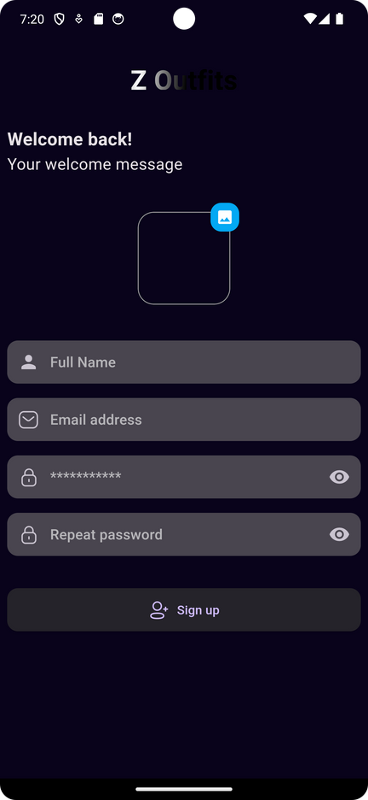



Application Features
SECURE
Secure authentication via Firebase
EASY TO USE
Simple and user friendly interface make the app very easy to use
EASY SEARCHING
Seamless item listing and search
KEEPS USER UPDATED
notify user about new clothes and any deals or discounts available

Slide 8
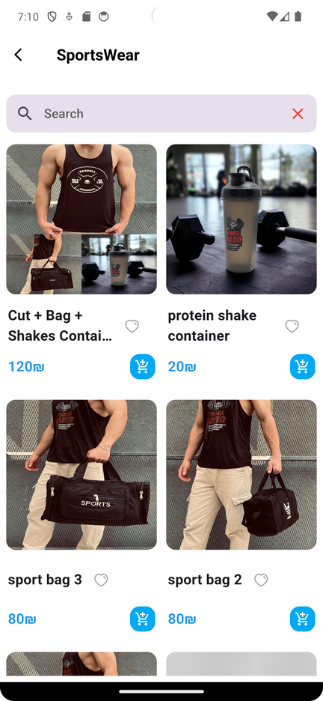
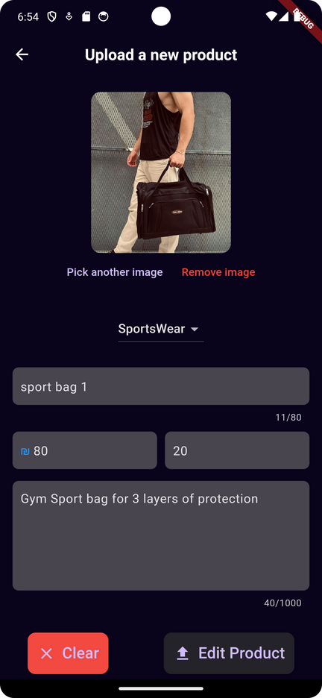
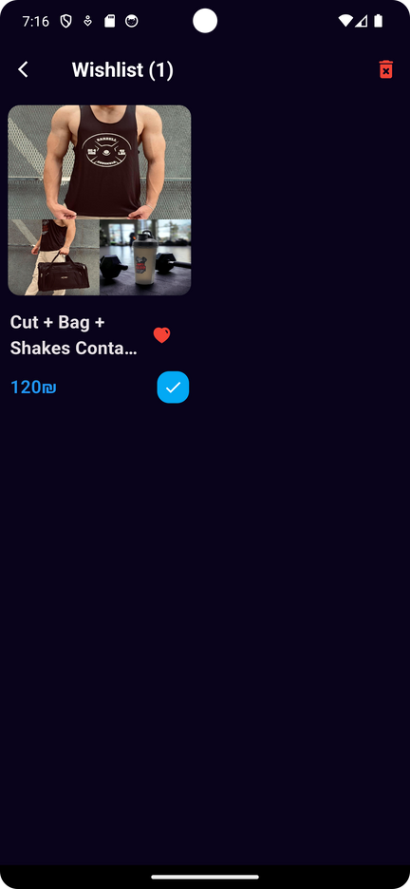
Added Values
Added Values
Main User Mobile App
Admin Panel Mobile App
  Seamless Shopping Experience:
Intuitive navigation and easy checkout process for a hassle-free shopping experience.
  Exclusive Offers:
Receive special deals and discounts directly through the app.
  Wishlist and Favorites:
Save your favorite items for later and get notified when they go on sale.
  Easy Management:
Admins can manage products, inventory, and orders directly from their mobile device.
  Real-Time Updates:
Make quick updates and see changes instantly reflected in the user app.

Slide 9

LETS JUMP TO THE PRACTICAL PART
If you would like to install the app scan this code
for android only

Slide 10


Problems Faced
Knowledge Limitations in Programming Languages and Databases
Limited expertise in programming languages and databases poses challenges in developing and maintaining the application effectively.
Ensuring App Functionality and Error-Free Operation
Ensuring that the application functions correctly and without errors requires meticulous testing and debugging, consuming time and resources.

Slide 11





Future work
MAKING A ONLINE PAYMENT FOR THE APPLICATION
INTEGRATION OF NEW FEATURES
INTEGRATING THE OTP MESSAGING FOR VERIFYING THE PHONE NUMBER

Slide 12
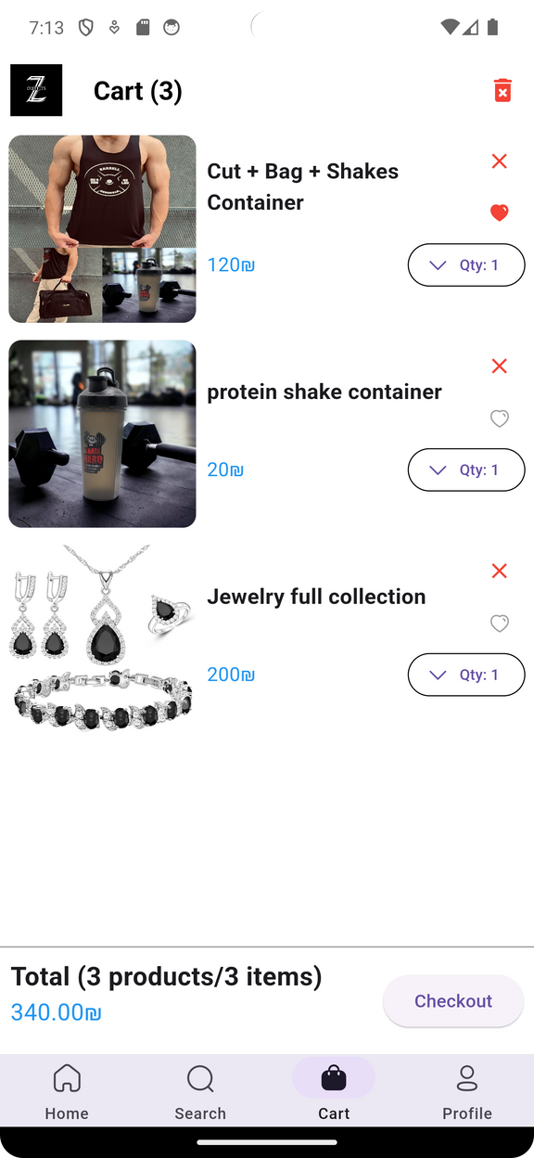
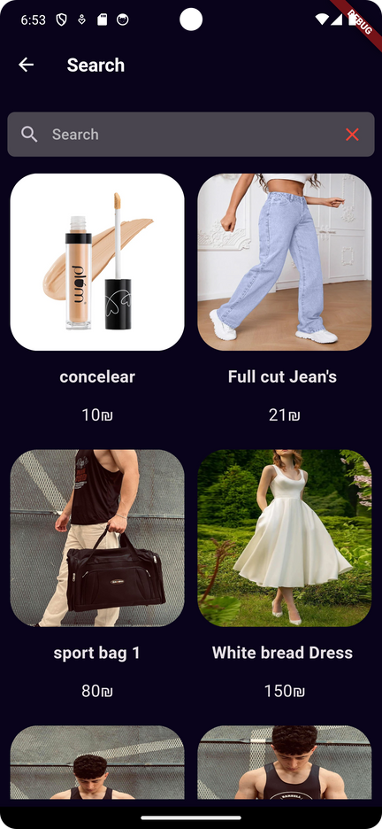
Thank You For your Attention !!

