Slide 1
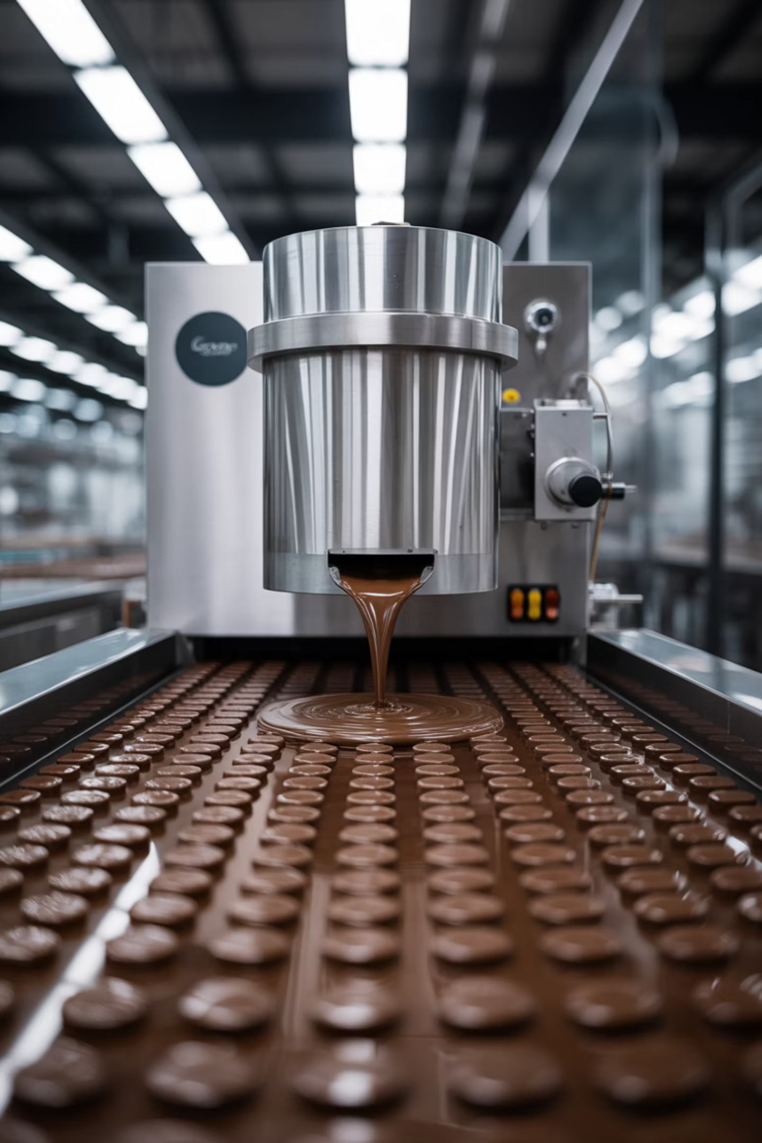
ChocoMatic: Automated Chocolate Bar Production System
A graduation project by Ahmad Dardook and Sayed Qutob from An-Najah National University, presenting a fully automated chocolate bar production line with integrated tempering and topping systems. This engineering solution combines precision temperature control, customizable toppings, and mobile app connectivity for small-scale chocolate manufacturing.

Slide 2
Project Overview
The Challenge
Our Solution
Small-scale chocolate manufacturing faces significant challenges in maintaining consistent product quality while minimizing manual labor. Traditional tempering processes are labor-intensive and require precise temperature control, while topping customization often relies on manual intervention.
An automated chocolate bar production line with real-time monitored tempering system, topping dispensers, and wireless control via a mobile application, offering a scalable solution for educational or semi-industrial environments.

Slide 3
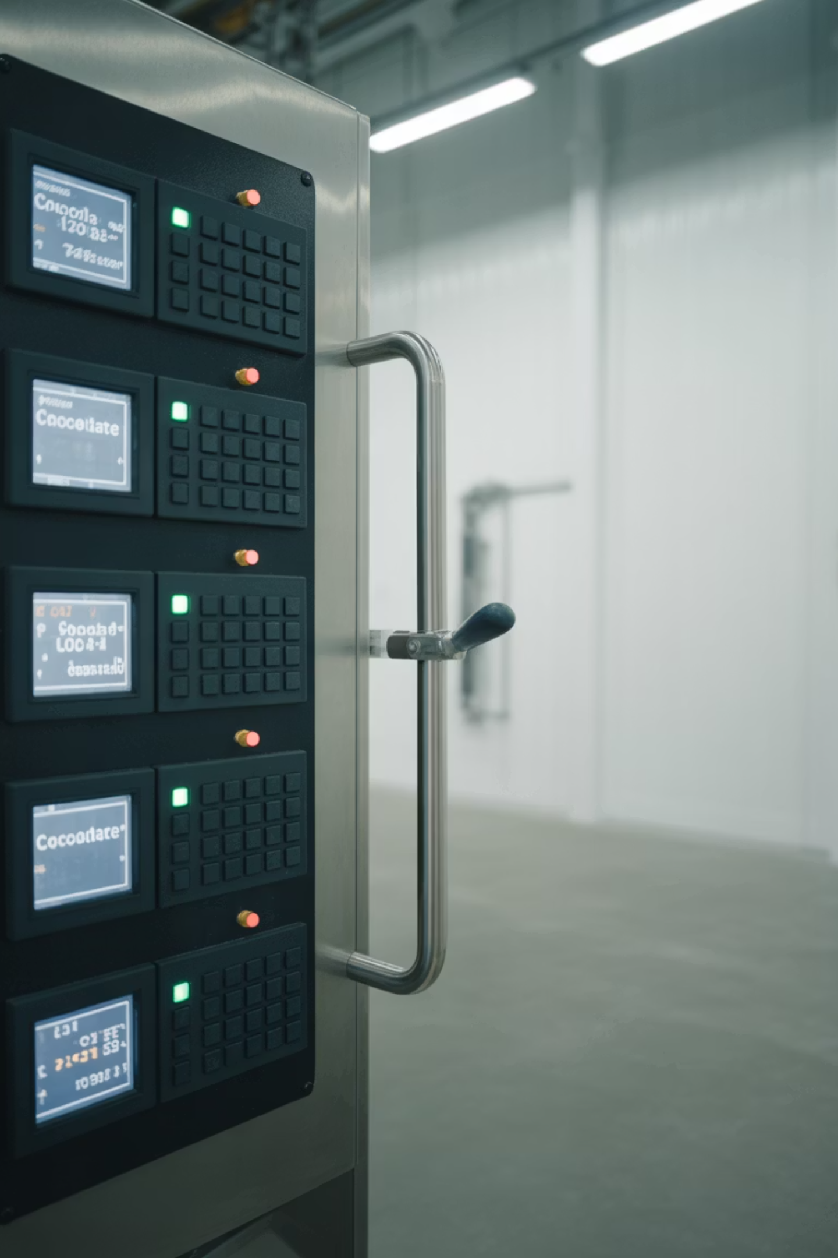




Key Objectives
Automate Chocolate Tempering
Implement real-time temperature monitoring via PT100 sensor and MAX31865 module with a 1950W heating element controlled through an SSR and ESP32.
Enable Customization
Support three chocolate types (milk, dark, white) with unique tempering profiles and topping options (raisins, nuts, or none) via dedicated keypads.
Ensure Precision & Monitoring
Achieve precise mold-filling control with our NEMA23 Motor, paired with a food-safe material wheel and a stainless-steel pipe. Enhance distribution uniformity with integrated vibration motor and keep track of filling levels using ultrasonic sensors.
Create User-Friendly Interface
Integrate user interaction through keypads, LCD displays for system status, and remote operation through a mobile app via Wi-Fi (ESP32).

Slide 4
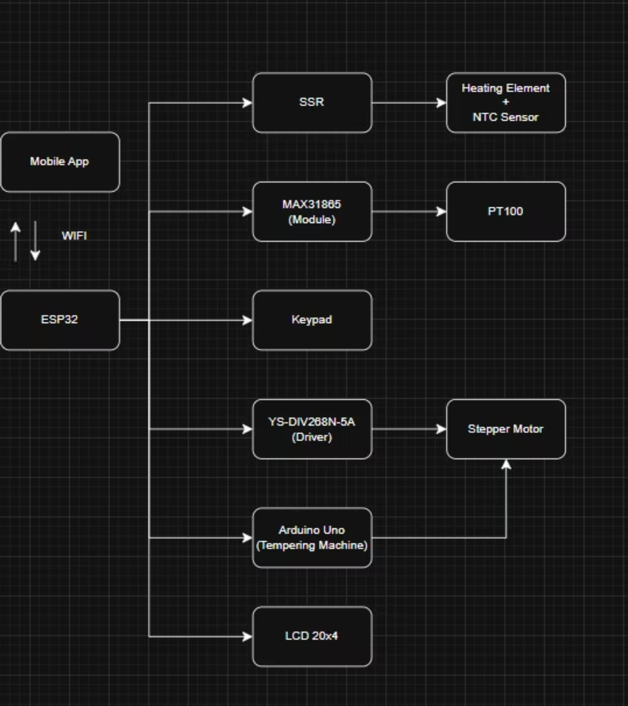
System Architecture
The system utilizes a modular microcontroller architecture with four dedicated controllers:
ESP32: Manages tempering machine, temperature monitoring, and Wi-Fi connectivity for mobile app control
Arduino Uno (Tempering Machine): Handles the chocolate mixing/transferring wheel for precise control, and is also connected to the ESP32 for signal control.

Slide 5
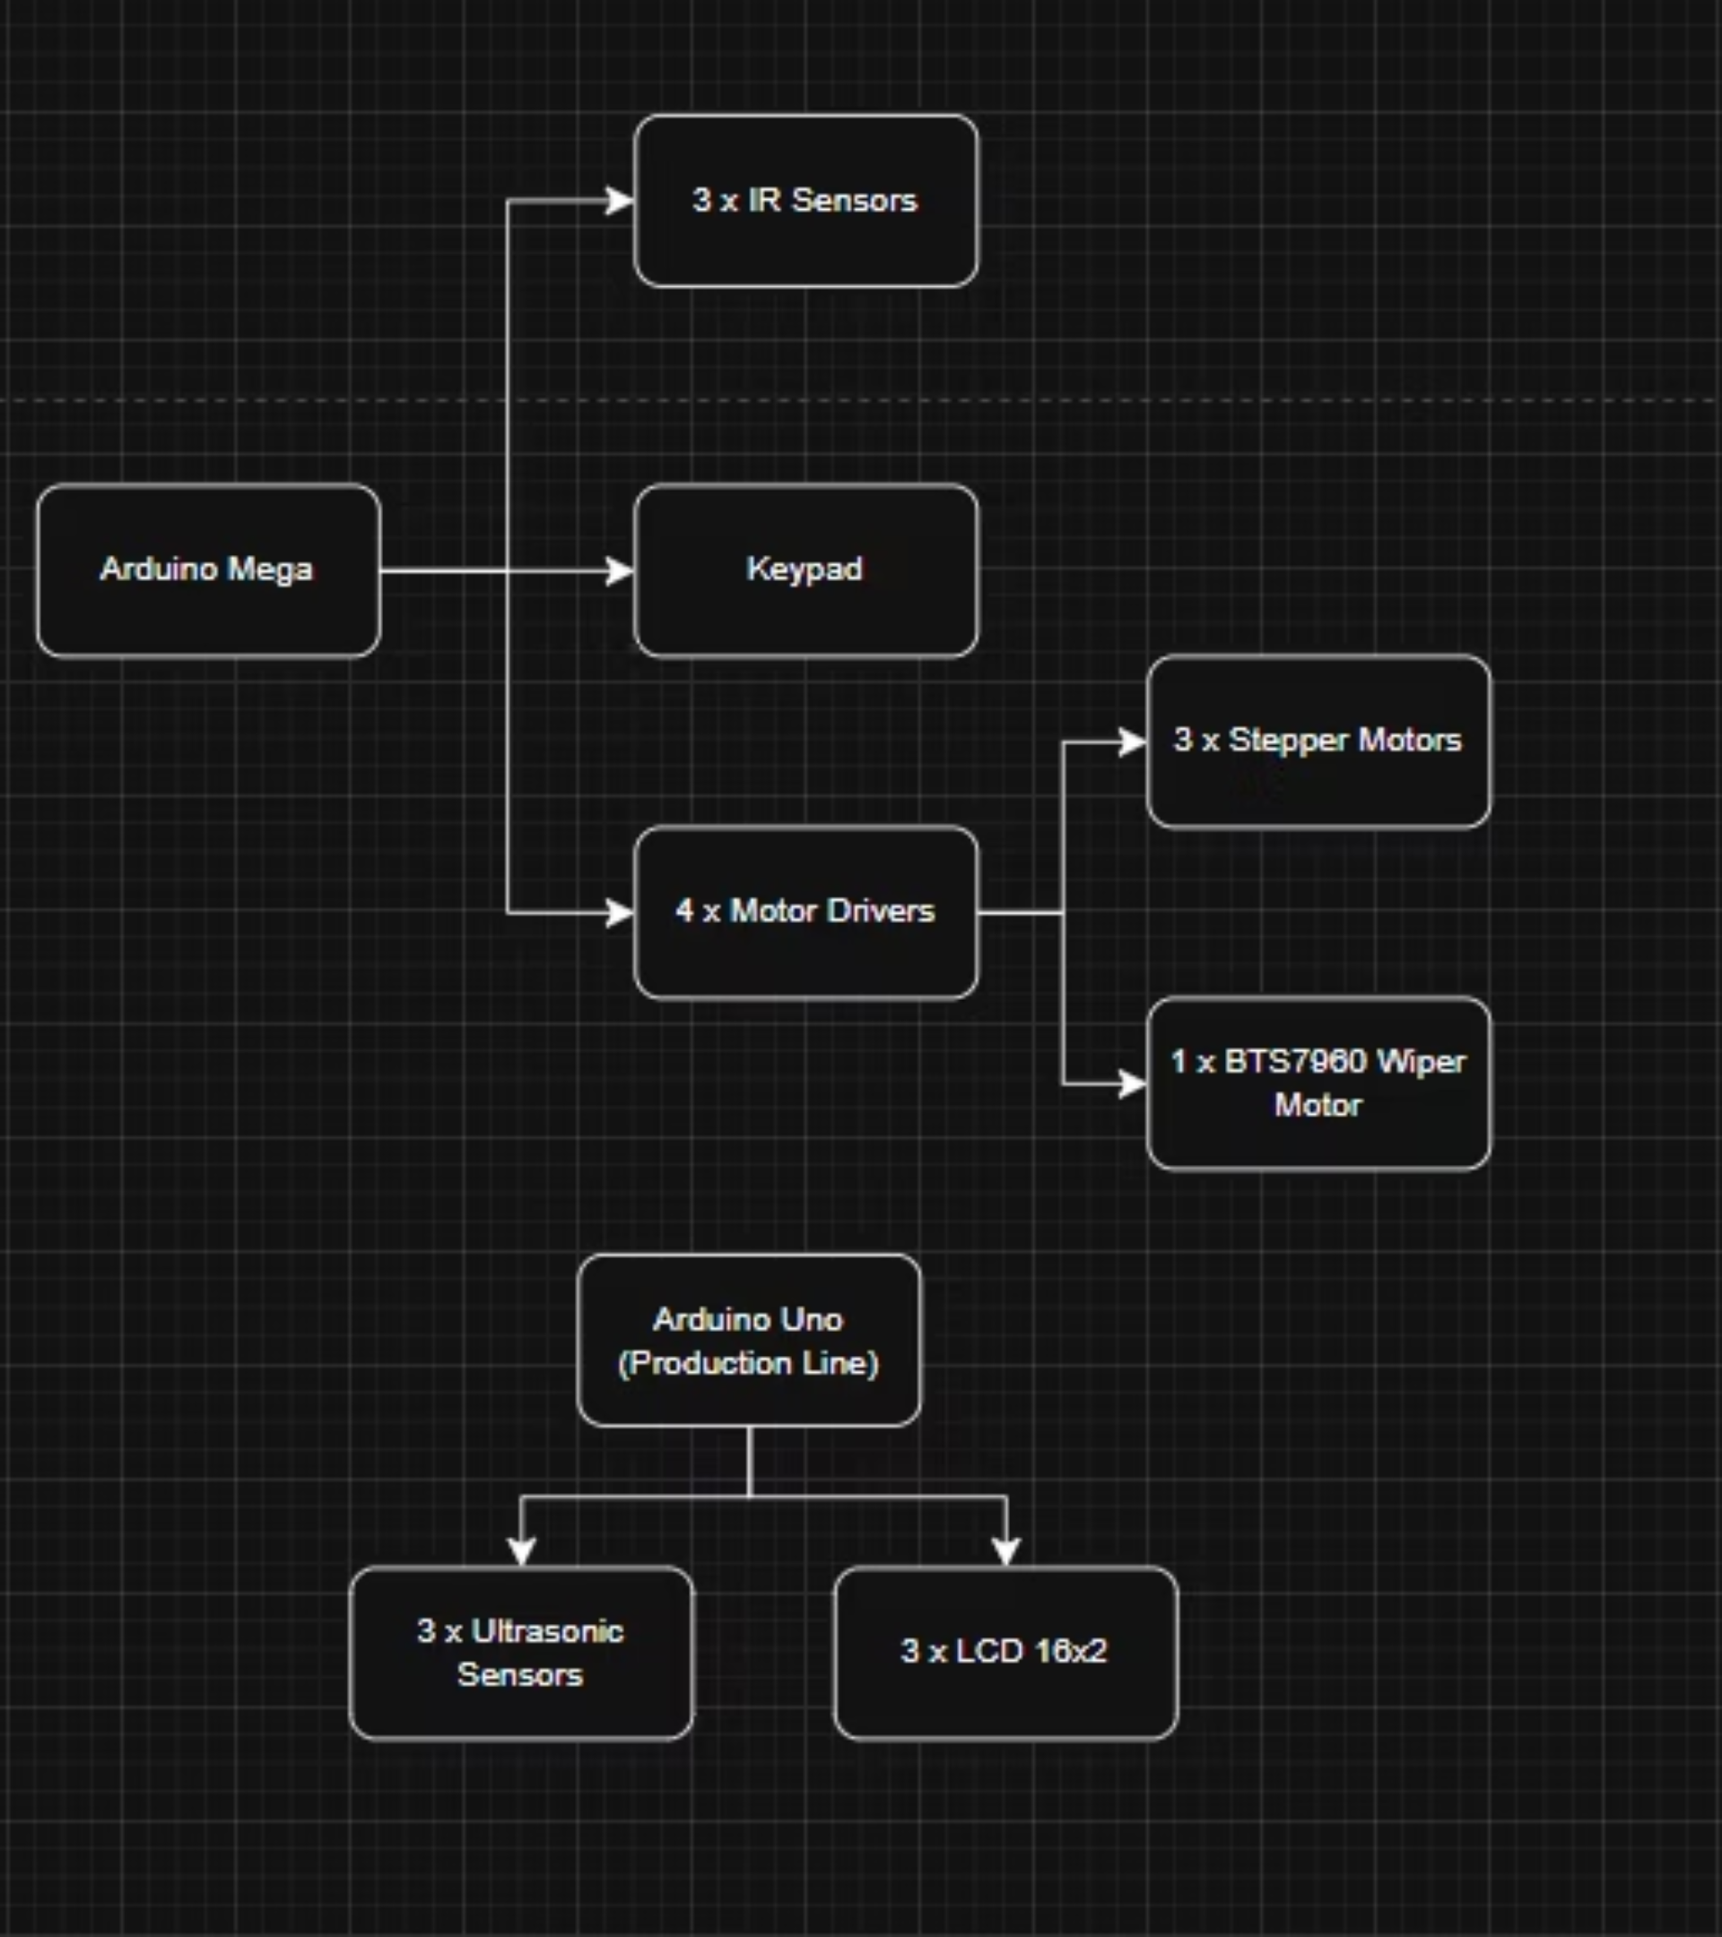
System Architecture(cont.)
The system utilizes a modular microcontroller architecture with four dedicated controllers:
Arduino Mega 2560: Controls the main production line, including conveyor belt, IR sensors, toppings dispensers, and keypad inputs
Arduino Uno (Production Line): Handles ultrasonic sensors for monitoring filling levels and drives additional LCD displays

Slide 6
Chocolate Tempering Machine
Key Components
Tempering Profiles
1950W heating element (230V)
Milk Chocolate
42°C → 27°C → 32°C
PT100 temperature sensor with MAX31865 module
Solid State Relay (SSR) for safe control
Dark Chocolate
45°C → 28°C → 30°C
Stainless steel double-layer container
White Chocolate
40°C → 26°C → 29°C
ESP32 for temperature control and Wi-Fi
NEMA23 motor
Food-safe wheel

Slide 7
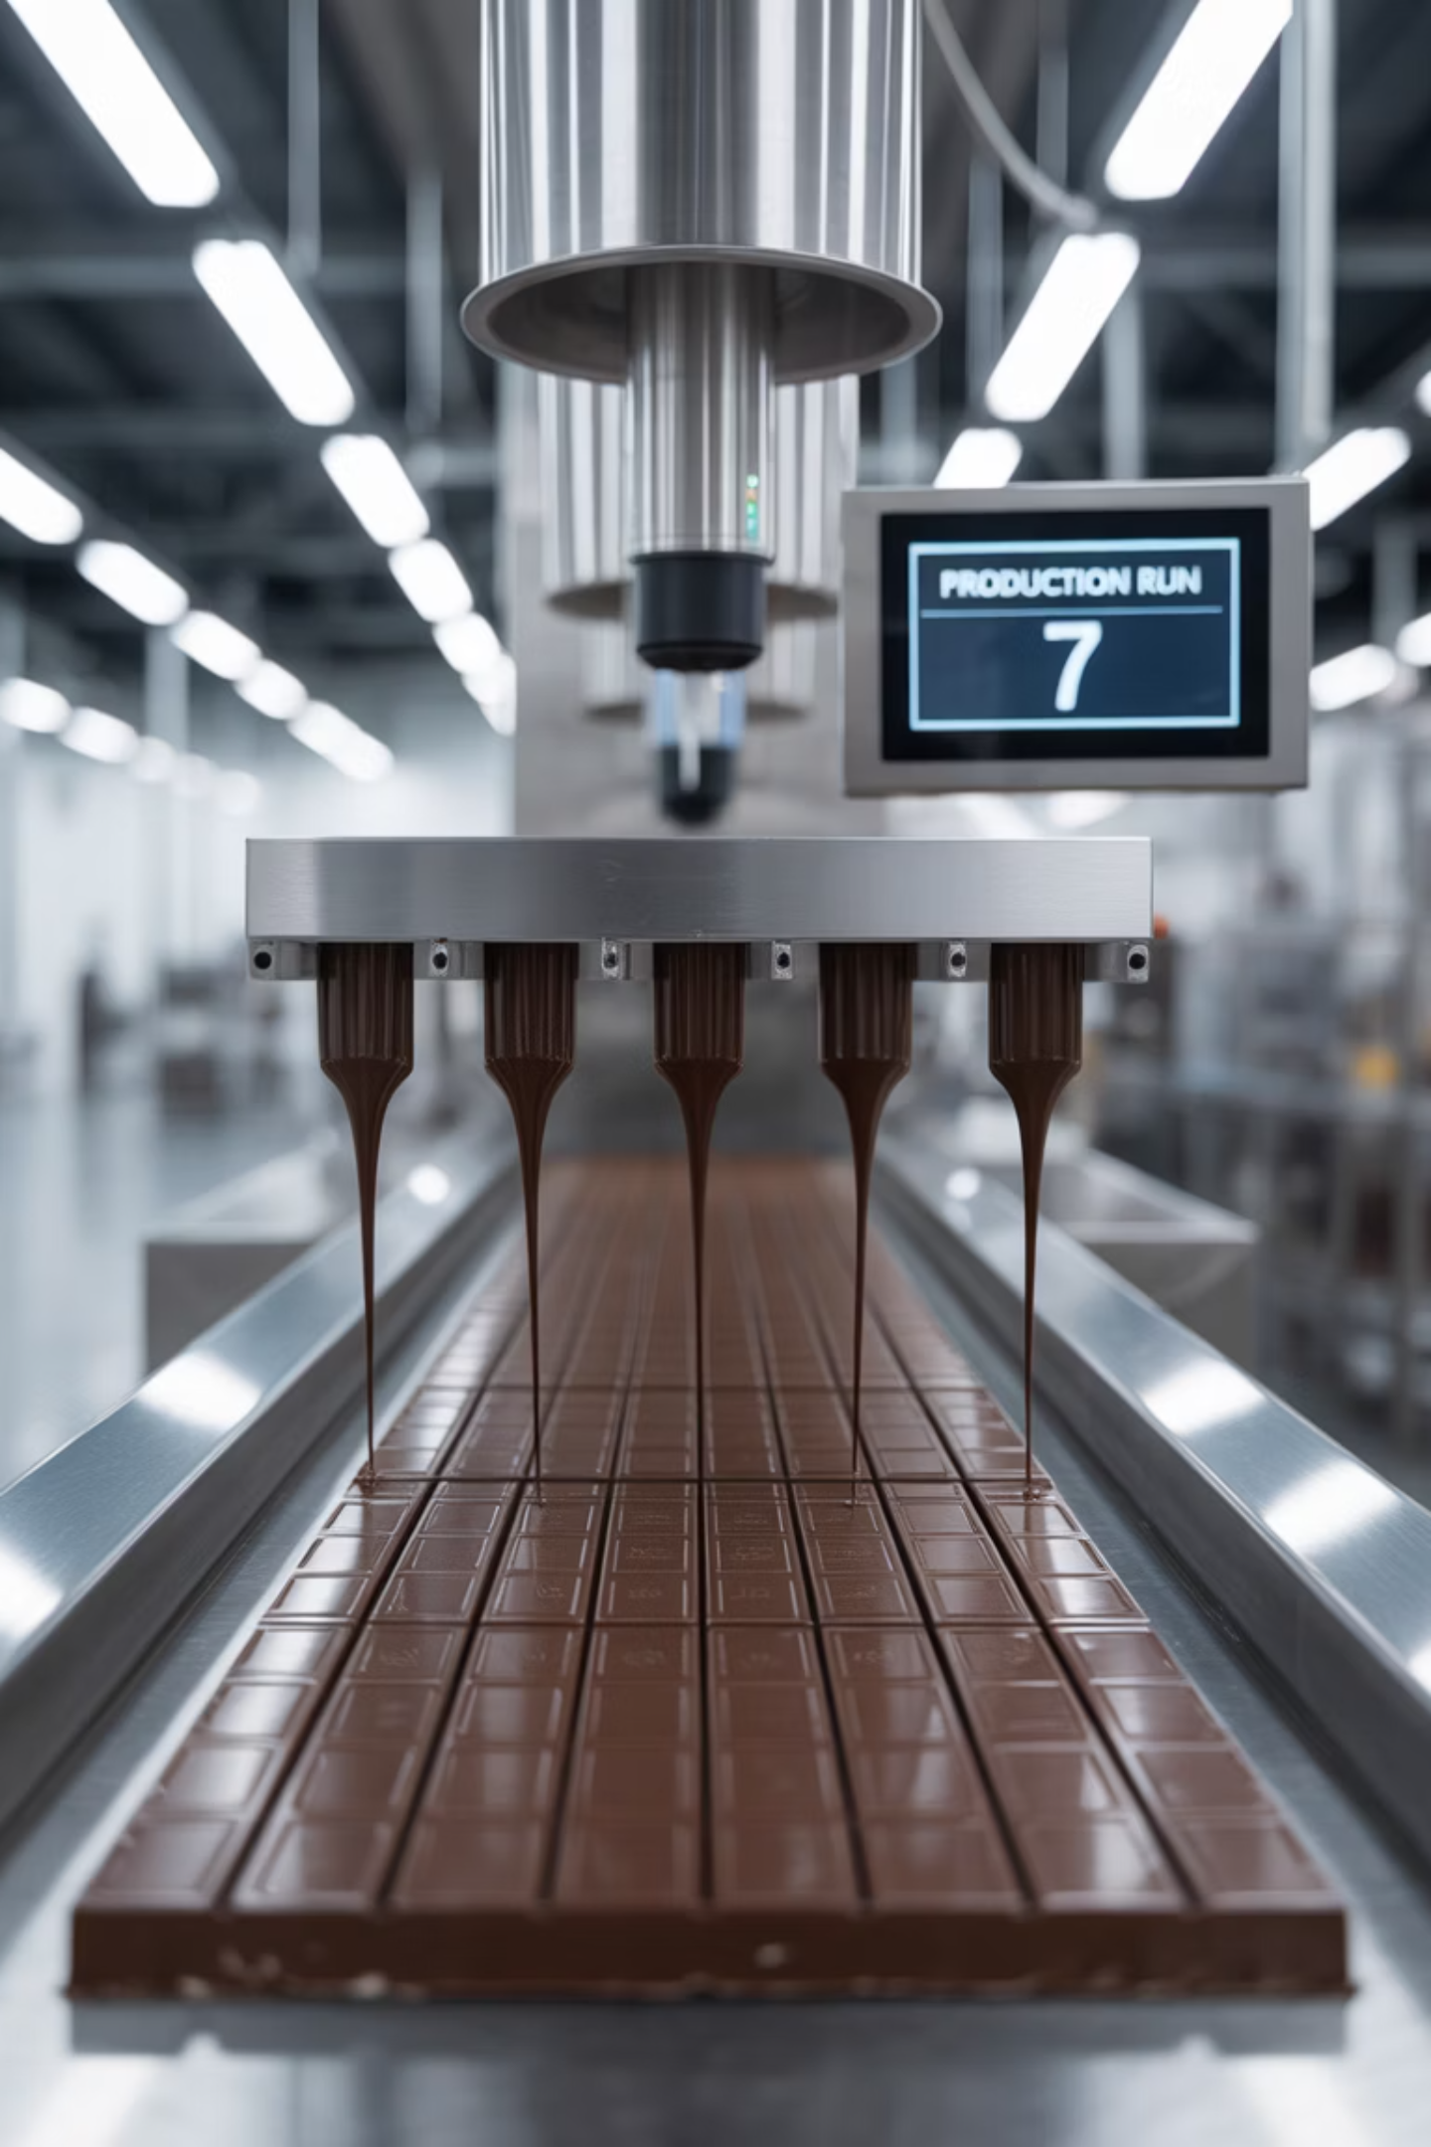
Production Line Components
Key Components
Windshield wiper motor drives the belt, controlled by BTS7960 motor
IR sensors to detect mold positioning
NEMA23 stepper motors with YS-DIV268N-5A drivers
2430 vibration motor
Ultrasonic sensors

Slide 8
Thermal Calculations
System Parameters
Energy Requirements
Water: 8L (8000g)
Water energy: 568,480J
Chocolate: 5kg (5000g)
Chocolate energy: 144,500J
Temperature change: 17°C (25°C to 42°C)
Heating element: 1950W
Total energy: ~712,980J
Ideal heating time: 6 to 11 minutes
Realistic time : around 40 to 80 minutes

Slide 9
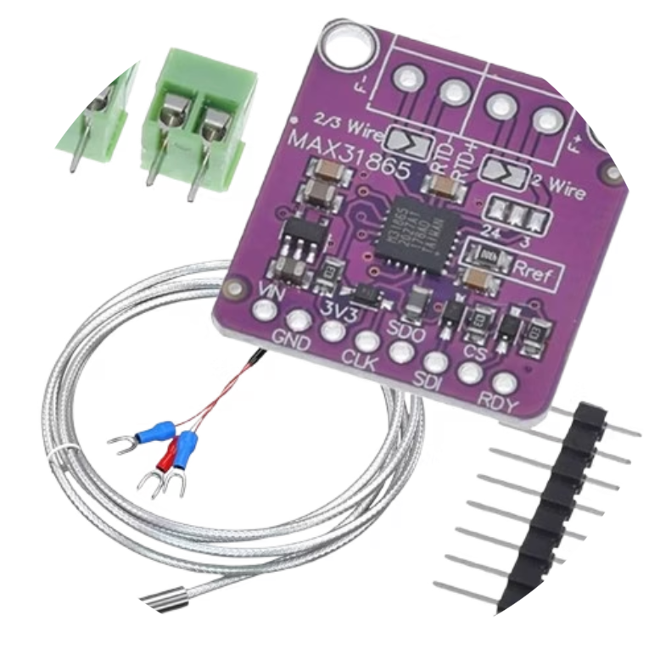
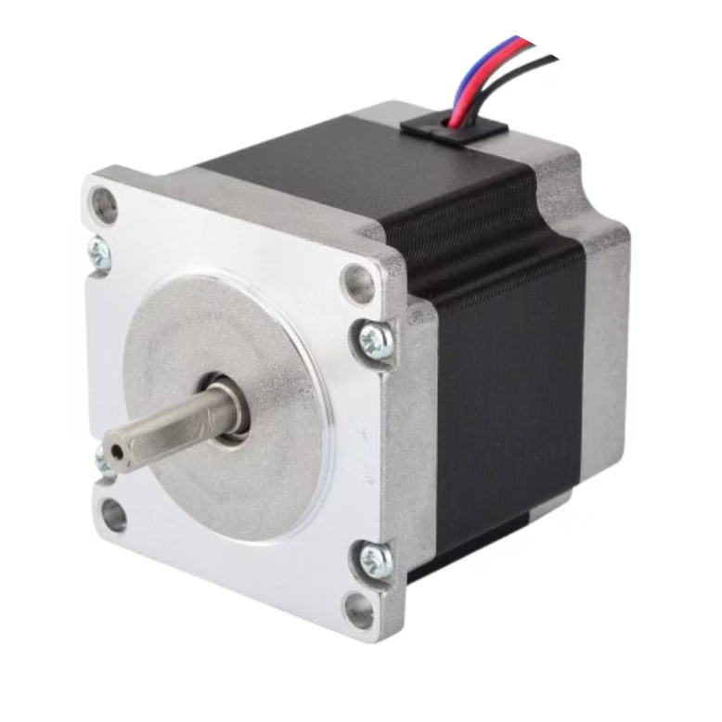
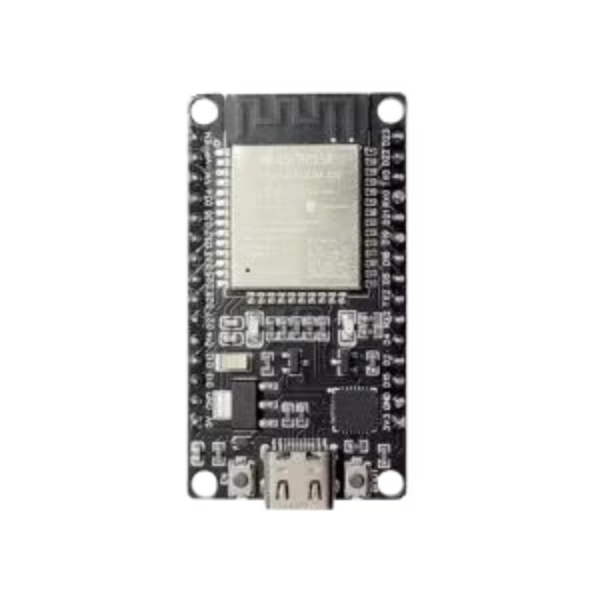
Hardware Components (tempering machine)
Temperature Sensing
Precision Motors
Smart Control
PT100 RTD sensor with MAX31865 module provides high-precision temperature monitoring essential for proper chocolate crystallization.
NEMA23 stepper motors with YS-DIV268N-5A drivers enable precise control of chocolate and topping dispensing mechanisms.
ESP32 microcontroller provides dual-core performance and built-in wireless features for tempering control and mobile connectivity.

Slide 10
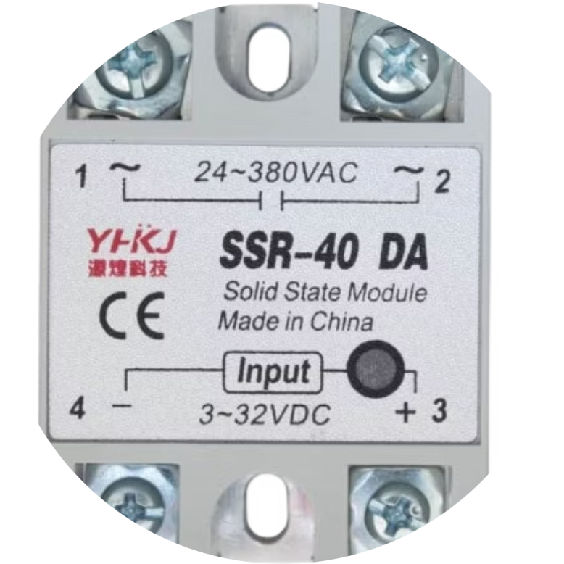
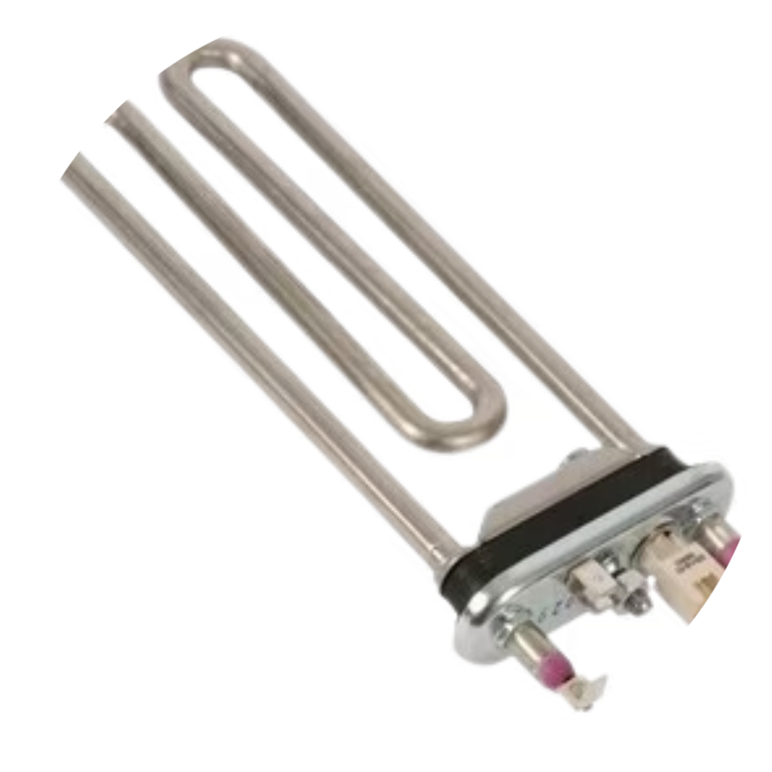
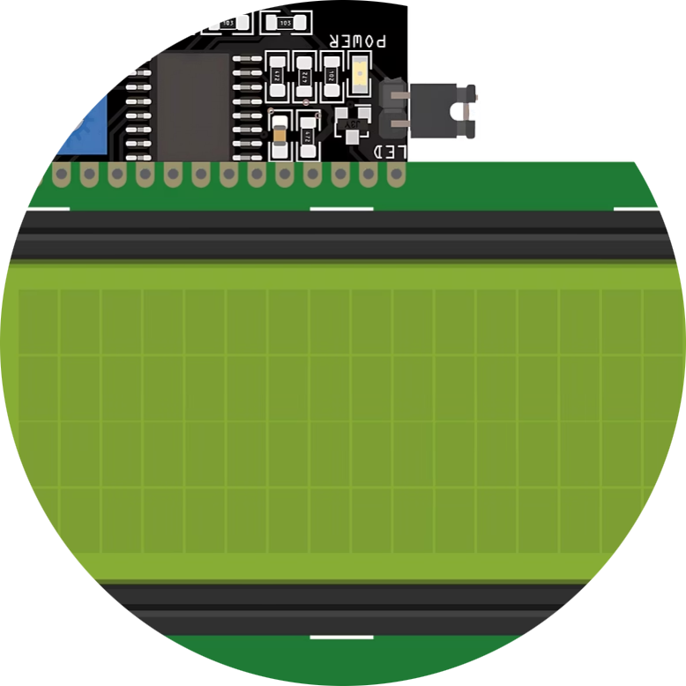
Hardware Components (tempering machine)
SSR-40DA Solid State Relay
NTC Thermistor
20x4 I2C LCD Display
The SSR-40DA module ensures safe and reliable switching of the 230V heating element using low-voltage control from the ESP32, enabling precise temperature regulation without mechanical wear.
The NTC thermistor monitors water bath temperature in real-time, providing essential feedback for maintaining stable heating conditions during the tempering process.
The 20x4 I2C LCD offers a clear interface to display real-time temperature data, system status, and phase transitions, enhancing user interaction and system transparency.

Slide 11
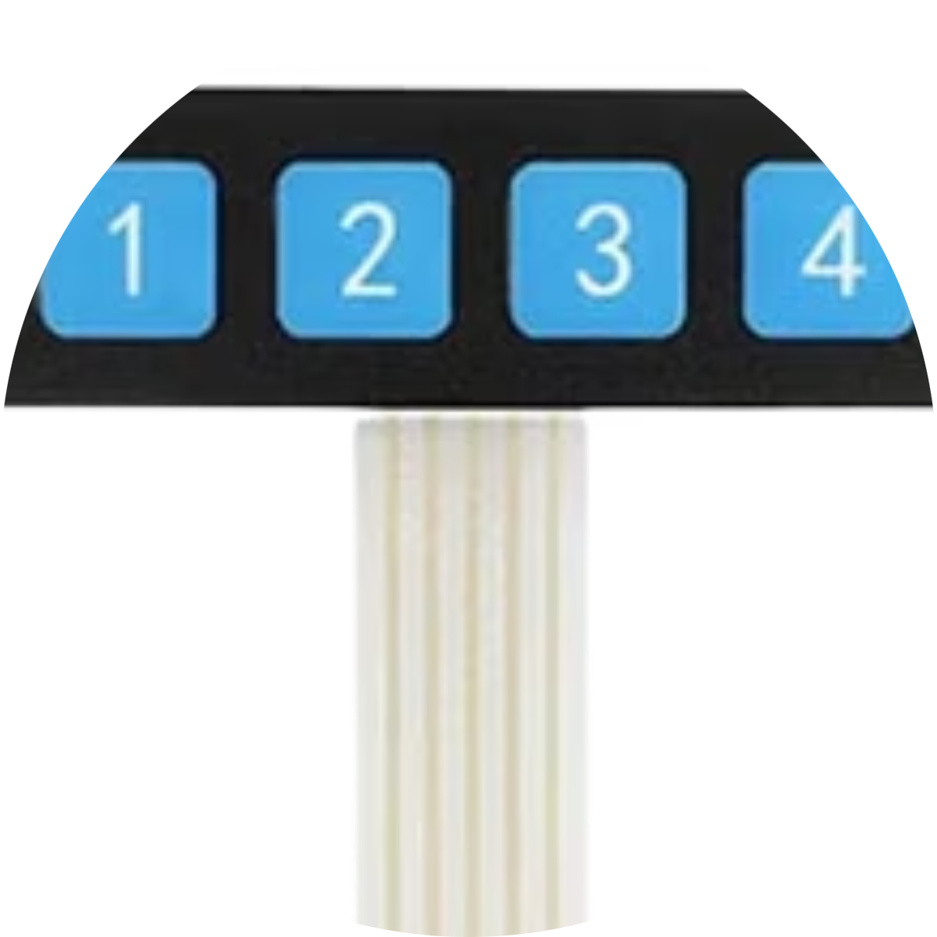
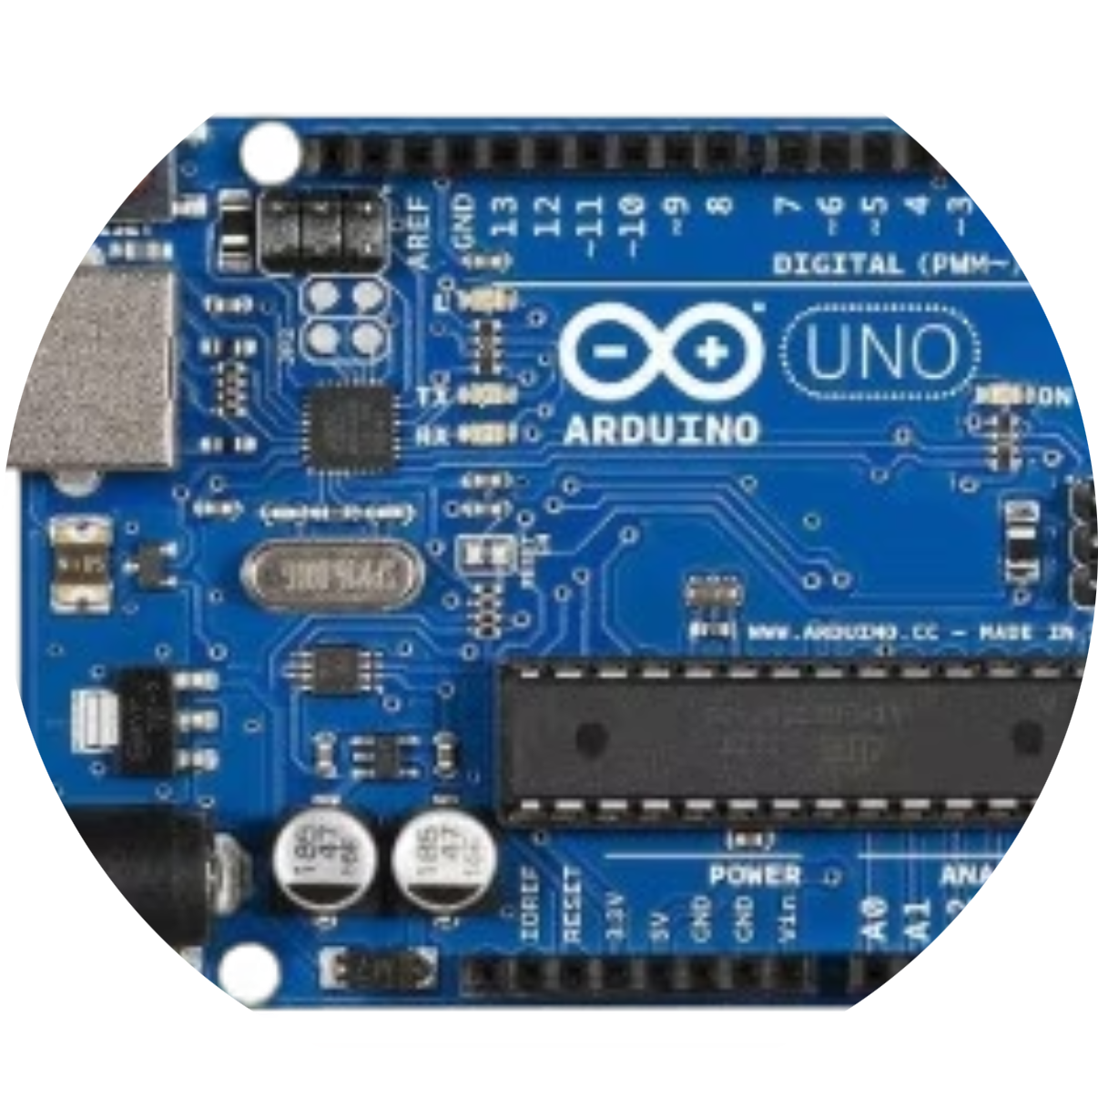
Hardware Components (tempering machine)
4x1 Membrane Keypad
Arduino Uno
The keypad allows users to interact with the system, navigate menus, and start or stop the tempering process manually, providing an intuitive local control option.
The Arduino Uno acts as a dedicated controller for specific subsystems, such as motor coordination or sensor integration, offloading tasks from the main ESP32 to ensure smoother and more responsive system performance.

Slide 12
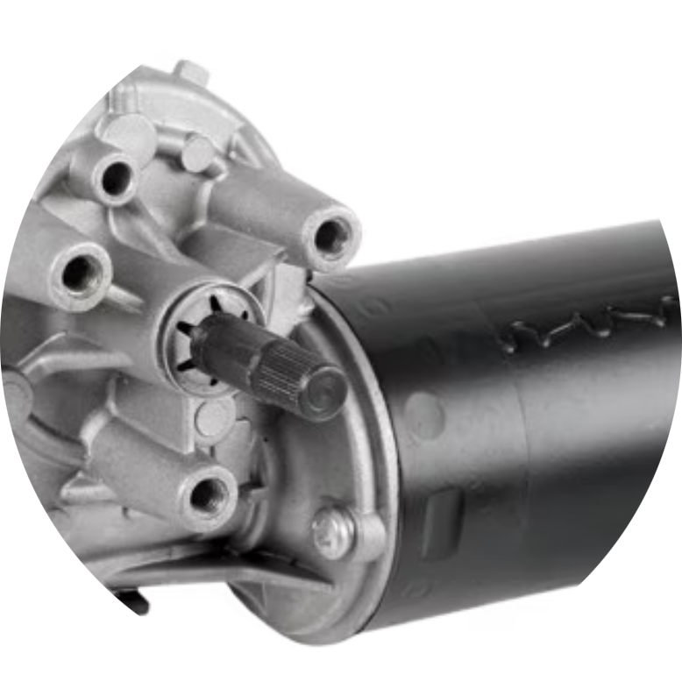
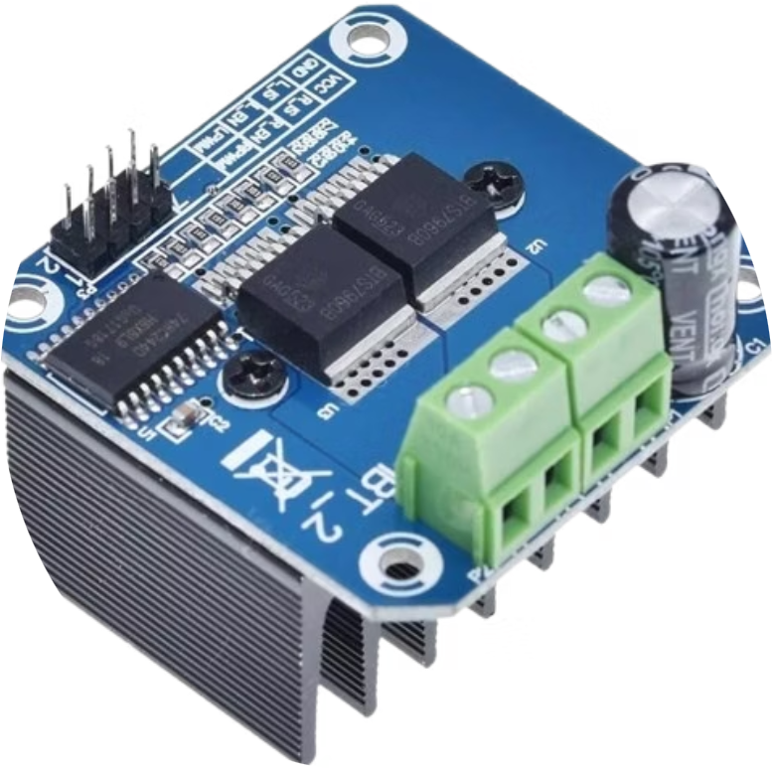
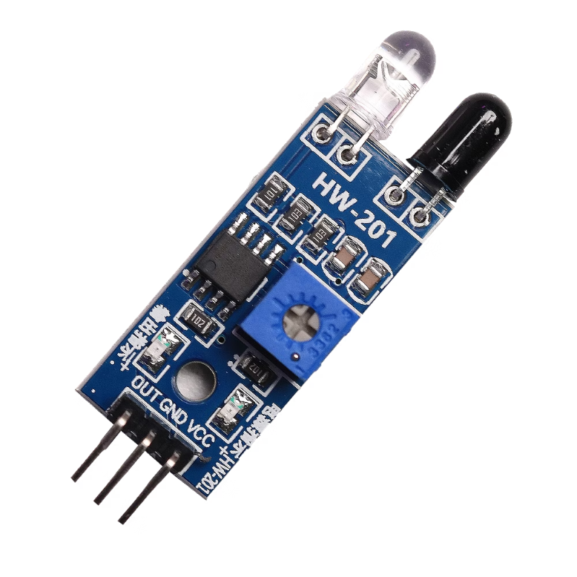
Hardware Components (production line)
Windshield Wiper Motor
BTS7960 Motor Driver
IR Sensors
Provides high torque to drive the conveyor belt for mold movement along the production line.
Controls the wiper motor's speed and direction, enabling smooth and reliable belt operation.
Detect mold position on the conveyor for precise timing of topping or filling actions.

Slide 13
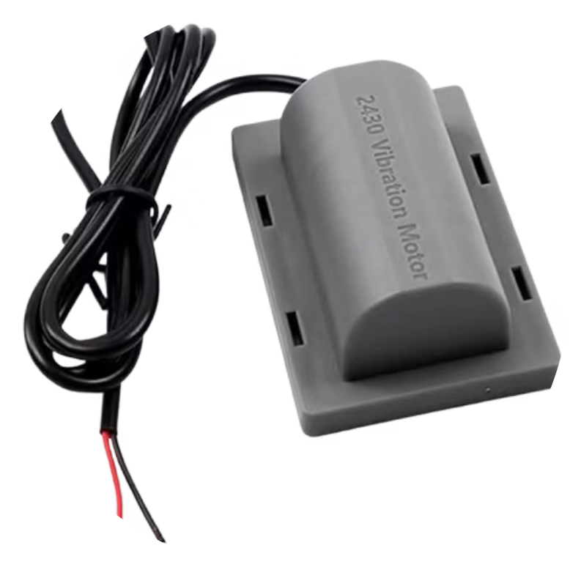
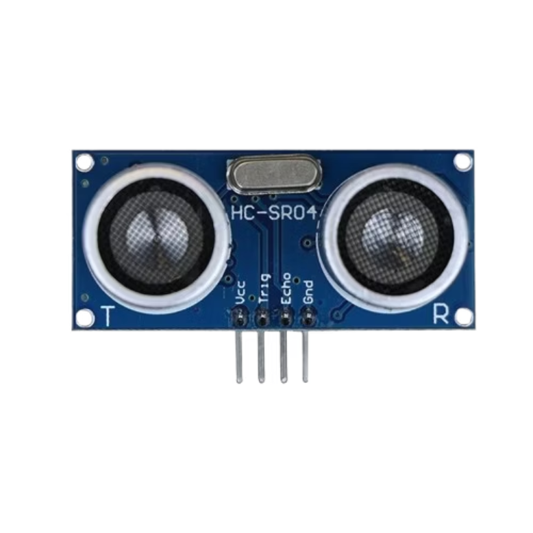
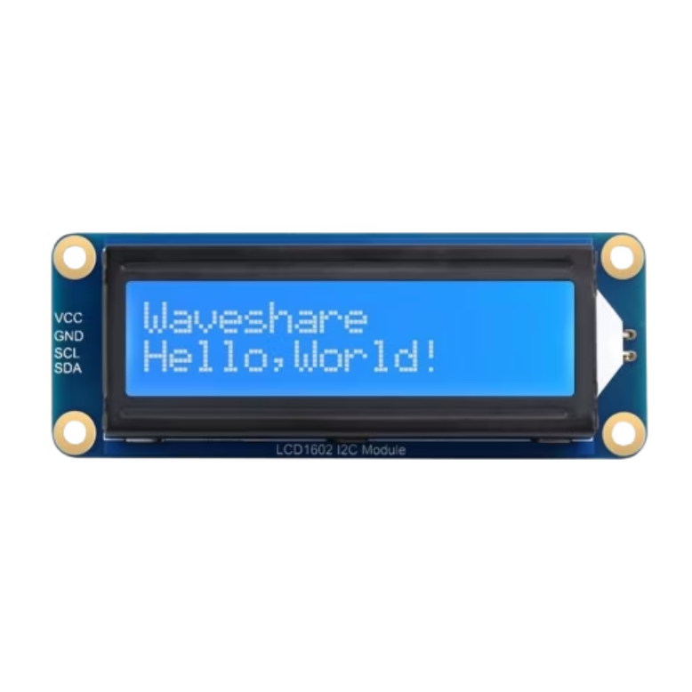
Hardware Components (production line)
2430 Vibration Motor
Ultrasonic Sensors
16x2 I2C LCD
Ensures chocolate settles evenly in molds by eliminating air bubbles through vibration.
Monitor distances to detect objects or obstacles along the production line.
Displays real-time status of mold filling and system operations, using I2C for efficient communication.

Slide 14
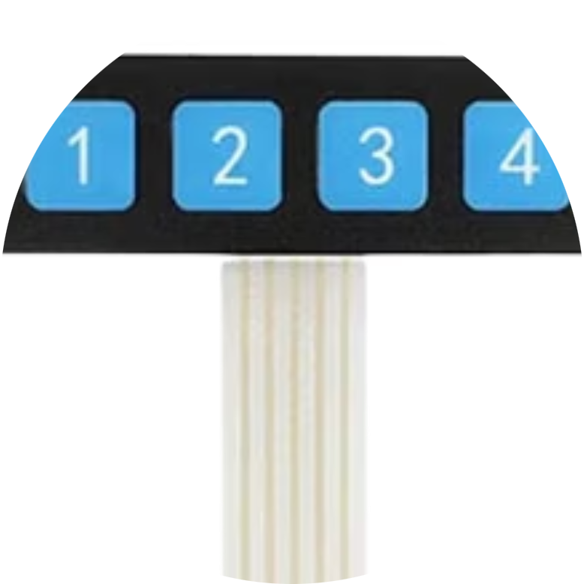
Hardware Components (production line)
Precision Motors
4x1 Membrane Keypad
16x2 I2C LCD
NEMA23 stepper motors with YS-DIV268N-5A drivers enable precise control of chocolate and topping dispensing mechanisms.
The keypad allows users to interact with the system, navigate menus, and start or stop the tempering process manually, providing an intuitive local control option.
Displays real-time status of mold filling and system operations, using I2C for efficient communication.

Slide 15
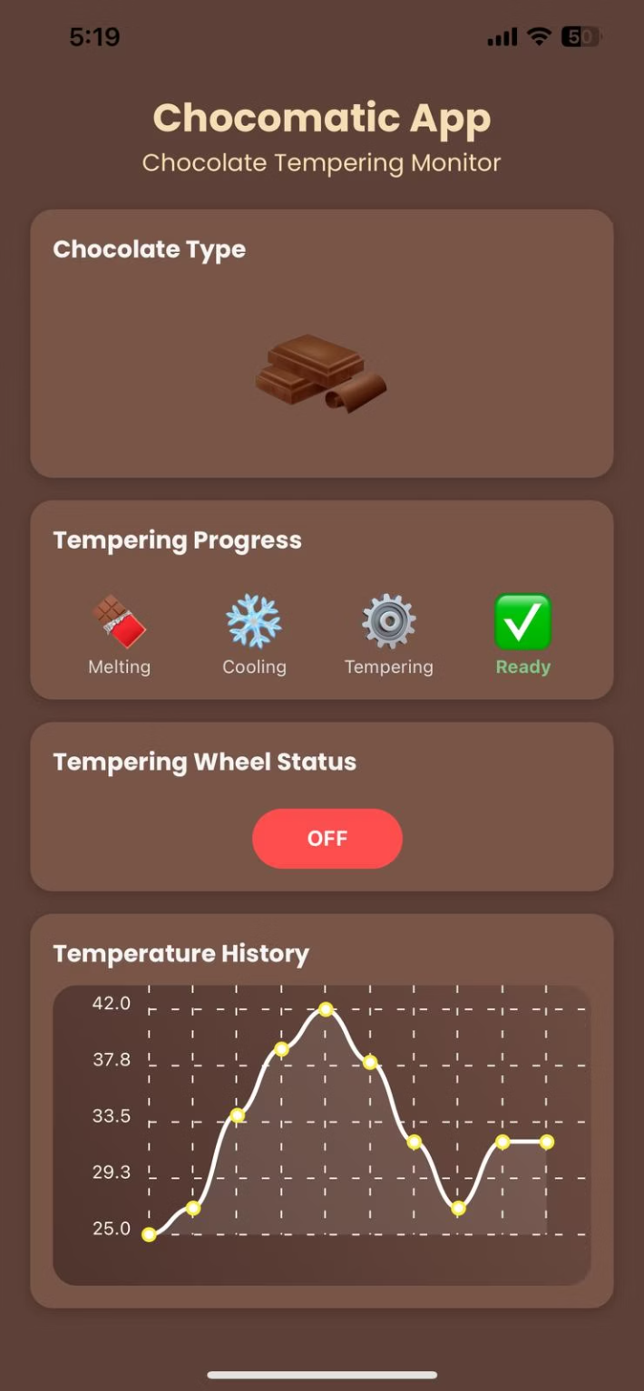
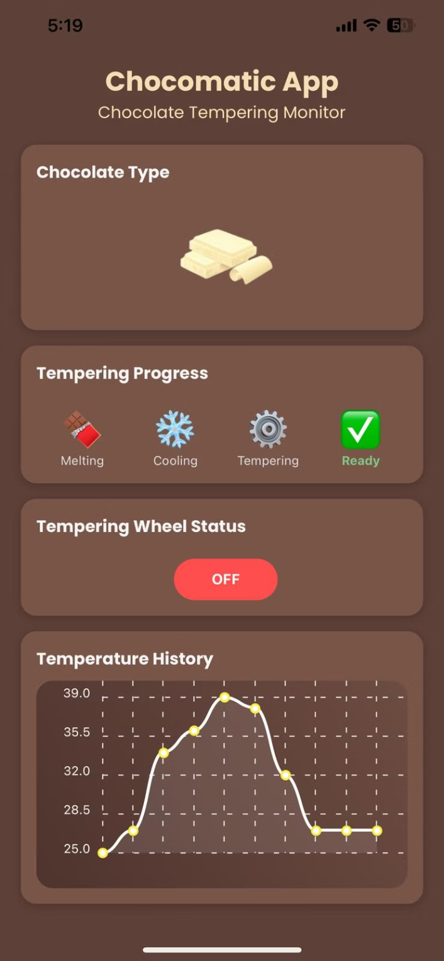
Monitors tempering process
Track the progress of the tempering process efficiently.
Tracks temperature & status
Keep an eye on temperature changes and equipment status.
Allows remote control & custom modes
Control the system remotely and customize operational modes.
Connected via Wi-Fi through ESP32
Connect wirelessly using ESP32 for seamless integration.

Slide 16
User Interface & Control
Physical Controls
Mobile Application
Two 1x4 keypads for chocolate type and topping selection
Remote monitoring of tempering process
20x4 LCD for system status display
Temperature and status tracking
Three 16x2 LCDs for container fill level monitoring
Custom mode with full control
Wi-Fi connectivity via ESP32

Slide 17





Implementation Challenges
High-Voltage Control
Temperature Accuracy
Safely controlling the 1950W 230V heating element through low-voltage microcontrollers required proper isolation using Solid-State Relay (SSR-40DA).
Initial fluctuating readings from the PT100 sensor were resolved using the MAX31865 module with proper shielding and grounding to minimize EMI (Electromagnetic Interference).
Microcontroller Workload
Electrical Isolation
Distributing tasks across four microcontrollers solved timing conflicts and slow response times that occurred when using a single controller.
Adding non-conductive material behind electrical components prevented malfunctions caused by contact with the stainless-steel structure.

Slide 18
Safety & Standards
Electrical Safety
Food Safety
230V AC heating element isolated from low-voltage circuits using SSR-40DA
Food-contact components made from food-safe stainless steel
Stepper mechanism mounted externally to avoid contamination
Power wiring insulated and routed according to IEC 60364 guidelines
Compliant with FDA and EU food-grade materials standards
300W regulated DC power supply with separate 5V and 12V rails

Slide 19
Control Flow Process
System Initialization
ESP32 initializes Wi-Fi and heating control, while Arduino Mega initializes motor control and keypad states.
User Input & Mode Selection
User selects chocolate type (milk, dark, white, custom) and topping option (raisins, nuts, none) via keypads or mobile app for custom temperatures.
Tempering Process
ESP32 utilizes NTC and PT100 sensors to precisely control SSR and maintain optimal temperature for your selected chocolate type.
Mold Detection & Filling
IR sensor detects mold position, and dispense topping depending on the chosen mode.
Vibration & Settling
The vibration motor activates briefly to ensure even chocolate distribution and remove air bubbles from the mold.
Continuous Monitoring
Arduino Uno continuously updates fill level displays based on ultrasonic sensor data from chocolate and topping containers.

Slide 20
Testing Procedures
Component Testing
1
Each hardware component was tested individually to verify functionality and calibration before integration.
2
Heating System Validation
PT100 readings were verified against real thermometers, confirming the system reached 42°C in ~60 minutes.
Motor Testing
3
Stepper motors were tested for correct positioning and timing with topping flow, while the pipe valve was verified for reliable operation without leaking.
4
Sensor Calibration
IR sensors were tested for mold detection reliability, and ultrasonic sensors were calibrated for accurate fill level monitoring.
Integration Testing
5
Full system testing verified all components worked together correctly, with proper communication between microcontrollers.

Slide 21
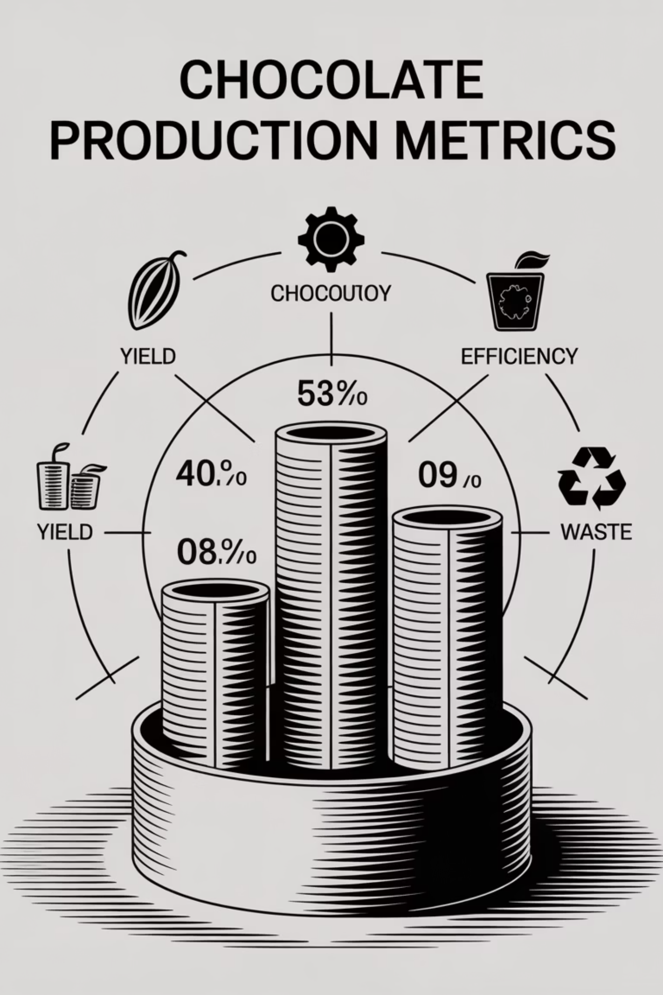
Test Results
±5ml
±10%
98%
Dispensing Accuracy
Fill Level Accuracy
Temperature Control
Chocolate dispensing system achieved consistency within ±5ml per cycle, ensuring uniform bar size.
Ultrasonic-based fill level reporting for chocolate and toppings maintained accuracy within ±10% of actual levels.
Chocolate tempering worked reliably with consistent temperatures maintained for each chocolate type profile.

Slide 22




Project Significance
Automation of Craft Chocolate
Improves product consistency and quality while reducing dependency on skilled manual labor for temperature-sensitive tempering processes.
Real Hardware Integration
Bridges the gap between academic microcontroller projects and real industrial deployment with high-power components and food-safe materials.
Scientific Engineering Approach
Incorporates thermal energy calculations to estimate heating time and ensure energy efficiency, while also using trial-and-error model to ensure accurate and realistic results.
Educational & Industrial Relevance
Serves as both an academic demonstration of interdisciplinary engineering and a practical foundation for small-scale industrial chocolate production.

Slide 23
Conclusions
The ChocoMatic project successfully demonstrates the design and implementation of an automated chocolate bar production line with integrated tempering and topping systems. The solution incorporates real hardware, food-safe components, and embedded systems to create a compact and semi-industrial chocolate processing workflow.
By dividing system control across four microcontrollers, we achieved modularity, improved performance, and flexibility. The use of real-time temperature monitoring, stepper-based chocolate dispensing, and ultrasonic-level feedback contributed to a high degree of realism and functional accuracy.

Slide 24





Future Work
Advanced PID (Proportional-Integral-Derivative control)
Replace basic threshold logic with full PID control to fine-tune heating behavior and minimize temperature overshoot.
Enhanced Mobile App
Expand the app to include complete topping/mode selection, temperature logging, and maintenance alerts.
Automated Mold Handling
Implement stepper-based positioning system for automated mold movement, reducing reliance on static IR detection.
AI Quality Control
Integrate computer vision to detect fill levels, topping placement, and defects for AI-assisted quality refinement.

Slide 25

Acknowledgments
We would like to express our deepest gratitude to our project supervisor, Dr. Mahmoud Asaad, for his continued guidance, support, and technical insight throughout the development of this project. His encouragement and expertise played a crucial role in shaping our approach and helped us overcome several engineering and design challenges.
We also extend our sincere thanks to the Computer Engineering Department at An-Najah National University for providing the facilities, tools, and environment necessary for completing this project. The lab access and technical resources made it possible for us to prototype and test our ideas effectively.
Special thanks go to our families and friends, whose patience and support helped us stay focused and motivated during the most intensive stages of the project.

Slide 26
Thank You
ChocoMatic
Ahmad Dardook (ID: 12112172)
Sayed Qutob (ID: 12111977)
Under the supervision of: Dr. Mahmoud Assad
Computer Engineering Department
An-Najah National University
June 2025-2026

