Slide 1
Test for Student (T4stdent)
Project : mamoun khanfa
Docter Baker Abdulhaq

Slide 2
Introduction : -
T4Student is a web-based platform designed to enhance online learning and manage tests for students and teachers. It offers features such as test creation, sharing, and performance tracking, addresses challenges such as engagement and personalized learning, and can get help from AI. The platform was initially developed for computer science majors, and aims to expand to all university majors in the future.

Slide 3
Scope of the T4Student Project
Test Management for Students: Enables students to take tests and track their performance.
Test Generation for Teachers: Provides tools to create, manage and assign tests, with analytics to monitor student progress.
Computer Science Dataset: A core dataset covering fundamental topics such as algorithms, data structures and databases, initially designed for computer science majors.
Performance Tracking and Feedback: Tracks student performance, progress and areas for improvement in real time.
AI Assistance: Supports students by identifying invalid answers and assists students by creating full tests based on your invalid answer.

Slide 4
Requirment for T4student (Functional)
1. User Authentication: Users (students, educators) can register, log in, and recover passwords securely.
2. Quiz Creation: Educators can create quizzes with different question types
(multiple choice, true/false) and configure settings like time limits and scores.
3. Quiz Participation: Students can take quizzes, receive instant feedback, and view correct/incorrect answers.
4. Progress Tracking: The system tracks quiz performance, providing detailed reports for both students and educators.

Slide 5
Requirment for T4student (Functional)
5. Search and Filtering: Users can search for quizzes by topic, or creator.
6. Mobile Compatibility: The platform is accessible and fully responsive on desktop, tablets, and mobile devices.
7. AI can help students study the subject they need and give them a full test based on their incorrect answer.

Slide 6
Requirment for T4student (non- Functional)
1. Performance
2. Scalability
3. Security
4. Usability
5. Reliability
6. Maintainability

Slide 7
Use case T4student
- Anonymous Teacher: Creates and manages quizzes, reviews student performance without sharing personal details.
- Student: Logs in, takes assigned quizzes, and views results.
- Admin (optional): Manages user accounts, oversees platform functionality.
- AI Assistant (optional): Provides feedback, suggests study areas, and can generate quizzes based on a student's level.

Slide 8
Advantages for T4student
Enhanced engagement: Interactive features and personalized recommendations improve student engagement.
Efficiency: Simplifies the process of creating and grading tests, reducing the administrative burden on teachers.
Scalability: Designed to expand and support additional undergraduate majors beyond computer science.
Comprehensive analytics: Provides actionable insights into student performance and learning gaps.
Accessibility: Fully responsive design ensures compatibility across devices and browsers.
Uses AI to help students

Slide 9
Disadvantages for T4student
Learning Curve: Users may need time to familiarize themselves with the platform.
Reliance on Internet: Requires stable internet connectivity, which may not be accessible to all users.
Data Privacy Concerns: Must comply with strict regulations to ensure user data security.
The dataset primarily consists of content from online exams taken during the COVID-19 years, with smaller portions taken from midterm and final exams.

Slide 10
Language use for build T4student
HTML: Builds the front-end page for the website.
CSS: Designs and styles the website layout .
JavaScript: Adds interactive functionalities to the website
Node.js: Serves as the back-end technology for handling server-side logic.
PostgreSQL: Manages the database for storing website data.
Google API: Integrates AI-powered features into the platform.

Slide 11
Ai-assist in T4student : -
How the Code Works
Receiving User Input : Student interacts with AI if their grade is above 60.
Handling API Keys : The system cycles between three API keys to avoid overload.
Generating AI Responses : AI provides topics & questions based on student performance.
Session Management : Saves & retrieves student data for further review.

Slide 12
Ai-assist in T4student : -
Key Features & Purpose
Multiple API Key Rotation : Prevents system overload.
Session Data Storage : Keeps track of student interactions for further learning.
Enhanced Learning : Provides personalized feedback and guidance.

Slide 13
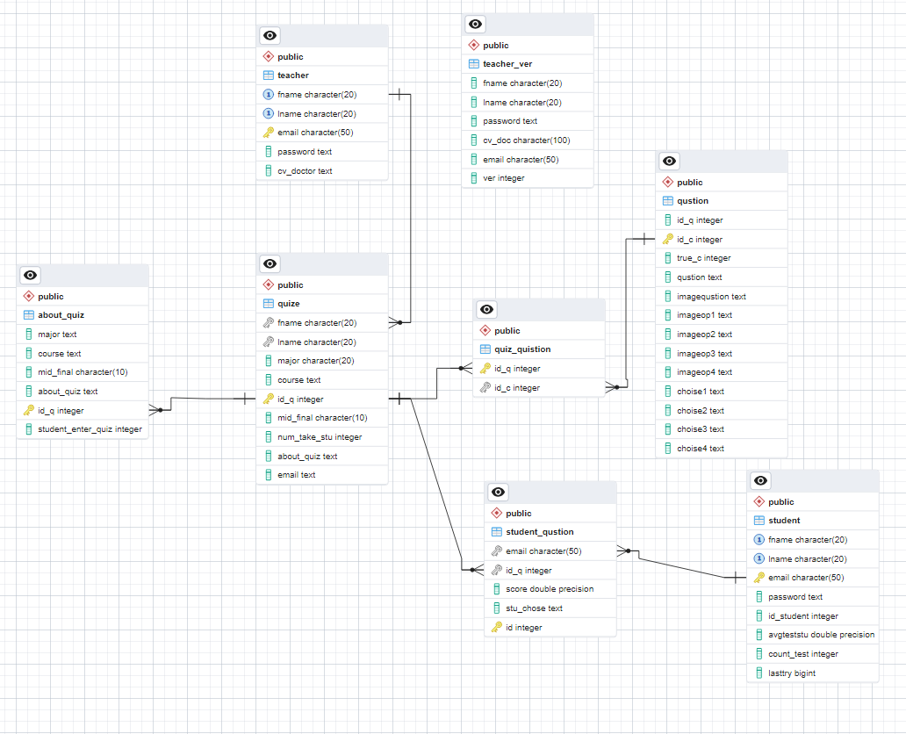
Data base for T4student

Slide 14
Thanks for Your Attention!

